Slide 1
Differentiating the Signal from the Noise
Towards Optimal Choices of Transient Follow-up
Bethany Suter
Mentors: Alex Urban, Michael Coughlin

Slide 2
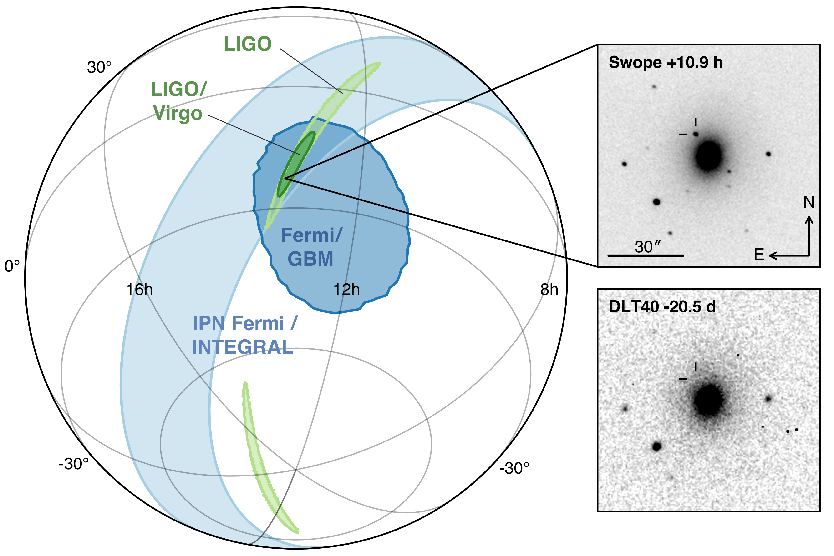
Background
GW170817 – first binary neutron star merger witnessed by LIGO
GW170817 was optimal
Close
Strong signal
Unseen in VIRGO
Small localization region
EM counterpart
Credit: LSC/LIGO

Slide 3
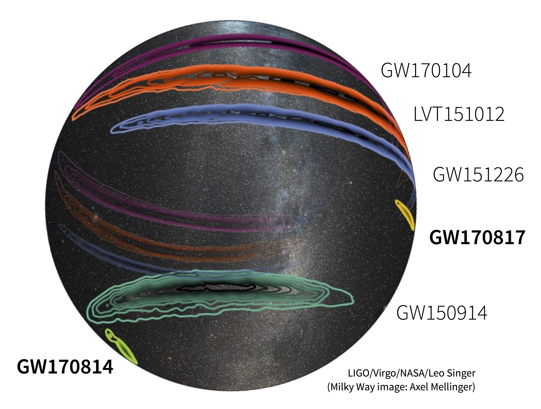
Background
Third run of LIGO beginning soon, new discoveries expected
Unlikely for new discoveries to be optimal like GW170817
Large localization regions
Binary neutron star (BNS) mergers require EM follow-up

Slide 4
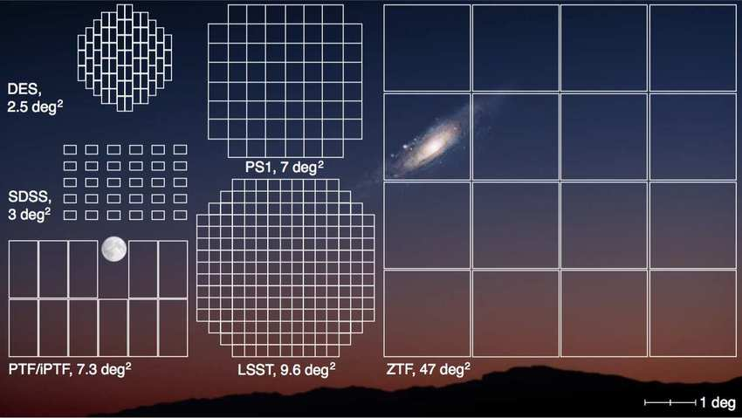
Background
Large Field of View Telescopes
ZTF – Zwicky Transient Factory
Other telescopes – Panstar, ATLAS, DECam
Can cover night sky several times in one night
Perfect for EM follow-up of BNS mergers
Credit: ResearchGate/Joel Johansson

Slide 5
Problem
Even with large field of view telescopes, since telescope time is limited, we still need efficient follow-up of kilonova candidates.
We must create prioritized lists based on the many identified candidates.

Slide 6
Goal
Minimize number of days necessary to identify an object as a kilonova
Maximize the certainty of the estimate of the properties of the kilonova

Slide 7
Methods
Photometry
Spectra

Slide 8
What is Photometry?
“Photometry is a technique in astronomy concerned with measuring the flux of an astronomical object’s electromagnetic radiation over time.$"^{1}$
Especially important for studies of transient objects like kilonovae
Each type of transient has different characteristic lightcurves.
Various means for objects to emit radiation – black body, synchrotron,
Bremsstrahlung
$^{1}$Credit: Wikipedia

Slide 9
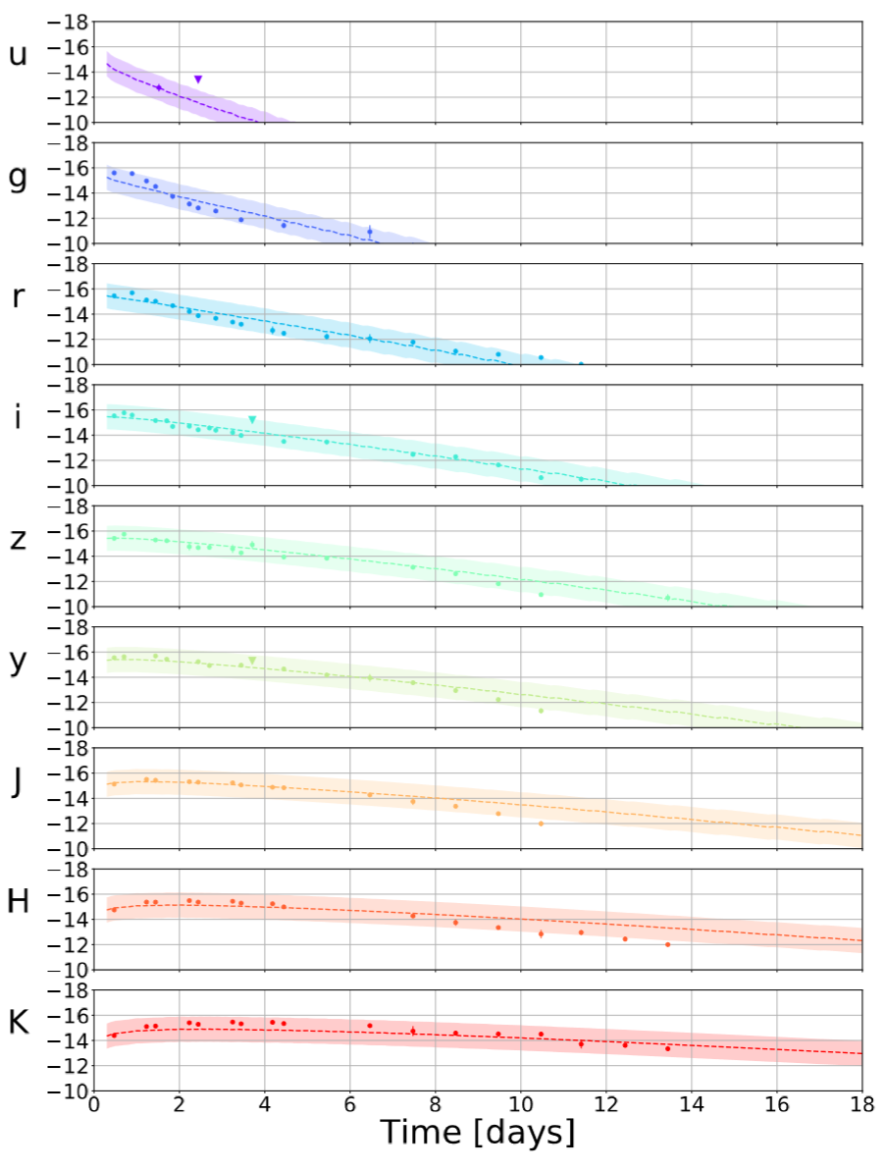
Methods
Used Metzger 2017 model
Based on modeling the lightcurve of the ejecta as a black body
Determines mass of ejecta, velocity of ejecta, and lanthanide fraction
Ran on GW170817 data, varying parameters
Ran on various other transients – ATLAS18qqn, GRB090426 , GRB051221A
GW170817 Lightcurve
Passbands/filters: ugrizyHJK
14 days of data

Slide 10
Methods
Varying number of days
1
Varying starting day
2
Varying cadences
4
Varying passbands
5
Varying zero point and T0
3

Slide 11
Varying Number of Days
§
GW170817
X axis
the number of days of data
used
Beginning fixed
Y axis
the value of the parameter
Violin plots
show the distribution of the
parameter.
Shorter and fatter == better

Slide 12
Varying Number of Days
§
GW170817
Log likelihood
Larger == better
$χ^{2}$
Smaller == better
Fit worse because of more
data
4 day cutoff

Slide 13
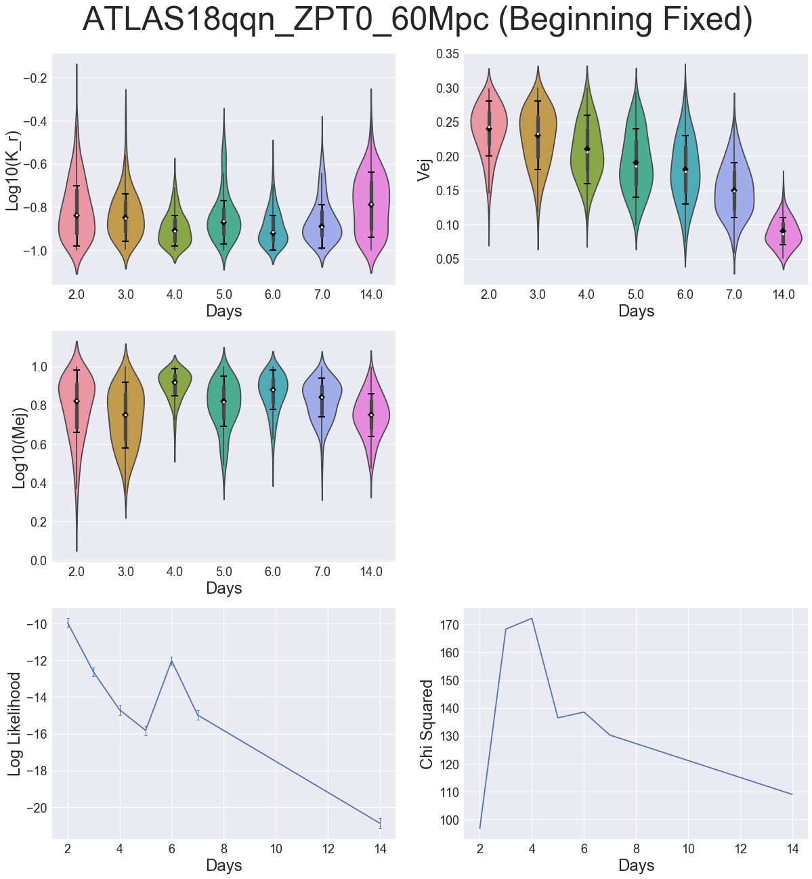
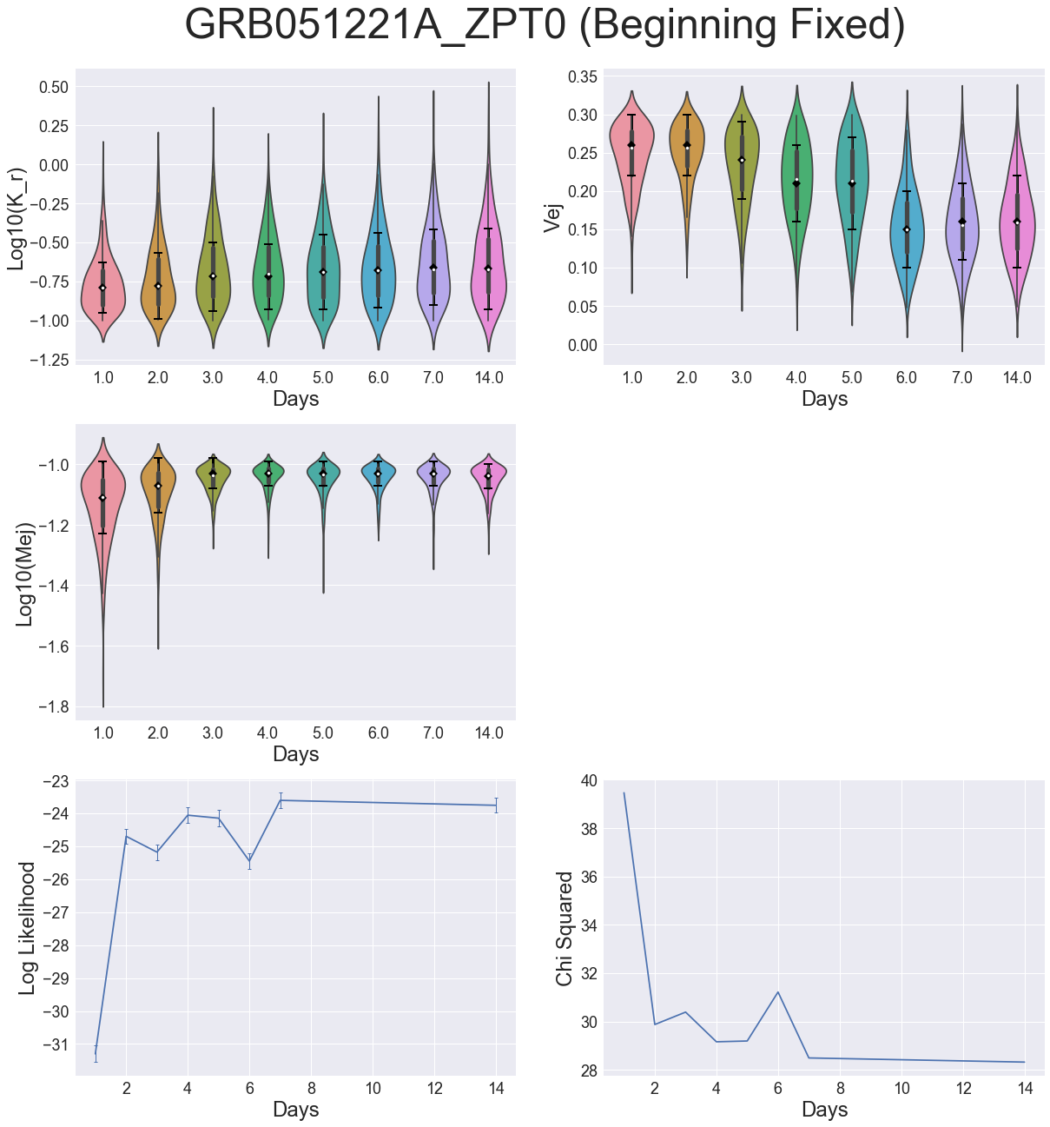
Varying Number of Days § Other Transient Objects
Types of transient objects
Possible supernova, GRBs
Irregularity of properties
Lowness of log likelihood

Slide 14
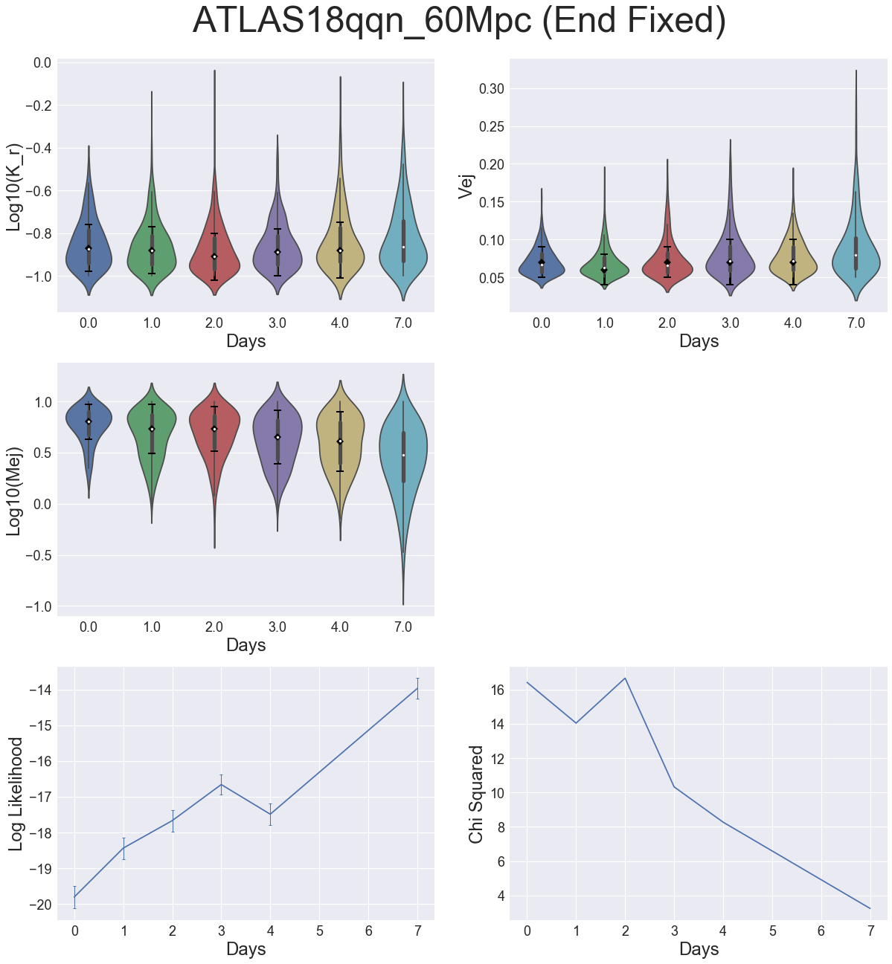
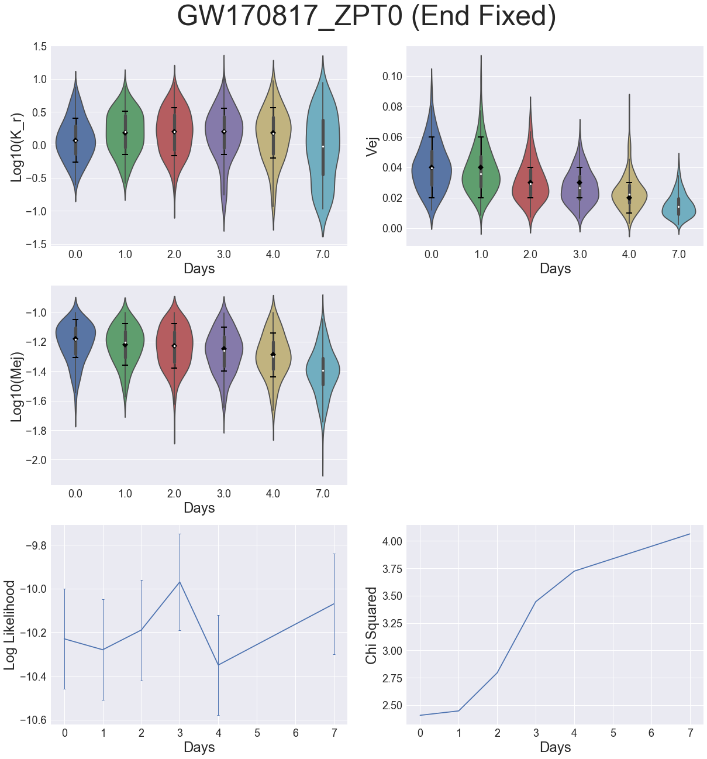
Varying starting day
ATLAS18qqn
Regular properties
Low likelihood
GRB051221A
Irregular properties
Low likelihood before
2 days after

Slide 15
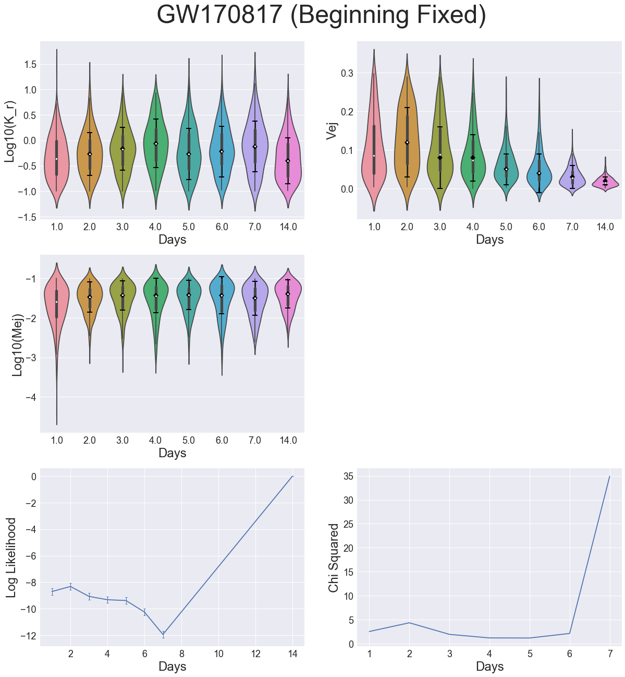
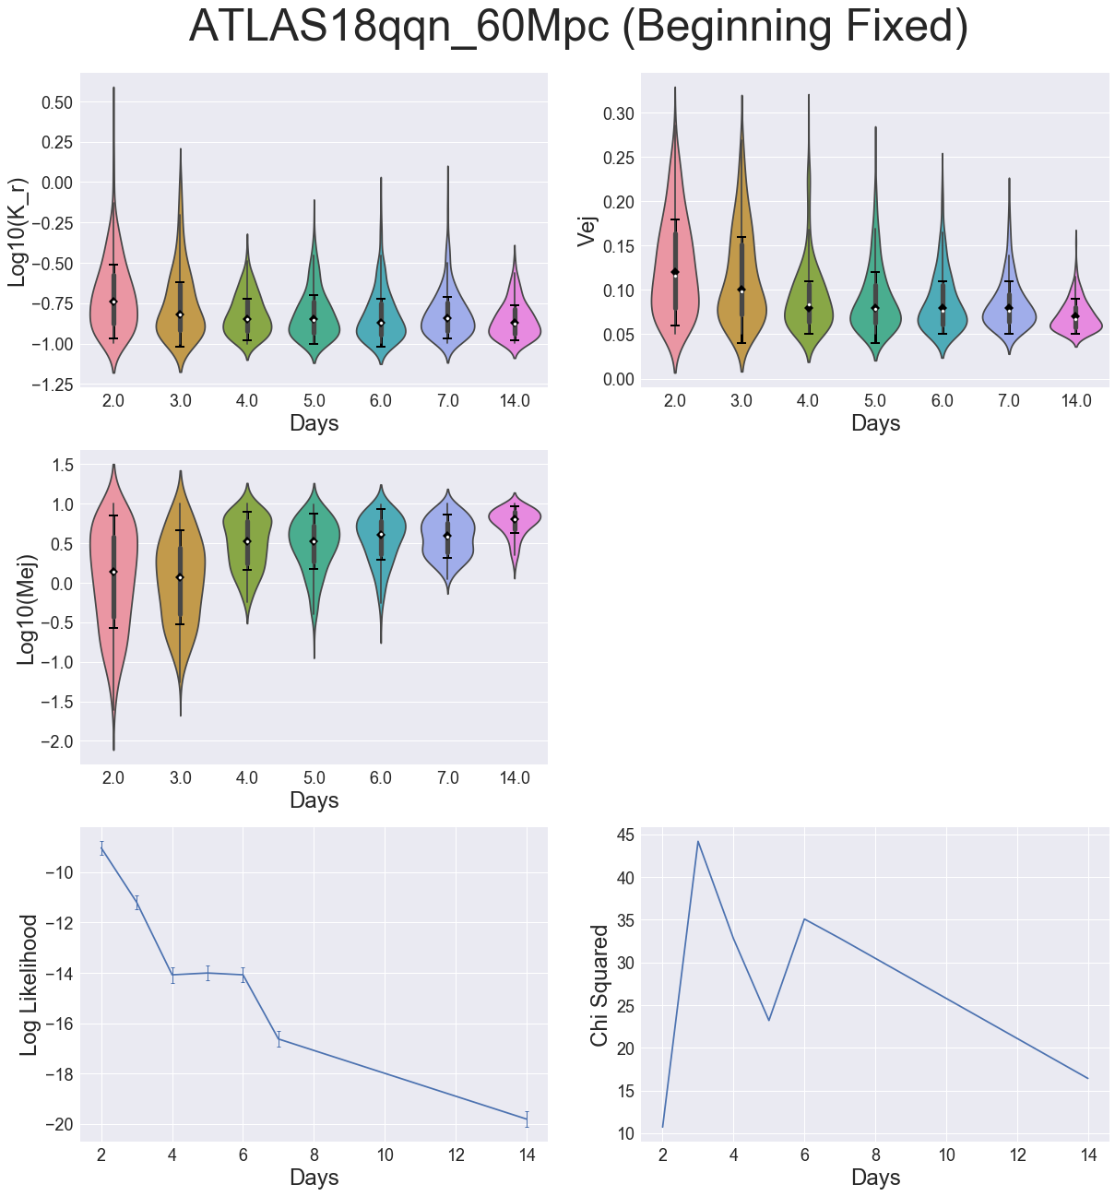
Varying zero point and T0
Distance calculation errors
Causes lower relative
magnitude
ATLAS18qqn
Regular properties
Higher log likelihood

Slide 16
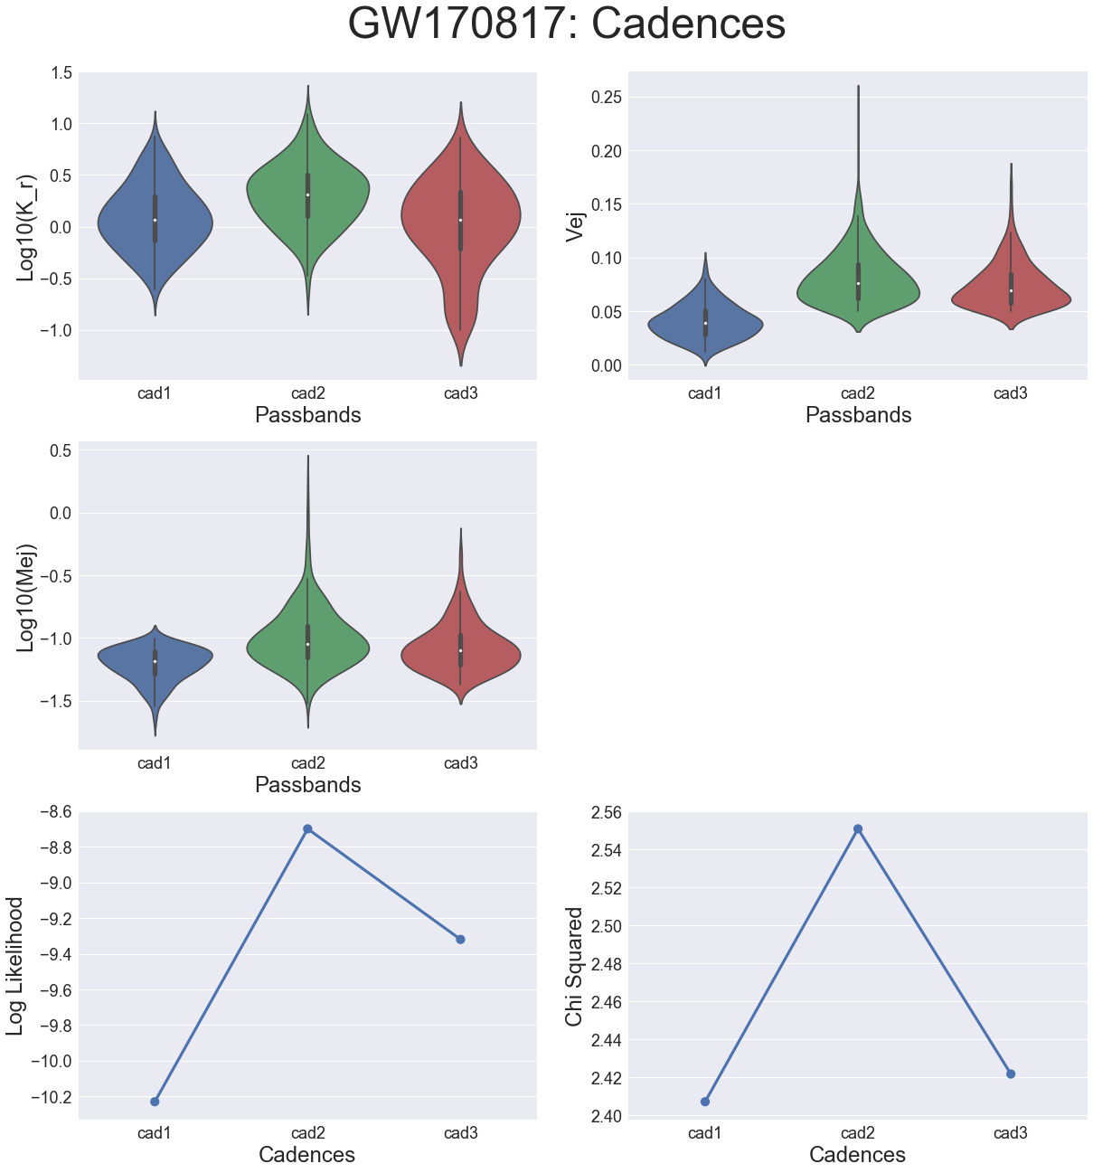
Varying Cadences
X axis
Number of days in between data collection
Cad1 == every night
Different cadences do not lose too much information
Cad2 - rise in log likelihood due to less data
Cad3 - fall in log likelihood due to poor fit

Slide 17
Varying Passbands
X axis
Different combinations of various
wavelength filters
Clearly need all passbands to accurately
determine properties
Rise in log likelihood again due to less
data

Slide 18
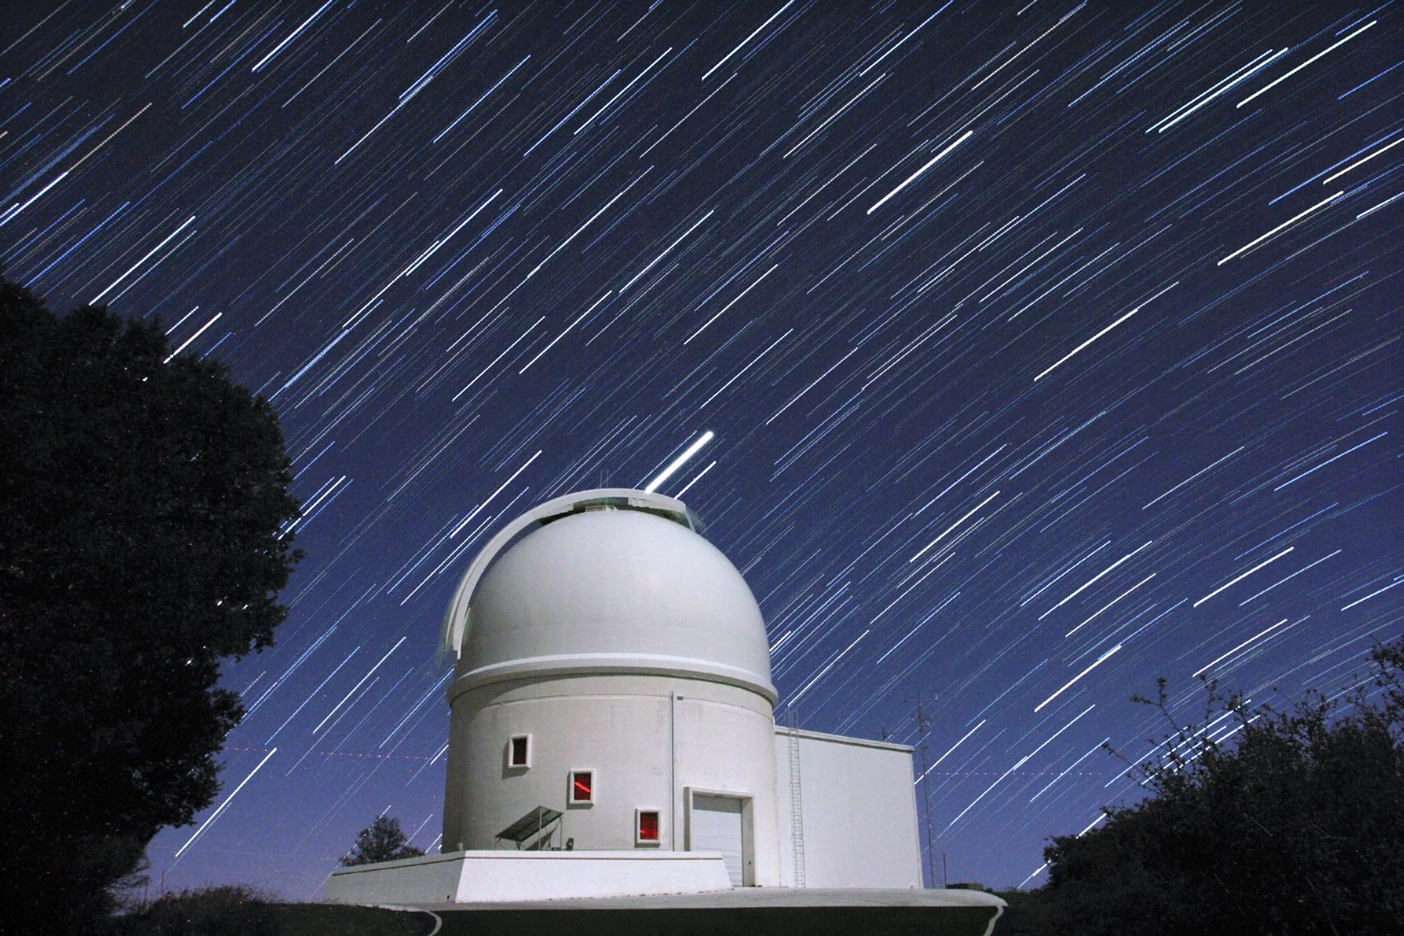
Discussion
Determined best parameters to identify kilonovae
Log likelihood > -10
4 days of data
Other requirements
Need early data
Need to fix zero point and T0
Need to take data at least every other day
Need all passbands
Credit: Palomar Observatory

Slide 19
Spectra
Astronomical Spectroscopy is a method of astronomy which measures the spectrum of
electromagnetic radiation which radiates from stars and other celestial objects in order
to determine their various physical properties$.^{1}$
Used Kasen et al 2017 model
Based on modeling the spectra of the ejecta not only as a blackbody
Determines mass of ejecta, velocity of ejecta, and lanthanide fraction
Created a whitening technique
$^{1}$Credit: Wikipedia

Slide 20
Whitening
Whitening is a technique in which the average is divided out of a dataset.
Our application
In each wavelength bin, take the average over the various days’ spectra and then divide it out.
Why?
Enhances the smaller features and lessens focus on overall magnitude
$M_{ej}$ determines magnitude; $V_{ej}$ and Lanthanide fraction determine bumps and wiggles
We want a better fit of all properties, not just $M_{ej}$

Slide 21
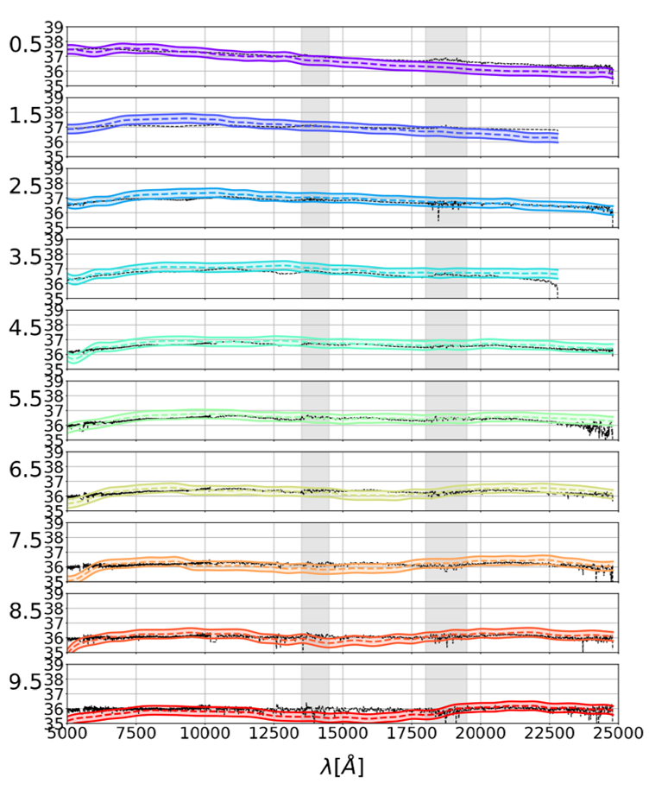
GW170817 (Without Whitening)
Log Likelihood: -76.28 ± 0.10
GW170817 (Whitened)
Log Likelihood: Unknown

Slide 22
Future Work
Test spectra model with varying numbers of days of spectra
Test spectra model on other types of transients
Test setup with LIGO open public alerts
Add other models for other transient objects
Compare log likelihoods instead of using a cutoff point

Slide 23
Acknowledgements
I’d like to thank my two amazing mentors, Alex Urban and Michael Coughlin!
I’d also like to thank both LIGO Laboratory and the SFP office for supporting me throughout my journey this summer!

