Slide 1
Seismic Cloaking for LIGO
Kaila Nathaniel
Virginia Polytechnic Institute and State University
Brittany Kamai
Rana X. Adhikari
Ayooluwa Odemuyiwa
California Institute of Technology
LIGO SURF 2018
Notes:
Hello, I’m Kaila Nathaniel, and I’ve been working with Brittany Kamai, Rana Adhikari, and Ayooluwa Odemuyiwa[ Oh-deh-moo-yee-wah], an FSRI participant, on seismic cloaking for LIGO

Slide 2
Cloaking
Manipulating waves around an object, making it appear invisible to certain types of waves
Original concept was invisibility cloaks for electromagnetic waves
Experimentally verified in 2006 by Schurig et al.
Research now underway for thermodynamic, acoustic, and elastodynamic cloaking
J. B. Pendry, D. Schurig, and D. R. Smith, Science 312, 1780 (2006)
Notes:
What is cloaking?
Cloaking is when you manipulate waves around an object to make it invisible to that type of wave
The original concept was invisibility cloaks for electromagnetic waves, like in Harry Potter. This was experimentally verified in 2006 with Schurig’s team. They created a 2D cloak that hid a copper cylinder.
Cloaked from microwaves
Electromagnetic cloaking is still a very active field, and research is now also underway in thermodynamic, acoustic, and elastodynamic cloaking

Slide 3
Metamaterials
Acoustic, thermodynamic, and elastodynamic cloaking is done with metamaterials
Carefully designed building blocks packed into a dense periodic structure
Usually artificially made, but some natural materials can be manipulated into metamaterials via spacing or other techniques
Notes:
Acoustic, thermodynamic, and elastodynamic cloaking is done with metamaterials
Metamaterials are building blocks packed into a dense periodic or crystalline structure
They are usually artificially made, but some natural materials can be manipulated into metamaterials via spacing or other techniques

Slide 4
Seismic cloaking
This field is less than 10 years old
Subset of elastodynamic cloaking
Interacts with surface (Rayleigh) waves
Wavelengths that match the dimensions of houses and other infrastructure
Notes:
My project focused on seismic cloaking, which is less than 10 years old
Seismic cloaking is a subset of elastodynamic cloaking, and it deals mainly with surface, or Rayleigh, waves
Rayleigh waves are important because they frequently originate from earthquakes, and their wavelength matches the dimensions of houses and other infrastructure

Slide 5
Seismic cloaking
z
Seismic metamaterials manipulate waves to attenuate and reflect energy away from the cloaked object
Seismic cloaking could protect valuable infrastructure from earthquakes
Graham Murdock, Popular Science
Notes:
Seismic cloaking was first investigated in the context of earthquake protection
Seismic metamaterials could manipulate waves to attenuate and reflect energy away from a cloaked object, like a hospital or nuclear reactor
Still being worked on, as currently much of the energy is directed back towards the source, which could spell disaster on a busy city street

Slide 6
Can we apply the concept of seismic cloaking to LIGO?
Notes:
Our question was if we could apply this concept to LIGO

Slide 7
LIGO and seismic noise
The gravitational wave strain amplitude of GW170817 (the binary neutron star merger) was ~10⁻²²
Average seismic activity at LIGO-Livingston and LIGO-Hanford is ~10⁻⁹ at 10 Hz
Notes:
As you know, managing noise is a huge part of LIGO
The gravitational wave strain amplitude of the recent binary neutron star merger was on the order of 10⁻²², while the average seismic activity at LIGO is around 10⁻⁹ at 10 Hz
Seismic noise is a lot louder than astrophysical signals

Slide 8
LIGO seismic isolation
Quadruple pendulum system isolates test masses from seismic noise
Dampens up to 10 orders of magnitude
Pendulum system shields at 10 Hz and below
Notes:
LIGO already has a lot of seismic isolation
The quadruple pendulum system works by passive noise cancellation, and it combines with an active noise cancellation system to dampen up to 10 orders of magnitude
This system shields at 10 Hz and below

Slide 9
Newtonian noise
Mass density fluctuations in soil due to surface waves can create changes in the gravitational potential around the test masses
Affects LIGO at mostly 10 Hz and below
Advantages of seismic cloaking
Reduce the amount of terrestrial noise
Improve LIGO operation
Notes:
Our project was looking specifically at Newtonian noise caused by seismic noise
Newtonian noise is created when seismic waves create mass density fluctuations in soil
The soil then has areas with slightly higher density, and some areas with slightly lesser density
This creates a slight difference in the gravitational potential around the test masses
Ordinarily this would never be noticed, but LIGO is so sensitive that it’s an actual source of noise
This affects LIGO at 10 Hz and below
If seismic cloaking is implemented for LIGO, it would reduce the amount of terrestrial noise the detectors pick up, as well as improve LIGO operations

Slide 10
Seismic cloaking experiments
Notes:
Now, let’s turn to seismic cloaking experiments

Slide 11
Seismic cloaking experiments: Brûle
An early seismic cloaking experiment was conducted by Brûle et al.
Published March 2014
Created a seismic metamaterial with a grid of 5 m deep self-stable holes, with a diameter of 0.32 m, and spaced 1.73 m apart
Tested with a 50 Hz source
Previous cloaking experiments have been at 1 kHz and 600 Hz
Notes:
The first experiment we’ll talk about is Brule’s team
He created a seismic metamaterial by drilling boreholes into the soil
His boreholes were 5m deep, 0.32 across, and spaced 1.73m apart
He tested his metamaterial with a 50 Hz source
50 Hz is significant, because previous work with seismic cloaking has been done around 1kHz and 600 Hz, which is much higher than the 10 Hz that affects detectors

Slide 12
Seismic cloaking experiments: Brûle
Elastic energy was 2.3 times larger at the source than in the metamaterial
Suggests that the seismic metamaterial has a significant effect on energy dissipation
Notes:
You can see here a diagram of the setup, and a photo of the actual experiment
The green is the velocimeters, the blue is the boreholes, and the red is the source
Brule found that the elastic energy was 2.3 times larger at the source than past his metamaterial
This suggests that his metamaterial was highly effective at dissipating the energy from the 50 Hz source

Slide 13
Seismic cloaking experiments: Colombi
What’s the opposite of a borehole? What about something sticking out of the ground?
Colombi et al. tested trees as a seismic metamaterial
Published January 2016
Geophysical survey on a ~6000 m² forest of mainly pine trees in Grenoble, France
Project genesis!
Notes:
The next experiment I’ll discuss is Colombi, which is actually the source of this project. Brittany and Rana read this paper before I came to Caltech, and wondered if the same ideas could be applied to LIGO
Brule tested boreholes, but Colombi thought to test the opposite—something poking out of the ground, like trees
He did a geophysical survey on a 6000 m² forest in France, using construction as his noise source

Slide 14
Seismic cloaking experiments: Colombi
Notes:
You can see here his configuration
Seismometers in an empty field and in the forest

Slide 15
Seismic cloaking experiments: Colombi
Found that the longitudinal resonance inside the trees created two highly attenuating regions around 40 Hz and 110 Hz
The various sizes and random spacing of the trees produced larger band-gaps than for a uniform configuration
Theorized that cloaking could be achieved for frequencies ≤ 10 Hz with trees of longitudinal resonant frequencies of ≤ 10 Hz
Notes:
He found that the longitudinal resonance inside the trees created two highly attenuating regions around 40 Hz and 110 Hz
Interestingly, he also found that the variability in size and position of trees cloaked more frequencies at once than for uniform configurations
This plot has the frequency on the x axis, with the spectral ratio on the y. The spectral ratio is the ratio of coherent to incoherent intensity
The red traces are the theoretical predictions, while the blue is the experimental results
The bandgaps are the grey regions, where you can see the spectral ratio drops intensely due to the cloaking
You can see that the experimental and theoretical results matched really well at the second bandgap, while the first bandgap needs some more work for the theory to match the results

Slide 16
Seismic cloaking experiments: Roux
The METAFORET project, by Roux et al. expanded upon Colombi’s work
Published January 2018
Demonstrated that a dense forest of trees can behave as a locally resonant metamaterial for seismic surface waves
Notes:
Lastly, the METAFORET project, headed by Roux
This demonstrated that a dense forest of trees can act as a locally resonant metamaterial

Slide 17
Seismic cloaking experiments: Roux
Data collection in Mimizan, France
Used a forest and a canola field
Took data with geophones and velocimeters
Notes:
METAFORET took data in Mimizan, France, in a forest and the adjacent canola field
They took data using geophones and velocimeters

Slide 18
Seismic cloaking experiments: Roux
Measured flexural and compressional resonance in the trees
Found that compressional resonance is what provides filtering for the waves
Measured ambient noise and noise from a 70 kg shaker that excited a 60 s long 10-100 Hz frequency-modulated sweep
Notes:
The METAFORET project measured flexural (side to side) and compressional (up and down) resonance in the trees
Compressional resonance is what provides filtering for the waves
They measured the ambient noise and a 10-100 Hz frequency modulated sweep from a shaker

Slide 19
Seismic cloaking experiments: Roux
Compressional resonances were ~50 Hz (cutoff frequency)
At 50 Hz the trees responded best with compressional resonance
Above 50 Hz a lot of waves get filtered out and cloaked
Notes:
METAFORET found that the compressional resonances were around 50 Hz
That means that cloaking was best at 50 Hz and above, while below 50 Hz a lot of waves still remained, as you can see in the plots

Slide 20
Our work: modeling cloaking
Notes:
Now, let’s move onto our work modeling cloaking

Slide 21
Modeling acoustic cloaking
Wanted an intuitive understanding of cloaking
Does not require a full-scale seismic model
Acoustic cloaking is a simpler 2D analog of seismic cloaking
Similar types of waves, but don’t need to account for soil density or speed of sound in soil
Future work in seismic cloaking will require full solutions of elastodynamic equations
Notes:
We wanted to get an intuitive model of cloaking, which we found did not require a full-scale seismic model
Acoustic cloaking is a good simplification of seismic cloaking, as the waves are the same, you just don’t have as many parameters to model
Future work in seismic cloaking will require full solutions of the elastodynamic equations

Slide 22
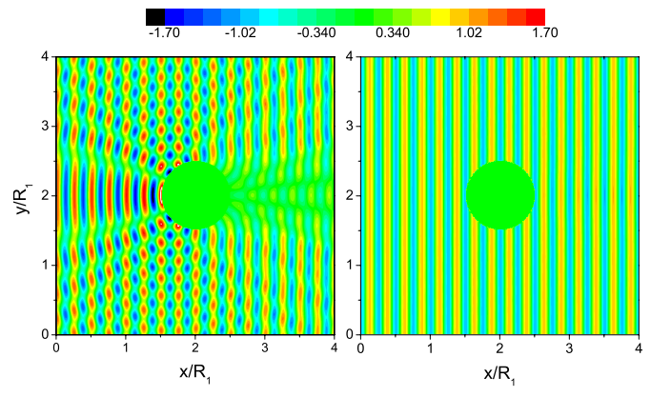
Modeling acoustic cloaking
Wave interacts with a boundary, which creates higher amplitude and pressure buildup
Torrent, D., & Sánchez-Dehesa, J. (2008). New Journal of Physics, 10(6), 063015.
Notes:
Normally, a wave interacts with a boundary, which creates a pressure buildup
You can see that here, where the waves break up around the object

Slide 23
Modeling acoustic cloaking
With a cloak, there is no pressure buildup and the wave just moves through
Cloaking requires both a negative bulk modulus and a negative mass density
Creates a negative phase velocity → negative refractive index
Torrent, D., & Sánchez-Dehesa, J. (2008). New Journal of Physics, 10(6), 063015.
Notes:
A cloak requires a negative bulk modulus and a negative mass density, which is a little weird to think about
The reason for this is so that you have a negative phase velocity, which then leads to a negative refractive index, which is what you need for cloaking
The negative refractive index makes the waves reflect rather than interact with the object
As you can see, a cloak means there is no pressure buildup, and the wave just keeps going and is not affected

Slide 24
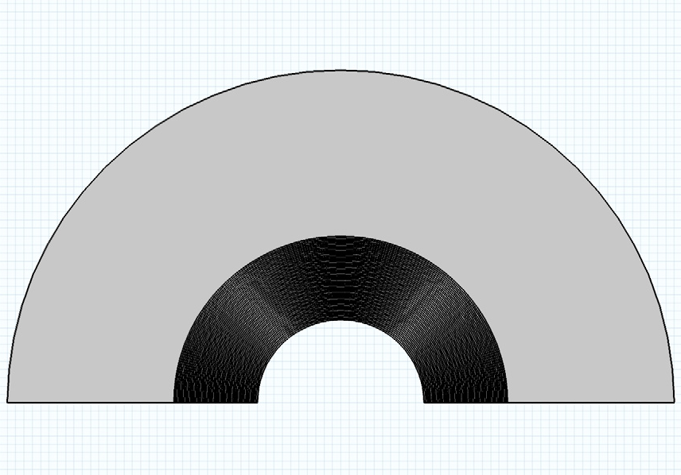
Modeling acoustic cloaking
z
Created cylinder model
1 m radius
50-layer metamaterial cloak of two alternating fluid-like materials
Each layer 2 cm thick
Notes:
We created a model very similar to the plot before, except in a half circle rather than a full circle
This was done to make it easier computationally, and because we were using a previously created model and that’s what it came with
This is a cylinder with a 1m radius and a 50 layer metamaterial cloak, each layer 2cm thick

Slide 25
Modeling acoustic cloaking
My results
200 Hz incoming wave
Notes:
The model we were using was designed for a 200 Hz wave propagating in the +x direction, so that’s what I started with. Here, you can see the object with a cloak and without
You can see the pressure buildup in the uncloaked model, and then how the pressure is strongly dampened once the cloak is added

Slide 26
Modeling acoustic cloaking
200 Hz
Notes:
If you increase the resolution on the cloaked model, you can see there’s an increase in pressure on the right side of the cloak, which is odd. We’re not quite sure what that is, yet

Slide 27
Modeling acoustic cloaking
Notes:
Here’s another plot, this time of the pressure plotted against the x axis. You can see the buildup of pressure in the red trace, which is the uncloaked model, and again the cloaked model in orange is a much smaller wave. Again, there’s something weird around 1.8m
Once I had investigated the 200 Hz model, I wondered how this would look at other frequencies. I tried doubling and halving the original 200 Hz to see what would happen

Slide 28
Modeling acoustic cloaking
Notes:
Here’s the same model, but at 400 Hz. While the cloaked model still has a lot less pressure, the buildup is stronger at the edge of the cloak

Slide 29
Modeling acoustic cloaking
Notes:
Now, look at the 100 Hz model
While this model was designed for 200 Hz, it seems to work at 100 Hz much better. If you look closely you can still see a slight pressure increase, but it’s much smaller

Slide 30
Modeling acoustic cloaking
Notes:
Then I wanted to know what would happen at a bunch of different frequencies, including some that were not integer multiples of 200
This plot is calculating variance, as I found that a more useful measure than more x versus pressure plots, or fourier transforms
The x vs pressure plots showed that the pressure was like a sine wave function, with the cloaked one having a much smaller amplitude
Using variance showed how much the pressure was damped for different frequencies
It’s odd that there does not seem to be much of a difference for non integer multiples of 200, but that the cloak starts to break down starting around 600 Hz and increasing

Slide 31
Measuring the effects of an existing seismic cloak
Wanted to find trees and see if they acted similarly to Colombi’s experiments
Criteria: relatively dense trees, flat, near a noise source (i.e. a freeway)
Most places in LA are either flat and full of houses or forested and mountainous
Notes:
We then wanted to see if we could find some trees that behaved like the ones in the Colombi and METAFORET experiments
We were looking for an area with dense trees, flat, and near a noise source
We found that most places in LA that are flat with trees have houses, and the ones with trees and no houses are mountainous

Slide 32
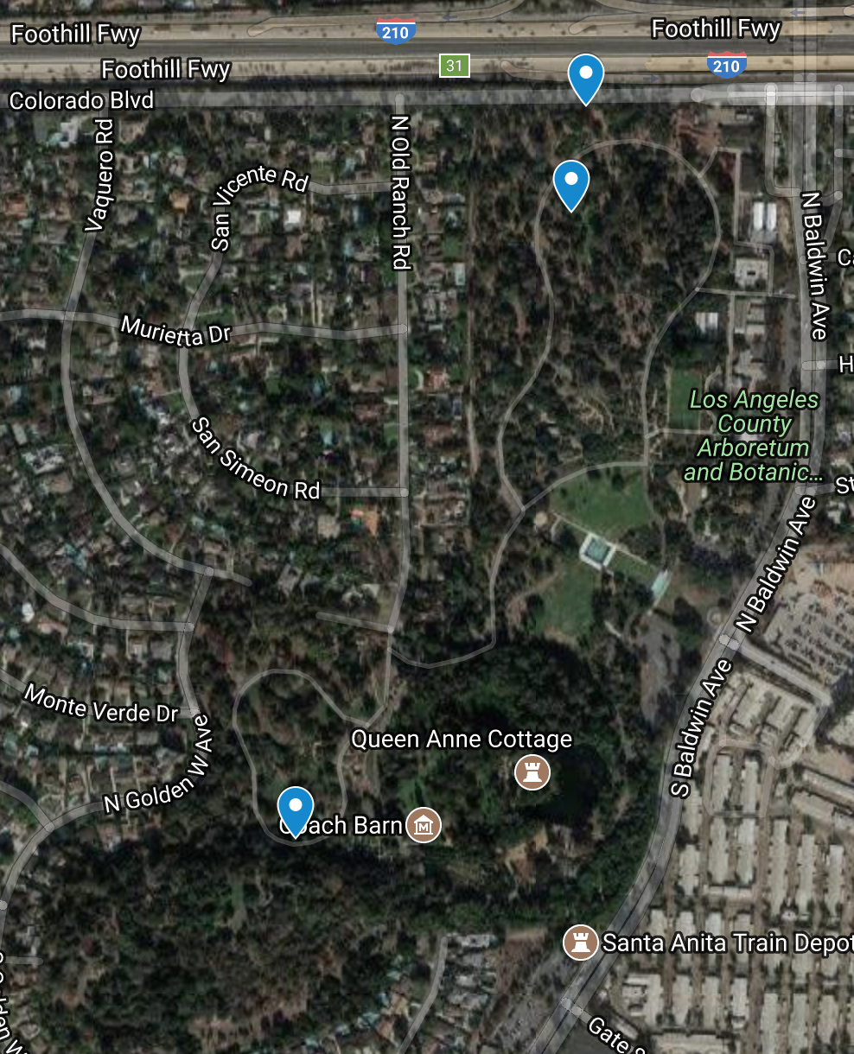
Measuring the effect of an existing seismic cloak
Ended up taking data at the Los Angeles County Arboretum
3 data sites
Freeway – source of anthropogenic noise
Trees – quiet/cloaking
Waterfall – white noise
Notes:
We ended up taking data at the LA County Arboretum, as it fulfilled most of our criteria and was only a short drive away
We took data near the freeway, in a grove of trees, and at a waterfall
The freeway was a noise source, the trees were quiet, and the waterfall was added because the noise from the freeway was very quiet

Slide 33
Measuring the effects of an existing seismic cloak
Took data with geophones
Looked at Wilcoxn accelerometers, and laser vibrometers, but both required an external power source
Geophones do not require an amplifier or a power source
Geophones convert ground movement into a voltage
The voltage is the seismic activity due to the source
Notes:
We chose to take data using geophones
We looked at accelerometers and vibrometers, but both required an external power source, which is hard to lug into a forest
Geophones have a small spring inside, which oscillates with ground movement. They convert that ground movement into a voltage, which you can then read as the seismic activity due to a source

Slide 34
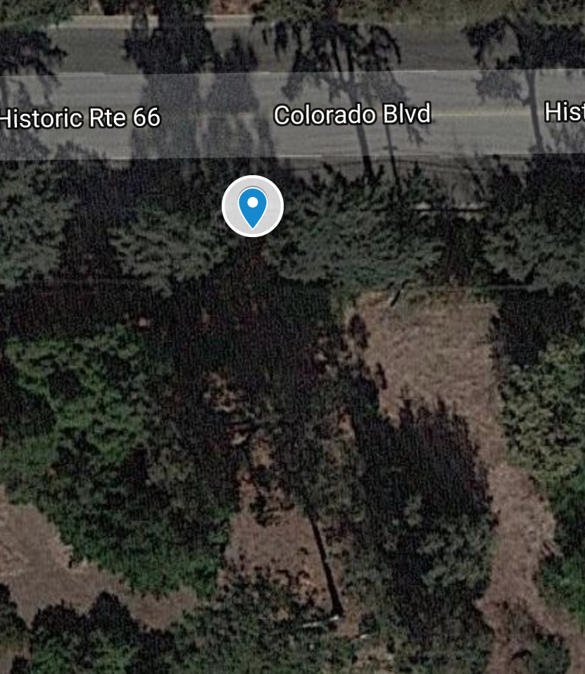
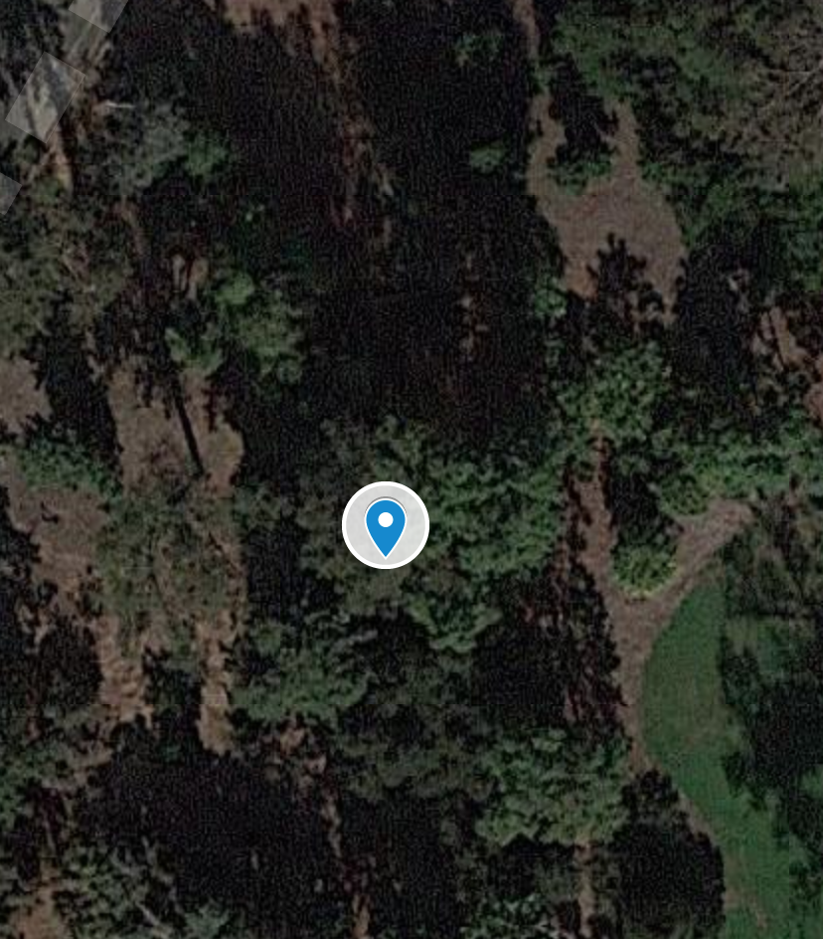
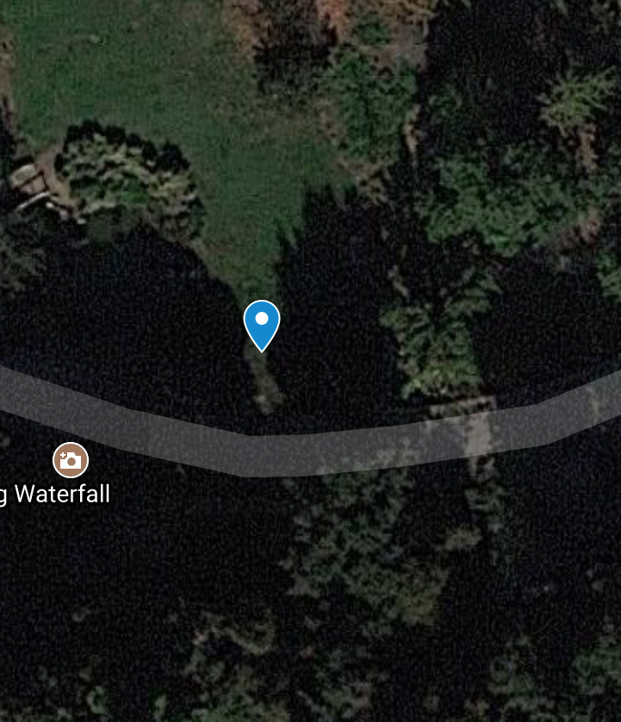
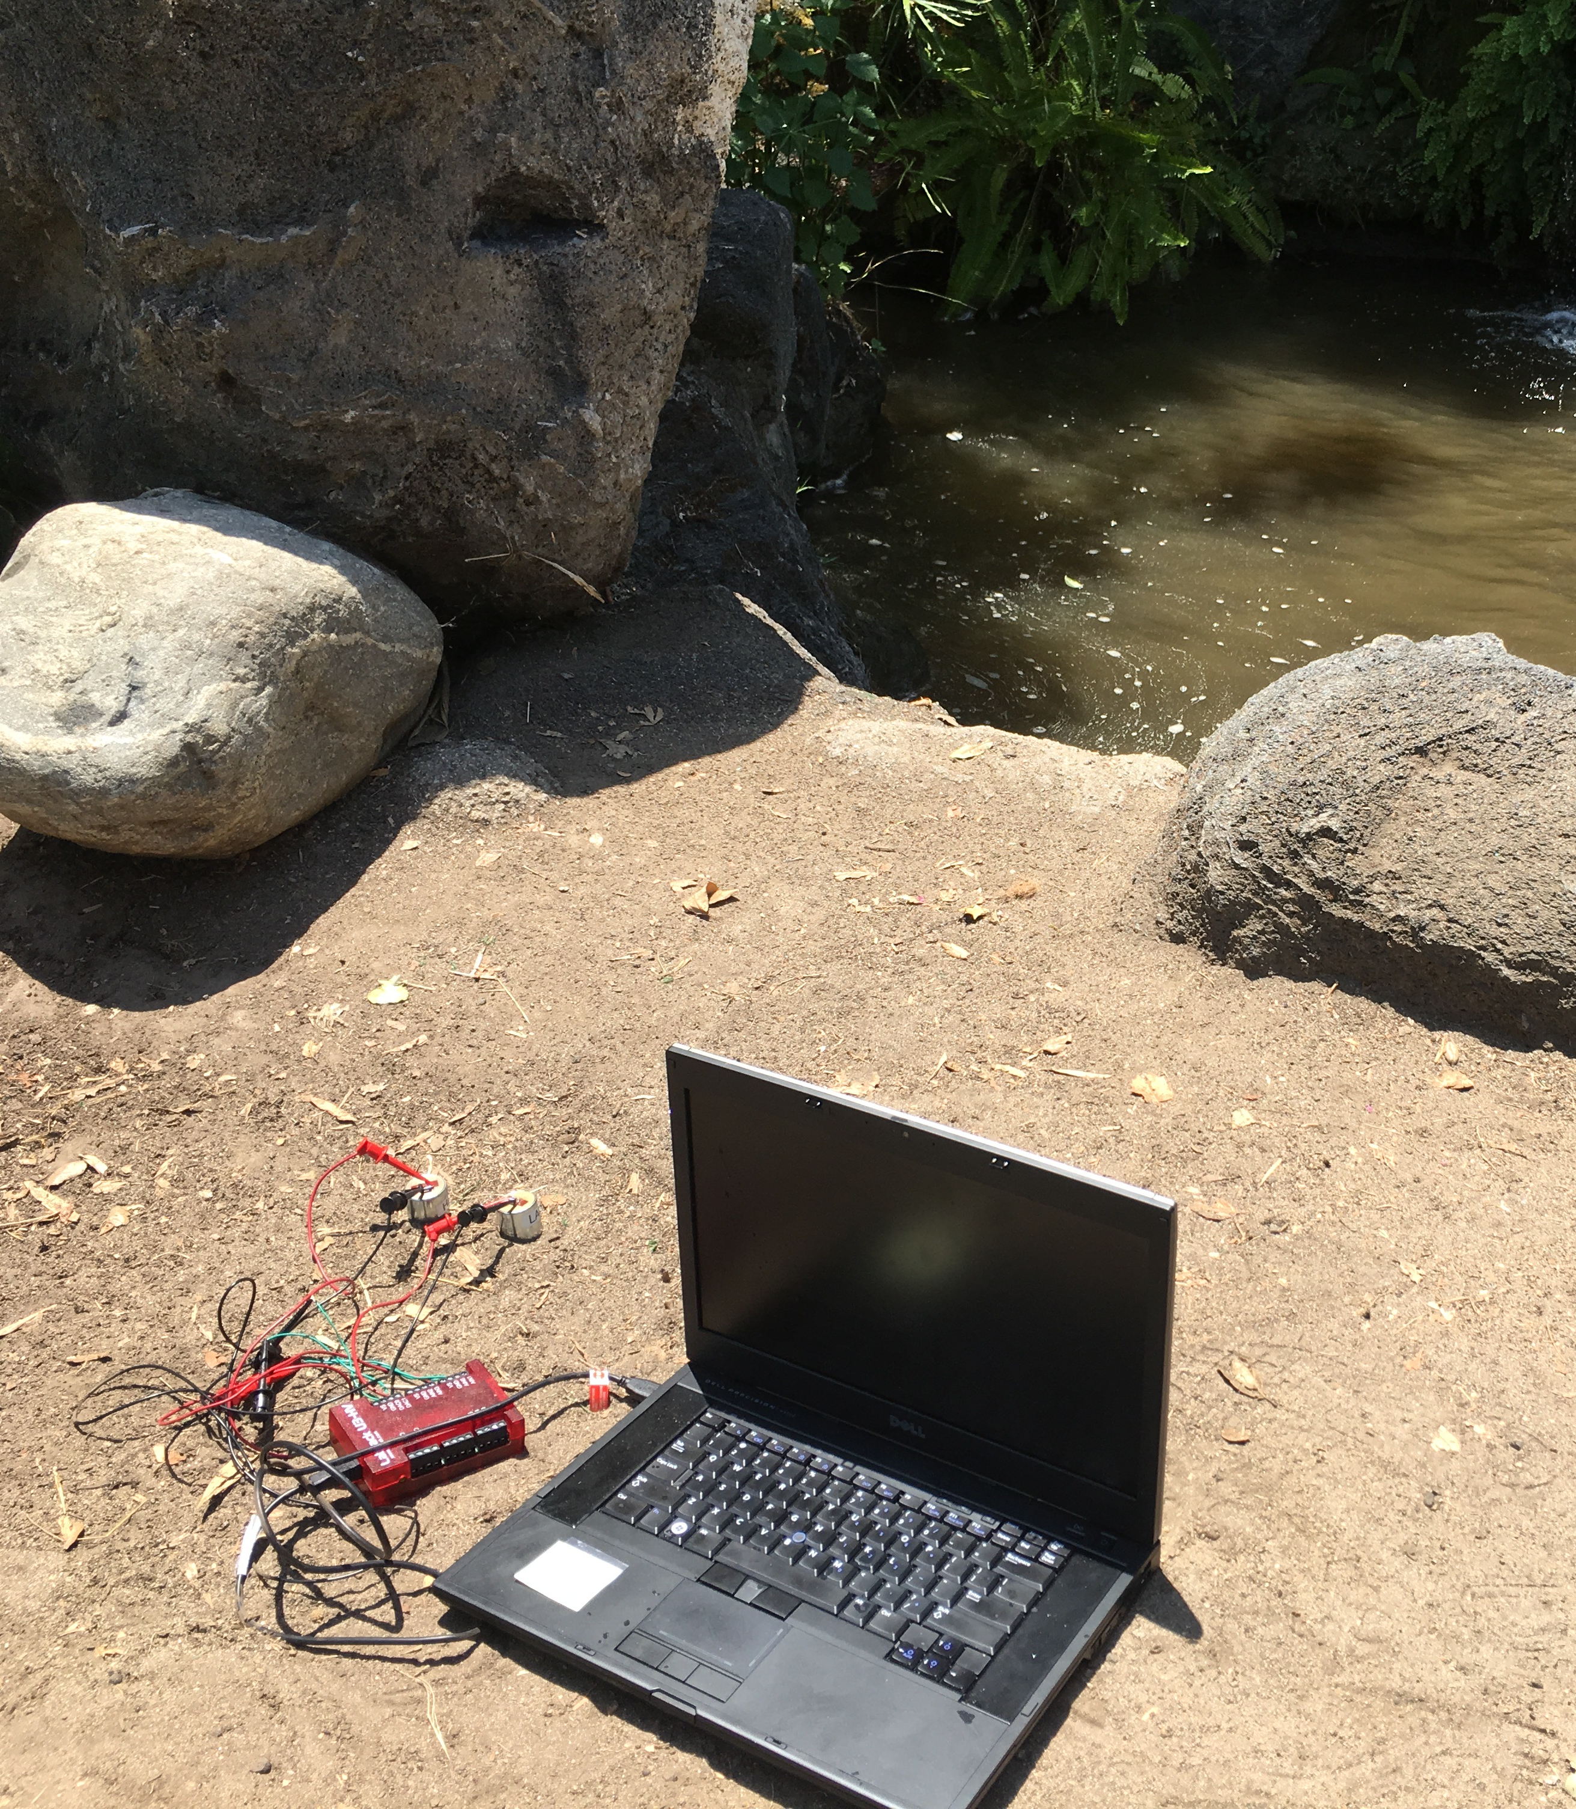
Measuring the effect of an existing seismic cloak
z
Data collection with Ayooluwa Odemuyiwa
Our three data collection sites
Freeway was very quiet
Taking data at the waterfall
freeway
trees
geophones
digitizer
waterfall
waterfall
Notes:
We took data with FSRI student Ayooluwa
These are photos of our three data collection sites, as well as our setup with the laptop, digitizer, and geophones at the waterfall

Slide 35
Measuring the effects of an existing seismic cloak
Figure: timeseries around a jump
Kaila and Ayooluwa jump
Kaila jump
Notes:
Here you can see some of our data from the freeway
In order to make sure we were picking up and recording data, Ayooluwa and I jumped during the datasets. You can see our jumps here
We also saw that our data is just oscillating around zero, which wasn’t good
We started to think the geophones weren’t sensitive enough to pick up the seismic activity

Slide 36
Measuring the effects of an existing seismic cloak
Notes:
We then tried a Fourier transform, and found that there was no real difference between data from the freeway and data from the trees, despite one having a lot more seismic activity than the other
Confirmed our suspicions that these geophones were not sensitive enough to pick up the data we needed

Slide 37
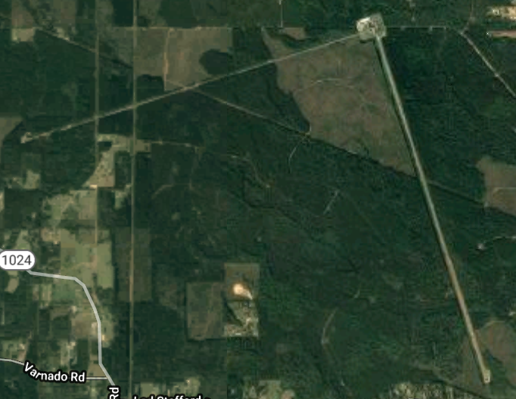
Future work
Seismic cloaking has a lot of potential, but still needs work
Need to bring models down to 10 Hz and below
Build a seismic cloaking model
Take more data
More data sites around LA and central CA
Could LIGO Livingston already have an effective seismic cloak?
Go to France
Seismic cloaking could factor into the location of future highly sensitive ground based detectors
Notes:
In conclusion, seismic cloaking needs a lot more work, but has a lot of potential
Immediate future is to bring the models down to 10 Hz and below, and also build a seismic cloaking model, not just an acoustic one
More data also needs to be taken, which can easily be done around LA and central California
It would be interesting to investigate if the deciduous forest around the Livingston detector already functions as a seismic cloak
Both Colombi and Roux took data in France, so Brittany and I also think we need to take data in France
If seismic cloaking is successful, it could factor into the location of future highly sensitive ground based detectors
For instance, if we know that choosing a site in a forest could dampen noise by a few orders of magnitude, that’s a huge saving in time and engineering

Slide 38
Thank you!
Brittany Kamai
Ayooluwa Odemuyiwa
Rana X. Adhikari
Alan Weinstein
Alex Urban
Tom Callister
Caltech SFP
LIGO SURF
Cosmosis
Notes:
I would like to thank Brittany, Rana, and Alan for giving me this opportunity
Ayooluwa for joining our project
Alex and Tom for their invaluable help
And Caltech SFP, LIGO SURF, and Cosmosis
Thank you

