Slide 1
Ground-based Gravitational-wave detectors and synergy with LISA
COSPAR
Pasadena 18 July 2018
David Shoemaker
For the LIGO and Virgo Scientific Collaborations

Slide 2
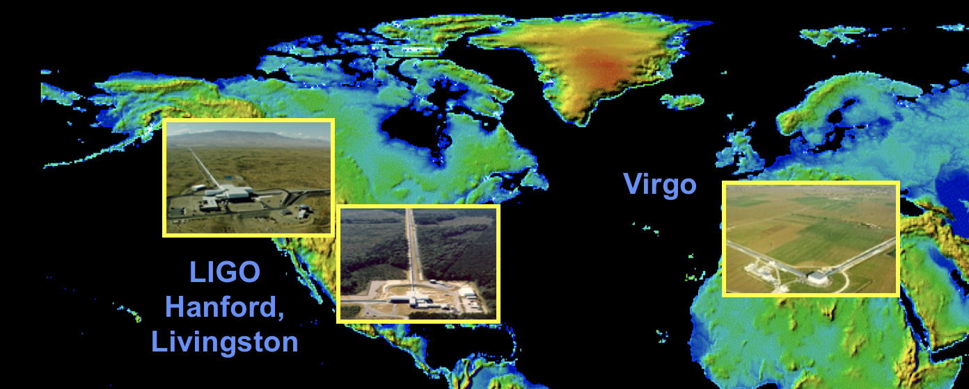
Ground based detectors
Initial observatories, and instruments, constructed starting in mid-90’s
NSF Physics for LIGO; Virgo’s support from CNRS and INFN
Observed, setting upper limits until 2011
Both Virgo and LIGO undertook a complete rework of the instruments
Advanced LIGO came on line in 2015 – First discovery 15 Sept 2015
Advanced Virgo came on line in 2017 – First signal 14 August 2017

Slide 3
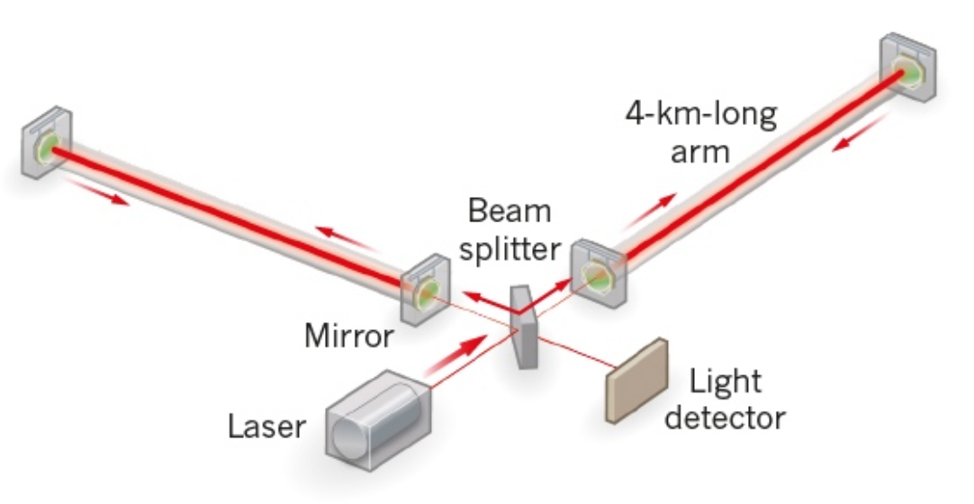
Measurement technique
Enhanced Michelson interferometers
GWs modulate the distance between the end test mass and the beam splitter
The interferometer acts as a transducer, turning GWs into photocurrent proportional to the strain amplitude
Arms are short compared to our GW wavelengths, so longer arms make bigger signals → multi-km installations
Arm length limited by taxpayer noise….
Magnitude of h at Earth:
Detectable signals h ~ 10⁻²¹
(1 hair / Alpha Centauri)
For L = 1 m, ΔL= 10⁻²¹ m
For L = 4km, ΔL= 4x10⁻¹⁸ m

Slide 4
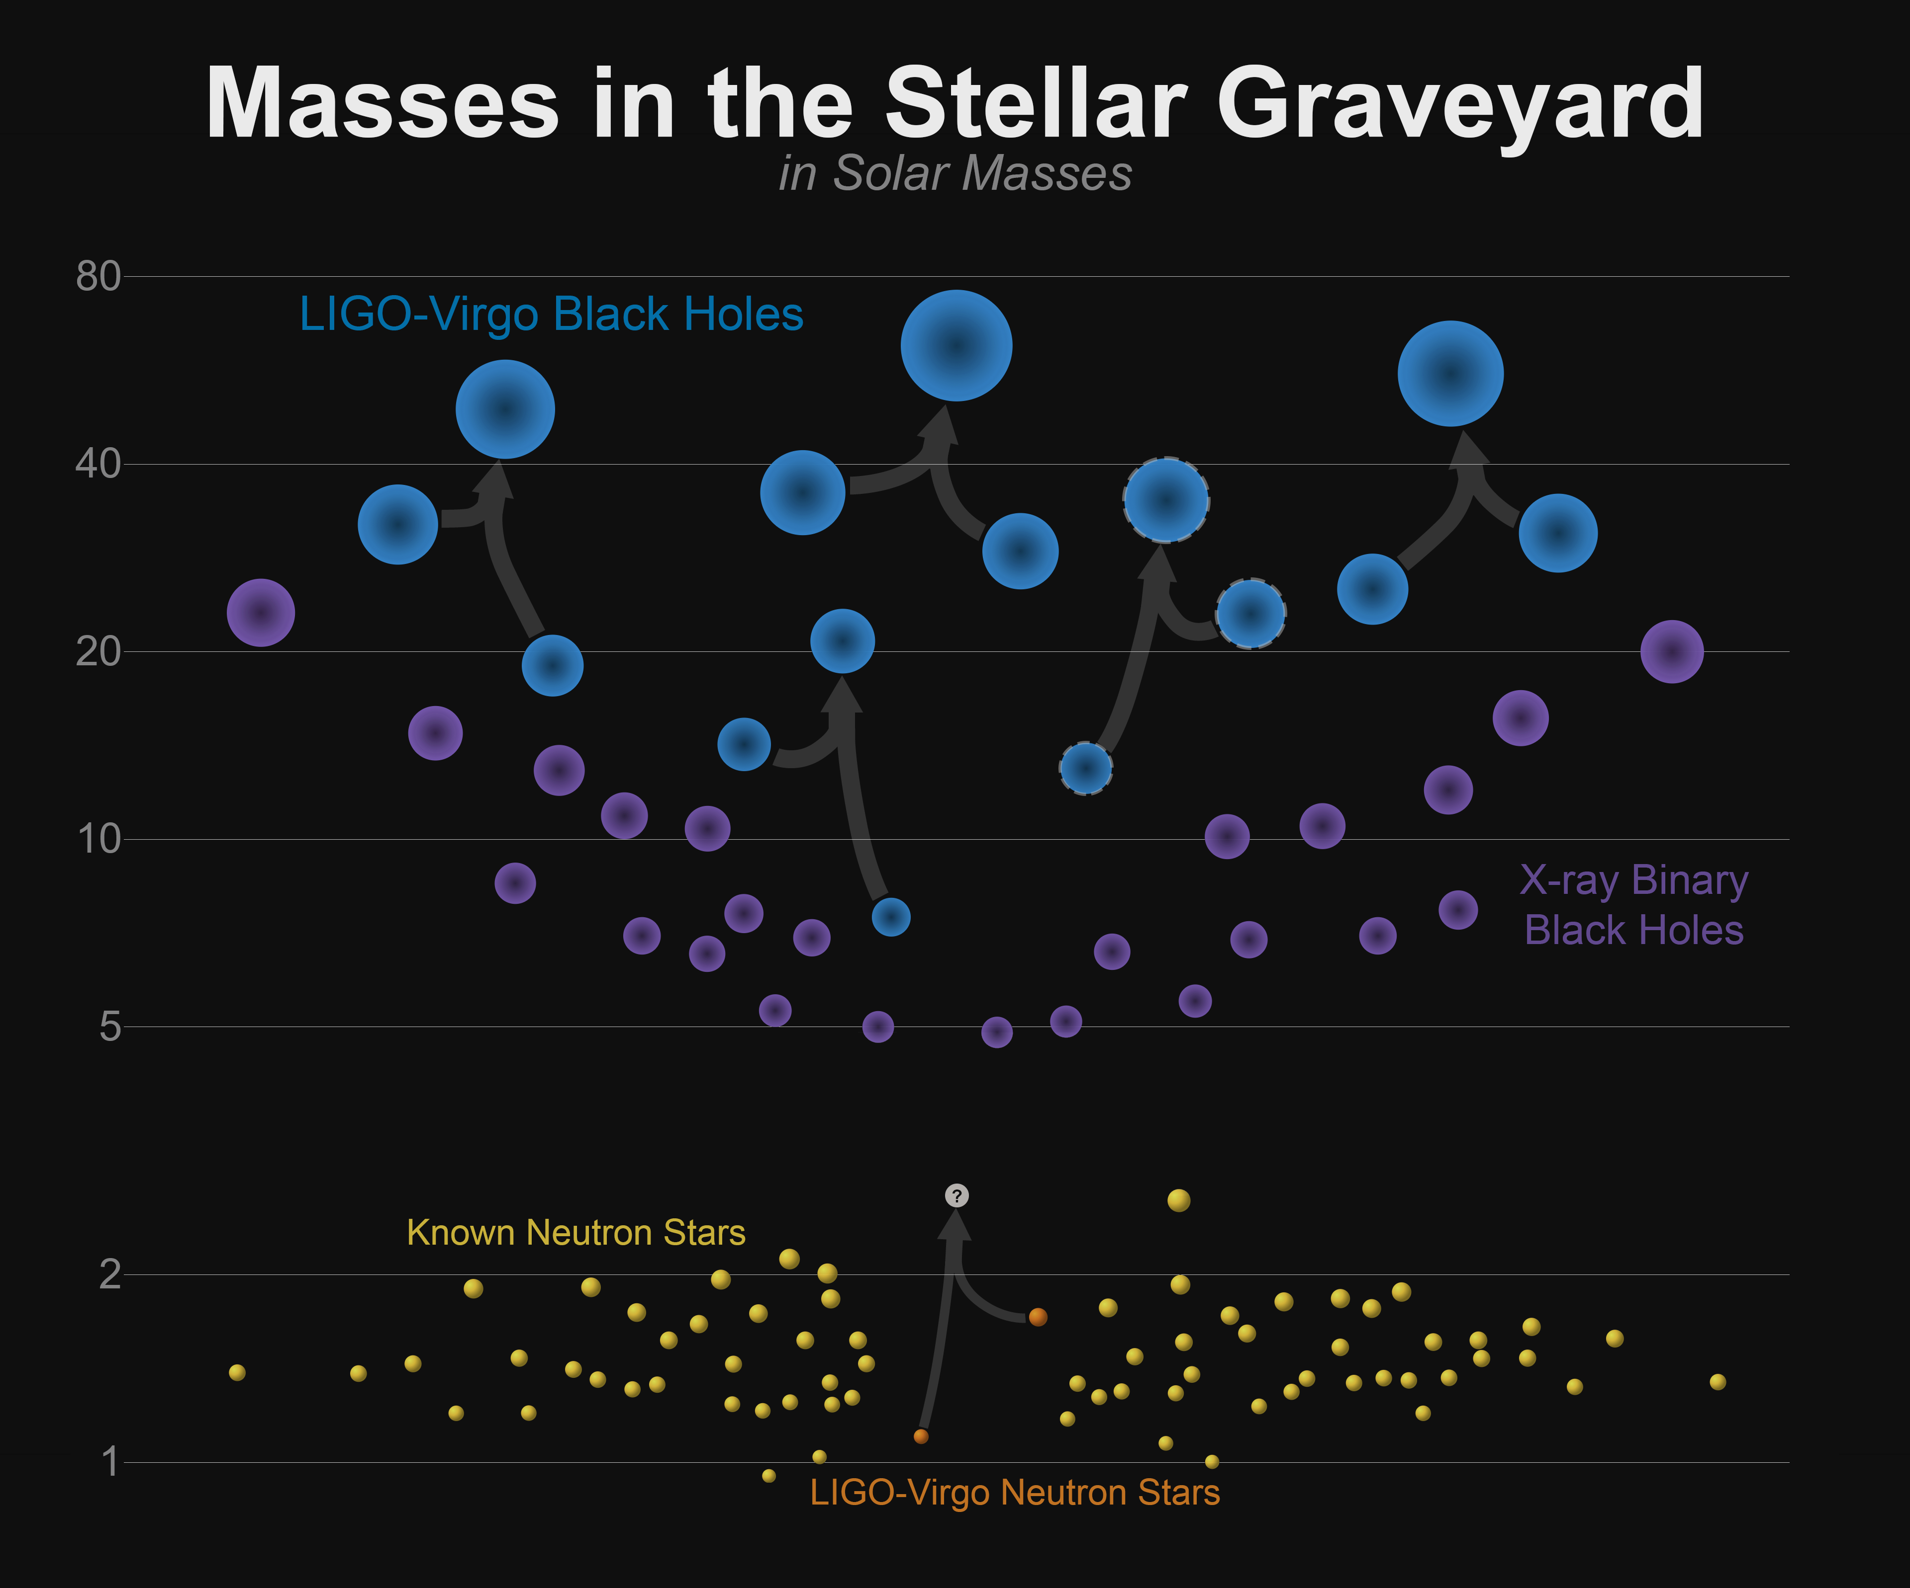
Stellar-mass Binary Black Holes
5 events published to date; 1 with both LIGO and Virgo detectors
Consistency with GR in extremes of compactness and v/c ~0.6
Revealed an unexpected class of heavier Stellar-mass BH

Slide 5
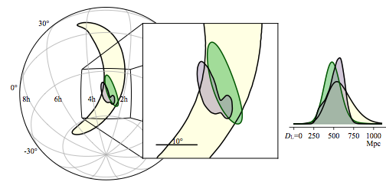
GW170814: Virgo and LIGO detectors, enabling triangulation, polarization sensing
Sky localization improves ~20x; Uncertainty in volume reduced ~34x
LIGO-Hanford and Livingston have similar orientations -> little information about GW polarizations
Virgo is not aligned with LIGO – giving polarization information
Hanford
Virgo
Livingston
13

Slide 6
Three days later…

Slide 7
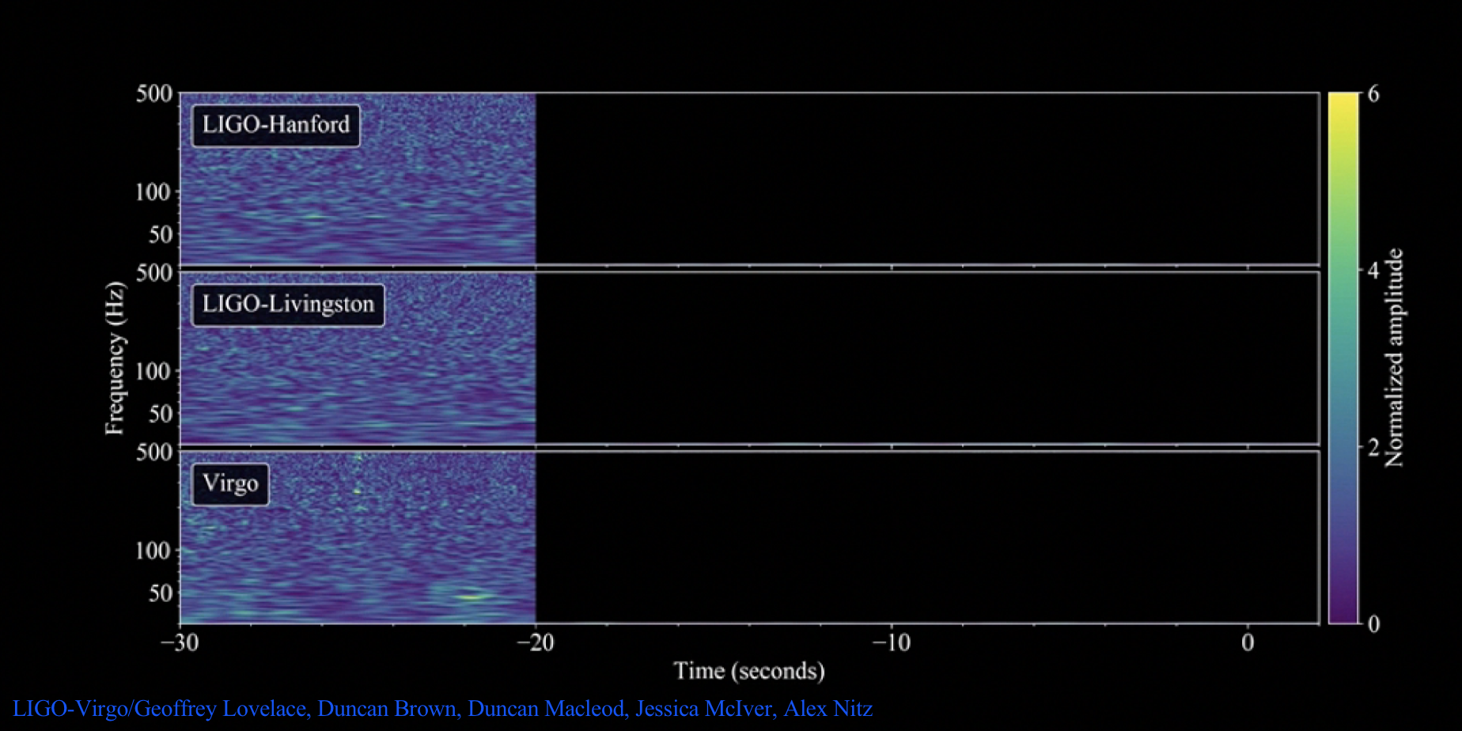
GW170817: Binary Neutron Star Coalescence
LIGO-Virgo/Geoffrey Lovelace, Duncan Brown, Duncan Macleod, Jessica McIver, Alex Nitz
https://doi.org/10.1103/PhysRevLett.119.161101
1

Slide 8
GW170817: Binary Neutron Star Coalescence
LIGO-Virgo/Geoffrey Lovelace, Duncan Brown, Duncan Macleod, Jessica McIver, Alex Nitz
https://doi.org/10.1103/PhysRevLett.119.161101
1

Slide 9
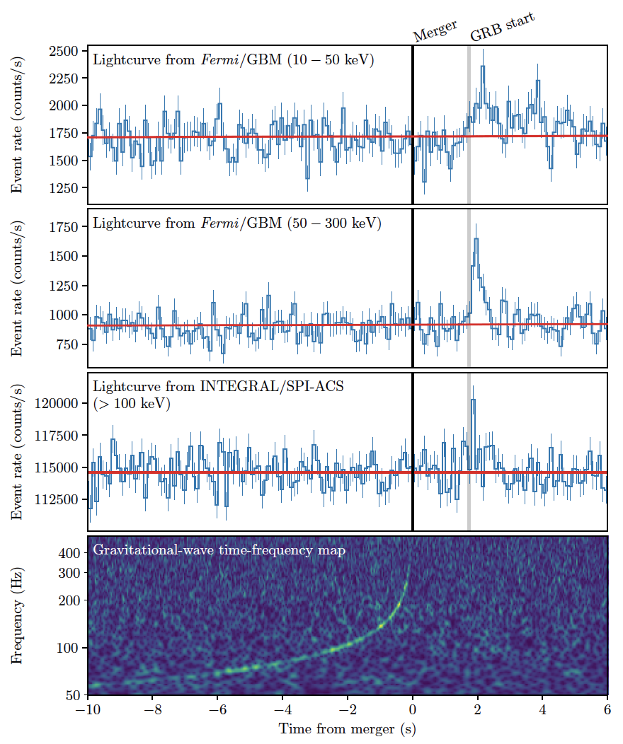
GRB 170817A
GRB 170817A occurs (1.74 ± 0.05) seconds after GW170817
It was autonomously detected in-orbit by Fermi-GBM (GCN was issued 14s after GRB) and in the routine untargeted search for short transients by INTEGRAL SPI-ACS
Probability that GW170817 and GRB 170817A occurred this close in time and with location agreement by chance is 5.0x10⁻⁸ (Gaussian equivalent significance of 5.3σ)
-> BNS mergers are progenitors of (at least some) SGRBs
B. P. Abbott et al., Gravitational Waves and Gamma Rays from a Binary Neutron Star Merger: GW170817 and GRB 170817A, 2017, ApJL
3

Slide 11
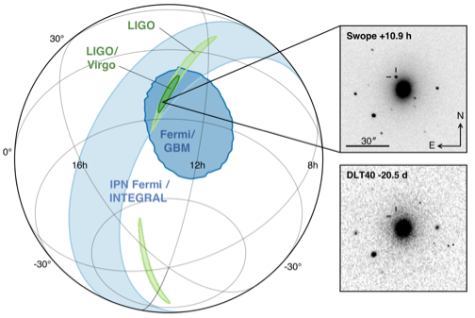
Multimessenger Observations
Approximate timeline:
GW170817 - August 17, 2017 12:41:04 UTC = t₀
GRB 170817A t₀ + 2 sec
LIGO signal found t₀ +6 minutes
LIGO-Virgo GCN reporting BNS signal associated with the time of the GRB t₀ +41 minutes
SkyMap from LIGO-Virgo t₀ + 4 hours
Optical counterpart found t₀ + 11 hours
The localisation region became observable to telescopes in Chile 10 hours after the event time Approximately 70 ground- and space- based observatories followed-up on this event
Working hard to make future alerts come sooner
Alerts to be open to all observers
B. P. Abbott, Multi-messenger Observations of a Binary Neutron Star Merger, 2017, ApJL in press. doi:10.3847/2041-8213/aa91c9
6

Slide 12
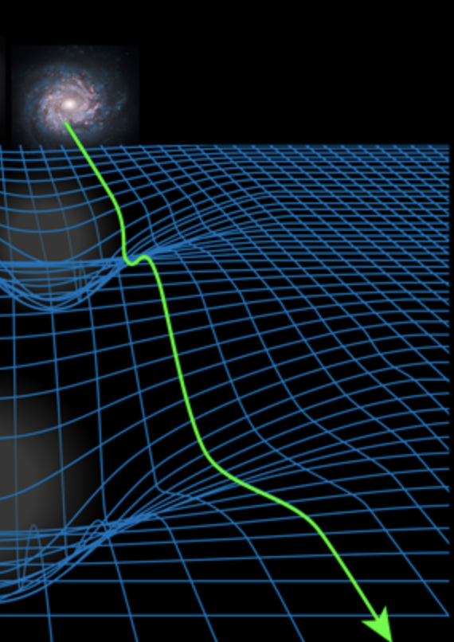
GW Physics with BNS
Tight constraints on total mass (2.74 M😎), individual masses likely 1.2 and 1.5
Equation of State/tidal deformability informed by deviations from point-mass waveform at end of coalescence
Hubble constant calculated using new independent GW distance measurement to source
Speed of GWs the same as Photons to one part in 10¹⁵ ; and Shapiro delay also the same
…and a wealth of knowledge on the post-merger evolution, from EM observations
APS/Alan Stonebraker

Slide 13
Visual summary of signals to date

Slide 14
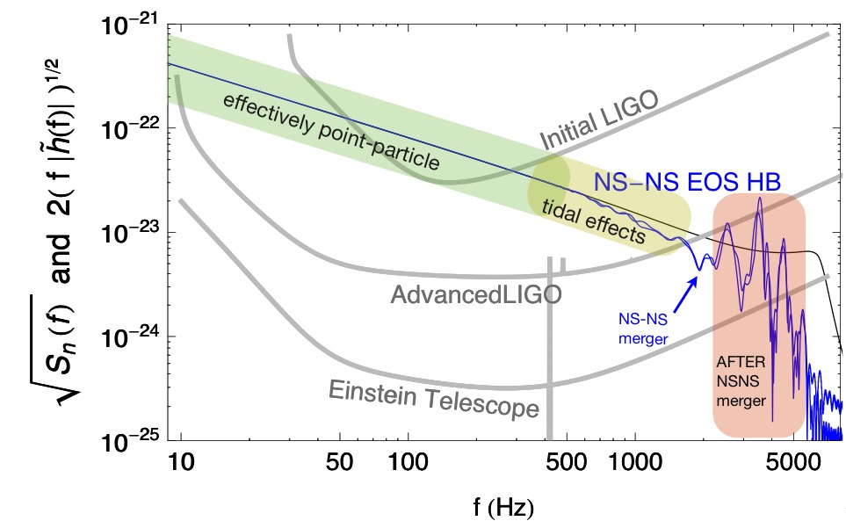
Near Future: 2019-20
Currently both LIGO and Virgo improving sensitivity of instruments
Next: ~1 year long O3 run
Start in early 2019
LIGO with a NS-NS ‘reach’ of ~120 Mpc, Virgo ~65 Mpc
N.B.: the rate goes up as the cube of the reach
Best guesses for O3:
BBH: Several per month to several per week
BNS: 1 to 10 in the year-long run
NSBH: p ~50% of one event
…and: better sensitivity offers more physics

Slide 15
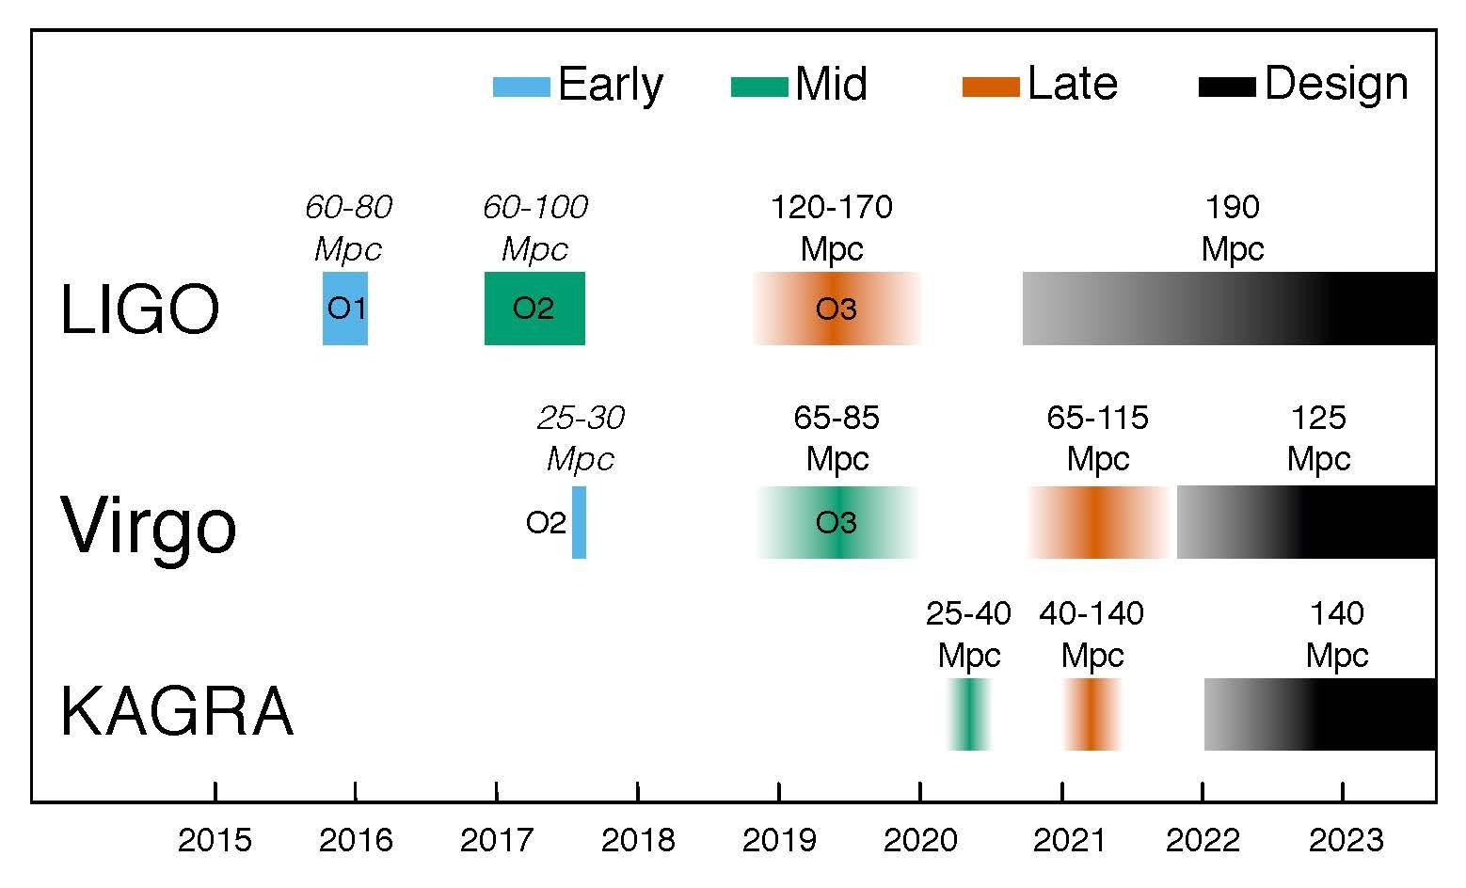
5-year plan

Slide 16
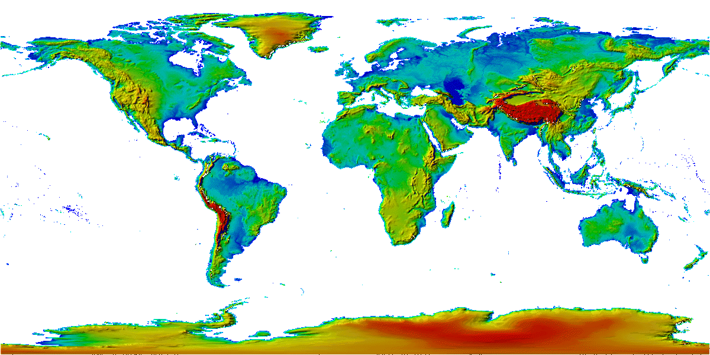
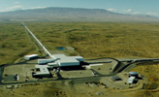
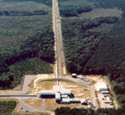
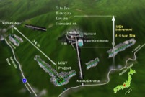
The advanced GW detector network
Advanced
Virgo
2017
Advanced
LIGO
Hanford,
Livingston
2015
KAGRA
2019
LIGO-India
2025
16
16

Slide 17
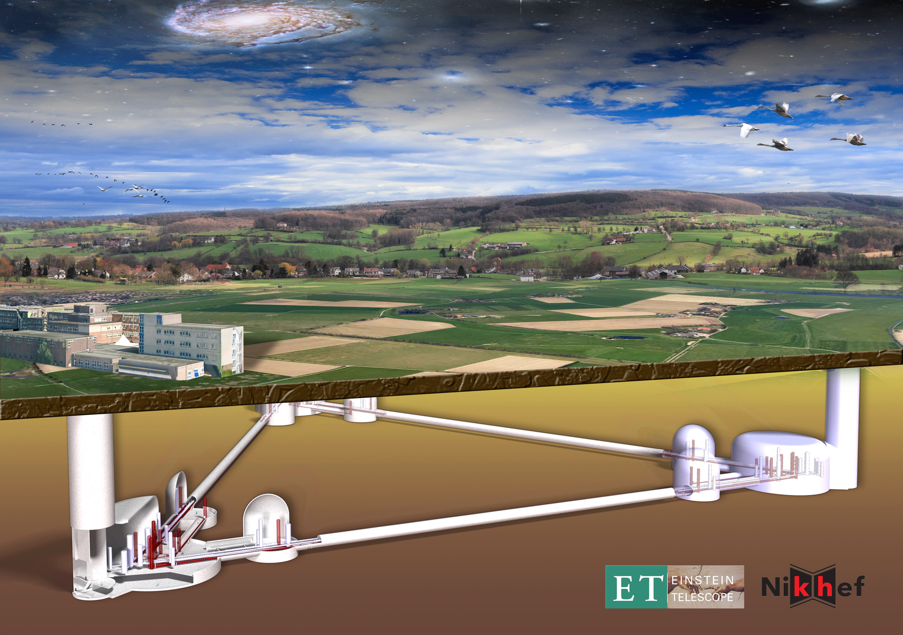
Longer Future
Signal grows with length – not most noise sources
Thermal noise, radiation pressure, seismic, Newtonian unchanged
Coating thermal noise improves faster than linearly with length
4km → 40km surface Observatory one ‘toy’ baseline
can still find sites, earthmoving feasible; costs another limit…
Could put current components in and have 10x better sensitivity, 1000x event rate
Or newer technologies and do even better
US and (figure) European visions
Surface or underground
‘L’ or Δ geometry
Cryogenics, multiple instruments
…Studies underway

Slide 18
3rd Generation
When could this new wave of ground instruments come into play?
Appears 15 years from t=0 is a feasible baseline
Initial LIGO: 1989 proposal, and at design sensitivity 2005
Advanced LIGO: 1999 White Paper, GW150914 in 2015
Modulo funding, could envision 2030’s
Should hope – and strive and plan – to have great instruments ready to ‘catch’ the end phase of binaries seen in LISA
Worldwide community working together on concepts and the best observatory configuration for the science targets
Crucial for all these endeavors: to expand the scientific community planning on exploiting these instruments far beyond the GR/GW enclave
Costs are like TMT/GMT/ELT – needs a comparable audience
Events like GW170817 help!

Slide 19
How can ground-based instruments profit from LISA?
Slide: D. Gerosa

Slide 20
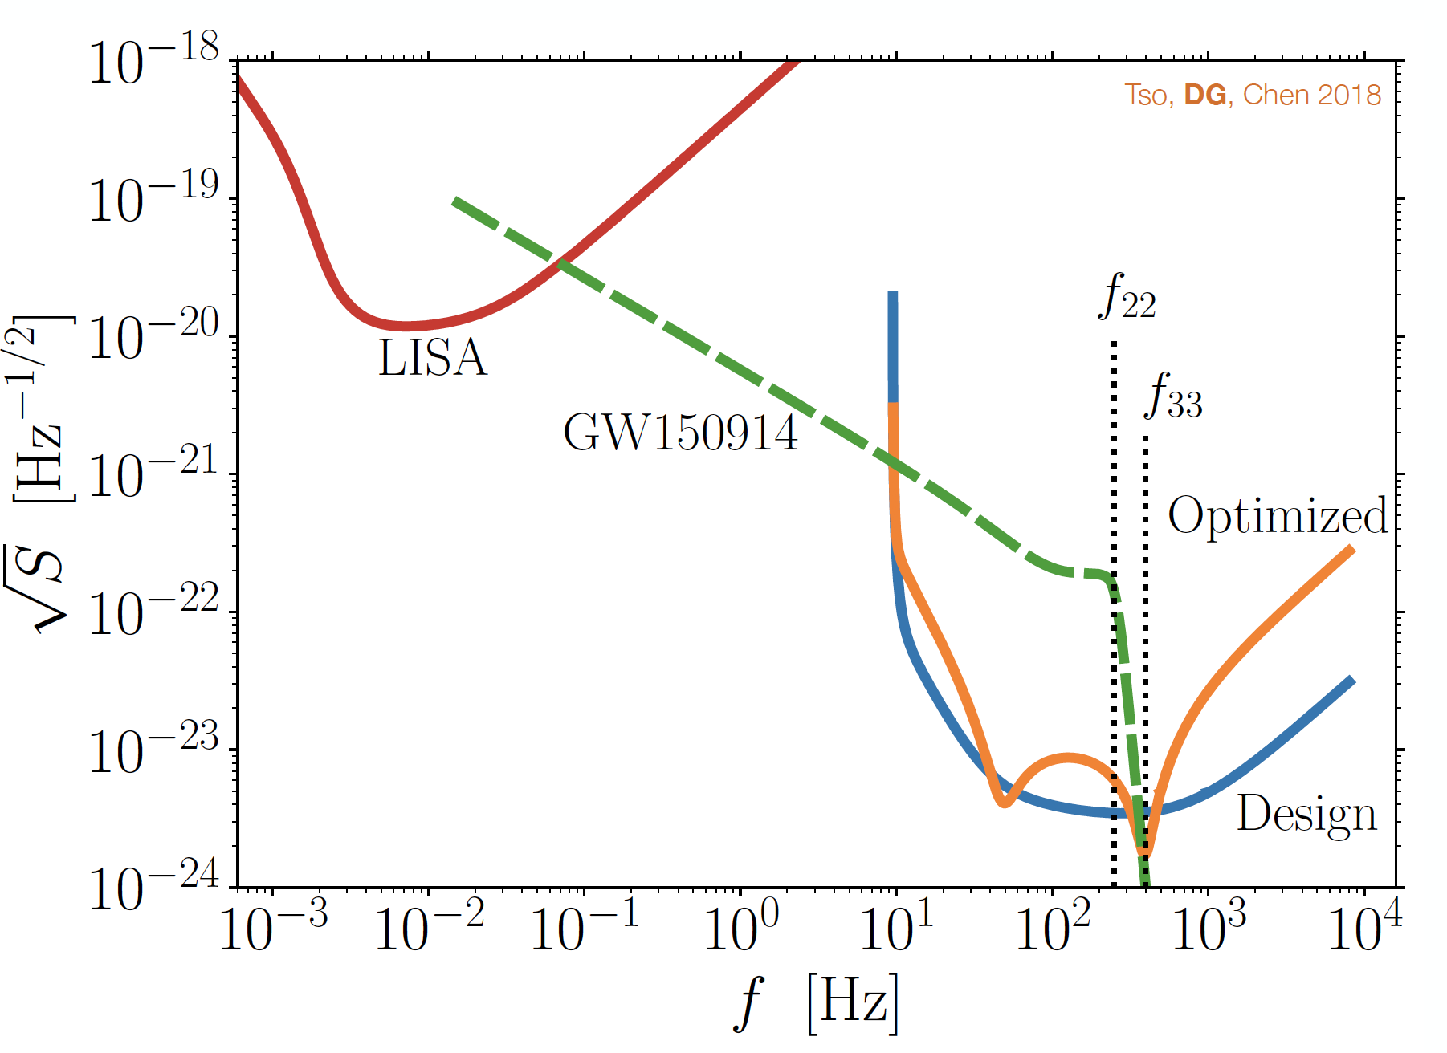
Optimize for specific signal
Exciting physics at the moment of coalescence – BH ringdown
Narrow-banding usually unattractive due to lost science
But knowing when and where could make it worthwhile (D. Gerosa)

Slide 21
How can LISA Profit from ground-based instruments?
Increase the reach of LISA for BNS sources that can also be seen years later by ground-based detectors
Outer circle: ρ=2 LISA threshold
Black dots: astrophysical events detected by LIGO
Red dots: noise
Green: detected with no extra information from LIGO
[Wong, Kovetz, Cutler, Berti, in preparation]

Slide 22
Use LIGO to clean up LISA detections
Detect with LIGO, Virgo, KAGRA in ~2045
Calculate back to time in LISA band ~2035-44, form a matched template for LISA search
Outer circle: ρ=2 LISA threshold
Black dots: astrophysical events (all detected by LIGO)
Red dots: noise
Detected with no extra information from LIGO
Blue dots: recovered by LIGO “coincidence”
[Wong, Kovetz, Cutler, Berti, in preparation]

Slide 23
Just the beginning of a new field –
new instruments, new discoveries, new synergies
LIGO/Virgo
LISA
Pulsar Timing Array
Cosmology Probes

