Slide 1
LIGO Status
For the 4th KAGRA International Workshop, Seoul
David Shoemaker
Slides Borrowed from Fritschel, Dwyer, Zucker, Raab, Landry, others
LIGO-G1801329-v1

Slide 2
LIGO Roadmap (touched up)
175
Mpc
O4
A+ Install
Commission

Slide 3
aLIGO Target Design Sensitivity
Plot shows ‘fundamental’ noises
Technical noises: each should be ≥10x below the Total at all frequencies
L1: O2
BNS range: 175 Mpc
Total noise
Seismic
Quantum
Test mass coating thermal noise
Gravity gradients
Suspension thermal

Slide 4
Noise Budget for LLO detector in O2

Slide 5
Upgrades & other changes for O3
Upgrade | Motivation | Frequency band impacted
Stray Light improved Control, part A LIGO-D1700361 | New & improved light baffles; some testing performed at LLO | 50-500 Hz
Monolithic Signal Recycling Mirrors | Original mirrors were temporary, held in a composite structure | 3 kHz noise peak; f <100 Hz
neoLASE amplifier for 70 W output LIGO-T1700046 | Allows doubling of laser power vs. O2 | freqs > 80 Hz
LHO vertex components done pre-O2 at LLO (SR3 heater, ISS upgrades, ISI dampers, TM Bounce/roll dampers, etc.) | LLO was the pathfinder for these components | various & duty cycle
New ITMX on H1 (point absorber on old optic) LIGO-T1700149 | Discovered during O2; caused noise problems | freqs > 30 Hz
Squeezed Light Upgrade LIGO-E1600387 | Both IFOs have squeezed vacuum injection capability | freqs > 80 Hz
Test Mass Discharge System on all Test Mass chambers LIGO-E1500235 | System to neutralize static charge buildup on/near test masses | freqs < 100 Hz
Replace End Test Masses, retrofit annular-End Reaction Masses LIGO-E1500264 | Better optical quality ETMs; ERMs have lower residual-gas damping | freqs > 20 Hz

Slide 6
Upgrades & other changes for O3
Upgrade | Motivation | Frequency band impacted
Acoustic Mode Dampers applied to all Test Masses LIGO-E1800071 | For parametric instability control; successful results after years of R&D | freqs > 80 Hz
Beam Rotation Sensors for LLO (4 units; built & installed by Univ. of Washington collaborators) LIGO-G1801085 | Ground tilt sensing for improved low-frequency isolation (higher duty cycle) | Duty cycle improvement
Signal Recycling Cavity alignment sensing with new 118 MHz modulation LIGO-E1700327 | For better sensing of the SRM alignment; required some new electronics & modulator modifications | Duty cycle improvement
Electric Field Sensors: outfit one end-station chamber per IFO LIGO-E1800049 | New diagnostic for electric field fluctuations near the test mass | freqs < 100 Hz
Scattered light control for Output Faraday Isolator LIGO-G1800787 | Identified in LLO testing as (most likely) the most sensitive remaining area for scattered light noise | 30-60 Hz

Slide 7
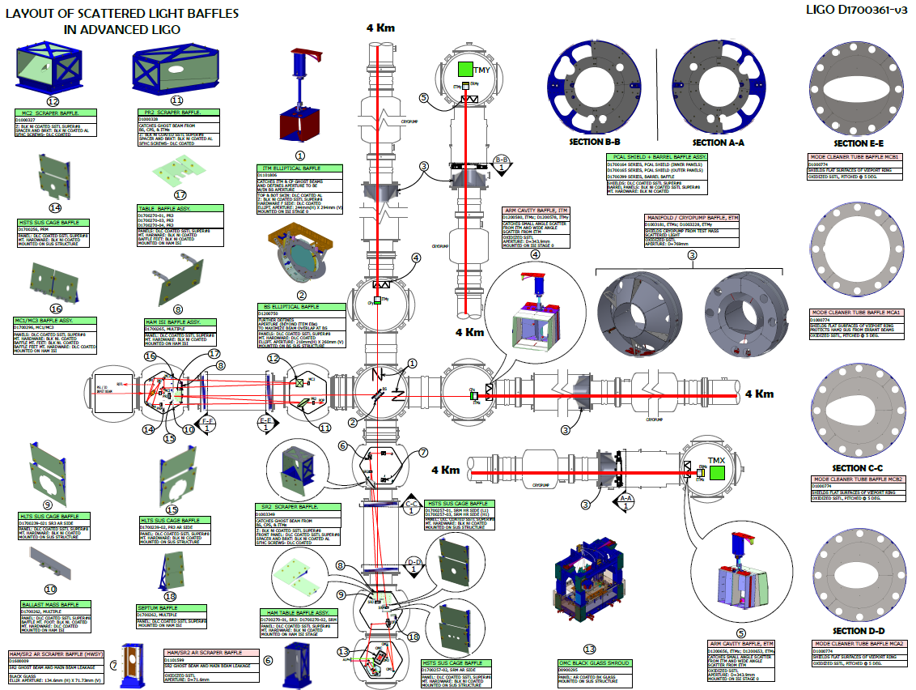
Baffles for Scattered Light
Stray light control:
Removing some baffles which caused noise
Adding new baffles
Modifying some baffles

Slide 8
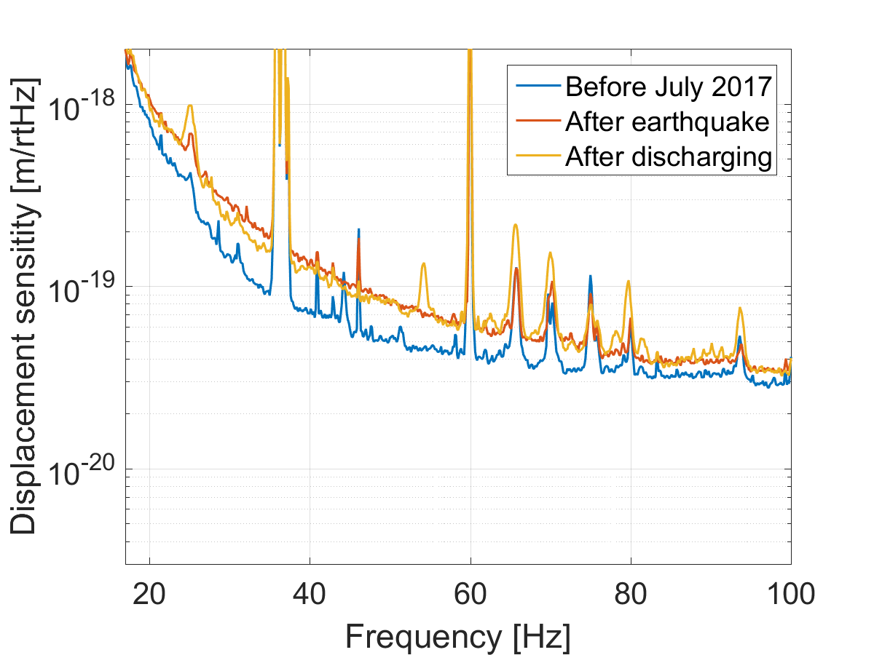
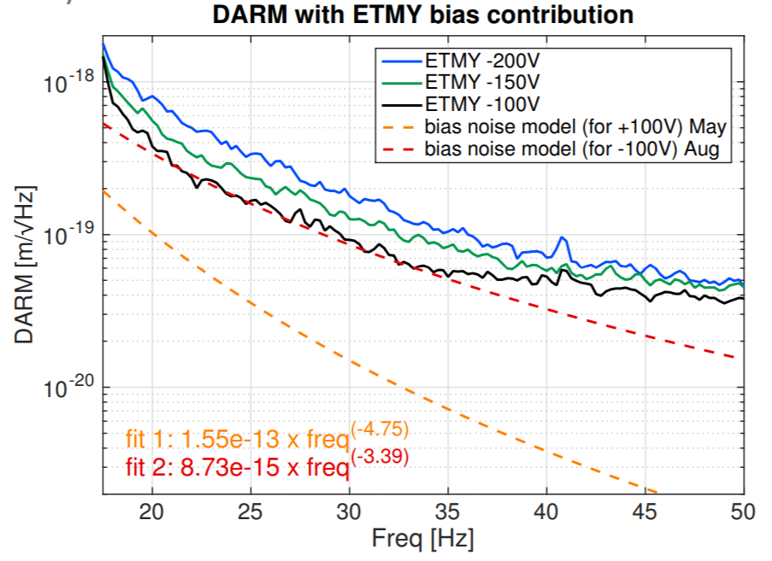
Charge on optics, fluctuating electric fields
Large earthquake added charge to Hanford test masses
Noise dependence on static electric fields around test mass at Livingston
Installing test mass discharging systems in place for all test masses
A Effler G1800748

Slide 9
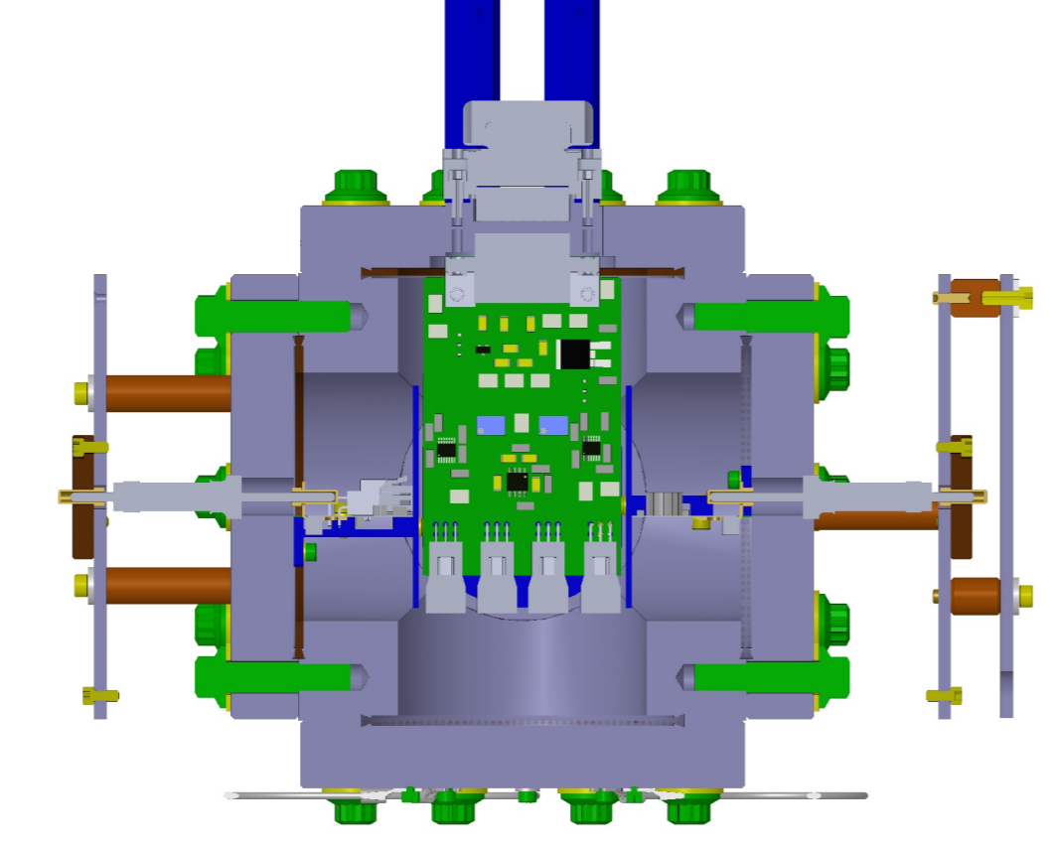
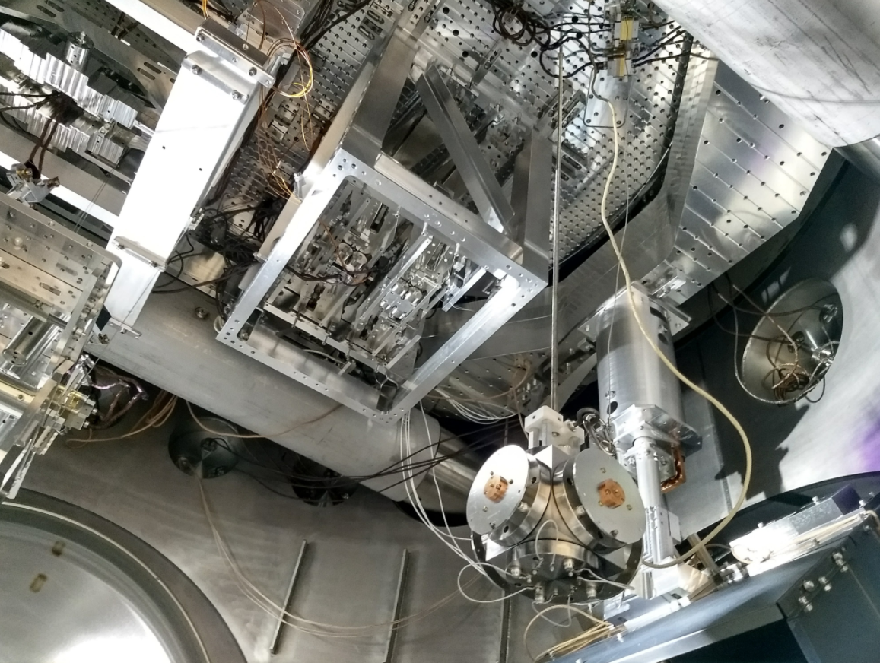
Electric Field Meters
Sensor for stray electric fields will be installed in one end chamber at each site
Photo: G Mansell C Cahillane
Design: G1800293

Slide 10
Pre-O3 commissioning:
Expect to start in August 2018
Sensitivity
  Goal is ≥120 Mpc range for binary neutron star mergers (1.2 Gpc for 30+30 M⦿ black holes)
Higher laser power operation
  Double the laser O2 power stored in the arm cavities to 200 kW
Realize Squeezed light injection
  goal of 3 dB of shot noise suppression
Iterate on Alignment control
  Improved robustness and reduced control noise coupling
Optics, cavities, wavefronts
  characterization of new optics & optimization of thermal compensation
Environmental couplings
Duty cycle improvements

Slide 11
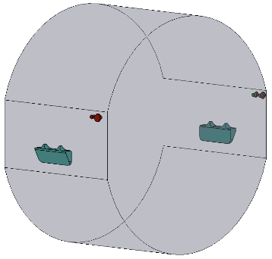
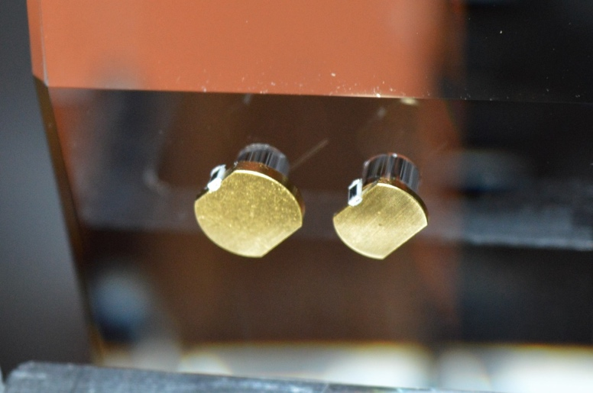
High Power Operations
Establish operations at high interferometer power
Goal: 200 kW arm power → 50W input laser power
New laser amplifier: Characterization of jitter etc.
Alignment control design to compensate for power induced instabilities
Thermal compensation
  Optimization for mode-matching, noise couplings
Parametric Instability control
  Opto-mechanical feedback between the test mass acoustic modes & the arm cavity optical modes can lead to instability
  For O3, all test masses will have Acoustic Mode Dampers to mitigate PIs
Small tuned dampers:
Resistively-shunted PZT + reaction mass,
bonded to sides of TM

Slide 12
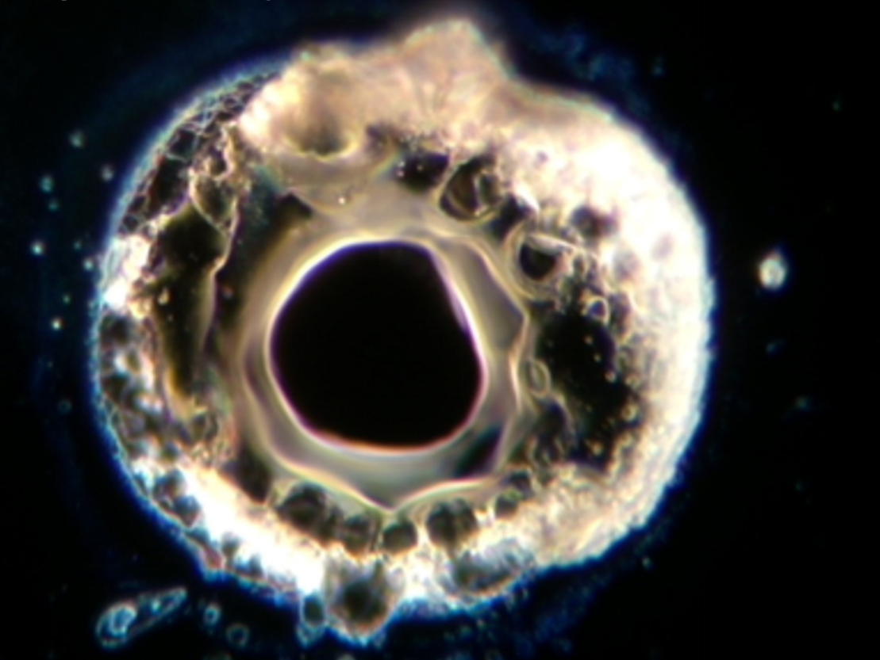
New test mass Optics
Anomalous absorption spot found on one Hanford input test mass (~10 microns dia.)
May have been responsible for increased jitter coupling
This test mass has now been replaced
Also: correcting wrong 532 nm transmission (locking), reduced coating planetary ripple
Photo: G Billingsley

Slide 13
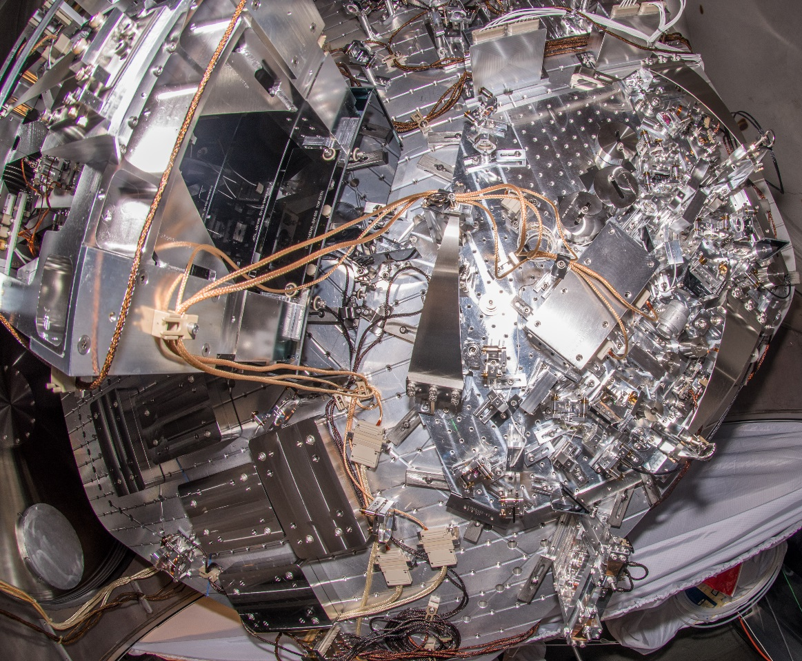
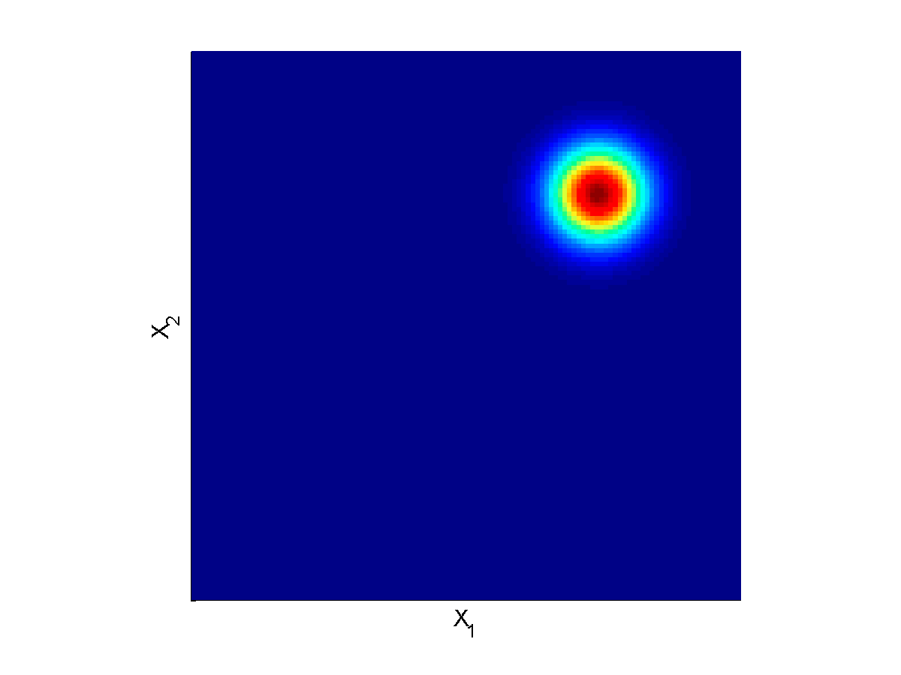
Frequency independent Squeezing for O3
Squeezers now installed at both sites
Laser
Photo: M Tse

Slide 14
Squeezing preliminary results
Early results from Livingston
Around 1 dB of squeezing measured
No harm done!
Goal is to 3dB of squeezing (40% shot noise reduction)
Plot: L Barsotti

Slide 15
Target sensitivity for O3
Projections made by starting with the L1 sensitivity in O2, and
Reducing technical noise by 1.5x, Increasing laser power, injecting squeezing

Slide 16
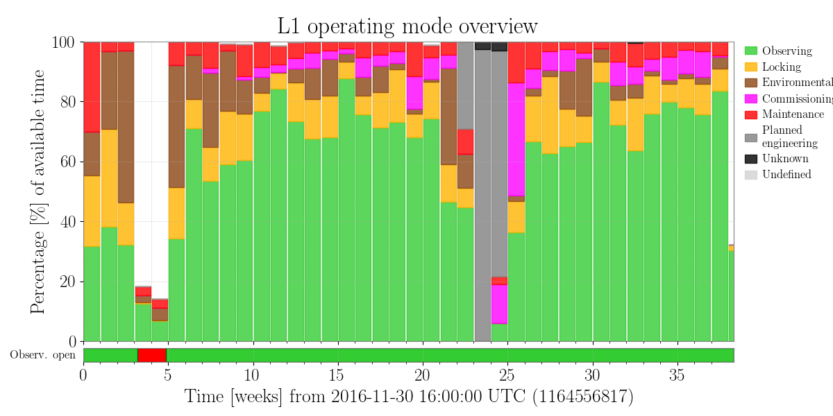
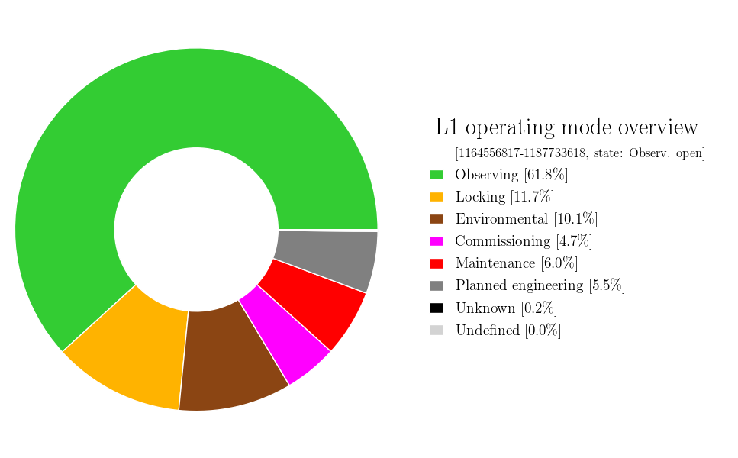
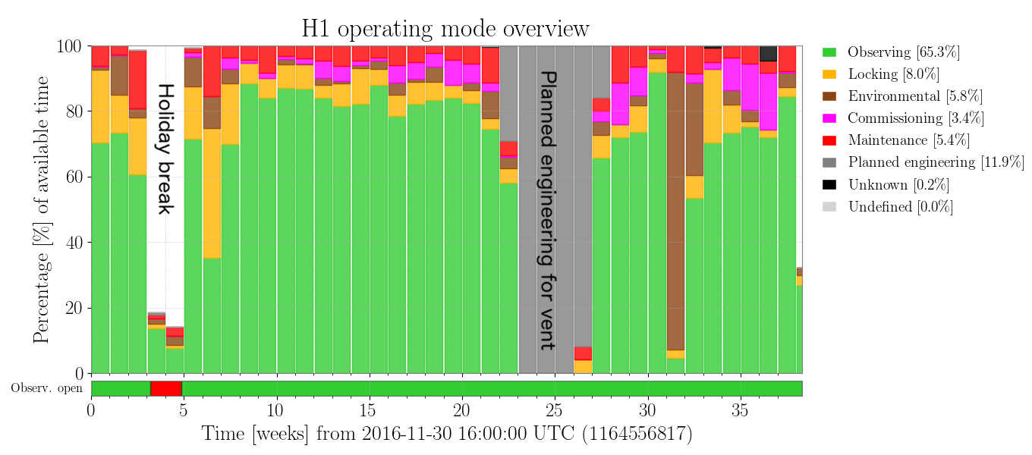
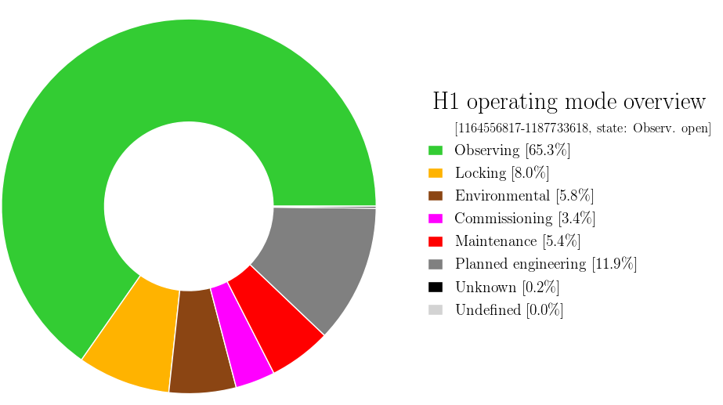
Detector duty factor
Observation run overall uptime of 70% for individual detectors, and 50% H1-L1 double-coincidence.
Suppresses events; could miss a unique event (supernova)
Holiday break
Planned engineering
for H1 vent
Notes:
Ensure people know what duty factor is: 24/7 no exceptions (i.e. when we are supposed to be on)

Slide 17
Improvements to robustness/duty cycle
Passive dampers for suspension modes to reduce time spent in active damping
  Bounce & roll mode dampers being propagated to H1 (successfully deployed on L1 prior to O2)
  Investigating designs for dampers for the violin modes, for possible O4 implementation
Improve ability to hold lock during low-level earthquakes
  Modify controls in advance of EQ arrival
Shorten time required for lock acquisition
  New ETMs: arm cavities will now have current, higher green finesse to benefit Arm Length Stabilization
  R&D ongoing on machine learning to speed up certain steps
Improve ability to lock in times of high wind and high microseism
  Beam rotation sensors, to deal with low-frequency tilts, now deployed at both observatories

Slide 18
Once O3 is running, ~February 2019
Fundamental change for O3: Open Public Alerts for Triggers
  No more standard EM follow-up MOUs or private GCN alerts!
  LIGO/Virgo to release public alerts for all event candidates for which we have reasonable confidence
    For binary mergers: one false-alarm-rate threshold, aiming for 90% purity overall (in practice, lower purity for neutron star binary candidates— i.e., pursue them more aggressively)
    More restrictive threshold for unmodeled GW burst candidates
    We can “promote” a weaker GW candidate if it is coincident with a GRB, core-collapse supernova, etc.
  We’ll provide basically the same information as in O2: significance, time, binary type classification, sky position and distance 3D map
    Considering adding some more information to aid prioritization
  We’ll provide automatic preliminary alerts before human vetting
See https://www.ligo.org/scientists/GWEMalerts.php for more info

Slide 19
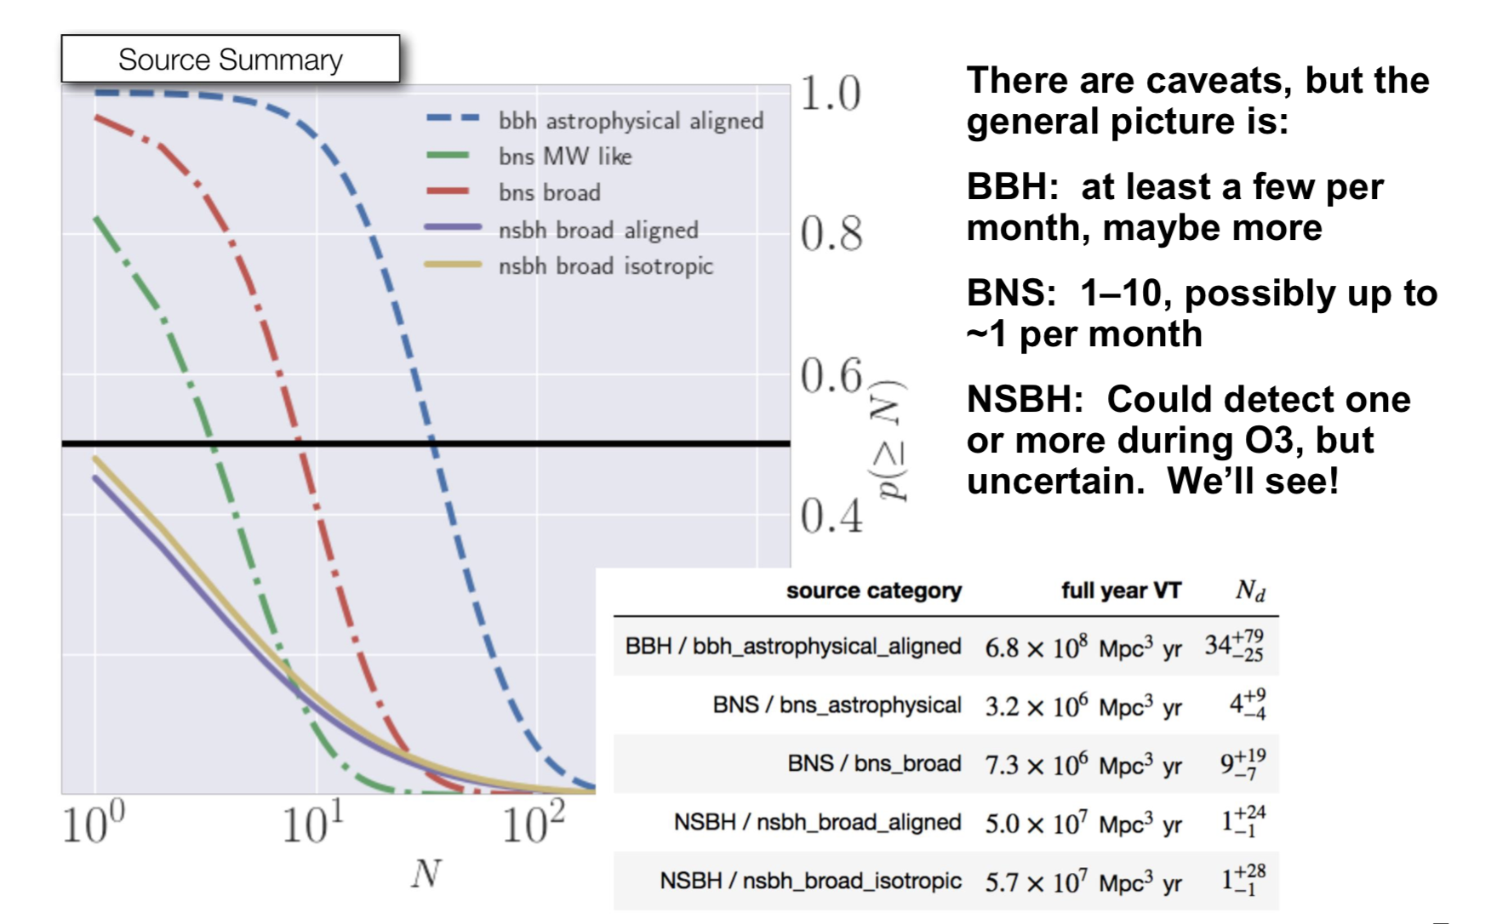
Rates in O3
From Town Hall presentations

Slide 20
LIGO Roadmap (touched up)
173
Mpc
O4
A+ Install
Commission

Slide 21
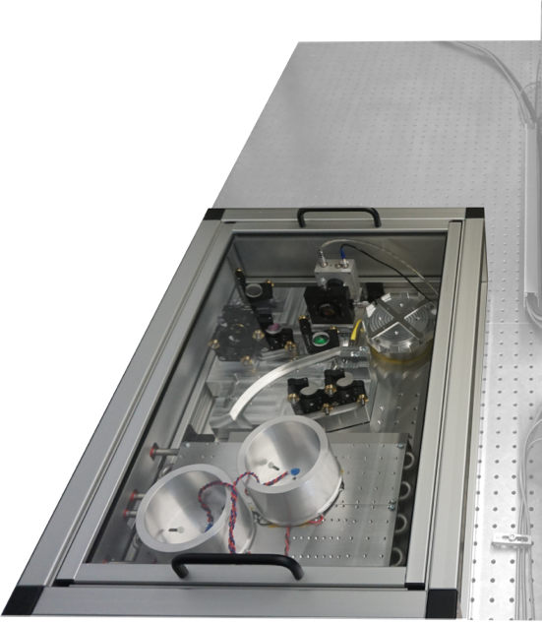
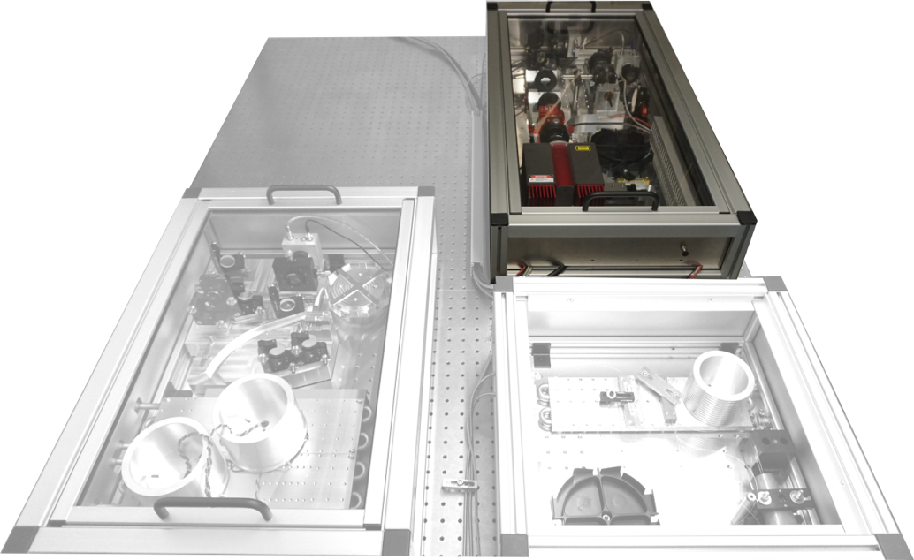
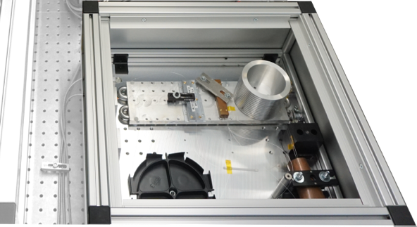
Detector upgrades for O4
New Higher Power Laser
200 W at the laser source → 600-700 kW in the arms
Will evaluate several options:
  Custom 200 W fiber amplifier
  Coherent beam combining of multiple amplifiers
  Original high power oscillators
Plan on down-selecting between these options in early 2019, to be ready with new lasers in early 2020 (right after O3)
LZH fiber amplifier
MIT-Lincoln Labs fiber amplifier

Slide 22
Detector upgrades for O4
Jitter Attenuation Cavity
Noise due to input beam pointing fluctuations
  (Input beam jitter) x (differential arm misalignment)
  Original requirements on both of these factors are proving difficult to achieve
  Projected to limit aLIGO target design sensitivity in the 200-1000 Hz band
Noise due to input beam higher order fluctuations
  (Input beam size fluctuations) x (differential lensing in the arms)
  Not considered in the original design; difficult to tightly control the differential lensing
An additional mode-filtering cavity would address both of these noise issues
  LIGO-T1700542, Jitter attenuation cavity preliminary design

Slide 23
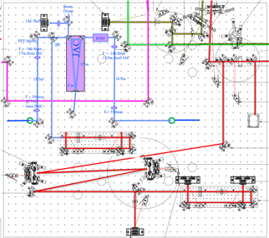
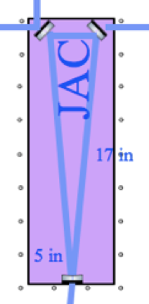

Detector upgrades for O4
Jitter Attenuation Cavity
JAC documentation:
LIGO-E1700002
Laser
Components added to HAM1

Slide 24
LIGO Roadmap (touched up)
173
Mpc
O4
A+ Install
Commission

Slide 25
A+ elevator pitch
An incremental upgrade to aLIGO that leverages existing technology and infrastructure, with minimal new investment, and moderate risk
Target: factor of 1.7* increase in range over aLIGO
About a factor of 4-7 greater CBC event rate
Bridge to future 3G GW astrophysics, cosmology, and nuclear physics
Stepping stone to 3G detector technology
Can be observing within 6 years (mid- 2024)
“Scientific breakeven” within 1/2 year of operation
Incremental cost: a small increment on aLIGO
*BBH 30/30 M: 1.6x
*BNS 1.4/1.4 M: 1.9x

Slide 26
A+: a mid-scale upgrade to
Advanced LIGO
Reduced quantum noise
  Improved optical losses
  Improved readout
  Frequency-Dependent Squeezing
Reduced thermal noise
  Improved mirror coatings
Observing by mid-2024
O2
aLIGO design
A+
BNS: 173 Mpc
BBH: 1607 Mpc
BNS: 325 Mpc
BBH: 2563 Mpc

Slide 27
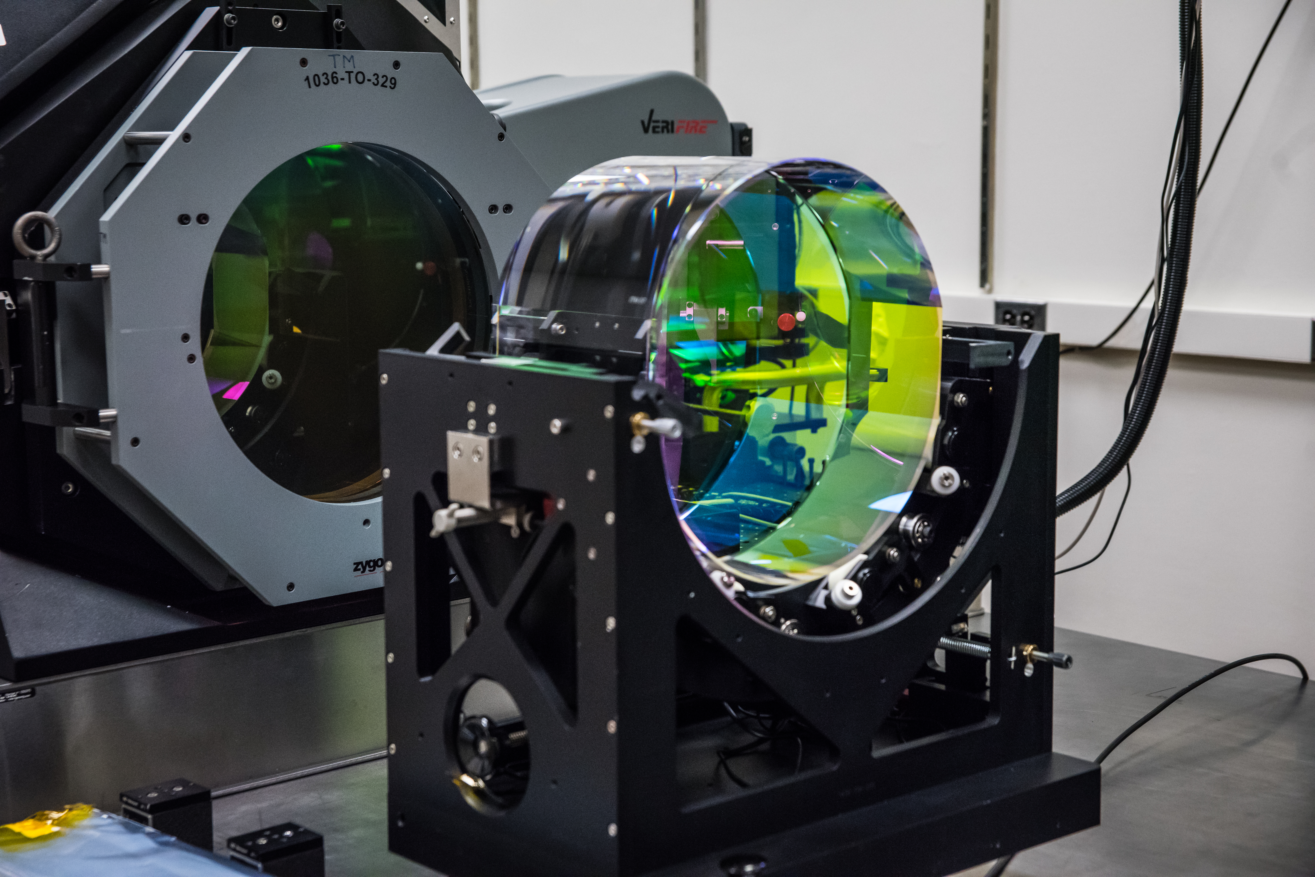
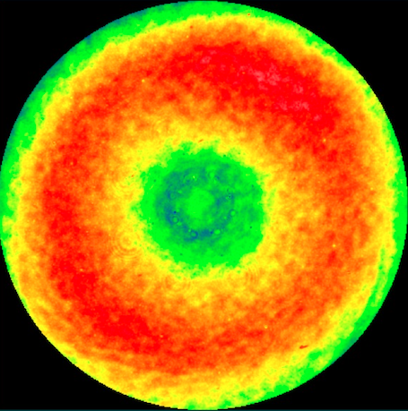
Improved Mirror Coatings for A+
400mm LIGO Fizeau
interferometer at CIT
TARGET: Elastic loss angle φ < 9 x 10⁻⁵
  (aLIGO φ = 3.6 x 10⁻⁴⁾
Current R&D on small samples
UK, Europe and US Center for Coatings Research initiative to select best low-loss coating design in about 2 years
A+ Coating Pathfinder program will spin up industrial vendor(s) and qualify full-aperture coatings for production
In parallel, new and existing spare aLIGO optics will be polished
Metrology, QA, lab infrastructure, tooling, procedures all same as aLIGO & reused
Replacement core optics delivered for final phase of A+ installation (mid-FY23)
aLIGO ETM figure map
6.5 Å_{RMS} over central 160 mm Φ
(LIGO Lab/G. Billingsley)

Slide 28
A+ Coatings
Gras & Evans, P1700448
A+ goal

Slide 29
Frequency-Dependent Squeezing
Optical “filter cavity” (FC)
Rotates squeezing phase; improve radiation pressure at LF and phase noise at HF
Low-loss, high finesse cavity with bandwidth ~100 Hz
Sensitive to optical losses, scattering and mirror motion
Requires seismic isolation and quiet mirror suspension
Requires high-quality FC mirrors
Requires L_{FC} ~ 300 m

Slide 30
Filter cavity vacuum system and facility modifications
C. Torrie & E. Sanchez
Corner station (Hanford)
50 m
300 m
(TO LLO)
50 m

Slide 31
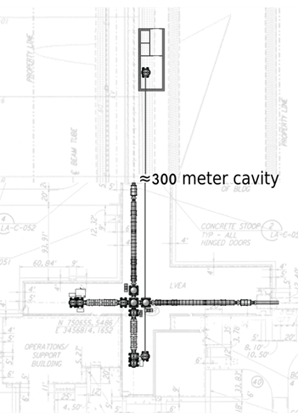
A+ FILTER CAVITY
BEAMLINE
New station
building
New HAM
Chamber
New 20cm
Beamtube &
Enclosure
New HAM
Chamber
View from future LLO FC end station back to corner
C. Torrie, E. Sanchez , G. Billingsley
M1800040

Slide 32
A+ Program/Funding Update
Preliminary Construction Proposal submitted March 2018
  NSF (lead)
  STFC (UK) planning partnering in support; ARC also helping
Peer review convened 5/10 with UK participation
  Rigorous and extremely positive panel report returned to NSF
A+ RECOMMENDED FOR CONSTRUCTION
Accelerated start date: October 2018
  Late-2022 construction completion unchanged
    paced by mirror coating development and observing obligations
Highly construction-efficient award funding profile

Slide 33
LIGO-India
Concept: Put the ‘spare’ aLIGO detector in a new southern Observatory
NSF contributes detector; India contributes Observatory
A greater number of detector facilities around the world improves:
  Sky localization
  Polarization information
  Network robustness/duty-factor; at 75% uptime,
      P(triple detection, 3 detector network) = 42%
      P(triple+ detection, 4 detector network) = 74%
      P(triple+ detection, 5 detector network) = 90%
Status:
  Site acquisition nearly complete
  Initial funding (~10%) being used for site, preparing engineering
Instrument is planned to be upgraded to A+ technology
Expect fully-commissioned observation to start in 2025

Slide 34
Summary
Preparations for O3 are challenging
  Instrument installation and commissioning
  Collaboration preparations for anticipated detection rates also challenging! But that’s another talk…
Future development of the instrument, and field, looks bright
Eager for KAGRA to join O3!

