Slide 1
Developing Phase Map of Cavity Mirrors using
Laser Mode Spectroscopy
LIGO-SURF 2018
Keerthana S Nair
IISER Bhopal, India

Slide 2
Overview of Project
Motivation ?
To develop an in-situ technique to characterize the Mirror surface.
To understand the irregularities in the Mirror Surface (Mirror Figure Error).
Precisely characterize the figure error of an optical cavity using an interferometric measurement.
How ?
Using an Auxiliary laser to scan the cavity and using the cavity scan data to understand the surface properties of the mirror.
This includes Experimental as well as computational skills.

Slide 3
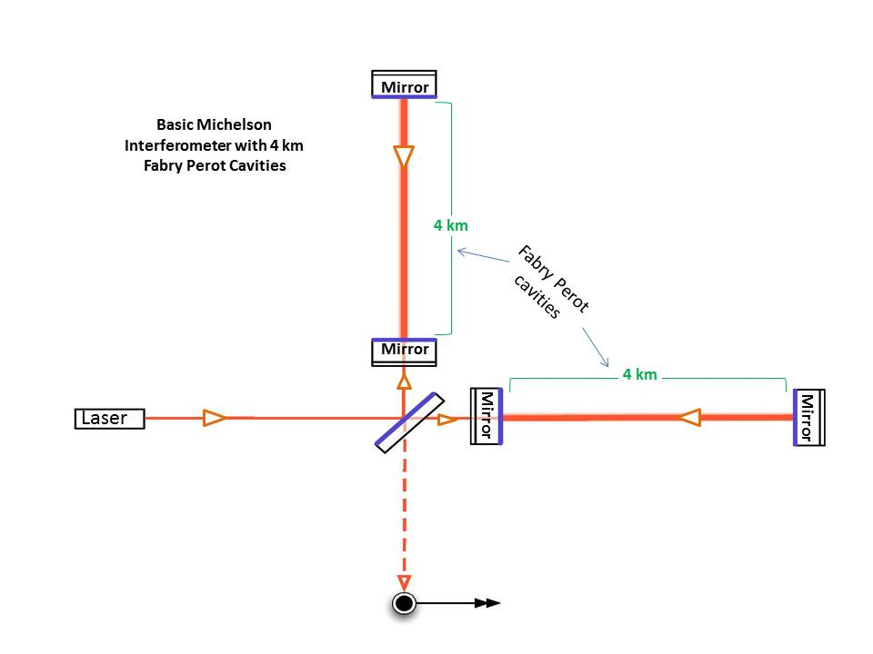
LIGO Gravitational Wave Detectors
Modified Michelson interferometers with Fabry Perot cavity introduced in it.
Light undergoes multiple reflection inside the cavity Increase in distance travelled by the laser.
In advanced LIGO, cavity length = 4 Km
In the Caltech prototype, cavity length = 40 m
ETM-Y
40 m
ITM-Y
40 m
ITM-X
ETM-X

Slide 4
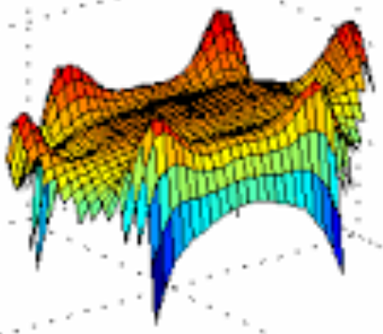
Mirror Figure Error
Lower Sensitivity to GW
Loss of light
One of the sources for optical Power loss due to unwanted scattering.
Other Sources
Point defects
Scratches
Contaminations
Optical Loss
Reduction in beam power
Increased Shot noise
Low Frequency surface defects present on the test masses, which produces low angle scattering of light.
Irregularities or deformations of the Mirror Surface.

Slide 5
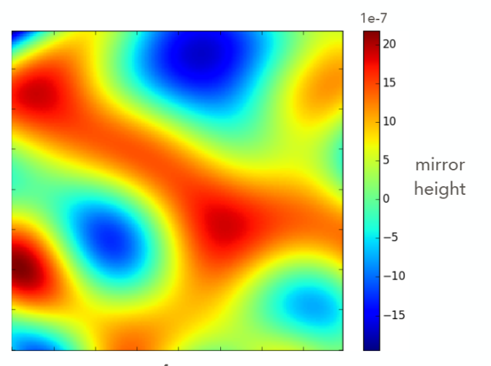
Phase Map
Collection of information showing the structure of the Mirror surface. It can be represented in many ways.
The in-situ technique we use to produce these Phase Map is called the Mode-Spectroscopy.
Method
Using the transverse mode spacings from the cavity transmission data to produce Phase Maps.

Slide 6
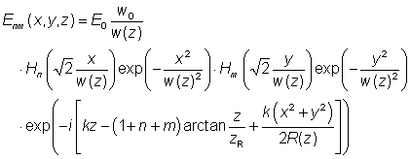
Hermite-Gaussian Modes
These are approximate solutions of the wave equation, valid under Paraxial Approximation.
The Electric Field Distribution of a beam can be represented by a product of a Gaussian function and Hermite polynomial, apart from the phase term.
H_{n}(x)—Hermite polynomial
n,m – Constants determining the shape of the profile in X,Y direction.

Slide 7
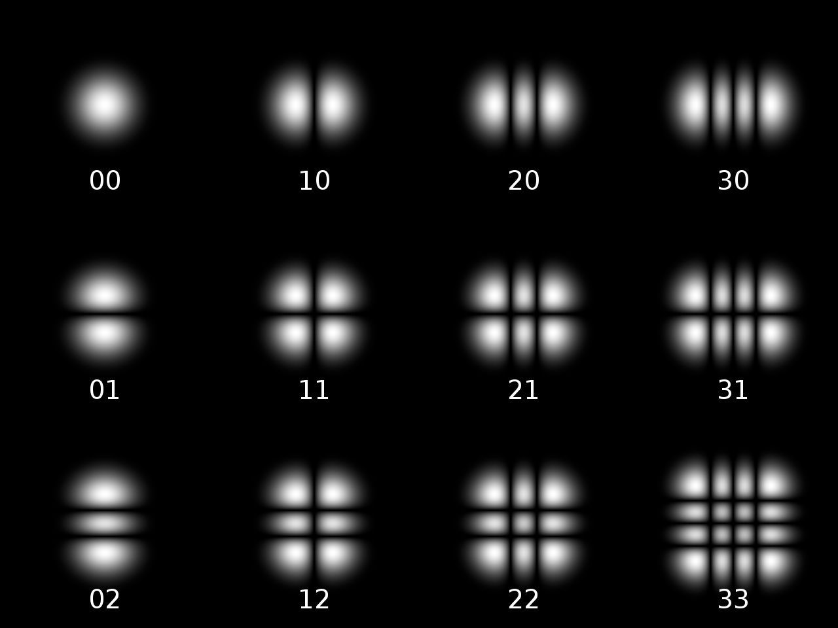
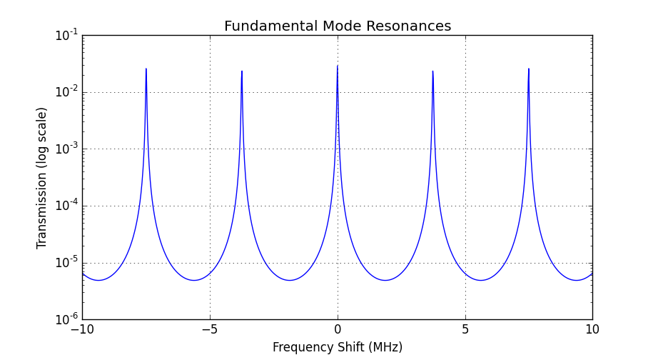
Resonant Modes of FP Cavity
TEM₀₀ Fundamental Mode. ^{[1]}
All other modes are higher order modes.
Beam aligned to a cavity only see the lowest order solution of the Gaussian beam, TEM₀₀^{[1]}

Slide 8
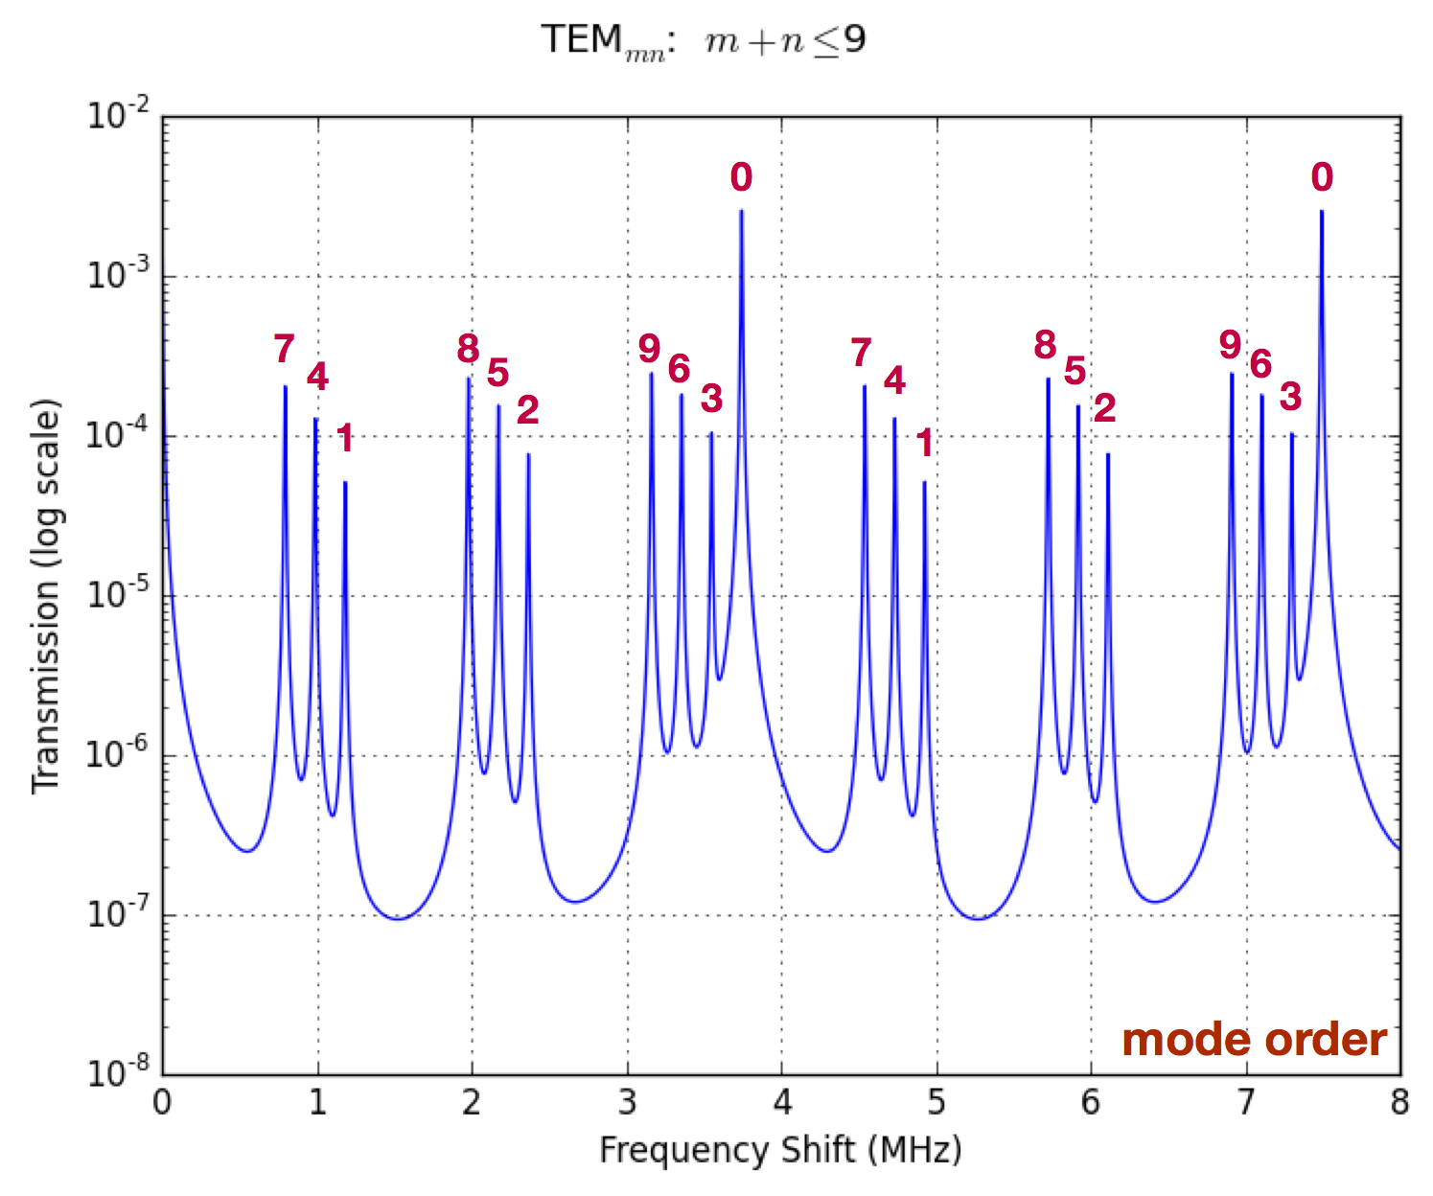
Misaligned beam gives higher-order modes also. ^{[1]}
FSR
TMS

Slide 9
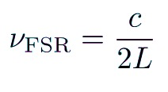
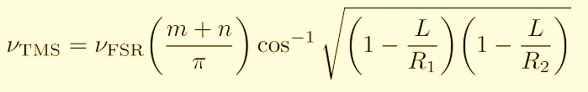
Mode Spectroscopy
Collecting information about certain parameters with the help of mode spacings.
Distance between two fundamental modes = Free Spectral Range (FSR)
Distance between fundamental mode and a higher order mode = Transverse Mode Spacing (TMS)

Slide 10
FS RFSR
Cavity Length
TMS
Cavity Length
Radius of Curvature of the mirrors
Mode Order
Each TEM mode comes in contact with different region of the mirror surface, depending upon the size of the beam.
Thus the shift in TMS spacing will be different for different modes. It depends on the effective radius of curvature of the mirror at the region where the beam is falling.

Slide 11
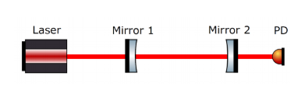
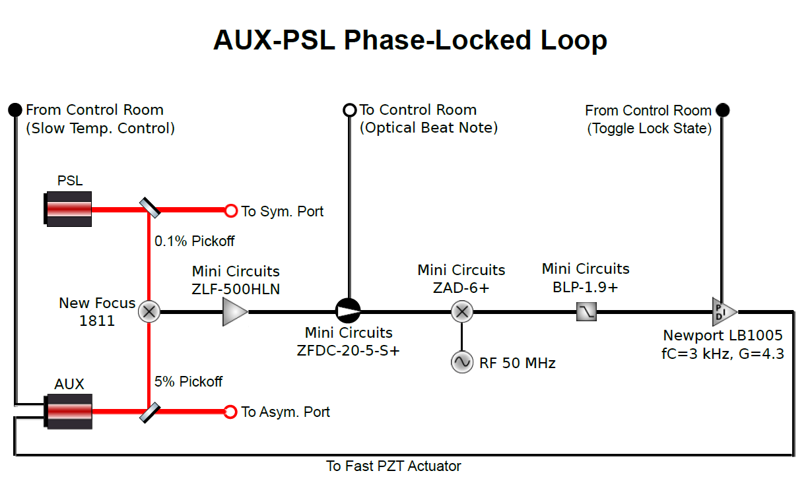
Cavity Scans
Unable to scan the PSL laser because we want it to be locked to the arm of the cavity. Thus we introduce an Auxiliary Laser to do the scans.
The PLL- Loop helps us to scan the AUX laser frequency in a controlled way.

Slide 12
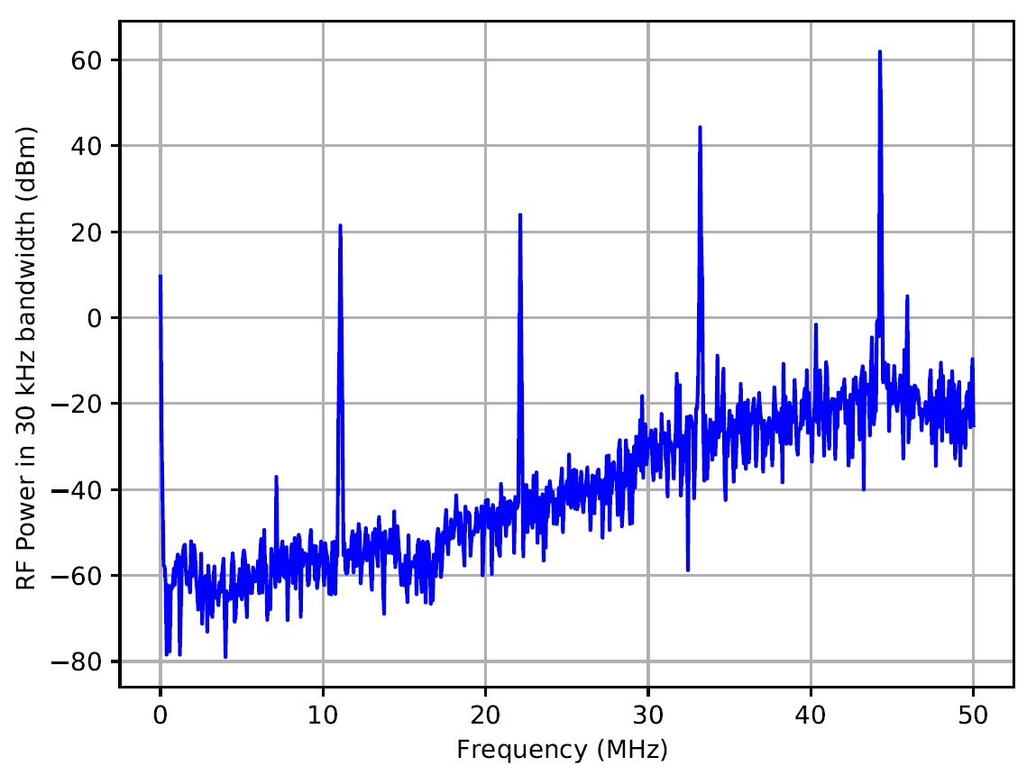
Cavity Scan Data
Cavity Scan data obtained from the transmitted AUX beam.
Max power goes to the cavity at the time of resonances. Thus we obtain peaks in the transmission power.
Cavity Scan data obtained from the Reflecting AUX beam.
Max power goes to the cavity at the time of resonances. Thus we obtain dips in the reflection power.

Slide 13
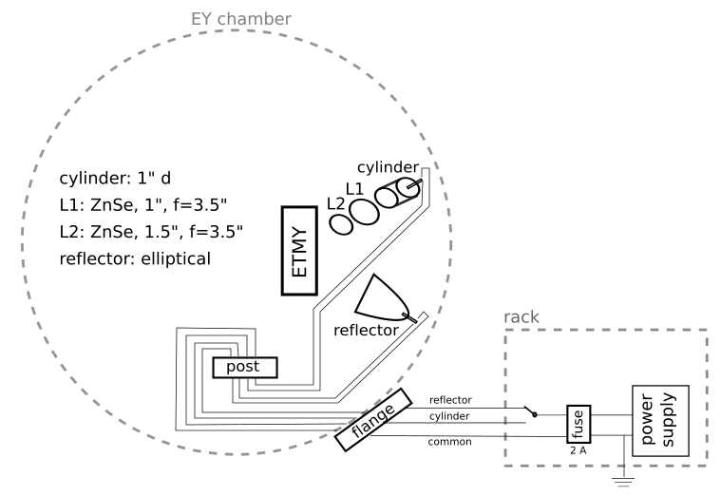
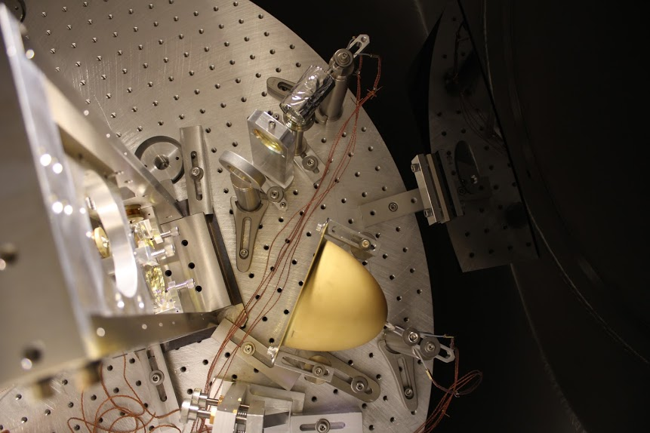

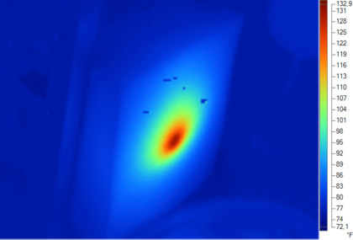
Heating the Mirror
Generating a known deformation on the mirror surface by focusing the heat on the centre of the mirror.
Observing the shift in mode frequencies due to this deformation.
Heat Pattern on the Mirror Surface due to the cylindrical reflector.
IR- image showing the focusing of heat produced by the rod heater and elliptic reflector.

Slide 14
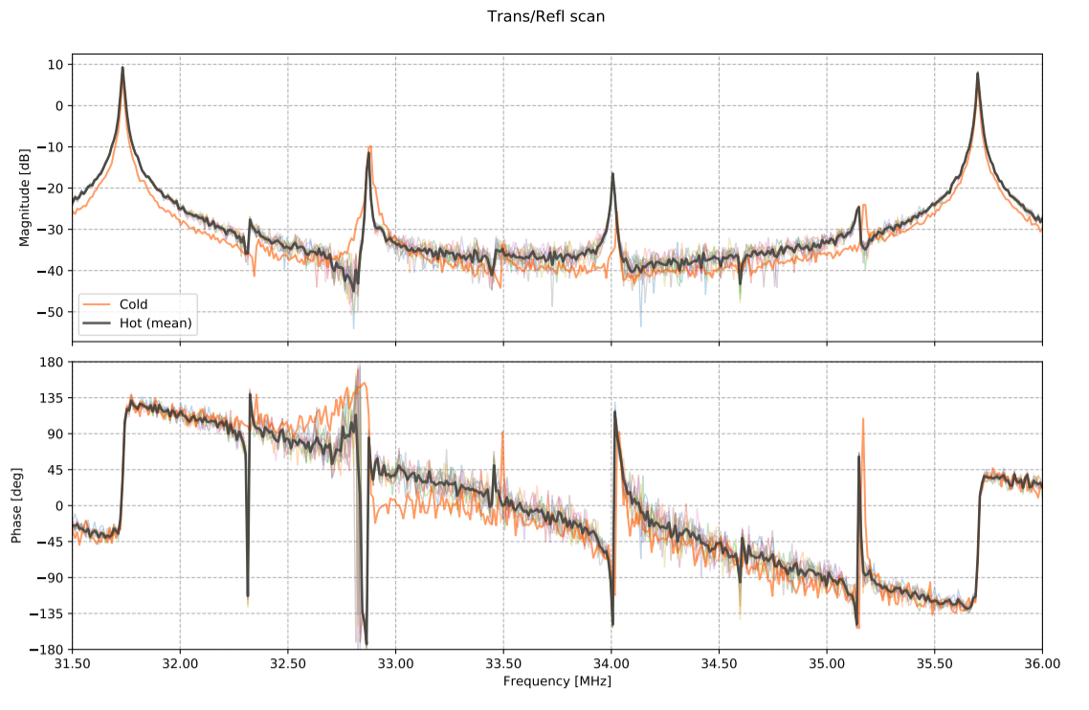
In the Mirror, the rate of diffusion of heat is less, this leads to the formation of a projection at the centre of the Mirror due to heat.
This increases the Radius of curvature of the mirror. Thus decreases the TMS frequency.
0
0
1
2
4
3

Slide 15
Next step….!!
Bayesian Inference
Markov chain Monte Carlo (MCMC)
To identify the most probable Mirror Figure error corresponding to the shift in each of the modes.
References
“Laser Mode Spectroscopy for Mirror Metrology” by Naomi Wharton (SURF 2017), Koji Arai and Rana Adhikari
“Technique for in situ measurement of free spectral range and transverse mode spacing of optical cavities” by Alberto Stochino, Koji Arai and Rana Adhikari

Slide 16
Special Thanks to :
Rana Adhikari
Koji Arai
Gautam Venugopalan
Jon, Terra, Annalisa
Steve
Special Regards to :
Sandrine Ferrans
Pooja Sekhar
Disha Kapasi
Shruti Jose
Serena, Mandy
LIGO-2018 Team
Dedicating to Mr. Unnikrishnan Nair (My Grandpa) !!!
Thank You..!

