Slide 1
Improving earthquake monitoring for gravitational-wave detectors with historical seismic data
Sky Soltero
Mentor: Michael Coughlin
LIGO SURF final presentation
August 24th, 2018

Slide 2
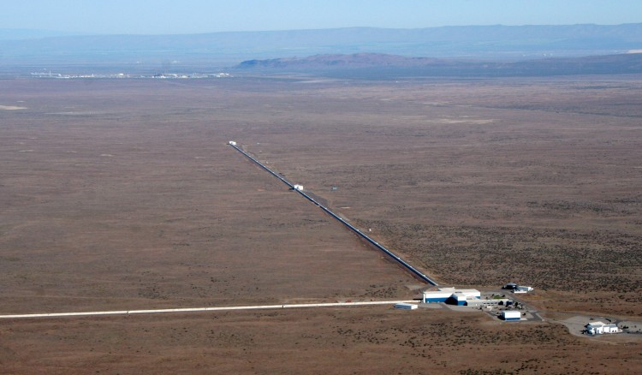
Agenda
Background
Neural Network
Comparing model results
Future work
Current earthquake monitoring
Earthquake waves
LIGO facility in Hanford, Washington.

Slide 3

Earthquake Isolation
A level of isolation from the ground is required for Advanced gravitational-wave detectors such as the Laser Interferometer Gravitational-Wave Observatory (LIGO) to function at peak performance.
High magnitude teleseismic events can disrupt proper functioning, operation and duty cycle.
Less time in proper observation mode mean less gravitational waves being observed.
Which makes us very sad

Slide 4
Earthquake Monitoring
With advanced warning of impeding tremors, the impact can be suppressed in the isolation system and the down time can be reduced at the expense of increased instrumental noise.
Is there a system in place that does this already?
YES!

Slide 5
Implementation at the sites
An early warning system, called Seismon predicts the arrival times of earthquakes and the likelihood of the interferometer to go out of observing mode.
If there is high chance of losing lock, a trigger is made to change the control configuration at the interferometers using the LIGO automation system called Guardian.

Slide 6
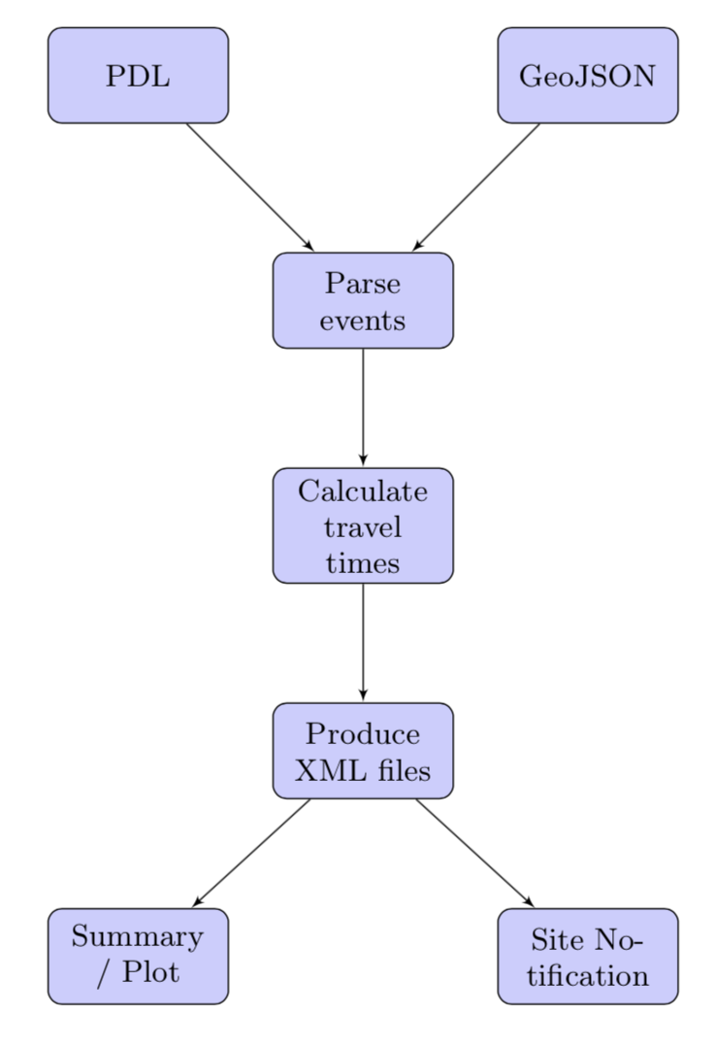
SEISMON
Seismon predicts the arrival time of the primary, secondary and surface waves of the earthquake
Predicts the likelihood for the interferometer to go out of observing mode and lose lock
Predictions are made using data from a worldwide network of seismic observatories compiled by the United States Geological Service (USGS)

Slide 7

Before trying to better improve the arrival time predictions it’s necessary to understand Earthquakes better.

Slide 8
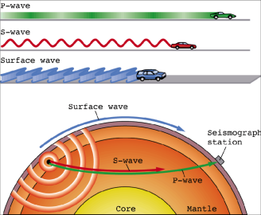
Earthquake Arrival times
Earthquakes are detected when seismometers detect P-wave arrivals then initial estimates of magnitude and hypocenter are made
These preliminary estimates can then be made more accurate with S-wave and surface wave arrivals

Slide 9
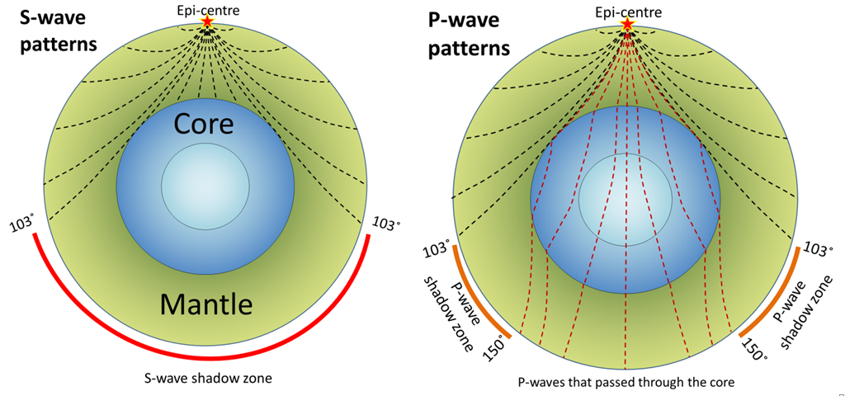
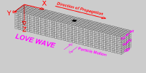
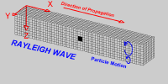
Waves 101
S- waves
P-waves
Solids
Shears rock sideways
1-8 km/s
Solids and liquids
Compresses and dilates
1-14 km/s
Occurs on crust
Love: side to side
Rayleigh: rolling
2-6 km/s

Slide 10
P and surface wave comparison
P-waves travel at about twice the speed of surface waves

Slide 11
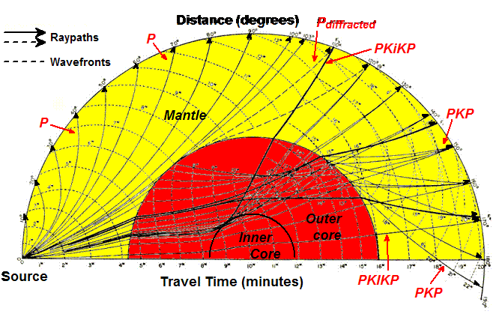
P- waves
Higher P-wave speeds are often due to the location and azimuth degree

Slide 12
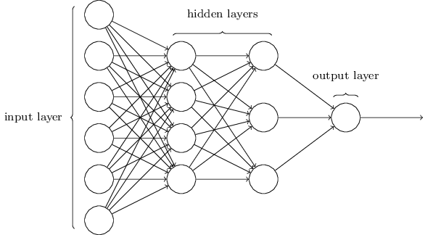
Improving predictions with a Neural Network
A Neural network was created to improve the arrival time predictions along with ground velocity and detector status
Using past historical data from the detectors at Hanford, Livingston, VIRGO and the large collection of IRIS data
Earthquake Magnitude
Latitude
Longitude
Arrival Times
OR
Ground Velocity
OR
Detector Status
Distance (m)
Depth (m)
Azimuth (deg)

Slide 13
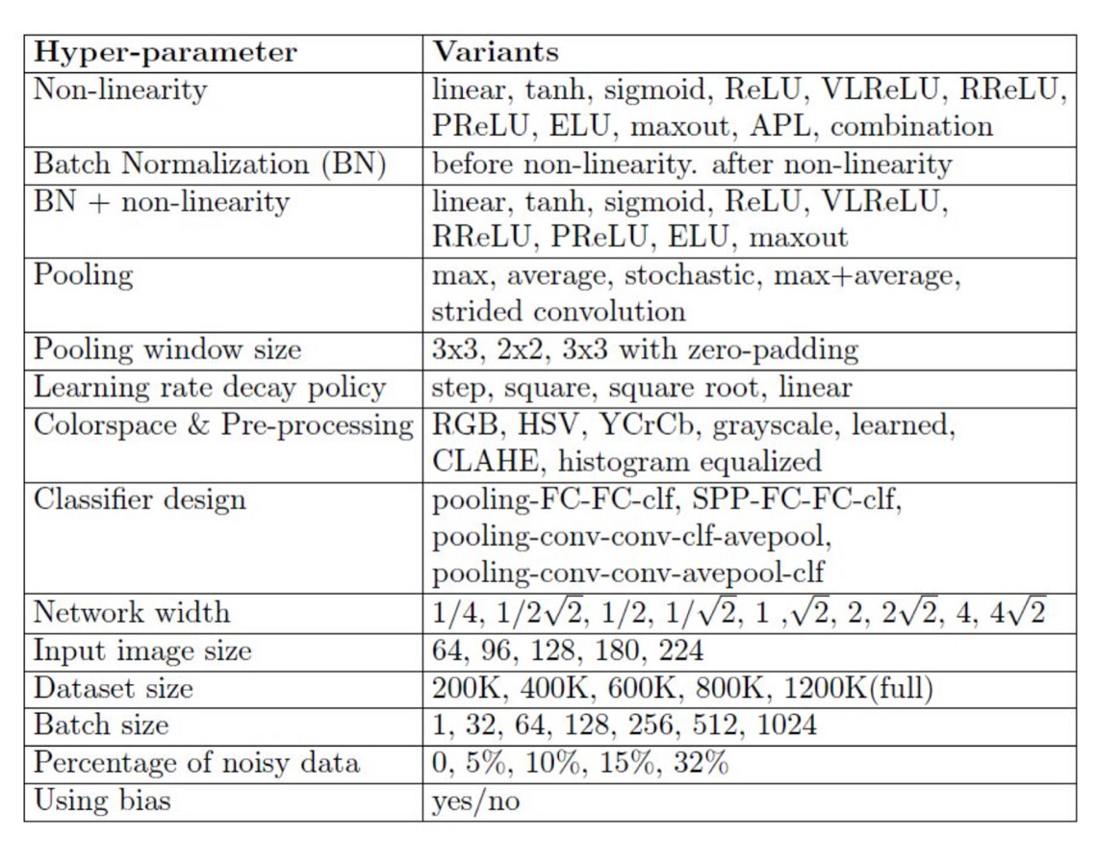
Hyper-parameters
Experimented with the amount of hidden layers and various Hyper-parameters
Best result models were then saved for predicting arrival times, ground velocity and detector status
Models were also trained on different historical data sets

Slide 14
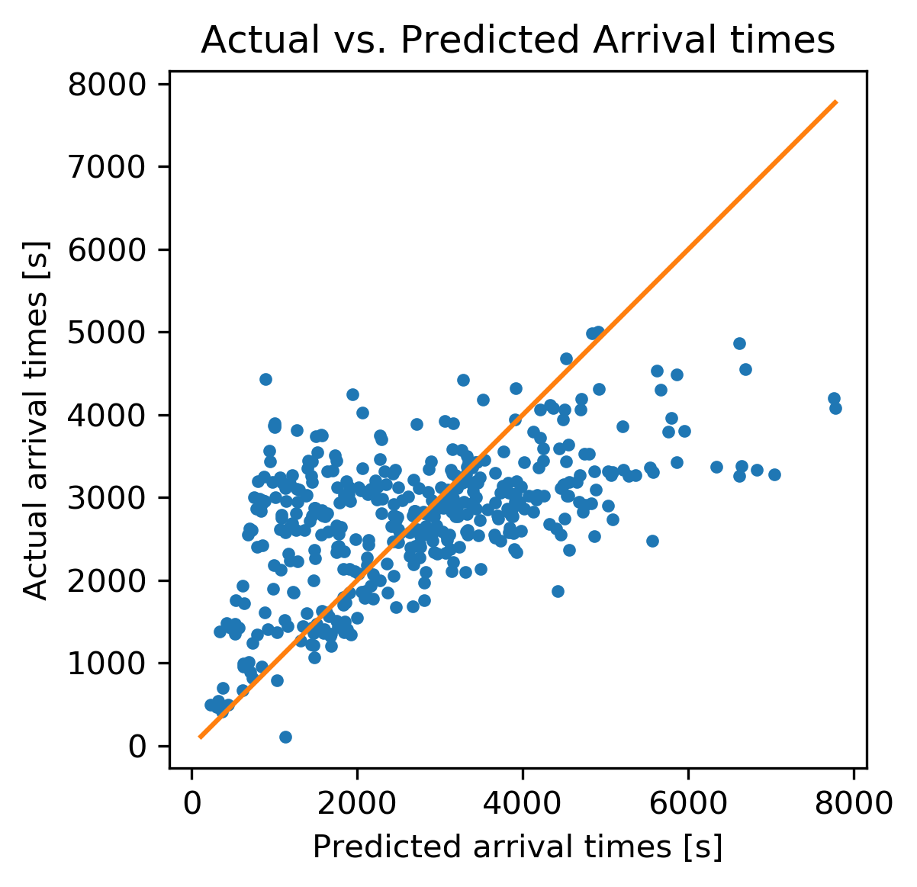
Hanford vs. Livingston vs. VIRGO
Arrival time
HANFORD
LIVINGSTON
VIRGO
These datasets were filter to not include earthquakes with a ground velocity smaller than a micrometer (μ) per second.

Slide 15

IRIS data
Earthquakes data at the detectors was small (2000-3000 Earthquakes)
Utilized earthquake data collected at Incorporated Research Institutions for Seismology (IRIS) (+730,000 Earthquakes)
Filtered the data to include only earthquakes originating around the United States

Slide 16
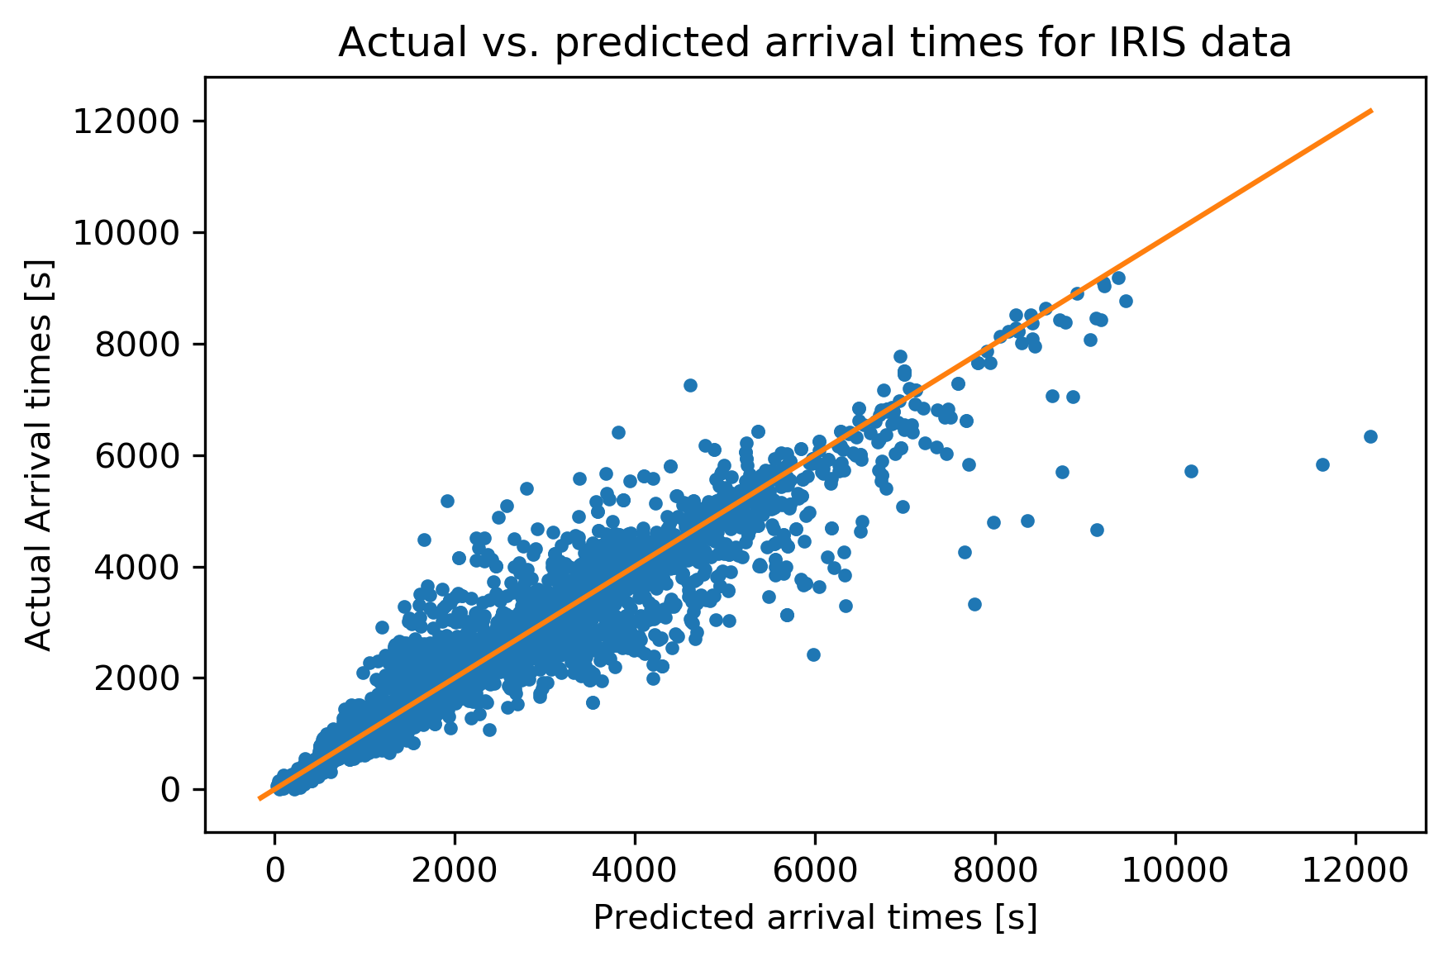
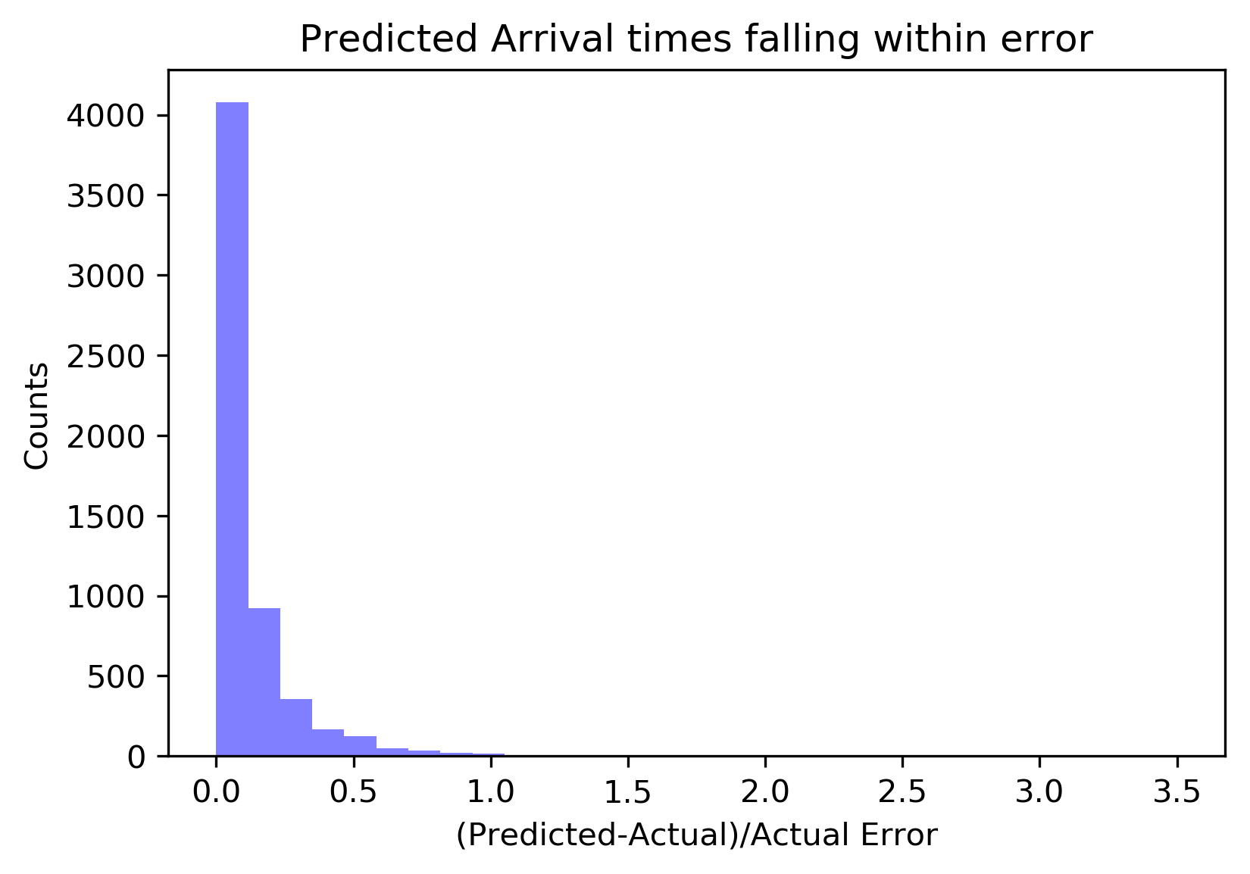
IRIS Arrival time
Cut earthquakes with a ground velocity less than a micrometer (μ) per second.
IRIS data includes P-waves
Cut earthquakes greater than > 6000 m/s to try and limit P-wave contamination
Cut earthquakes not originating on land
Reduced to about 29,600 EQS

Slide 17
Neural Network models
When training a Neural Network a randomized portion of data is set as the training set and another portion as the testing set.
Can save Neural network model with particular architecture and weights
What happens if we train a model on a portion of one dataset and test it on the complete data set of another?

Slide 18
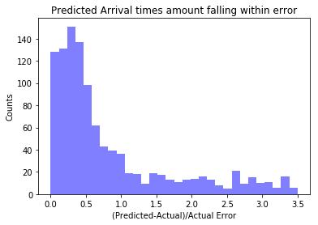
Arrival times
Trained models on other data sets
 | IRIS TRAINED TRAINED | HANFORD TRAINED | LIVINGSTON TRAINED | VIRGO TRAINED
IRIS TESTED
HANFORD
TESTED
LIVINGSTON TESTED
VIRGO TESTED

Slide 19
Arrival times
What happens if the model is trained with data omitting earthquakes with velocities > 6000 m/s?

Slide 20
Arrival times
What happens if the model is trained with data omitting earthquakes with velocities > 6000 m/s?
Hanford trained:
Velocities <6000m/s
Hanford tested:
Velocities <6000m/s
Hanford trained:
Velocities <6000m/s
Hanford tested:
All velocities

Slide 21
Detector Status Neural Network
Detector status was hardest to predict
Can’t use IRIS data or Virgo data
Predicting classes > loss: categorical_crossentropy
K-fold Cross-evaluation to evaluate model accuracy
Confusion matrix to present results
0:Not Locked
1:Locked but can’t take data
2: Locked but lost lock

Slide 22
Lets make some predictions!
Script written to take in neural network models, different data sets (or one earthquake’s data) and make predictions
Earthquake
Magnitude
Arrival Times Model
Latitude
PREDICTIONS
ARRIVAL TIMES,
GROUND VELOCITES,
DETECTOR STATUS
Earthquake Data
Longitude
Ground Velocity
Model
Distance (m)
Detector Status Model
Depth (m)
Azimuth (deg)

Slide 23
FUTURE WORK
Improving the models further with hyper tuning, grid searches and random searches
Combining Hanford, Livingston, and VIRGO data to train network
Filter out high frequencies of IRIS data
Determining if including all of IRIS data OR further filtering along different parameters can improve model training and predictions
Implementing prediction models into Seismon pipeline

Slide 24
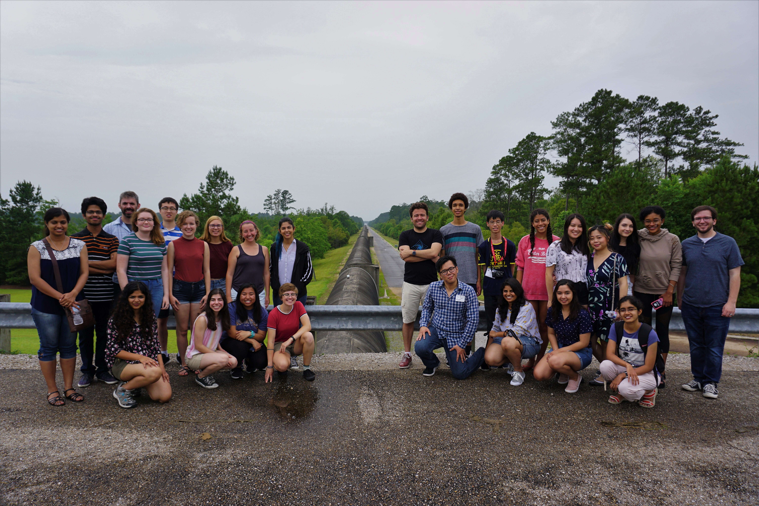
Acknowledgements
THANK YOU!
MICHAEL COUGHLIN
LIGO CALTECH
CALTECH SFP
CSUF GWPAC
LIGO SURF

Slide 25
Extra Slides

Slide 26
Neural Network Specifics: Arrival times (IRIS trained)
Lr:1e-3
Reg: 0.0
Dropout: 0.2
Layers: 7 Dense layers of 64 nodes
Activation:relu
Epochs:500
Batch Size: 32
Optimizer: Adam
Loss=mse.

Slide 27
IRIS Ground velocity Trained and Tested
Cuts were made:
Ground velocities >micrometer
Velocity <6000
Only land points

Slide 28
Models on iris data (No data input cuts)
Hanford Livingston Virgo

Slide 29
Ground Velocity
Trained models on other data sets
 | IRIS TRAINED | HANFORD TRAINED | LIVINGSTON TRAINED | VIRGO TRAINED
IRIS TESTED
HANFORD
TESTED
LIVINGSTON TESTED
VIRGO TESTED

Slide 30
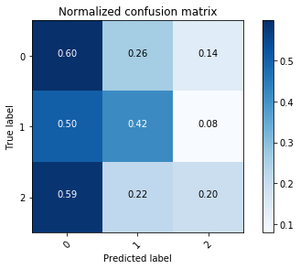
Detector Status
Trained models on other data sets
 |  | HANFORD TRAINED | LIVINGSTON TRAINED
HANFORD TESTED
LIVINGSTON TESTED

