Slide 1
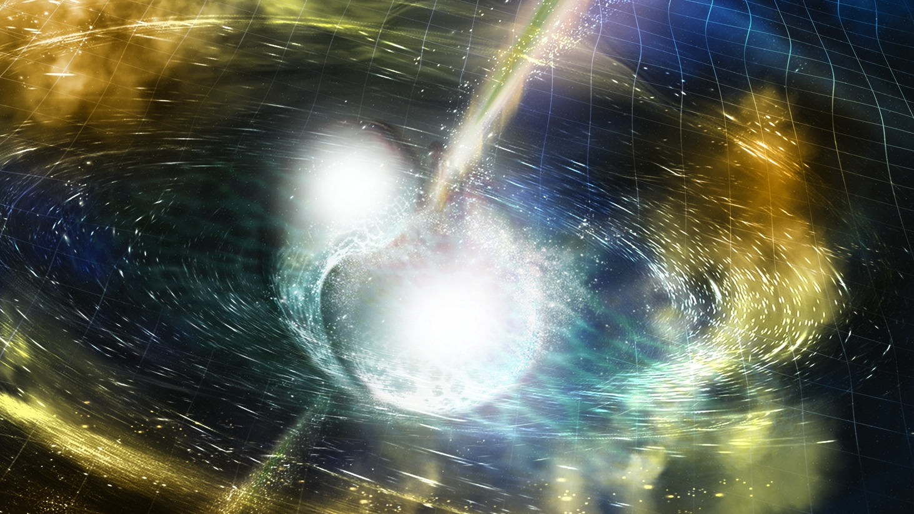



Gravitational Waves: From Idea to Discovery
Daniel Sigg
LIGO Hanford
Observatory
California Institute
of Technology
June 4, 2018
For the LIGO Scientific Collaboration and the Virgo Collaboration
LIGO-G1801078-v1
Credit: NSF/LIGO/Sonoma State University/A. Simonnet

Slide 2
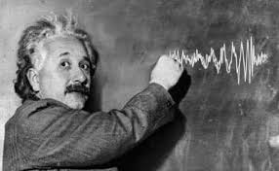
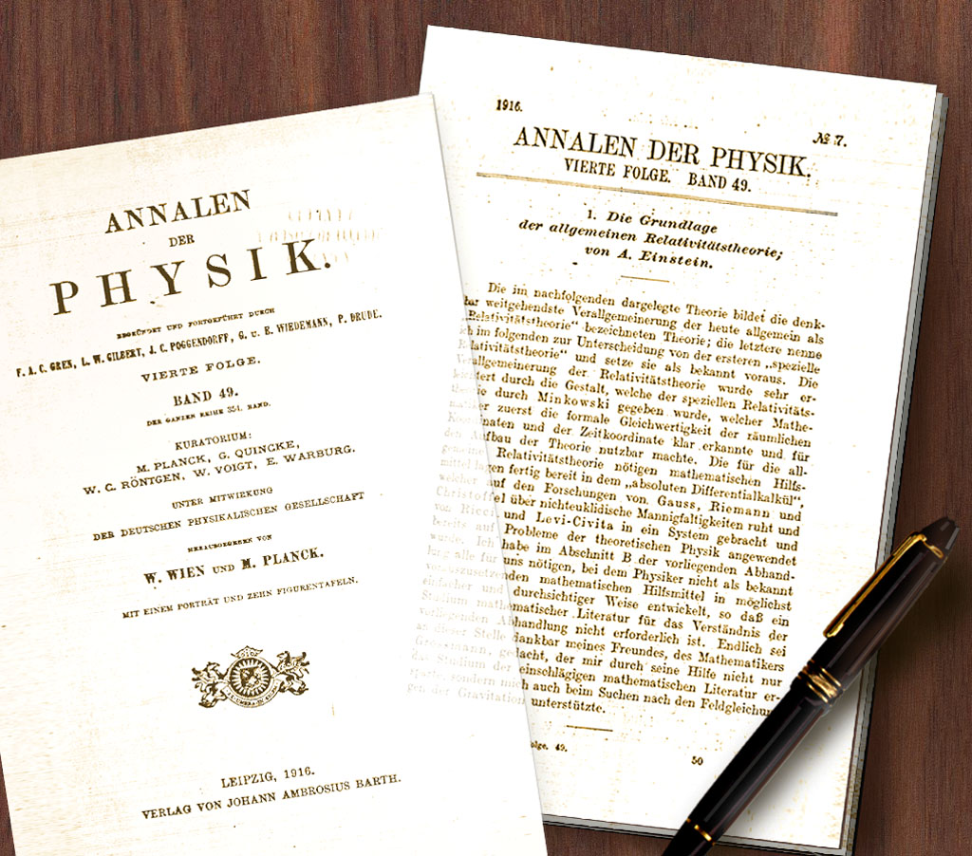
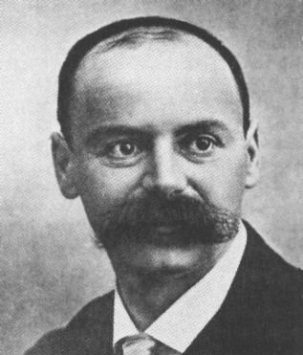
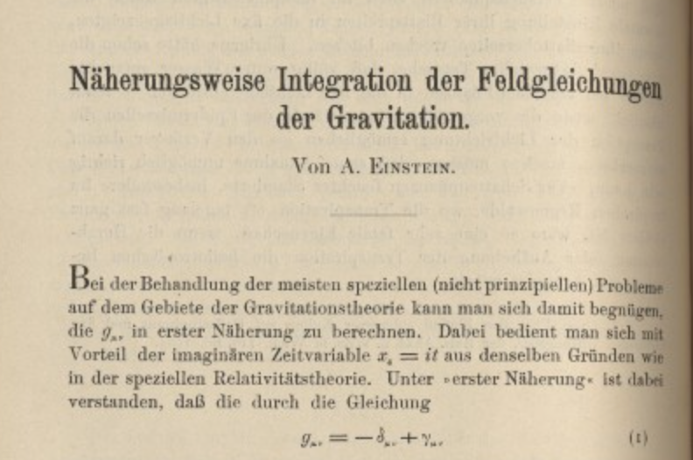
A Century of General Relativity
Karl Schwarzschild

Slide 3
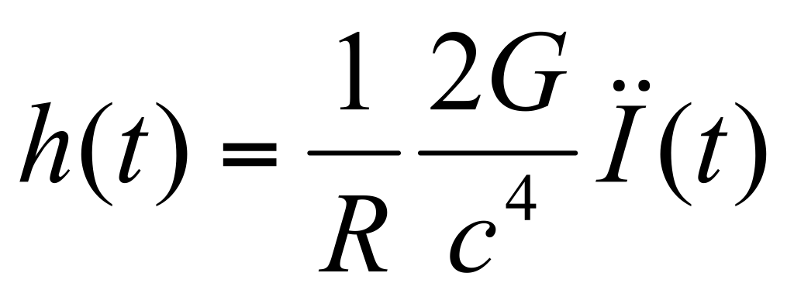
Gravitational Waves
Perturbations of the space-time metric produced by rapid changes in shape and orientation of massive objects.
Speed of light
2 polarization (plus & cross)
h = dimensionless strain
I = source mass quadrupole moment
R = source distance

Slide 4
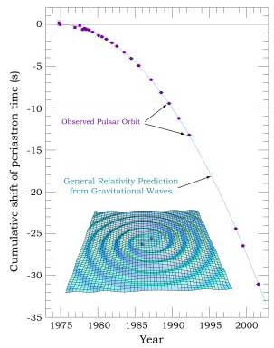
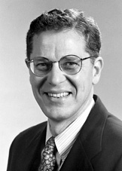
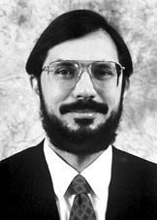
Indirect Evidence of gravitational radiation: PSR 1913+16
1974:
Hulse and Taylor
discover binary
neutron star
Observed over the course of decades
Slow orbital decay
Gravitational waves carrying away orbital energy
Nobel Prize in Physics 1993
Coalescence in about ~300 million years
GW emission strongest near the end
J. Taylor
R. Hulse

Slide 5
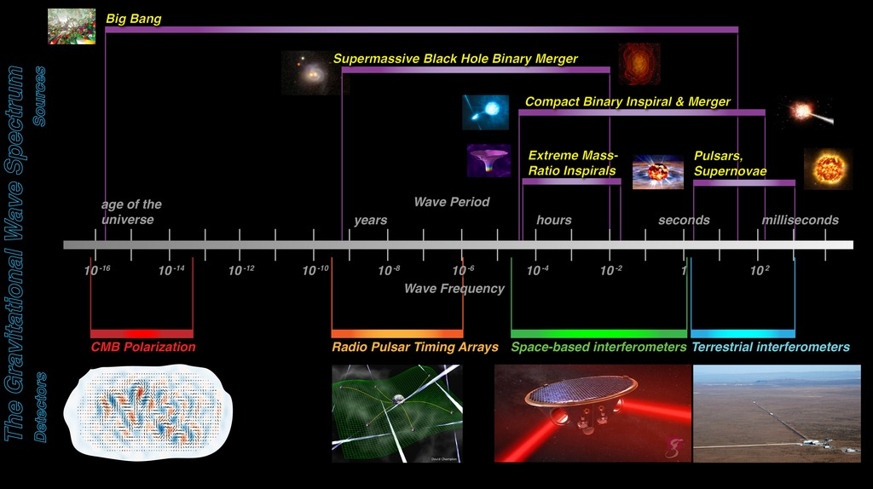
The Gravitational-wave Spectrum

Slide 6
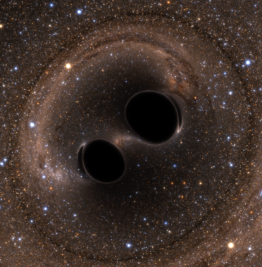
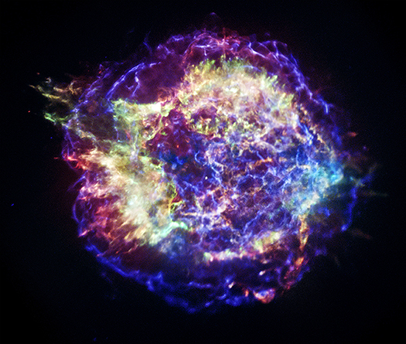

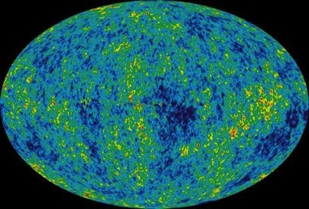
Ground-based
Astrophysical Targets for Ground-based Detectors
Coalescing Binary Systems
Black Holes
Neutron stars
‘Bursts’
Asymmetric core collapse supernovae
cosmic strings
???
Credit: NASA/CXC/SAO
Credit: Bohn, Hebert, Throwe, SXS
Continuous Sources
Spinning neutron stars
crustal deformations, accretion
Cosmic GW Background
Stochastic,
incoherent
background
NASA/WMAP Science Team
Casey Reed, Penn State
Notes:
Quickly walk through sources/characteristics

Slide 7
Ground-based
Astrophysical Targets for Ground-based Detectors
Coalescing Binary Systems
Black Holes
Neutron stars
‘Bursts’
Asymmetric core collapse supernovae
cosmic strings
???
Plus, potentially something unexpected
Credit: NASA/CXC/SAO
Credit: Bohn, Hebert, Throwe, SXS
Continuous Sources
Spinning neutron stars
crustal deformations, accretion
Cosmic GW Background
Stochastic,
incoherent
background
NASA/WMAP Science Team
Casey Reed, Penn State
Notes:
Quickly walk through sources/characteristics

Slide 8
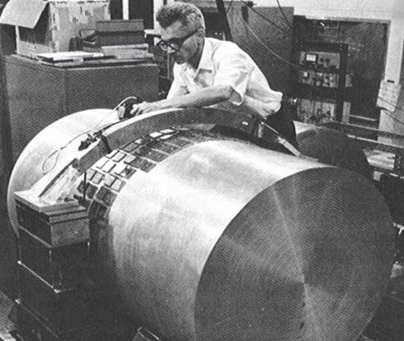
Terrestrial Detection of Gravitational Waves
1960s: Joseph Weber constructs resonant bar detectors
Claims several detections per day
Not reproducible by similar experiments in US, Europe, Japan
Theoretical objections:
Milky Way should be losing energy at a noticeable rate!
If not this way, how would one detect gravitational waves?

Slide 9
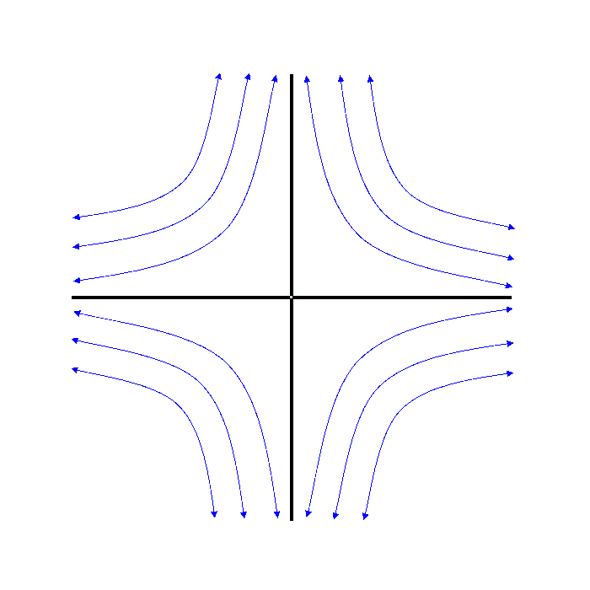
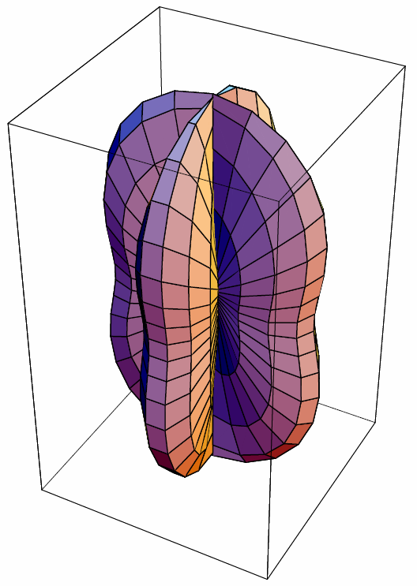
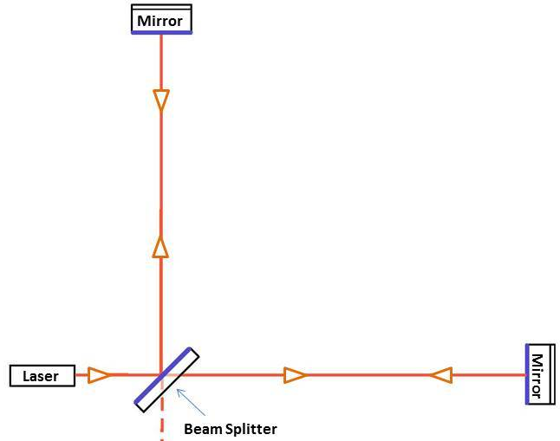
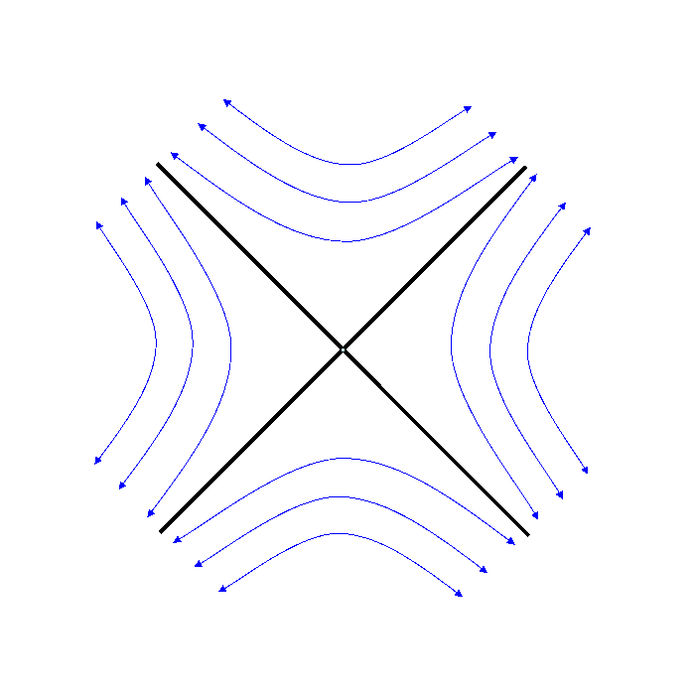
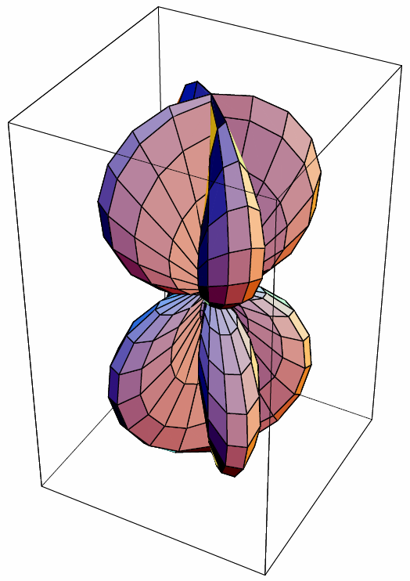

Michelson Interferometer
Physically,
h is a strain ~ $Δ$L/L
LIGO measures: h ~ 10⁻²¹
For Example:
L = 4 km → 4 x 10⁻¹⁸ m
(Proton radius ~ 1 fm)
L = 4.4 ly (Alpha Centauri)
→ ~40 µm (human hair)
h₊
h×

Slide 10
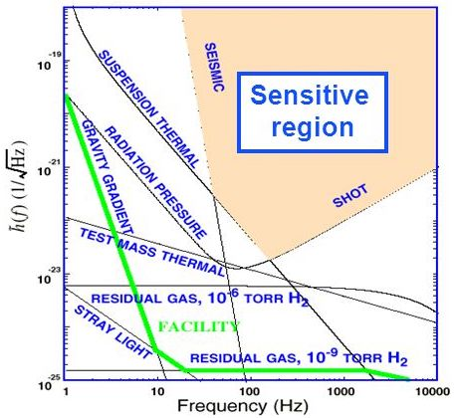
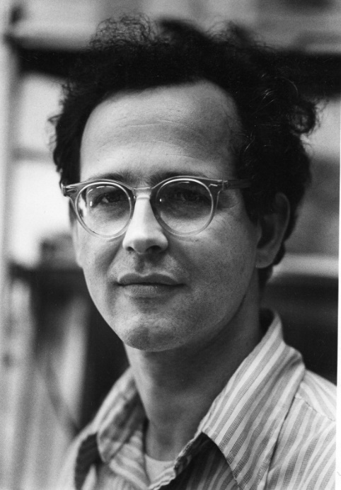
Interferometric Detectors
Design study 1971 by
Rai Weiss
Major noise sources:
Seismic
Thermal
Photon Shot Noise
Need for km long
laser interferometers!
Rainer Weiss (1972)

Slide 11
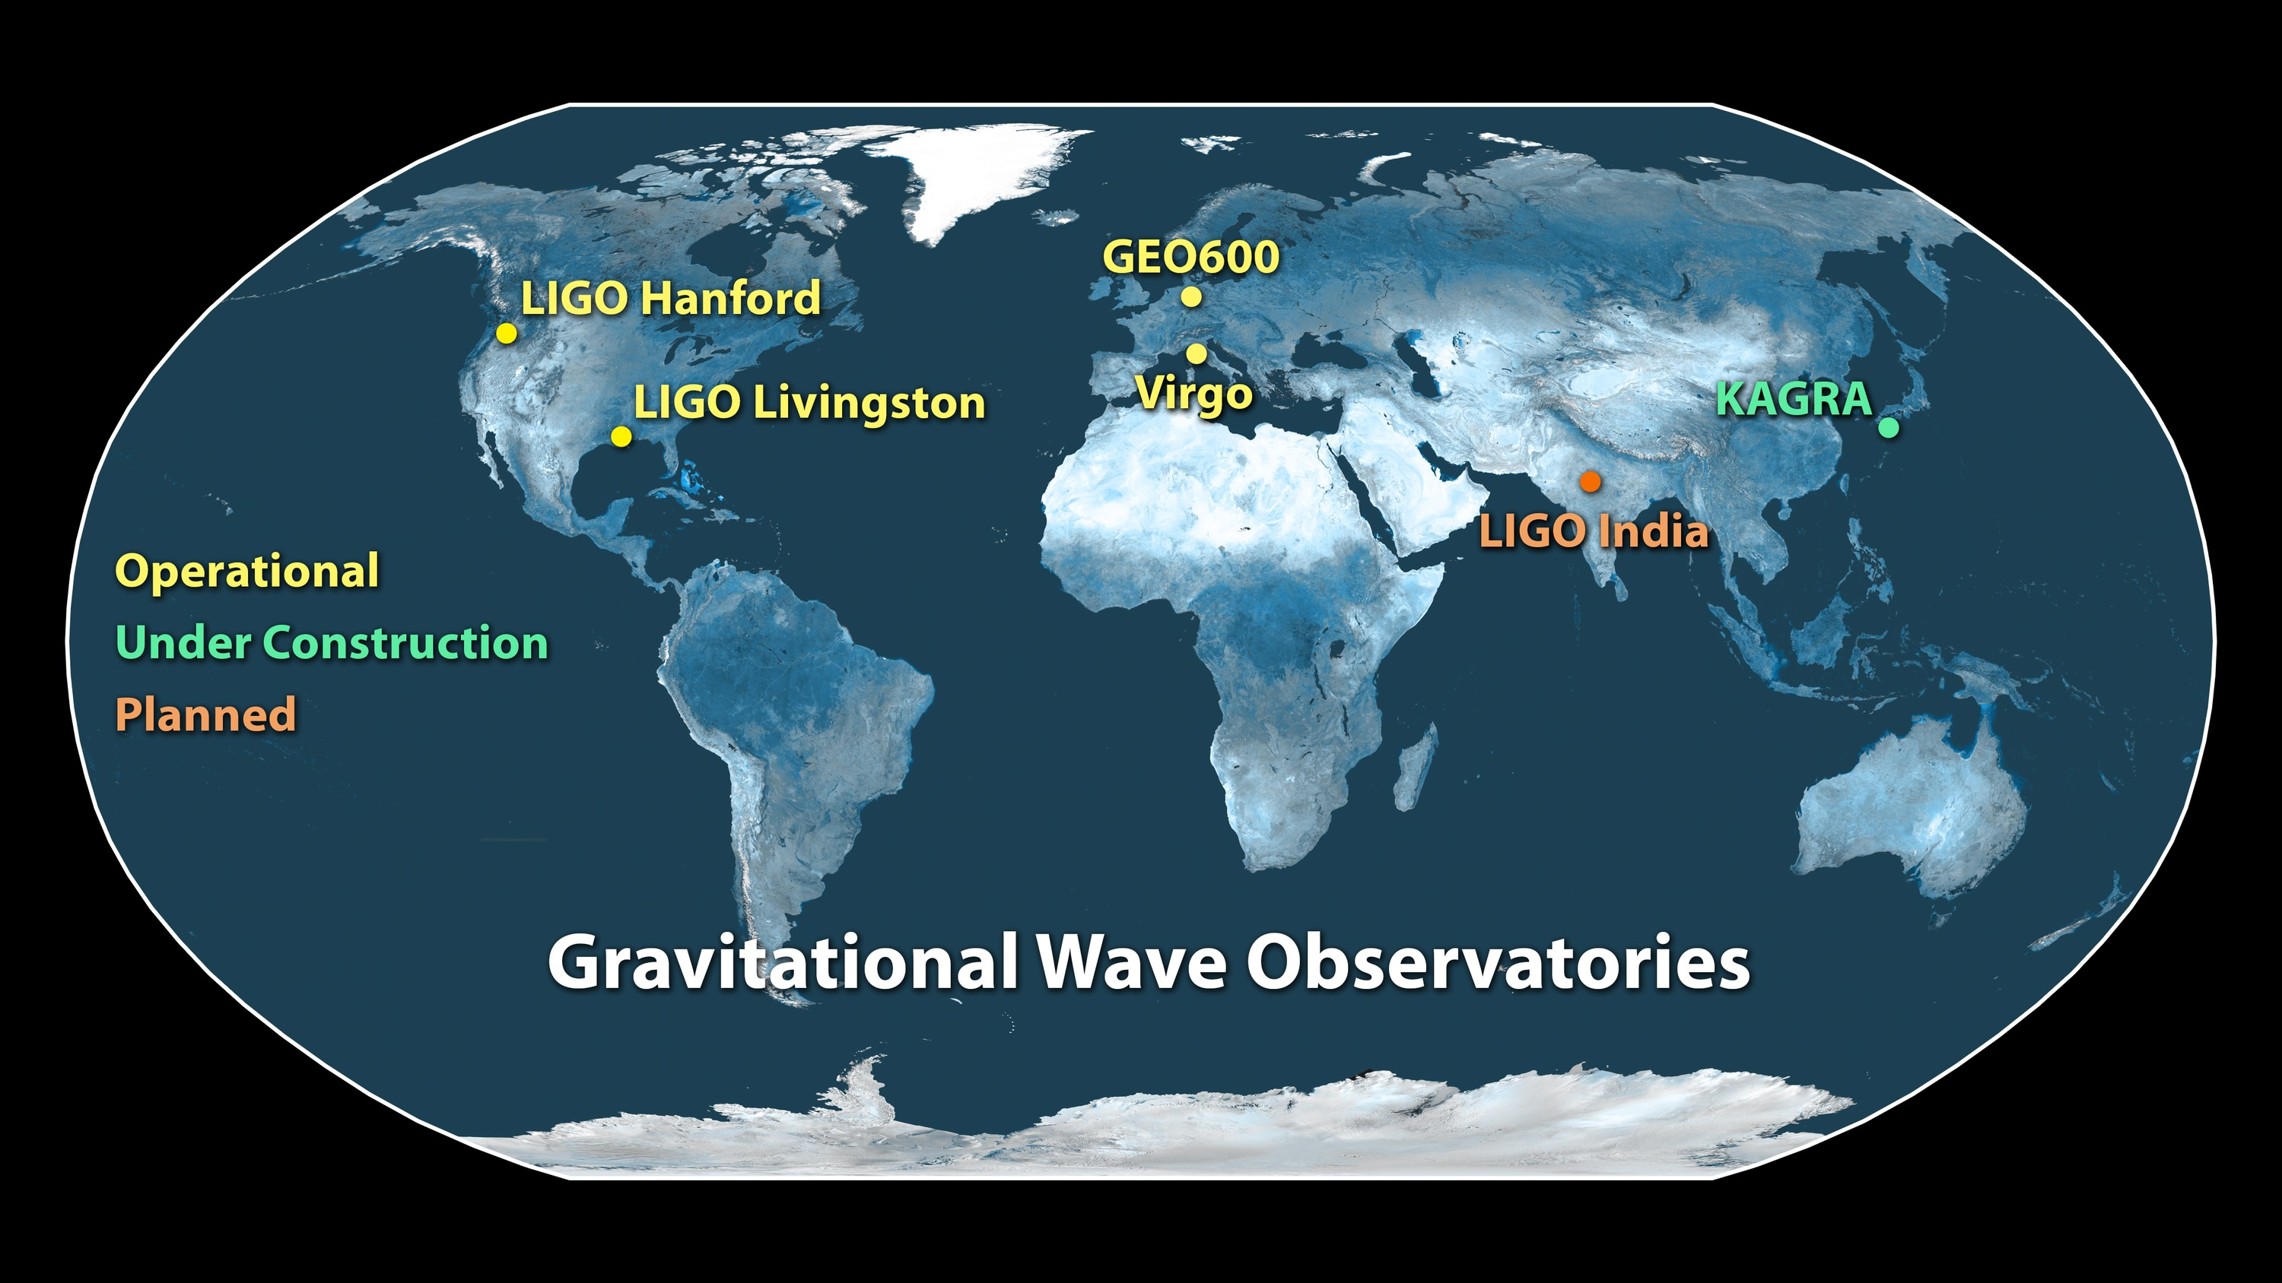
Notes:
Having three or more detectors will help us narrow down the location of the gravitational signals even more: You need at least two ears to know where a sound comes in a plane, but having more ears you can localize the source much better. We have more detectors in the near future: The Virgo detector will joining the gravitational wave network later this year – and we expect more detectors to join in Japan and perhaps India.
We have opened the era of gravitational wave astronomy, and expect to learn much astrophysics from the many detections to come. This is the end of a long quest, but more than that it’s the beginning of a new era. To quote one of our young scientists: we’ll never stop listening to gravitational waves now!
I have the honor to let now Rai Weiss, one of the founders of LIGO, tell you more about the history and technology involved in these amazing instruments.

Slide 12
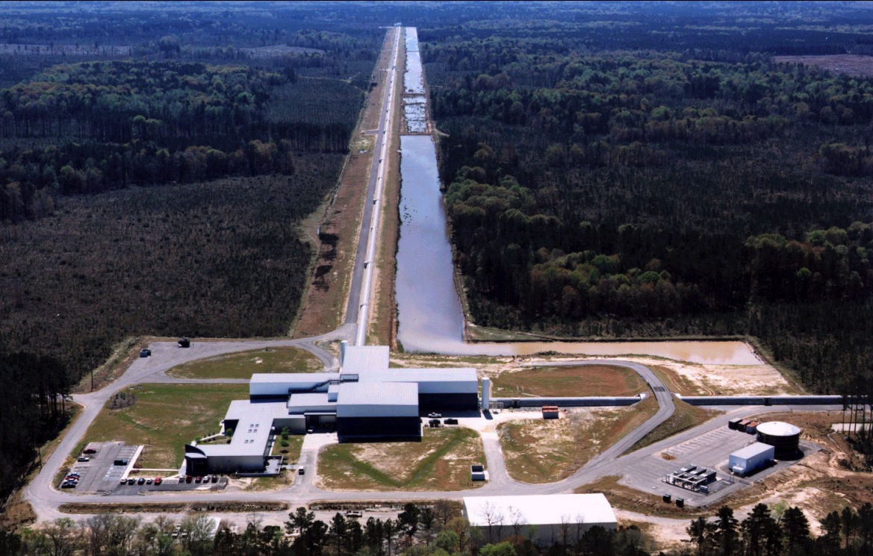
Livingston Observatory

Slide 13
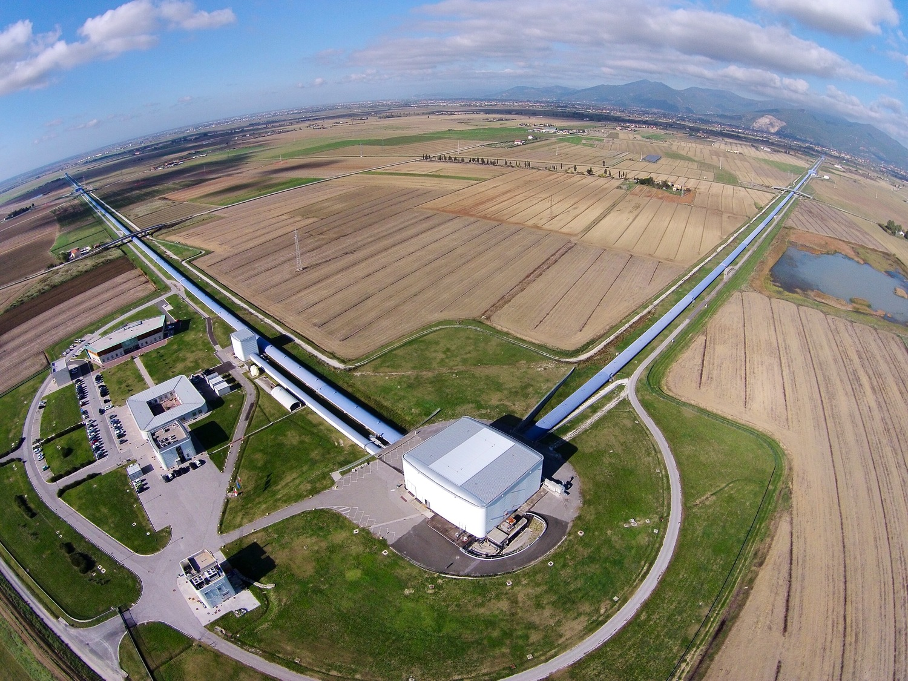
Virgo Detector

Slide 14
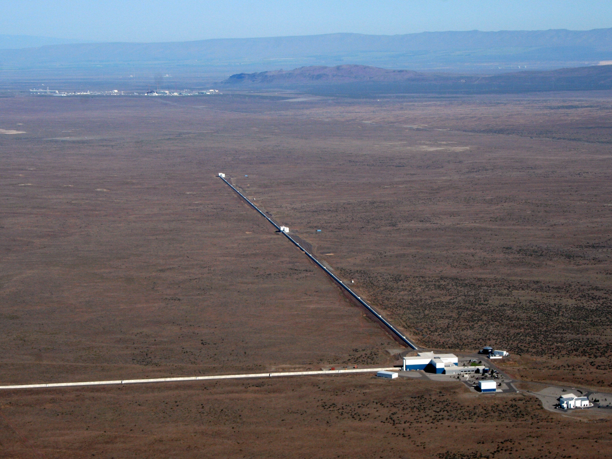
Hanford Observatory

Slide 15
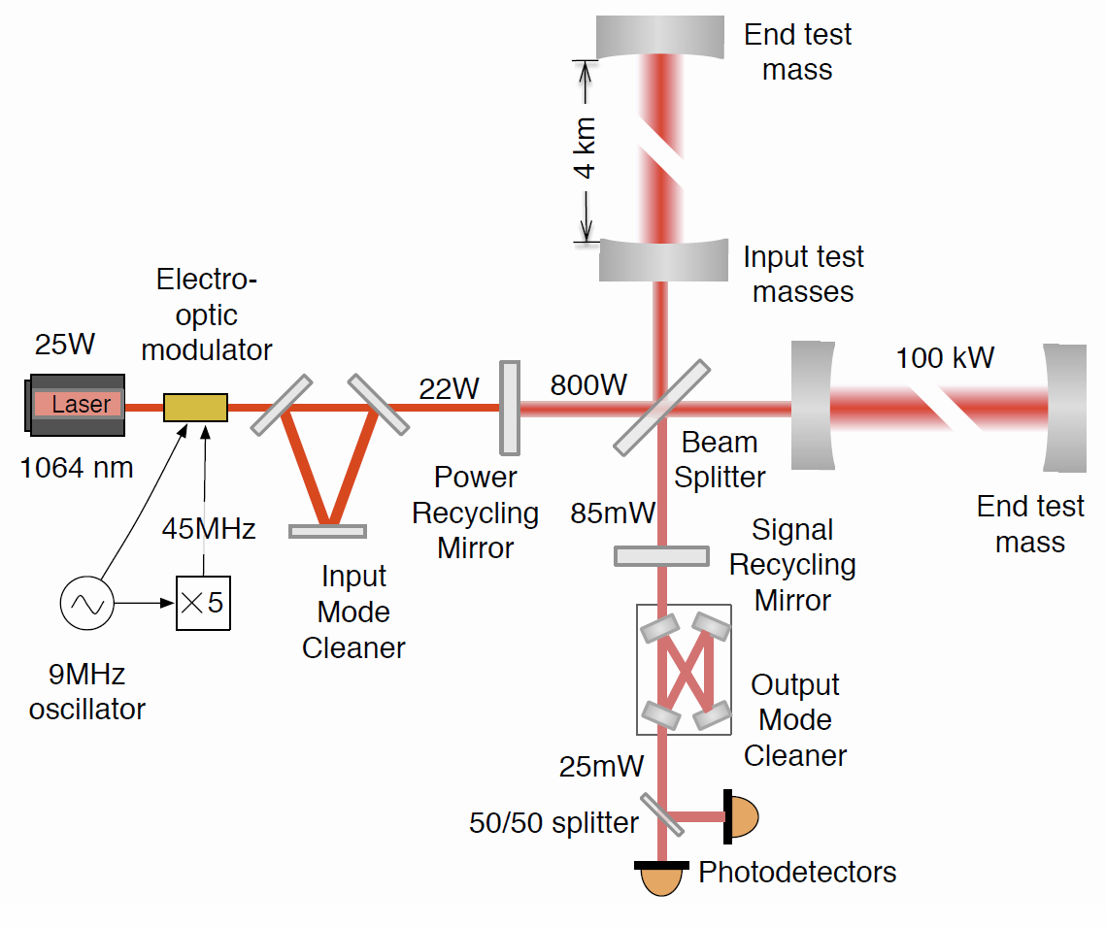
Advanced LIGO detectors during first observation run
  Timeline:
  Funding 1984-1992
  Construction 1992-2002
  Initial LIGO 2002-2010
  Advanced LIGO 2008-now

Slide 16
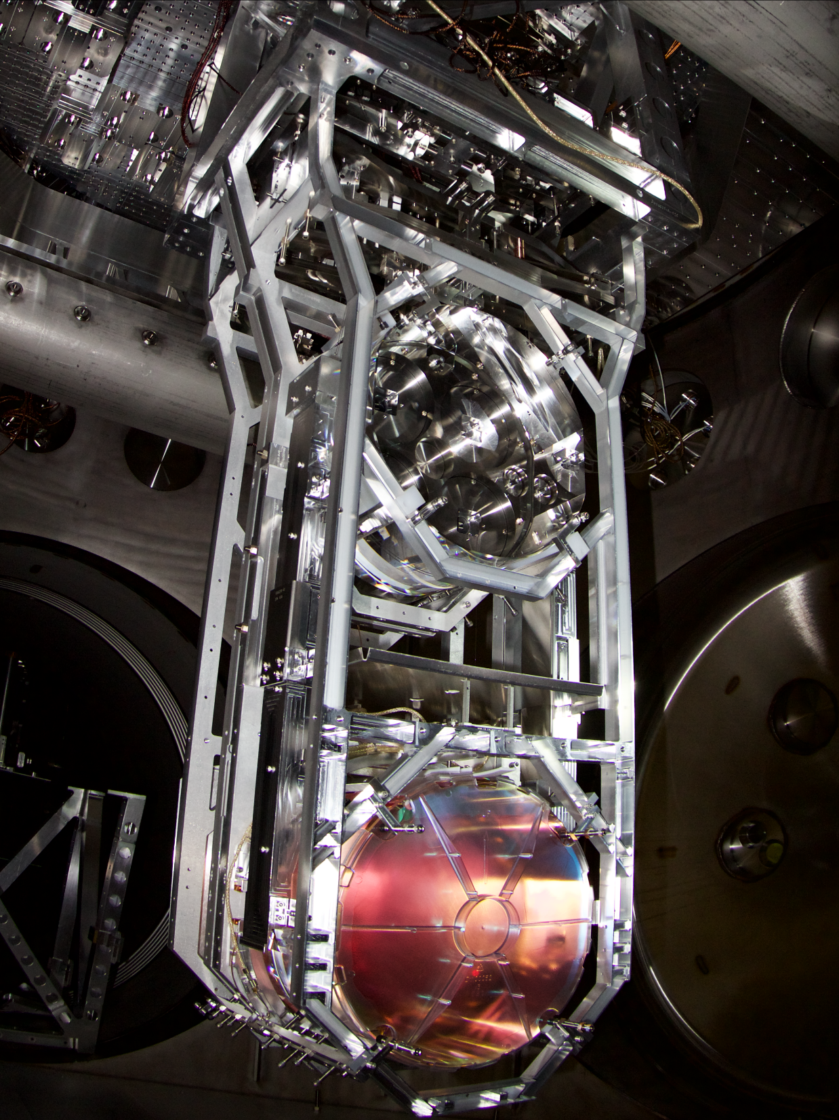

Test Mass Suspension
40 cm

Slide 17
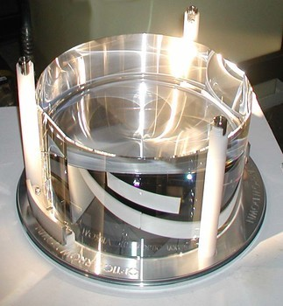
  Specifications:
  Diameter: 340 mm
  Thickness: 200 mm
  Mass: 39.6 kg
  ROC: 2250 m / 1940 m
  Figure: <1 nm rms
  Scatter: ~10 ppm
  Surface absorption: ~0.3 ppm
  Bulk absorption: ~0.2 ppm/cm
  HR transmission: ~4 ppm
  AR reflectivity: ~200 ppm
Large Test Mass Optics

Slide 18
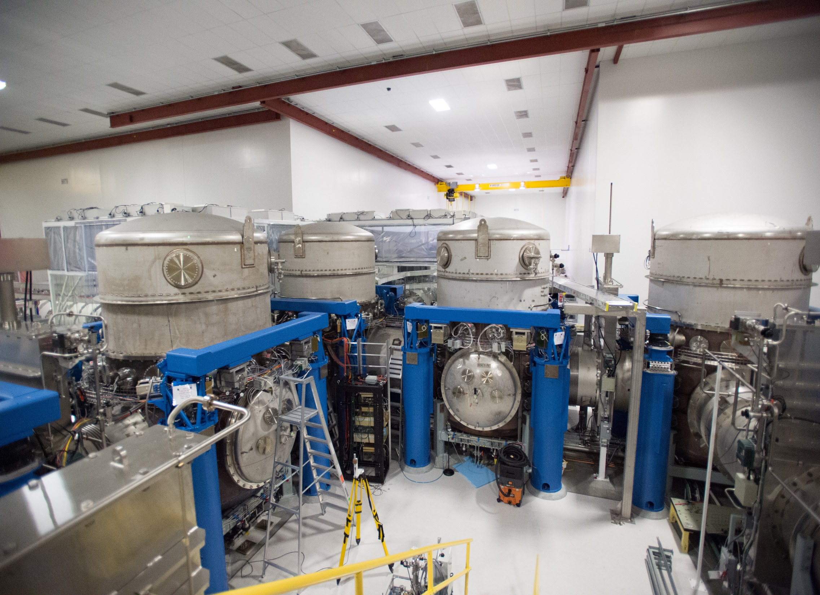
Vacuum System Vertex

Slide 19
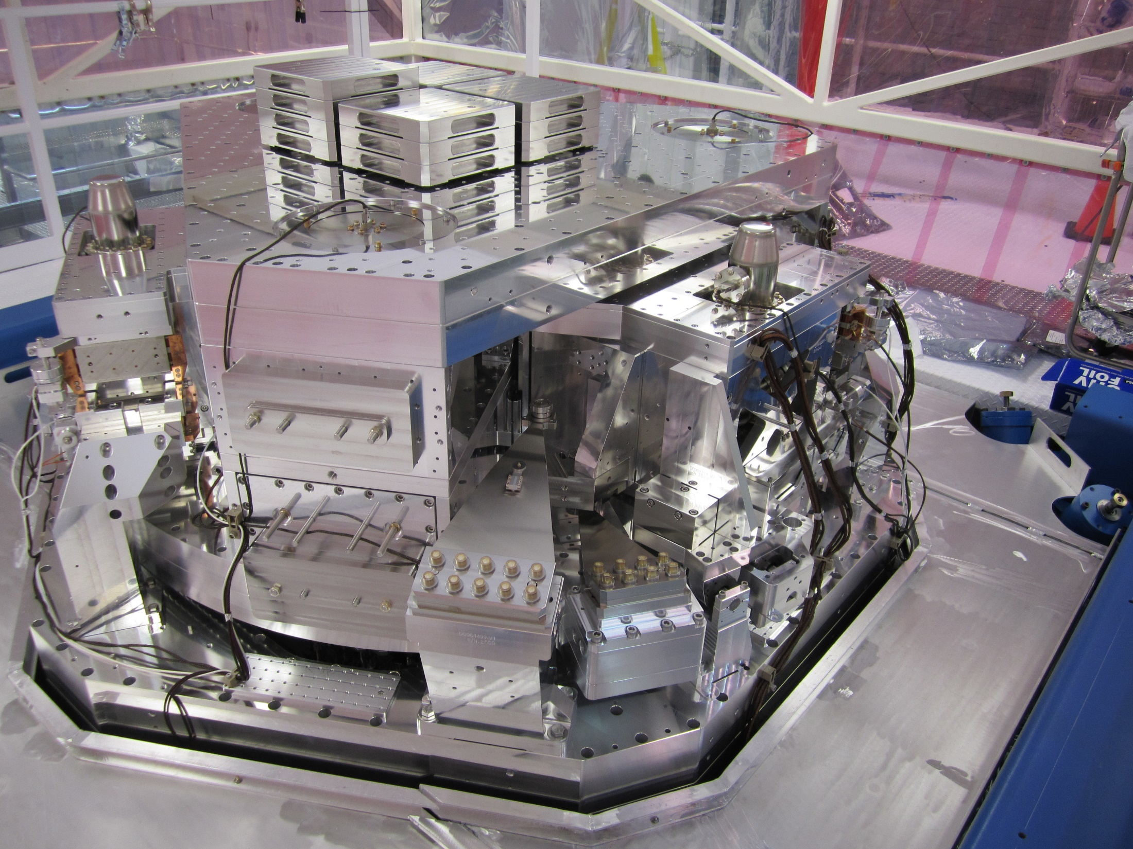
Seismic Isolation Platform

Slide 20
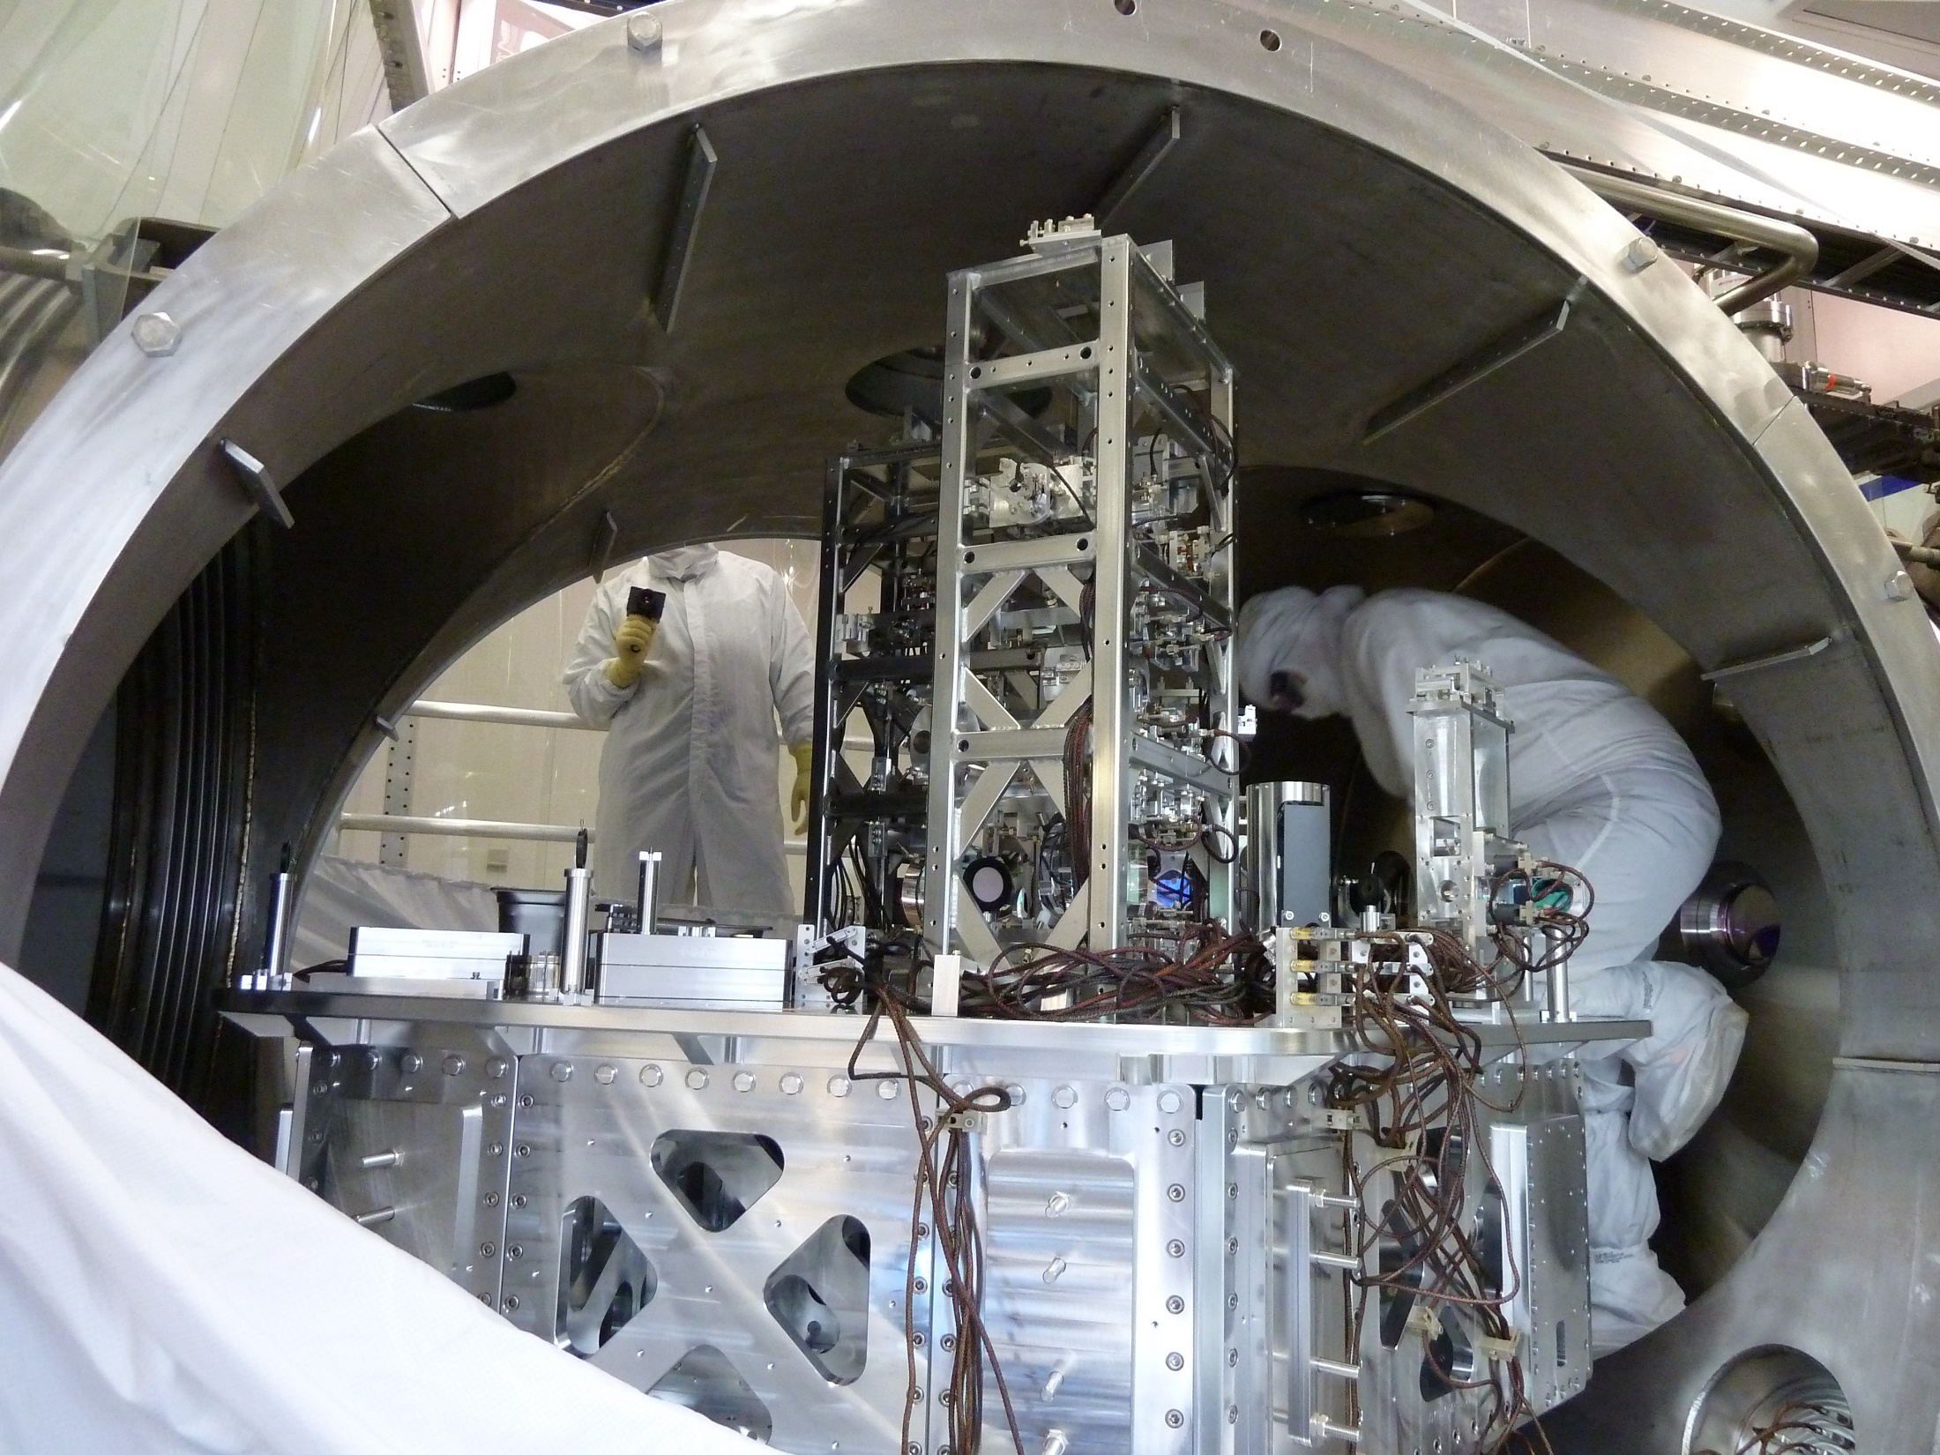
Input Optics Table

Slide 21
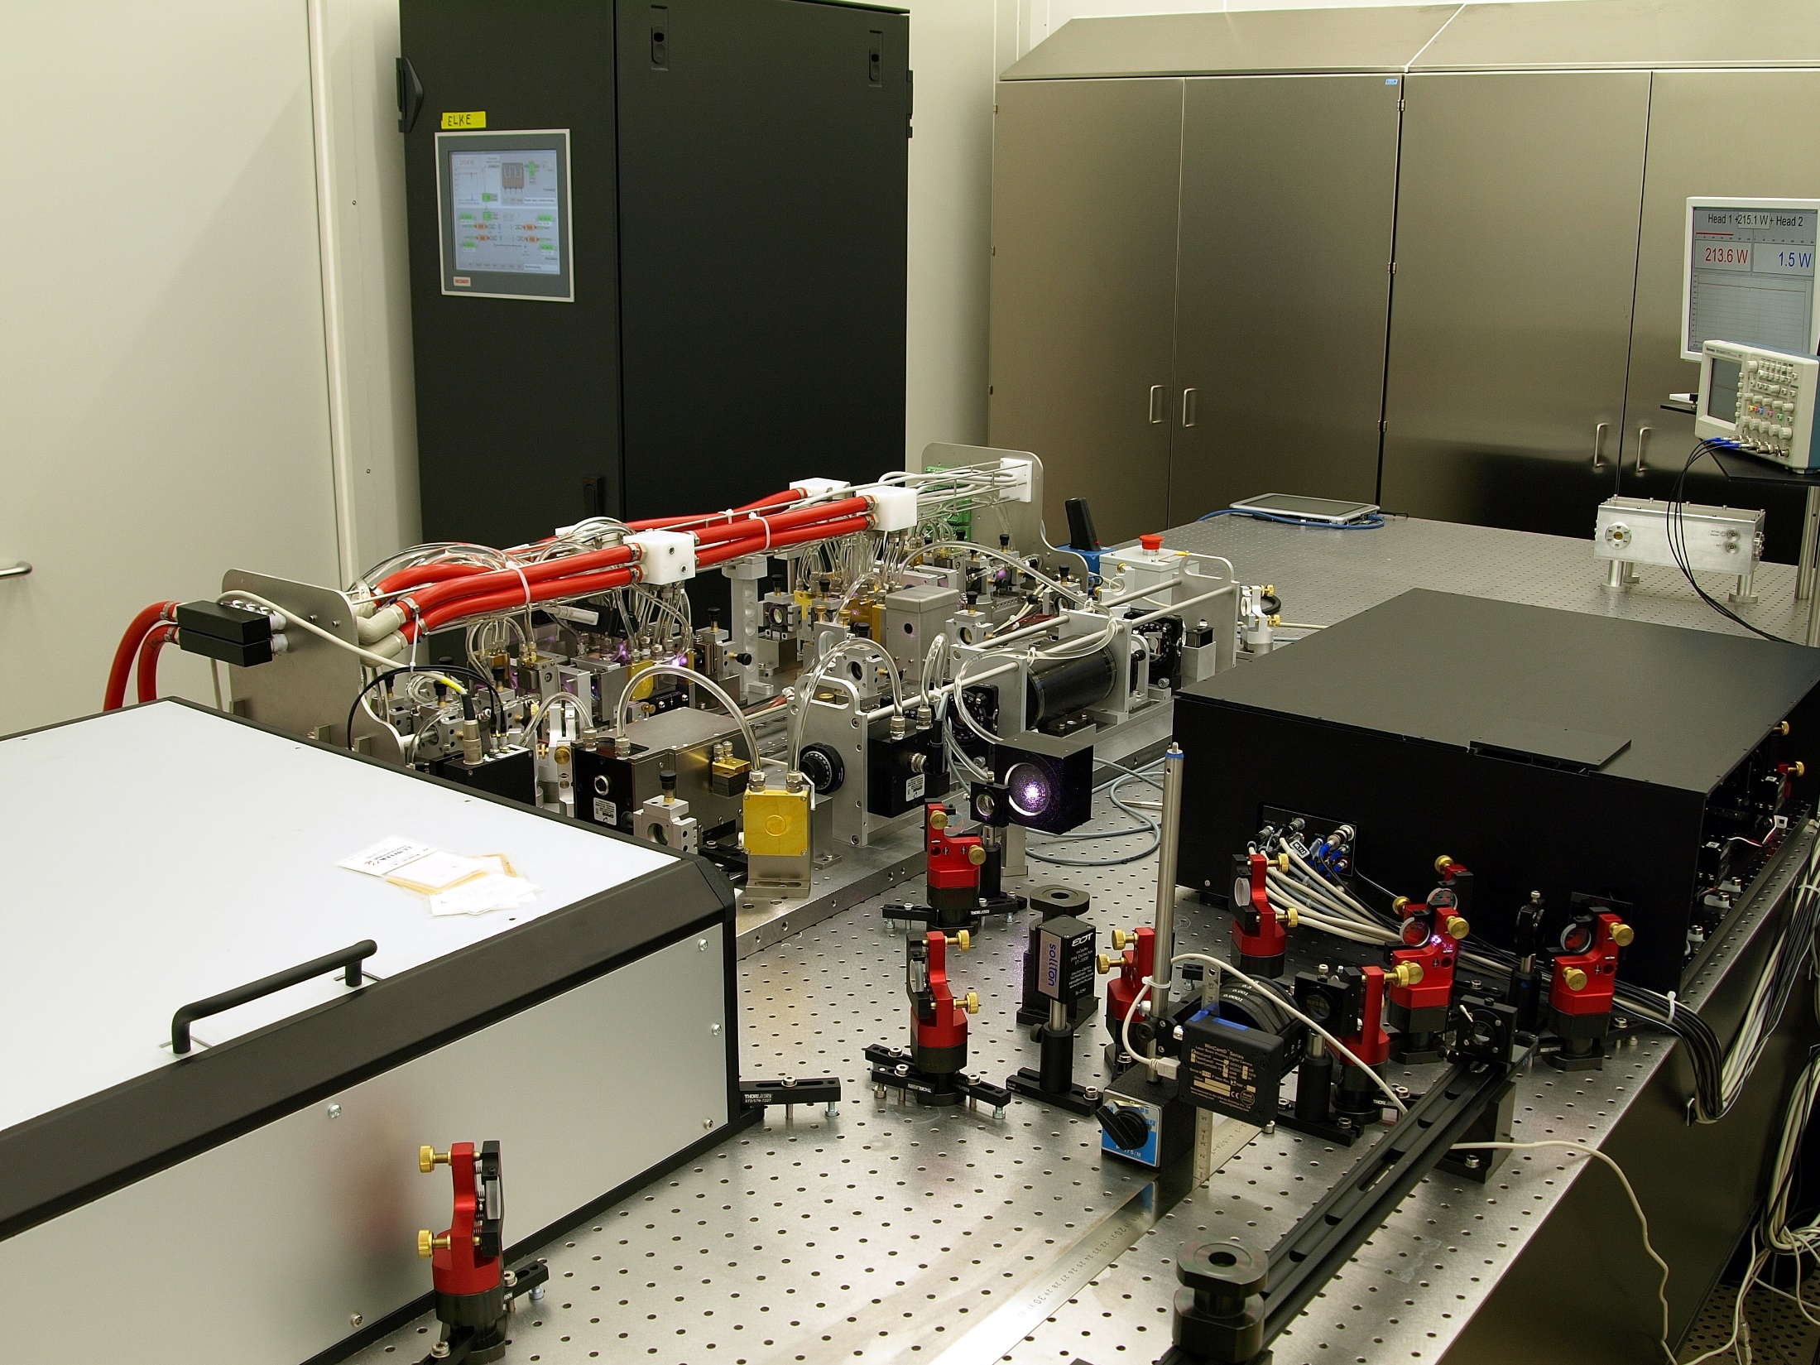
200W Pre-Stabilized Laser

Slide 22
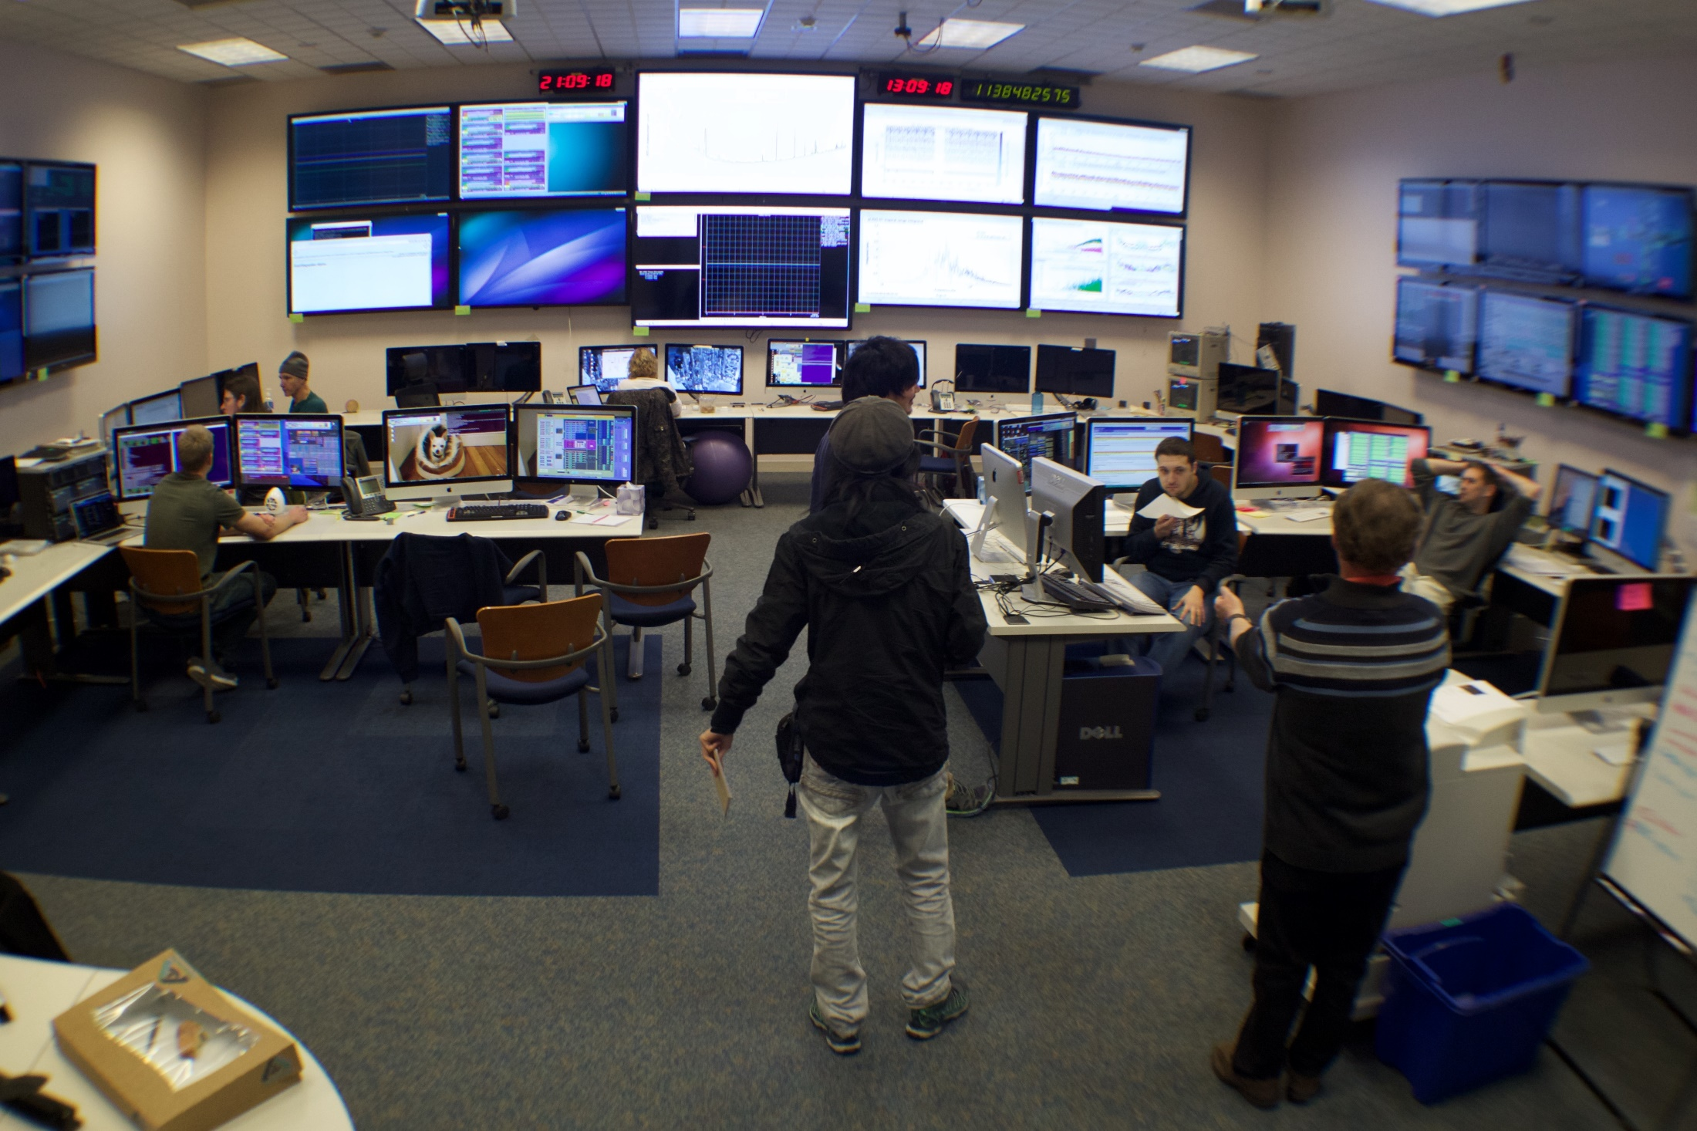
Control Room

Slide 23
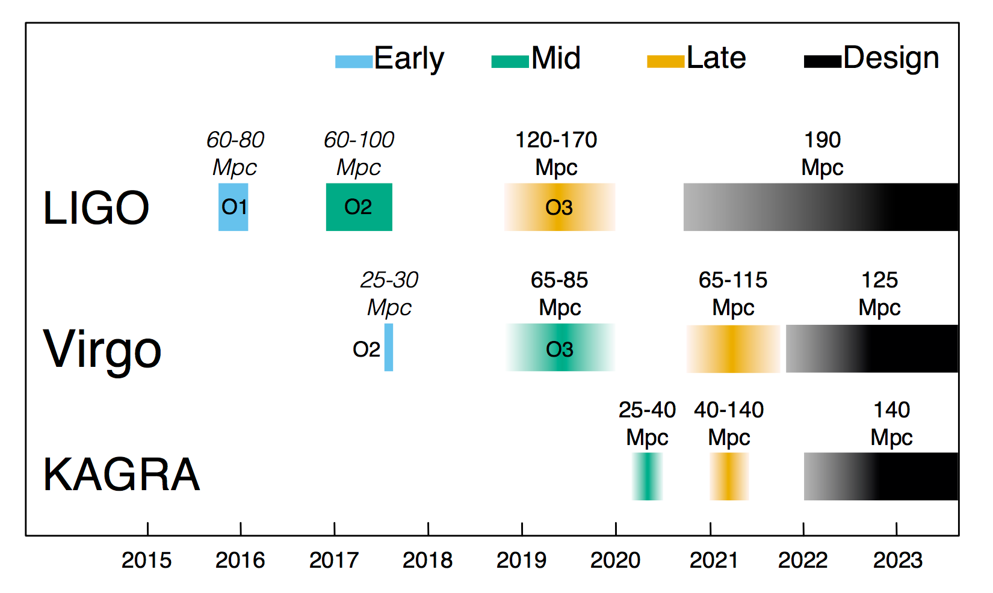
Observation Runs

Slide 24
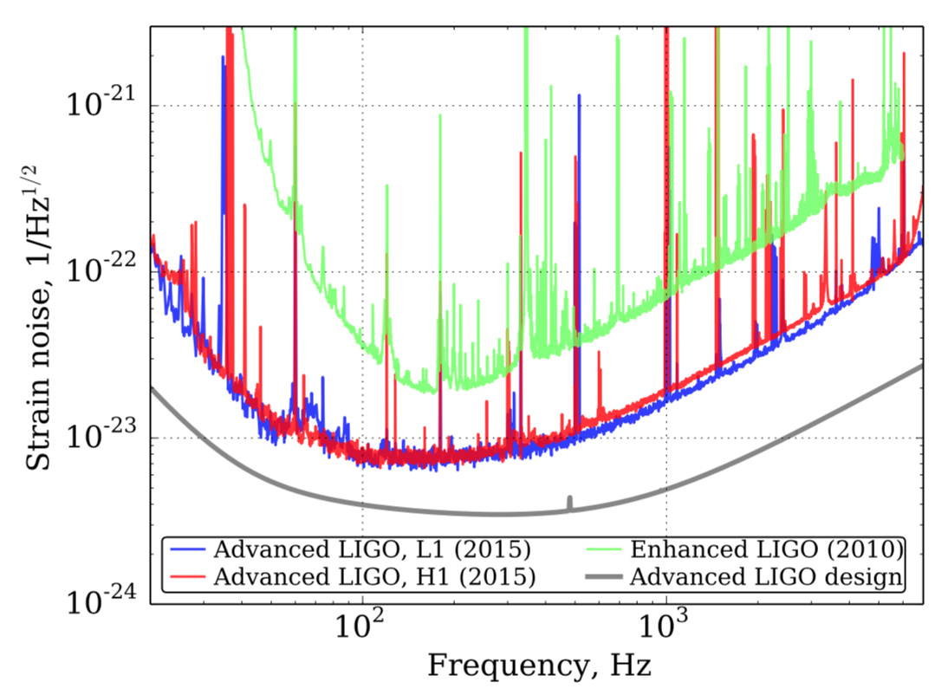
Broadband
factor ~3
improvement
At ~40Hz,
factor ~100
improvement
Detector Sensitivity
First Observation Run

Slide 25
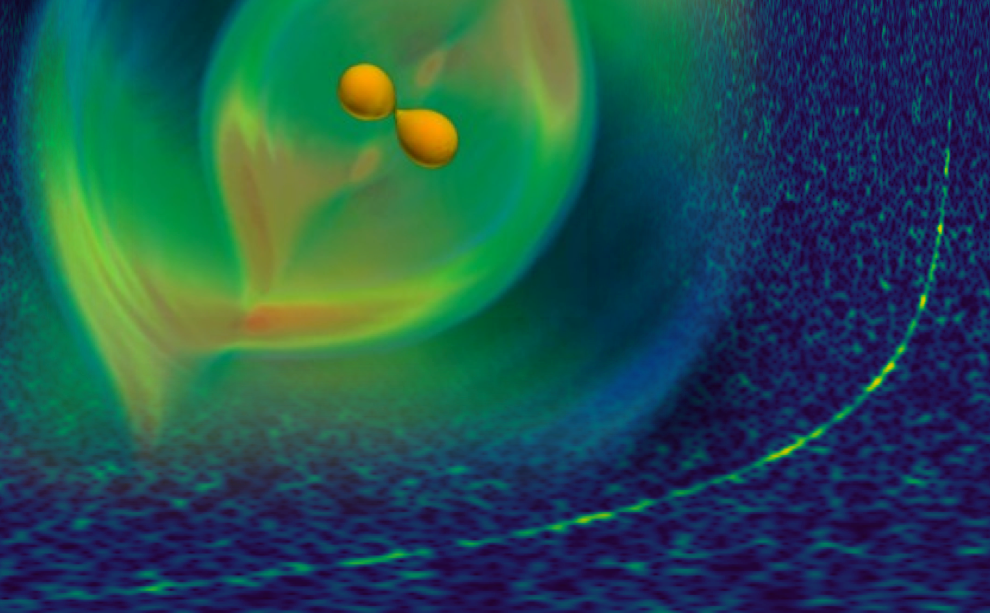
GW150914 and GW170817: Two discoveries that launched gravitational wave astrophysics
1.3 billion years ago
135 million years ago
Sep 14, 2015
Aug 17, 2017
Binary Black Hole Mergers
Binary Neutron Star Coalescence

Slide 26
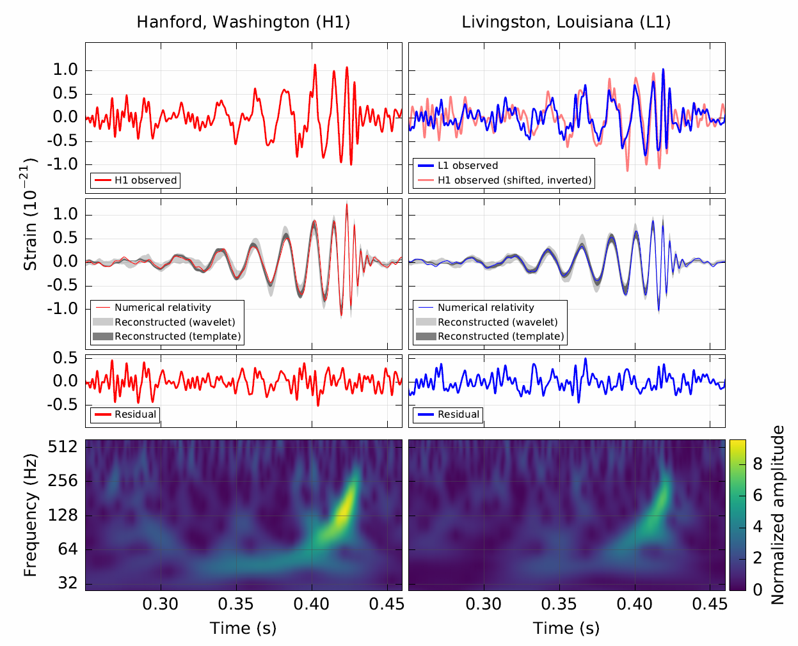
GW150914

Slide 27
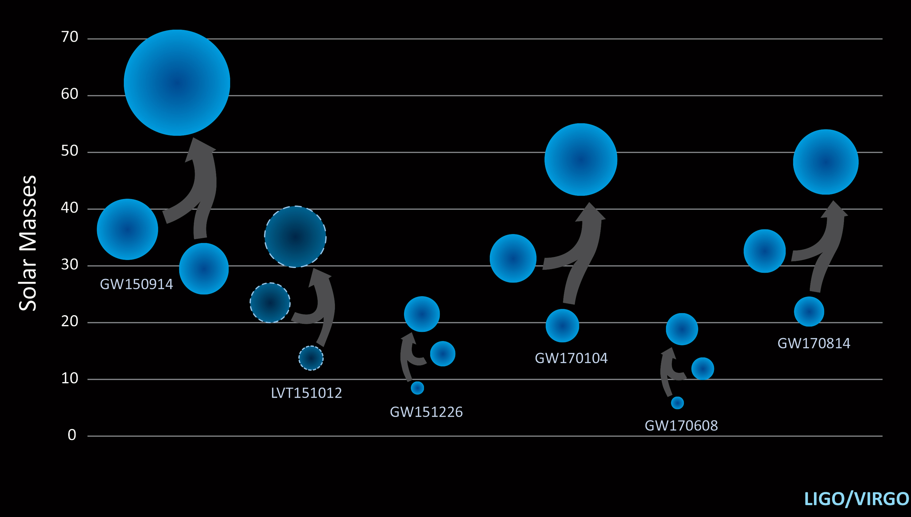
Solar Mass Black Holes

Slide 28
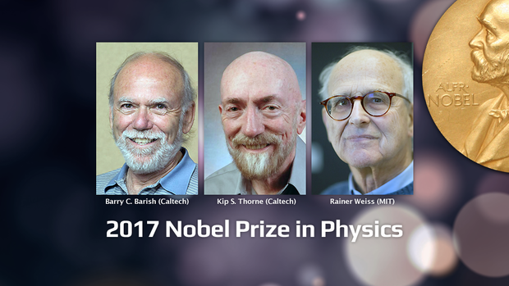
Solar Mass Black Holes

Slide 29
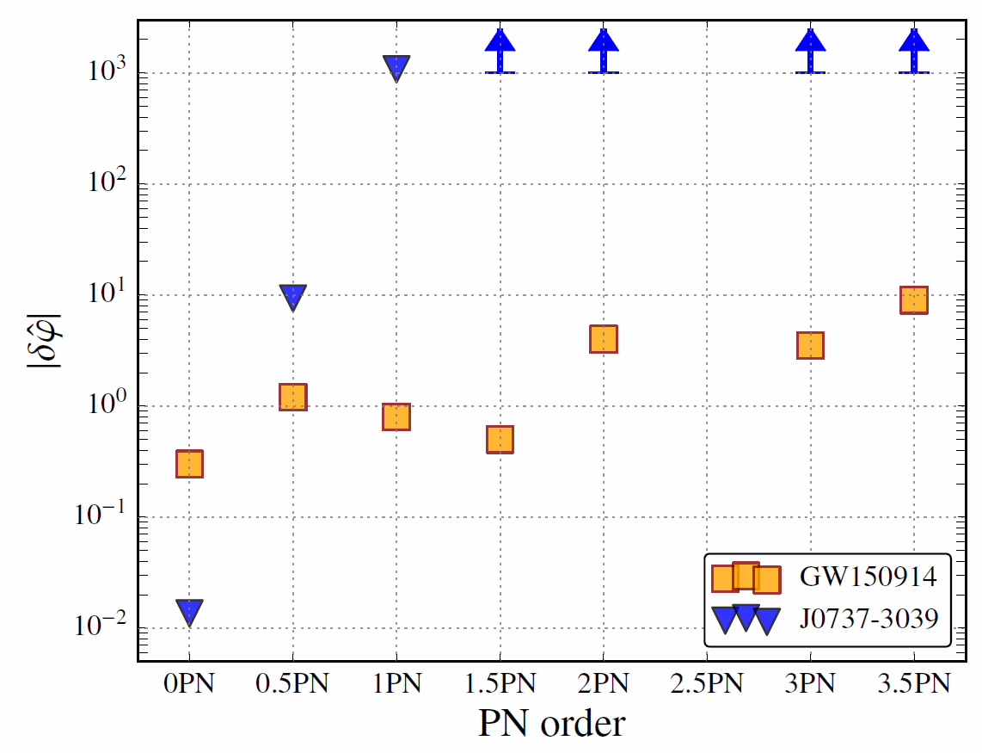
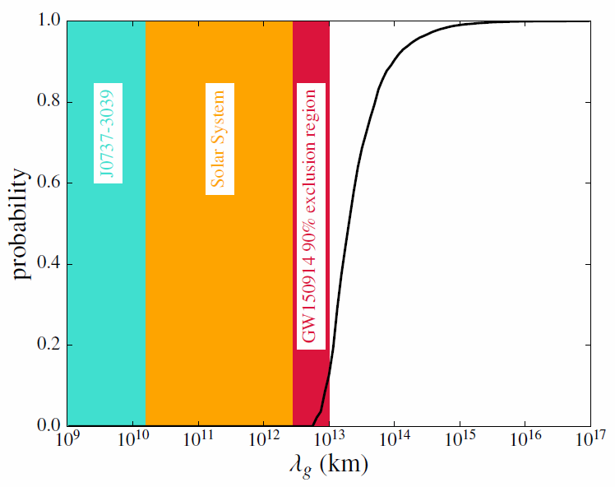
General Relativity Tests
Binary black hole mergers are the
best test of GR in the strong field, nonlinear regime
Post Newtonian Approximation
Graviton Mass / Compton Wavelength

Slide 30
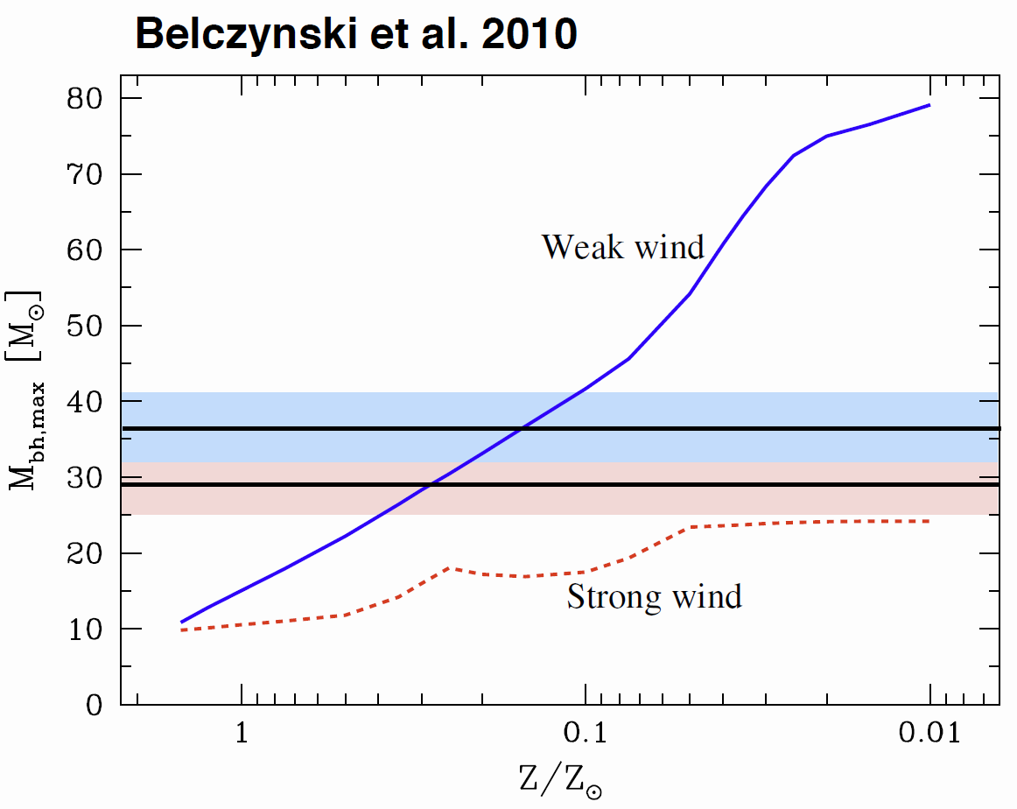
Astrophysical Implications
Early in the Universe
monster stars can form
out of Hydrogen only
Stars produce metals
(meaning anything
heavier than Helium)
30 solar mass black holes
can not be formed with
core collapses in the
current solar environment
LIGO Black Holes
Current solar environment
Early
Universe

Slide 31
Binary Black Hole Formation
From isolated stars
Inside globular clusters

Slide 32
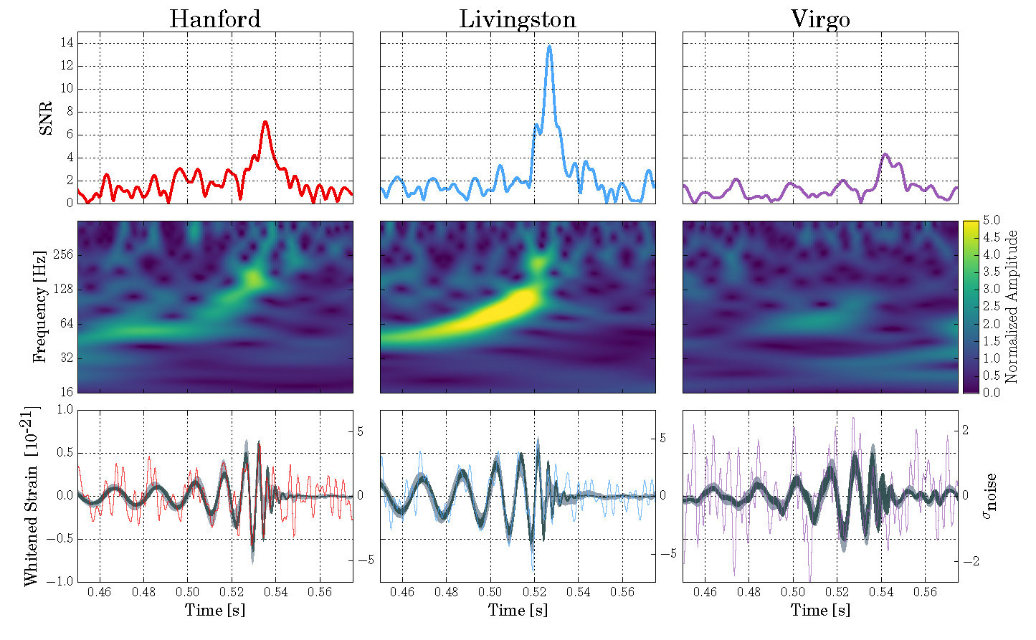
GW170814: 3x Coincidence

Slide 33
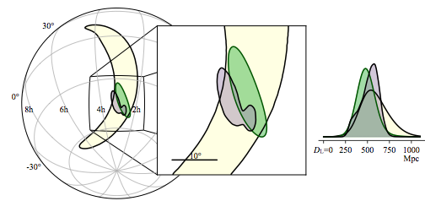
Sky Localization

Slide 34
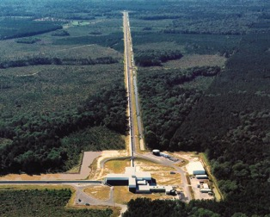
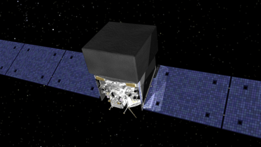
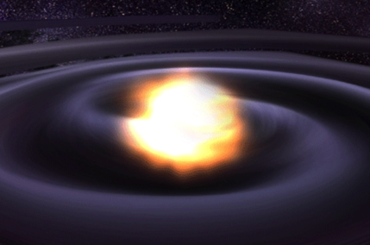
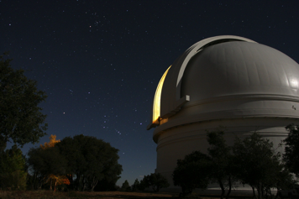
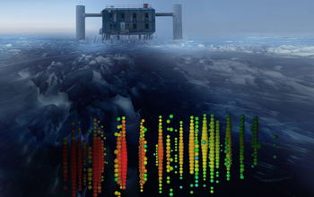

Multi-messenger Astronomy with Gravitational Waves
Binary Neutron Star Merger
X-rays/Gamma-rays
Gravitational Waves
Visible/Infrared Light
Neutrinos
Radio Waves

Slide 35


Neutron Star Merger: GW170817
1.7s

Slide 36
Neutron Star Merger: GW170817
1.7s
Speed of gravity
=
Speed of light
(to ~1 part in 10¹⁵)

Slide 37

Multi-messenger Observations
The Astrophysical Journal Letters, 848:L12, 2017

Slide 38

EM Follow-up Campaign

Slide 39

Kilonova

Slide 40


Slide 41
Cosmology without
Distance Ladder

Slide 42


Advanced LIGO Plus (A+)
An incremental upgrade to aLIGO that
leverages existing technology and infrastructure, with minimal new investment and moderate risk
Target: x1.7 increase in range over aLIGO x5 greater event rate
The Next Decade
LIGO Voyager
Additional x2 sensitivity broadband improvement,
lower frequency 20Hz → 10Hz
Larger Si masses, cryogenic operation,
new laser wavelength

Slide 43

Next Generation Gravitational Wave Detectors
  Einstein Telescope (10 km)
  European conceptual design study
  Multiple interferometers underground,
  10 km arm length, in triangle.
  10-15 year technology development
  ~10⁵ binary coalescences per year
  Cosmic Explorer (40 km)
  US-based design, just starting
  Based on LIGO Voyager technology, expanded to 40 km arms.
  20 Years+: New Facilities Needed

Slide 44

  Where do we go from here?
  Mergers at cosmological distance
    H0, dark energy EOS
  Black hole ring down
  Binary black hole formation channels
  Neutron star equation of state
  Tests of general relativity
PBH?
First Stars Formed
High SNR Signals!
BNS
BBH
Credit: Evan Hall
  Next generation detectors will detect:
  ~10⁵ Binary black mergers
  Everywhere in the Universe!
  ~10⁶ Binary neutron star mergers
We are here

Slide 45

Advanced LIGO/Virgo and the Dawn of
Gravitational-waves Physics and Astronomy
Merging binary black hole and neutron star systems have been observed for the first time
  ‘a scientific revolution’
Future increases in sensitivity will increase the rate of detections
  Daily Binary Black Hole Mergers, weekly binary neutron star mergers
The future looks bright!
Stay Tuned…

Slide 46








LIGO Livingston Observatory
LIGO Hanford Observatory
Thanks to:
ligo.caltech.edu
www.ligo.org
Support: National Science Foundation
LIGO Caltech
LIGO MIT
LSC

