Slide 1
Cryogenic suspensions for future gravitational wave detectors
Mariëlle van Veggel
on behalf of IGR, University of Glasgow
LIGO G1800845
May 2018 GWADW – Girdwood - Alaska

Slide 2
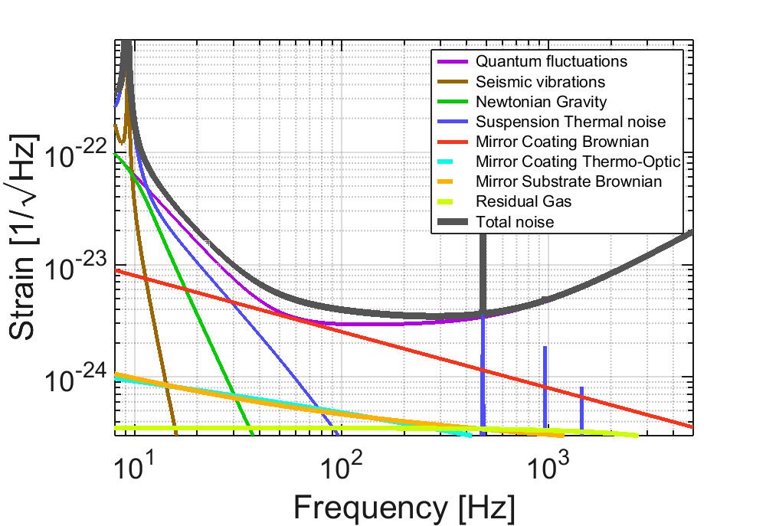
Suspension system functions
Support the optics to minimise
the effects of
thermal noise in the suspension
seismic noise
Provide damping of low frequency
suspension resonances (local control)
Provide means to maintain interferometer arm lengths (global control) while at same time
Not compromise low thermal noise of mirror
Not (re)introduce noise through control loops
Provide interface with seismic isolation system and core optics system
Support optic so that it is constrained against damage from large motions
Accommodate a thermal compensation scheme
GWINC v3.1

Slide 3
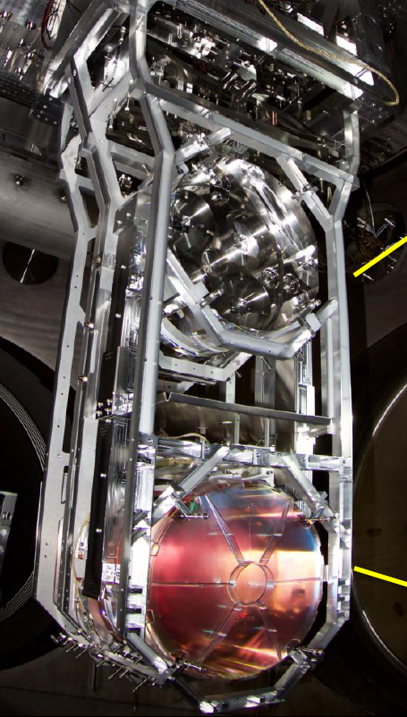
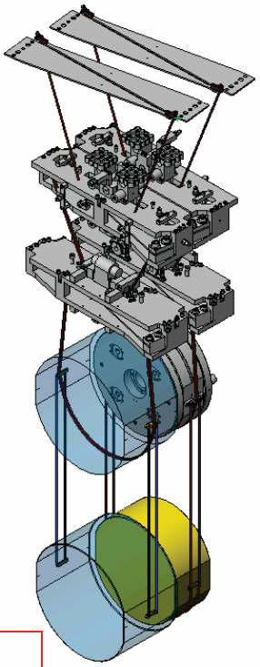
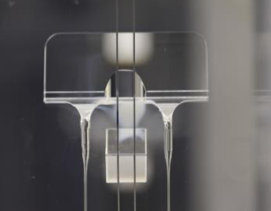
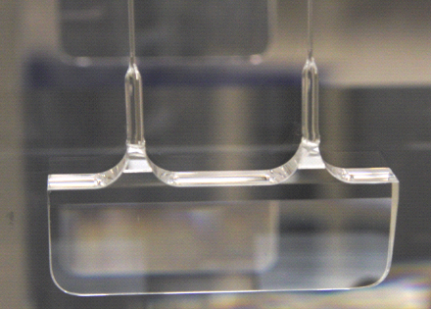
aLIGO test mass suspension
Source: G1600324
Steel upper stages
Fused silica middle stage
Fused silica optics last stage.
Fused silica fiber suspension.
Strong chemical bonds and welds create quasi-monolithic assemblies. (i.e from two pieces of glass you get one)
Fibre
Weld horn
Ear

Slide 4
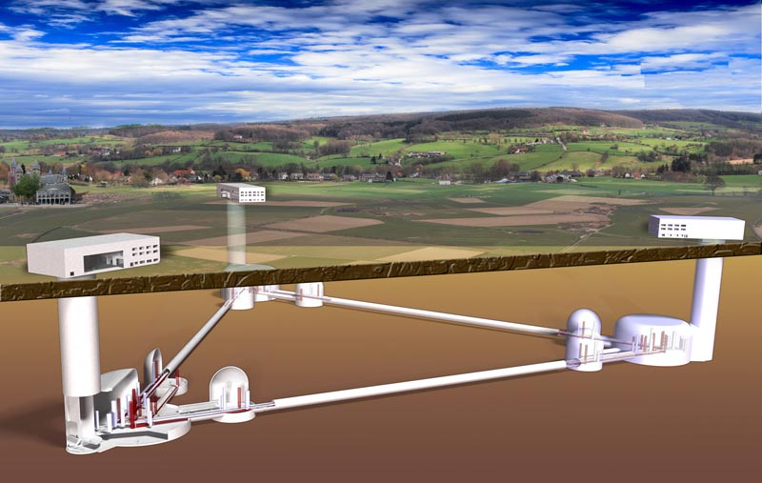
The future
Room temperature detectors with heavier and longer suspensions -> A+, ET-HF, Cosmic Explorer
Cryogenic detectors with heavier and longer suspensions -> Voyager, ET-LF, Cosmic Explorer
M. Evans, T1500293-v8

Slide 5
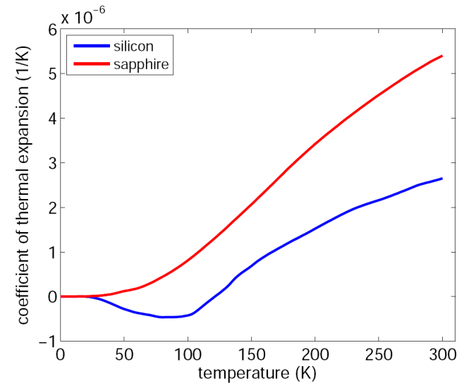
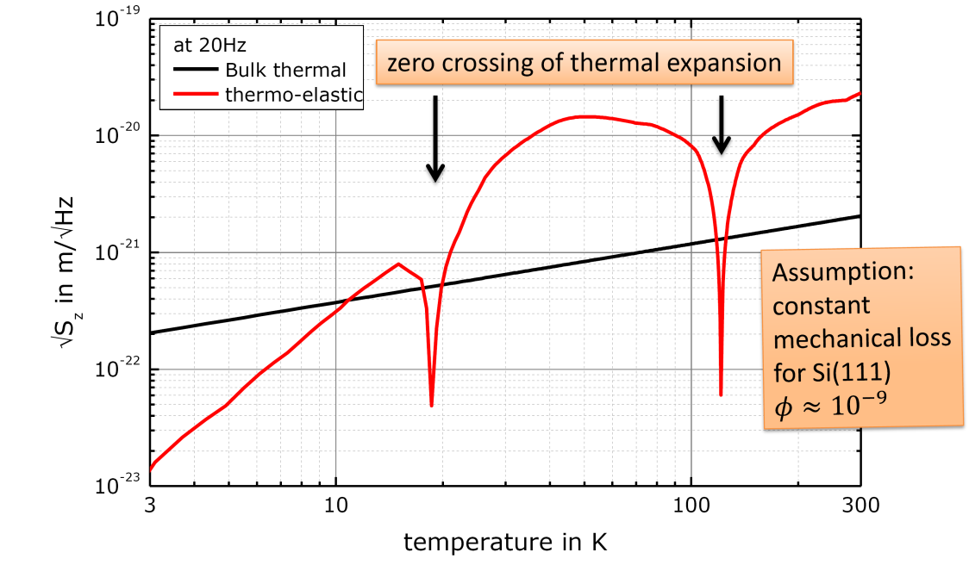
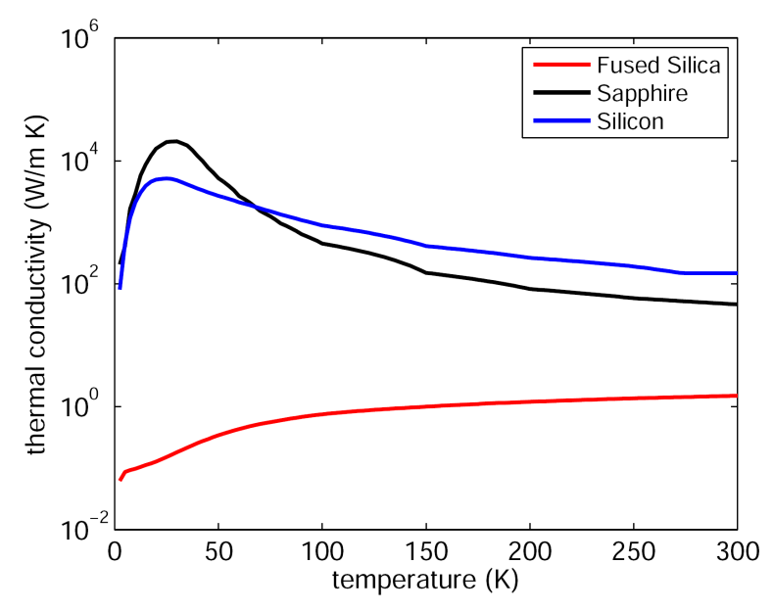
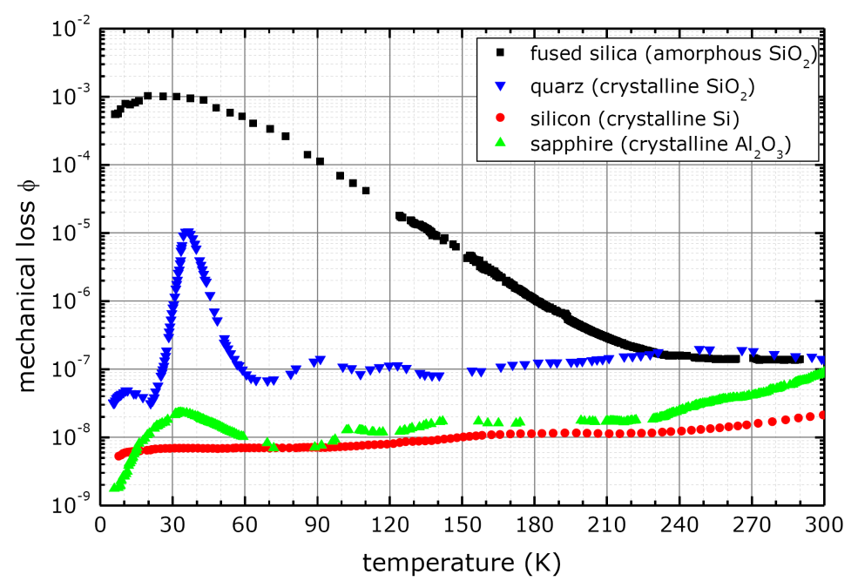
Silica, silicon, sapphire
Additional requirements for cryogenic suspensions
High thermal conductivity (to dissipate laser heat)
Low thermal expansion (minimise thermo-elastic)
Low loss
Silicon and sapphire are top candidates
ET concept design doc. 2011
G. Hofmann, GWADW, Elba, 2013
ET concept design doc. 2011
G. Hofmann, GWADW, Elba, 2013

Slide 6
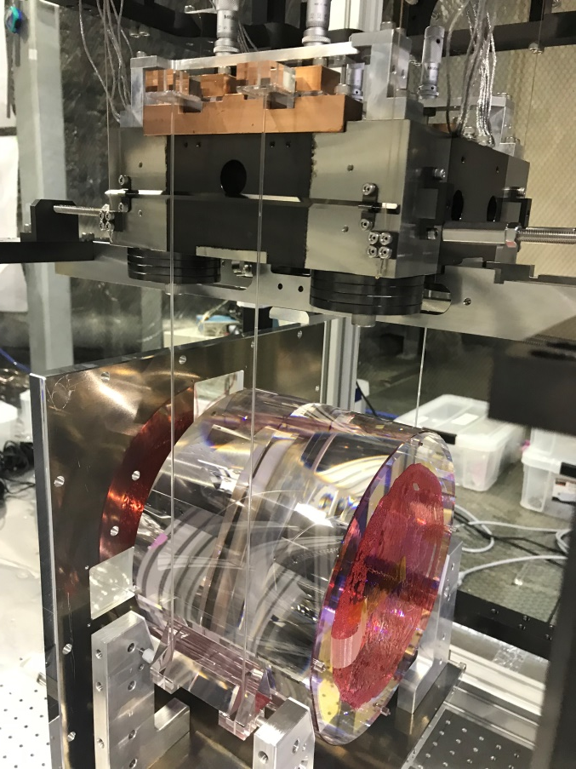
Cryogenic crystalline suspension designs
KAGRA sapphire suspension
Voyager silicon suspension
NOT A CONCEPT: REAL
A CONCEPT
See talk 13 May, Rana Adhikari
LIGO-G1800986-v1
~200 kg @ 123 K with 2 µm laser in LIGO 4 km facilities
Courtesy of Rahul Kumar
ET-LF silicon suspension
A CONCEPT
See talk 13 May, Harald Lück,
LIGO-G1800984-v1
~200 kg @ 10 K with 1.55 or 2 µm laser in triangular 3-in-1 10 km arm length, xylophone facility
Few pictures of quasi-monolithic silicon suspensions exist. Focus has been on feasibility and technology development studies for different elements of a suspension.
23 kg @ 20 K
See talk on 12 May, KAGRA: Status and near term plans Kiwamu Izumi (ISAS) Yutaro Enomoto (U-Tokyo)
LIGO-P1800131-v1

Slide 7
Cryogenic crystalline suspension elements
How can big enough test masses with the right opto-mechanical properties be produced?
See core optics for 3G detectors talk by Iain Martin (LIGO-G1801018)
How best to produce silicon (or sapphire) suspension fibres?
Etching from wafer
Machining
Crystal growth techniques (e.g. micro-pulling technique and laser heated pedestal growth)
Jointing techniques
Welding
Hydroxide catalysis bonding
Indium/gallium bonding

Slide 8
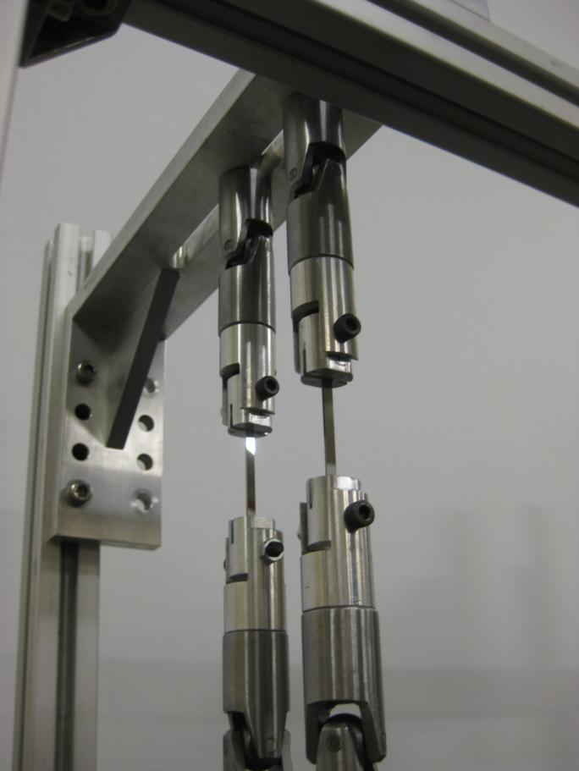
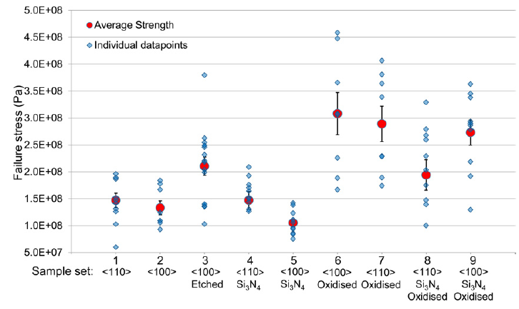
Silicon and sapphire fibre production and performance research in Glasgow
First steps to sapphire fibres with laser heated pedestal growth
Strength tests on silicon ribbons etched from a wafer
Cumming et al.,
Class. Quantum Grav. 31
(2014) 025017 (16pp)
Notes:
combine this to show all noise budgets together. leave slides complete in additional slides.
In aLIGO thermal noise arising from bonds was to be 10% of the total thermal noise budget @ 100 Hz
Thermal noise budget @ 100 Hz is ~2⋅10⁻²⁴ /√Hz ⇒
Bond thermal noise budget per test mass ~2⋅10⁻²⁵ /√Hz (7⋅10⁻²² m/√Hz, (T010075-01,2009))
Calculated: 1.4⋅10⁻²⁵ /√Hz (5.4 ⋅10⁻²² m/√Hz )
assuming bond loss of 0.11 at 293 K
1/sqrt(Hz)
KAGRA 2⋅10⁻²⁵ *1500
aLIGO 2⋅10⁻²⁵
ET 4⋅10⁻²⁶

Slide 9
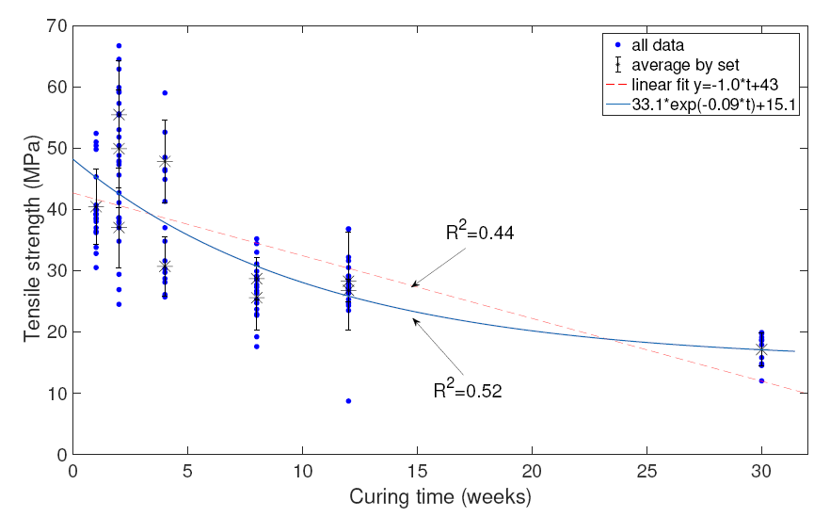
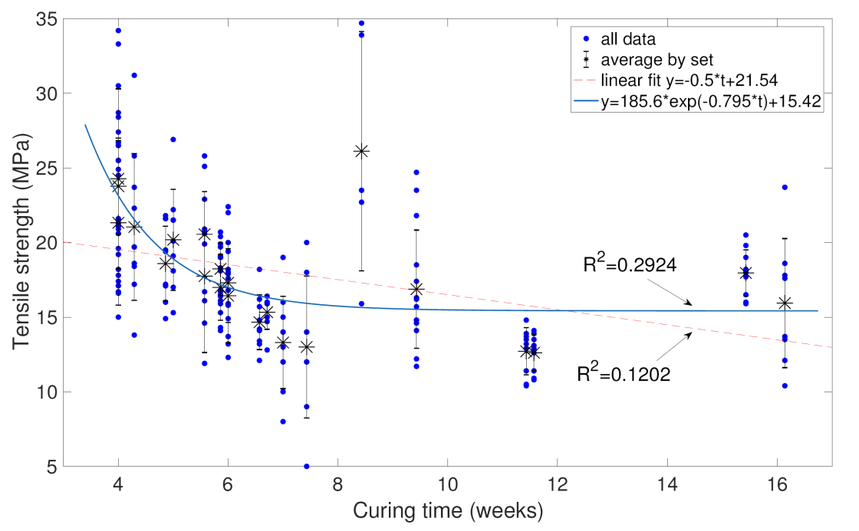
Hydroxide catalysis bonding of silicon and sapphire - strength
Tensile strength (4-point bending) of sapphire-sapphire and silica-silica HCBs with curing time (in air)
C-plane sapphire
Silica
PhD work Rebecca Douglas and Margot Phelps – manuscript in preparation
Similar curing time experiments with silicon-silicon bonds are ongoing.
PhD work Mariela Masso Reid
Silicon halves after bond strength test.
Thermal image through silicon sample to assess bond quality
Notes:
combine this to show all noise budgets together. leave slides complete in additional slides.
In aLIGO thermal noise arising from bonds was to be 10% of the total thermal noise budget @ 100 Hz
Thermal noise budget @ 100 Hz is ~2⋅10⁻²⁴ /√Hz ⇒
Bond thermal noise budget per test mass ~2⋅10⁻²⁵ /√Hz (7⋅10⁻²² m/√Hz, (T010075-01,2009))
Calculated: 1.4⋅10⁻²⁵ /√Hz (5.4 ⋅10⁻²² m/√Hz )
assuming bond loss of 0.11 at 293 K
1/sqrt(Hz)
KAGRA 2⋅10⁻²⁵ *1500
aLIGO 2⋅10⁻²⁵
ET 4⋅10⁻²⁶

Slide 10
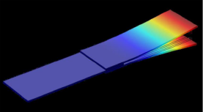
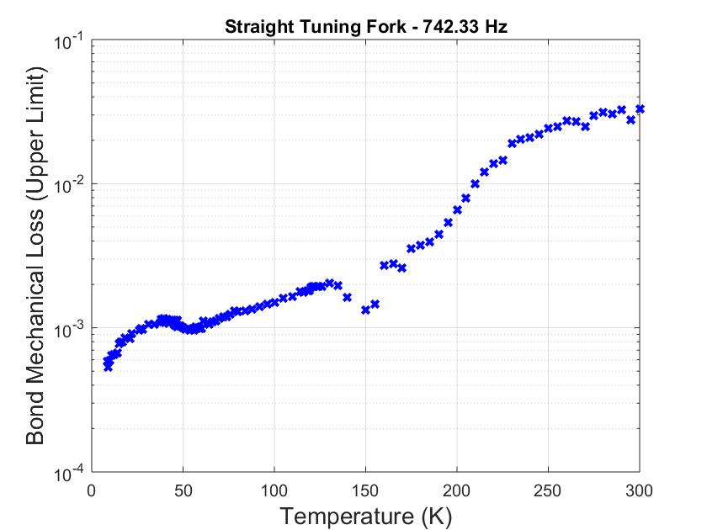
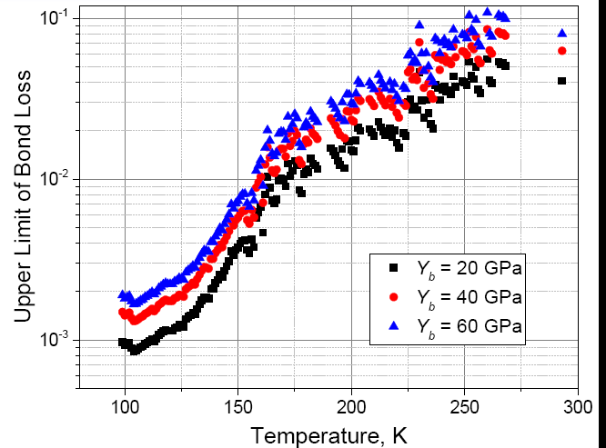
Hydroxide catalysis bonding of silicon and sapphire – mechanical loss
Mechanical loss of silicon-silicon HCBs
In tuning fork design
PRELIMINARY
Prokhorov et al., Phys. Lett. A, 2017
Losses are very similar to loss in sapphire-sapphire bonds
(see Haughian et al. PRD 2016)
Joint work with colleagues at Moscow State University
Latest measurements and modelling by Peter Murray and Karen Haughian
Notes:
combine this to show all noise budgets together. leave slides complete in additional slides.
In aLIGO thermal noise arising from bonds was to be 10% of the total thermal noise budget @ 100 Hz
Thermal noise budget @ 100 Hz is ~2⋅10⁻²⁴ /√Hz ⇒
Bond thermal noise budget per test mass ~2⋅10⁻²⁵ /√Hz (7⋅10⁻²² m/√Hz, (T010075-01,2009))
Calculated: 1.4⋅10⁻²⁵ /√Hz (5.4 ⋅10⁻²² m/√Hz )
assuming bond loss of 0.11 at 293 K
1/sqrt(Hz)
KAGRA 2⋅10⁻²⁵ *1500
aLIGO 2⋅10⁻²⁵
ET 4⋅10⁻²⁶

Slide 11
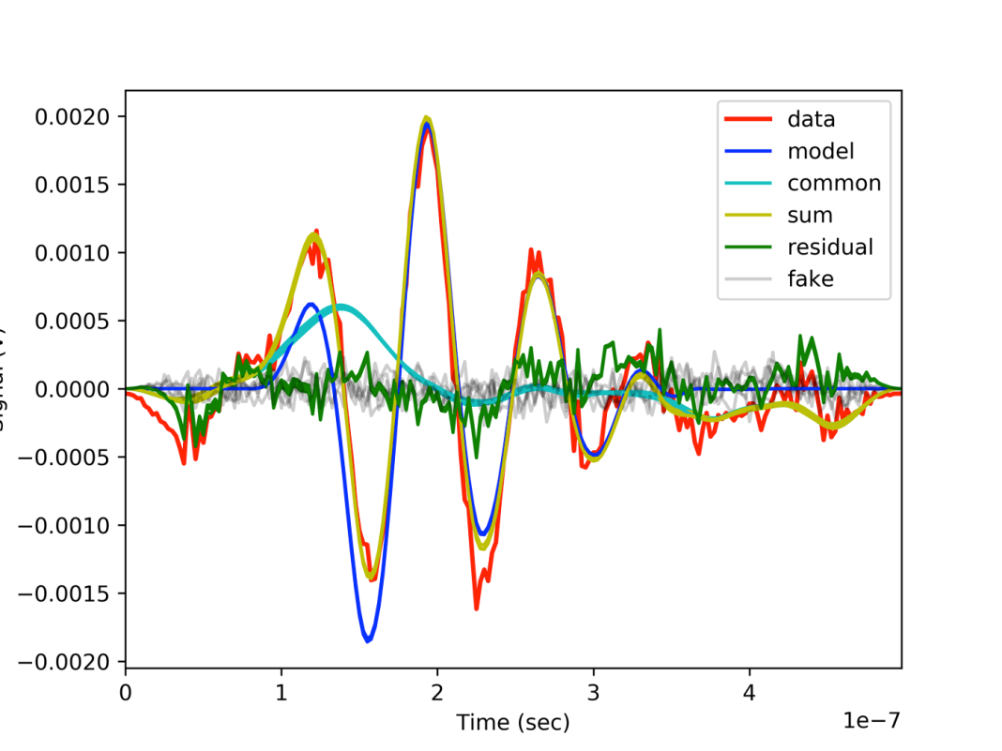
Thermal noise contribution HCB’s
New value Young’s modulus of bonds through ultrasonic measurements and Bayesian analysis – ${18.5}_{−2.3}^{+2.0}$ GPa
substrate 1
substrate 2
Signal(V)
T_{pulse}
R_{bond interface}
Transducer
T_{pulse}
bond
R_{back}
Transducer control
~6mm
~6mm
<100nm-100nm
Time(s)
Paper accepted Phelps et al.,
PRD April 2018
LIGO-P1700423
Detector | KAGRA | ET-LF-1 | ET-LF-2
TM | 23 kg sapphire | 211 kg sapphire | 211 kg silicon
Temperature | 20 K | 10 K | 10 K
Thermal noise required (⋅10⁻²² m/√Hz per TM) | 6 | 5 | 5
Thermal noise modelled (⋅10⁻²² m/√Hz per TM) | 0.45±0.02 | 0.38±0.12 | 2.8±0.5
… and impact on thermal noise
… which is below expected requirements

Slide 12
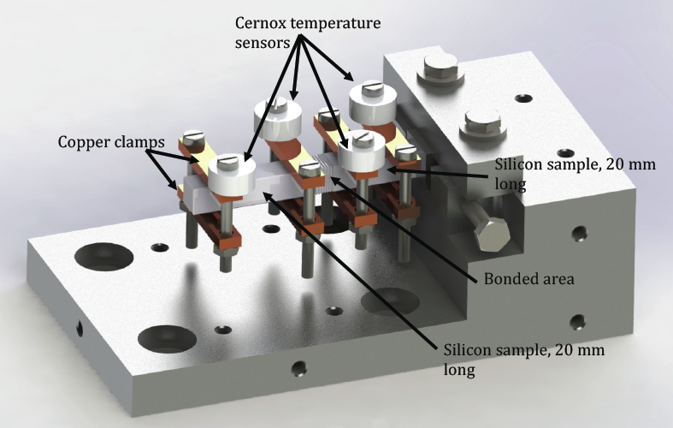
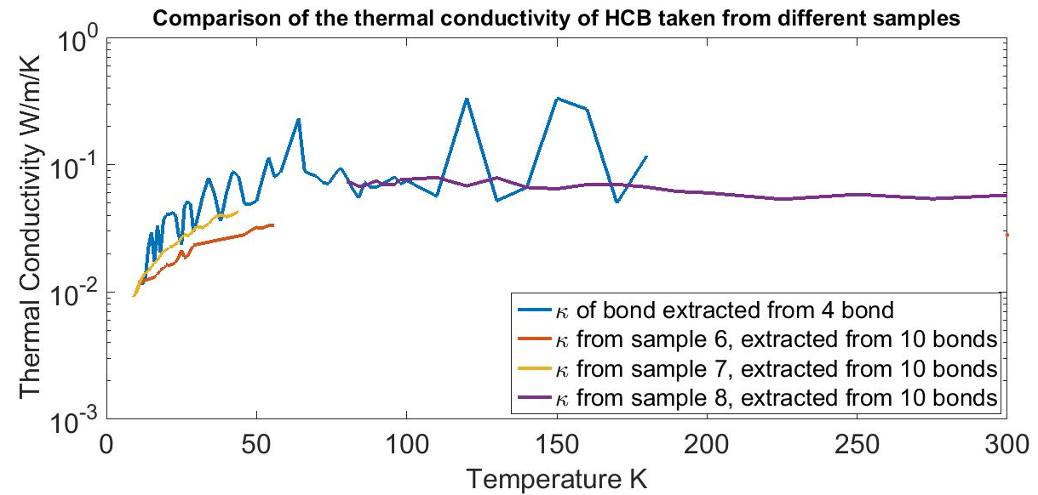
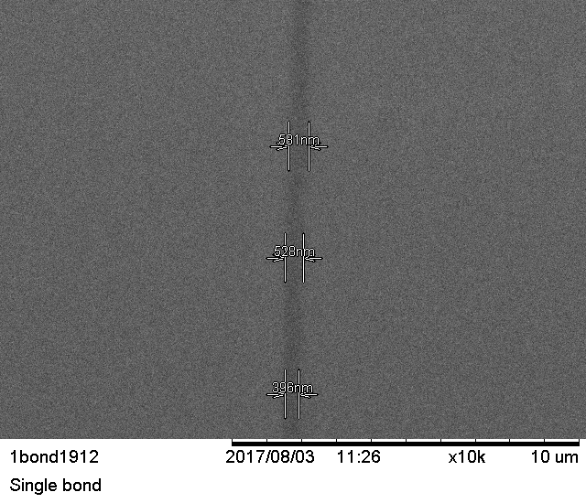
Hydroxide catalysis bonding of silicon – thermal conductivity
Sample 8 during curing
Though thermal conductivity is low, the bond is also extremely thin. The expected thermal gradient across a bond is extremely small.
0.06 mK for a total thermal gradient of 15 K between test mass and marionetta for ET
581 nm
528 nm
10 bonds
396 nm
PhD work Mariela Masso Reid
Notes:
combine this to show all noise budgets together. leave slides complete in additional slides.
In aLIGO thermal noise arising from bonds was to be 10% of the total thermal noise budget @ 100 Hz
Thermal noise budget @ 100 Hz is ~2⋅10⁻²⁴ /√Hz ⇒
Bond thermal noise budget per test mass ~2⋅10⁻²⁵ /√Hz (7⋅10⁻²² m/√Hz, (T010075-01,2009))
Calculated: 1.4⋅10⁻²⁵ /√Hz (5.4 ⋅10⁻²² m/√Hz )
assuming bond loss of 0.11 at 293 K
1/sqrt(Hz)
KAGRA 2⋅10⁻²⁵ *1500
aLIGO 2⋅10⁻²⁵
ET 4⋅10⁻²⁶

Slide 13
Towards future cryogenic detectors – indium bonding
Considering indium bonding for suspension designs with nail head fibres underneath the ear (like Adv Virgo and KAGRA)
Bond under compression
Debonding possible - fibres with nailheads are replaceable – with low risk of damage to test mass
Indium bonding was considered for GEO600 (Twyford thesis, 1998) and KAGRA (LIGO-G1500951)
Is considered a potential solution for some interfaces ET (ET-0106C-10)
Rejected for GEO600 as indium has low melting temperature (156 °C), so creep during vacuum bake out
Indium bond under compression between ‘nailhead’ and ‘ear’
Notes:
remind people they are posterior distributions so important thing is that they overlap.

Slide 14
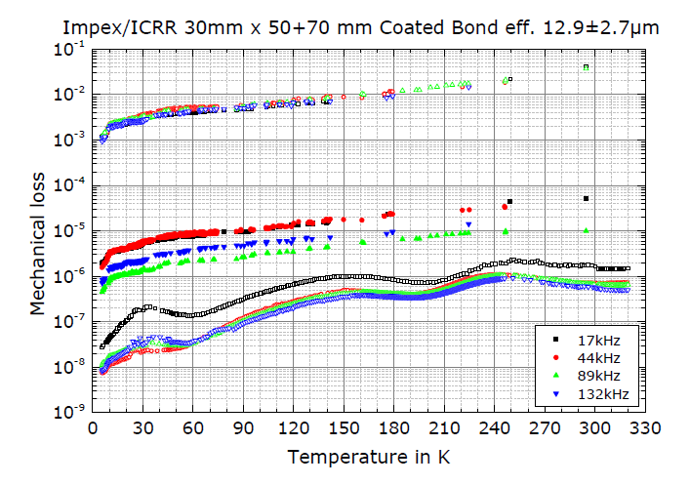
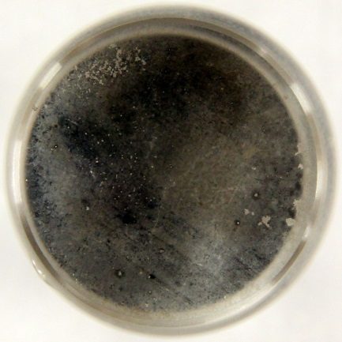
Indium bond loss, sapphire
Indium bond loss
Loss of the bonded sample
Loss of the reference sample
A non-uniform indium layer can increase the loss of the joint.
Indium bond loss is ~ (2 – 3) x 10⁻³ at 20K.
(Class. Quantum Grav. 32 (2015) 245013 G Hofmann et al)

Slide 15
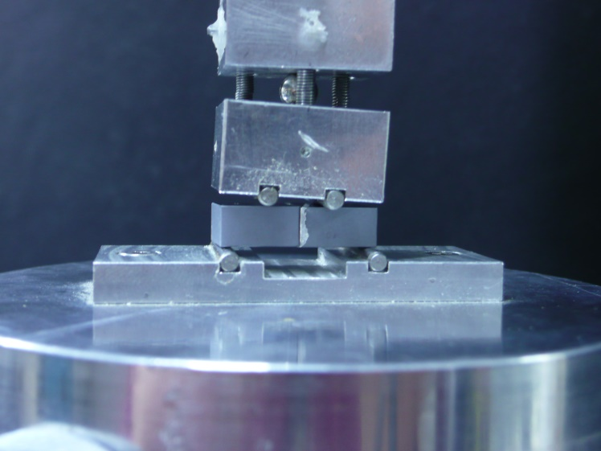
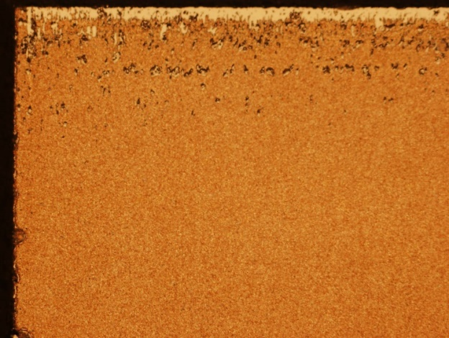
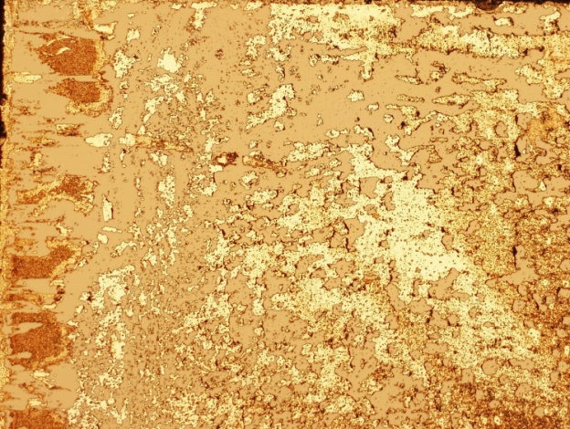
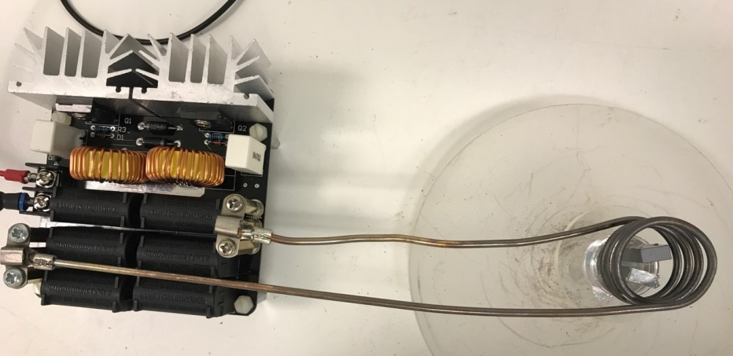
Indium bonding - assessing bond quality
4-point bend test
Visual inspection
Images under Nomarski microscope
Induction
heating
Poor quality bond
High quality bond
PhD work Margot Phelps
Notes:
remind people they are posterior distributions so important thing is that they overlap.

Slide 16
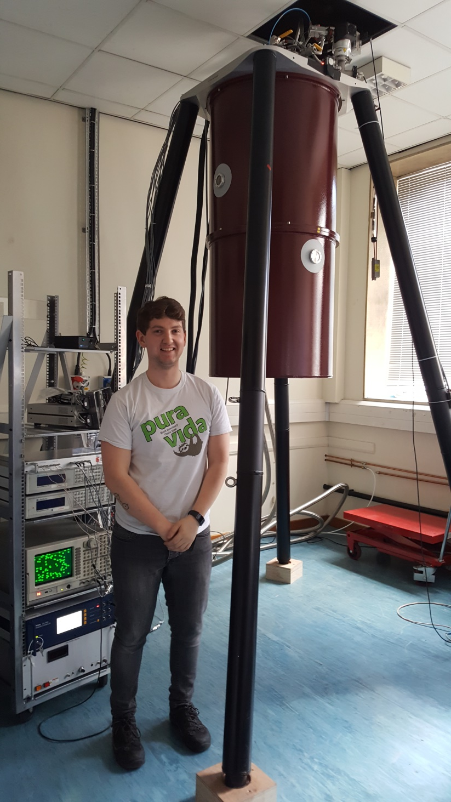
Cryogenic crystalline suspension designs
Leiden Cryogenics cryogen free cryostat
+
PhD student Graeme Eddolls
Working towards a 1 kg scale
4 fibres silicon suspension
There are still many questions to answer for a design and assembly of 200 kg scale crystalline mirror suspensions, but making good progress in assessing/developing techniques to make it possible.

