Slide 1
LIGO Hanford
Science Education Center

Slide 2
Outreach Growth 2012-2017

Slide 3
Teacher Professional Development

Slide 4
Impact on Teachers
Over 6 years LHO has provided professional development for 1,016 teachers.
How does that translate to student impact?
We conservatively estimate each teacher impacts an average of 50 students each year.
Even if we assume they only teach one year that translates to 50,800 students impacted!!!
In the same time LIGO Livingston with the availability of their Science Education center has provided professional development for 2,360 teachers with a student impact of approximately 118,000 students.

Slide 5
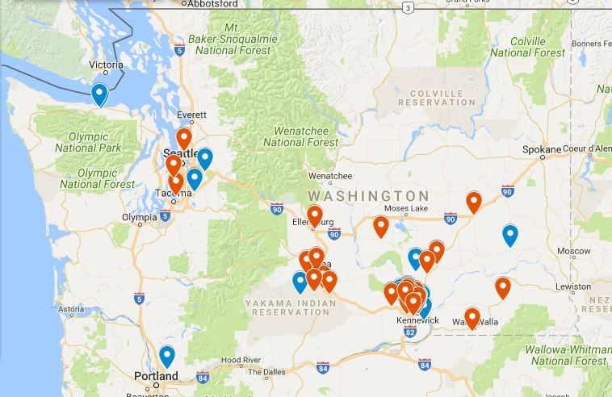
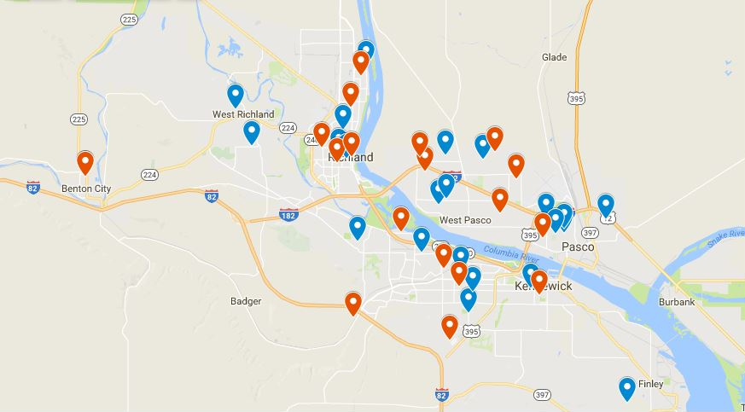
These maps show the schools impacted in Washington State (right) and the Tri-Cities area (below) in 2017 alone.
Orange Markers are schools that have visited LIGO for a field trip.
Blue markers are schools visited by LIGO staff.

Slide 6
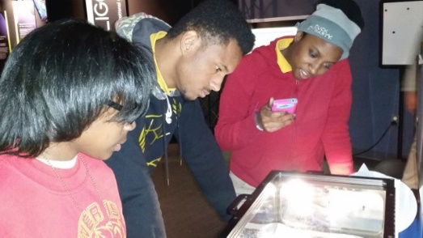
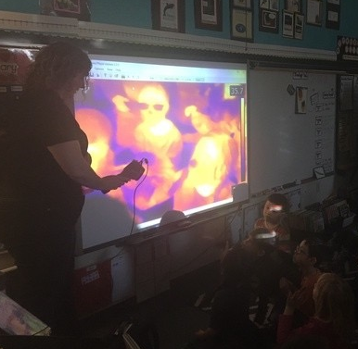
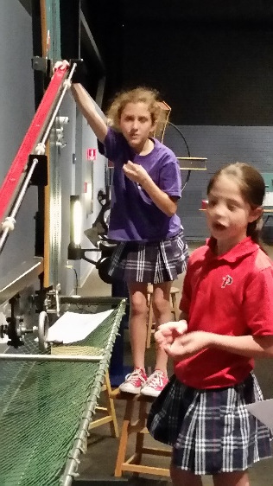
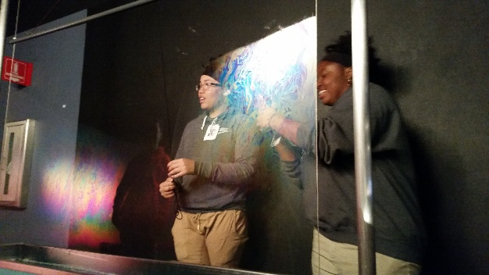
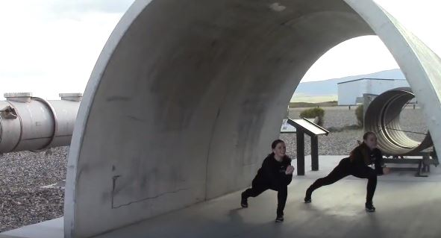
“My son may be six years-old, but the LIGO observatory is his favorite place in the world.”
“Our son now wants to be a scientist, previously he just wanted to be Spiderman.”
“We loved everything about the field trip! When we returned to school we had the kids write what they learned, saw, and did. We were surprised at the amount of information they remembered, how they made connections to the units we did, and how much fun they had learning.”
“Awesome yesterday to see how many women are in senior science positions at @LIGOWA it was super inspirational to my daughter, a freshman physics major.”
“I have been teaching for 35 years and have been on quite a lot of field trips, but LIGO is by far the best.”

