Slide 1
Updates on the QUAD State Space Matlab model
Edgard Bonilla
LVC Sonoma 2018
1

Slide 2
Contents
Overview
Some features of the model
SVN folder for the model
New model interface
Adding features
Future directions
The Matlab Model manual can be found at G1401132.
Send questions or comments to Edgard (edgard [at] stanford.edu)

Slide 3
Overview
The Matlab model generates a first-principles state space model of a QUAD suspension.
It is a very powerful tool for both commissioning and control design for the suspensions.
It has been used by the collaboration for years.
It now has a new interfacing structure, both for use and modification.

Slide 4
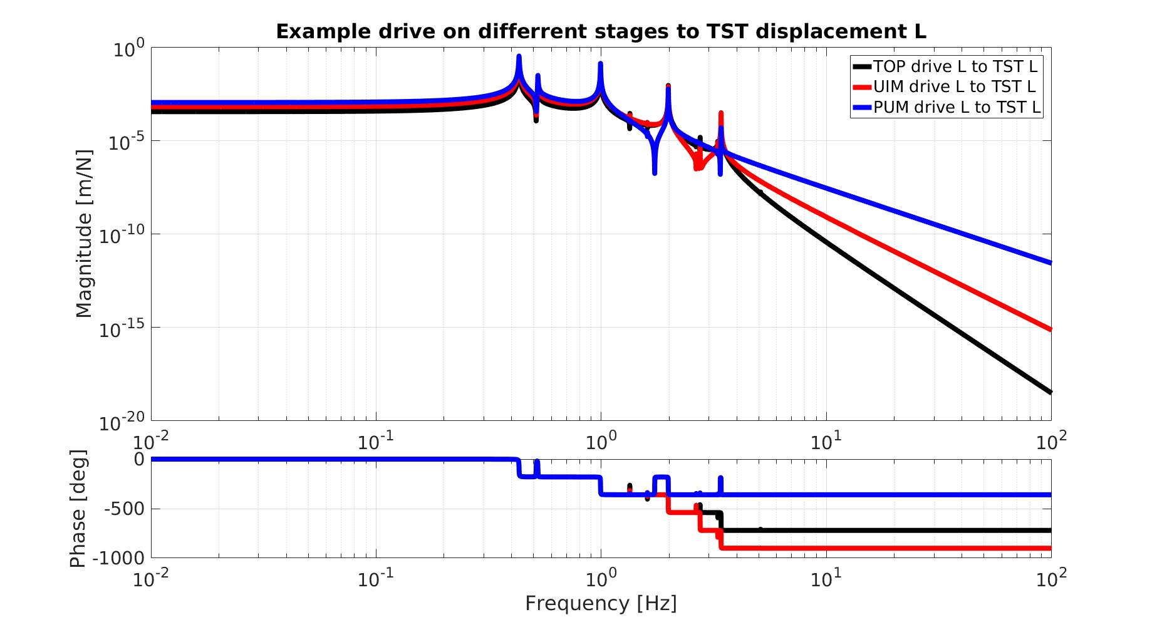
Some Features

Slide 5
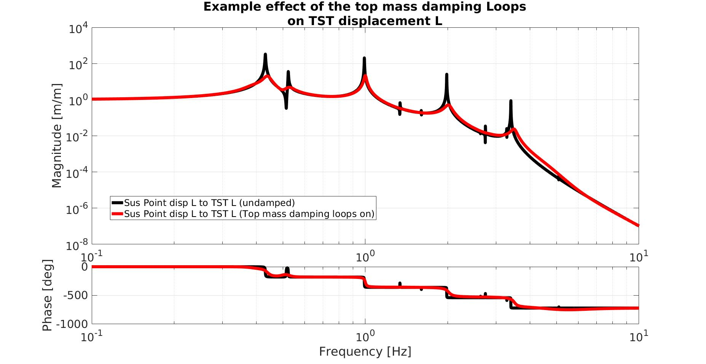
Some Features

Slide 6
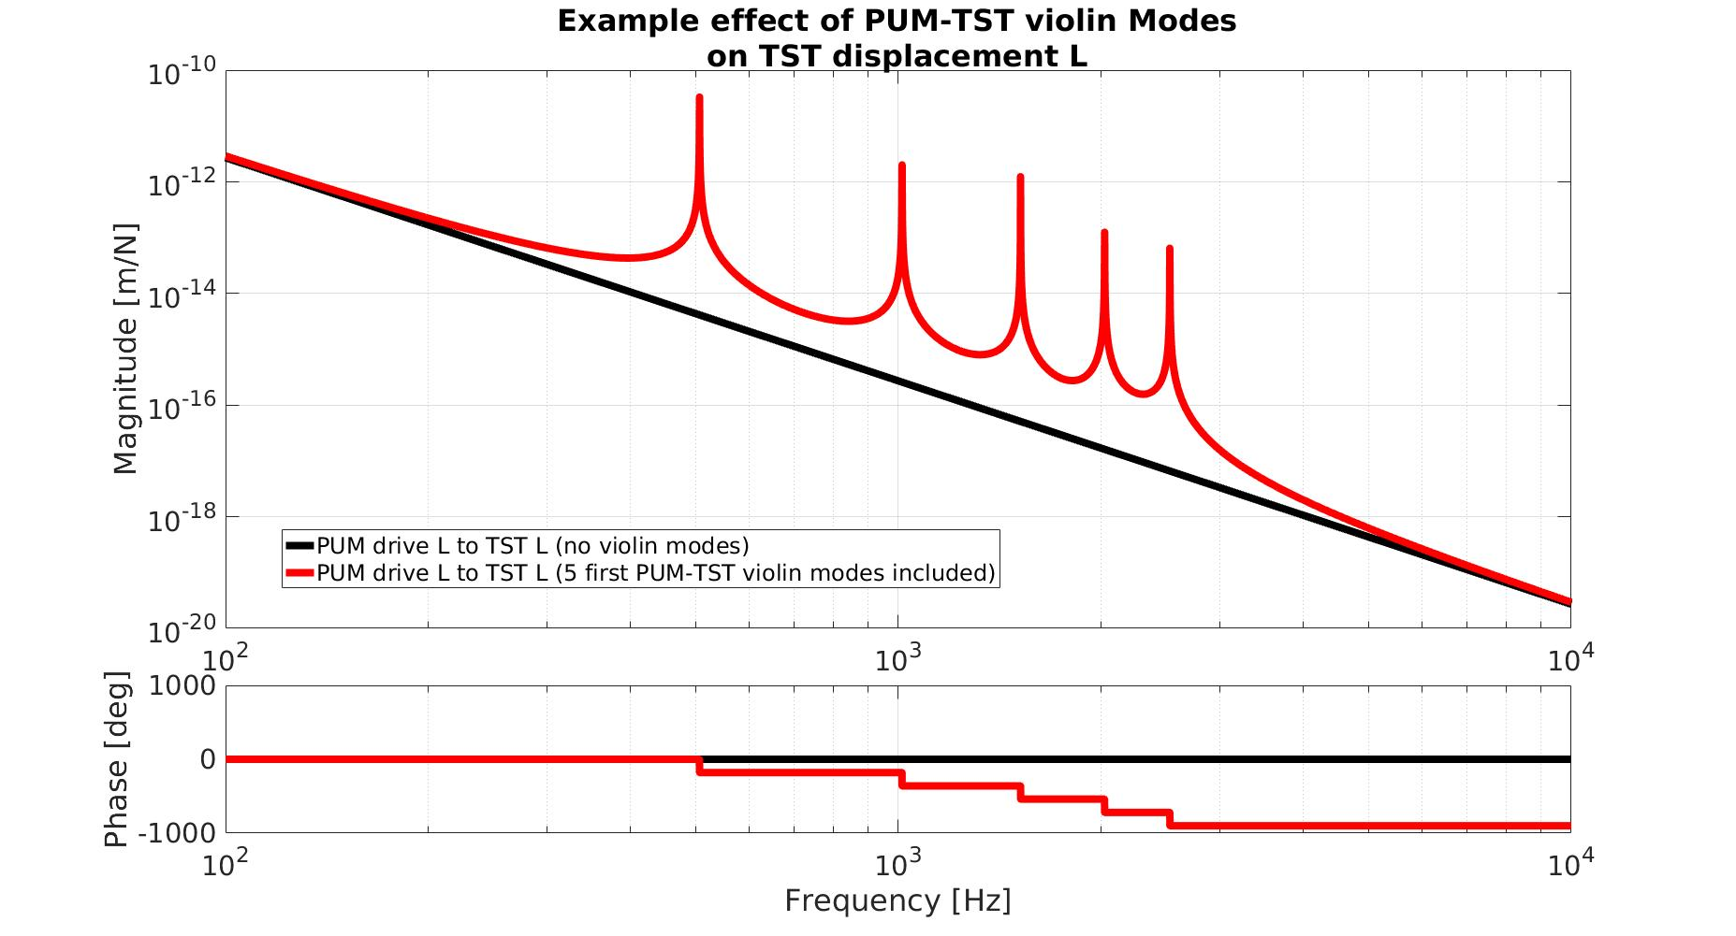
Some Features
*For a complete feature list, check G1401132.

Slide 7
SVN location
The model files are found in
…/SusSVN/sus/trunk/QUAD/Common/MatlabTools/QuadModel_Production/
The model is compiled with the function:
generate_QUAD_Model_Production.m
The new interfacing script for the model is:
QUAD_Model_input_options_template.m
*More information can be found at G1401132.

Slide 8
New Interface
The interfacing script lays all the modifiable options:
QUAD_Model_input_options_template.m
*Excerpt from:

Slide 9
New Interface
It doubles down as an user manual for the model options:
QUAD_Model_input_options_template.m
*Excerpt from:

Slide 10
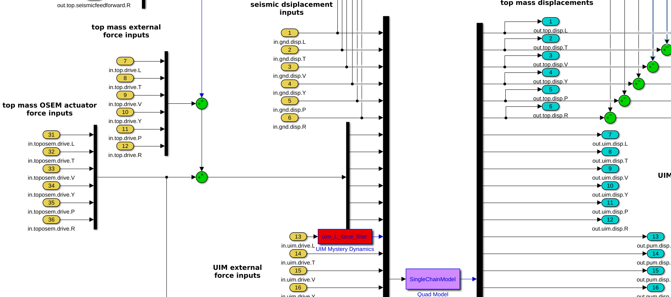
Adding Features
All the models are compiled with Simulink diagrams:
Generate_QUAD_SingleChainUndamped.slx
*Excerpt from:

Slide 11
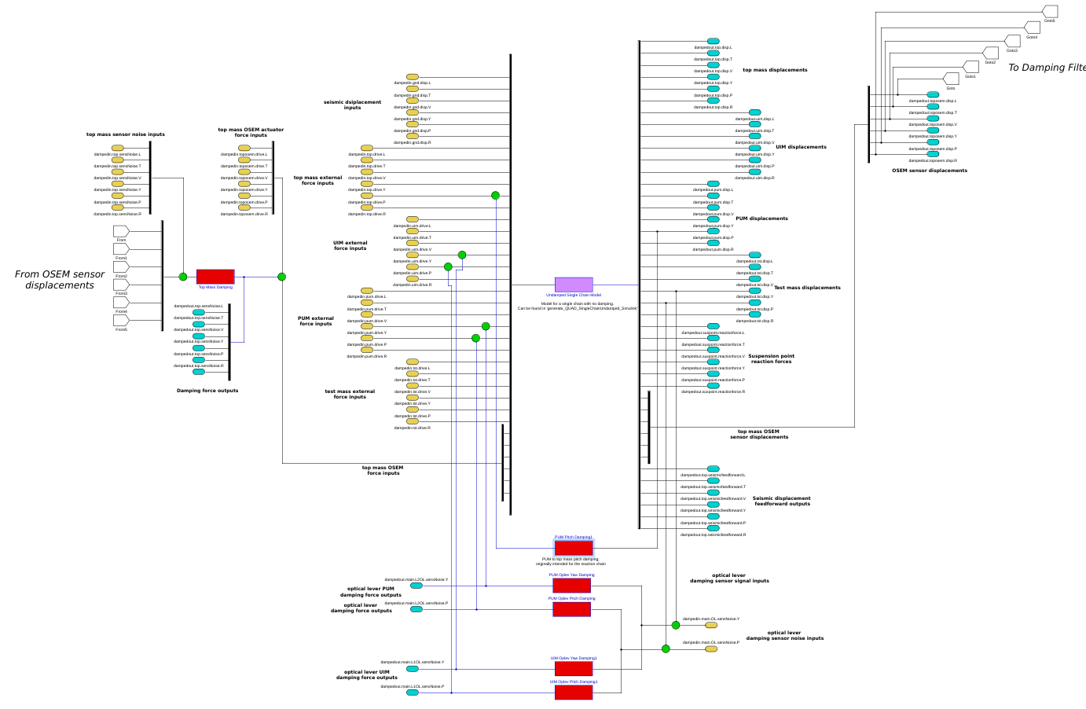
Adding Features
The single undamped chain sits at the heart of the damped model
Single Chain damped model
The 36 inputs to the single undamped chain have to be fed to it in the correct order
… The same applies for the 42 outputs.
*More information can be found at G1401132.

Slide 12
Future Directions
Continue to maintain the model. Adding features as needed.
Bring the other Matlab suspension models to a similar state to this one.
*The Matlab Model manual can be found at G1401132.
*Send questions or comments to Edgard (edgard [at] stanford.edu)

