Slide 1
Improving DARM
with ISI→ SUS feedforward
Edgard Bonilla
LVC Sonoma 2018

Slide 2
Outline
Motivation
Effects of a top mass length feedforward.
Removing the cross coupling to pitch at the top mass.
Sensitivity of the cross couplings

Slide 3
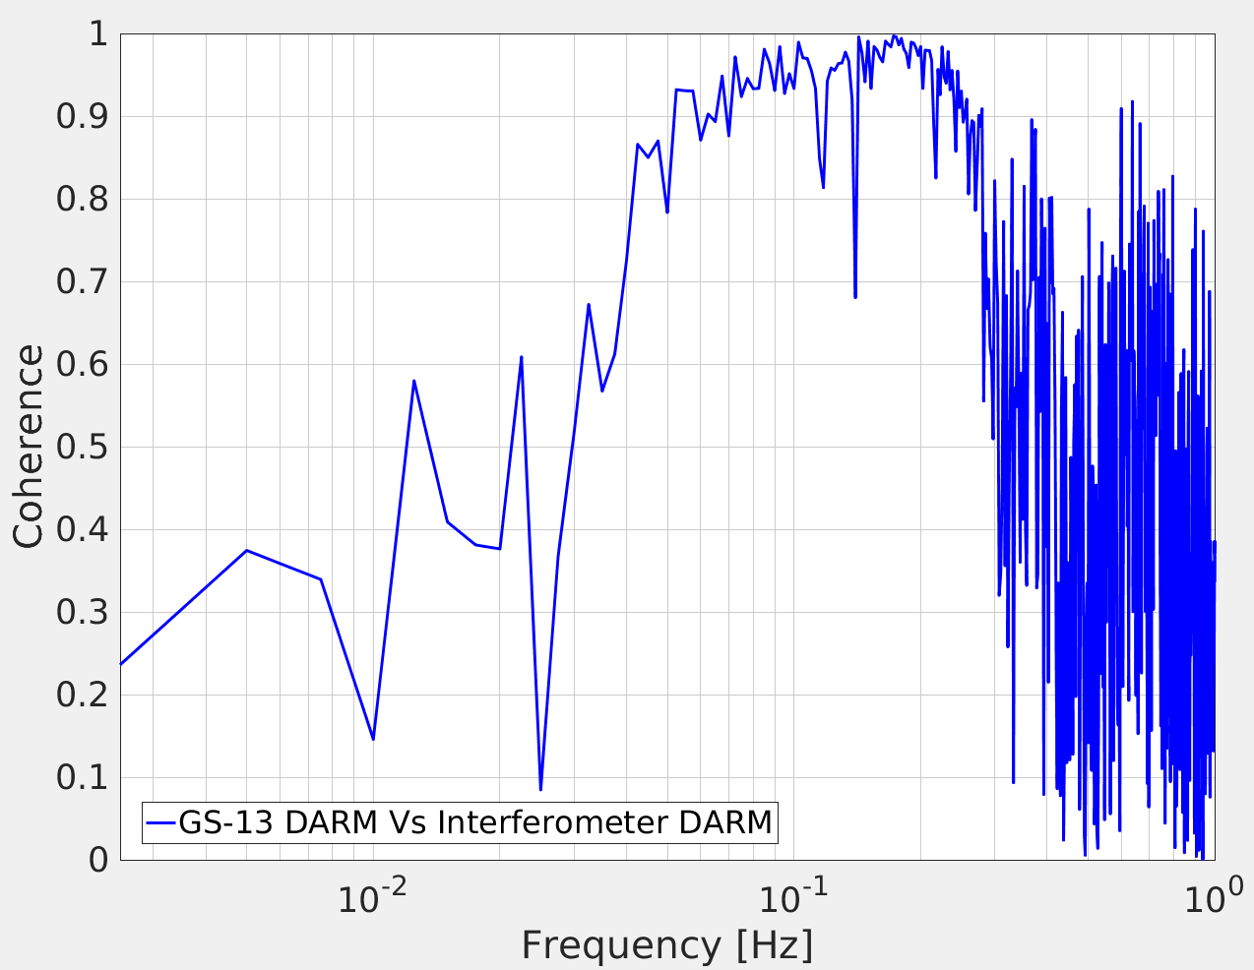
Coherence of DARM and GS13 DARM
High coherence from 60 – 300 mHz
Credit: Conor Mow-Lowry

Slide 4
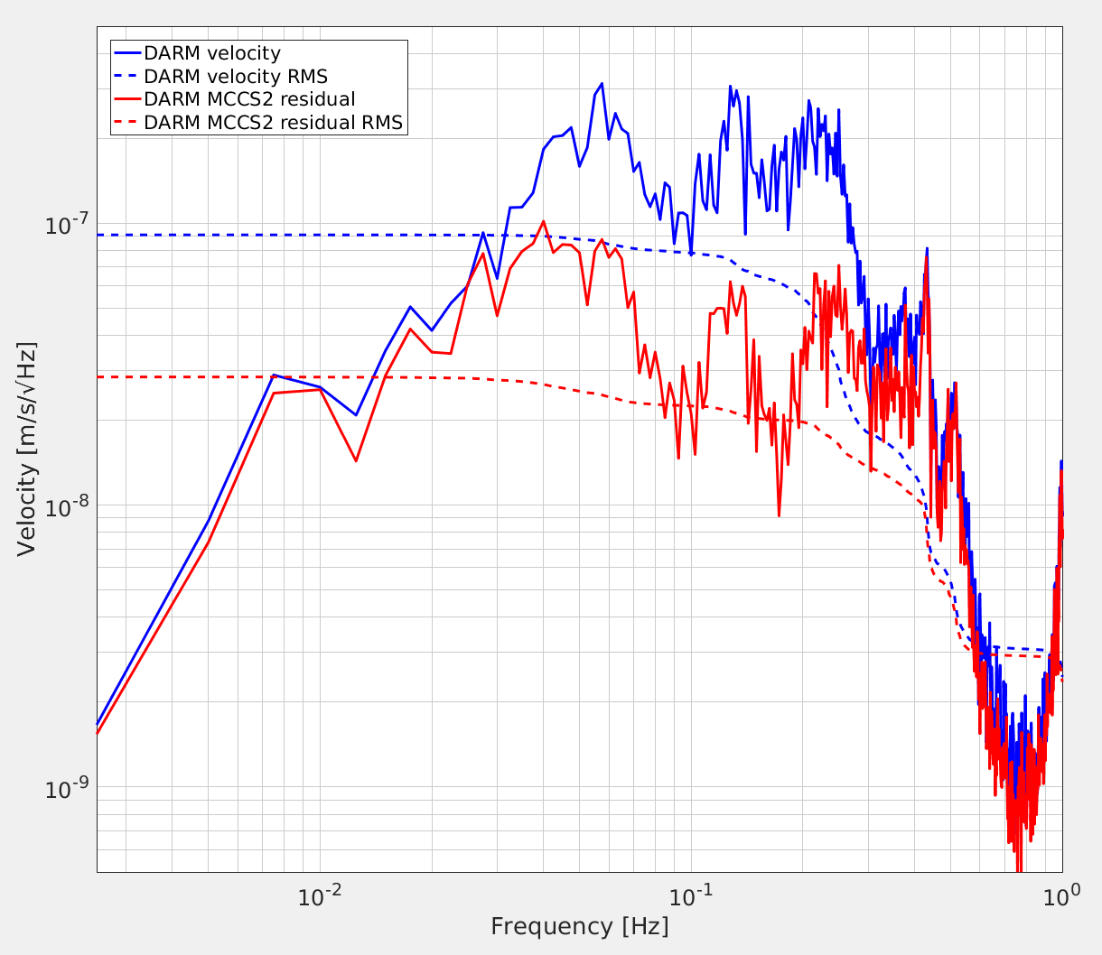
Removal of the coherent GS13 signal
Credit: Conor Mow-Lowry

Slide 5
Summary (so far)
The sus point GS13 signal can be used to improve DARM from .1 to .3 Hz.
The Feedforward filter cannot ignore the pitch cross coupling at the Top Mass.
It is sufficient to isolate the top mass in L and P to get a similar performance at the test mass.
The L-P coupling cannot be treated with an unified scheme for all QUADs.
If these cross couplings are time dependent, pure Feedforward is impractical

Slide 6
Length Feedforward
SUS POINT displacement
L
L to L Filt
TOP MASS
Drive
L
This compensation has unintended consequences...
TEST MASS
displacement
L
= GS13
= Top Mass OSEM

Slide 7
Length Feedforward
SUS POINT displacement
L
L to L Filt
TOP MASS
Drive
L
This compensation has unintended consequences...
TEST MASS
displacement
L
= GS13
= Top Mass OSEM

Slide 8
Length Feedforward
SUS POINT displacement
L
L to L Filt
TOP MASS
Drive
L
There is DC coupling to Pitch
TEST MASS
displacement
L
= GS13
= Top Mass OSEM

Slide 9
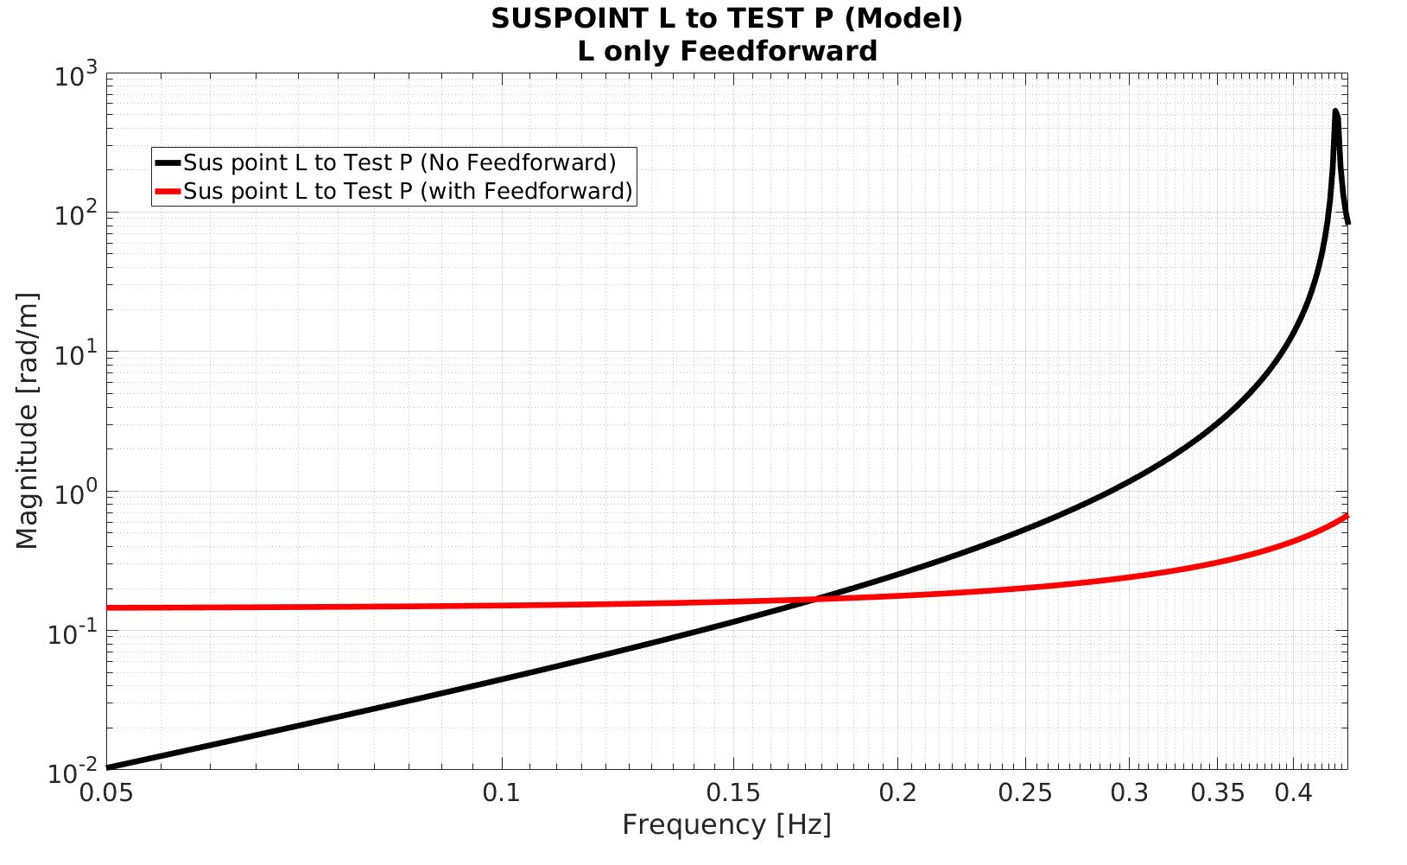
～170 mHz

Slide 10
Summary (so far)
The sus point GS13 signal can be used to improve DARM from .1 to .3 Hz.
The Feedforward filter cannot ignore the pitch cross coupling at the Top Mass.
It is sufficient to isolate the top mass in L and P to get a similar performance at the test mass.
The L-P coupling cannot be treated with an unified scheme for all QUADs.
If these cross couplings are time dependent, pure Feedforward is impractical

Slide 11
Pitch Compensation
SUS POINT displacement
L
L to L Filt
TOP MASS
Drive
L
TEST MASS
displacement
L
= GS13
= Top Mass OSEM

Slide 12
Pitch Compensation
SUS POINT displacement
L
L to L Filt
L to P Filt
TOP MASS
Drive
L , P
TEST MASS
displacement
L , P
= GS13
= Top Mass OSEM

Slide 13
Pitch Compensation
SUS POINT displacement
L
L to L Filt
k
L to P Filt
k l
TOP MASS
Drive
L , P
The leading order term counteracts the DC torque
Iteration leads to:
k ~ 2800 N/m
l ~ 1.3 mm
TEST MASS
displacement
L , P
= GS13
= Top Mass OSEM

Slide 14
Summary (so far)
The sus point GS13 signal can be used to improve DARM from .1 to .3 Hz.
The Feedforward filter cannot ignore the pitch cross coupling at the Top Mass.
It is sufficient to isolate the top mass in L and P to get a similar performance at the test mass.
The L-P coupling cannot be treated with an unified scheme for all QUADs.
If these cross couplings are time dependent, pure Feedforward is impractical

Slide 15
DC Pitch estimation
SUS POINT displacement
L
L to L Filt
L to P Filt
TOP MASS
Drive
L , P
We need to counteract
The unintended DC torque
TEST MASS
displacement
L , P
= GS13
= Top Mass OSEM

Slide 16
DC Pitch estimation
Let’s abstract the problem:
F
Pivot Plane

Slide 17
DC Pitch estimation
Let’s abstract the problem:
The torque generated by the force F is given by:
F
τ = leff F
leff
Approximate at DC
Pivot Plane

Slide 18
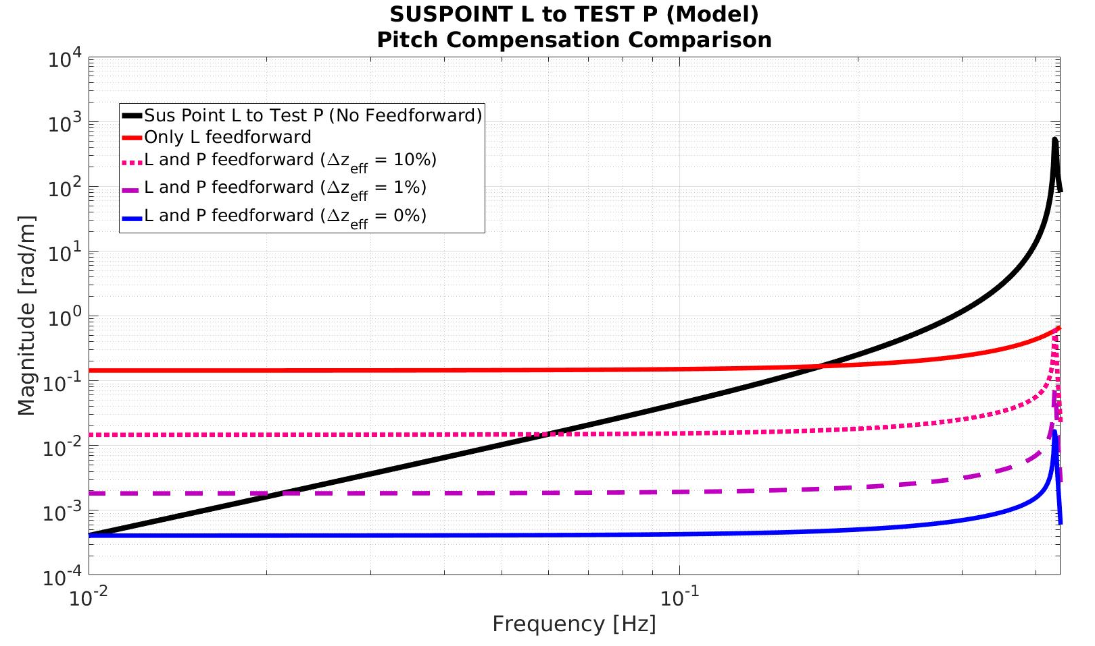

Slide 19
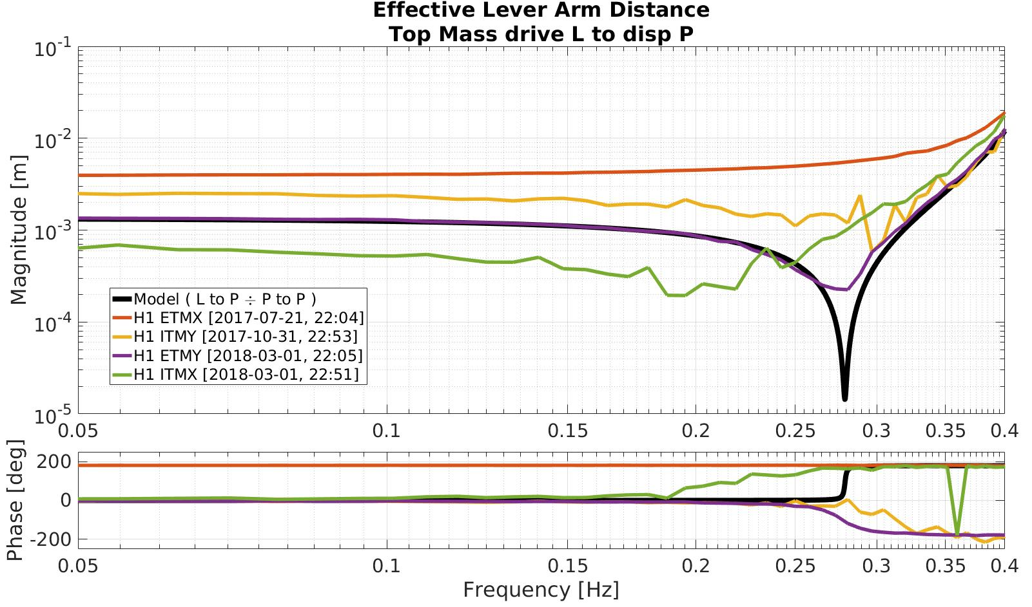

Slide 20
Summary
The sus point GS13 signal can be used to improve DARM from .1 to .3 Hz.
The Feedforward filter cannot ignore the pitch cross coupling at the Top Mass.
It is sufficient to isolate the top mass in L and P to get a similar performance at the test mass.
The L-P coupling cannot be treated with an unified scheme for all QUADs.
If these cross couplings are time dependent, pure Feedforward might be impractical

Slide 21
Next Steps
Study in more detail the possible physical origin of the cross coupling variations across different QUADs.
Evaluate the time dependence of zeff for each individual QUAD using collected data.
Explore the idea of counteracting the torque in the top mass in a different way.

Slide 22
Q & A

Slide 23
Summary
The sus point GS13 signal can be used to improve DARM from .1 to .3 Hz.
The Feedforward filter cannot ignore cross coupling to Pitch at the top mass.
It is enough to isolate the top mass in Length and Pitch
The L-P coupling cannot be treated with an unified scheme for all SUS.
If these cross couplings are time dependent, pure Feedforward might be impractical

Slide 24
Next Steps
Study in more detail the possible physical origin of the cross coupling variations across different QUADs.
Evaluate the time dependence of zeff for each individual QUAD using collected data.
Explore the idea of counteracting the torque in the top mass in a different way.

Slide 25
