Slide 1
Ground-based Gravitational-wave detectors: Plans for the coming decade (and a bit beyond)
HEAD 2020
Chicago 20 March 2018
David Shoemaker
For the LIGO and Virgo Scientific Collaborations

Slide 2
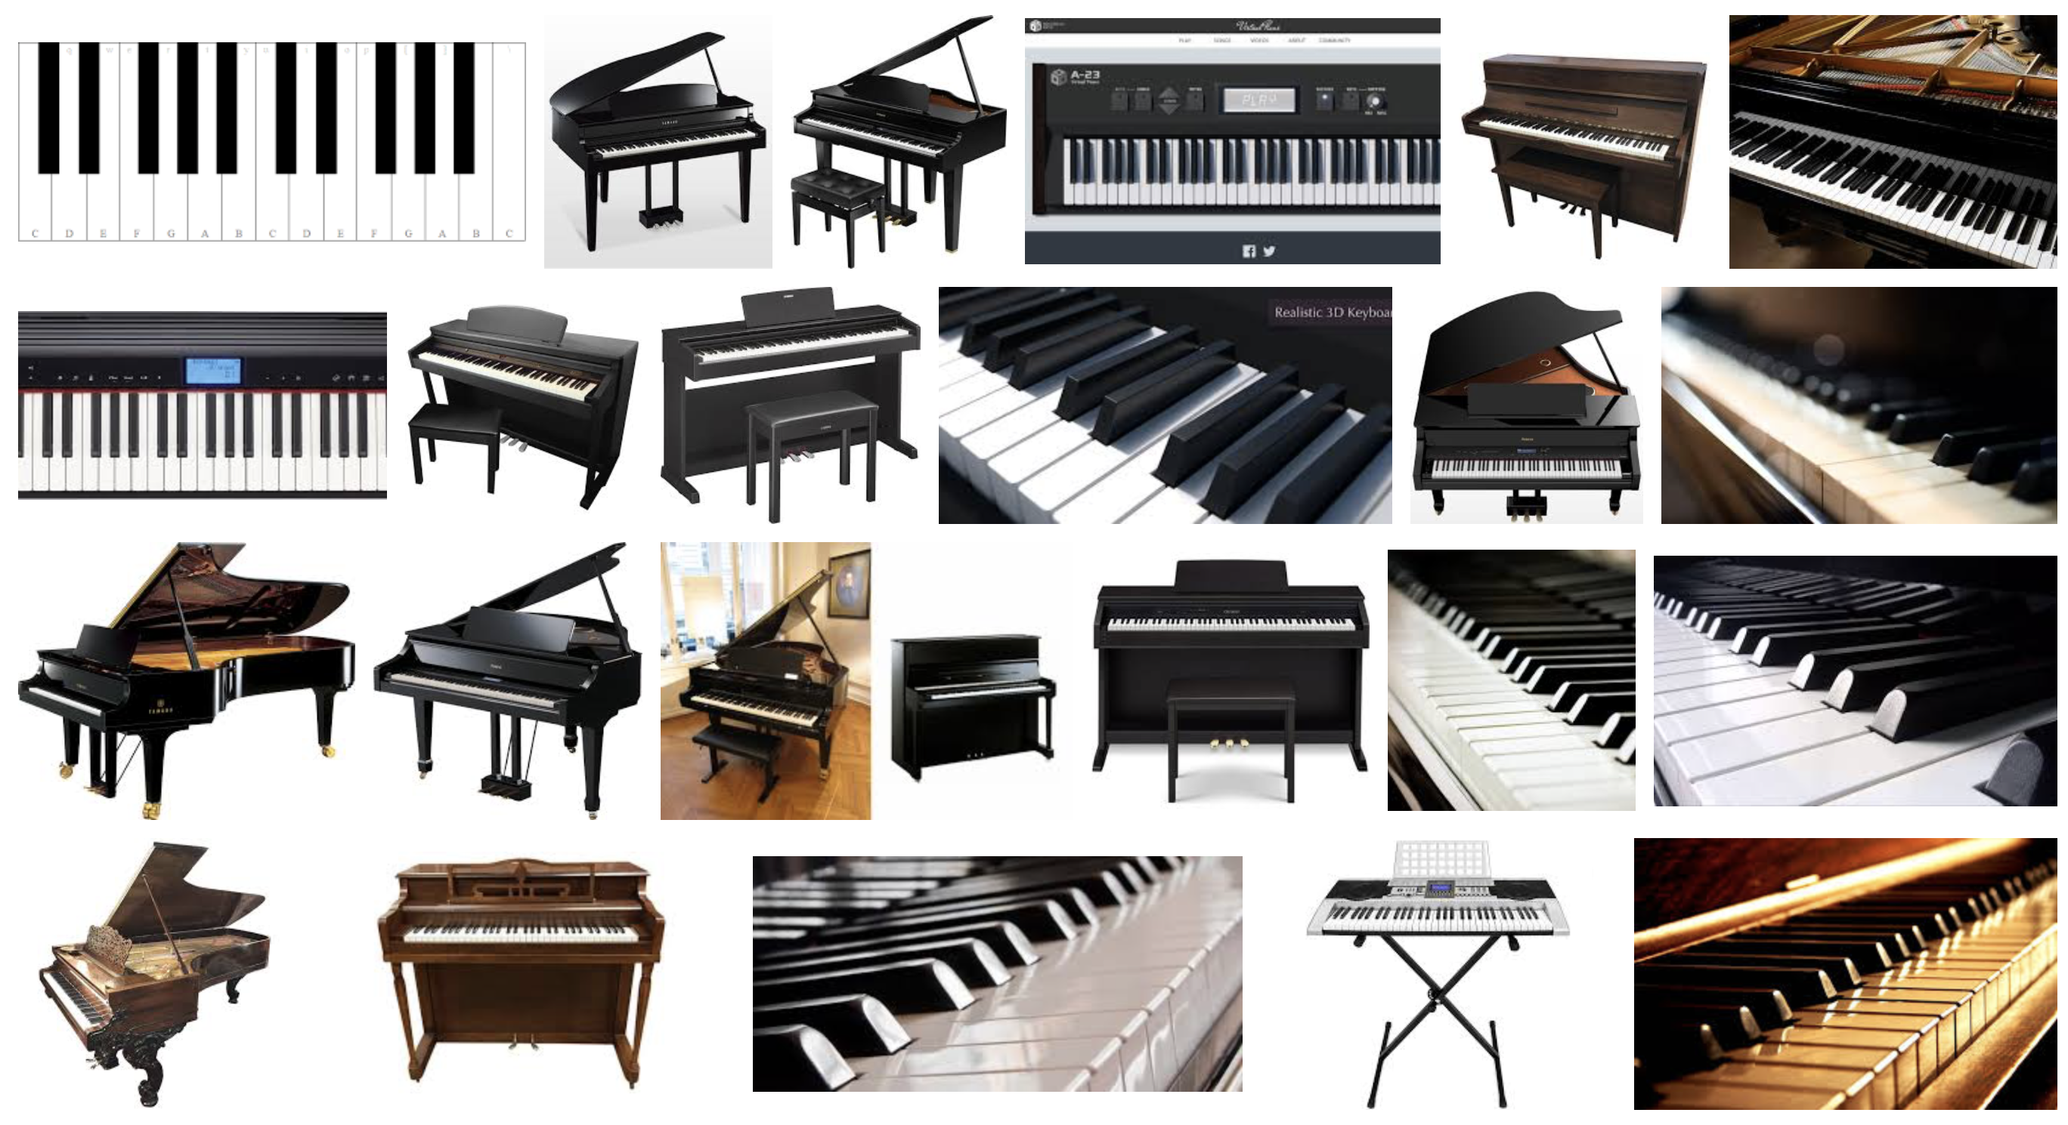

Slide 3
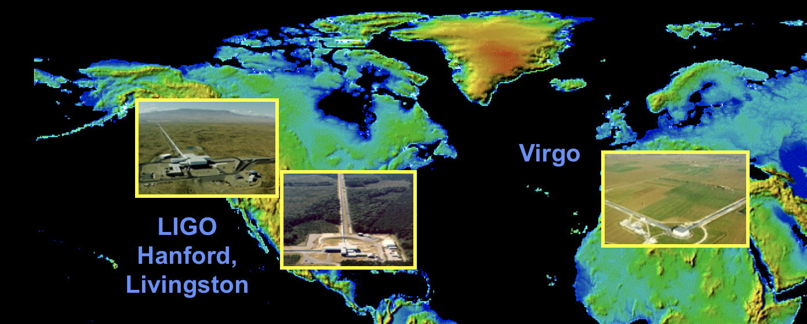
Ground based detectors
Initial observatories, and instruments, constructed starting in mid-90’s
NSF Physics for LIGO; Virgo’s support from CNRS and INFN
Observed, setting upper limits until 2011
Both Virgo and LIGO undertook a complete rework of the instruments
Advanced LIGO came on line in 2015 – First discovery 15 Sept 2015
Advanced Virgo came on line in 2017 – First signal 14 August 2017
….then, on 17 August 2018….

Slide 4
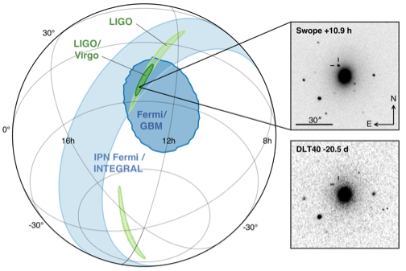
Multimessenger Observations
Approximate timeline:
GW170817 - August 17, 2017 12:41:04 UTC = t₀
GRB 170817A t₀ + 2 sec
LIGO signal found t₀ +6 minutes
LIGO-Virgo GCN reporting BNS signal associated with the time of the GRB t₀ +41 minutes
SkyMap from LIGO-Virgo t₀ + 4 hours
Optical counterpart found t₀ + 11 hours
The localisation region became observable to telescopes in Chile 10 hours after the event time (wait for nightfall!)
Approximately 70 ground- and space- based observatories followed-up on this event
B. P. Abbott, Multi-messenger Observations of a Binary Neutron Star Merger, 2017, ApJL in press. doi:10.3847/2041-8213/aa91c9
6

Slide 5
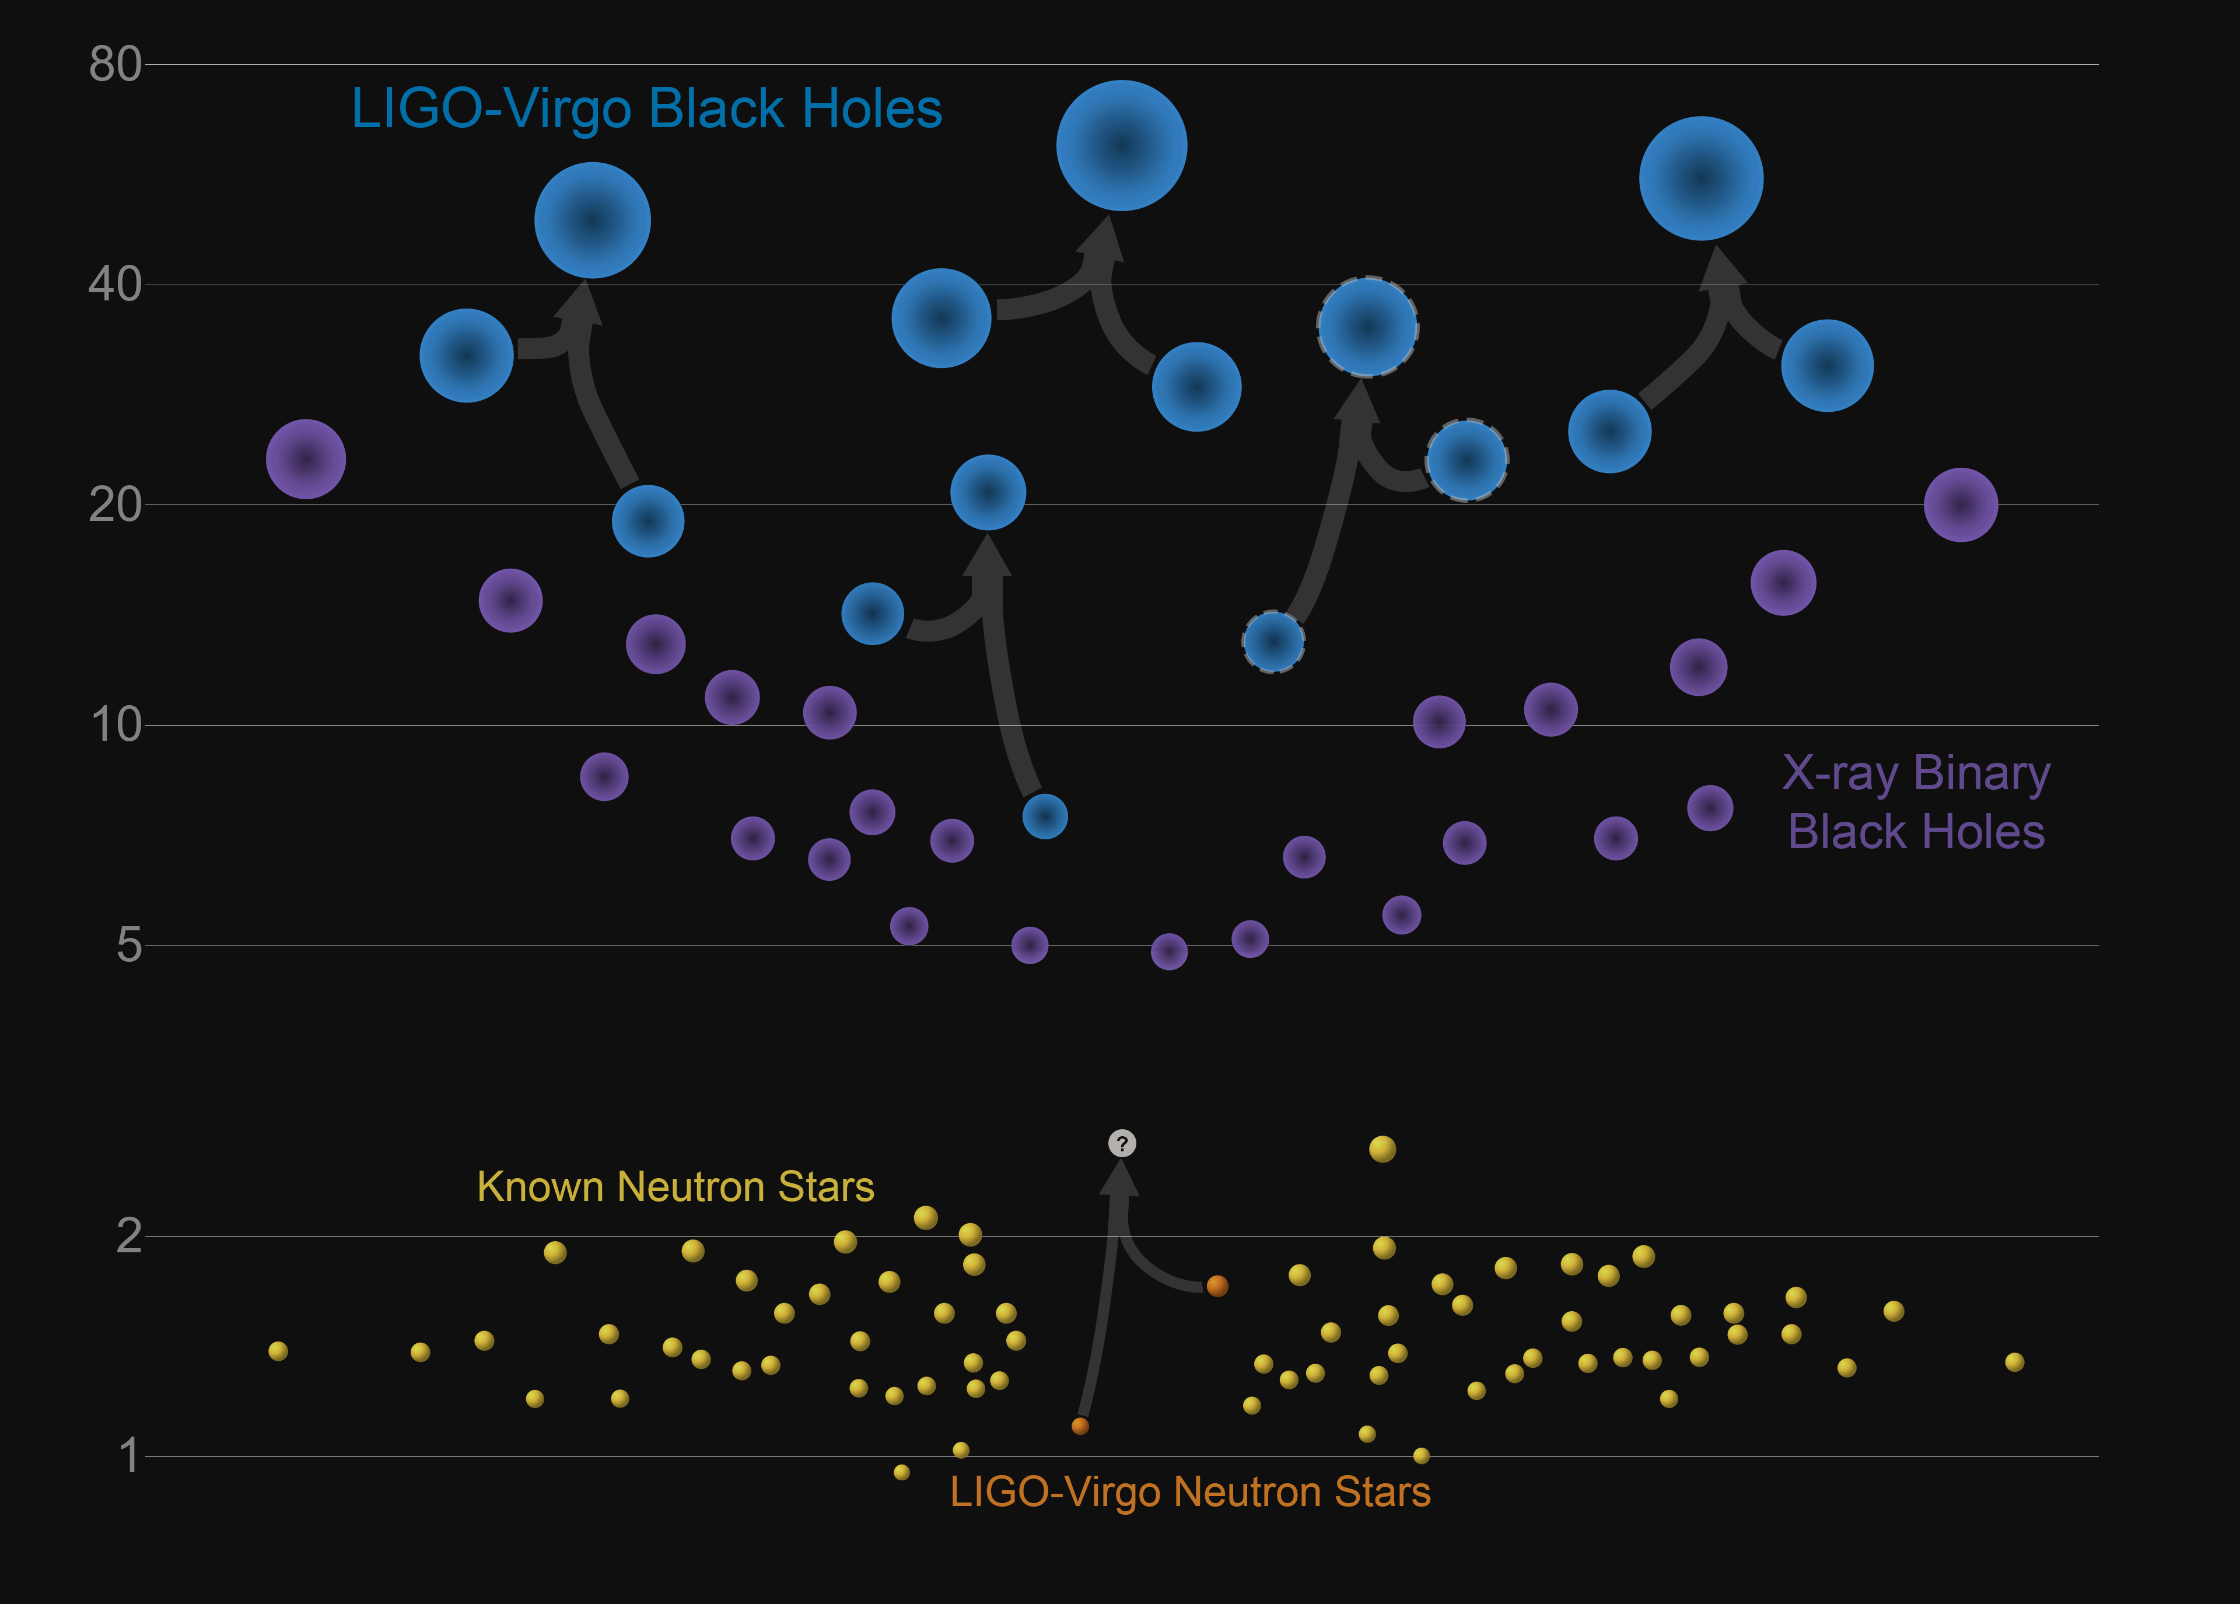
Visual summary of signals to date

Slide 6
Near Future: 2019-20
O2 – The Second Advanced detector Observing Run – was undertaken at 1/3-1/2 of the design sensitivity of the LIGO and Virgo instruments
Currently both LIGO and Virgo improving sensitivity of instruments:
Introduction of higher laser power and use of ‘squeezed light’ (better high frequency performance)
Changes in Virgo Suspension (better low-frequency performance)
Better baffling/scattered light handling (better stationarity)
(for Advanced LIGO, these are undertaken with LIGO Lab Operating funds, and anticipated as part of the commissioning)
Next: ~1 year long O3 run
Start in Winter (late 2018/early 2019)
LIGO with a NS-NS ‘reach’ of ~120 Mpc, Virgo ~65 Mpc
What can we expect from O3? Best guesses:
BBH: Several per month to several per week
BNS: 1 to 10 in the year-long run
NSBH: N=0 not ruled out in any scenario, most give ~50% N>0

Slide 7
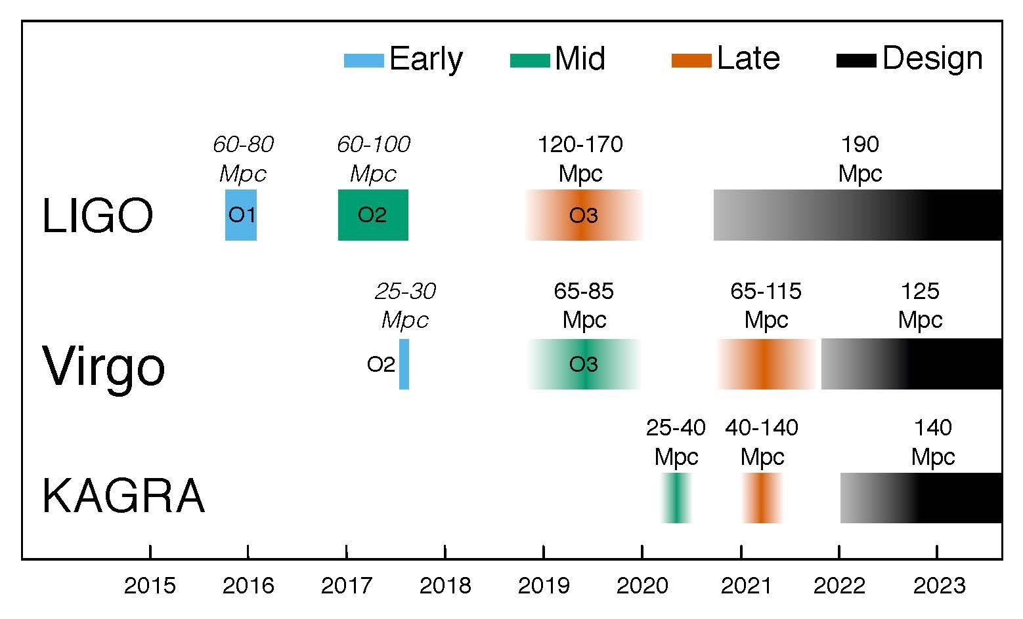
5-year plan

Slide 8
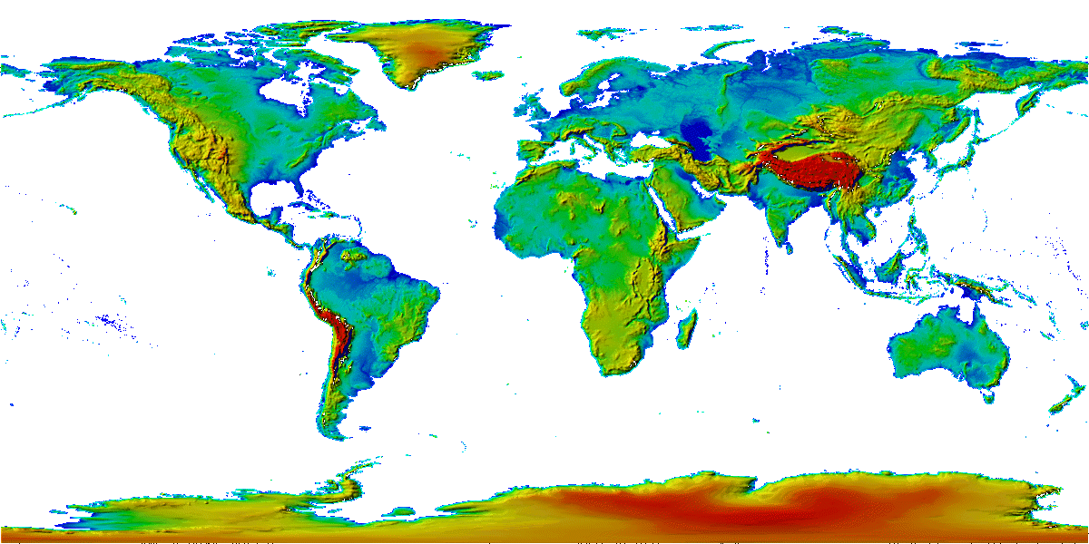
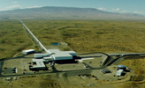
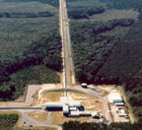
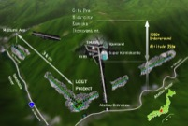
The advanced GW detector network
Advanced
Virgo
2017
Advanced
LIGO
Hanford,
Livingston
2015
KAGRA
2019
LIGO-India
2025
8
8

Slide 9
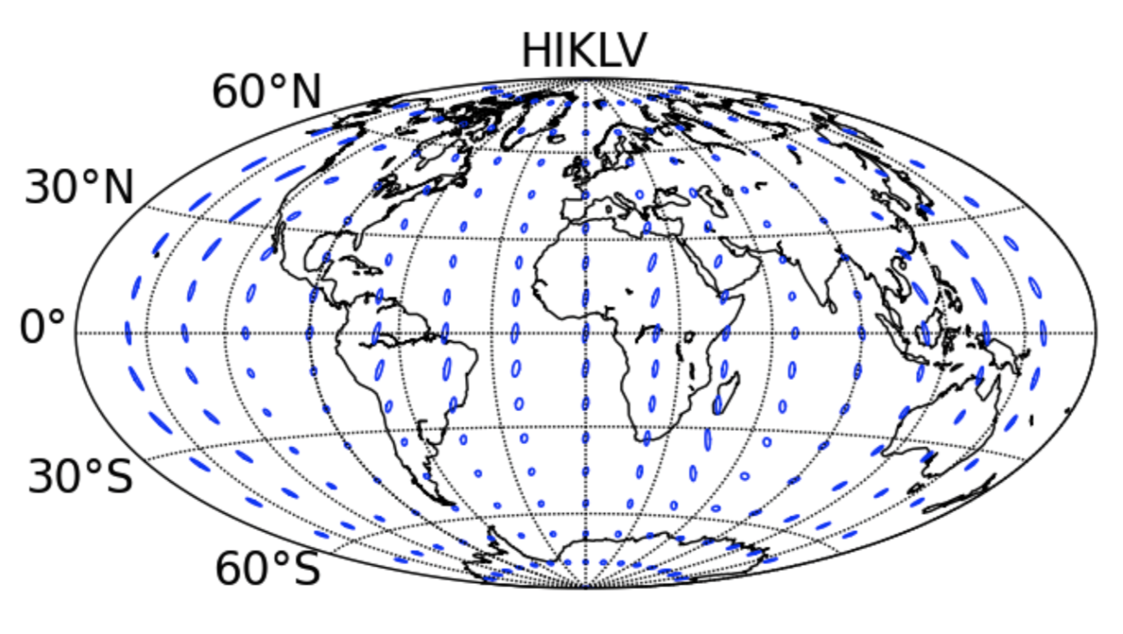
2025 Sensitivity/configuration:
5 detectors (add India and Japan)
far improved source localization
~60% in 10 sq deg
Notes:
P0900125-v8

Slide 10
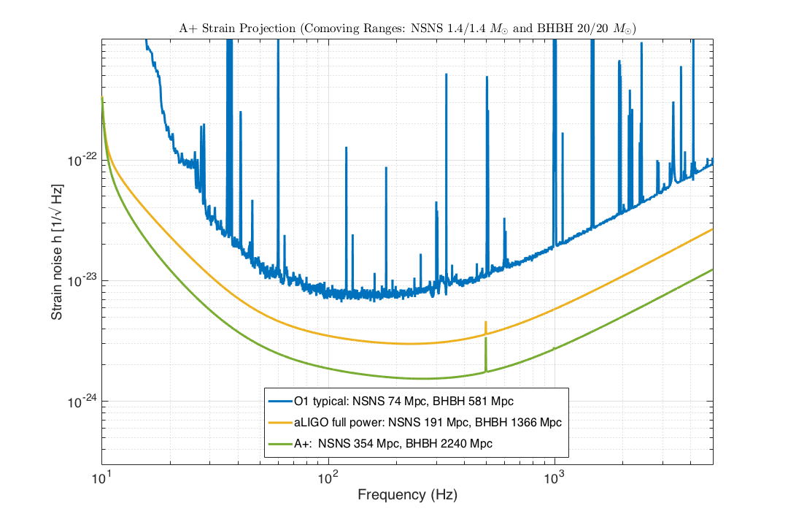
Next LIGO Improvement: A+, ~2024

Slide 11
A+ ‘elevator pitch’
An incremental upgrade to aLIGO that leverages existing technology and infrastructure, with minimal new investment and moderate risk
Target: factor of 1.7 increase in range over aLIGO
About a factor of 5 greater event rate (goes as the cube of sensitivity)
“Scientific breakeven” within 1/2 year of operation
Could be observing within 6-7 years
Incremental cost: a small fraction of aLIGO -- NSF Mid-Scale Project
Requires some technical progress on
High laser power handling
Low optical losses
Lower-mechanical loss optical coatings
(our principal thermal noise source)
Sensitivity offers e.g., NSNS rates of 20-200 in a year observation
Proposal in preparation to NSF Physics and the UK STFC

Slide 12
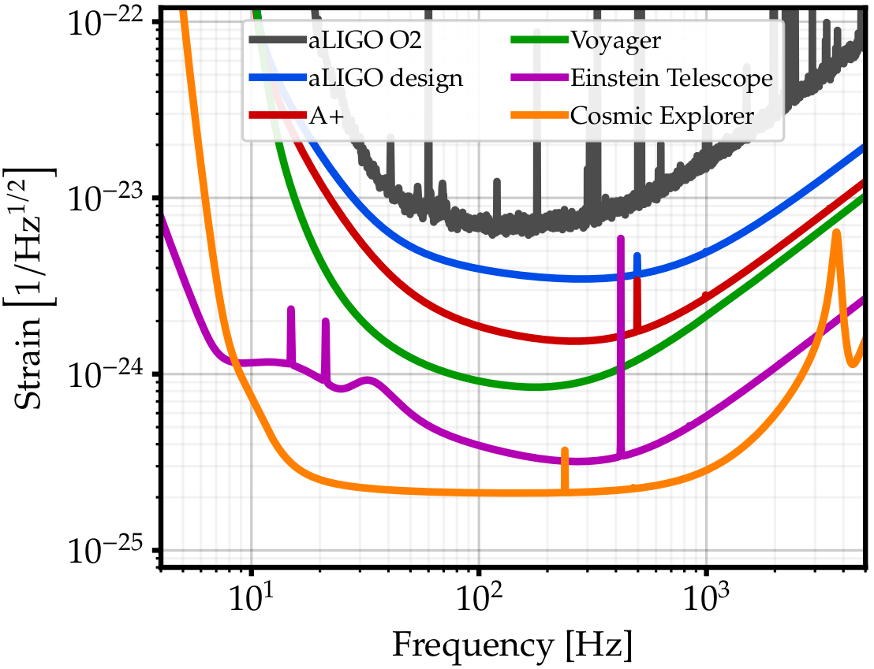
Evolution of detectors
aLIGO, AdV – commission to full sensitivity by early 2020’s
A+, AdV+ – add squeezing, lower thermal noise coatings; ~2024
Voyager – cryogenics to reduce thermal noise; ~2028
..at that point there is no choice but to seek longer arms
→ Einstein Telescope
→ Cosmic Explorer

Slide 13
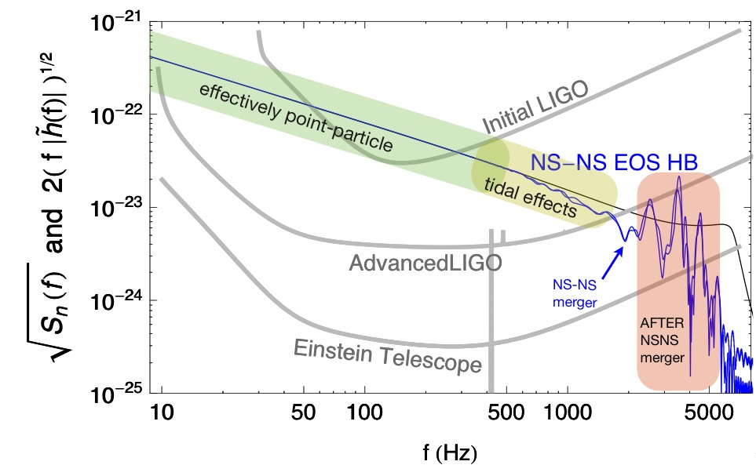
Not just about rates: With sensitivity comes new physics
GW170817 limit
Read, Schmidt, Clark and Lackey, G1700453
Read et al, Phys. Rev. D 88, 044042 (2013)

Slide 14
Not just about rates: With sensitivity comes new physics
Vanilla aLIGO limit
Read, Schmidt, Clark and Lackey, G1700453
Read et al, Phys. Rev. D 88, 044042 (2013)

Slide 15
Not just about rates: With sensitivity comes new physics
3rd Gen limit
Read, Schmidt, Clark and Lackey, G1700453
Read et al, Phys. Rev. D 88, 044042 (2013)

Slide 16
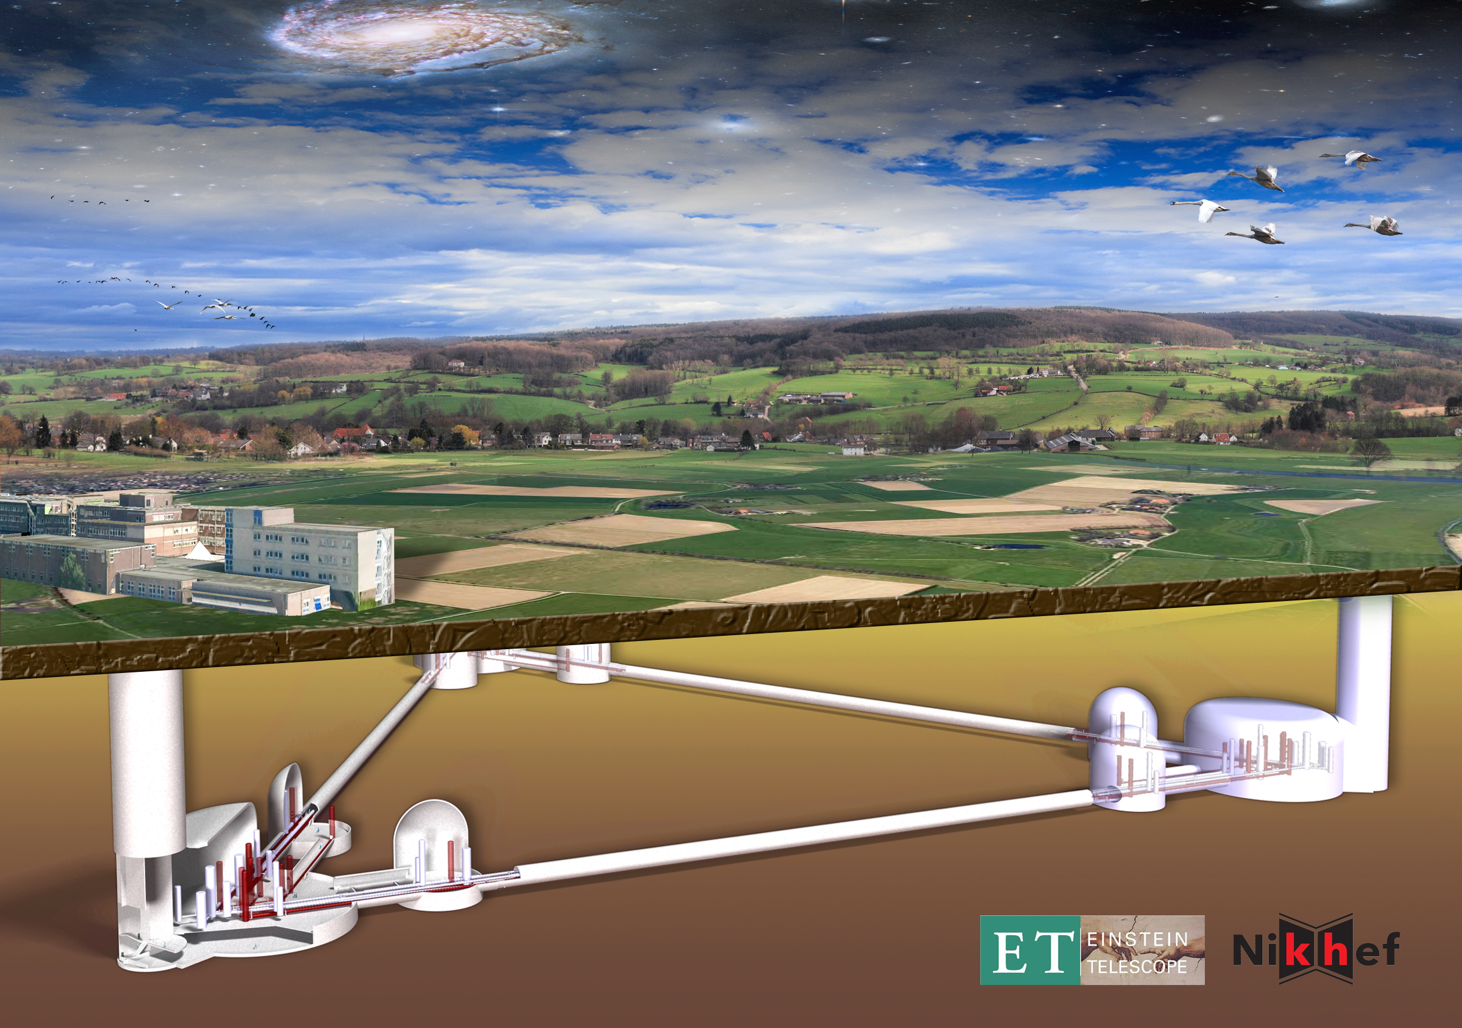
Einstein Telescope
The next gravitational wave observatory
Coordinated effort with US to realize a
worldwide 3G network …
Conceptual Design Study

Slide 17
Another Concept: Make Advanced LIGO 10x longer,
10x more sensitive
Signal grows with length – not most noise sources
Thermal noise, radiation pressure, seismic, Newtonian unchanged
Coating thermal noise improves faster than linearly with length
40km surface Observatory ‘toy’ baseline
can still find sites, earthmoving feasible; costs another limit…
Concept offers sensitivity without new measurement challenges; could start at room temperature, modest laser power, etc.
Sigg et. al

Slide 18
3rd Generation
When could this new wave of ground instruments come into play?
Appears 15 years from t=0 is a feasible baseline
Initial LIGO: 1989 proposal, and at design sensitivity 2005
Advanced LIGO: 1999 White Paper, GW150914 in 2015
Modulo funding, could envision 2030’s
Should hope – and strive and plan – to have great instruments ready to ‘catch’ the end phase of binaries seen in LISA (ref. Sesana)
Worldwide community working together on concepts and the best observatory configuration for the science targets
Crucial for all these endeavors: to expand the scientific community planning on exploiting these instruments far beyond the GR/GW enclave
Costs are like TMT/GMT/ELT – needs a comparable audience
Events like GW170817 help!

Slide 19
Just the beginning of a new field –
new instruments, new discoveries, new synergies
LIGO/Virgo
LISA
Pulsar Timing Array
Cosmology Probes

Slide 20
Summary on Future planning
All ground-based interferometric detectors planning on working together – LIGO, LIGO-India, Virgo, KAGRA
Sharing data, analysis development and execution
Sharing instrument science technology development
Coordinating on observing and upgrade schedules
Will share events via public alerts (GCN) with low latency to enable effective followup by EM/neutrino observers, Maximizing the joint MMA science
Incremental funding enables incremental improvements for the next decade
GWIC – the Gravitational Wave International Committee – coordinating development of ‘3rd Generation’ instrument concepts and approaches
Explicitly global to ensure the best science, and best use of resources
Refinement of the science case currently underway
Governance models being explored
Will look for support from the EM/neutrino Observers when seeking funding for major new infrastructures and instruments
Expect the GW Field to be a growing and reliable partner for EM and neutrino observatories and observers

