Slide 1
Virgo and LIGO Detector Progress towards O3
Brian O’Reilly
Alessio Rocchi
LV-EM Town Hall Meeting
March 16 2018

Slide 2
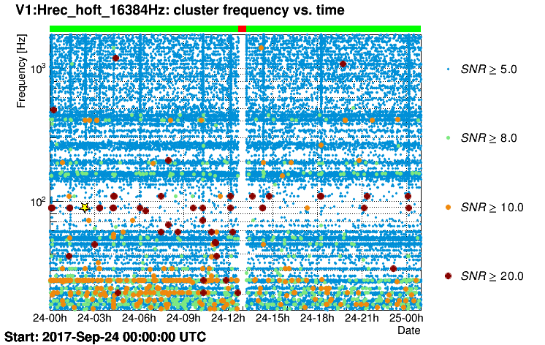
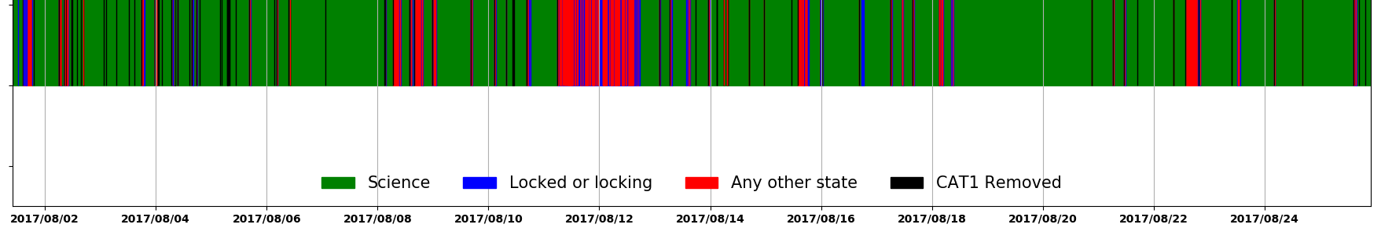
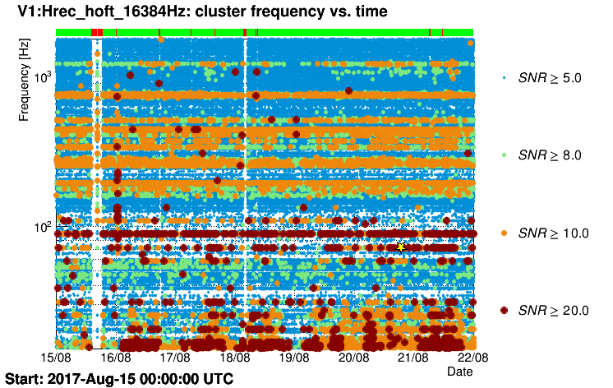
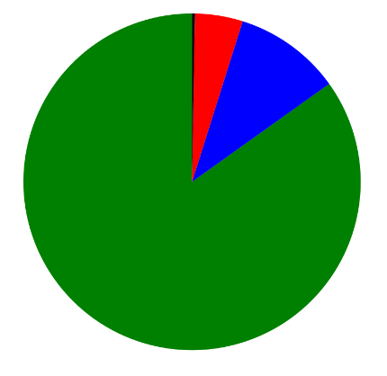
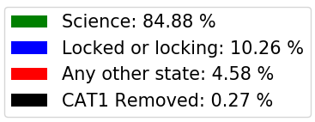
Status of Advanced Virgo
Time towards O3 shared between commissioning and installation of upgrades:
  Commissioning activities after O2 focused on ITF configuration finalization;
  Some progress on sensitivity, with overall reduction of glitch rate;
  Installation of upgrades:
    Monolithic suspensions;
    High power laser;
    Frequency independent squeezing source: in collaboration with AEI.
After O2
During O2
Longest data stretch: 69 hrs;
BNS range up to 28 Mpc;
Science duty cycle: 85%.

Slide 3
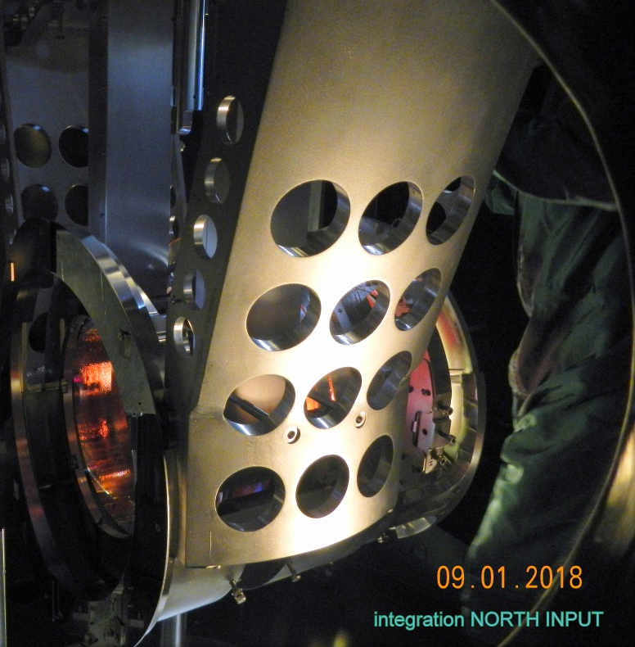
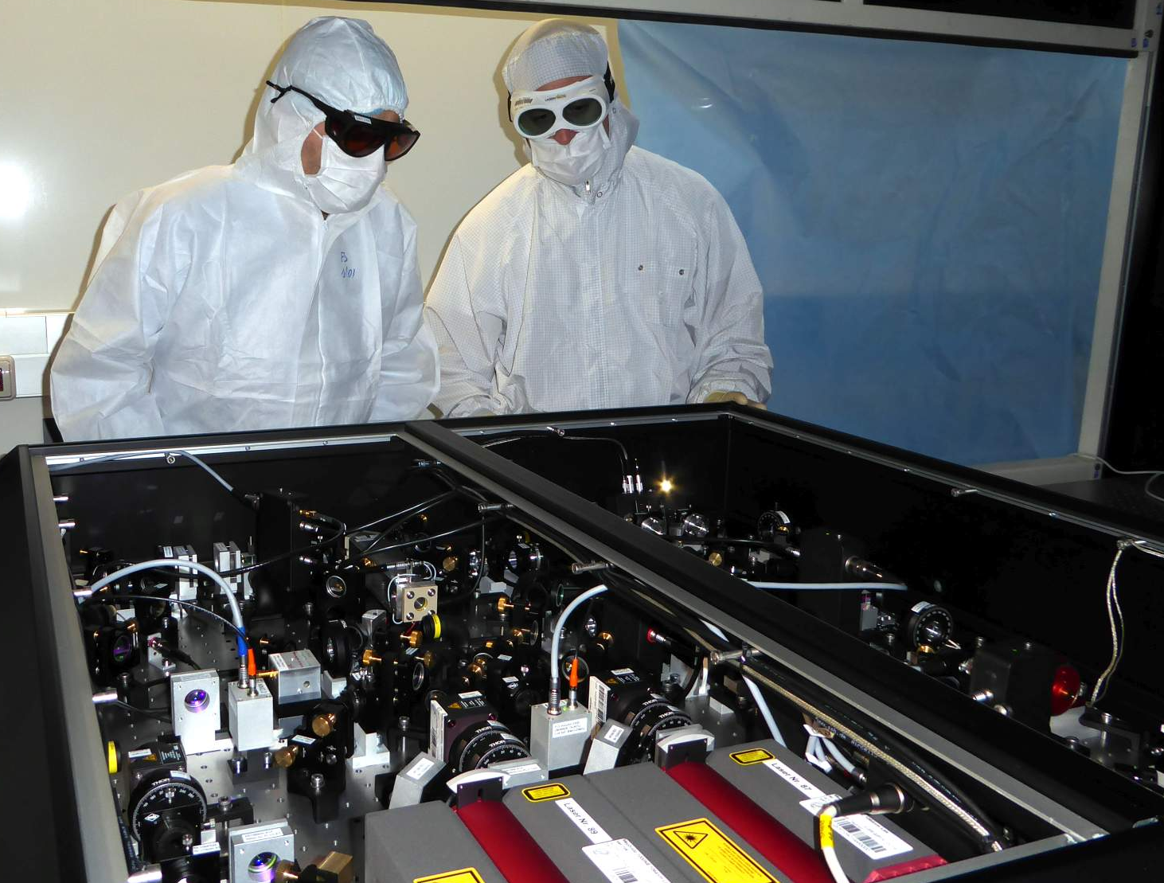
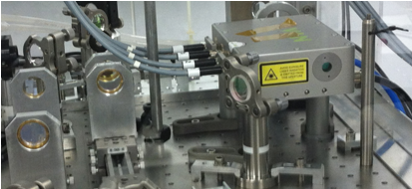
Main upgrades: Nov 2017-Mar 2018
All test masses suspended with fused silica fibers;
Will boost the low frequency sensitivity.
The AEI squeezer installed in the DET lab
On-site measured squeezing: around 10 dB;
Improves high frequency sensitivity.
New high power laser amplifier: delivers up to 60 W to the ITF;
New monolithic pre-mode-cleaner.
The 100W amplifier on the laser bench

Slide 4
Commissioning and upgrades
General plan of the commissioning (at least up to end of June):
  First problem solving activities;
  Increase of input power (mitigate possible Parametric Instabilities);
  Commission squeezed light source;
Engineering runs possibly starting from end of April.
Sep | Oct | Nov | Dec | Jan | Feb | March | April | May | June
Commissioning
Installation of upgrades
Commissioning
March | April | May | June
Recovery + calibration
Improve detector configuration, re-measure noise couplings, Optical Characterization
Input power increase, mitigate parametric instabilities, TCS
Commissioning of FI squeezing

Slide 5
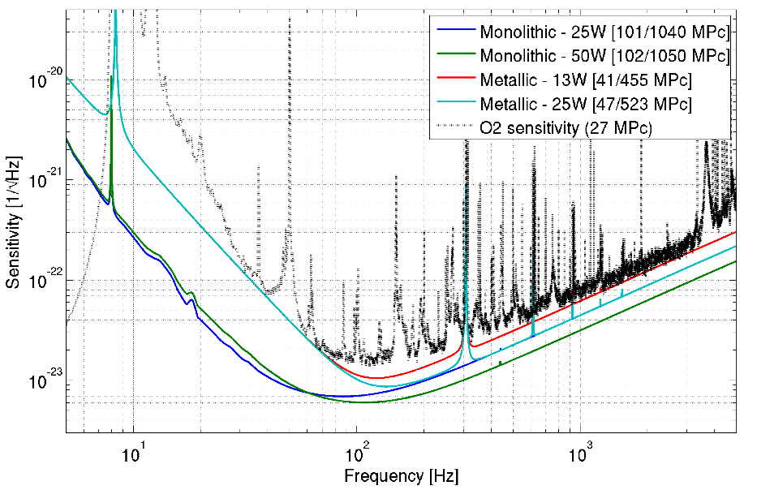
O3 sensitivity target
Target BNS range: between 60 and 85 Mpc;
Upgrades promise a boost of the frequency sensitivity at all frequencies;
Goal for ITF input power set at 50 W: not much effect on BNS (or BBH) range, improves SNR of last inspiral cycles and merger;
Commissioning of the full ITF to restart on March 19th;
Virgo ER plans: starting from end of April (if ITF status allows), one per month, during the weekends;

Slide 6
Post O2 Installation and Commissioning
LLO
Relock full interferometer
GV repair, chevron baffles
Scattered Light.
OFI actuator.
Active MM
Squeezed light installation
Prep
Scattered Light.
New SRM.
70W Amp.
Commissioning:
Squeezed Light Higher Power
Scattered Light
Commissioning
Commissioning
ETMX AMD Test
ETM & ERM replacement
O2 end
Sep
Oct
Nov
Dec
Jan
Feb
Mar
Apr
May
Jun
Prep
Replace ITMX, Scattered Light Baffles, New SRM, SR3 heater.
Squeezed light upgrade
X-arm
70 W Amp.
Commissioning
ERM & ETM replacement
Cryo-pump decommissioning, chevron baffles
LHO
Virgo Commissioning
6

Slide 7
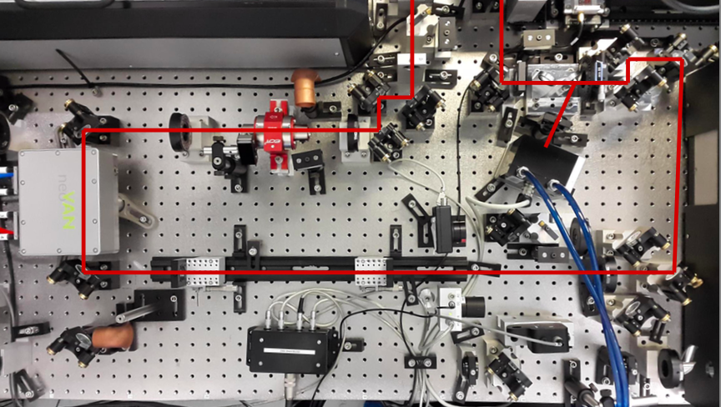
70 W Amplifier
Installed Fall 2017 at LLO
Currently providing up to 50
Installed March 2018 at LHO
2 W
NPRO
35W amp
~ 50 W
35 W
pre
mode
cleaner
70W amp
70 W

Slide 8
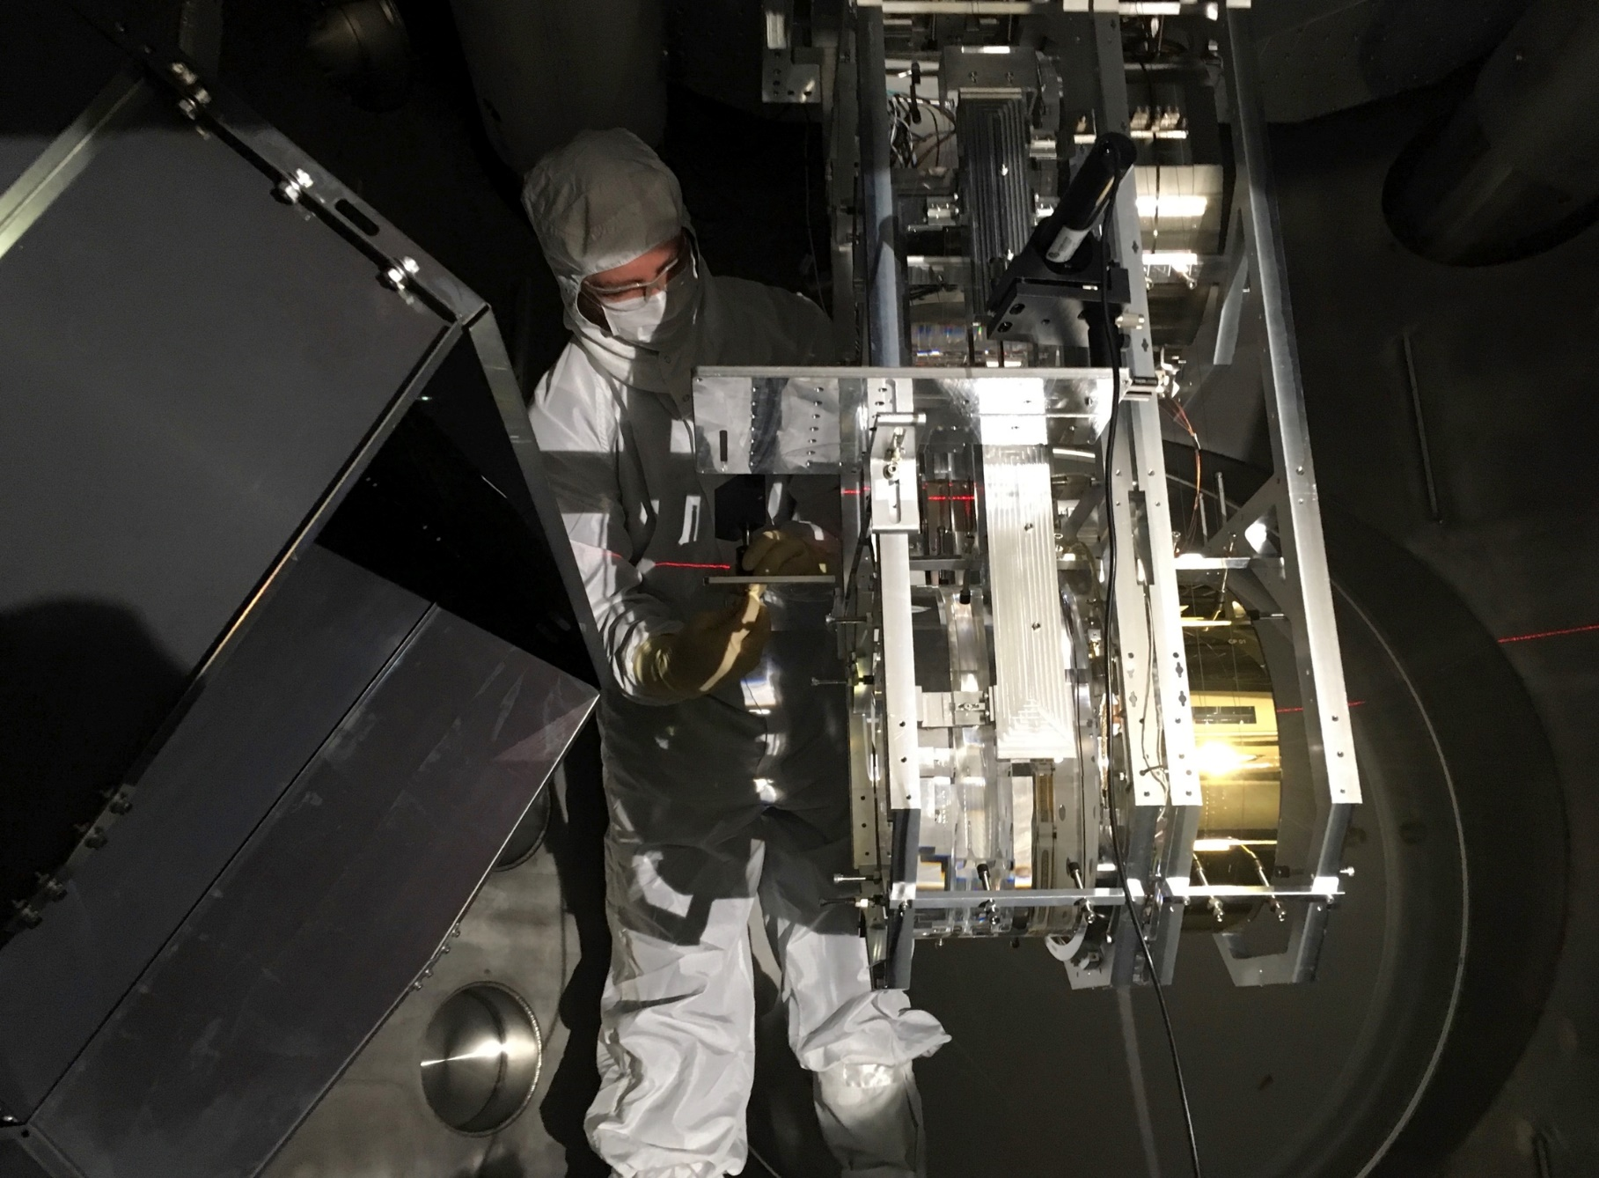
ITMX Replacement
A point absorber was found on the HR
side of H1 ITMX during the May 2017 Vent.
Cleaning was unsuccessful.
Optic replaced in September 2017
Affected ability of H1 to operate at higher
power.

Slide 9
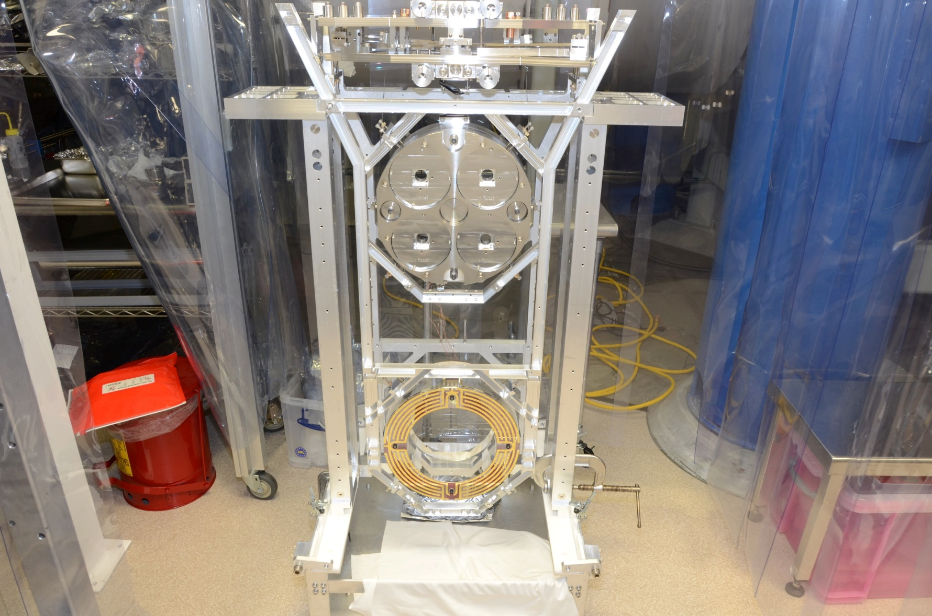
ERM and ETM Replacement
Hope to reduce residual gas damping noise
by a factor of 2.5
This is a significant noise source at LLO
below ~60 Hz

Slide 10
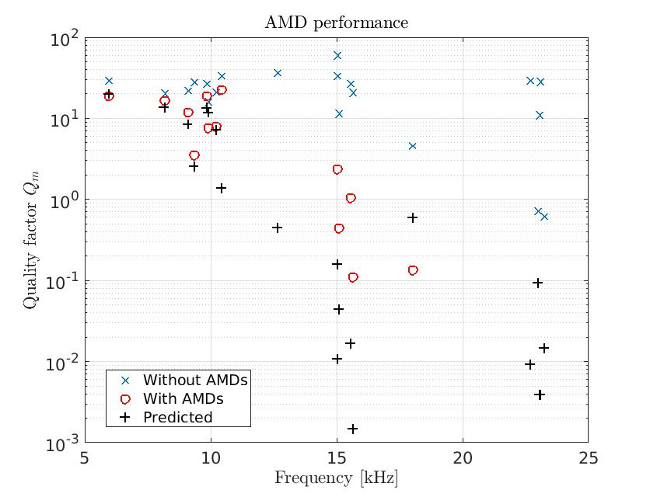
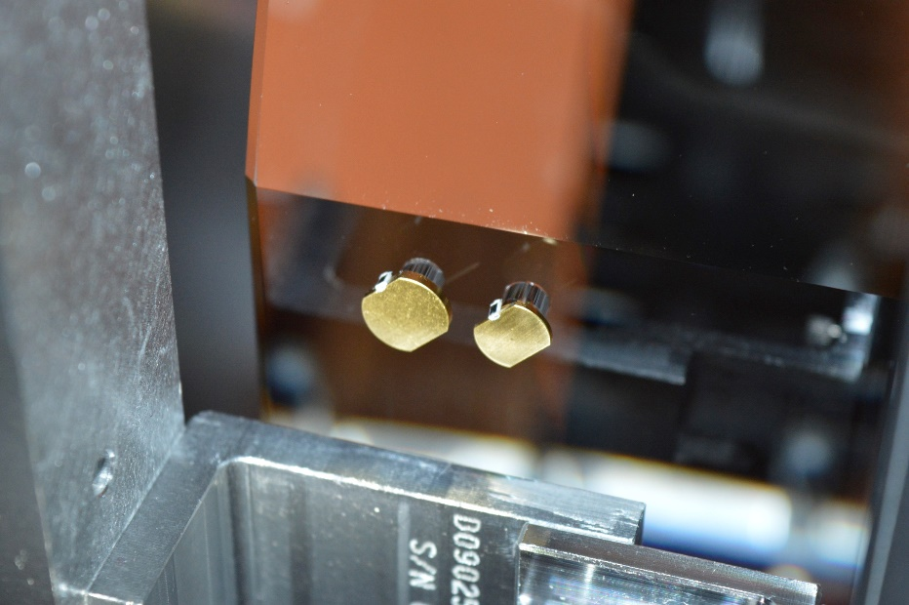
Acoustic Mode Dampers
Passively damp mechanical modes of the
Test Mass
Mitigate Parametric Instabilities.

Slide 11
Squeezing
First promising test of squeezing injection at LLO:
  ~15% shot noise reduction
  improvement visible down to 70 Hz
  target is 40% shot noise reduction for O3

Slide 12
Status
Higher Power: 70 W Amplifier works, now working on stable operation.
Squeezing: Much work yet to do but early results are very promising.
Acoustic Mass Dampers: Promising results from test at LLO.
ETM and ERM Replacement: In progress, ETMY and ERMY at H1 already done.
Scattered Light: Lots of new baffles to absorb scattered light. This is very much a work in progress.
Optimistic that we will reach our O3 goal of 120 Mpc BNS range.
12

Slide 13
Noise Projection
(luminosity distance)
13

Slide 14
Engineering Runs
Virgo: Starting from end of April will attempt to have an ER once per month if instrument status allows.
LIGO Instruments may join starting in June/July.
Possibly a longer ER if progress permits.
Best effort to distribute alerts during this phase.
Will inform LV-EM mailing list of upcoming short Engineering Runs.

Slide 15
O3
O3 will be preceded by a month-long Engineering Run.
Best guess is Engineering Run October/November 2018.
O3 anticipated to start towards end of 2018 and last for one calendar year.
Much progress has been made, much remains to be done…
We are Optimistic

Slide 16
Extra Slides

Slide 17
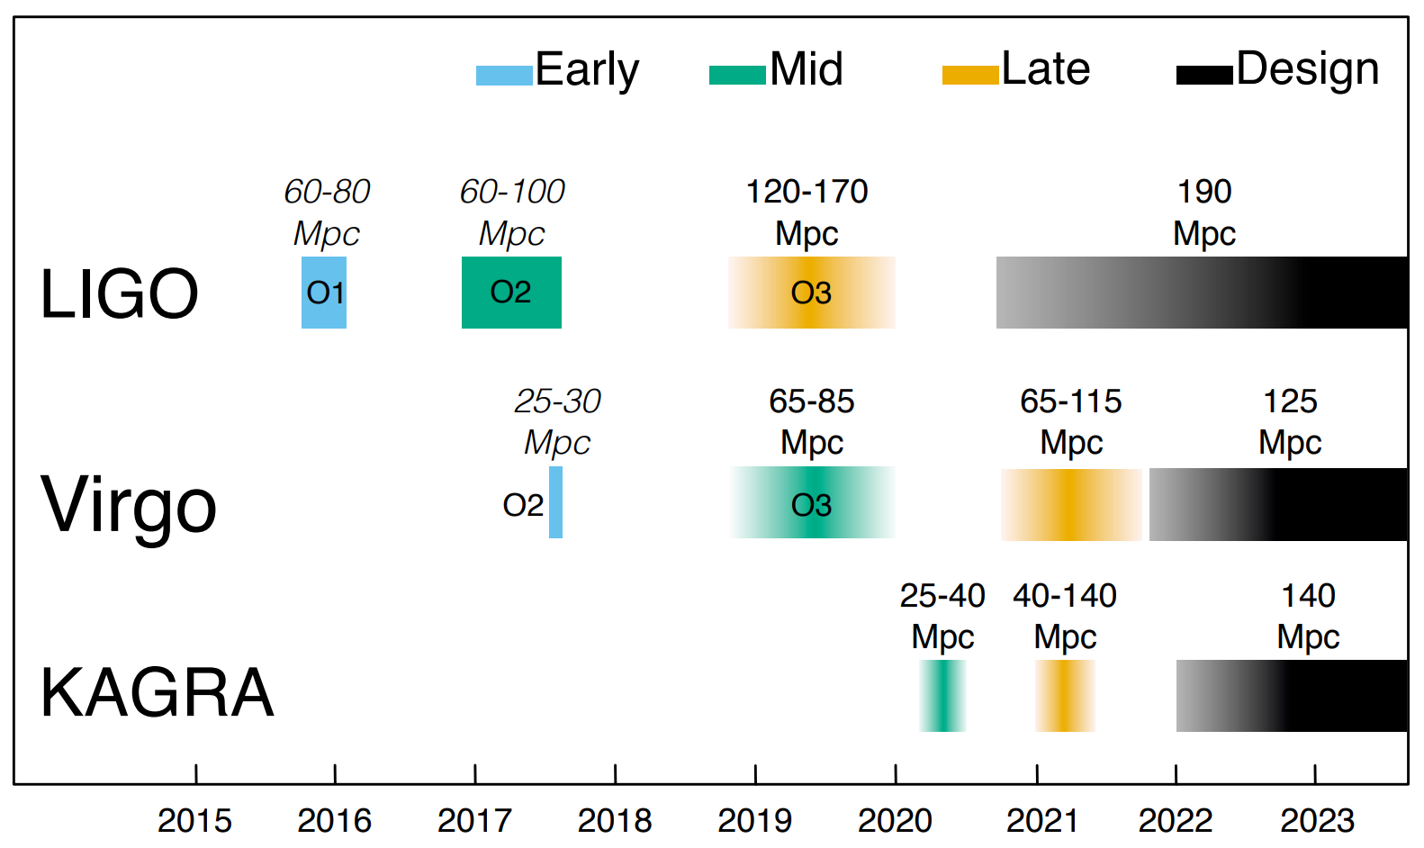
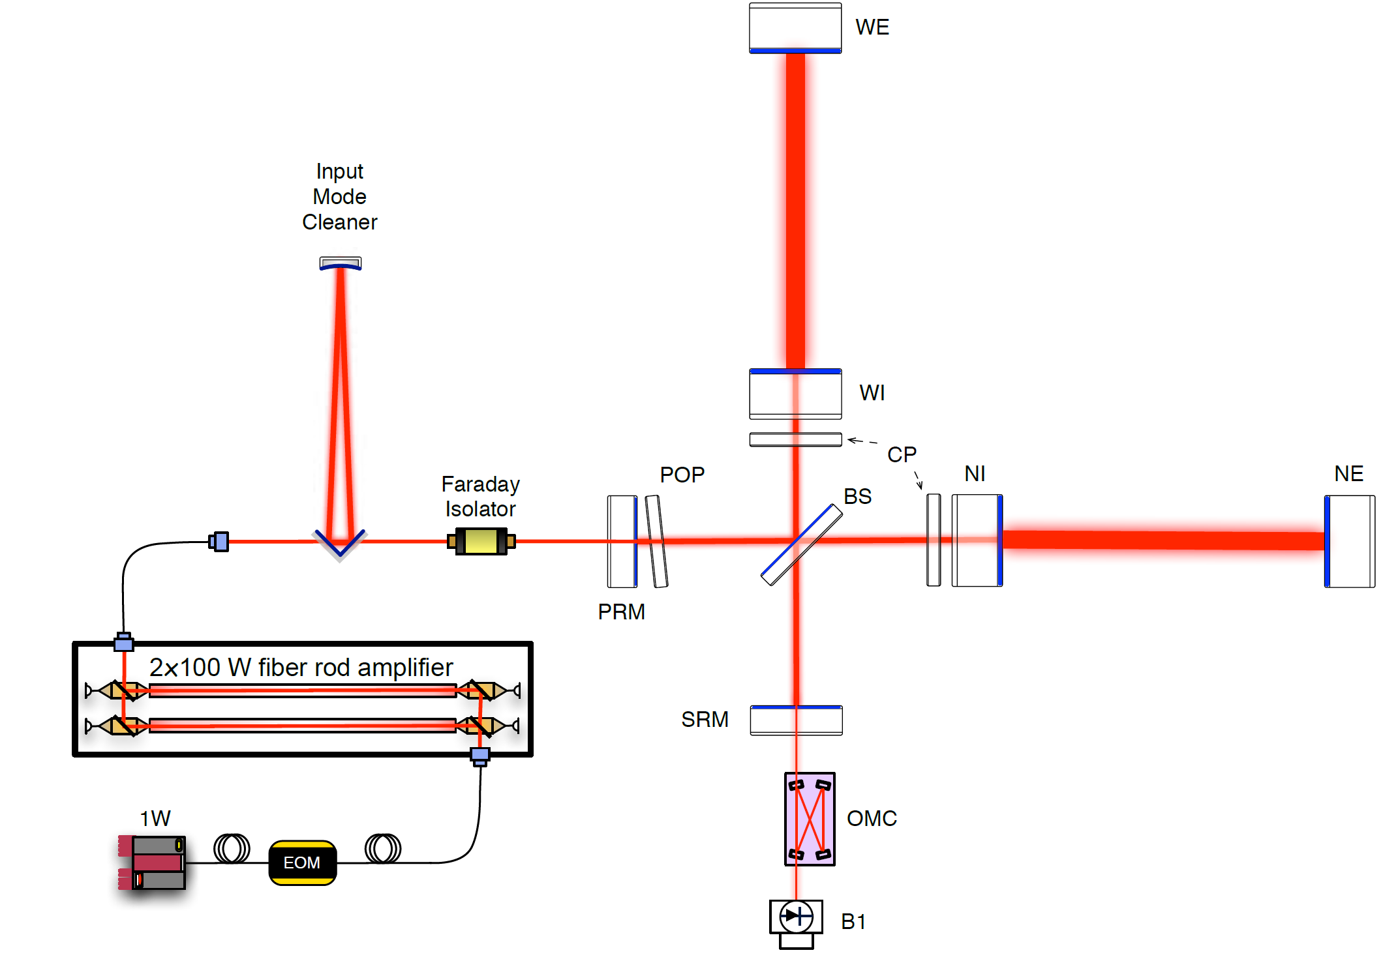
Plans for O4 (2021)
Install further upgrades:
  Signal recycling mirror;
  Input power increase to 125 W;
Expected range for BNS in the range 100’s Mpc;

Slide 18
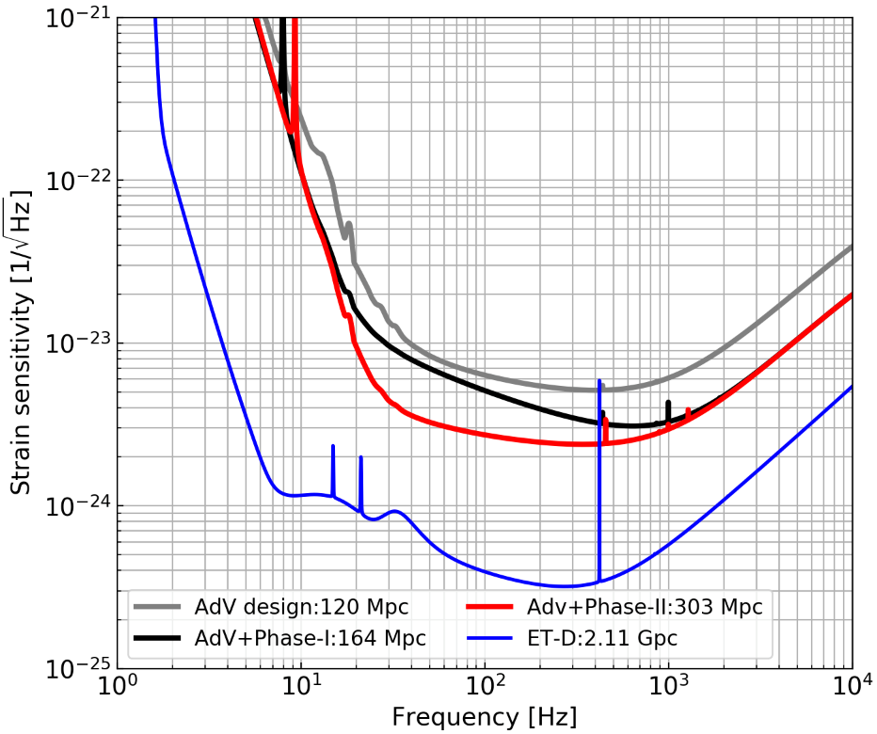
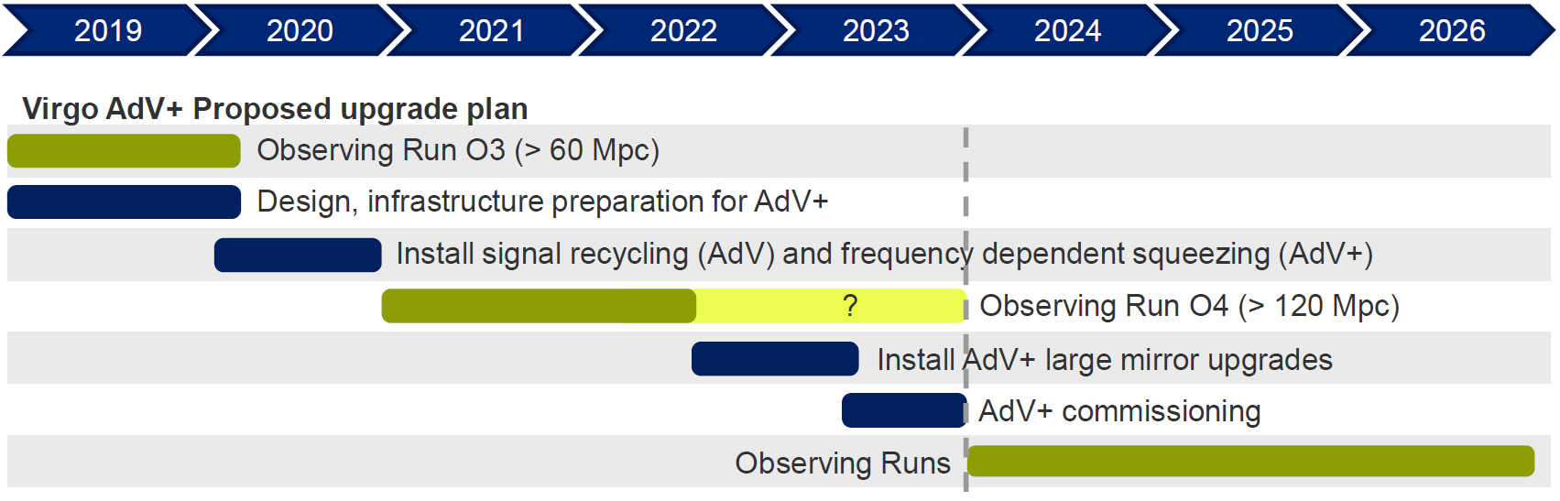
Beyond Advanced Virgo: AdV+
Major upgrade to fully exploit the current infrastructure;
Two distinct phases:
  Phase-I in time for O4;
  Installation of frequency dependent squeezing and reduction of low frequency fundamental noise;
  Phase-II, major upgrade with replacement of test masses with heavier ones to reduce thermal noise;
Expected multi-messenger event rates per year:
  BNS: 36-540;
  NSBH: 0.7-1010;
Proposal submitted to funding agencies.

