Slide 1
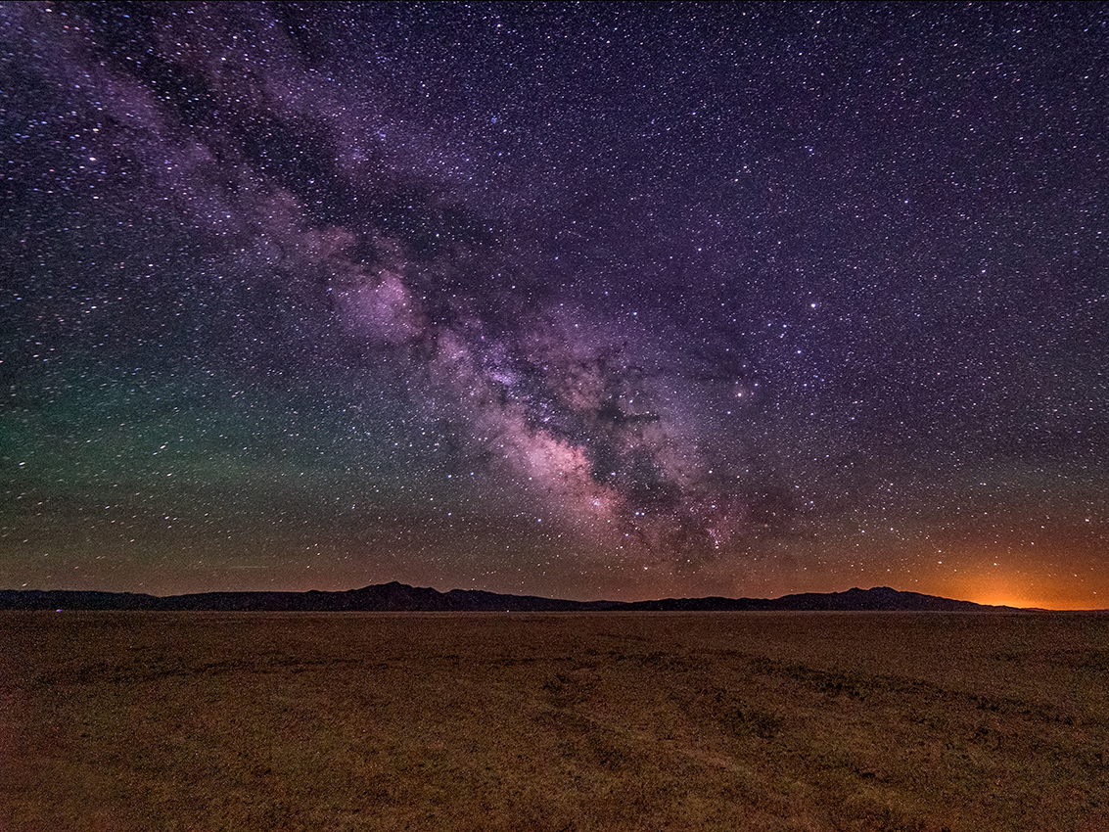
Future Observatories
Panelists: Barry Barish (Caltech)
Matthew Evans (MIT)
Evan Hall (MIT)
David Reitze (Caltech)
Chair: Lisa Barsotti (MIT)

Slide 2
The GW world-wide network
The present:
Advanced LIGO, Advanced Virgo: 2nd generation detectors (2G)
The near future:
Kagra: 2G detector, pioneering 3G technologies
LIGO-INDIA
The future:
Improved detectors in current facilities (A+, Voyager, …):
3G technologies in 2G facilities = 2.5G
Length and shape constrained by existing facilities
New detectors in new facilities (3G)
Einstein Telescope concept, Cosmic Explorer concept

Slide 3
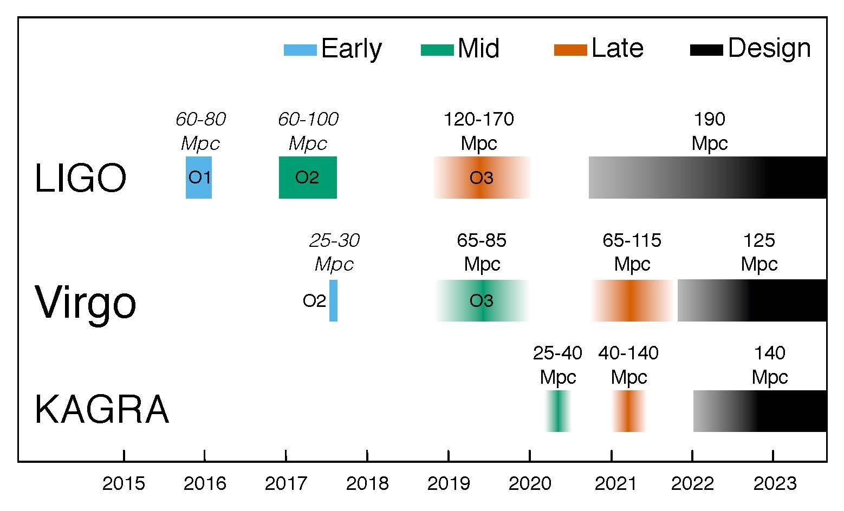
LIGO-VIRGO-KAGRA Observing plan
https://arxiv.org/abs/1304.0670

Slide 4
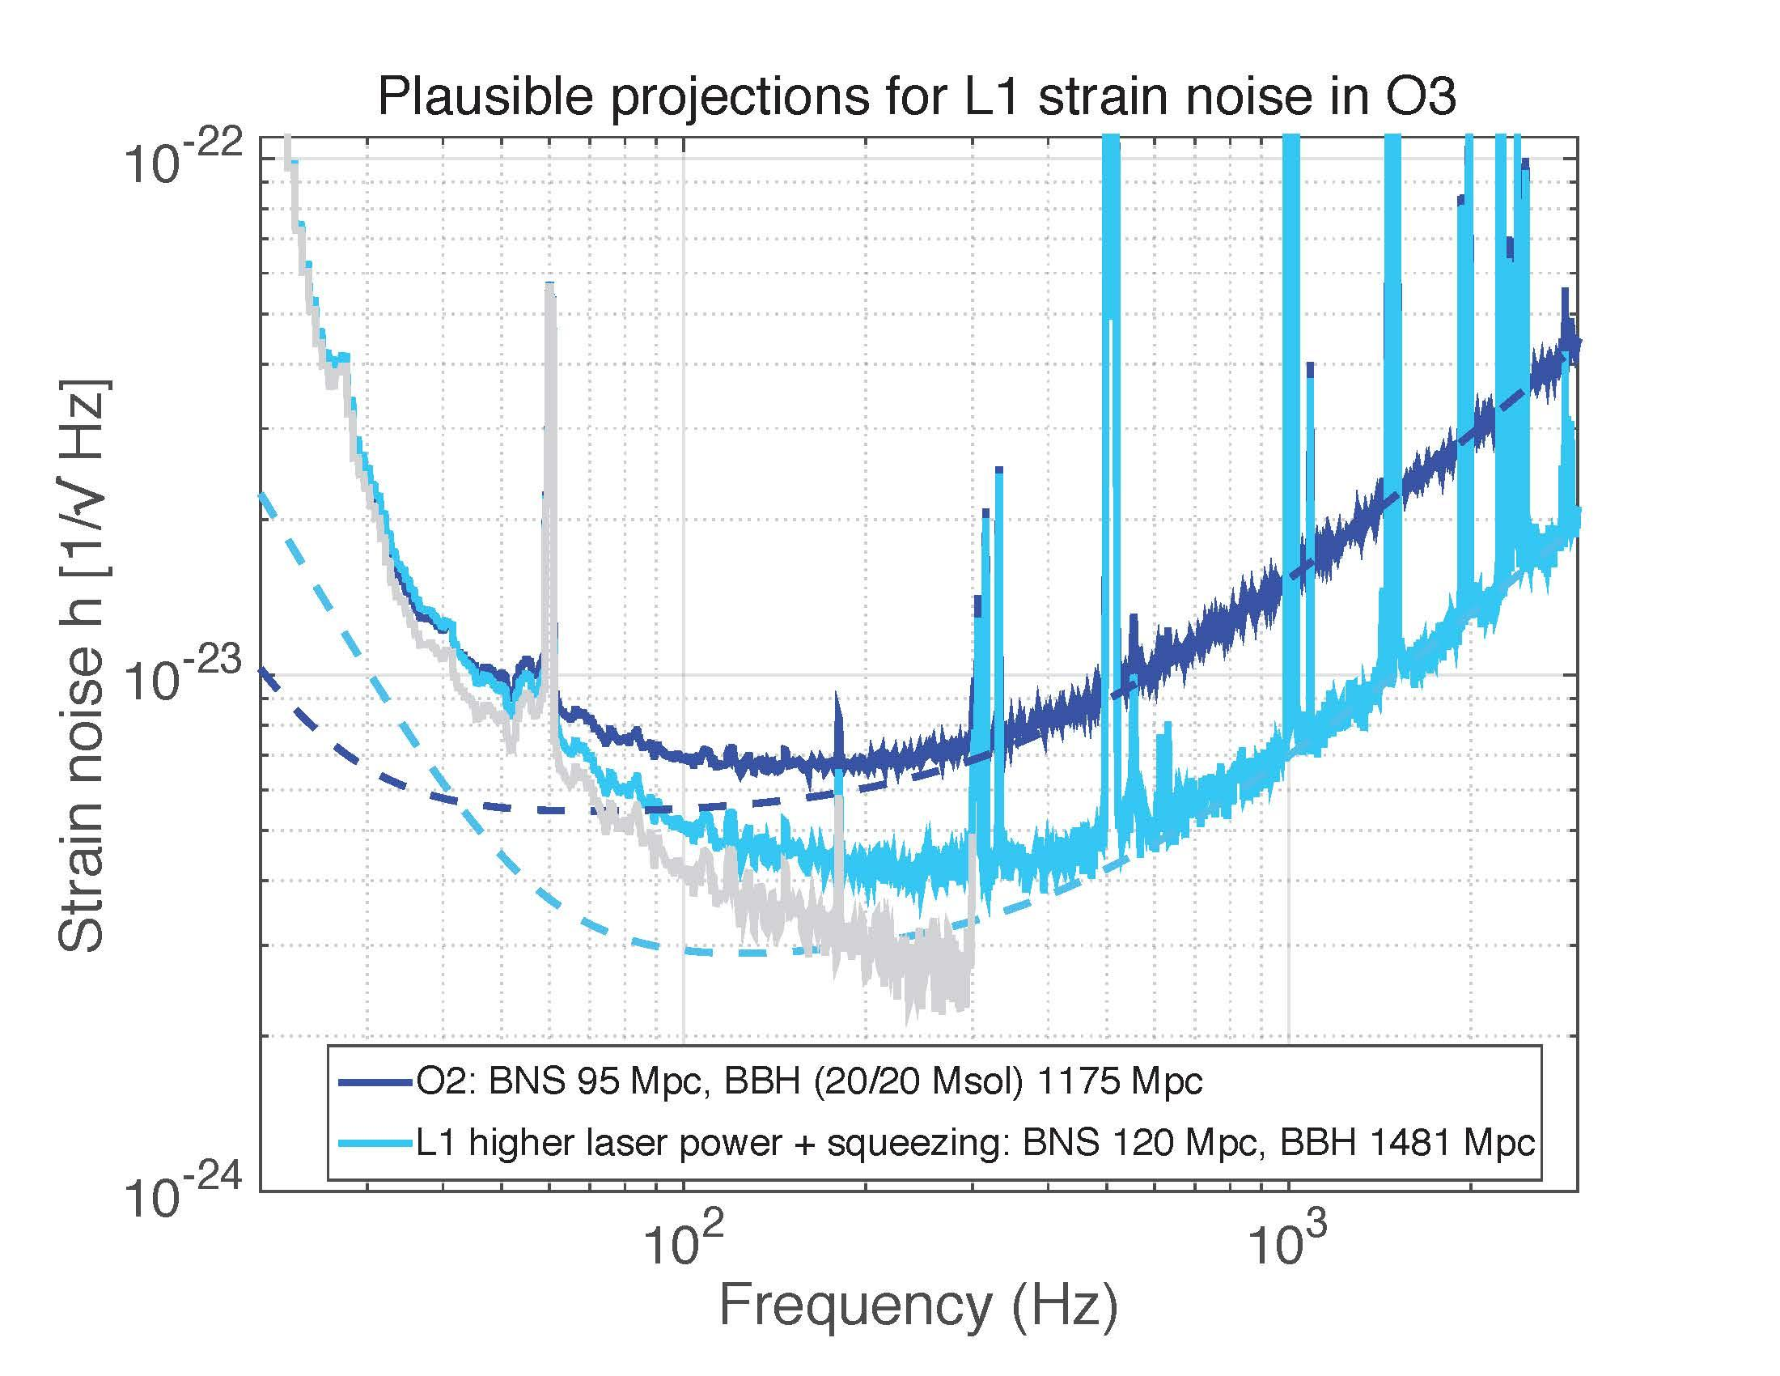

Slide 5
Can we build more sensitive detectors? YES, we can.
More of the same, but even better: more power, bigger/heavier masses, lower loss mirror coatings, better suspensions, …
New technologies: squeezed light, alternative wavelengths + cryogenics, alternative optical configurations, ..
Make it longer: take advantage of scaling of noises with arm length
Go Underground: access low frequencies
New concepts: triangular shape, xylophone, ..
ONLY FOR NEW FACILITIES

Slide 6
Vision beyond Advanced LIGO
A+: near term improvement to Advanced LIGO
Lower mechanical loss mirror coatings, frequency dependent squeezing
⇒ proposal to the NSF in preparation
⇒ could be operational by mid-22
Voyager: same Advanced LIGO facility, possibly 2 um wavelength, modest cryogenics 120K,
⇒ world-wide R&D in progress

Slide 7
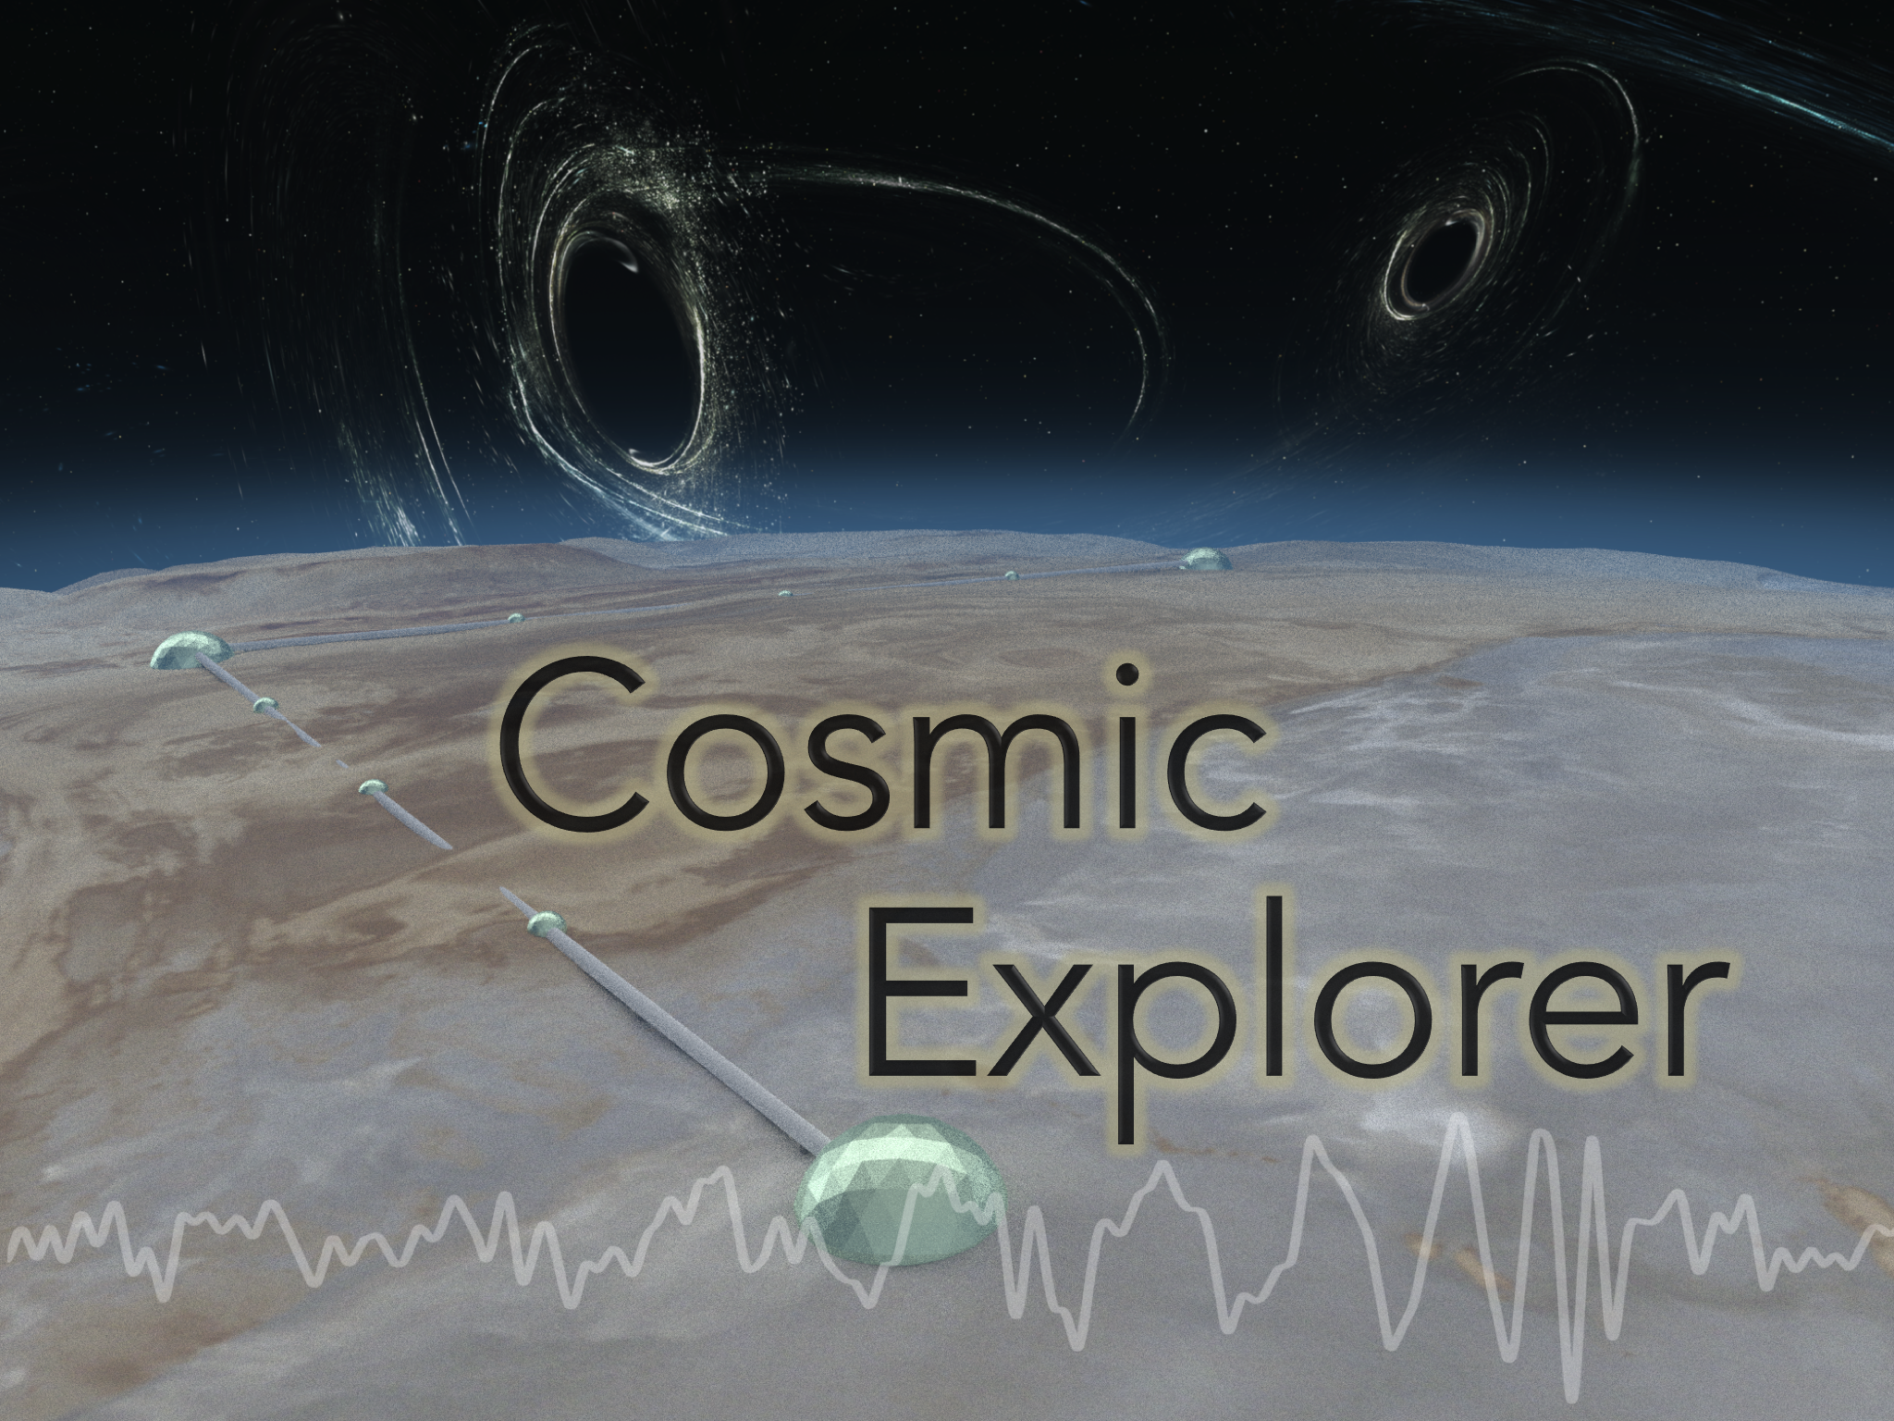
Cosmic Explorer
Surface, right-angle, 40km on a side, 1 interferometer

Slide 8
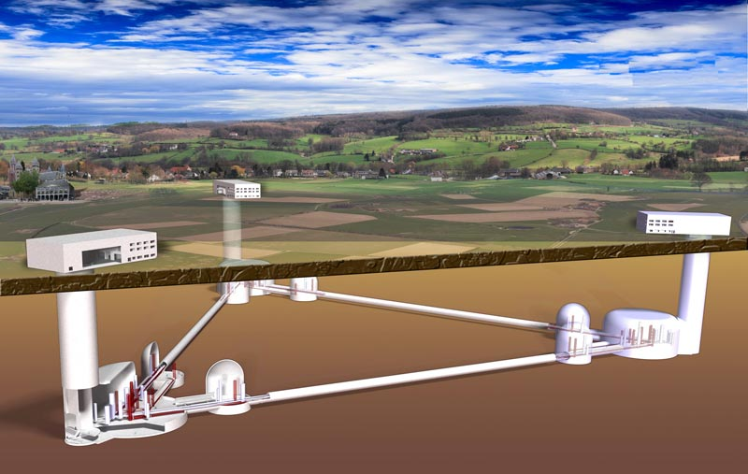
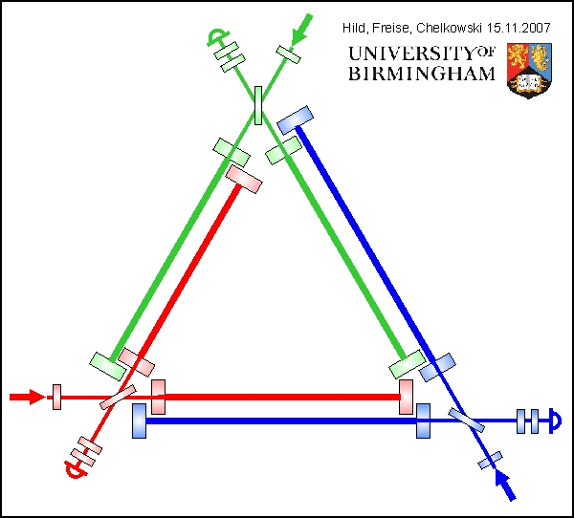
Einstein Telescope
Underground, triangular, 10km on a side, 6 interferometers

Slide 9
Concept Roadmap
Ultimate R&D (ET, CE)
New Facilities
Other wavelengths, cryogenics
Voyager – Current Facilities
Coatings, squeezing
A+
Advanced LIGO
Now
Early 2020s
Late 2020s
Mid 2030s

Slide 10
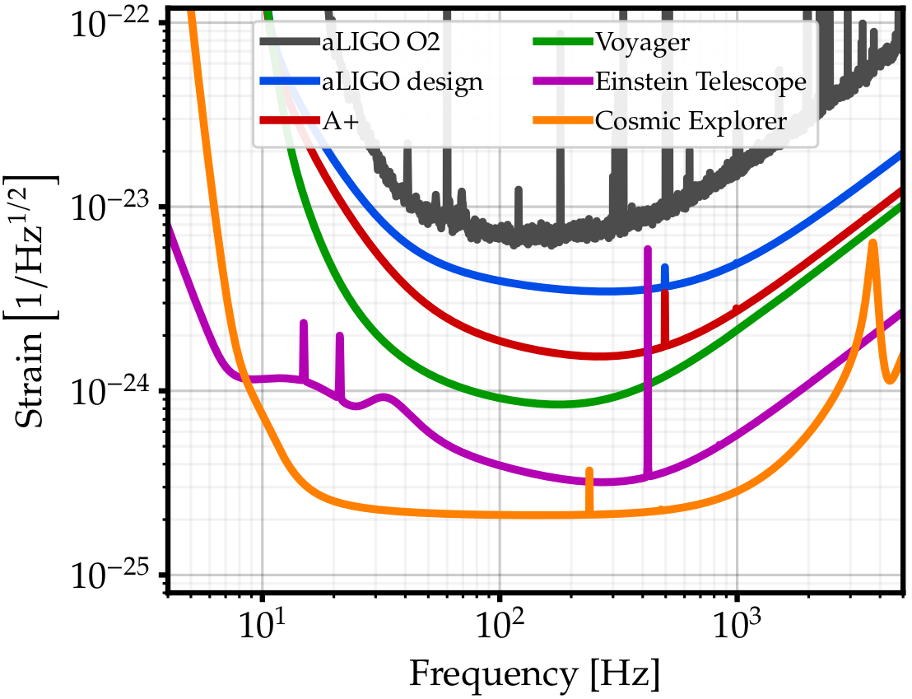
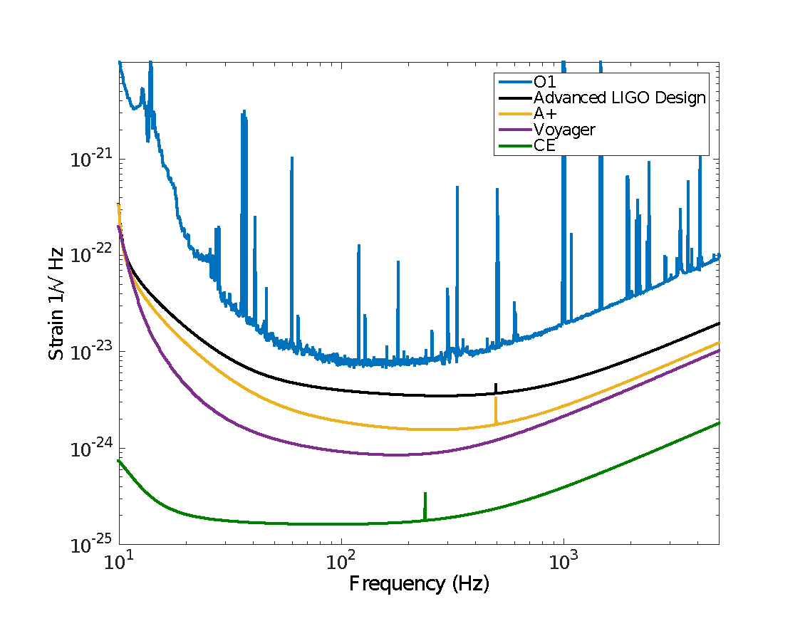
Example of curve progression
LIGO-T1500293
PRELIMINARY

Slide 11
Uncontroversial goal of the future world-wide GW network: “maximize the science”
BUT...what does it mean exactly?
GWIC 3G https://gwic.ligo.org/3Gsubcomm/
How can we condense the exciting physics that has been described here in a set of relevant metrics to inform the design of the future GW network?

Slide 12
Network Metrics
How to measure the performance of a network of GW detectors?
BBH Range?
Median sky localization for BNS sources?
High frequency sensitivity?
How do each of these metrics connect to our science goals?

Slide 13
Metrics: not so simple..
For a given source, maximizing the number of events might not be what we want:
Is the science based on populations, or can we cherry pick the best events?
Localization only important for close, bright events (don’t need BNS localization for z>1)
Cost (both for construction and operation) is a fundamental driver: how can we compare “cost-equivalent” configurations?

Slide 14
Some Science Targets
Kilonova, Afterglow, … Multi-messenger physics with BNS events
NS EOS, Merger and Nuclear Physics
Testing-GR
Hubble, Dark Energy, … H(z)
Populations
Metal Production over Cosmic Time - BNS
Cosmic Dawn - POP III
Inflation - Primordial Black Holes
Non CBC Sources (CCSN, Strings, …)

Slide 15
Some Science Targets
Kilonova, Afterglow, … Multi-messenger physics with BNS events
NS EOS, Merger and Nuclear Physics
Testing-GR
Hubble, Dark Energy, … H(z)
Populations
Metal Production over Cosmic Time - BNS
Cosmic Dawn - POP III
Inflation - Primordial Black Holes
Non CBC Sources (CCSN, Strings, …)
Low-z Localization
kHz sensitivity
CBC SNR
GW Polarization
Low-z Localization
kHz sensitivity
CBC SNR
CBC SNR
High-z Mass and Distance Estimation
kHz sensitivity

Slide 16
3G Mentality
With 3G detectors we will have ~10⁵ of events each year, mostly from z ~ 2 or 3
Population based science won’t need good sky localization
Mean and median values are meaningful
Precision test will be done with the nearby high-SNR events
Only best ~10 events per year will be useful

Slide 17
Previous work on network design
Raffai+ 2013, Hu+ 2015:
Numerically optimize detector placement for 2G (aLIGO) and 3G (ET) networks
Figures of merit: polarization sensitivity, sky localization, and chirp mass reconstruction
Vitale+ 2016:
Evaluate CBC parameter estimation capabilities for 3G networks (CE, ET)
Mills+ 2017:
Evaluate localization capabilities for 2G, 3G, and heterogeneous networks (Voyager, CE, ET)

Slide 18
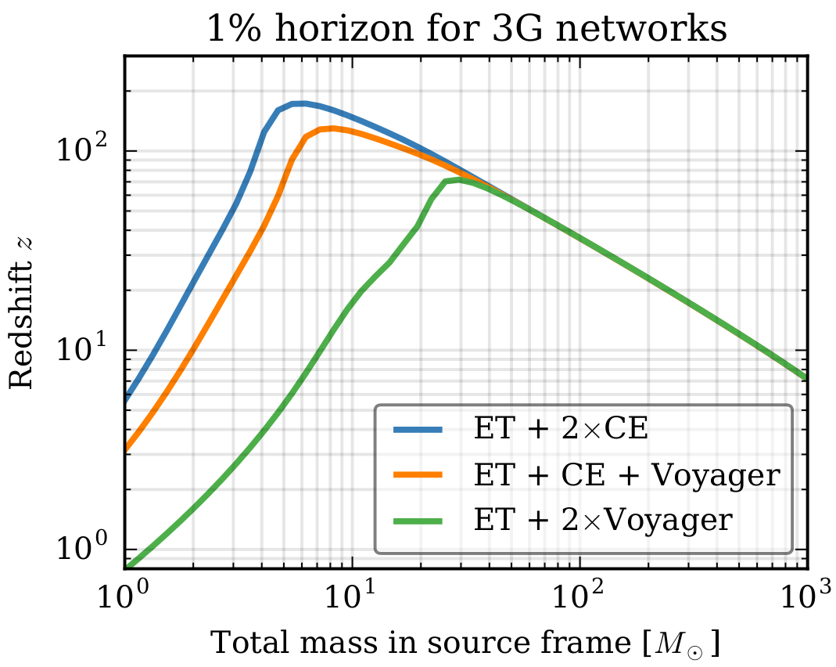
Network horizons
(Redshift at which 1% of sources are detected)

Slide 19
Rough Cost Estimation
We have cost estimates based on LIGO, ET and LIGO-India experience and costing
These are not accurate, since costs are inevitably driven by site specific factors and market prices which change with time, but they can be used as a means of making cost-based network optimizations
We account for:
number of interferometers (1 xylophone ET detector is 2 ifos)
Ltube, Dtube = length of tube [km] with diameter Dtube [m]
Lsurface = length of surface grading [km] (80 for CE)
Lflat, Nflat = length and number of flat sections [km] (40, 2 for CE)
Ltunnel = lentgh of tunnel [km] (30 for ET)
Hdepth = depth of tunnel [m] (200 for ET)
Ncavern = major halls (3 for ET triangle)

Slide 20
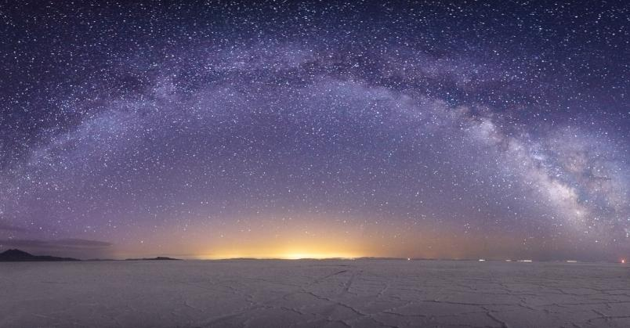

Slide 21
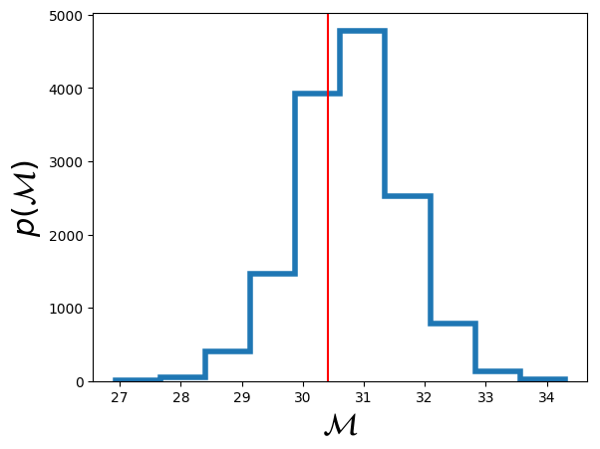
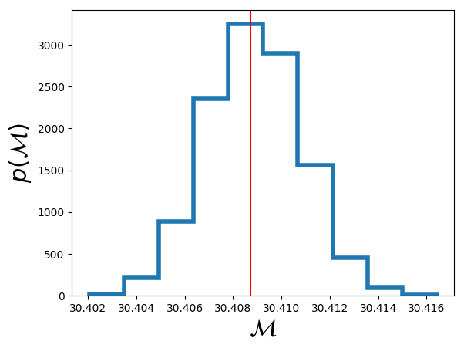
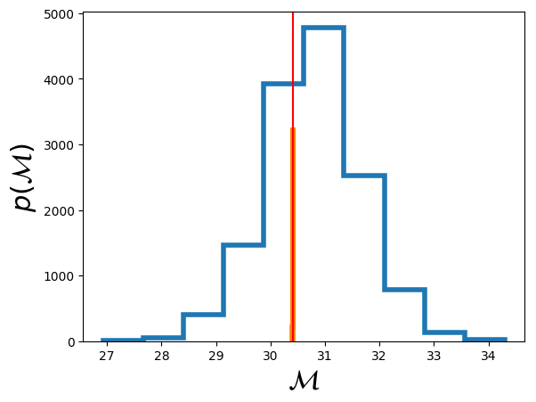
From Salvatore Vitale
A GW150914-like event will have SNR~2000 in a Cosmic Explorer facility.
How well can we do parameter estimation?
Vitale, preliminary

Slide 22
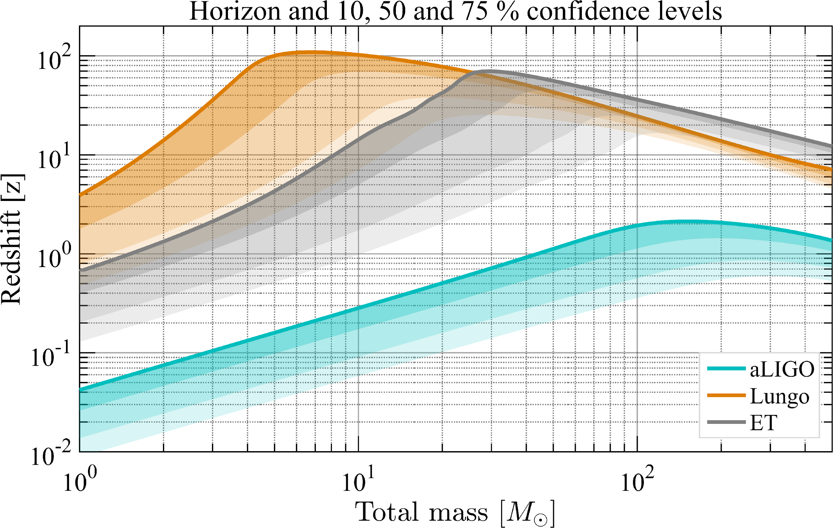
BBH and BNS from the entire Universe!
PBH?
First Stars Formed
High SNR Signals!
CE
BNS
NSBH
BBH
POP3?
Parameter estimation for binary black holes with networks of third-generation gravitational-wave detectors.
Vitale, Evans (2017) PRD 95, 064052
Observing primordial gravitational waves below the binary-black-hole-produced stochastic background
Regimbau, Evans, …, Vitale, (2017) PRL 118, 151105

Slide 23
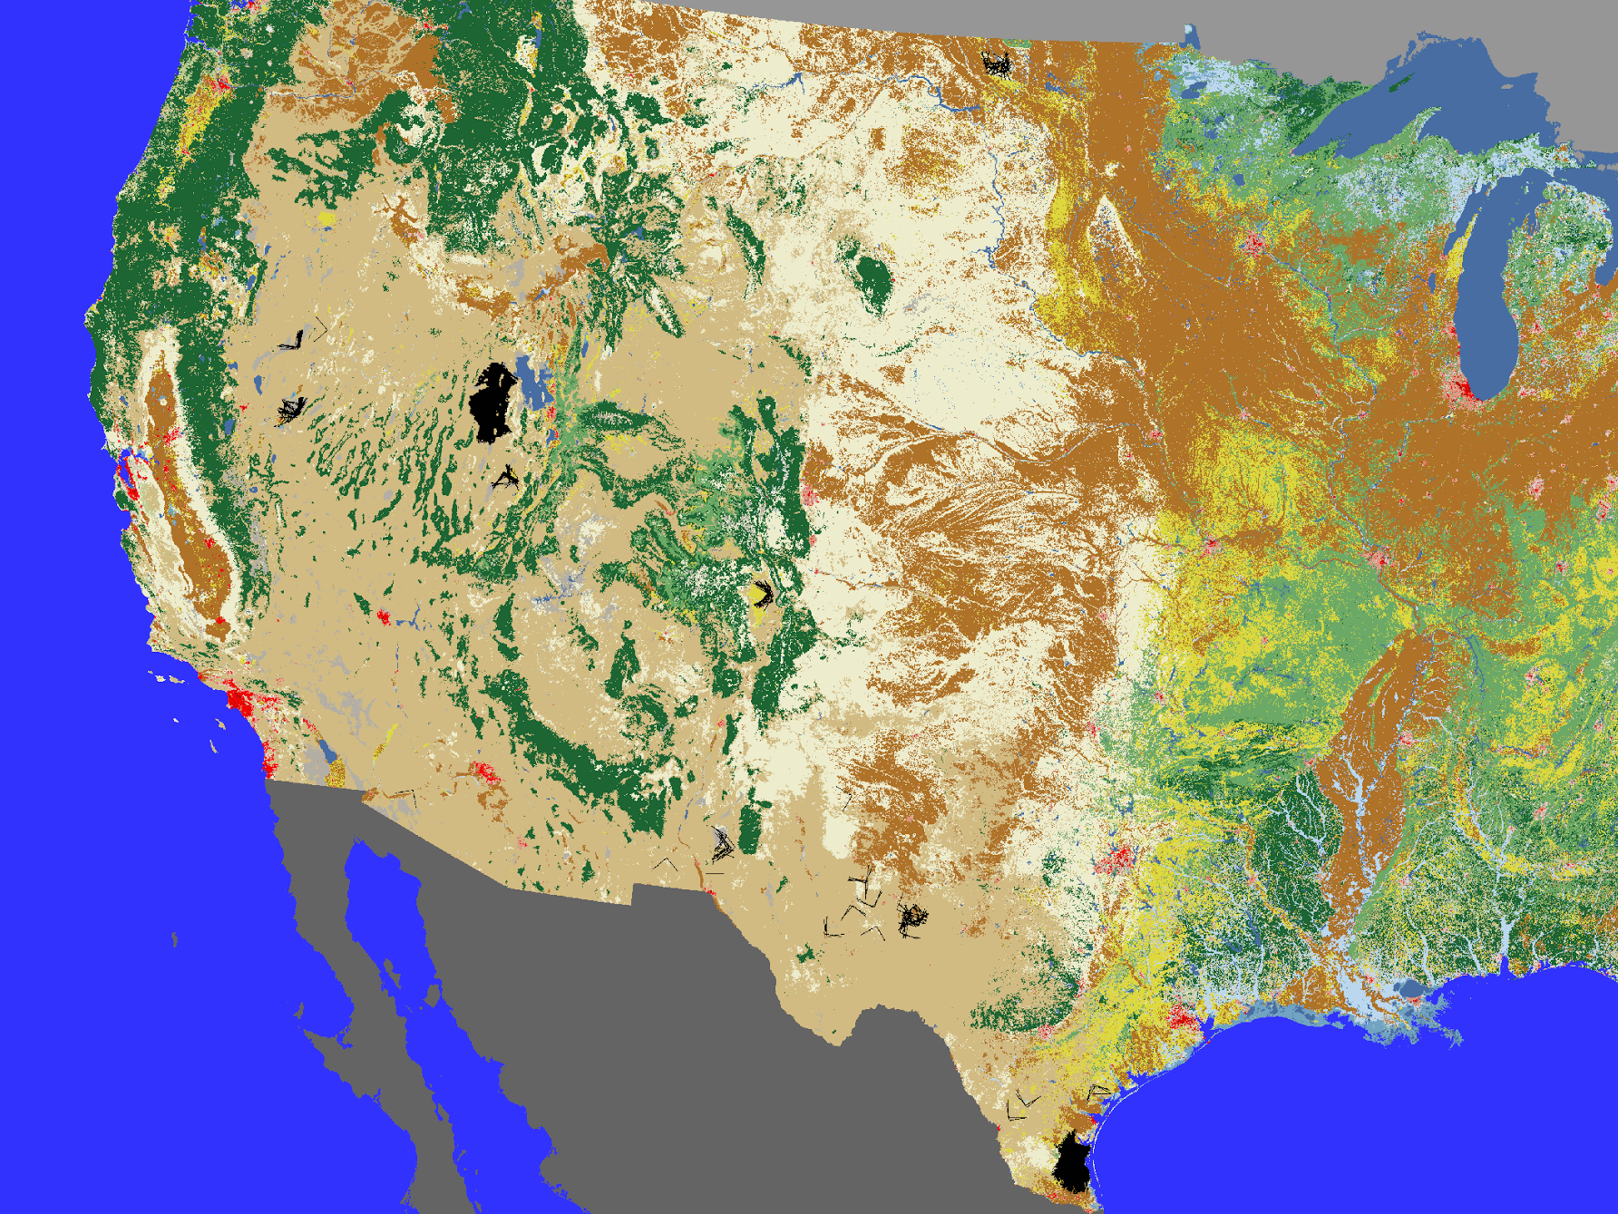

Slide 24
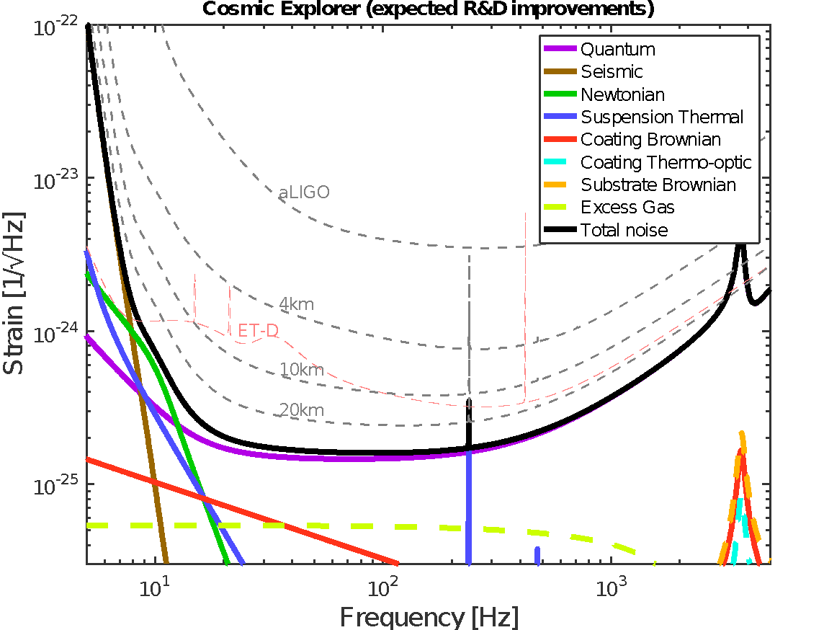
COSMIC EXPLORER:
a 40km facility with new coatings and squeezing
better
Exploring the sensitivity of next generation gravitational wave detectors (2017) CQG 34, 044001
longer

Slide 25
Over the next 20 years…
Sensitivity progression from the present (O1 and O2) to potential detectors of the 2030s.

Slide 26
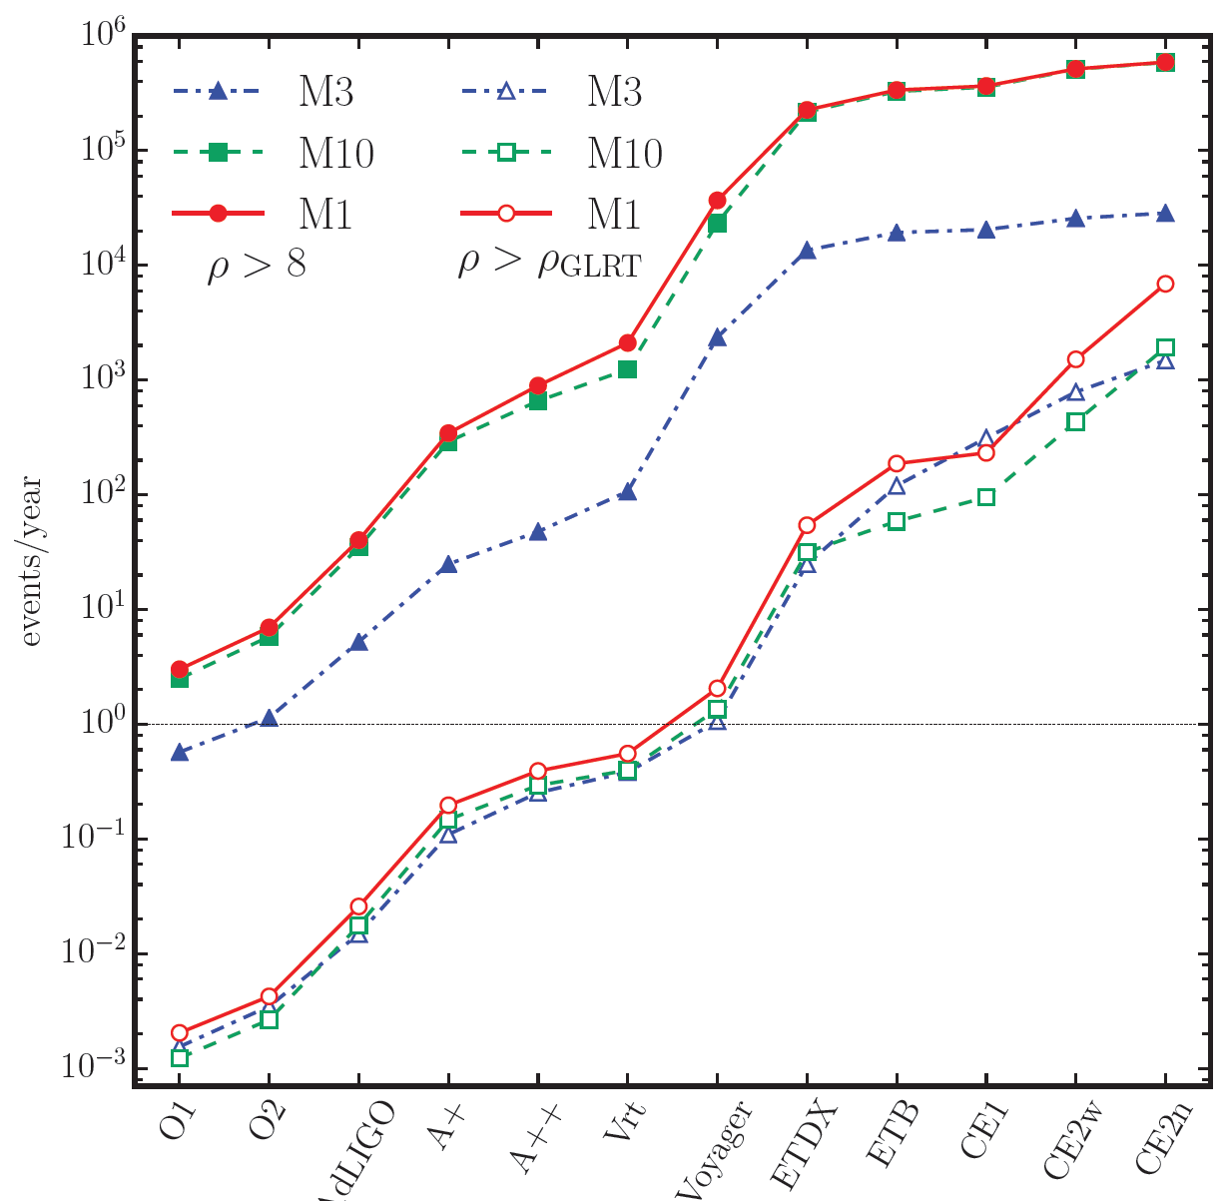
~10⁶ “detectable”
M3: high natal kicks
“detectable”
“high SNR”
~10³ “high SNR”
M1: standard
M10: M_{BH} < 50 M_{o}

Slide 27
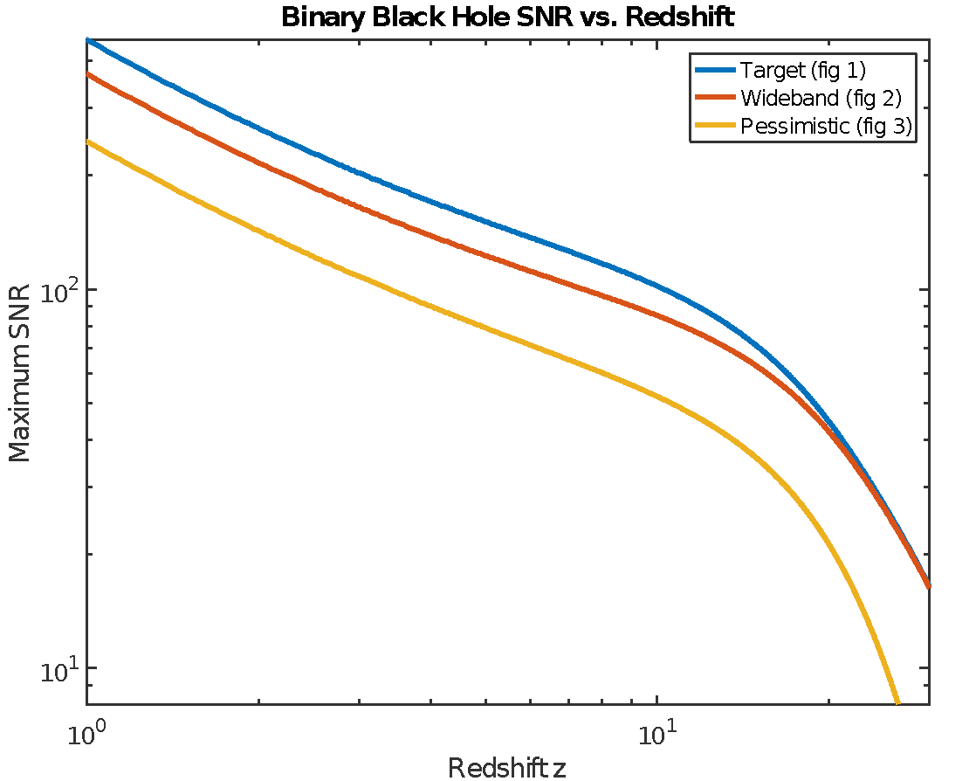
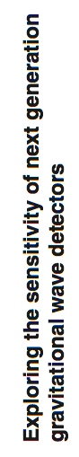
Close BBH Mergers will have high SNR
CQG doi:10.1088/1361-6382/aa51f4

Slide 28
2 3 4
M1 model
“detectable”
“high SNR”

Slide 29
Hubble Constant (science goal weight? Not high?)
Galaxy associations with localization volume
Requires localization of 10s of sources
Limited to low redshifts by galaxy catalogs
Mass distribution
Just needs many sources
BNS Spectroscopy
Needs high frequency sensitivity
EM counterparts
Needs localization of local sources
BBH matter distribution vs. BAO

