Slide 1
Effects of different sizes of
BS and RM3 for A+
and Field from ITM
Study of various losses for different sizes of BS and RM3
PRFPM is used
  No maps of aberrations and ESD included to emphasize geometrical effects
  BS size : 37cm (6cm), 45cm (6cm) and 55cm (6.5cm) : no BS baffle
  RM3 size : 26.2cm and 30cm
  Beam centering on ITM : 0cm and 6mm
Configurations (BS, RM, beam)
    Case 1 (37,26,0), Case 2 (37,26,6), Case 3 (45,26,0), Case 4 (45,26,6), Case 5 (45,30,0), Case 6 (45,30,6), Case 7 (55,26,0), Case 8 (55,26,6), Case 9 (55,30,0), Case10 (55,30,6)
Losses calculated
  BS – power in (x and y arm)-> power out (dark and bright)
  RM3 – power from RM2->RM3->BS, BS->RM3->RM2

Slide 2

Geometry related to performance
ESD on CP
(modeled by a simple with hole with 266mm aperture)
266mm
BS
230x260mm
262mm

Slide 3
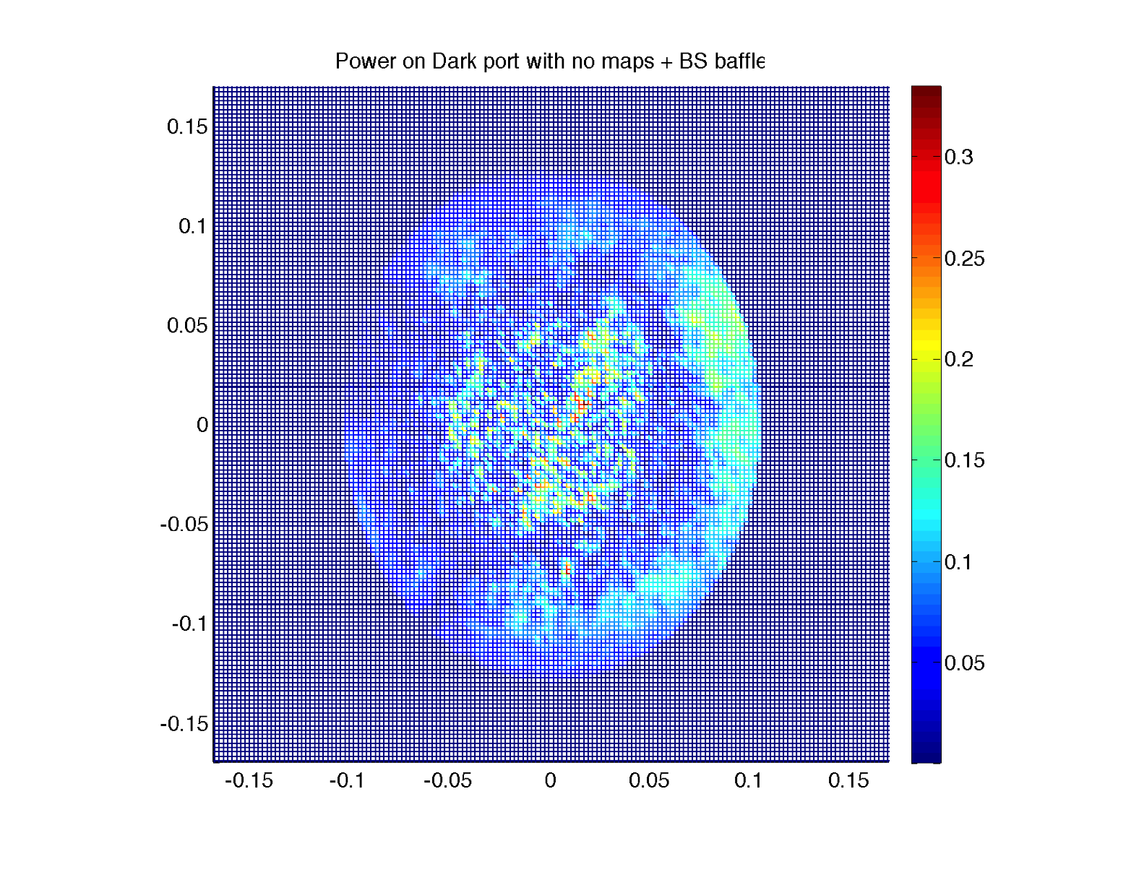
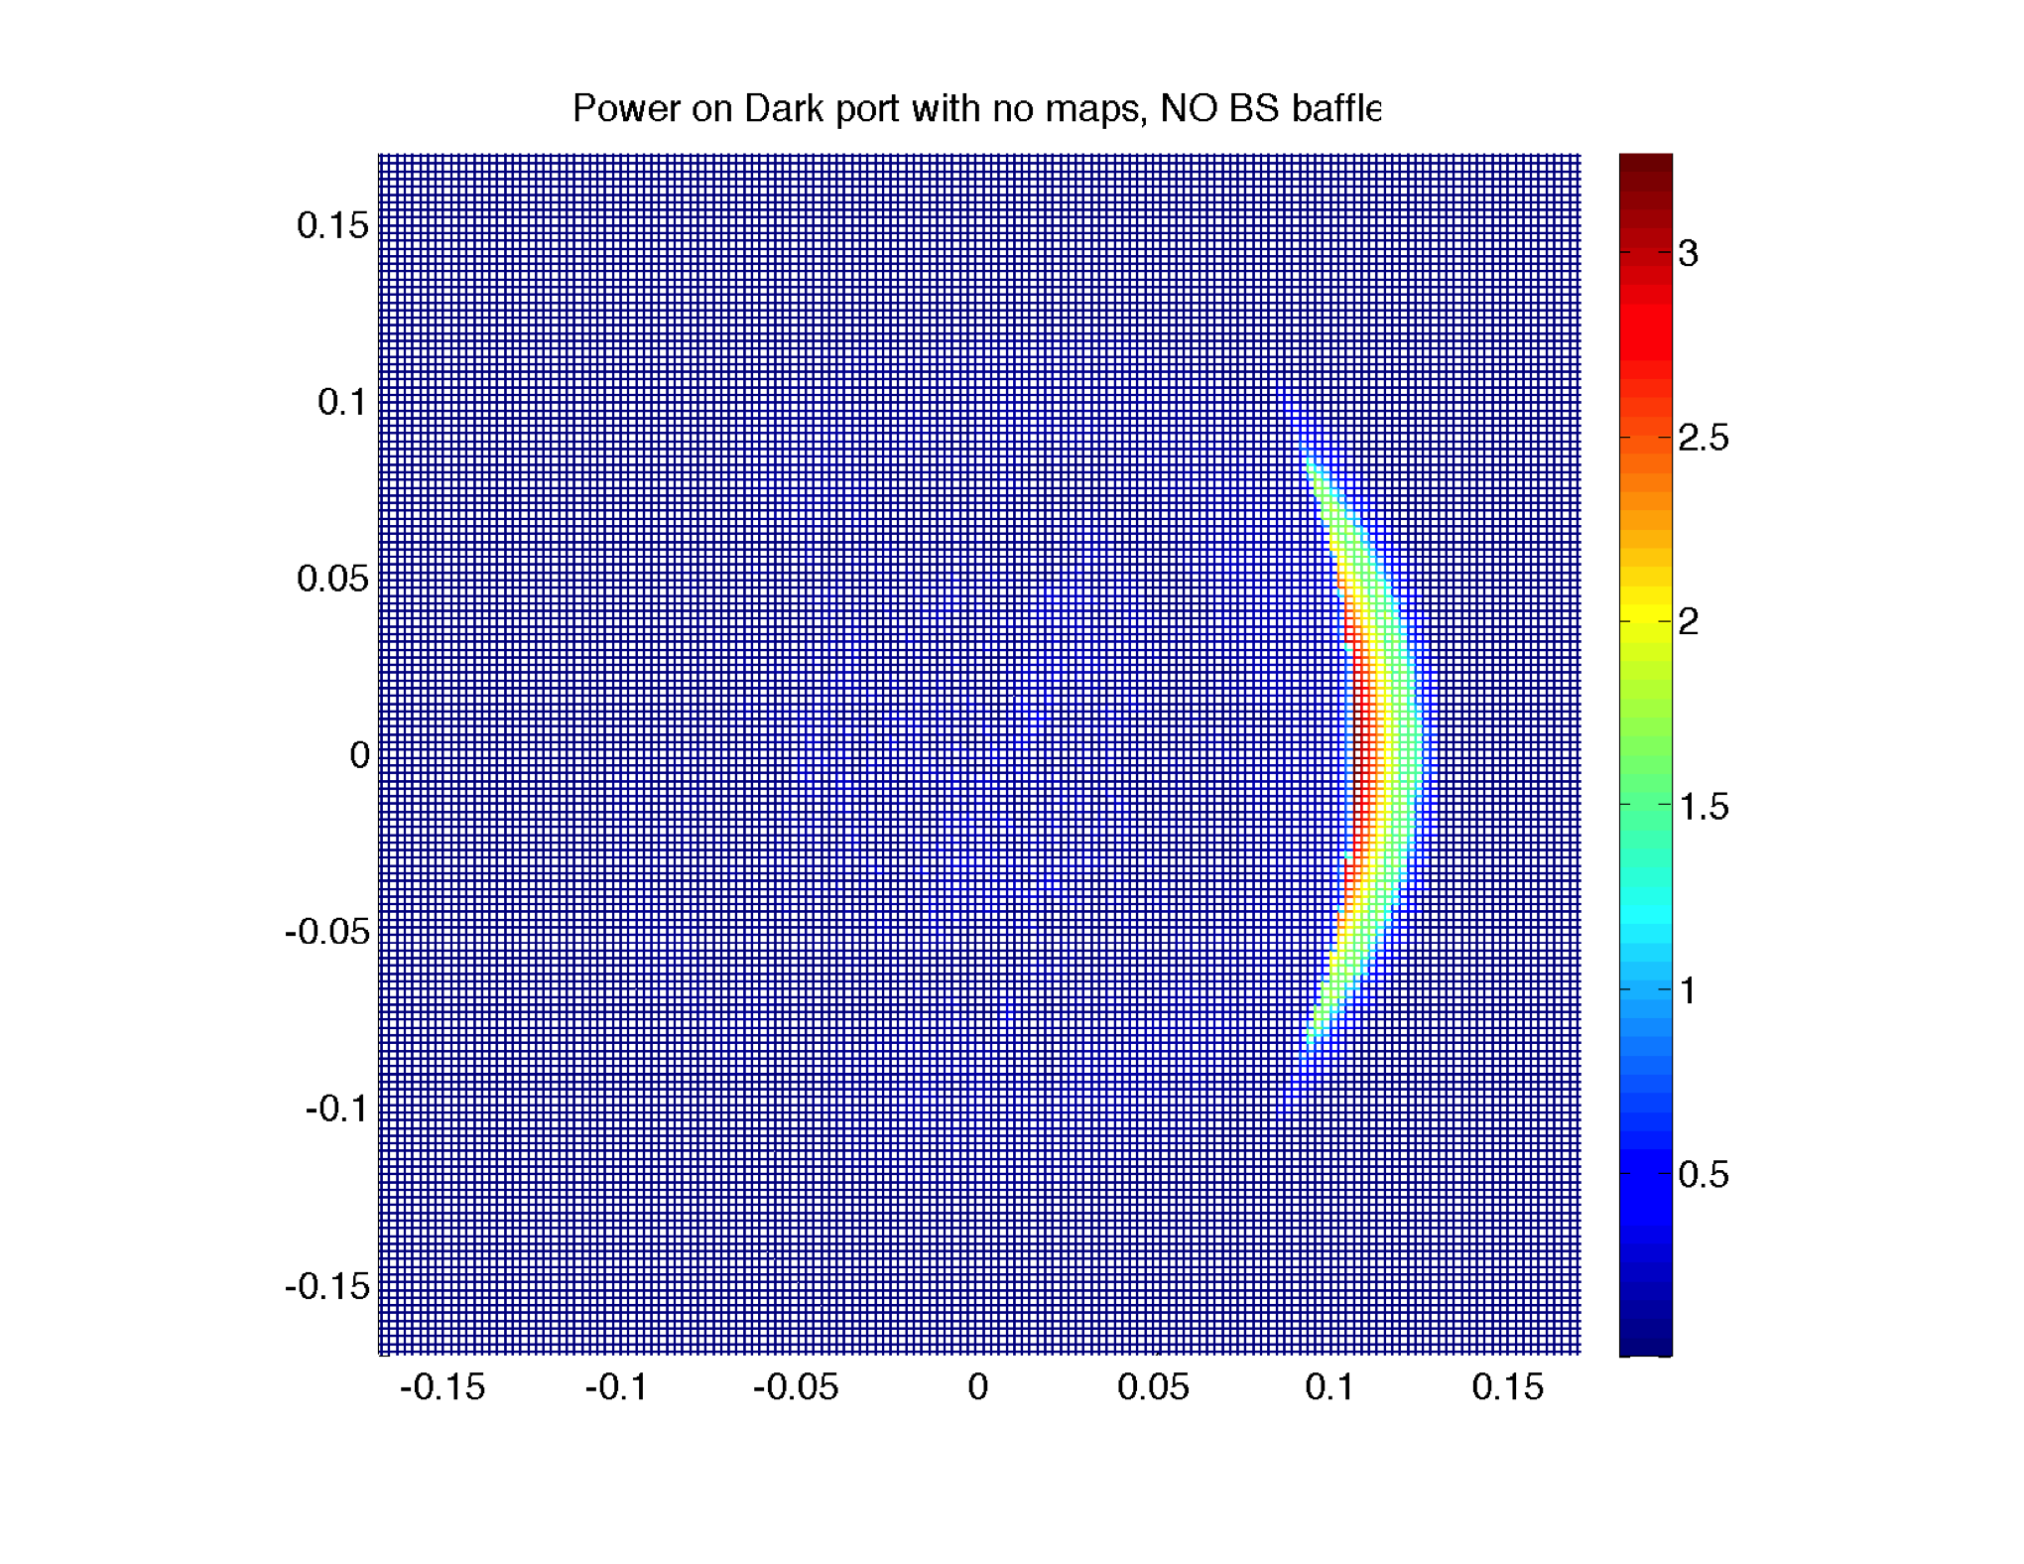
BS baffle designed to suppress CD
With BS baffle : 7ppm
Without BS baffle : 210ppm
(d) – (b)

Slide 4
45cm BS geometry
45cm / 2 / 5.3cm
= 4.2
27.1cm / 2 / 5.3
= 2.6

Slide 5
Results
Case 1 (37,26,0), Case 2 (37,26,6), Case 3 (45,26,0), Case 4 (45,26,6),
45/√2 = 31.8cm
BS loss =
(Pd+Pb3)/(Px+Py)-1
PR2 → BS loss =
P3b / P23 – 1
BS → PR2 loss =
P32 / Pb3 - 1

Slide 6
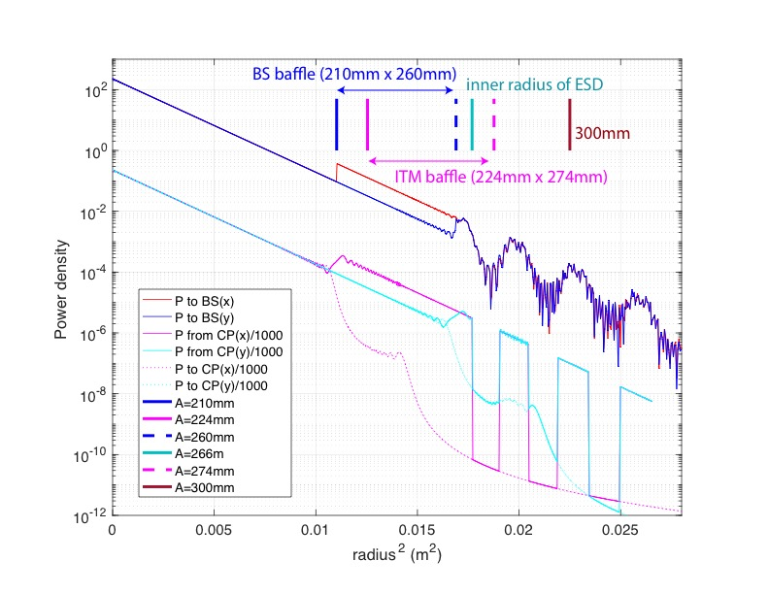

ITM baffle > BS baffle and no clipping effect
Outside of 260mm is bumpy
E from CP

