Slide 1
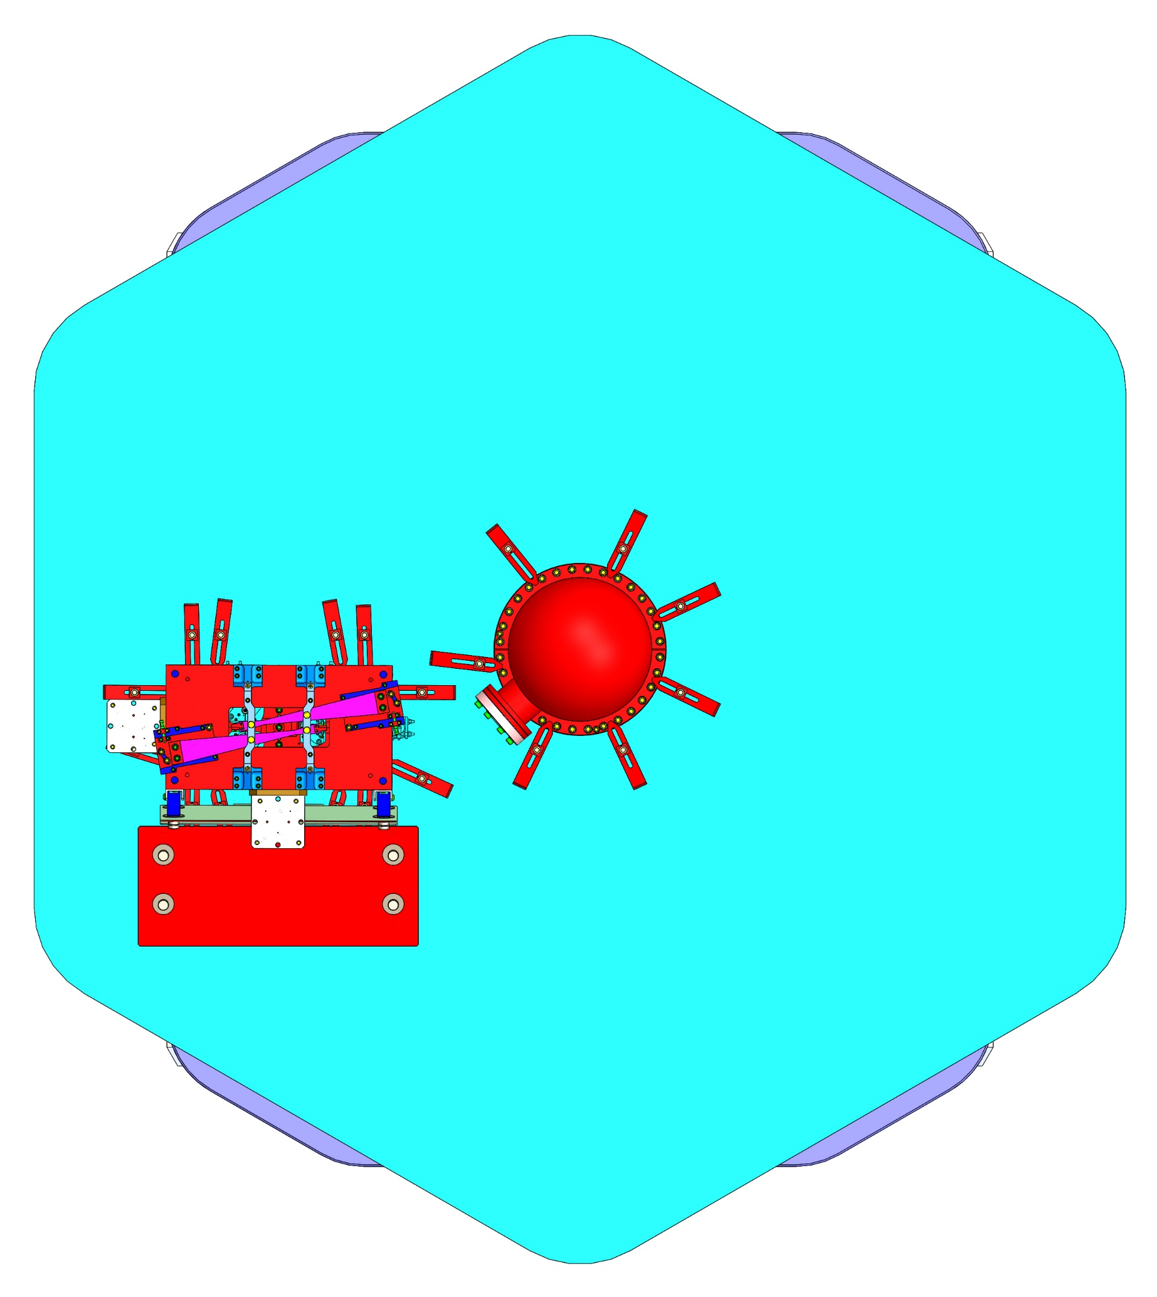
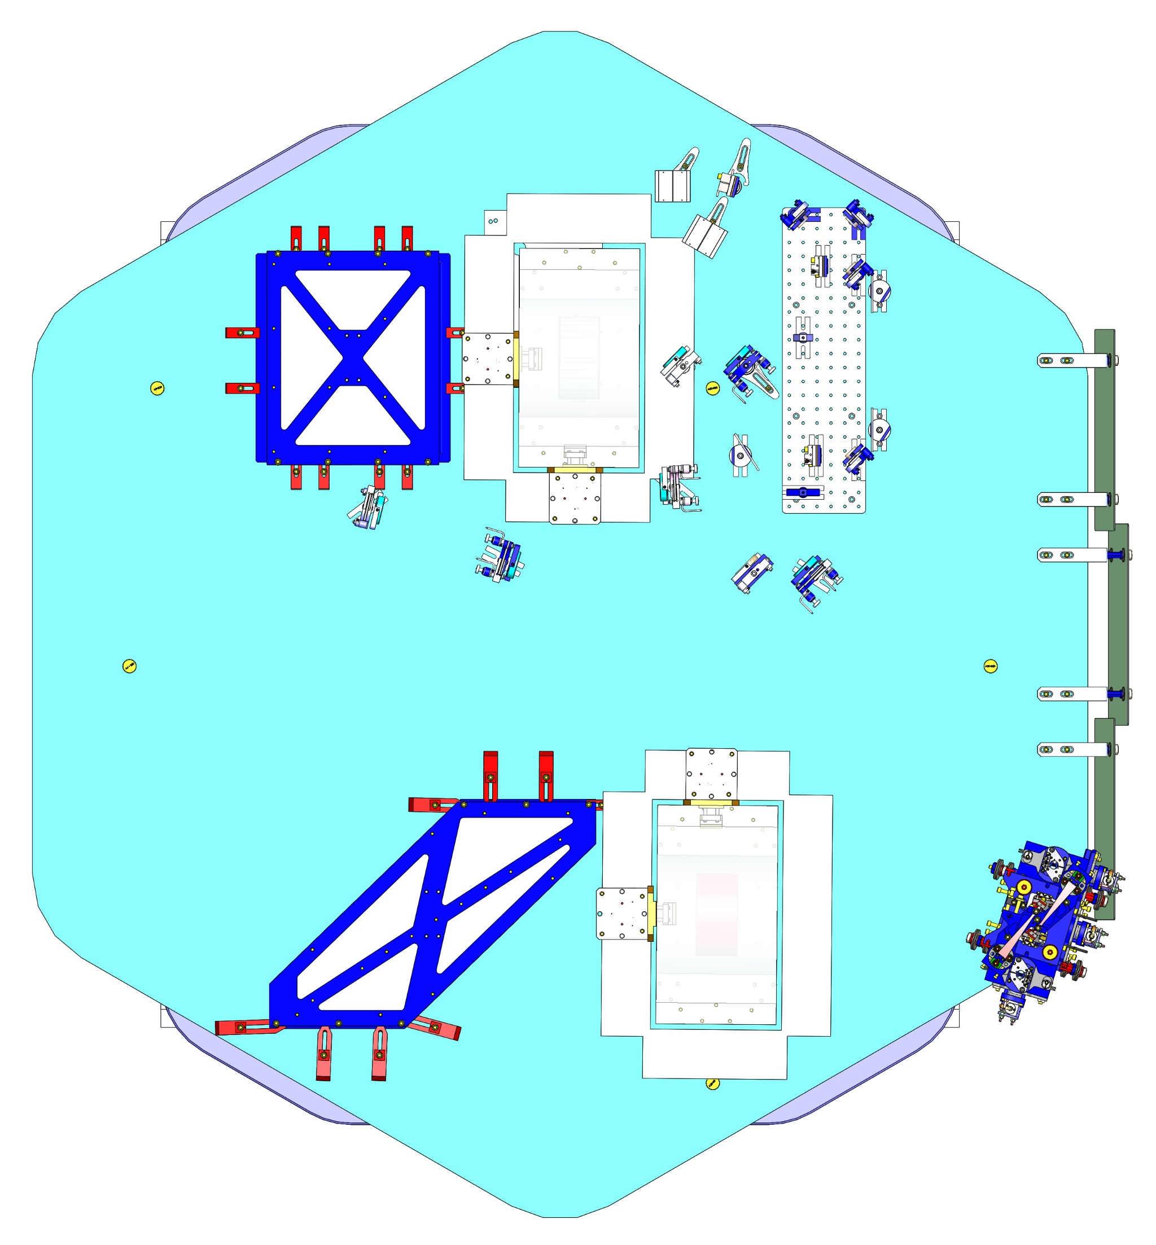
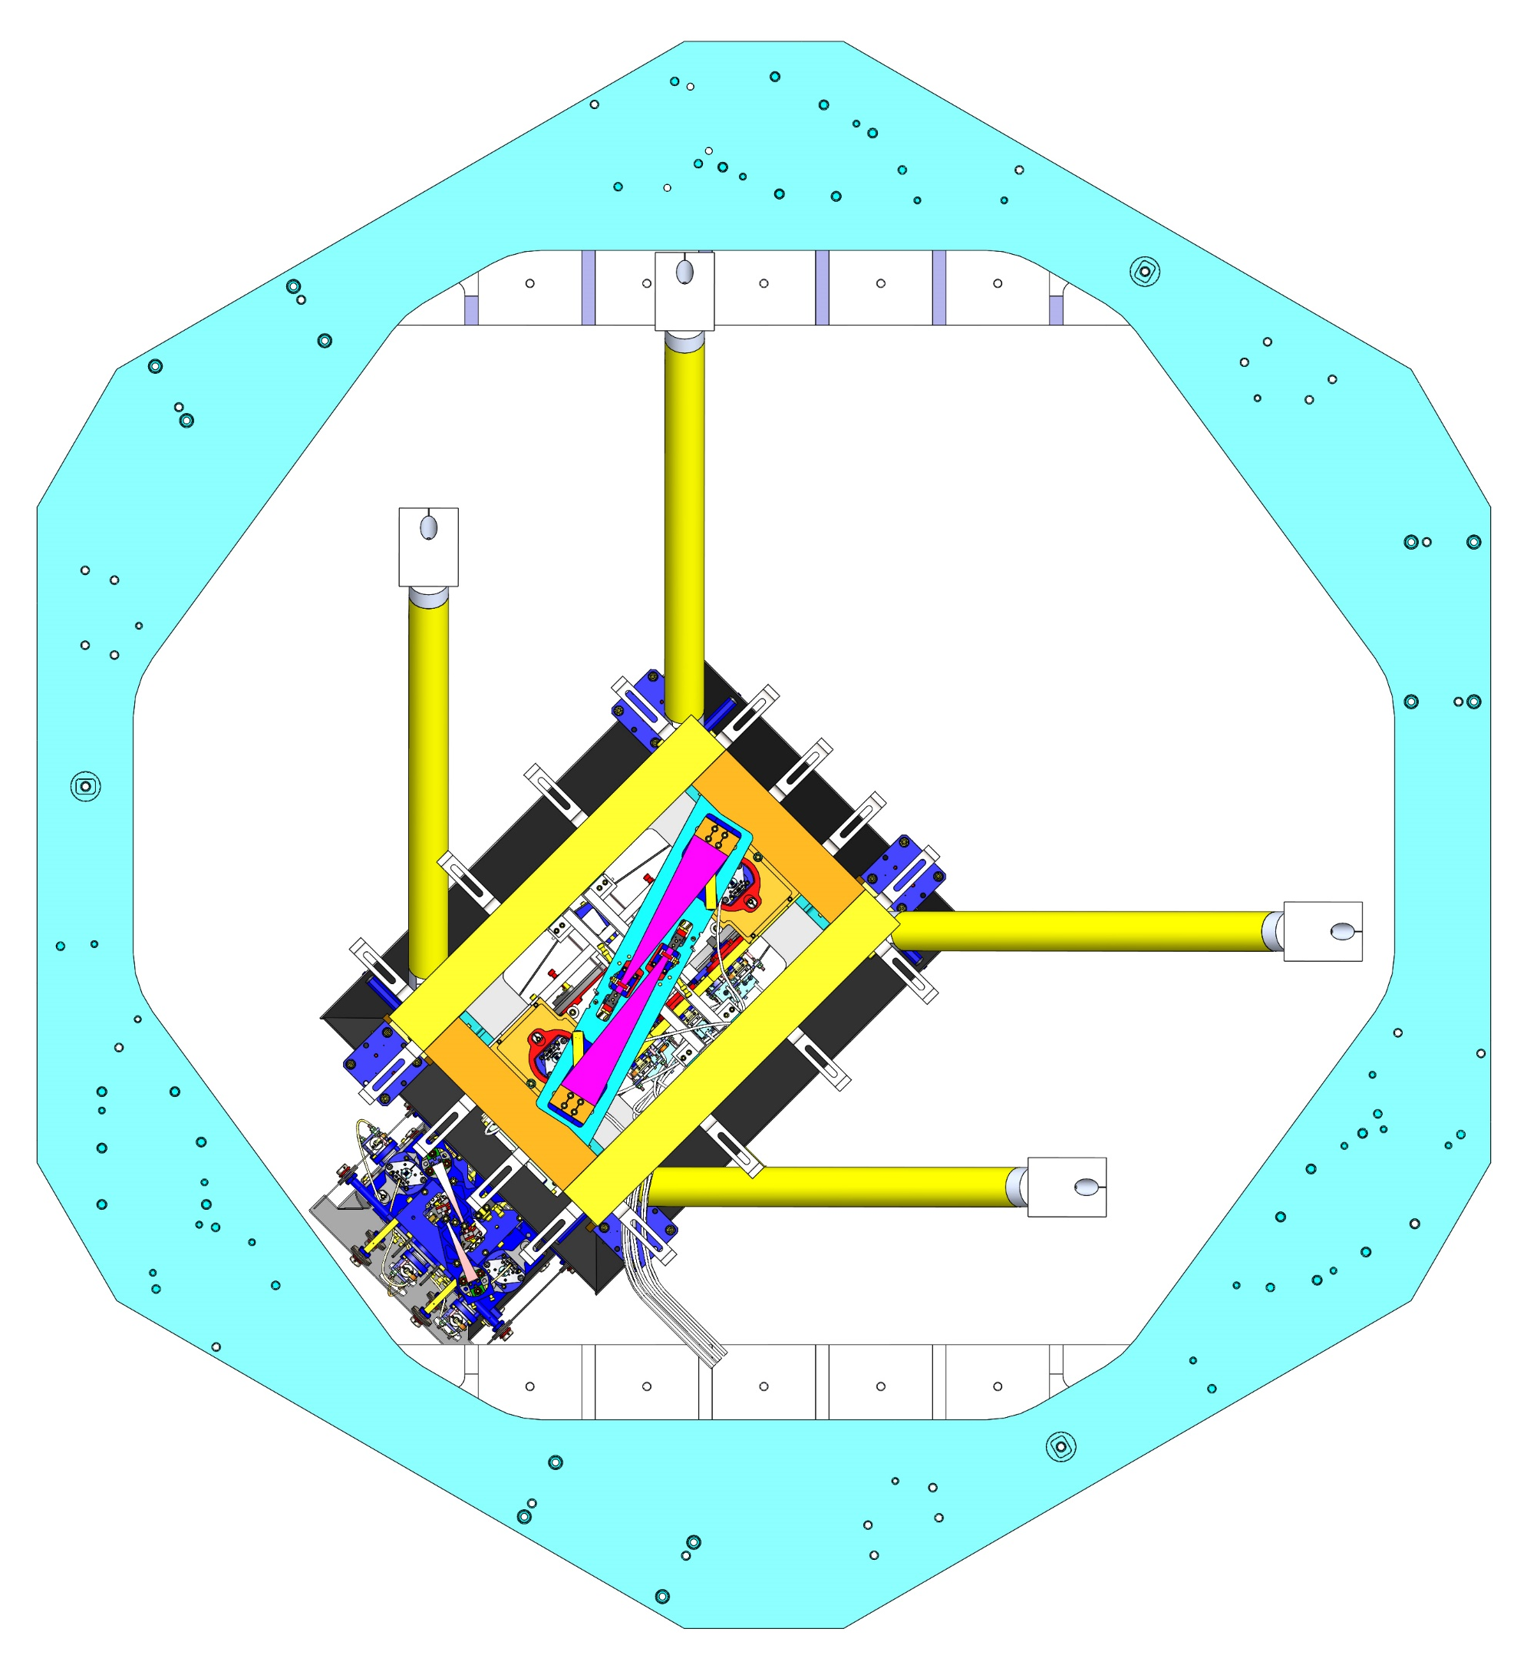
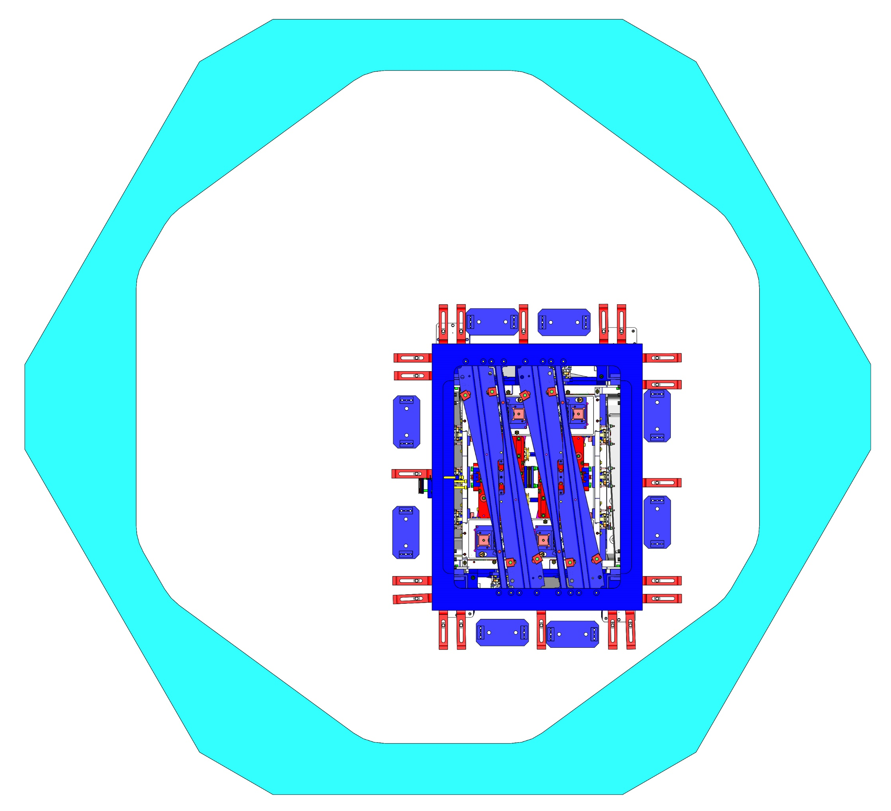
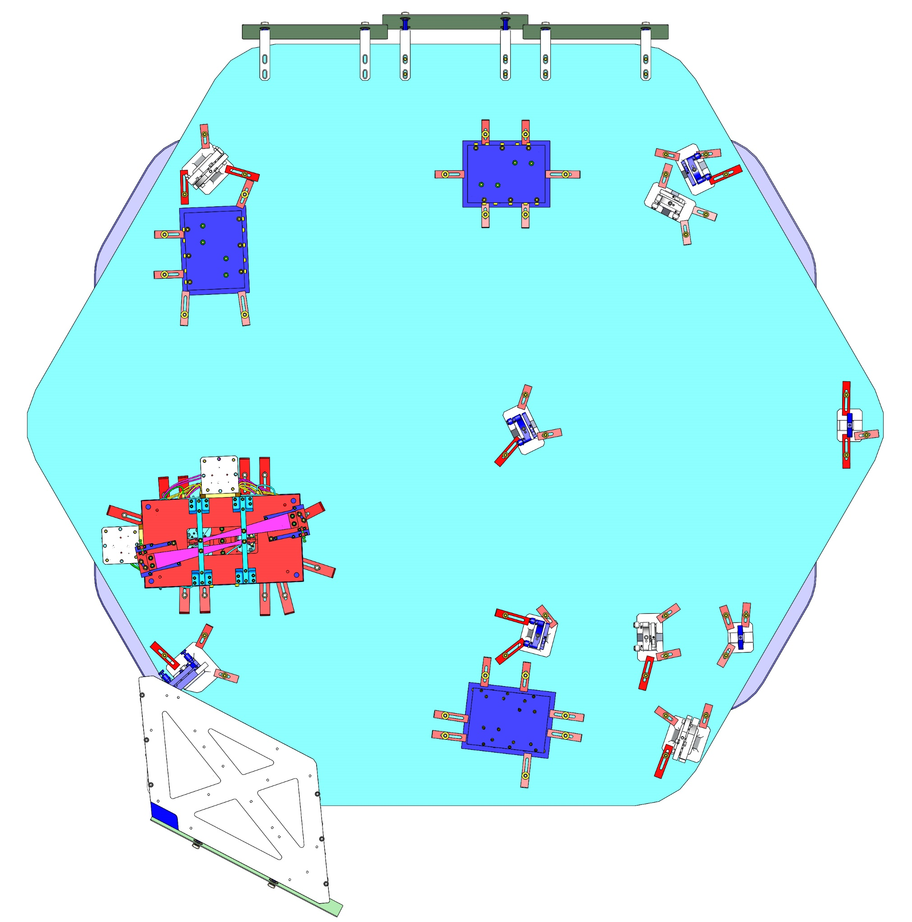
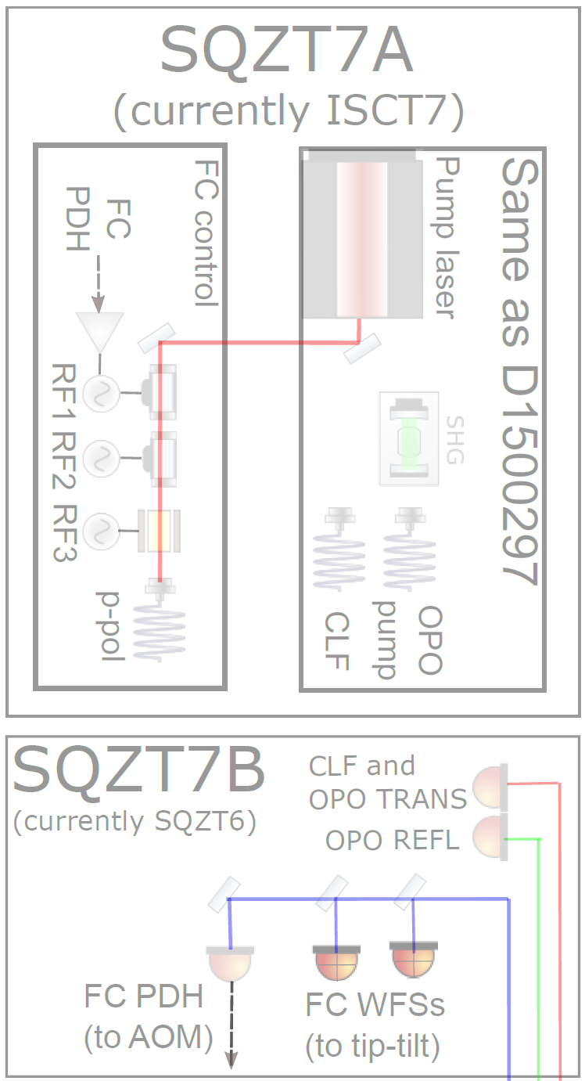
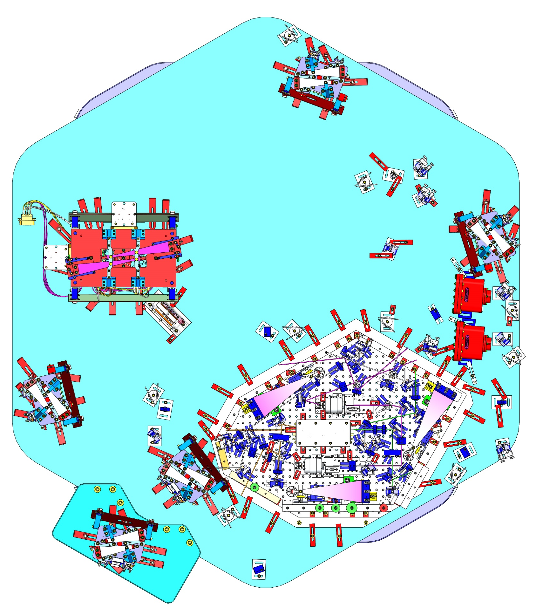
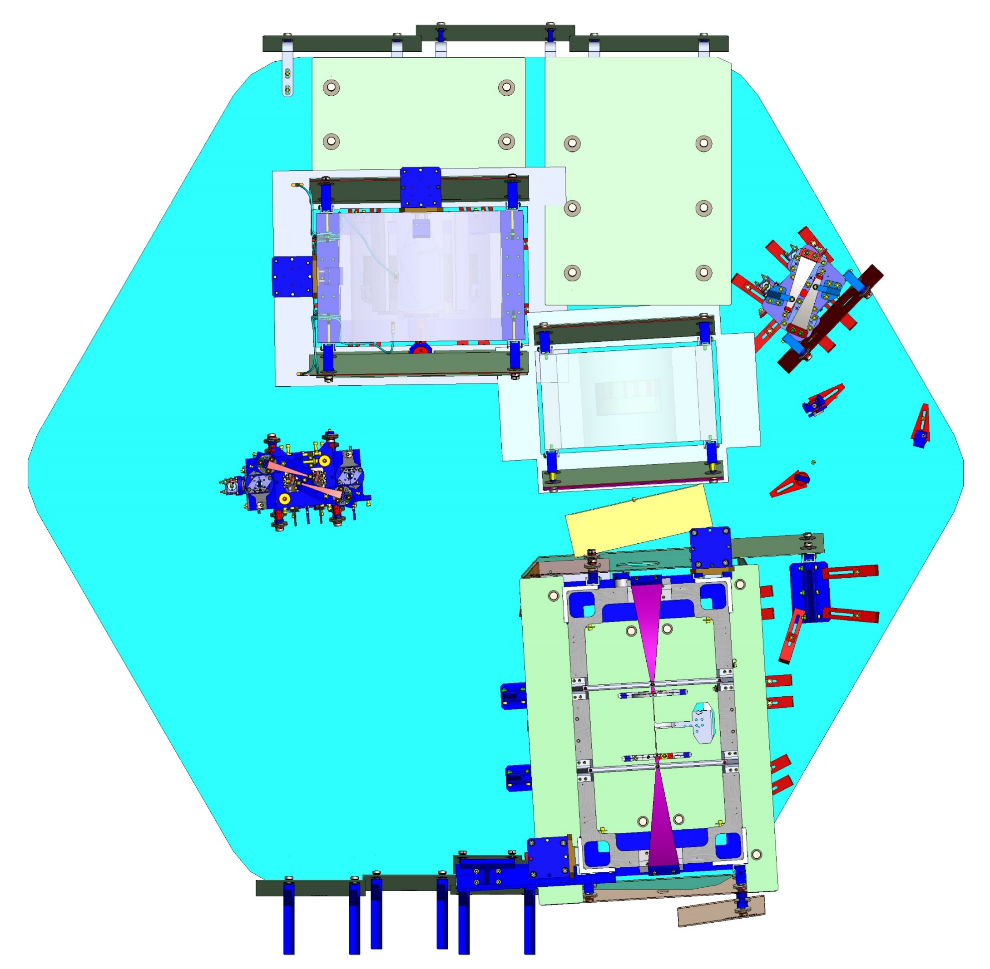
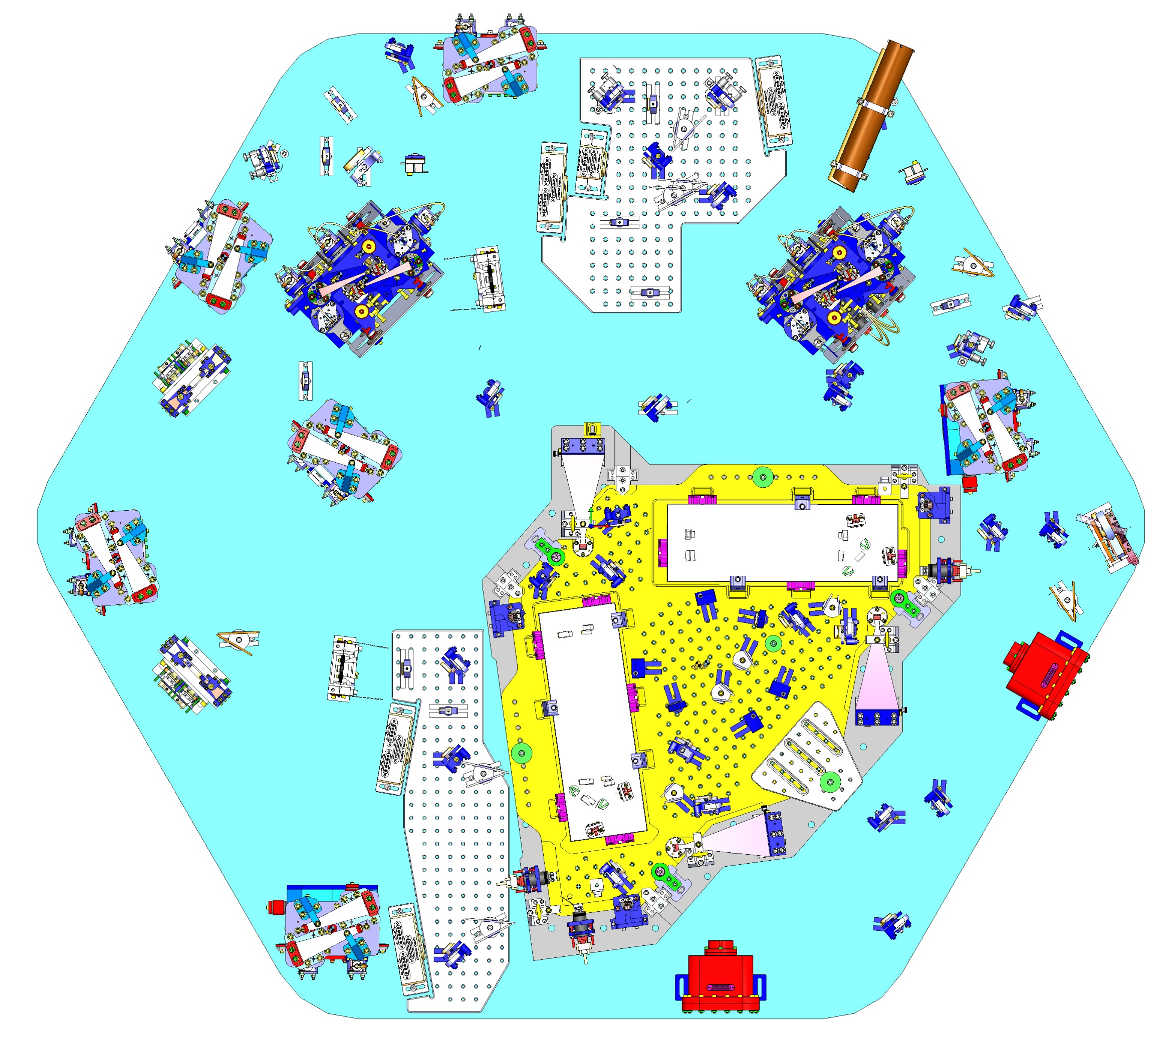
A+ CONCEPTUAL DESIGN - 05
HAM8 FLANGE LAYOUT OF ELECTRICAL FEEDTHROUGHS
L1: LIGO-D1900113
H1: LIGO-D1900115
(Completed A+ integrated layout for observing run 05)
LIGO-D1800027-v28
page 1 of 2
24
HAM8
H1: D1900369
L1: D1900311
HAM3
BSC2
H1: D0901094
L1: D0900520
H1: D0901142
L1: D0900428
~300m long filter cavity
2
1
3
BSC3
H1: D0901146
L1: D0900492
HAM4
H1: D0901125
L1: D0900421
DETAILS:
HAM3
LO1 (HRTS with BS, Lo Beam)
1
HAM7 FLANGE LAYOUT OF ELECTRICAL FEEDTHROUGHS
L1: LIGO-D1900114
H1: LIGO-D1900116
BSC2
BS (BS 450mm Diameter)
2
LO2 (HRTS, with Mirror, Lo Beam)
19
3
HAM4
23
22
HAM5
LO3 (HRTS with Lens, Lo Beam)
4
ZM6 (HSDS, Double SUS)
5
5
LOW LOSS FARADAY ISOLATOR
6
21
HAM6
OBS (HRTS, Triple SUS)
7
OM0 (HRTS, Triple SUS)
4
18
8
OMA2 (HPDS, Double SUS w/ Piezo SAMS)
HAM7
9
OMA3 (HCDS, Double SUS w/ Piezo SAMS and Dither)
20
10
OMA1 (HDDS, Double SUS w/ Dither)
6
HAM5
H1: D1900365
L1: D1900274
11
OMB2 (HPDS, Double SUS w/ Piezo SAMS)
12
OMB3 (HCDS, Double SUS w/ Piezo SAMS and Dither)
H1: D0901129
L1: D0900456
13
OMB1 (HDDS, Double SUS w/ Dither)
14
OMCA
10
15
OMCB
On Single OMC Platform
7
+Y
16
HAM7
ZM1 (HDDS, Double SUS w/ Dither)
11
8
18
ZM2 (HPDS, Double SUS w/ Piezo SAMS)
+X
19
ZM3 (HDDS, Double SUS w/ Dither)
14
12
20
ZM4 (HPDS, Double SUS w/ Piezo SAMS)
21
ZM5 (HPDS, Double SUS w/ Piezo SAMS)
16
22
FC1 (HSTS TRIPLE, FILTER CAVITY)
13
23
15
HAM8
FC2 (HSTS TRIPLE, FILTER CAVITY)
HAM6
24
9
H1: D0901822
L1: D0901811

Slide 2
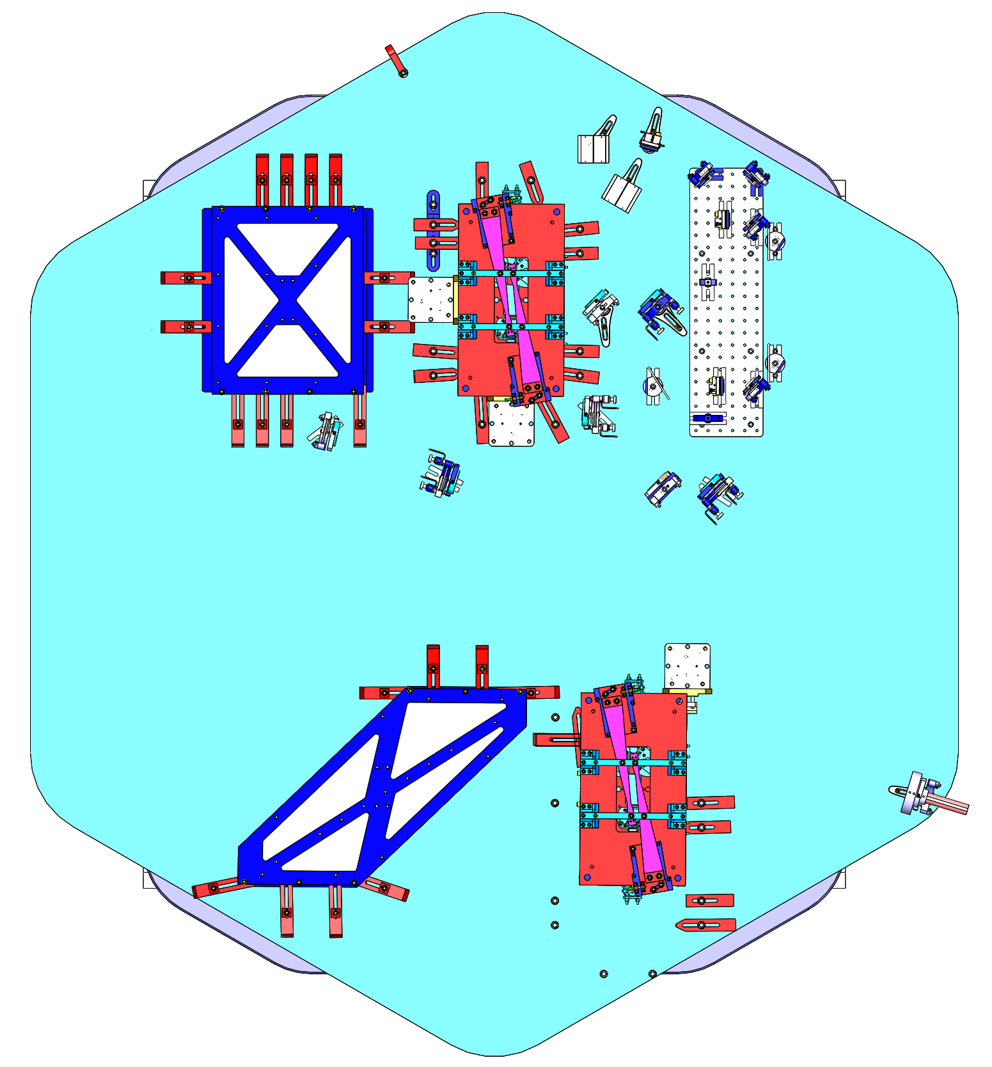
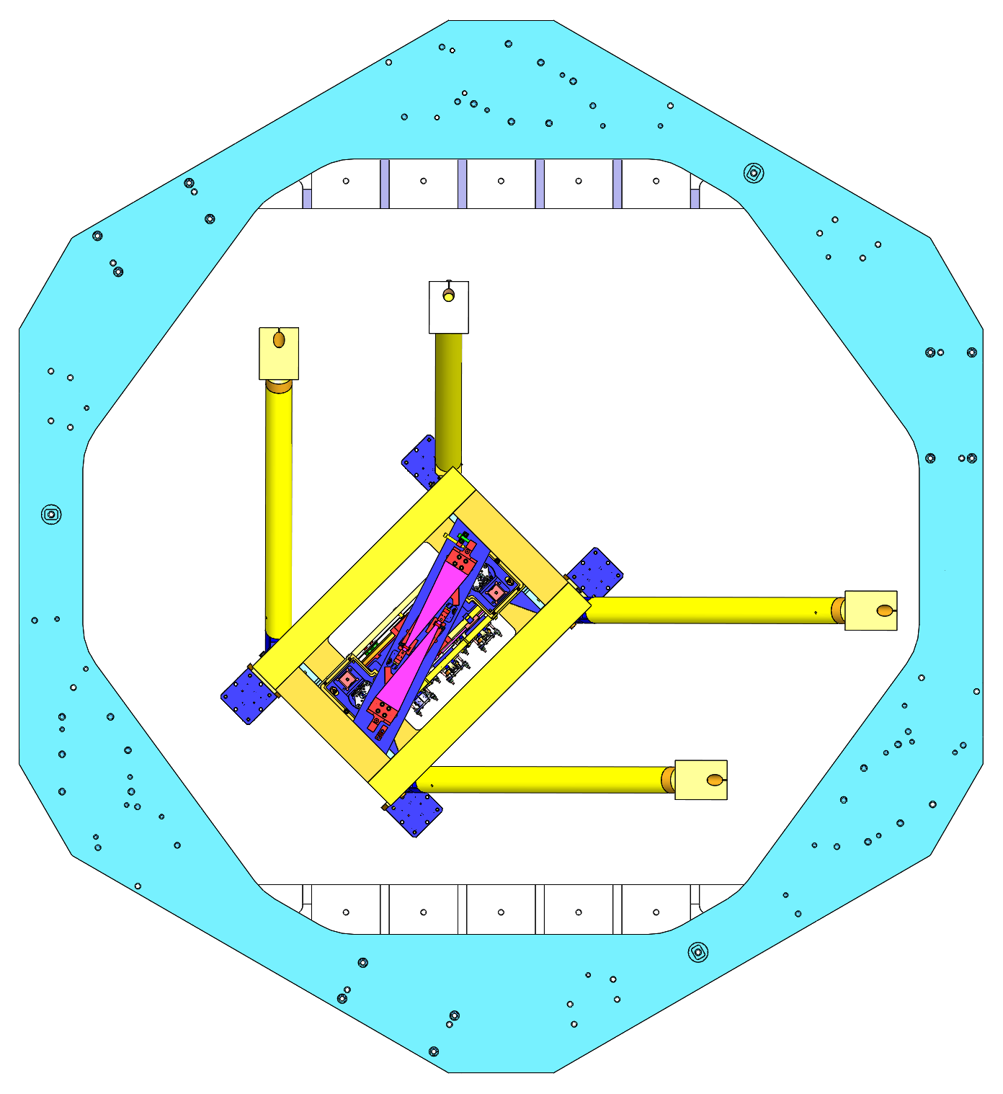
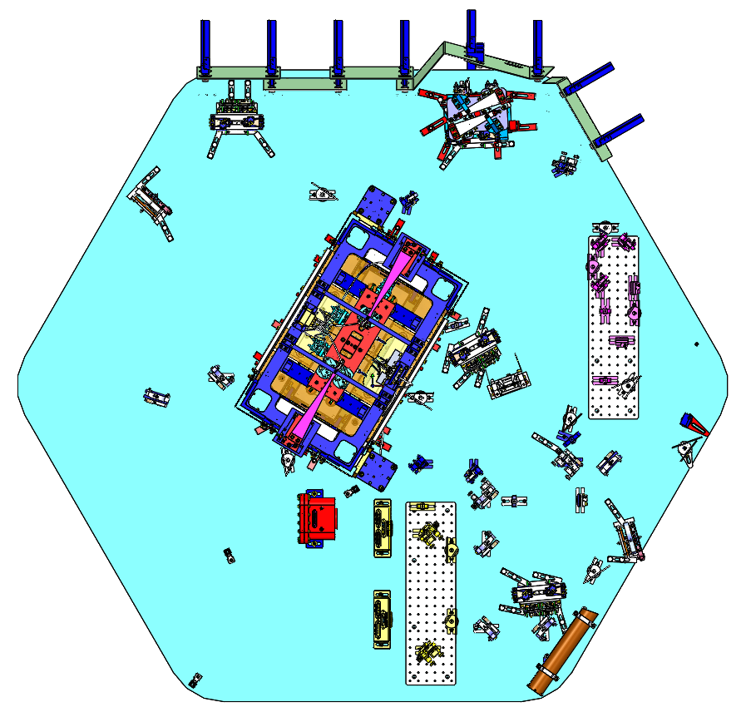
A+ CONCEPTUAL DESIGN - 04
HAM8 FLANGE LAYOUT OF ELECTRICAL FEEDTHROUGHS
L1: LIGO-D1900113
H1: LIGO-D1900115
(Partial A+ integrated layout for observing run 04)
LIGO-D1800027-v28
page 2 of 2
24
HAM8
HAM3
BSC2
~300m long filter cavity
BSC3
HAM4
DETAILS:
HAM3
BSC2
HAM7 FLANGE LAYOUT OF ELECTRICAL FEEDTHROUGHS
L1: LIGO-D1900114
H1: LIGO-D1900116
HAM4
19
HAM5
ZM6 (HSDS, Double SUS)
23
22
5
LOW LOSS FARADAY ISOLATOR
6
HAM6
OM1 (TIP-TILT)
5
25
OM2 (HTDS, Double SUS w/ Thermal SAMS)
26
OM3 (TIP-TILT)
21
27
HAM7
ZM1 (HDDS, Double SUS w/ Dither)
18
18
ZM2 (HPDS, Double SUS w/ Piezo SAMS)
20
HAM7
19
ZM3 (HDDS, Double SUS w/ Dither)
20
ZM4 (HPDS, Double SUS w/ Piezo SAMS)
6
HAM5
21
ZM5 (HPDS, Double SUS w/ Piezo SAMS)
22
FC1 (HSTS TRIPLE, FILTER CAVITY)
23
HAM8
FC2 (HSTS TRIPLE, FILTER CAVITY)
+Y
24
26
+X
27
25
HAM6

