Slide 1
ITM03; LHO ITMx
Post O2 inspection
LIGO-T1800013-v1
A feature was found at the location predicted by TCS. This feature is highly absorbing. This feature was present in the scans of the optic as received from the coater.
No other absorbers over 20 ppm were found in the center 60 mm of the optic.
Authors: G. Billingsley, L. Zhang January 2018
G
Scatter

Slide 2
Experimental process
Scatter measurement - The map before installation: measured after First Contact cleaning with ion gun. The map after O2: measured as-returned from LHO, no cleaning
Cleaning with ion gun because there was some dust visible when checking with a flash light.
Gentle absorption: the measurement was carried out with a beam of 0.3mm in diameter and 0.9W, i.e. 12.7W/mm^2. The lower limit of sensitivity for this scan was about 20ppm.
High resolution probe of the high absorption spot. The measurement was done with a beam of 60 um in diameter at 25 mW, i.e. 8.8 W/mm^2.
All scatter and absorption data are referenced from LIGO-E1000766

Slide 3
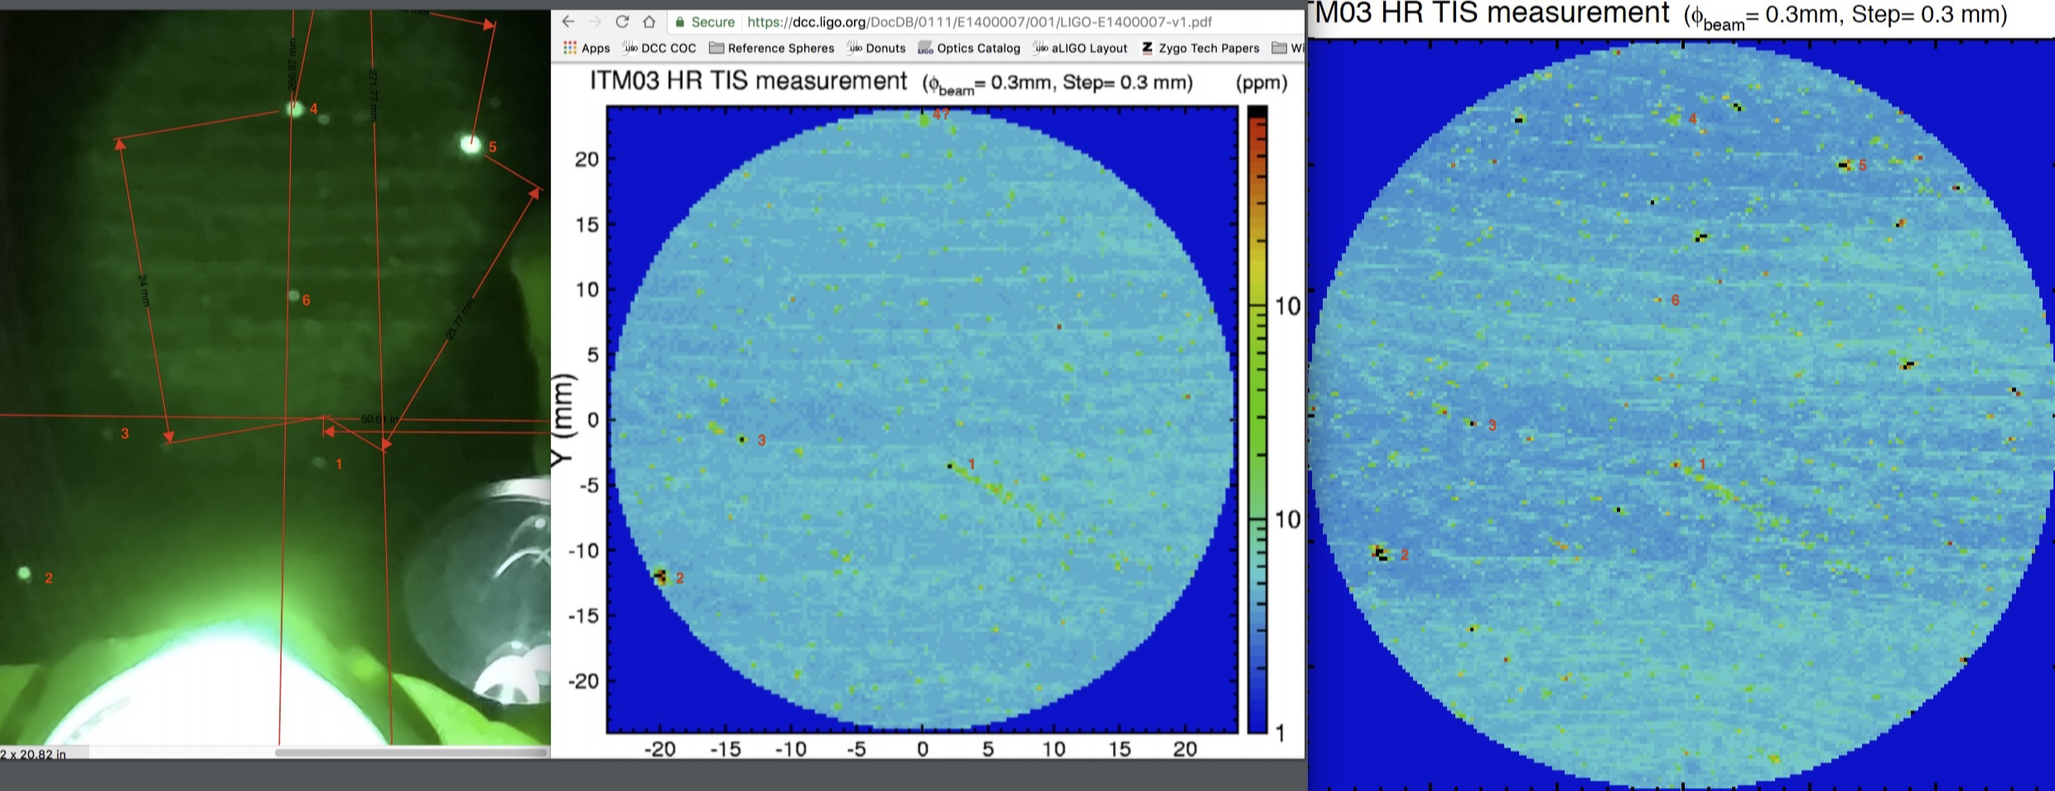
ITM03 scatter
In chamber view, before install, after removal
Scatter before installation: 5.6 ppm. Scatter after installation 6.3 ppm
Spot # 2 found to be the high absorber,
Present in “before” and “after” scatter scans

Slide 4
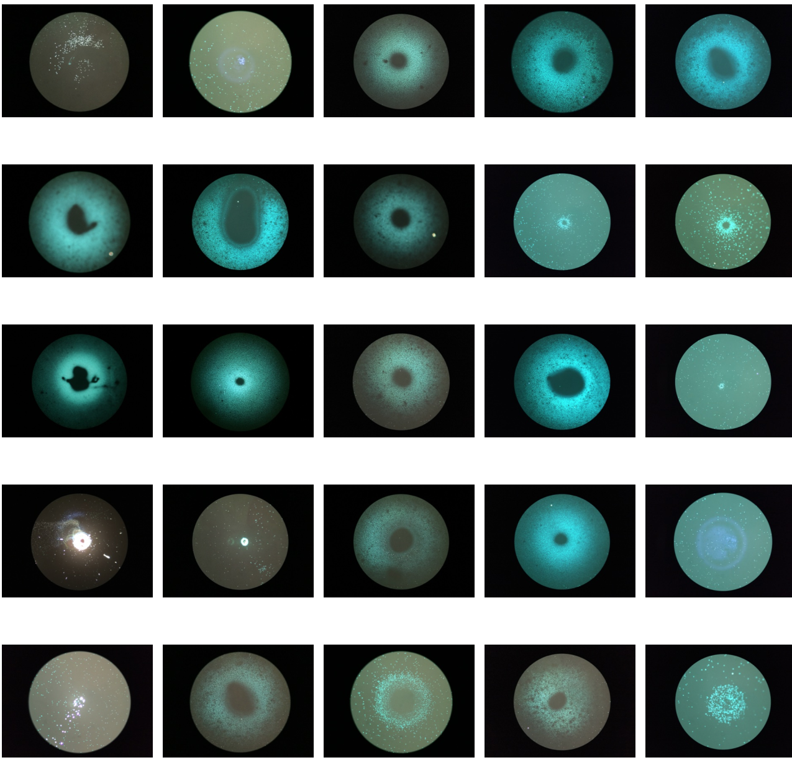
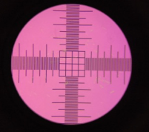
Interesting 1
Features found within a radius of ~60 mm of center.
1 mm ∅ field
Center scale squares are 50 µm
Absorbing
Interesting 2
Interesting 3

Slide 5
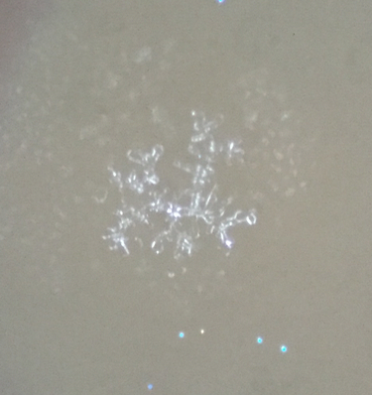
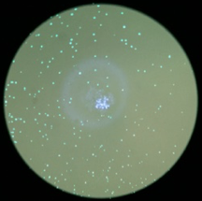
Interesting 1 (5, -27)
Branch-like center structure

Slide 6
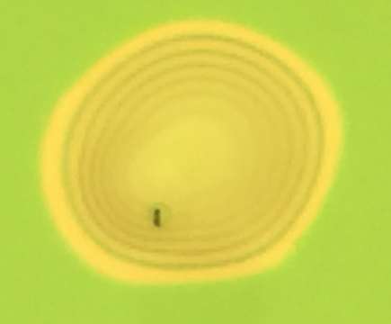
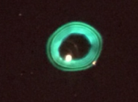
Interesting 2 (-8, -39)
Shown in bright field
~80 µm in diameter

Slide 7
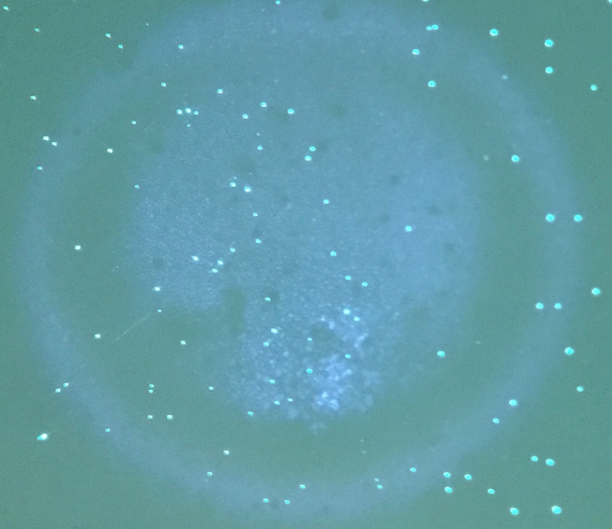
Interesting 3 (-60, -43)
Center is filled

Slide 8
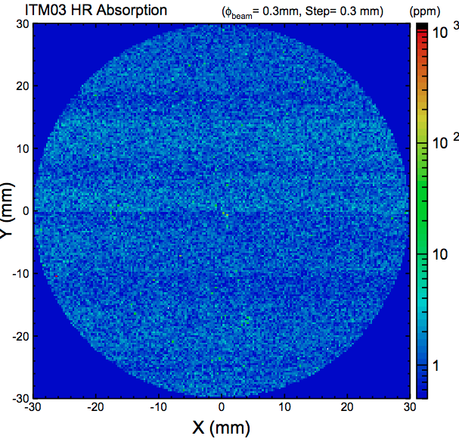
Absorption spot
noise floor ~20 ppm

Slide 9
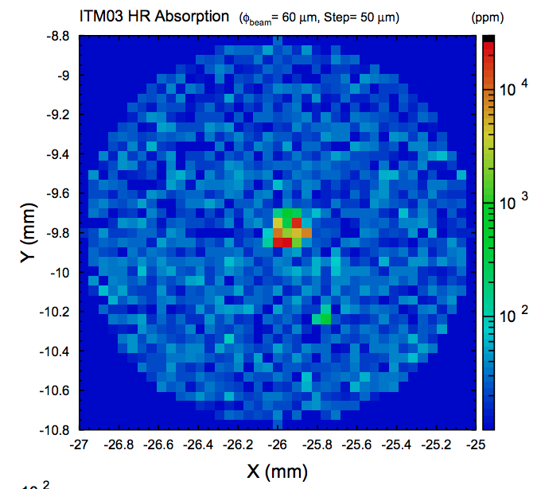
Probe absorption with smaller beam

Slide 10
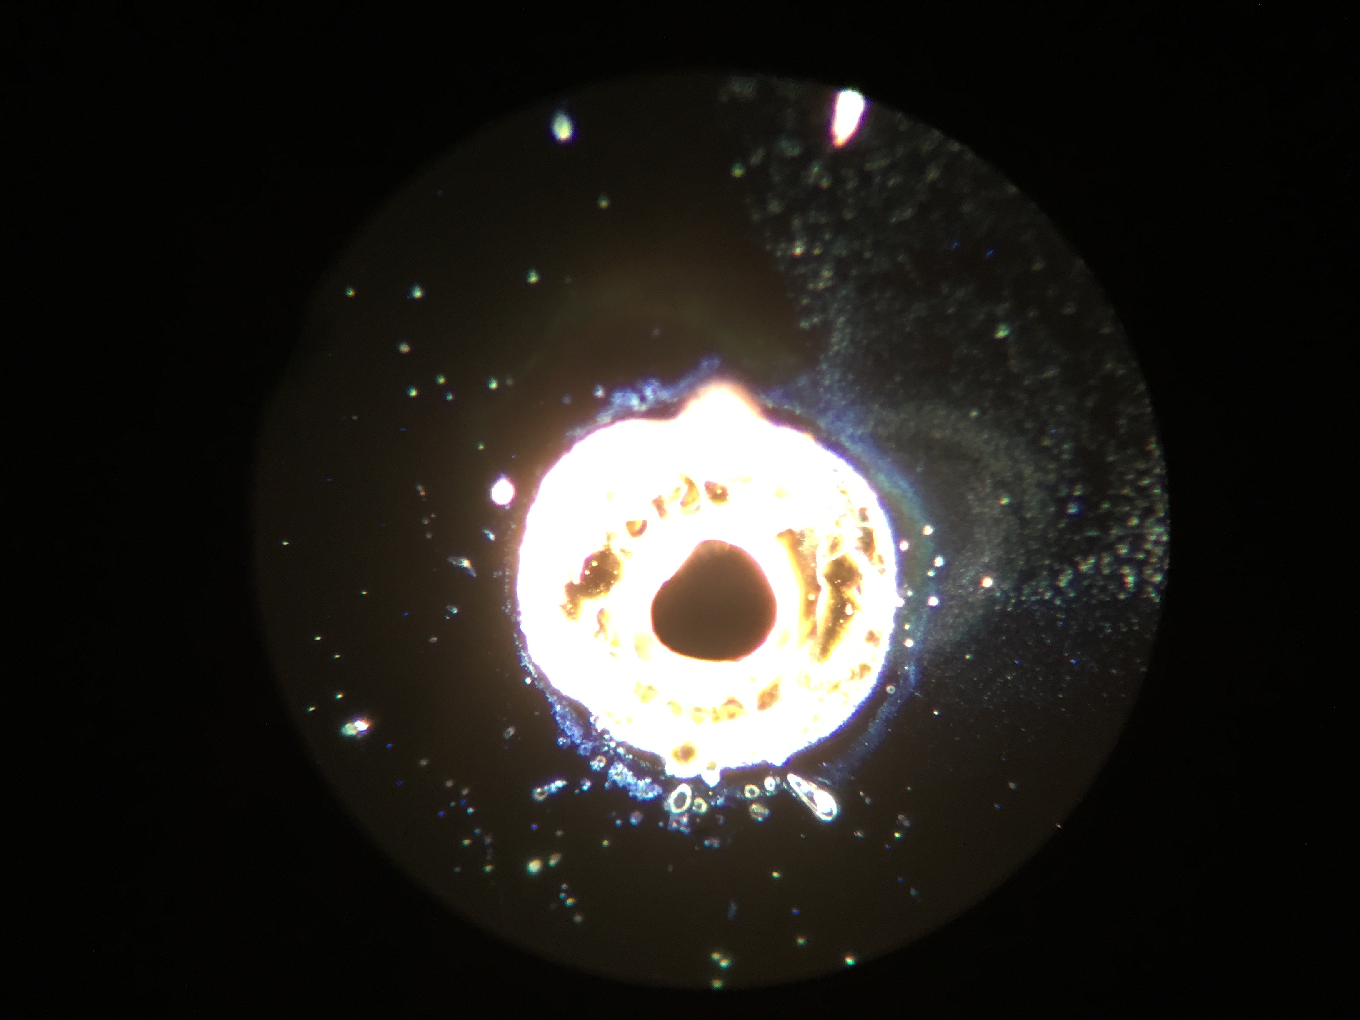
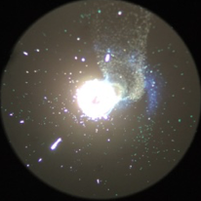
absorber: 155 µm across bright center

Slide 11
absorber: 155 µm across bright center

Slide 12
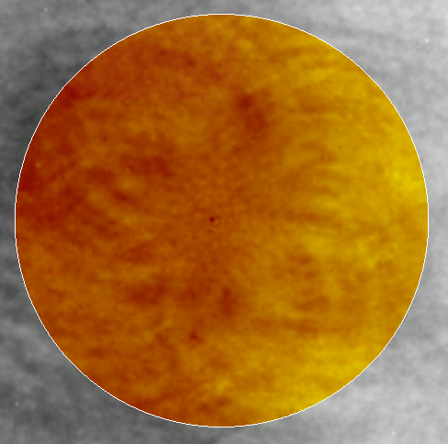
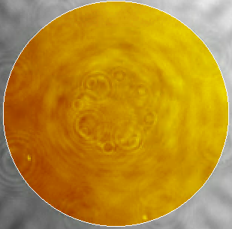
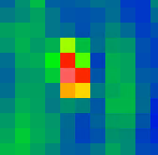
Absorption spot seen in figure data?
Polished and coated data 60 mm mask (orange circle) 0.06 nm rms polished, PV 0.49 nm 0.08 nm rms coated, PV 1.06 nm - 1 pixel = 400 µm
Interesting point #1 is in a similar, though not exact location to the point seen low right.

