Slide 1
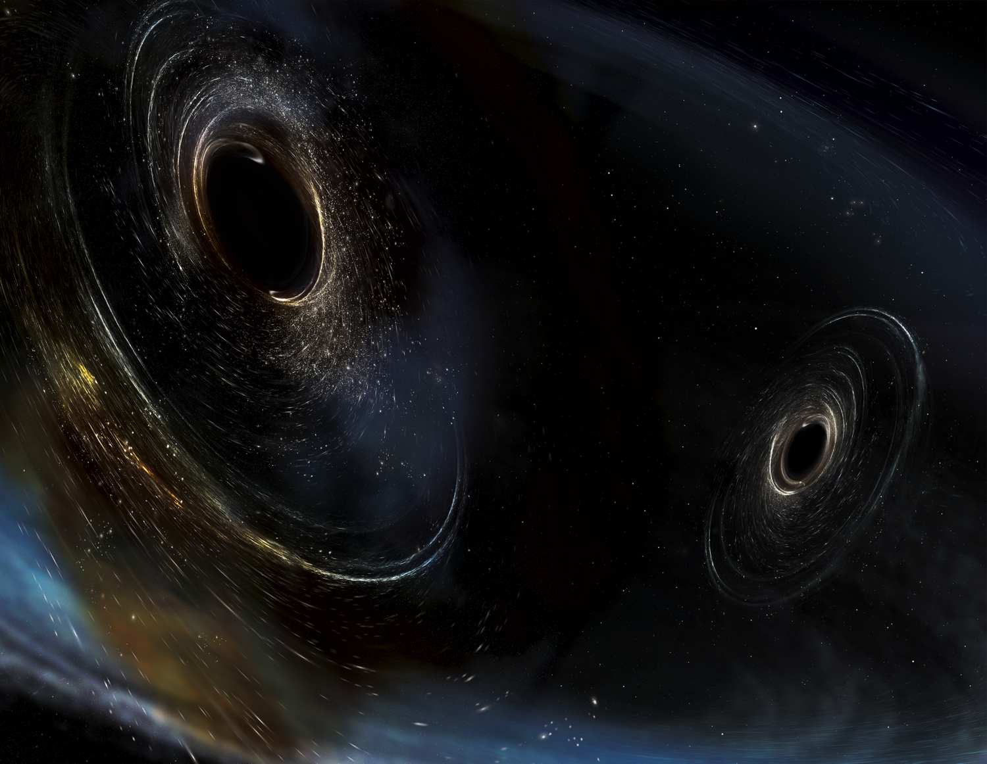




LIGO: The Instruments that Launched Gravitational-wave Astronomy
Peter Fritschel, LIGO Laboratory
Massachusetts Institute of Technology
AAS 231st Meeting
Washington, DC
12 January 2018
LIGO-G1800030-v1
Image Credit: Aurore Simmonet/SSU

Slide 2
What have our detectors seen?
h =
± 1x10⁻²¹
30-250 Hz
24
± 3x10⁻²²
35-400 Hz
13
± 5x10⁻²²
30-200 Hz
13
± 6x10⁻²²
30-200 Hz
18
Frequency
band
SNR

Slide 3
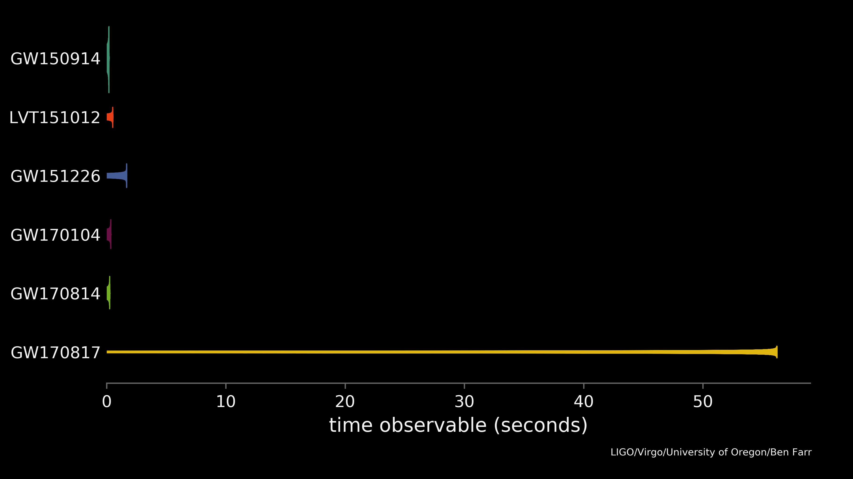
The BNS inspiral was rather different
This talk will describe the incredible detectors that made this collection of discoveries
h_{p-p} = 1x10⁻²²
Over ~100 sec, f_{gw} 25 → 400 Hz
SNR = 32

Slide 4

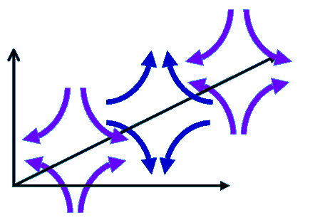
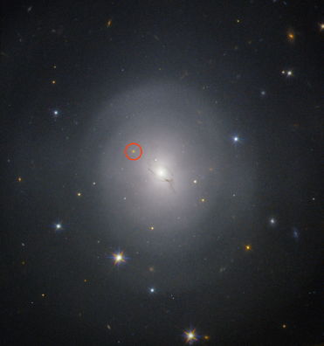
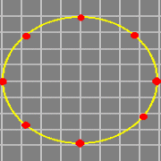
Detecting the effects of GWs
GW’s produce time-varying transverse strain in space
→ Monitor separations of free test particles
(Earth)
In a galaxy far far away…
NGC4993
European Southern Observatory
Very Large Telescope

Slide 5

Michelson interferometer
Inertial test body
Inertial test body
L_{y}
L_{x}
LASER
Beamsplitter
Photodetector

Slide 6
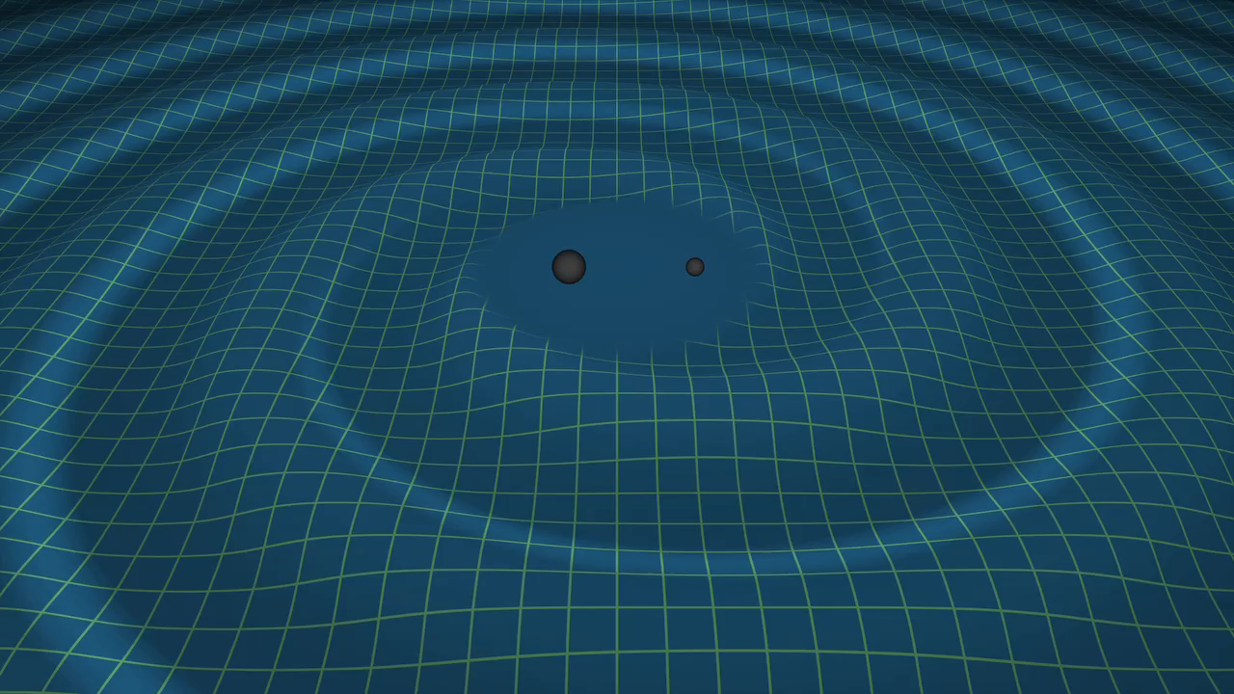
A “small” problem…
A wave’s strength is measured by the strain induced in the detector →
We can calculate expected strain at Earth:
Our interferometer arms are 4,000 meters long,
!!
A ten-thousandth the size of an atomic nucleus

Slide 7
The Enemies: NOISE
Seismic Noise
test body (mirror)
Quantum Uncertainty
Residual gas scattering
Radiation pressure
LASER
beamsplitter
"Shot" noise
Wavelength & amplitude fluctuations
Thermal (Brownian) Noise
photodiode

Slide 8
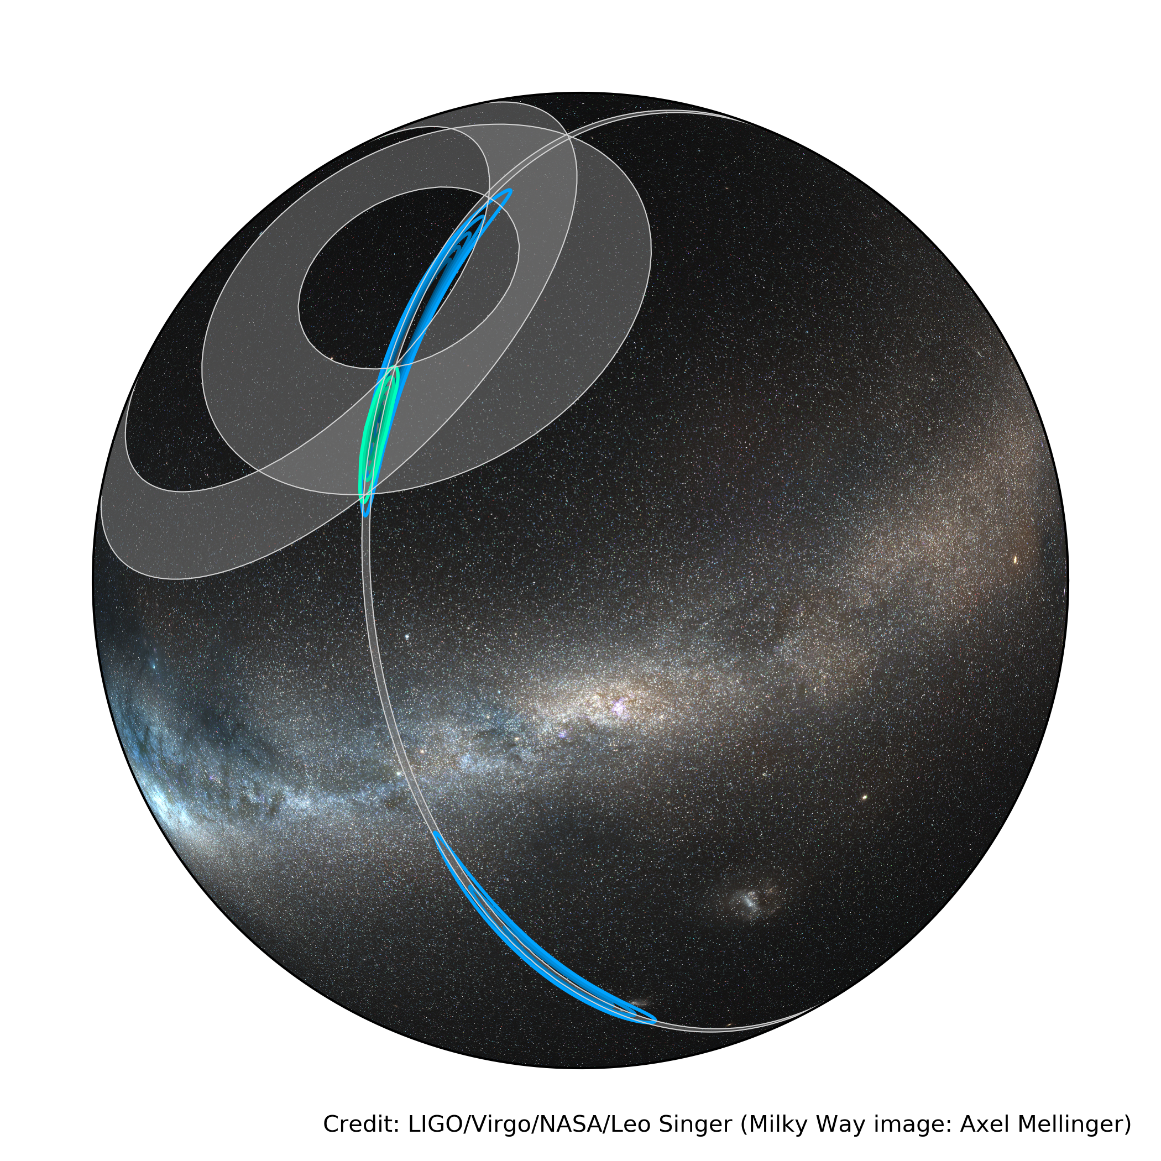
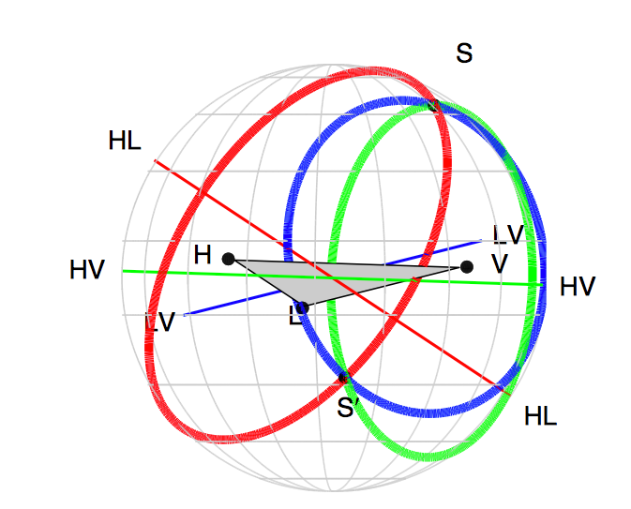
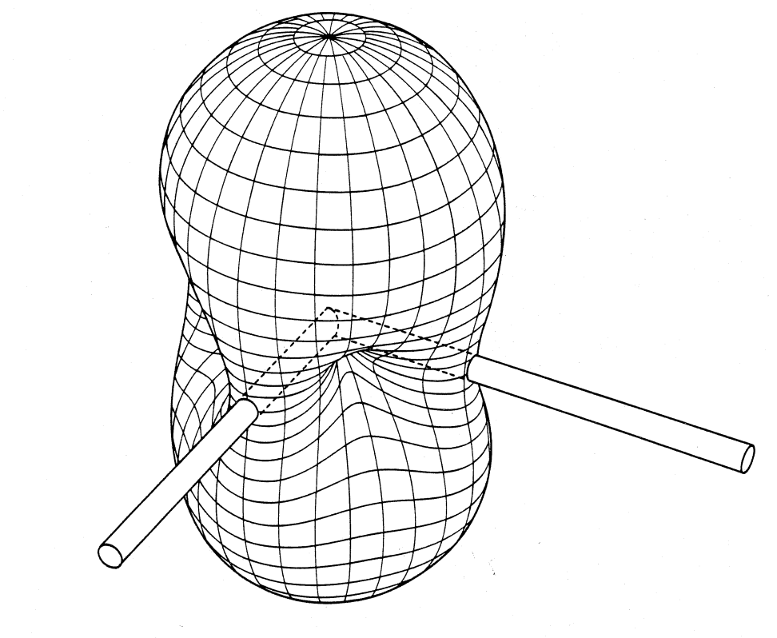
Features of Interferometric
GW Detectors
Frequency band for terrestrial detectors:
  ‘Unavoidable’ noises at low frequencies
  Detector response falls off as 1/f above a few hundred Hz
Interferometers have a broad directional response
10 Hz – 10 kHz
Binary neutron star detection
GW170817
Arrival time triangulation
Antenna pattern for
unpolarized GWs
Nearly omnidirectional, but still useful for source localization

Slide 9
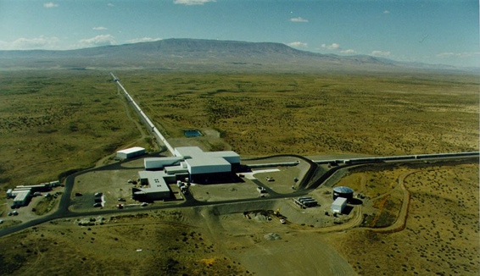
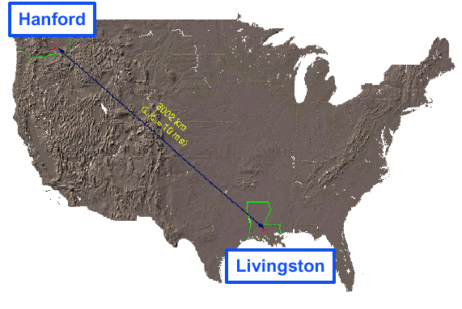
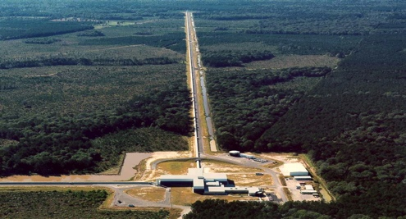
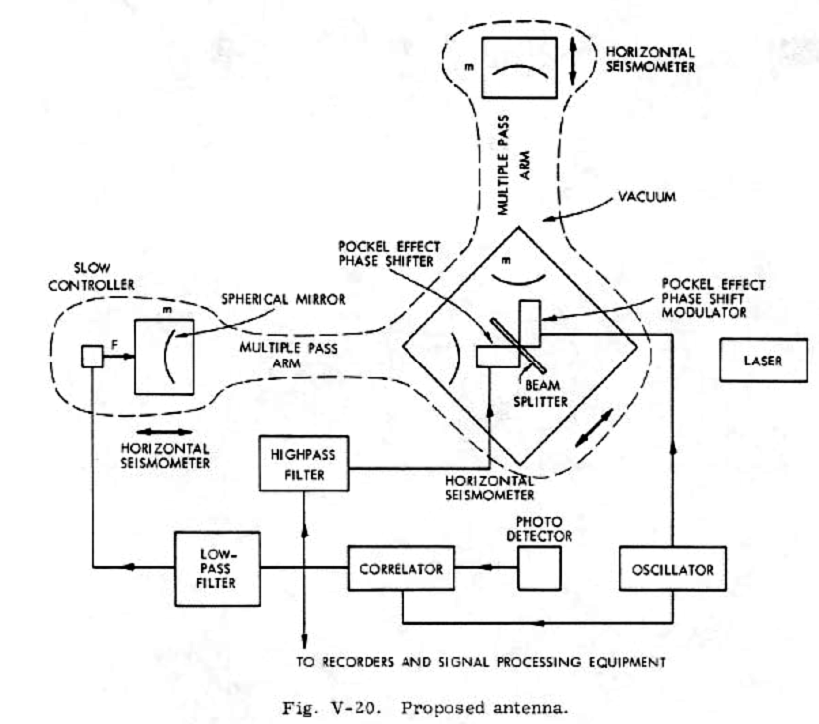

Brief history of LIGO
Original concept: 1972, Rai Weiss
Two observatories constructed from 1994 – 2000
  3 Interferometers:
  4 km & 2 km at Hanford
  4 km at Livingston
Initial LIGO operated from 2002 – 2007
Enhanced LIGO operated from 2008 – 2010
Reached design sensitivity, though no gravitational waves were detected
3000 km (10 ms)
MIT
Caltech
LIGO Livingston

Slide 10
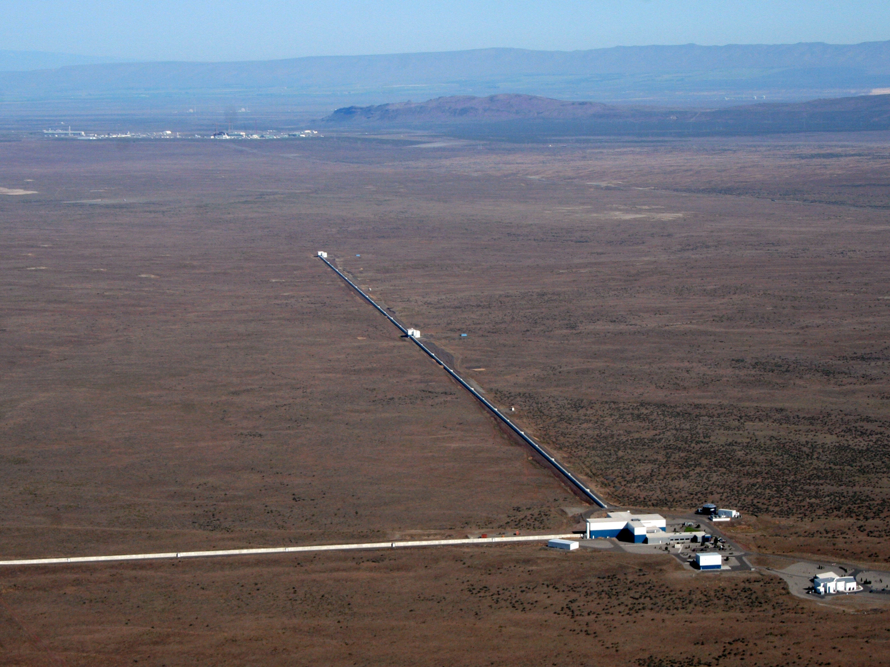
LIGO Hanford Observatory
H1 detector

Slide 11
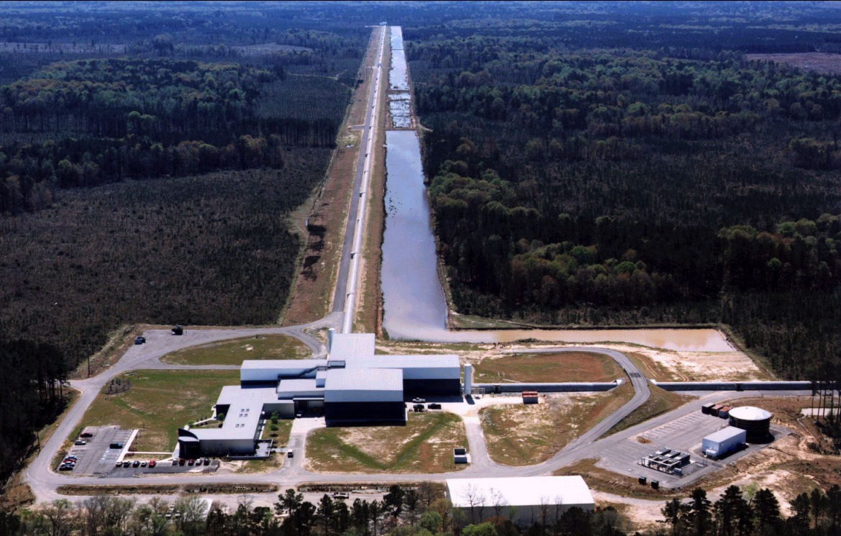
LIGO Livingston Observatory
L1 detector

Slide 12
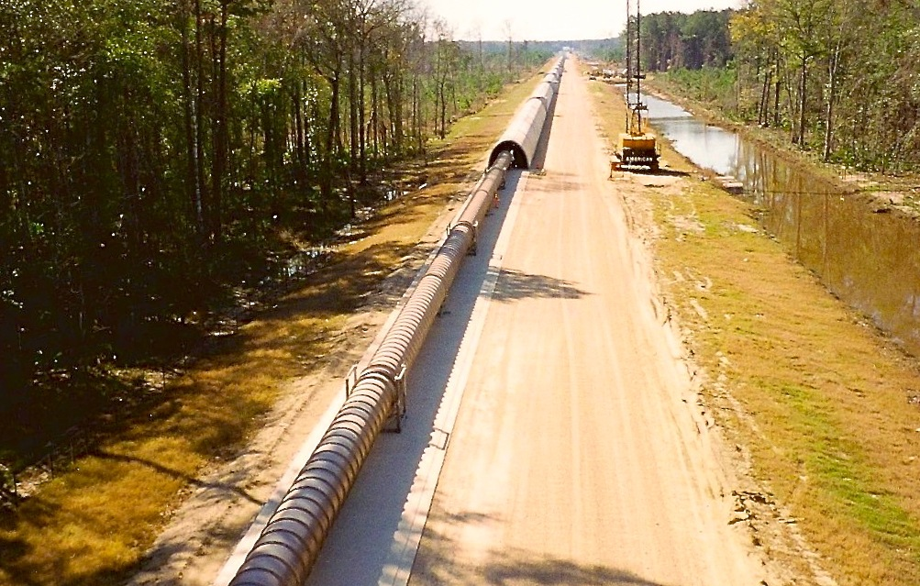
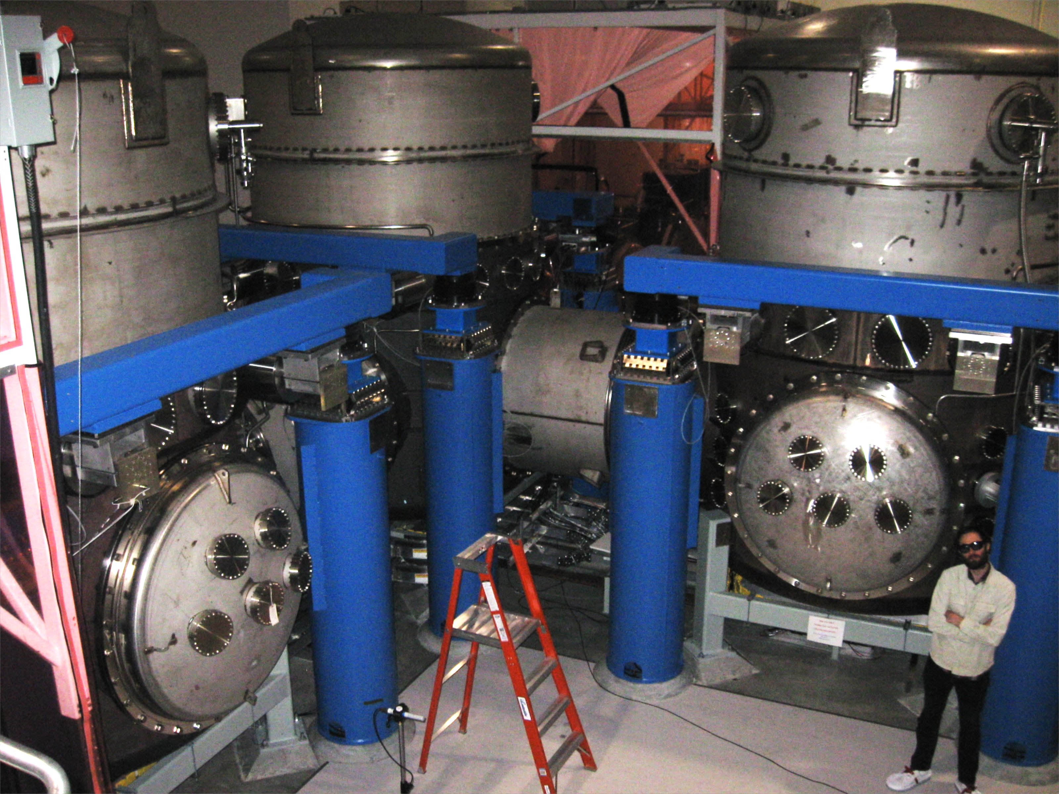
Built with the future in mind
4 km beam tubes were designed for the better vacuum needed by more sensitive interferometers
P = 10⁻⁹ torr
1.2 m diameter – avoid scattering against walls
Straight to fraction of a cm
Vacuum chambers were designed to contain larger test masses

Slide 13




Enter Advanced LIGO
Project funding began in 2008
An international partnership
Max Planck Institute (Germany): Laser
Science & Technology Facilities Council (UK): Suspensions
Australian Research Council: Sensors & controls
Advanced LIGO timeline
2011
2012
2013
2014
2015
2016
2017
Installation
Integration
H1
L1
Commissioning
O1
O2
= first full lock
First observing run:
Sept 2015 – Jan 2016
Second:
Nov 2016 – Aug 2017

Slide 14
LIGO Optical Configuration
Advanced
Initial
Michelson
Interferometer
Power Recycled
end test mass
with Fabry-Perot Arm Cavities
Light bounces back and forth along arms about 100 times
& signal recycling
Light is “recycled” about 40 times
input test mass
Laser
beam splitter
signal recycling
signal

Slide 15
Advanced LIGO Optical Layout
High power stage
Up to 750 kw in each arm
So far, 100-120 kW
Medium power stage
In air
In vacuum
Gravitational wave, or

Slide 16
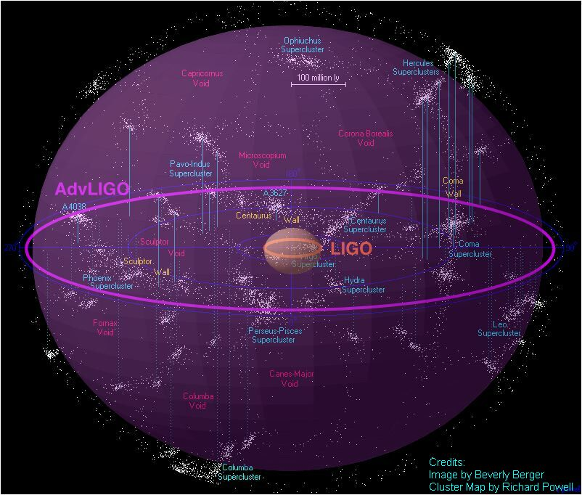
It’s all about the sensitivity
Two common ways of characterizing sensitivity
quantum
radiation
pressure &
seismic noise
1
Strain Noise Spectrum:
Since IFOs detect GW amplitude, plot amplitude spectral density of detector noise (square root of power spectrum), expressed as equivalent GW strain
ΔL/L,
per
Hz^{1/2}
quantum shot
noise
thermal noise
frequency
2
Inspiral Range:
the distance to which the coalescence of a pair of 1.4-solar mass neutron stars can be detected, averaged over direction and orientation
GW150914

Slide 17
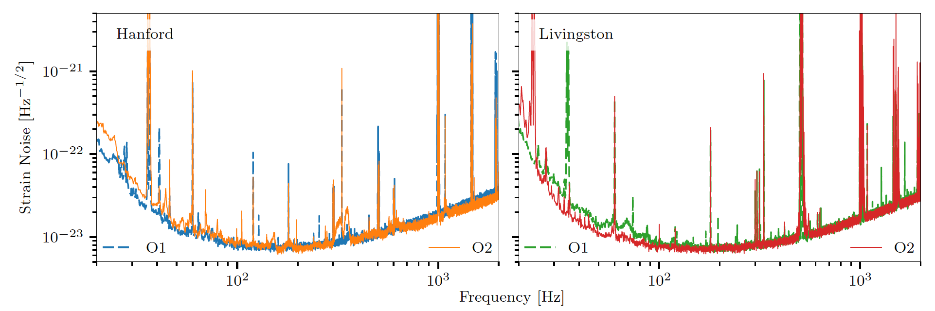
Strain Noise: O1 vs O2
L1 detector: O2 is 30-40% more sensitive than O1
  Using max available laser input power of 25 W
H1 detector: O2 is 5-10% less sensitive
  Laser power limited by excess absorption in one of the Input Test Masses
Hanford H1 Strain Sensitivity
Livingston L1 Strain Sensitivity

Slide 18
H1 data can be improved
H1 had more contamination from auxiliary noise sources
  Largest culprit was laser beam motion, coupled with excess absorption in one of the test masses
These noise sources are monitored and can be removed with post-processing
  Performed on data around GW detections
Excess due to laser beam jitter

Slide 19
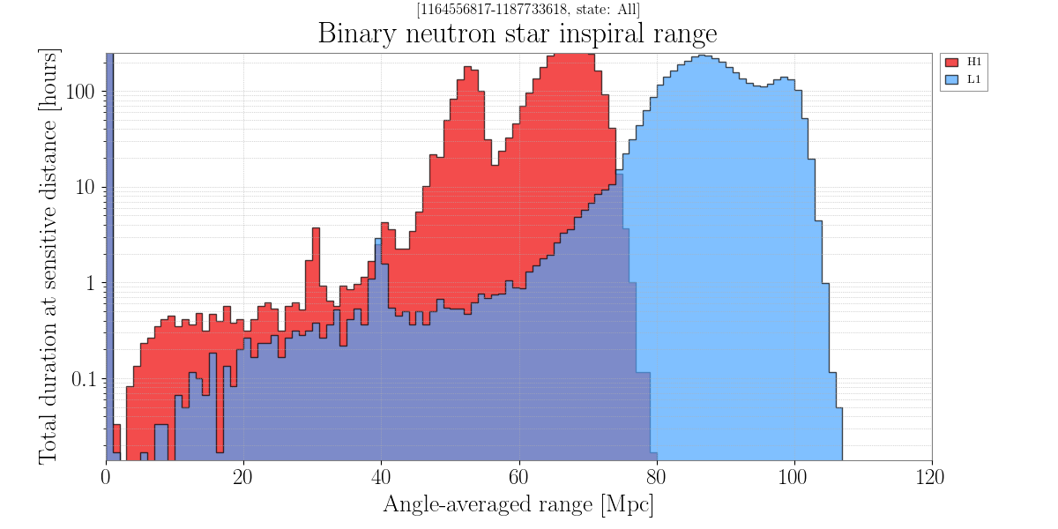
Binary Neutron Star Inspiral Range
Goal for O2: > 80 Mpc BNS range for H1 and L1

Slide 20
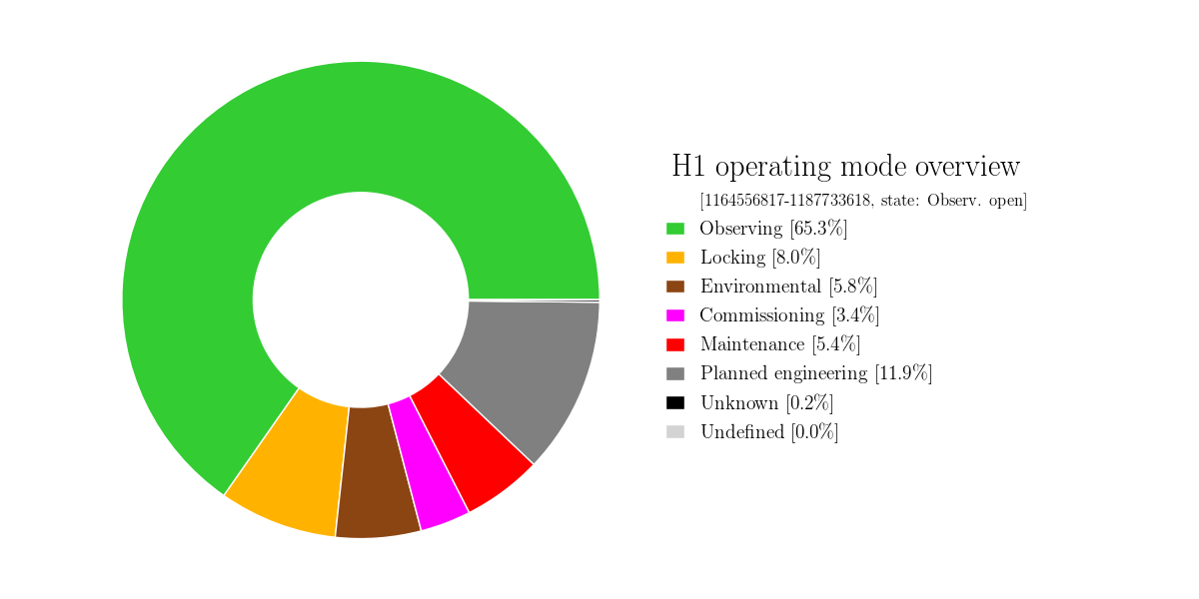
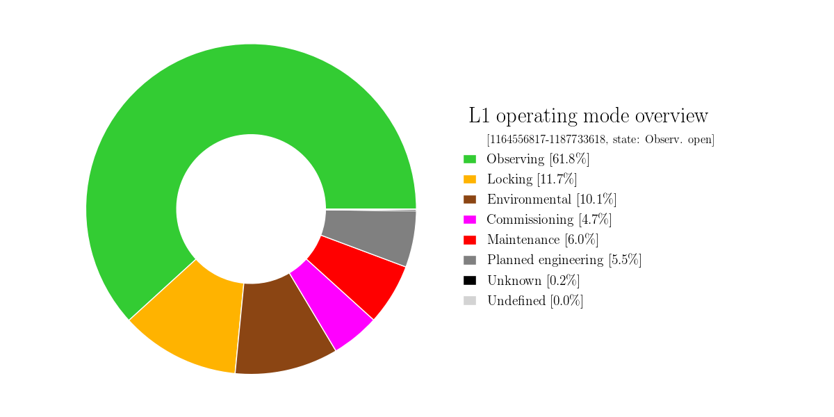
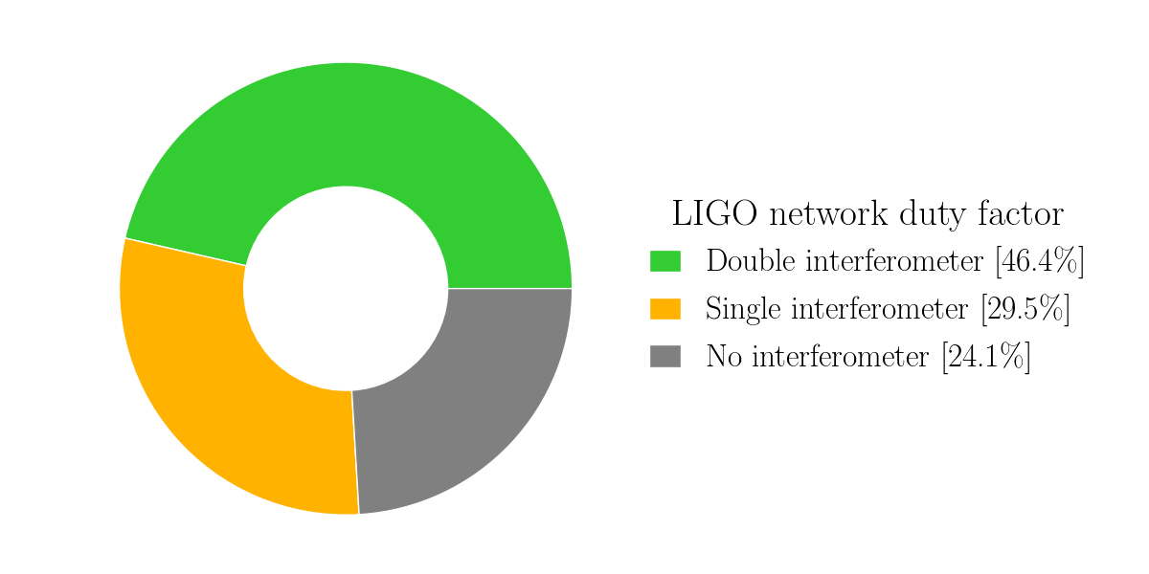
O2 Detector Duty Cycle
65%
62%
120 days

Slide 21
Adv LIGO Target Design Sensitivity
L1: O2
Total noise
Seismic
Quantum
Test mass coating thermal noise
Gravity gradients
Suspension thermal

Slide 22
Tour of the Detector

Slide 23
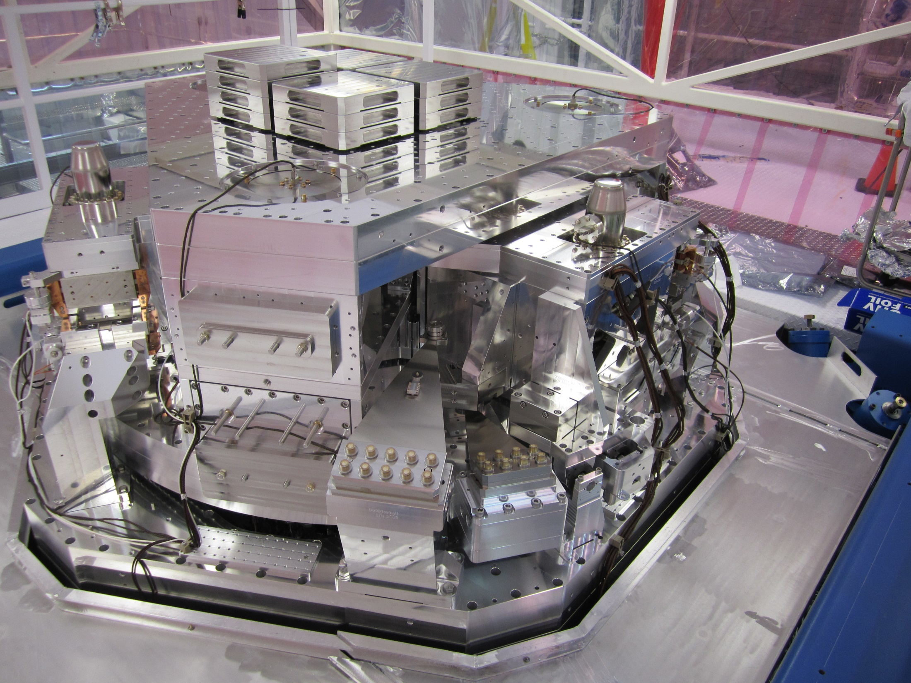
Seismic Isolation Platform

Slide 24
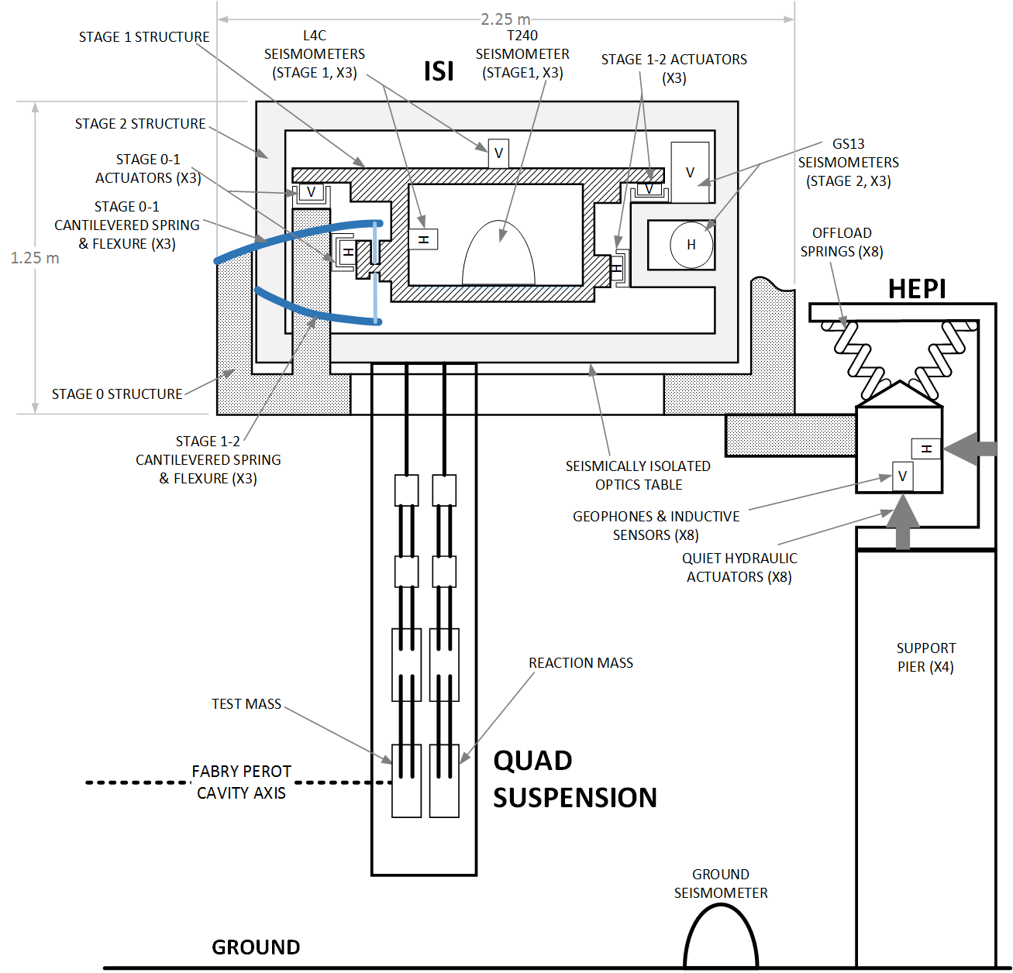
Seismic Isolation
Active suppression of sub-20 Hz vibrations
3-stage, 6 DoF active isolators
Motion of platform that supports test mass suspension

Slide 25
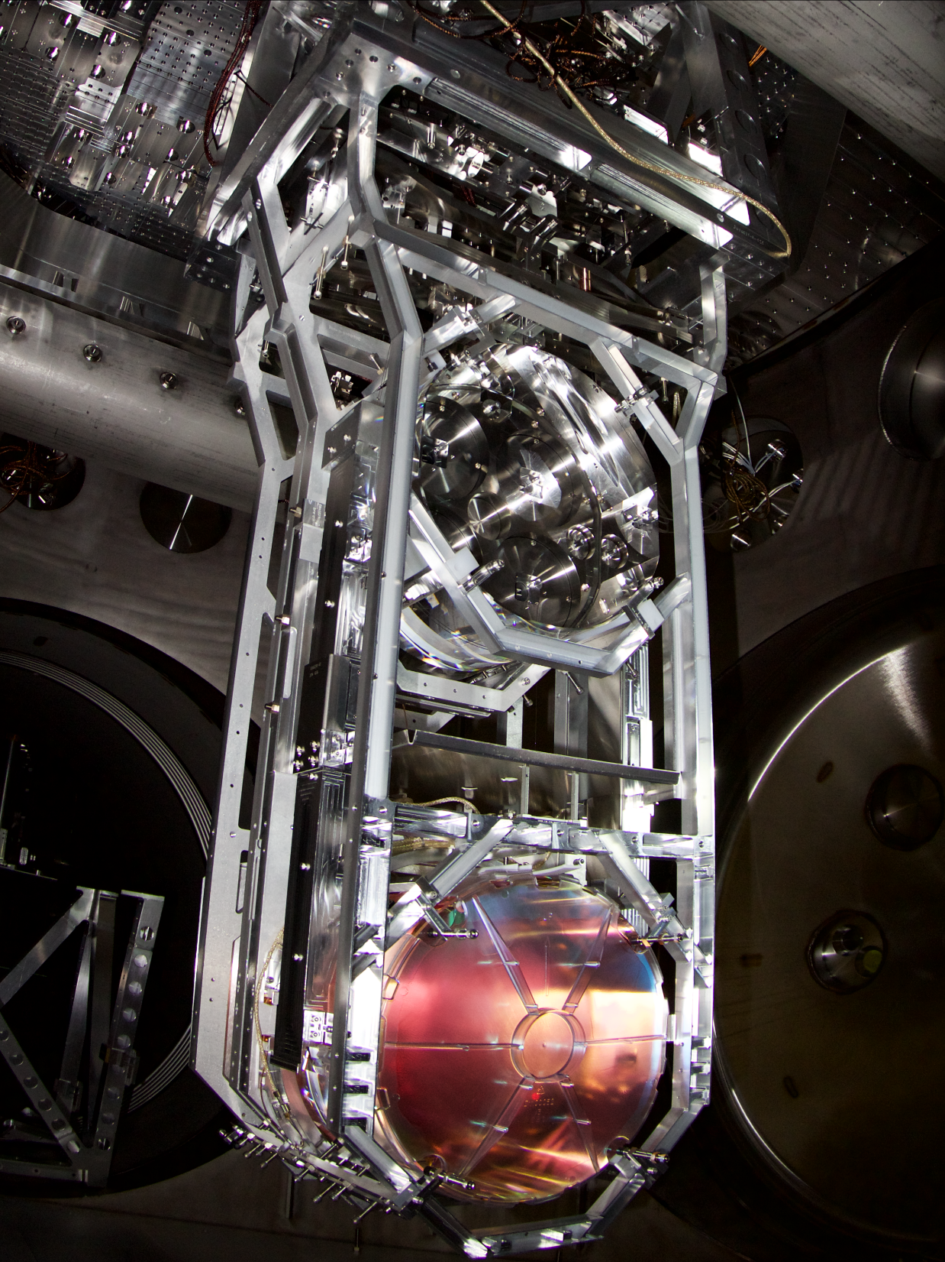

Test Mass Suspension
Reaction chain
Main chain
40 cm

Slide 26
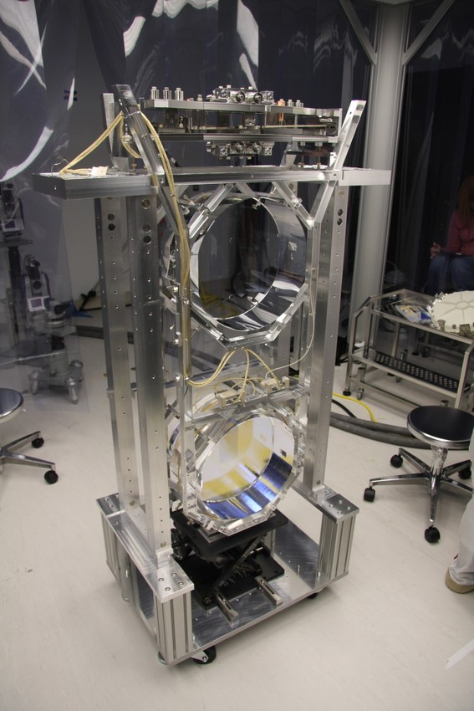
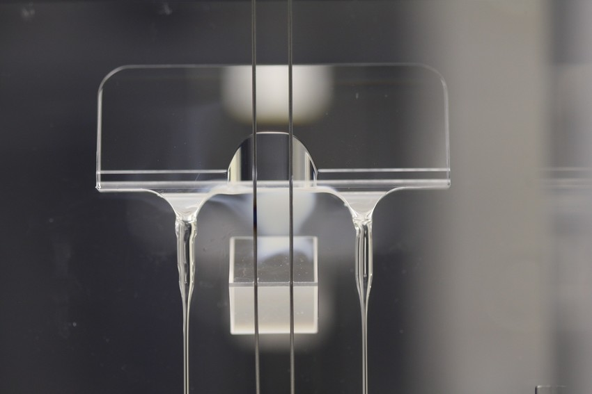
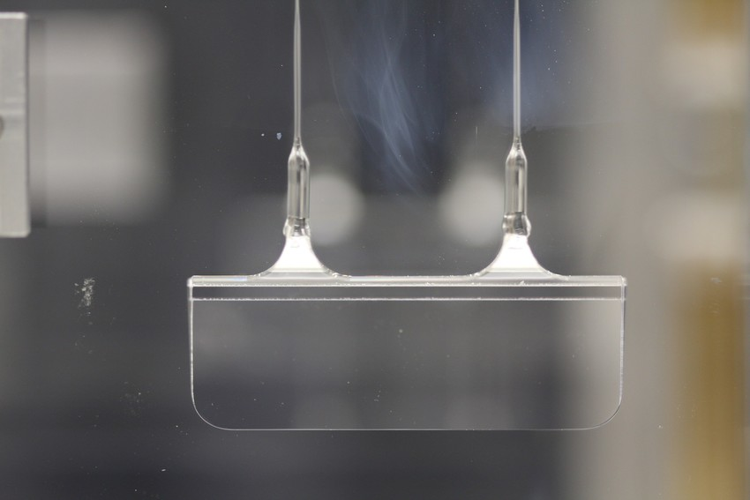
Design for very low suspension thermal noise
Final stage of test mass suspension: all fused-silica, high quality factor to reduce thermal noise
Q ~1 billion
Penultimate mass
Welded connection at the top
60 cm of 400 micron silica fiber in between
Welded connection at the bottom
Test mass

Slide 27
Test mass motion
3-stage active isolator
Test mass seismic noise:
falling as f ⁻¹¹
Suspension thermal noise
4 stages of passive isolation
4
6
8
20
30

Slide 28
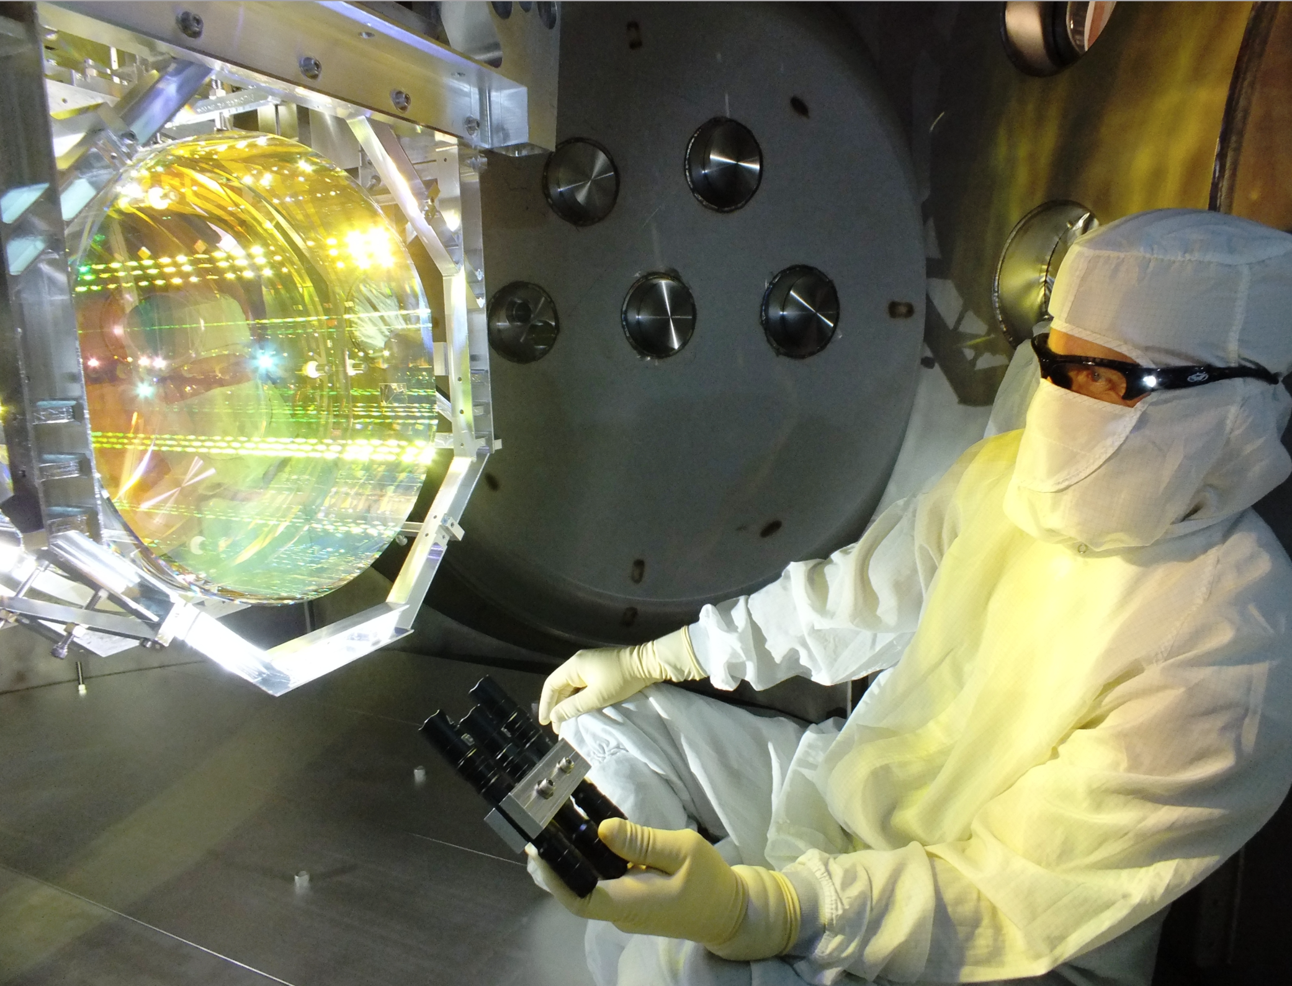
Test Mass
Ultra-low-loss fused silica
34 cm φ x 20 cm thick, 40 kg
Super-polished + ion beam milling
  <0.15 nm RMS deviation from sphere
Mirror coatings:
  Ti:Ta₂O₅ / SiO₂ multi-layers
Very high Optical quality:
> a few 10’s ppm of total loss
> absorption of ≤ 0.5 ppm

Slide 29
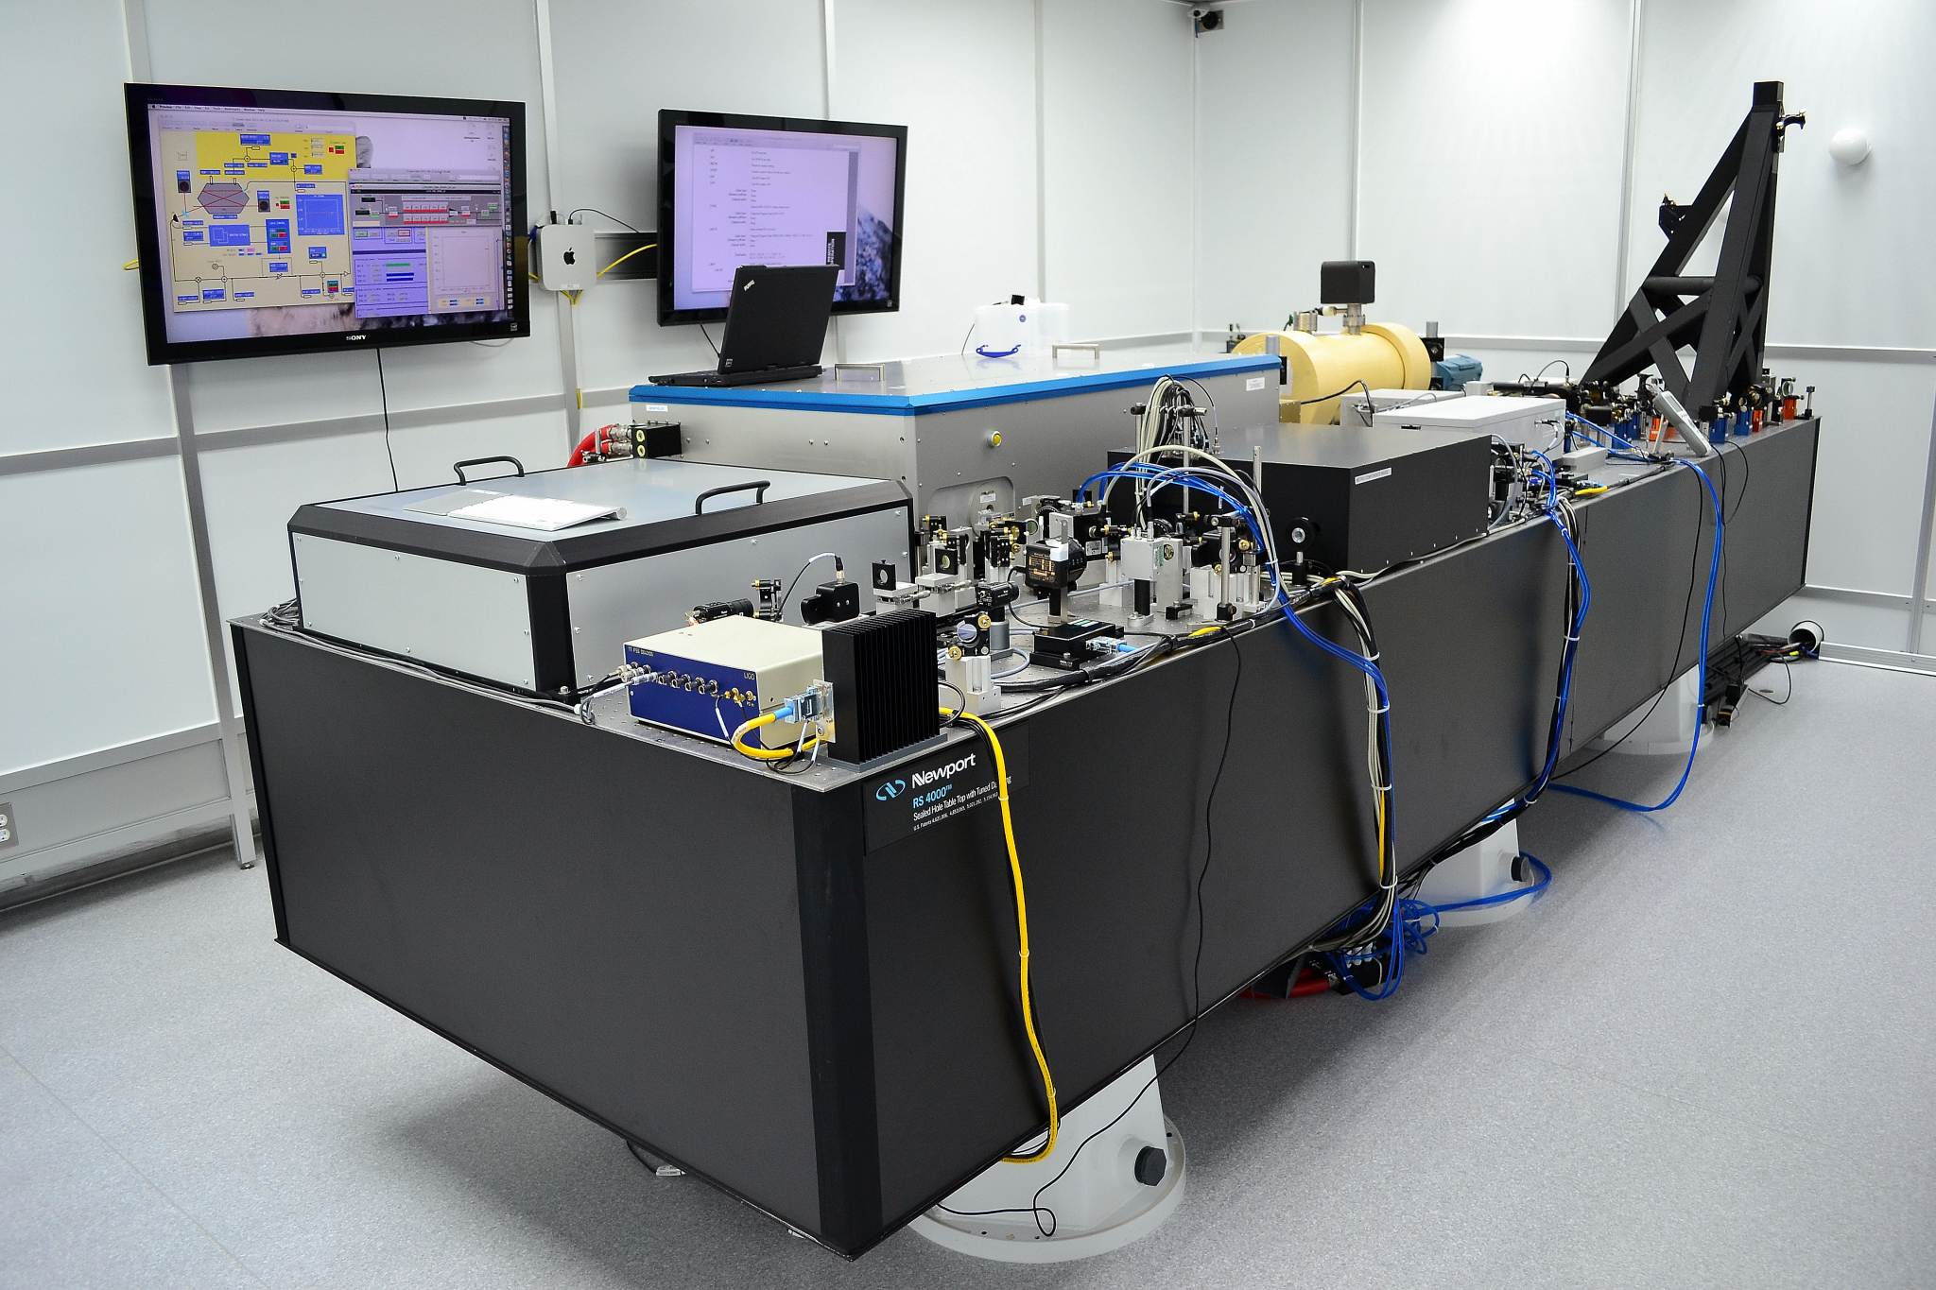
200 W pre-stabilized laser
Frequency & intensity stabilization
Injection locked high-power oscillator
Master Oscillator Power Amplifier
1 micron wavelength

Slide 30
Future Plans

Slide 31
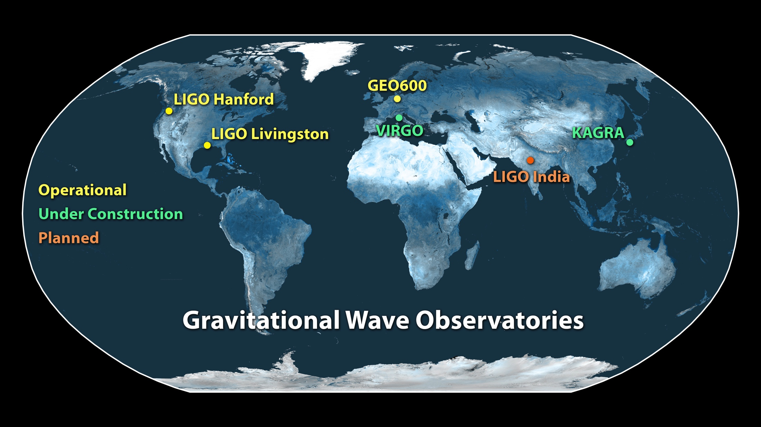
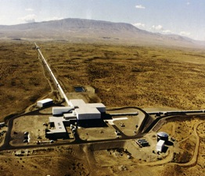
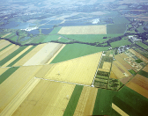
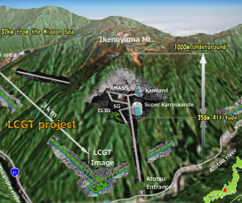
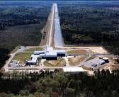
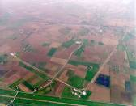

Global network of detectors
VIRGO

Slide 32
Near term prospects
Envisioned sensitivity evolution and observational runs
Currently preparing for O3
From LIGO-P1200087-v42

Slide 33
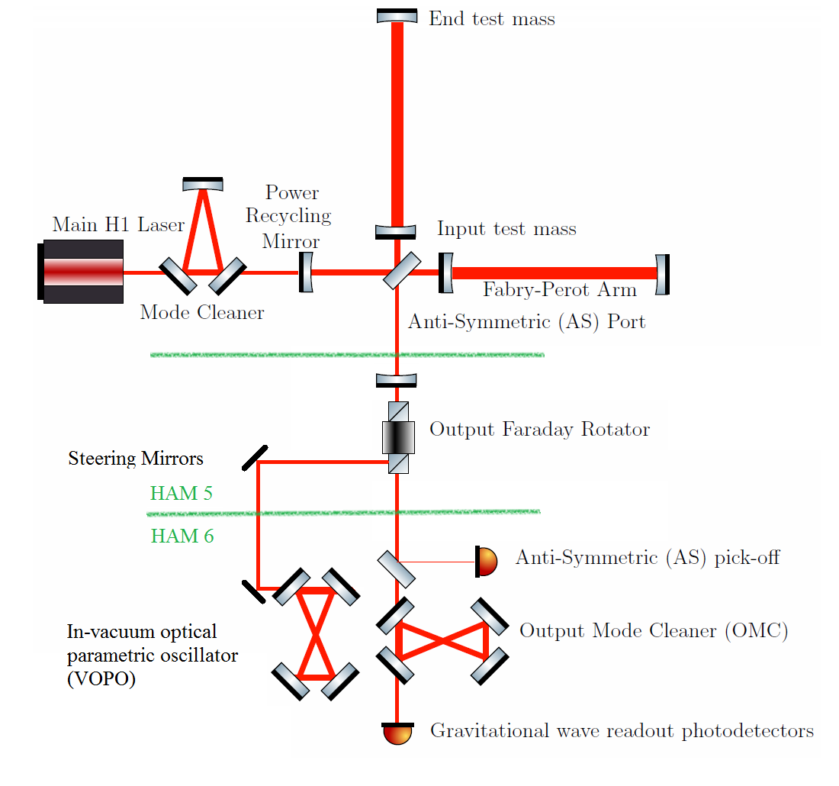
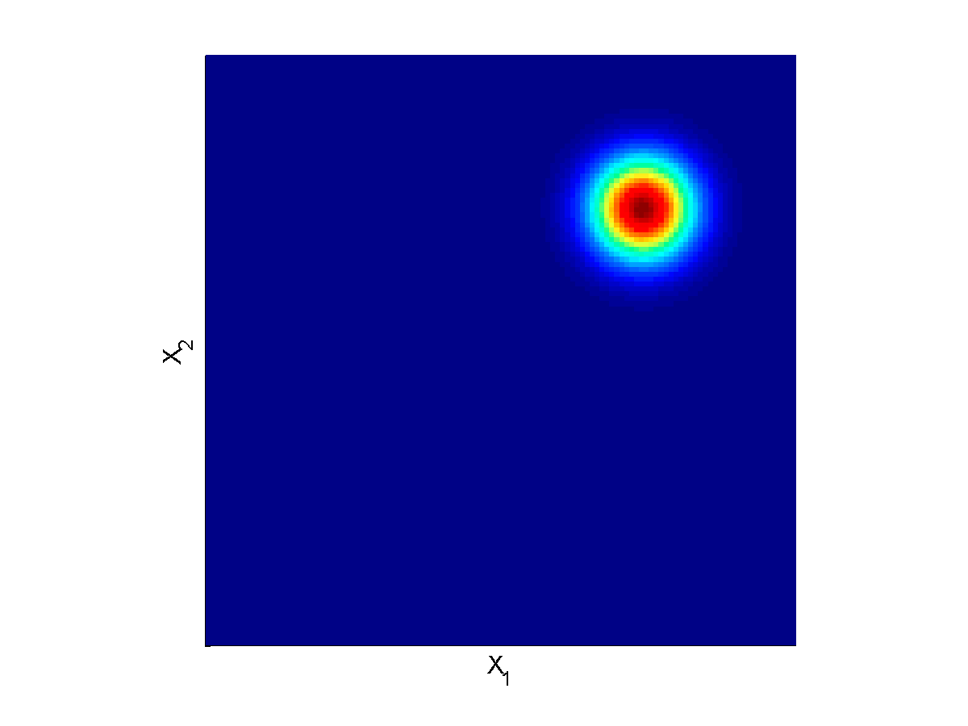
Squeezed Light for O3
Squeezed light and squeezed vacuum
∆X₁ ∆X₂ ≥1
X₂
X₂
∆X₂
∆X₁
X₁
X₁
Coherent
state of light
Vacuum
fluctuations
X₂
X₂
X₁
X₁
Squeezed light
Squeezed vacuum

Slide 34
Impact for O3 performance
Squeezed light injection has essentially the same impact on quantum noise as increased laser power
x2 Higher power
x2 Higher power + squeezing
No further reduction of low frequency noise assumed in this plot

Slide 35
Beyond Advanced LIGO:
The A+ Upgrade
2020-2025

Slide 36
A+: a mid-scale upgrade to
Advanced LIGO
Improvements to quantum noise & thermal noise
Projected time scale for A+ operation: 2023-2025
O2
AdvLIGO design
A+
BNS: 175 Mpc
BBH: 1600 Mpc
BNS: 350 Mpc
BBH: 2250 Mpc

Slide 37
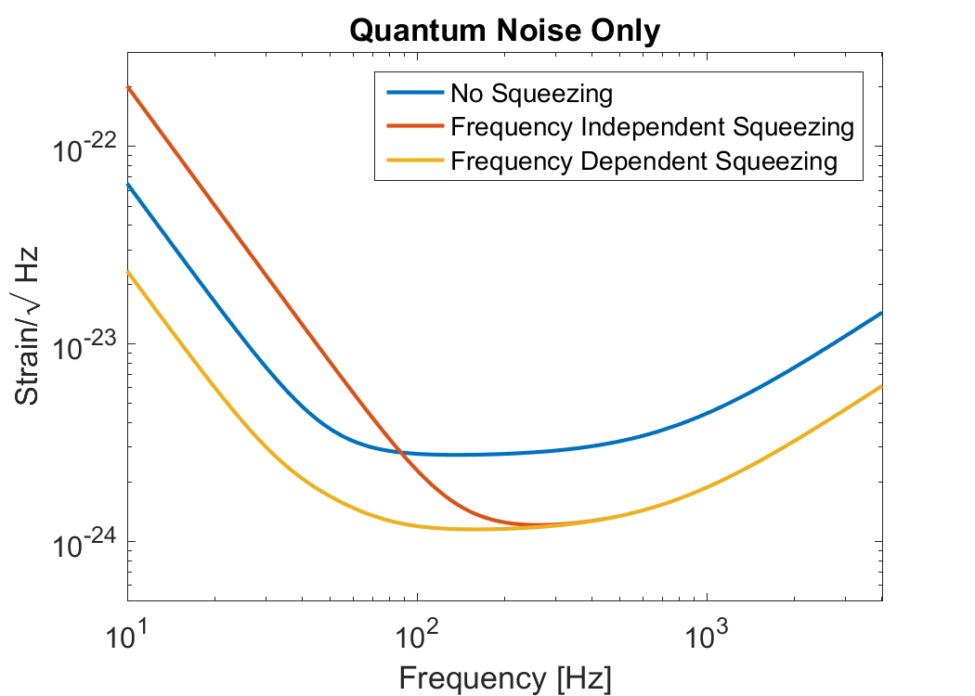
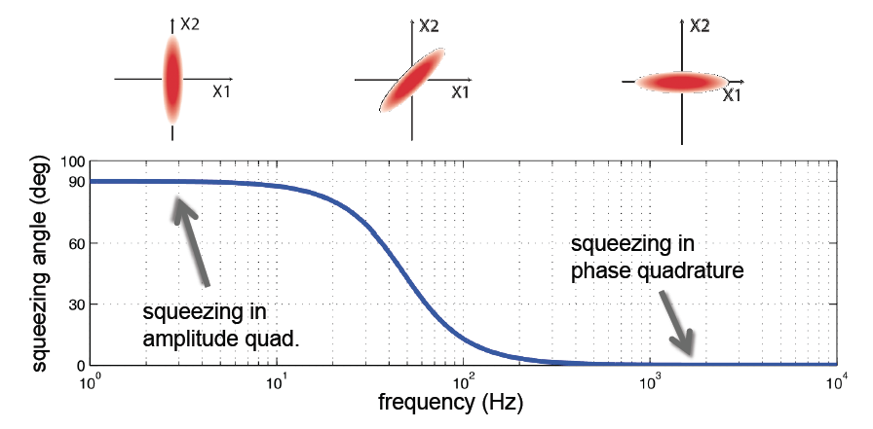
Main elements of A+
New test masses with coatings that have lower thermal noise
  R&D in progress to find better materials
  Targeting a factor of 2 reduction in coating thermal noise
Higher levels of squeezing &
frequency dependent
2.5x
~100 m

Slide 38
Final remarks
Advanced LIGO – the first of the 2nd generation detectors – launched GW astronomy in 2015
  Joined soon after by Virgo in 2017
Next Observing run with LIGO + Virgo starting near the end of 2018
  Sensitivity target for Binary Neutron Star mergers: 120+ Mpc
More coming
  KAGRA: start observing in 2020 with 25-40 Mpc range, 2021 with 40-140 Mpc range
  LIGO-India: to start observing in 2025

Slide 39
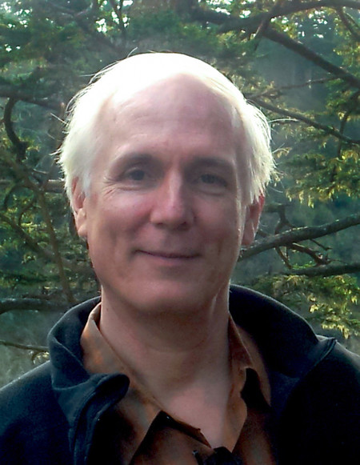
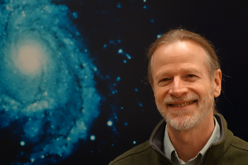
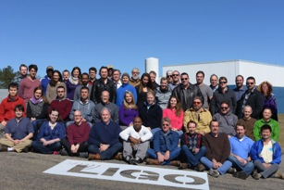
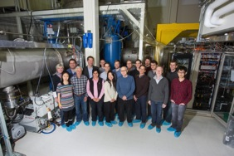
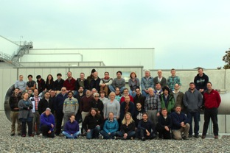
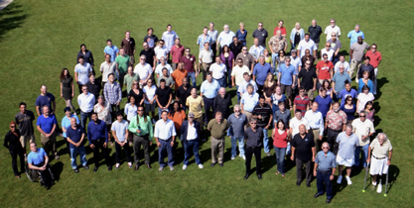

THANKS to:
My fellow Berkeley prize recipients
Dennis Coyne
Caltech
Chief Engineer,
Advanced LIGO/LIGO Lab
David Shoemaker
MIT
Advanced LIGO Project leader
Members of the LIGO Laboratory
LIGO Livingston Observatory
LIGO Hanford Observatory
LIGO Caltech
LIGO MIT
Support:
National Science Foundation

Slide 40
Extra slides

Slide 41
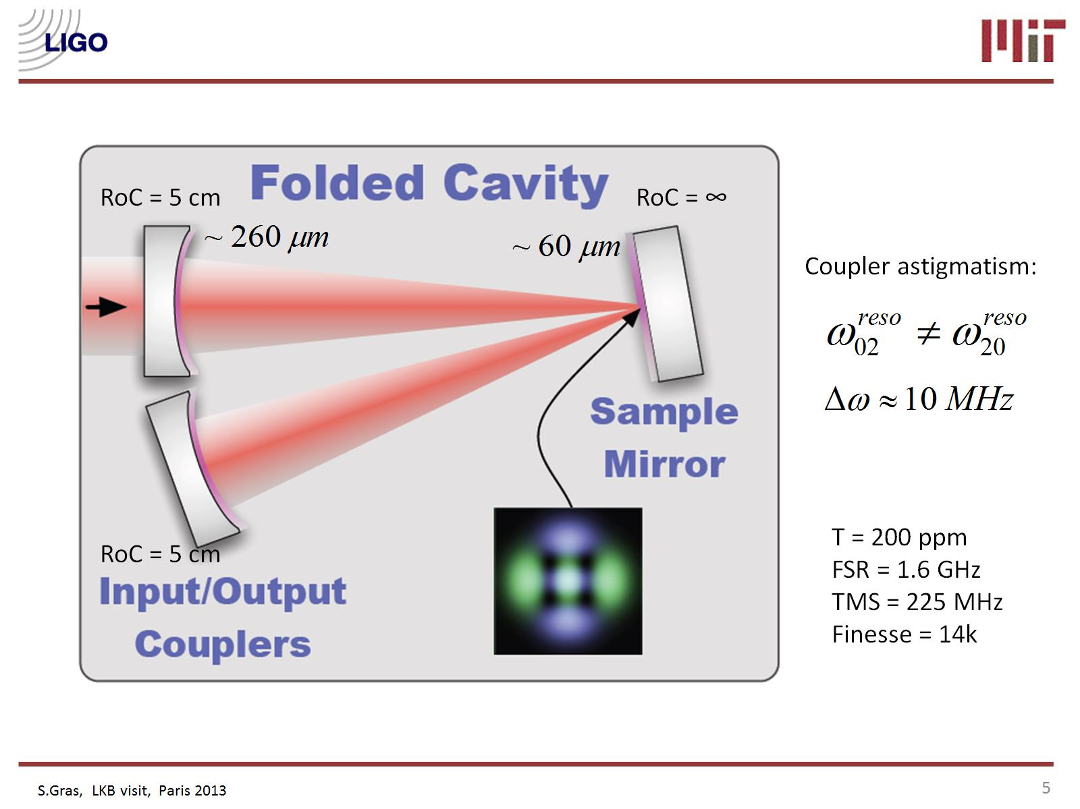
Design limited by quantum & thermal noise
Quantum:
  well-established, depends on laser power & optical losses
Test mass thermal:
  dominated by Brownian noise of the mirror coatings; depends on materials properties that are not all well-known
  New experiment measures thermal noise directly on an AdvLIGO sample mirror
S Gras, M Evans
Extrapolating to LIGO beam size:
Thermal noise is 20-25% higher than previous estimate
Target design BNS range reduced from 185 Mpc to 175 Mpc
Coating thermal noise

Slide 42
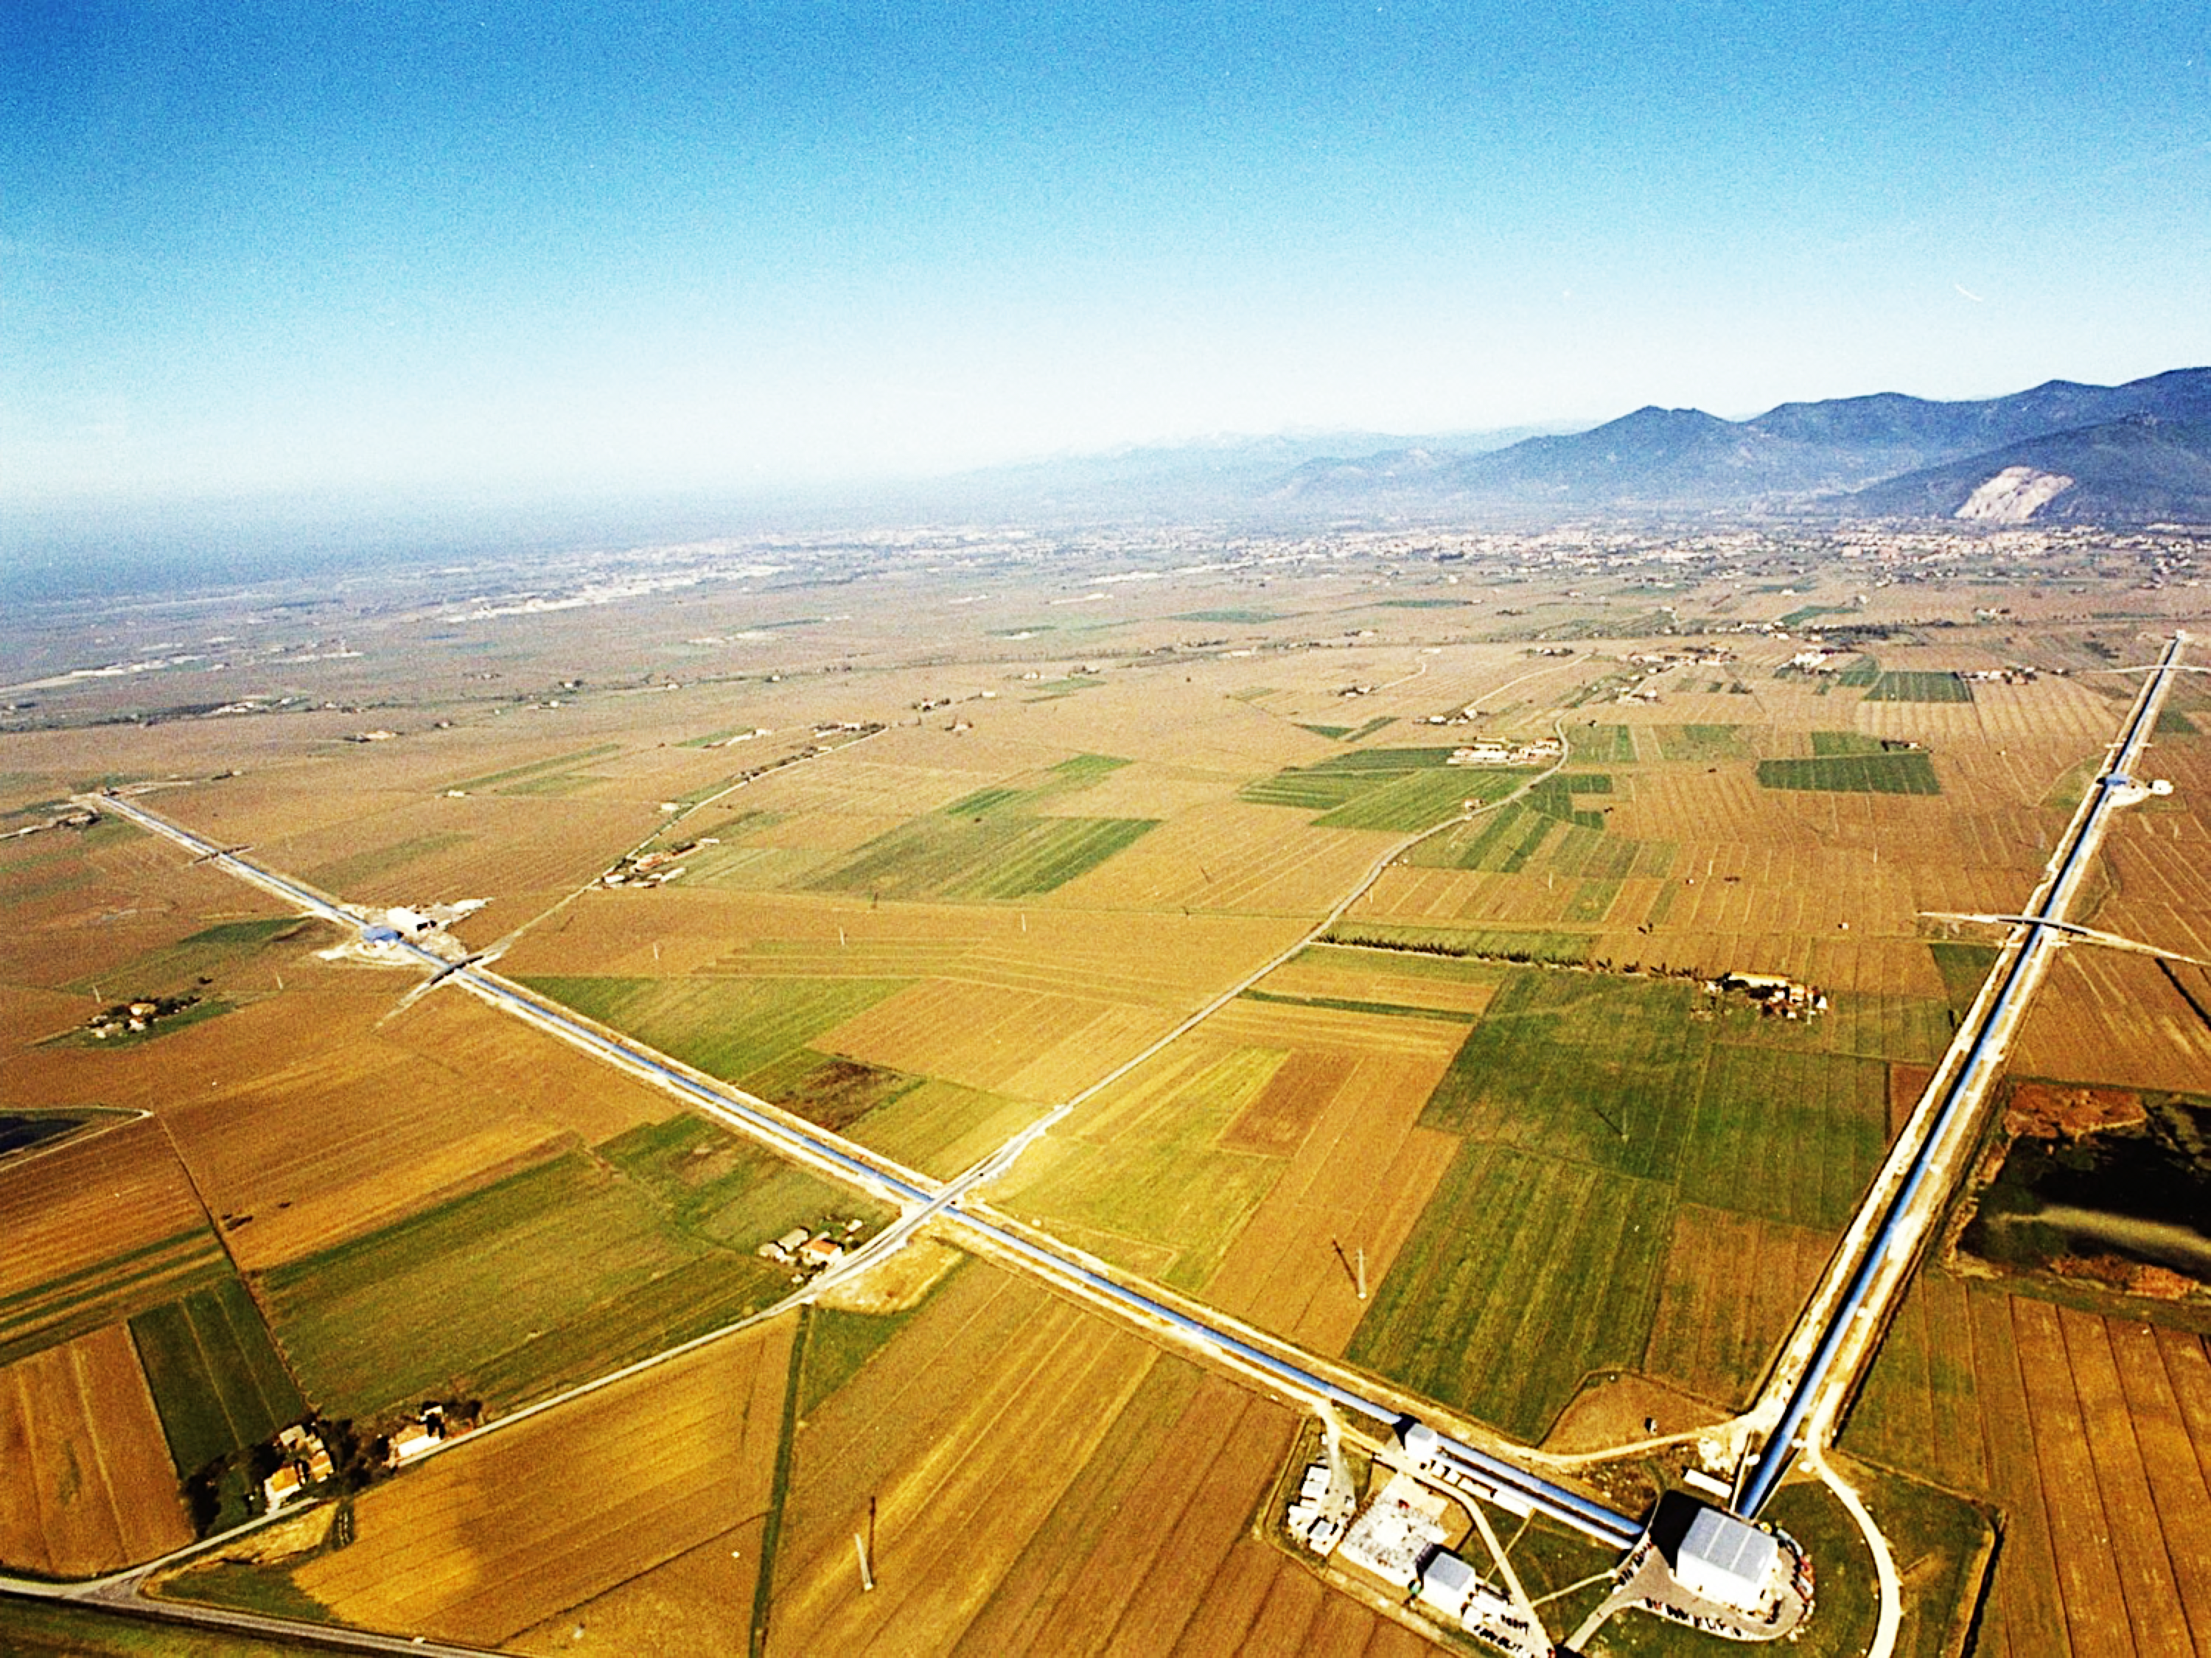







ADVANCED VIRGO
6 EU countries
20 labs, ~250 authors
APC Paris
ARTEMIS Nice
EGO Cascina
INFN Firenze-Urbino
INFN Genova
INFN Napoli
INFN Perugia
INFN Pisa
INFN Roma La Sapienza
INFN Roma Tor Vergata
INFN Trento-Padova
LAL Orsay – ESPCI Paris
LAPP Annecy
LKB Paris
LMA Lyon
NIKHEF Amsterdam
POLGRAW(Poland)
RADBOUD Uni. Nijmegen
RMKI Budapest
University of Valencia

Slide 43
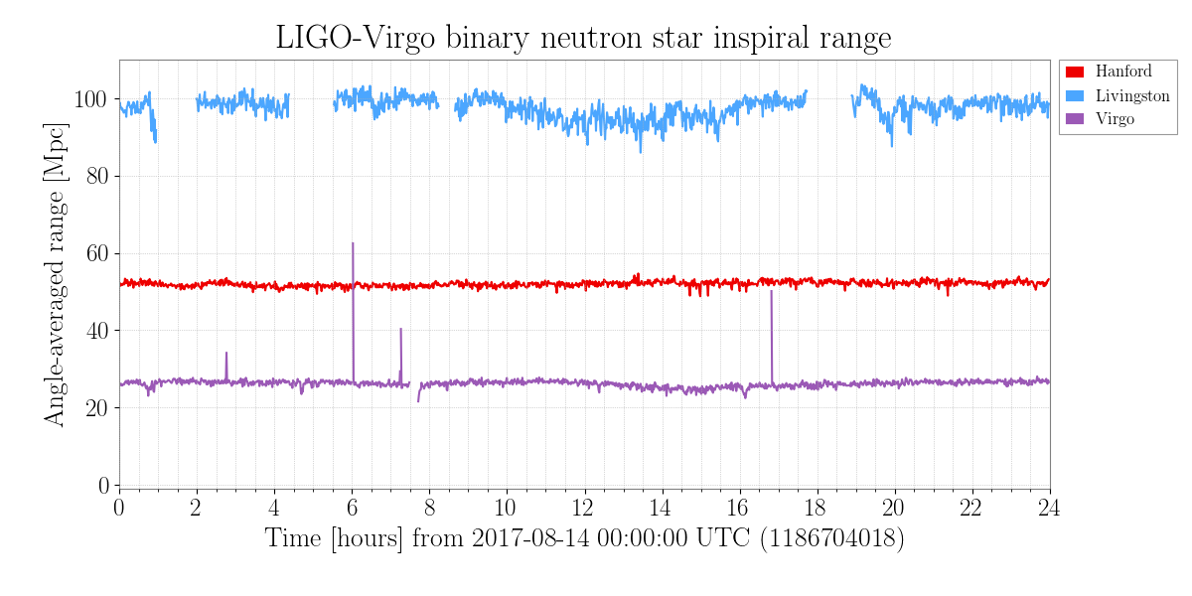
Advanced Virgo in a nutshell
Design is very similar to Adv LIGO
3 km arm length
Temporary configuration for O2
  No signal recycling
  Test masses suspended on metal wires

Slide 44




KAGRA
22 cm
Cryogenic sapphire mirror & suspension
Kamioka Underground SIte
Currently working on cryogenic simple Michelson interferometer,
Operation spring 2018
3 km

Slide 45


Major work being done on H1 & L1
Replace H1’s ITMX (excess absorption)
Stray Light Control improvements
70 W laser amplifier stage
  Goal is to double the operating laser power compared to O2
Replace End Test Masses & End Reaction Masses
  Better optical quality ETMs
  Reduce squeezed film gas damping with ERMs
Monolithic Signal Recycling Mirrors
Annular ERM
Old SRM
New SRM

