Slide 1
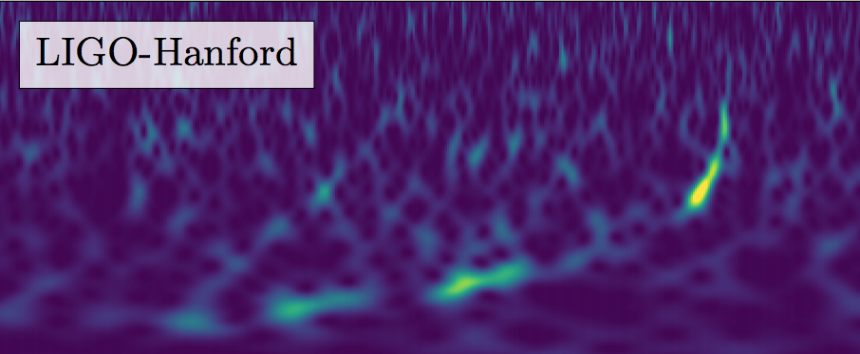
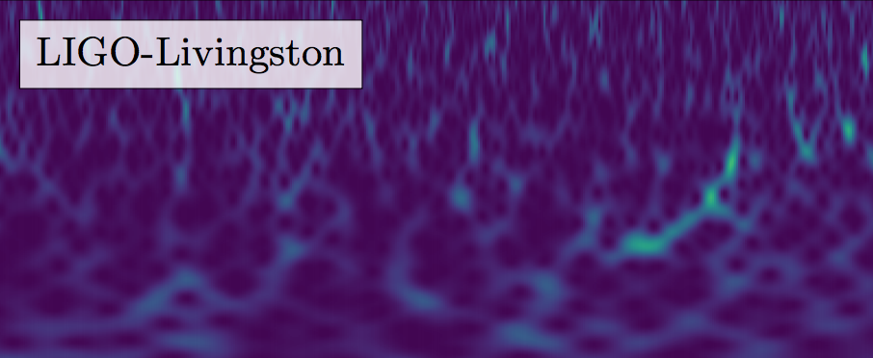

GW170608 FACTSHEET
observed by | H, L
source type | black hole (BH) binary
date | 08 June 2017
time of merger | 02:01:16 UTC
signal-to-noise ratio | 13
false alarm rate | < 1 in 3 000 years
distance | 0.7 to 1.5 billion light-years
redshift | 0.04 to 0.1
total mass | 18 to 24 M⦿
primary BH mass | 9 to 19 M⦿
secondary BH mass | 5 to 9 M⦿
mass ratio | 0.3 to 1.0
remnant BH mass | 17 to 23 M⦿
remnant BH spin | 0.64 to 0.72
remnant size (effective radius) | 47 to 63 km
remnant area | 2.7 to 5.0 × 10⁴ km²
effective spin parameter | -0.01 to 0.30
effective precession spin parameter | unconstrained
peak GW luminosity | 1.8 to 3.9 × 10⁵⁶ erg s⁻¹
radiated GW energy | 0.68 to 0.91 M⦿c²
duration from 30 Hz | ~ 2 s
# of GW cycles from 30 Hz | ~ 100
signal arrival time delay | arrived at H ~ 7 ms before L
HL sky area† | ~ 520 deg²
peak GW strain (10⁻²²) | ~ 4 (H), 3 (L)
peak stretch of interferometer arm | ~ ± 0.8 am (H), 0.6 am (L)
frequency at peak GW strain | 453 to 610 Hz
wavelength at peak GW strain | 492 to 662 km
remnant ringdown frequency | 745 to 1013 Hz
remnant damping time | 1.0 to 1.4 ms
consistent with general relativity? | passes all tests performed
Images: time-frequency traces (top),
mass distributions (bottom right)
GW=gravitational wave, M⊙=1 solar mass=2x10³⁰ kg,
am=attometer (10⁻¹⁸ m), H/L=LIGO Hanford/Livingston
Parameter ranges are 90% credible intervals.
†90% credible region

