Slide 1
Ion beam sputtering of thin films and multilayers for aLIGO
Carmen S. Menoni
Electrical & Computer Engineering
Colorado State University
Collaborators:
Le Yang (Grad. Student), Mariana Fazio (post-doctoral student), Colorado State University
Gabriele Vajente, Alena Ananyeva, Eric Gustafson, Caltech
Ashot Markosyan, Riccardo Bassiri, Martin Fejer, Stanford

Slide 2
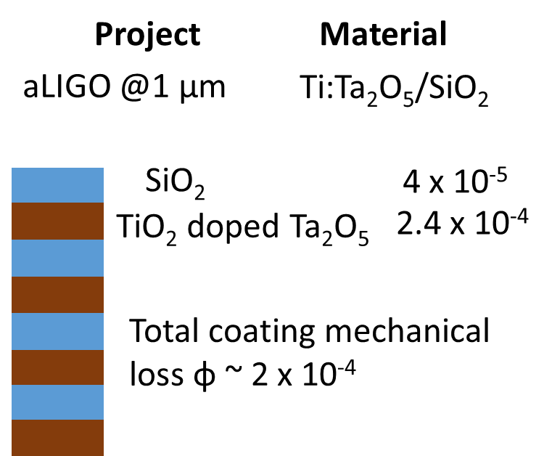
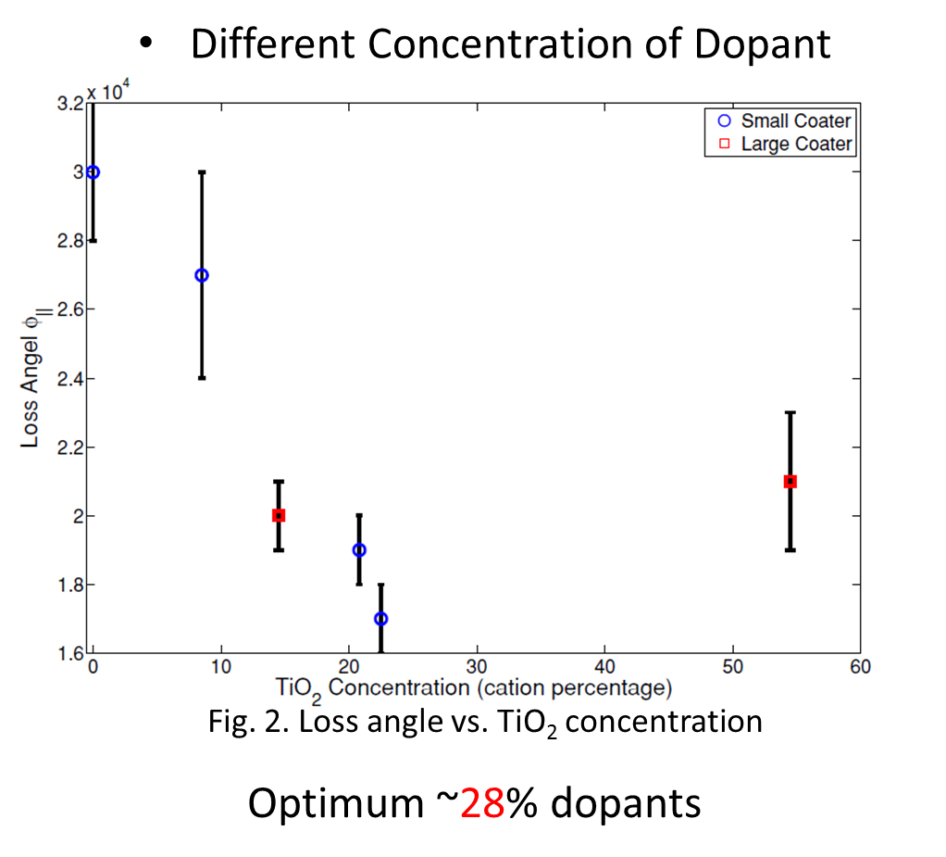
Present status
Ti:Ta2O5
Next generation aLIGO φ < 1 x 10⁻⁴
Absorption loss: 0.5 ppm
n=2.07
Mechanical loss: 2.4 10⁻⁴
Penn. S. D. et al Class. Quantum Grav. 2003, 20, 2917 ; Harry, G. M. et al Class. Quantum Grav. 2007, 24, 405
Flaminia, R. et al Class. Quantum Grav. 2010, 27, 084030

Slide 3
Outline
  Ion beam sputtering of thin films
    Physical characteristics of thin films
    Characterization
  DIBS of single layers of Ta2O5
    Use of assist source
  Multilayer coatings
  Technology challenges
  Plans within the CCR
  Summary

Slide 4
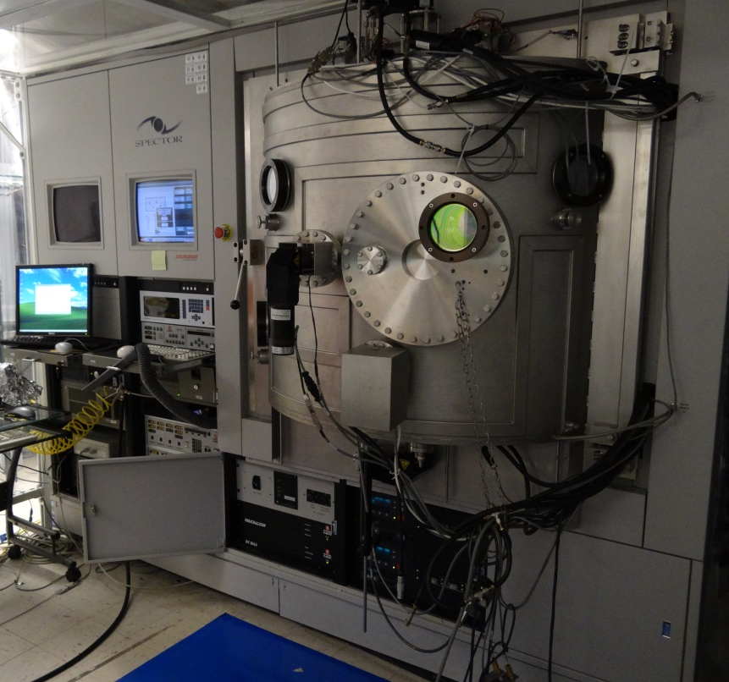
Colorado State Univ. has capabilities to grow and characterize interference coatings
High quality dielectric stacks are grown by DIBS
DUAL ION BEAM SPUTTERING SYSTEM
TEM of HfO2/SiO2
Ion beam sputtering (IBS) is the process that grows LIGO coatings

Slide 5
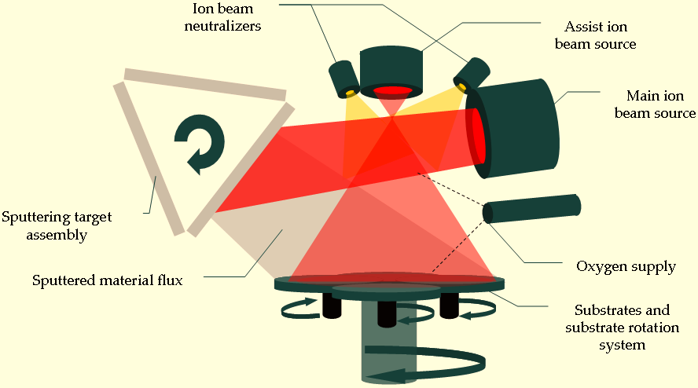
Reactive Dual Ion Beam Sputtering
Main source: Ar+: ~ 600eV – 1250 eV, up to 600 mA
Assist source: Ar+, O2+, N+ or their combination; ~ 600eV – 1250 eV, up to 600 mA
Base pressure: 10⁻⁶ Torr
Primary ions impact the target at ~ 45 deg -Sputtered material leaves the target at ~45 deg
Planetary rotates the substrates through the plume during film growth
Oxygen is provided when sputtering a metal target
Three targets available during a coating run. One used at a time
Geometry of the Veeco SPECTOR Ion beam sputtering system
IBS offers direct control of:
Ion beam current
Ion beam voltage
Reactive gas partial pressure
Other variables that influence film structure
Use of assist source

Slide 6
DIBS Features
Targets for Reactive sputtering:
Metal targets – Ta, Hf, Y, Ti, Zr, Nb2O3, Si, Al
Oxide targets: SiO2, Al2O3
Oxygen partial pressure is selected to minimize absorption loss
Other chemistries possible: nitrogen to grow nitrides by DIBS
Gas is fed through a tube next to the target. It can also be activated with secondary ion source
Substrate size: discs 4” diameter are routinely coated with ~1% uniformity
Largest substrates deposited: 4”x19”x 2” thick (1% uniformity)
Deposition temperature: typically 60°C – variable to 200 °C
Assist source: is typically run with Ar or O or both. Also, N and H.
Energetic Ar+ (∼50-1000 V) alter ad-atom energy –
Structure diagram predicts variation in crystallinity depending on ion energy

Slide 7
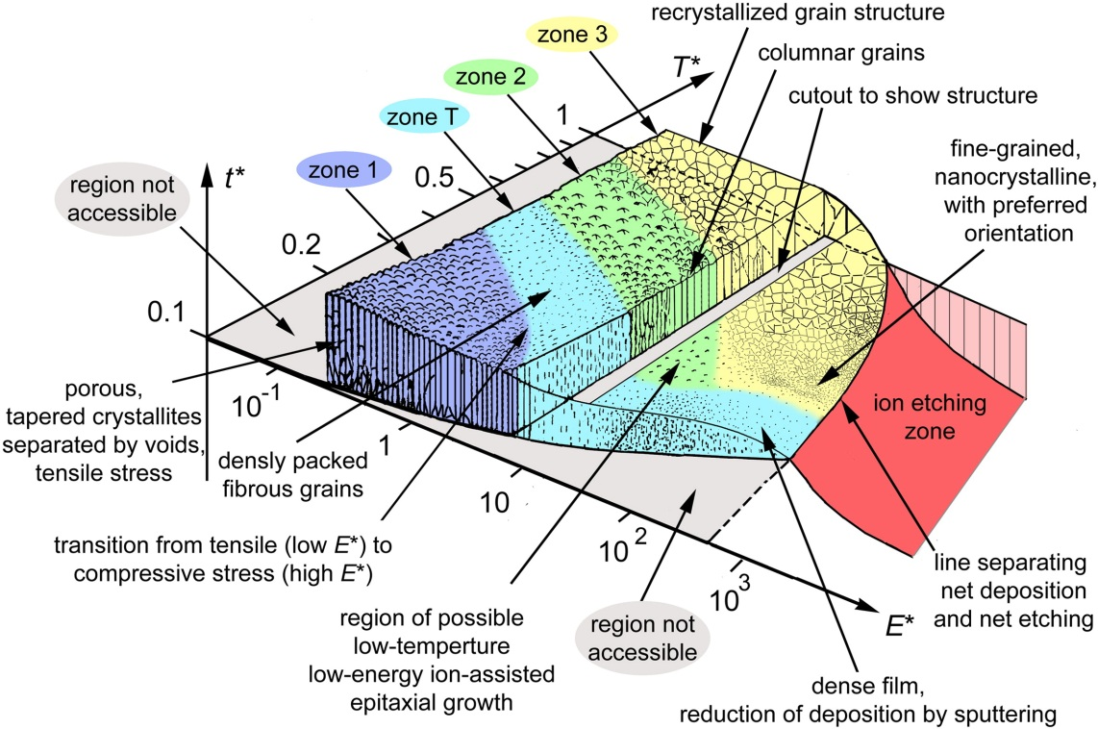
Physical vapor deposition methods produce amorphous thin films
with different microstructure depending on deposition conditions
Subset of parameter space
(temperature T* (T/Tm, where Tm is the melting temperature, ion energy, E*, t*: net thickness )
Evaporation
Porous films
Low stress
IBS produces films with:
(Nearly) amorphous structure with no detectable inclusions
High Packing Densities
Environmental Stability
Bulk-like refractive indices
Impurities alter surface energies and thus can affect growth mechanism
A. Anders, Thin Solid Films, vol. 518 (2010) 4087.
Notes:
1) T*, includes the homologous temperature plus a temperature shift caused by the potential energy of particles arriving on the surface.
2) logarithmic axis for a normalized energy, E*, describing displacement and heating effects caused by the kinetic energy of bombarding particles.
3) net film thickness, t*, allows one to maintain the familiar qualitative illustration of film structure while indicating thickness reduction by densification and sputtering; it also allows us to include “negative thickness”, i.e. ion etching.

Slide 8
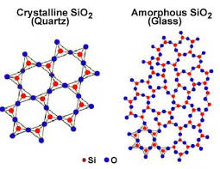
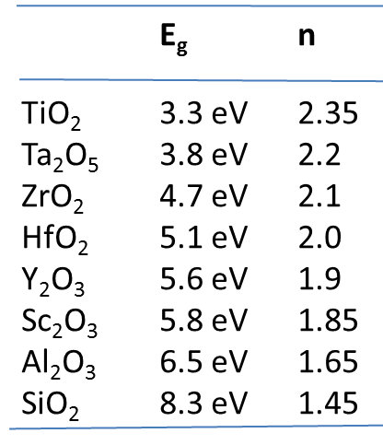
Ion beam sputtered thin films are amorphous
OXIDES PROVIDE THE LARGEST BANDGAP AND HIGHEST INDEX CONTRAST FOR THE ENGINEERING OF INTERFERENCE COATINGS
BULK – SINGLE CRYSTAL
AMORPHOUS
E_{c}
E_{c}
Defect band
E_{g} >> hν
Defect state
E_{v}
E_{v}
Network of defects exist.
Defect states can be localized and/or form sub-bands, and are distributed throughout the ‘bandgap’.
These defects can be ‘active’ under illumination conditions.
We have identified ‘O₂⁻ interstitials. Vacancies? Clusters of point defect?

Slide 9
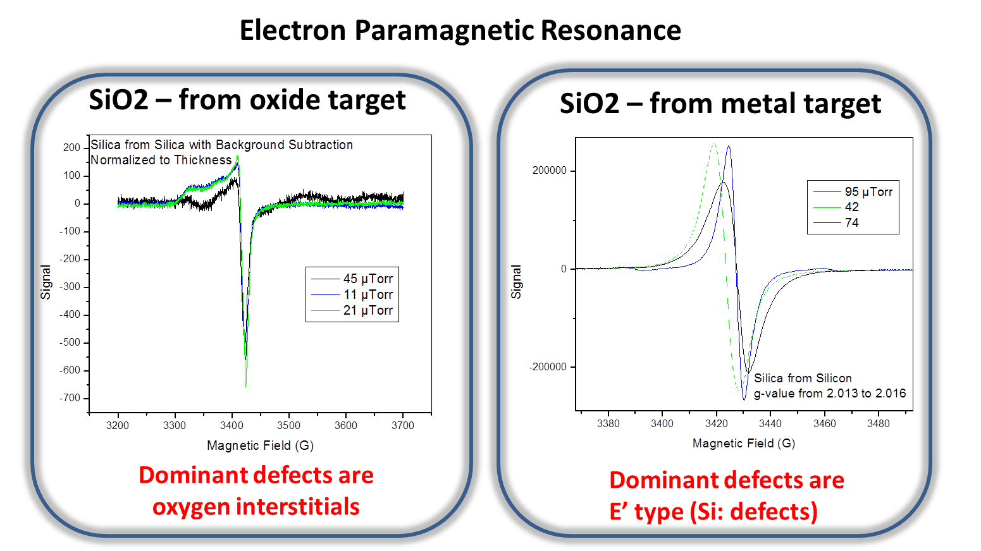
Ion Beam Sputtered SiO2 has distinct native defects when sputtered using a metal or oxide target
Absorption loss of ∼ 1 ppm
Absorption loss of ∼ 20 ppm (best conditions)
C.S. Smith, SPIE Laser Damage 2011

Slide 10
Deposition system for growing mixed alloys up to 400 °C: Bias target deposition
Bias target deposition of oxide films with continuous variation of composition
Schematics of the instrument
Ion source
6 target assembly
Sample holder
ADVANTAGES OF THE METHOD
Tunable film composition
Lower probability of implanting Ar into growing film (Ar increases stress in the films)
Superior control in the engineering of interfaces
Ions are generated by a low energy ion gun. The ions produce sputtering of the target when they are accelerated within the potential region established at the target.
Deposition rates are slow, comparable to e-beam evaporation

Slide 11
Bias target deposition of oxide films
OPERATING CONDITIONS
Low energy plasma source: Beam current: 10 A max; Beam voltage (ion energy): 15 to 150 eV
Target bias voltage: can be applied simultaneously to one or two targets. Selectable from 10 to 1000 V. Pulsed DC frequency is varied up to 71.4kHz. Ion beam current: 200 mA
Biased Target deposition main features
CO-SPUTTERED MATERIALS
Co-sputtering allows to create alloys of controlled composition, i.e. Si_{x}O_{y}Hf_{1-x} ; allows for doping
HIGH TEMPERATURE OPERATION: Up to 400°C
METAL TARGETS (today): Hf, Sc, Ti, Ta, Y for high index layers and Si, Al, for low index layers
- Maximum substrate size for good uniformity: ∼2”
Load Locked system- Base pressure 10⁻⁸ Torr

Slide 12
Thin film characterization
Thin films deposited by DIBS realize ppm absorption without annealing. This is achieved through optimization of the process
Thin films and multilayers are characterized by:
Elipsometry: n(λ)
Absorption loss by Photothermal Common Path Interferometry – (Stanford)
X-ray diffraction: to assess how amorphous films are
X-ray photoelectron spectroscopy – to assess bonding
Electron paramagnetic resonance – to identify defects
Interferometry – to assess stress, which is high and typically compressive

Slide 13
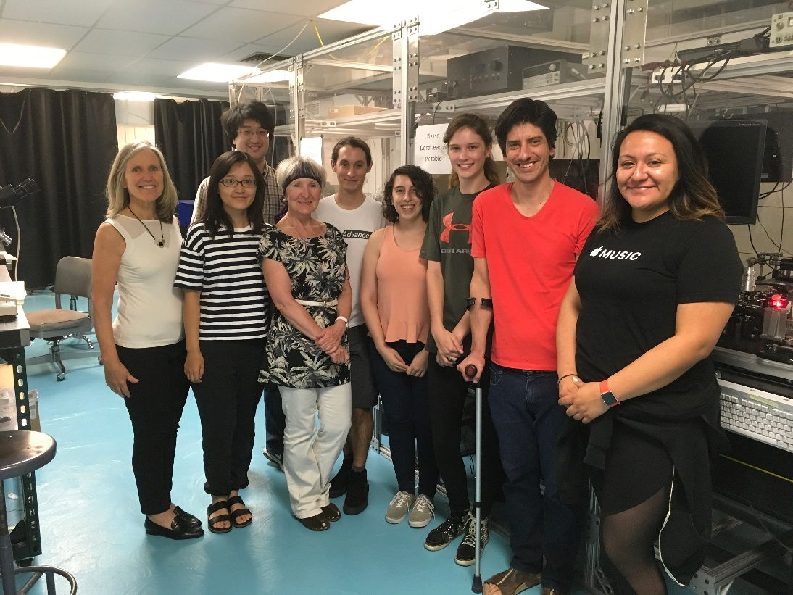
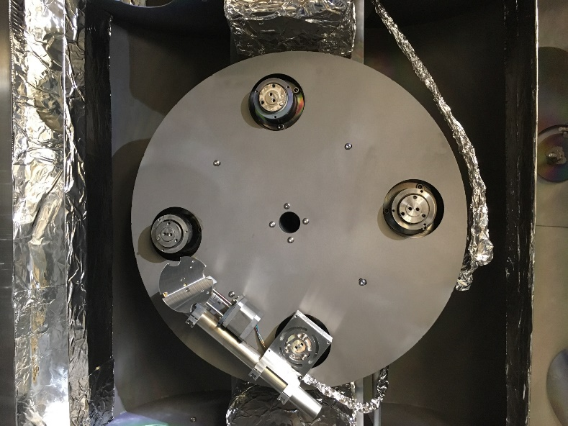
Progress toward Ultrastable Amorphous Thin Film Coatings for LIGO
Use of Ar assist source during deposition
Hypothesis: Ion bombardment using the assist source during deposition increases mobility of ad-atoms at the surface leading to a structural configuration which reduces mechanical loss
Le Yang
Experiment details:
Spector sample holder modified to keep sample in front of the assist Ar beam.
Sample holder engineered to hold the 3” FS wafers where films are deposited.
Each FS wafer is annealed previously at CALTECH
Ta2O5 is sputtered reactively (Ta target).
Assist source: Ar
Collaboration with LIGO-CALTECH

Slide 14
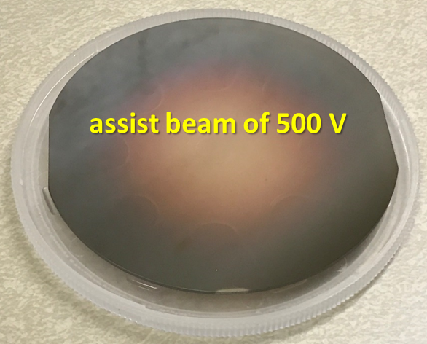
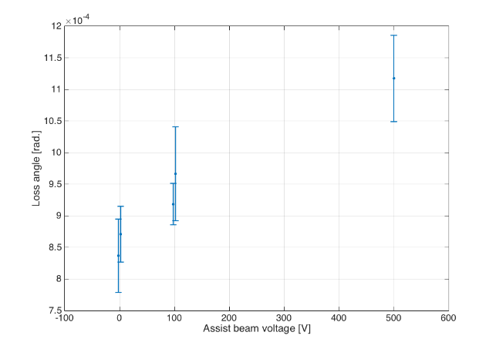
Use of Ar assist source during deposition
Exp. 1 Assist source with Ar
sample | assist source beam voltage (V) | assist source beam current (mA) | deposition rate (Å/s) | absorption @ 1µm (ppm)
s1 | 0 | 0 | 5.0 | 22
s2 | 100 | 100 | 3.3 | 12
s3 | 500 | 100 | n.a. | n.a.
Loss Angle vs assist beam voltage
Metallic film
Annealing 3 hours at 300°C reduced loss angle to 4.5 10⁻⁴

Slide 15
Use of Ar +O2 assist source during deposition
Exp.2. Assist source with Ar and O₂ flow and with different ion dose
Ar assist preferentially sputters oxygen from the film. Oxygen was added in the ion source to compensate for preferential oxygen sputtering
sample |  | Assist beam voltage/V | Assist beam current/ mA | Assist ion source gas / sccm |  | Thickness / nm | Dep. Rate / Å/s | Abs. /ppm | Mechanical loss / 10⁻⁴ | Stress / MPa
 |  |  |  | Ar | O₂
group 1 | s11 | 100 | 100 | 12 | 0 | 540.9±4.1 | 3.5 | 7.2±0.5 | 6.8±0.3 | 107.1±0.6
 | s12 |  |  | 6 | 6 | 528.2±2.0 | 3.1 | 15.4±0.8 | 8.1±1.2 | 238.8±5.4
 | s13
 |  |  |  | 3 | 9 | 531.8±1.6 | 2.9 | 20.2±0.2 | 8.9±0.2 | 174.7±1.5
group 2 | s21 | 200 | 100 | 12 | 0 | 517.6±2.3 | 3.3 | 17.8±2.0 | 7.2±0.3 | 182.5±1.7
 | s22 |  |  | 6 | 6 | 539.3±0.6 | 2.9 | 11.6±0.4 | 7.8±0.3 | 177.9±2.1
 | s23 |  |  | 3 | 9 | 541.1±3.4 | 2.9 | 17.7±0.2 | 8.3±0.3 | 223.7±2.3
group 3 | s31 | 100 | 200 | 12 | 0 | 537.3±0.8 | 3.4 | 10.3±0.5 | 6.4±0.6 | 147.5±2.6
 | s32 |  |  | 6 | 6 | 531.9±3.2 | 3.0 | 17.2±0.7 | 7.7±0.3 | 137.0±1.3
 | s33 |  |  | 3 | 9 | 518.6±1.4 | 3.0 | 19.9±0.4 | 8.1±0.7 | 199.8±1.0
Higher voltage
Higher dose

Slide 16
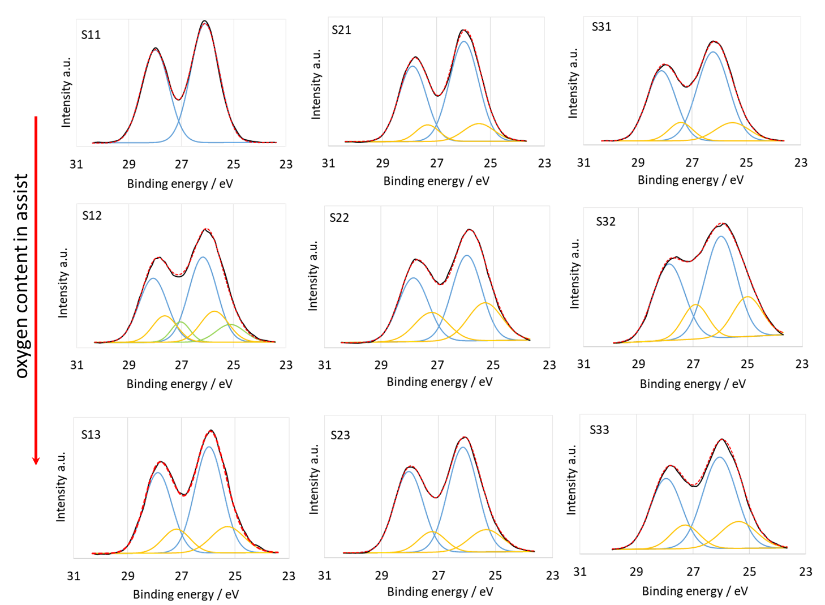
X-ray photoelectron spectra: Ta⁵⁺ 4f d doublet
R=16%
R=19%
Different suboxidation states on the samples except on s11
Oxygen atoms in the film were re-sputtered by assist ions at different degrees with Ar and Oxygen beams
Stoichiometric sample
R=33%
R=33%
R=27%
R=23%
R=19%
R=22%
Higher voltage
Higher dose
SubTa/total Ta = R – varied from 16% to 33%

Slide 17
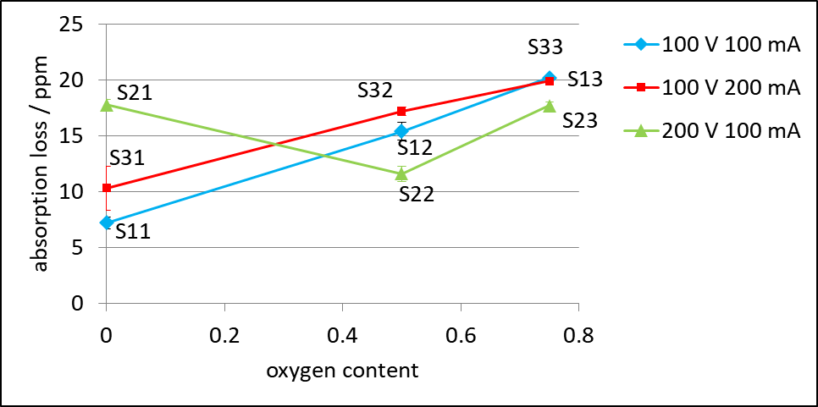
Absorption loss at λ=1µm
With No Oxygen: Increasing dose or voltage increase absorption loss
With Oxygen: there is some compensation of sputtered oxygen with increase of dose
TRIM (TRansport of Ions in Matter) CALCULATIONS
At 100 and 200 eV
Sputtering yield of Ta with oxygen is 1/3 that with Ar
Sputtering yield of O2 is the same for either gas
Sputtering yield of O2>Ta for all conditions
Mass of projectile important (momentum transfer)
High dose, low voltage necessary to keep stoichiometry
Notes:
SubTa/Ta – varied from 16% to 33%

Slide 18
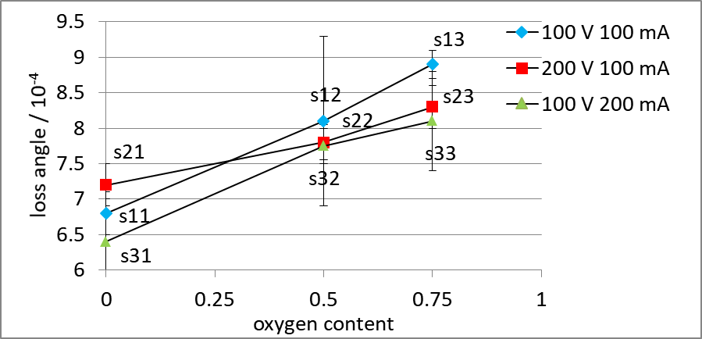
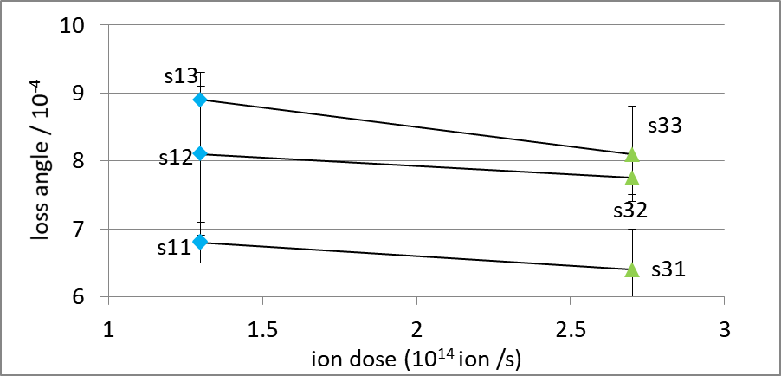
Loss Angle
There is not a significant variation in loss angle with deposition conditions
Increasing dose of Ar may reduce loss angle
After annealing in air for 9 hours all samples’ loss angle dropped to ~4 × 10⁻⁴

Slide 19
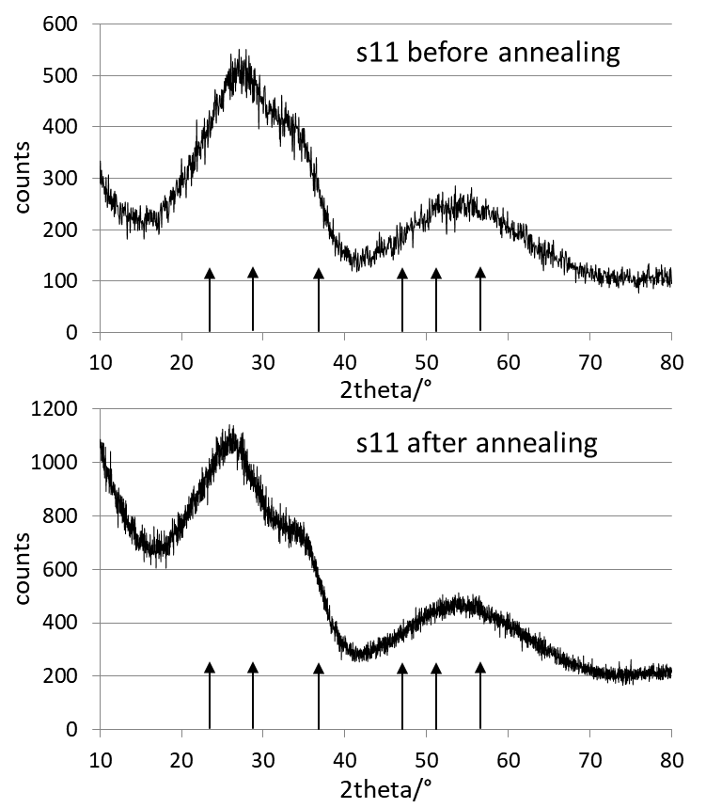
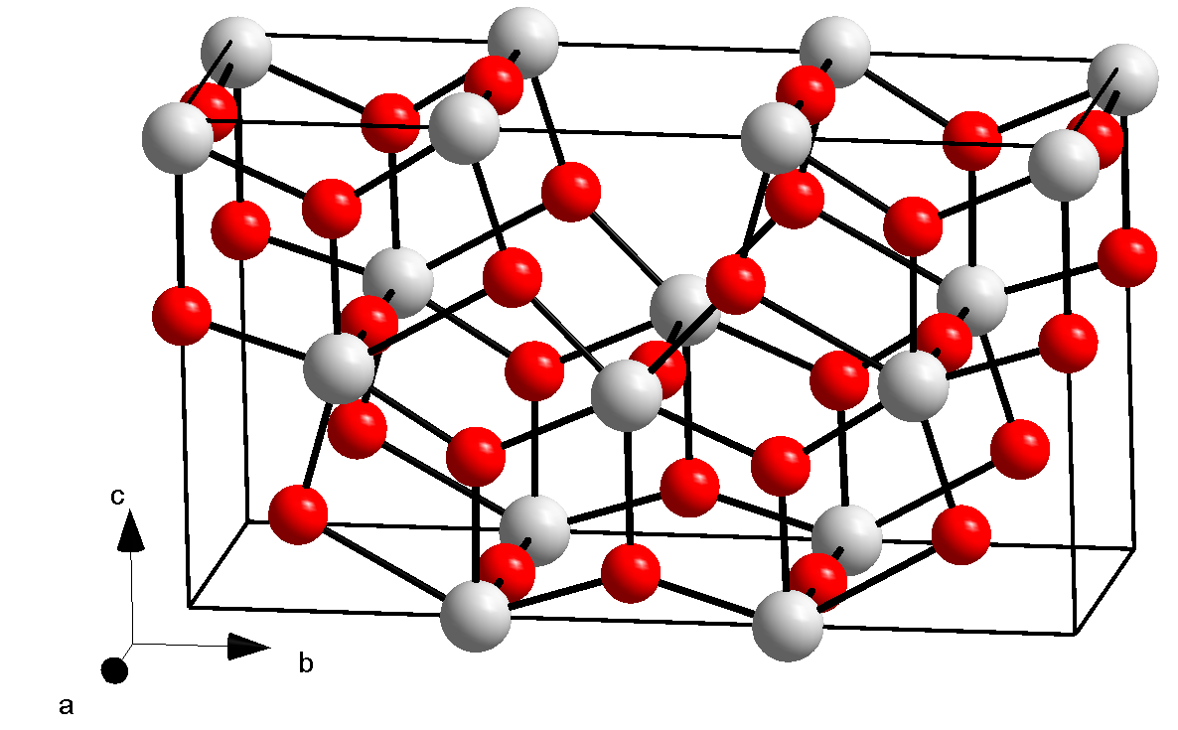
Grazing angle x-ray diffraction shows films are amorphous even when annealed to 500 °C
Arrows: crystalline orthorhombic Ta₂O₅ phase
Ta⁵⁺ O²⁻
Some relaxation observed upon annealing in air to 500 °C but not crystallization
By Orci - Own work, data source: B. O. Loopstra: Neutron diffraction investigation of U3O8. In: Acta Cryst. (1964). 17, 651-654., CC BY-SA 3.0, https://commons.wikimedia.org/w/index.php?curid=8584983

Slide 20
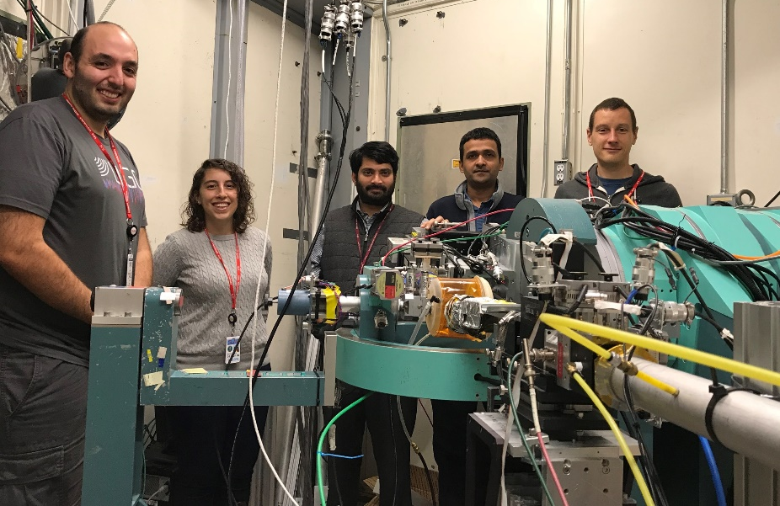
More understanding of what structural modifications occur upon annealing are needed
XAS studies to gain insight on medium range order
Team at SSRL measuring Ta2O5 deposited under different conditions:
IBS – high temperature
IBS – assist source and with annealing

Slide 21
Multilayer coatings
aLIGO – Stacks of Ti:Ta2O5/SiO2
Deposited by LMA by ion beam sputtering
Conditions (?)
Specifications
Transmission: 1.4±0.1% at 1064 nm, ΔT<0.01%
(2 mirrors coated at once in a chamber with planetary system)
Average absorption at 1064 nm < 0.5 ppm
Average scattering < 10 ppm
3 band AR coating (532, 800, 1064 nm), R< 100 ppm at 1064 nm
Flatness of substrate after HR < 0.5 nm RMS on 15 cm diameter
Suprasil FS substrate 34 cm diameter, 20 cm thick
Micro-roughness < 0.1 nm RMS
L. Pinard, et al, App. Optics vol. 56, C11, 2017

Slide 22
Multilayer Coatings
LMA coatings are not quarter wave, [aH(bLcH)^{n}dL
a, c <1 and b>1 (Most likely d is >1)
H: Ti:Ta2O5, L: SiO2
Total coating thickness: ∼5-6µm
Mechanical loss scales with total coating thickness
There will be advantages replacing Ti:Ta2O5 by higher index materials – if the same absorption and scattering losses remain the same

Slide 23
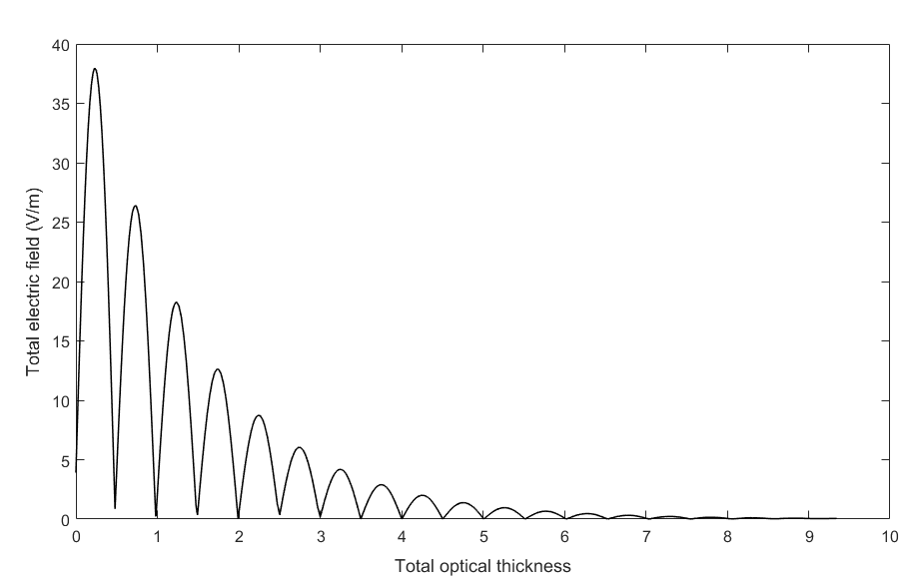
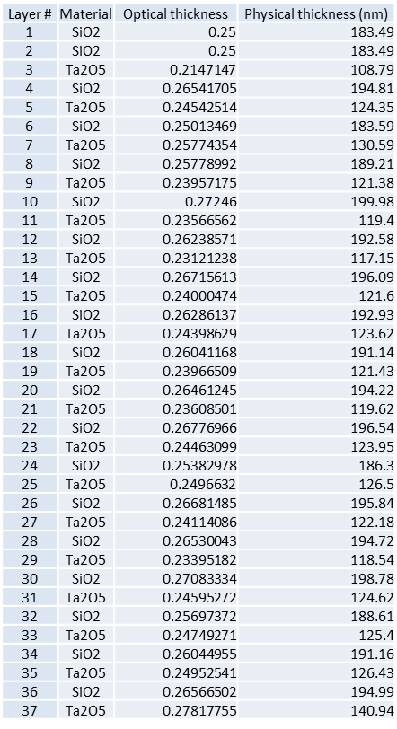
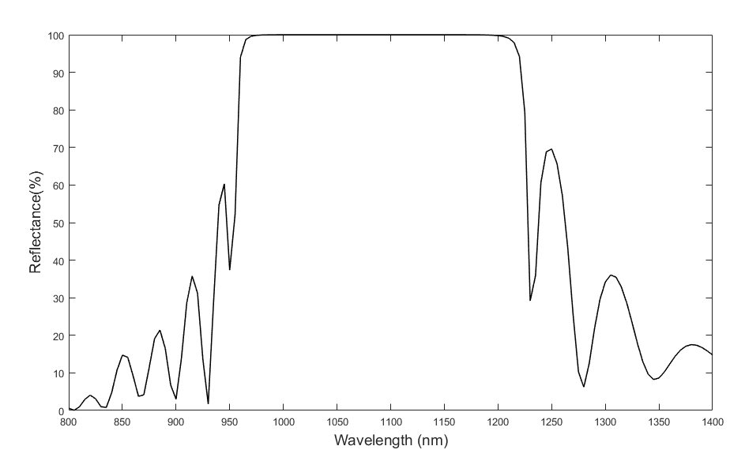
Multilayer Coatings
Ta₂O₅/SiO₂ QW for 1064 nm HR
Electric field decreases to <10% by layer 15
Reflectance: 99.99%
Total thickness: 5865 nm
(37 layers)
Reflectance @ 1064 nm 99.99%

Slide 24
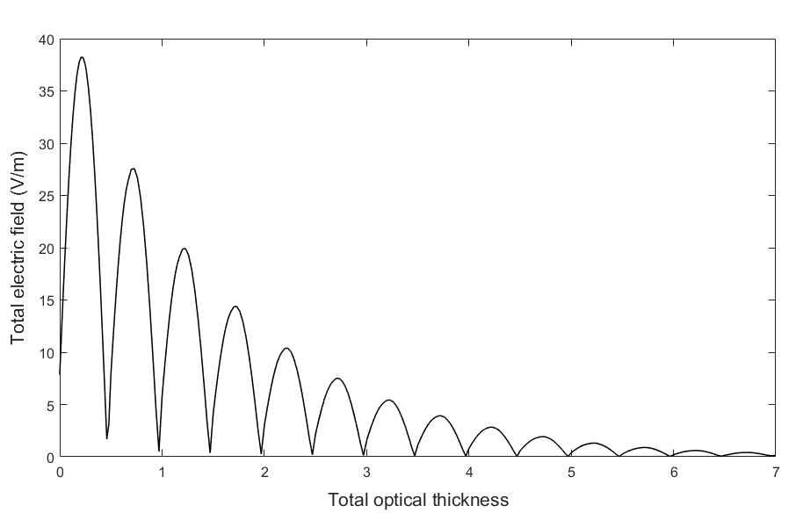
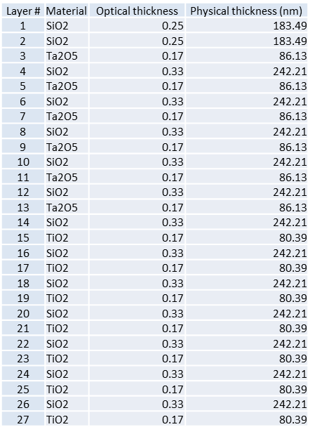
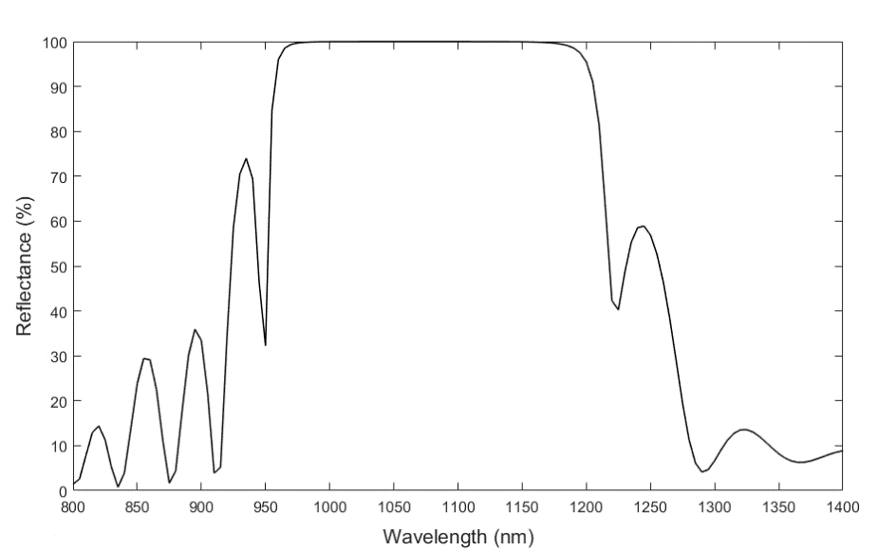
Multilayer Coatings
Ta₂O₅₋TiO₂/SiO₂ QW for 1064 nm HR
Non-quarter wave design
The 7 layers of Ta2O5 closer to substrate replaced by TiO2
Electric field
Total thickness: 4998 nm (27 layers)
Reflectance: 99.99%

Slide 25
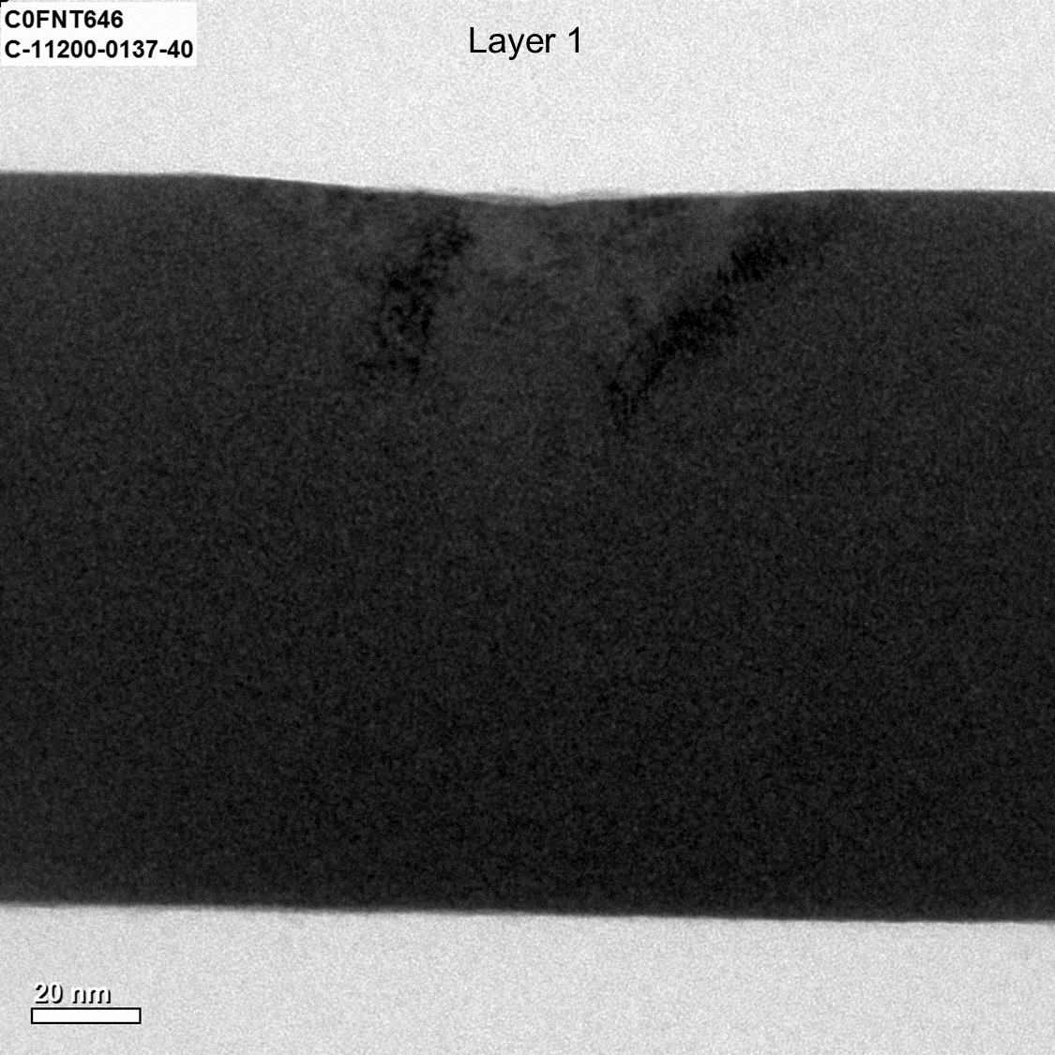
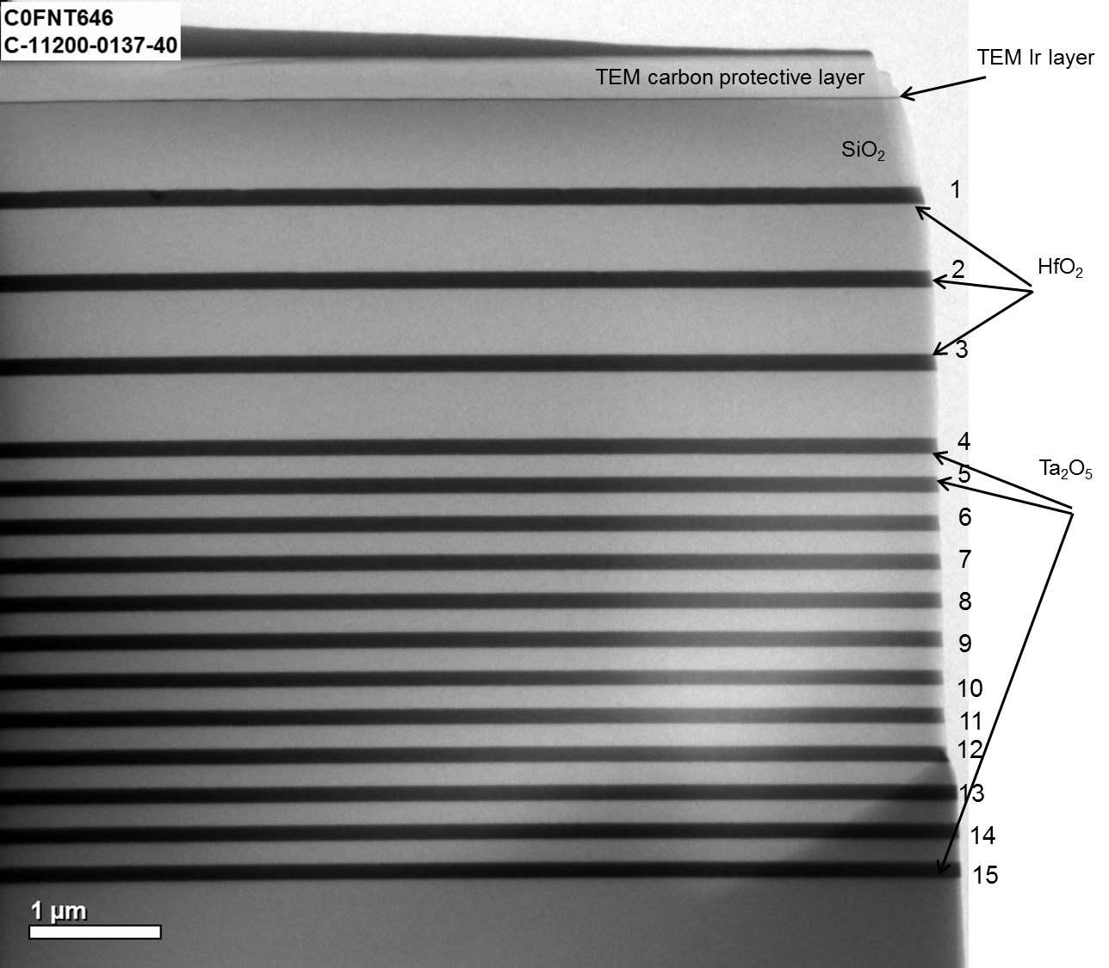
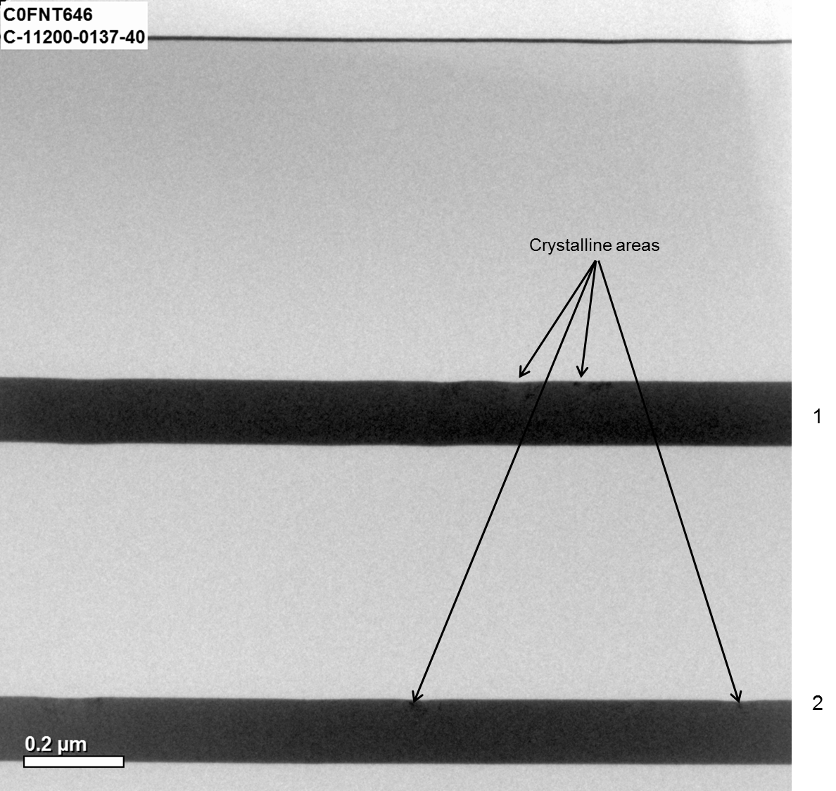
Multilayer Coatings
The high index layers in a multilayer can have different structure than a single layer depending on layer number
Ta2O5/SiO2 with HfO2 replacing Ta2O5 on top layers by HfO2
Crystallinity observed on top HfO2 layers

Slide 26
Nanolayers as a strategy to reduce crystallization and increase annealing temperature
Use of nanolayers may further reduce absorption and scattering loss, and MECHANICAL LOSS
Nanolayers of TiO2/SiO2
SiO2
TiO2
H.W. Pan, Optics Express, 22(24): p. 29847 29854.(2014).

Slide 27
Multilayer Coatings
Other strategies: Optimize design of the cavity to reduce mechanical loss of the coating
N. M. Kondratiev,
PHYSICAL REVIEW D 84, 022001 (2011)
Add a corrector layer (thick layer of approximately λ/2) either at the surface of the coating or a specific location inside.
Use different H/L ratio
Concepts relies on optimization of reflection phase noise
M. Evans et al, PHYSICAL REVIEW D 78, 102003 (2008)
A.E. Villar et al, PHYSICAL REVIEW D 81, 122001 (2010)

Slide 28
Plan for CCR effort
Near term
1. THIN FILMS MORPHOLOGY AND MECHANICAL LOSS (With CALTECH and STANFORD)
Use assist source with Xe, low voltage and high dose to deposit Ta2O5 to assess if mechanical loss can be reduced (Spector tool)
Room temperature deposition of Ti:Ta2O5 and Zr:Ta2O5 (LANS tool) – Very low deposition rates, i.e. 0.01 nm/s at room temperature and 400 °C
Annealing studies
MECHANICAL LOSS IN MULTILAYERS
Quarter wave, non-QW and mixed materials coating designs
Mechanical loss will be measured by M. Evans and P. Fritschel, MIT and possibly at CALTECH (if we can coat 1 mm wafer on both sides)
Comparison of mechanical loss measurements on a thick layer of Tantala of equal thickness as in a mirror

Slide 29
The large size of the
Plan for CCR effort
Longer term
1. NEW MATERIALS (λ=1064)
Develop reactive sputtering of Silicon Nitride
  Refractive index ∼2 (similar to Ta2O5 at 1064 nm)
  Predicted to have very low mechanical loss at room and low temperature
Nanolayers – Ta2O5/TiO2; Ta2O5/SiO2 and ……(??)
2. MATERIALS FOR 1.5-2 µm
Develop process for sputtering of aSi with low absorption loss

Slide 30
Process technology
Running for LIGO 3” wafers – requires modifications of the SPECTOR system
A run takes one day – deposition time is short but pumping down takes long
One 3” sample per run
A run precedes the final run to test rates
A third run is loaded with up to 3, 1” samples for other characterization
Conventional runs (mirrors)
Can load many substrates of different dimensions
Mirror runs take a day
Planet
System maintainance is intensive
Grid and bowl sandblasting – every 3 mirror runs
Panels have to be cleaned and covered with new foil to prevent flaking

Slide 31
Summary
First studies of DIBS Ta2O5 films with assist source operating with Ar and O2 showed:
  Amorphous films with low absorption loss are obtained. Most are slightly sub-oxide
  Mechanical loss for all conditions is similar. Only with post-annealing loss angle reduced to values observed in Ta2O5 deposited at high temperature.
In progress: Use Xe to sputter Ta2O5 (mass of Xe similar to Ta)
Advances in the understanding of thin films that make the multilayers and simultaneous investigations of multilayer coatings are needed to realize mechanical loss metrics for aLIGO coatings and

Slide 32
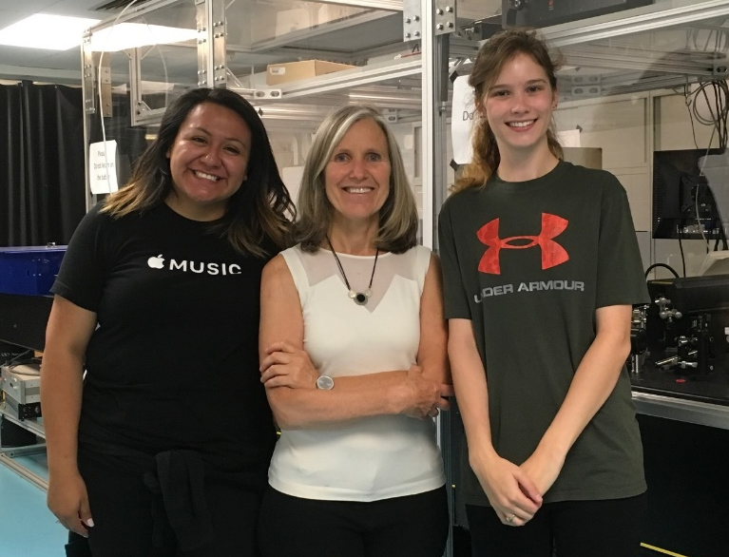
Acknowledgments
Thanks to the National Science Foundation and the Moore Foundation for financial support
Undergraduate students who participated in coatings’ research in Summer 2017
CSU coatings’ group
Emily Dawson (CSU)
From right: Yannette Navarrete (CAL State, LA); Fabio Cavalcante, Emily Dawson, Mariana Fazio, Emmett Randel, Ela Jankowska, Le Yang, Hanchen Wang, Carmen Menoni
Yanette
Navarrete
(CAL State LA)

