Slide 1
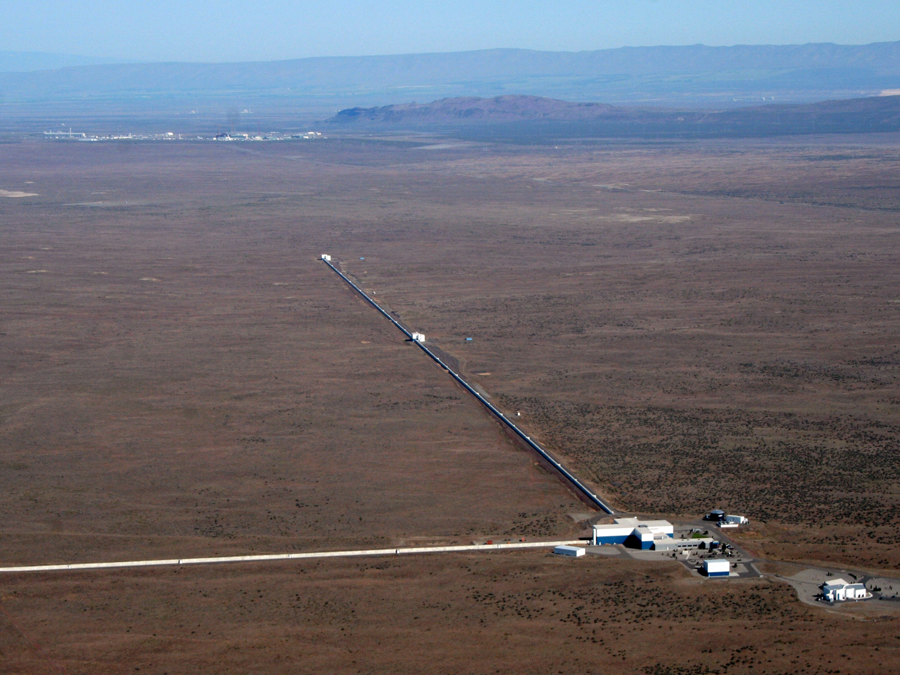
aLIGO Past and Future
David Shoemaker, MIT LIGO Laboratory
For Joint ET/LIGO future
Meeting, September 2017
1
LIGO GG1701783

Slide 2
Is aLIGO relevant for ET?
From the technical/programmatic side Not very:
No Civil Construction
Small budget ($200M)
Small science audience sufficed
From the ‘enabling’ side, rather useful:
Started up the ’post detection’ phase
What lessons to learn? I’ll mention topics – please ask questions

Slide 3
What elements helped aLIGO succeed?
…to meet time and budget plans?
Robust request to NSF
Engineering cost, manpower, time estimates
Senior engineering review (and increases)
Management review (and increases)
Monte-Carlo approach to estimating how much of the contingency estimate to include
Robust response from funding agencies
NSF accepted the basis of estimate, but said ‘never any more’
STFC, Max Planck, ARC all significant help
Program environment
Designed own reviews, safety program, etc.
Paid for labor and equipment, and could trade between the two
Full ‘earned value’ cost reporting required, expensive!

Slide 4
What elements helped aLIGO succeed?
…to start out well technically?
Good system engineering flowdown of requirements
Prototyping of ideas around the world; very collaborative environment
Models of various kinds – parts in detail, top-level
Prototyping of ’brassboards’ – similar to first articles
Testing of first articles in real vacuum chambers installed by real technicians with real analysis of the results: can we meet requirements for the performance?
Schedule which allowed some iteration (e.g., SEI system first prototype was ‘everything can be aligned’; 2nd was ‘nothing can be adjusted’
…to run pretty well as a project? Leadership team of…
Professional project manager
Engineer
Scientist

Slide 5
What helped aLIGO quickly reach an interesting sensitivity?
The design and testing described on the previous page, and…
More testing:
Of assembled parts
Of sensors/motors/cables in production with statistics
Of electronics with actual cables in actual lengths
Of complete assemblies outside of the vacuum
Of complete assemblies in the vacuum
Assembly by previous initial LIGO operators/engineers who were building the machine they would operate as operators and engineers – total ownership of the results
(need to fold in AdVirgo’s excellent commissioning success to make generalizations)

Slide 6
aLIGO Timeline – an existence proof
1990’s: very active R&D and table-top demonstrations
1999: white paper with a conceptual design, a few important open questions (test mass material, laser technology); Lab cost and schedule estimate
1999: NSF acknowledges that this is a feasible plan and they support it being developed into a proposal
2000-2005: larger scale prototypes, ‘v0.8’ style prototypes
2003: Proposal formally submitted to the NSF (final approval in 2007)
2005-2010: preliminary designs, some final designs
Meet NSB start criteria: Initial LIGO at design sensitivity, one year run
2008: funding starts for Advanced LIGO Project
2014: Project complete
2015: Two detectors functioning at 1/3 final sensitivity, ~50% joint uptime
From 1995 to 2015: 20 years

Slide 7
Initial LIGO Timeline – maybe more relevant
1978 Proposal to make an industrial study
1989 Proposal to the NSF
1992 Site selection
1993 Beam Tube Contract signed
1994 Site Groundbreaking
1999 Vacuum systems ‘accepted’
2000 First lock
2002 First Science Run
2010 Design sensitivity science run completed
~20 years for the infrastructure to come into being
~25 years to good science data
If we are e.g., at the ‘1978’ level of maturity for 3rd gen…
2037 completed infrastructure
2042 good science data

Slide 8
Back to Advanced LIGO: Near-term plan for O3?
What’s the near-term plan for aLIGO for O3?
1 year (or more if needed)
~1.3-1.5 LLO, factor ~2 LHO
(factor ~2+ for AdV)
Things we plan to address:
Scattered light
Difficulty of working with high-power lasers
RF and Digital electronics getting into signal chain
Mystery noise (squeeze film damping? ESD actuators?)
Things we should be addressing in addition:
Documentation
Remote access to the instrument state
Inclusiveness in Commissioning

Slide 9
From Valera Frolov’s talk at LVC

Slide 10
From Valera’s talk at LVC

Slide 11
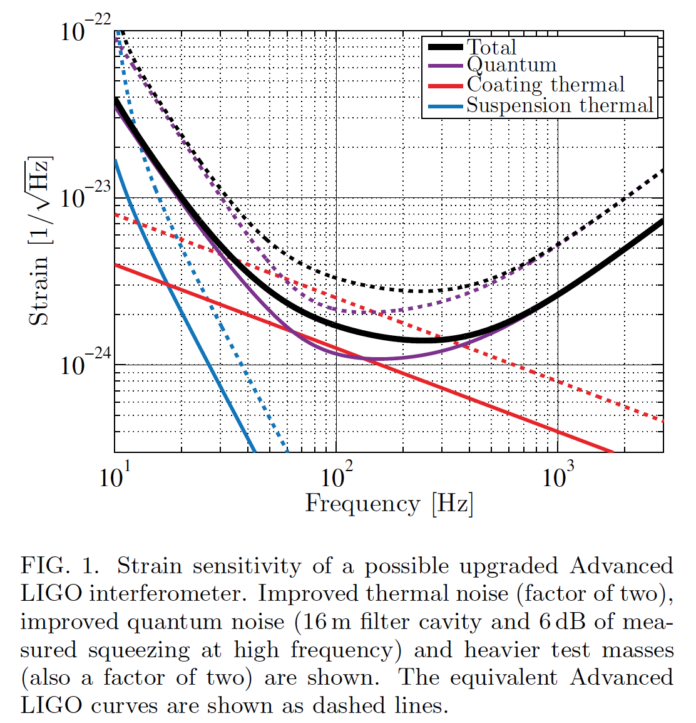
aLIGO Upgrades: +, ++, +++… ‘modest’ cost, ‘modest’ downtime
A+ now well defined; possible submission in one year
Freq. Dep. Squeezing
Installation of ‘better’ mirrors
Lower loss, scatter
Lower thermal noise
Maybe other bits and pieces
~1.7 greater reach for BNS
⨉5 in rate
2022 or so completion
Later…
Increasing mirror mass, Extending suspension length (ok, not so modest…)
…clearly can keep busy till 2025

Slide 12
Voyager scale Upgrade
Some approach to another step up; several concepts in discussion
Dennis Coyne and Eric Gustafson made an educated guess for the cost and time required for a Cryogenic, Silicon, Voyager-style instrument for the current LIGO facilities, and re-using what one can
Extrapolated from the aLIGO experience for both cost and time.
Costs: ~$100M, using US accounting
Timing with hopes for start dates and resignation for the later pace:
End-2016 NSF review of Concept, NSF go-ahead mid-2017
Design through PDR, Construction proposal to NSF end 2019
Construction award end of 2021 (if …)
3 years Fabrication,
2 years installation ~4 years with
1 year integration no observation
Commissioning begins at the end of 2027
What’s the science lifetime of this upgrade? 10 years? That determines…:
When do we want to see an ET/LUNGO operating?

Slide 13
Tensions in the Cold Voyager path
Time down for a given observatory
Have to assume we do a staged upgrade of the instruments, with the other partners in the network continuing observations
What scale of upgrade in the ‘Voyager’ epoch will be well motivated in terms of the science and the downtime?
Time to first observation
First guess for a cryogenic Voyager Observing Run is ~2028
Will the ‘Advanced+++’ detectors be interesting until then?
Quasi-parallel or slightly time-shifted request for ~$10⁸ and ~$10⁹
Is there a community to support this pair of investments?
Is there an optimization of draws from the bank in terms of timing?
Is a $10% ‘prototype’ a good investment to control final costs?
Can it be better to skip the ‘cold Voyager’ phase?
Can we find more ‘modest’ upgrades with ‘modest’ downtime?
Science Objective: Bring in the earliest readiness date for an ET/LUNGO scale observatory, reduce downtime
Funding Objective: Decrease sum of draws from funding agencies

Slide 14
Recycling (of slides, that is): A rough timeline to critique (stolen from Evans, G1401081)

