Slide 1
RF Leakage Investigations & Atomic Clock Signal Phase Drift Analysis
John Schaefer
Mentor: Dick Gustafson

Slide 2
RF Signals and the IFO
LIGO Radio Frequency (RF) roughly ranges from 100 kHz to 150 MHz
RF signals used to derive control signals for achieving resonance in our optical cavities
  Tells cavities whether they’re too short or too long and steers changes in cavity length accordingly
RF leakages can contaminate signals in other electronics
Suspected to be a reason behind some losses of lock and source of noise

Slide 3
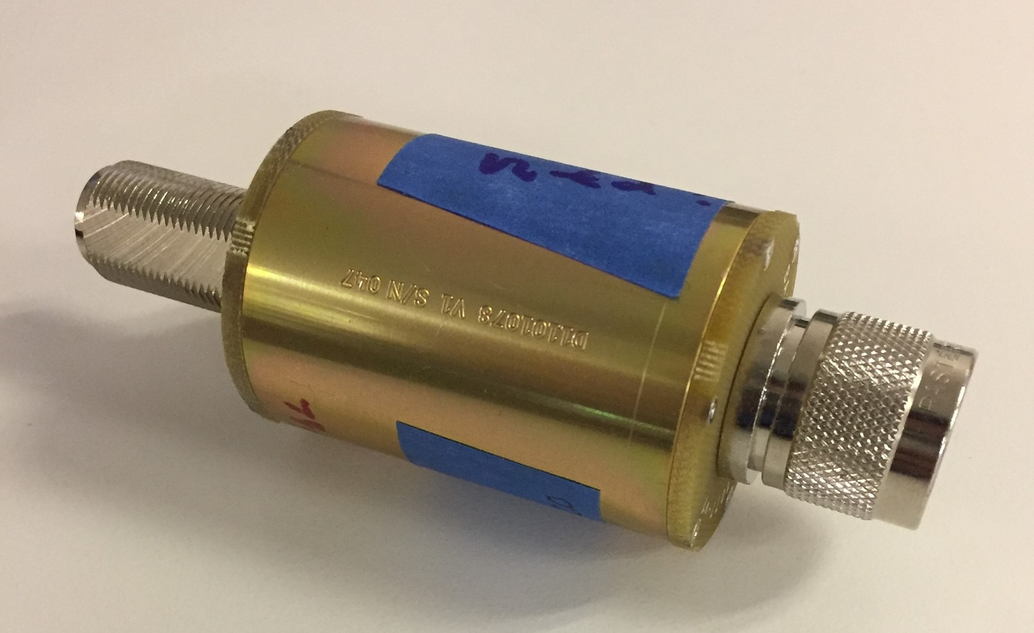
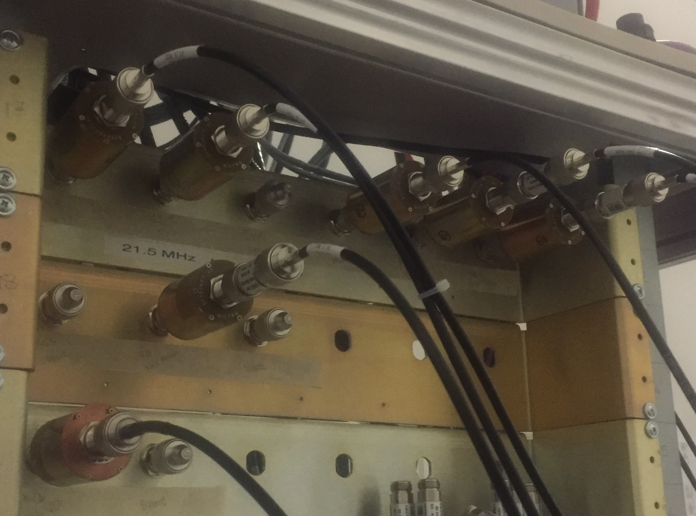
DC Ground Isolation Units (“Baluns”)
Decouples DC grounds using a transformer and shields leakage with enclosure
RF leakages observed when measuring ground to ground across the balun
Largest leakage seen on balun mounted on PSL electronics rack with -22 dBV (~79 mV_{rms}) at 80 MHz

Slide 4
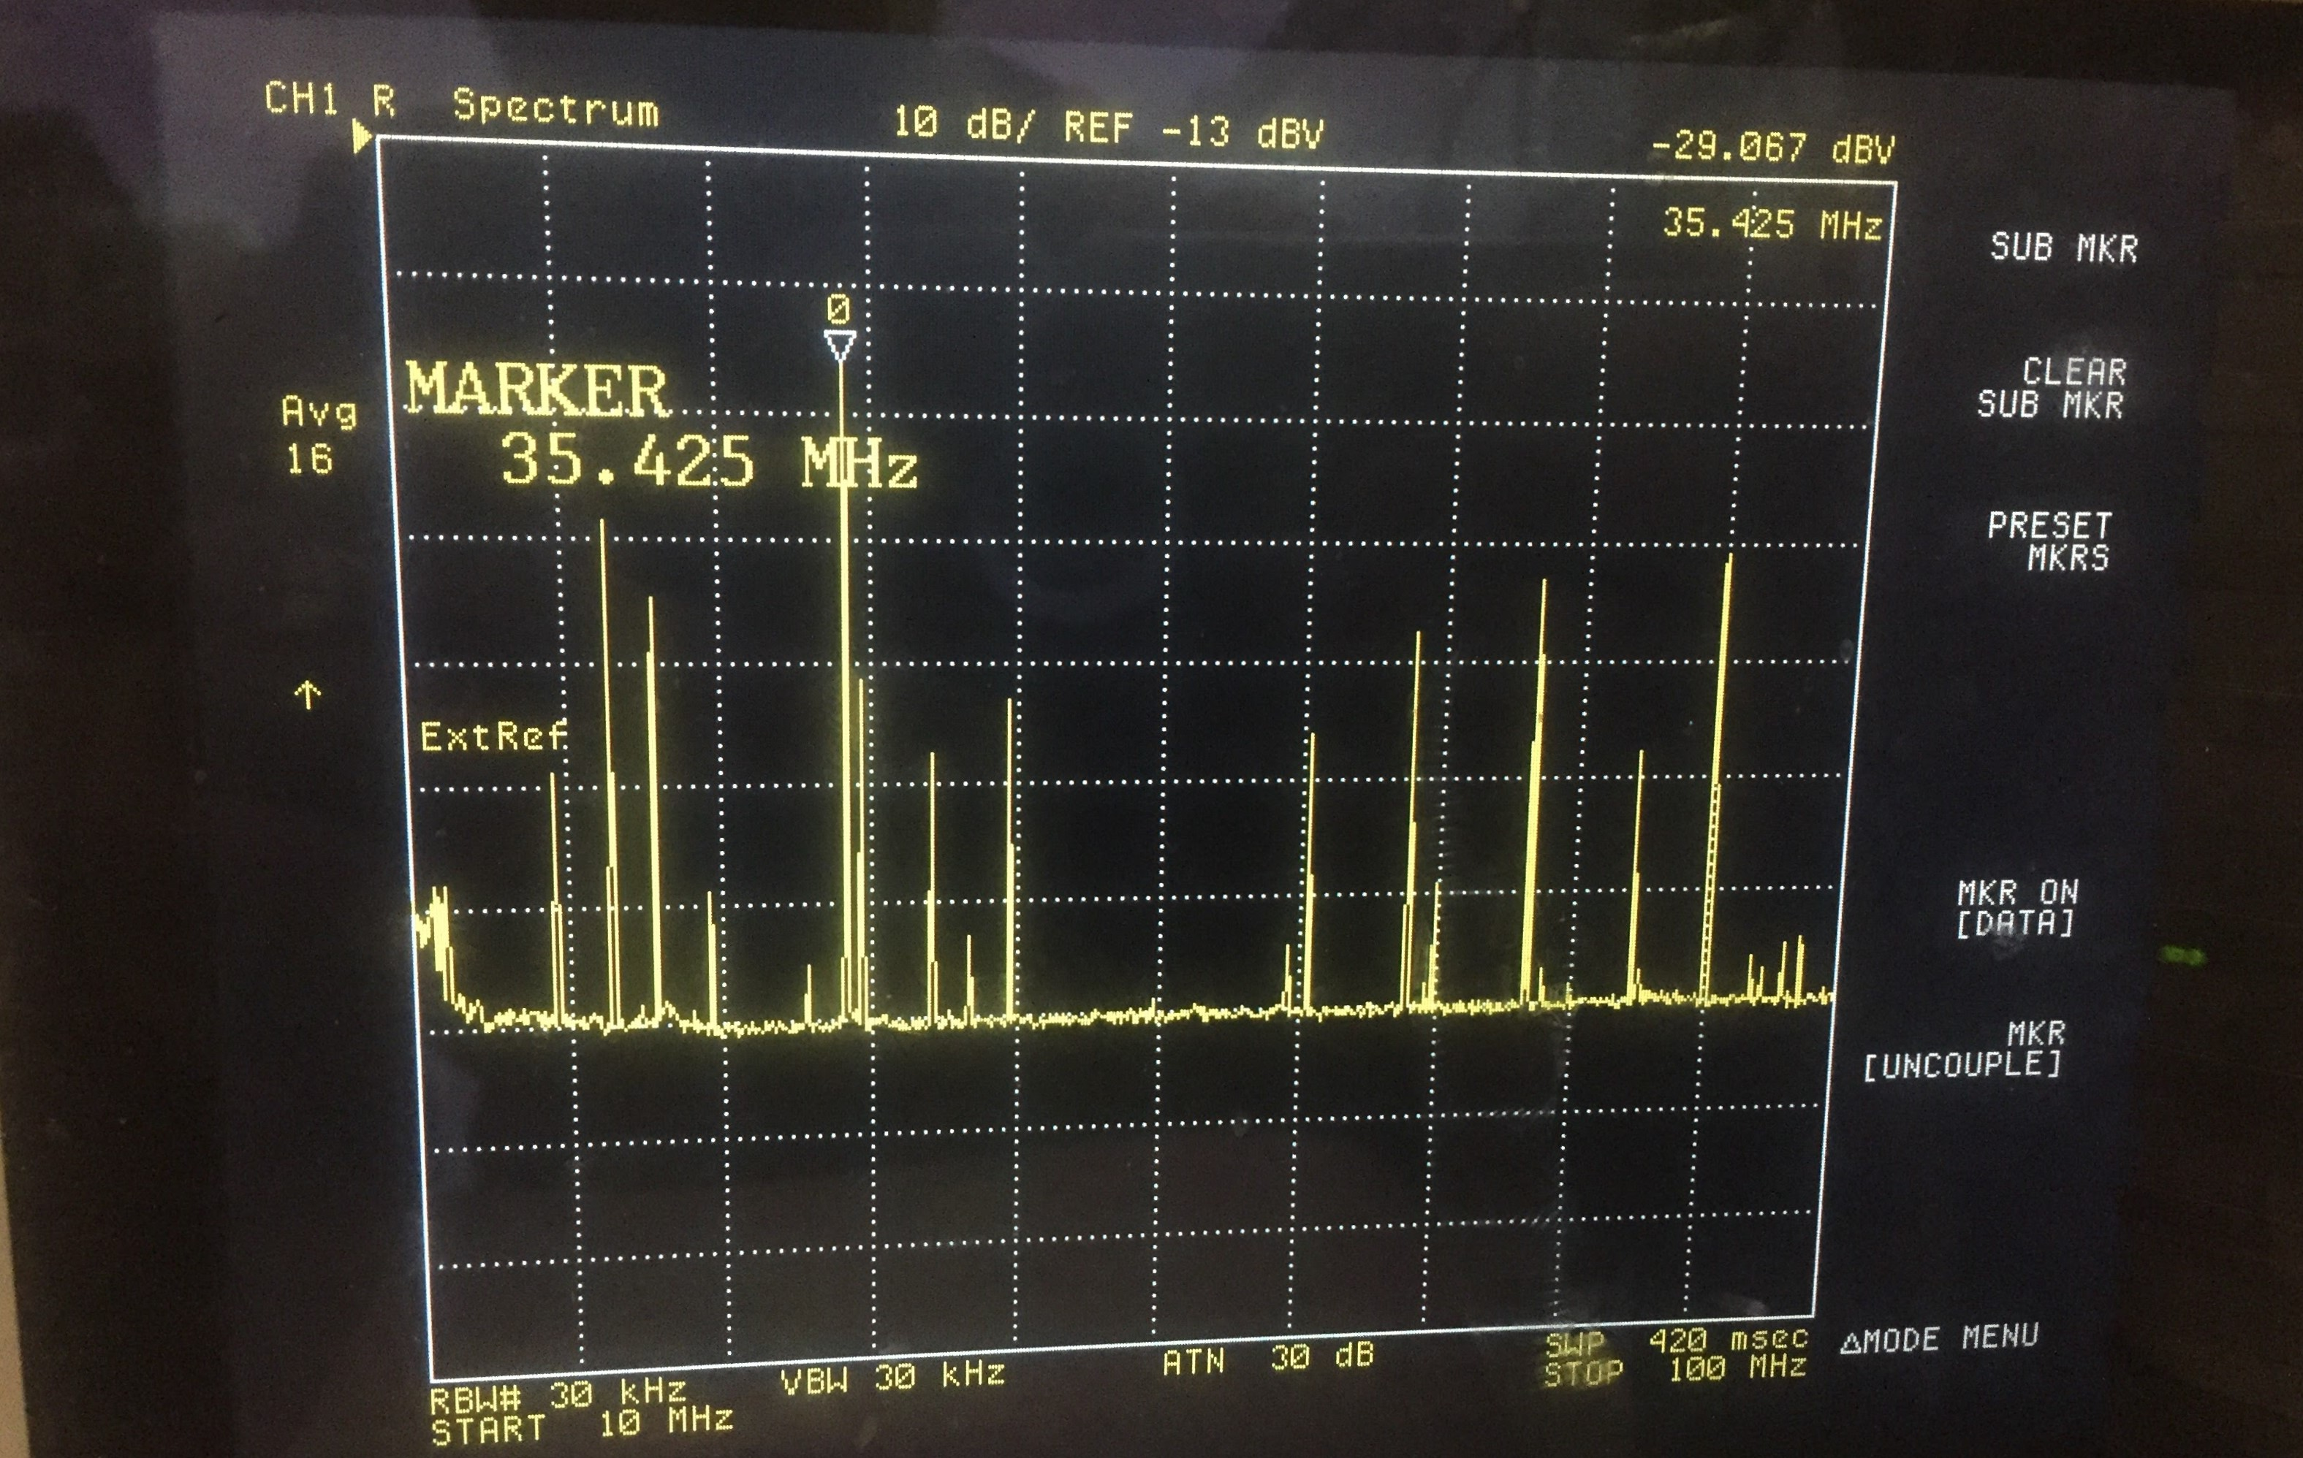
Typical Spectrum Analysis using RF Analyser
Measured from cabling ground to cabling ground across balun
This balun transmits a 35.5 MHz current
-29 dBV is about 35 mV_{rms}
Other peaks are suspected to be due to leakages from neighboring baluns

Slide 5
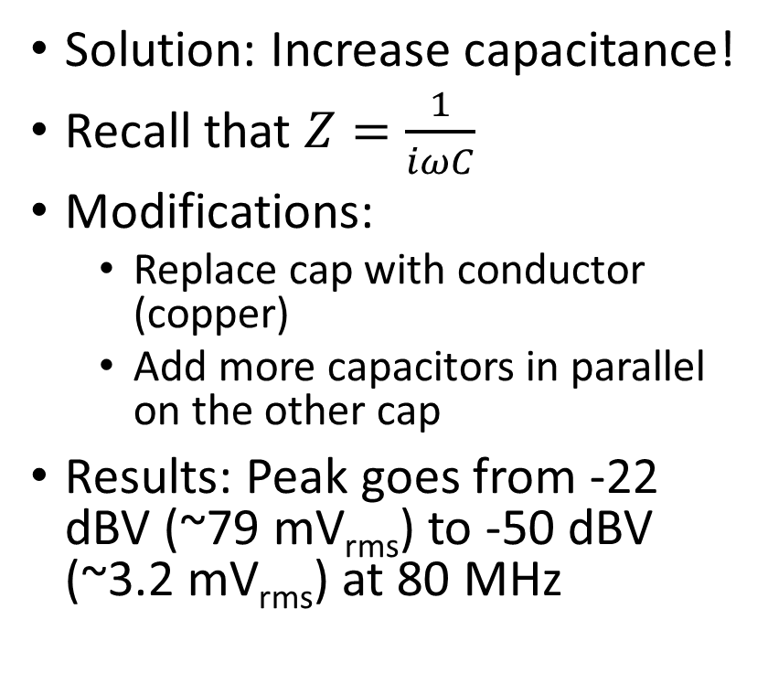
Circuit Diagram & Solutions
Solution: Increase capacitance!
Recall that $Z=\frac{1}{iωC}$
Modifications:
  Replace cap with conductor (copper)
  Add more capacitors in parallel on the other cap
Results: Peak goes from -22 dBV (~79 mV_{rms}) to -50 dBV (~3.2 mV_{rms}) at 80 MHz
DCC: LIGO-D1101077-v1

Slide 6
Future Plans
Improve and test further modifications to the baluns (i.e. add more capacitors?)
Identify other baluns that are candidates for replacement
Investigate “big picture” impact on IFO

Slide 7
Atomic Clock Phase Drift
We use an atomic clock as well as GPS for timing on the IFO
When triggering a signal from a rubidium clock on a 1 PPS GPS signal, the signal seems to wander in phase
Small phase shifts may not matter in small timescale measurements, but algorithms that use long integration times would see the effect
  i.e. Algorithms that perform continuous wave searches

Slide 8
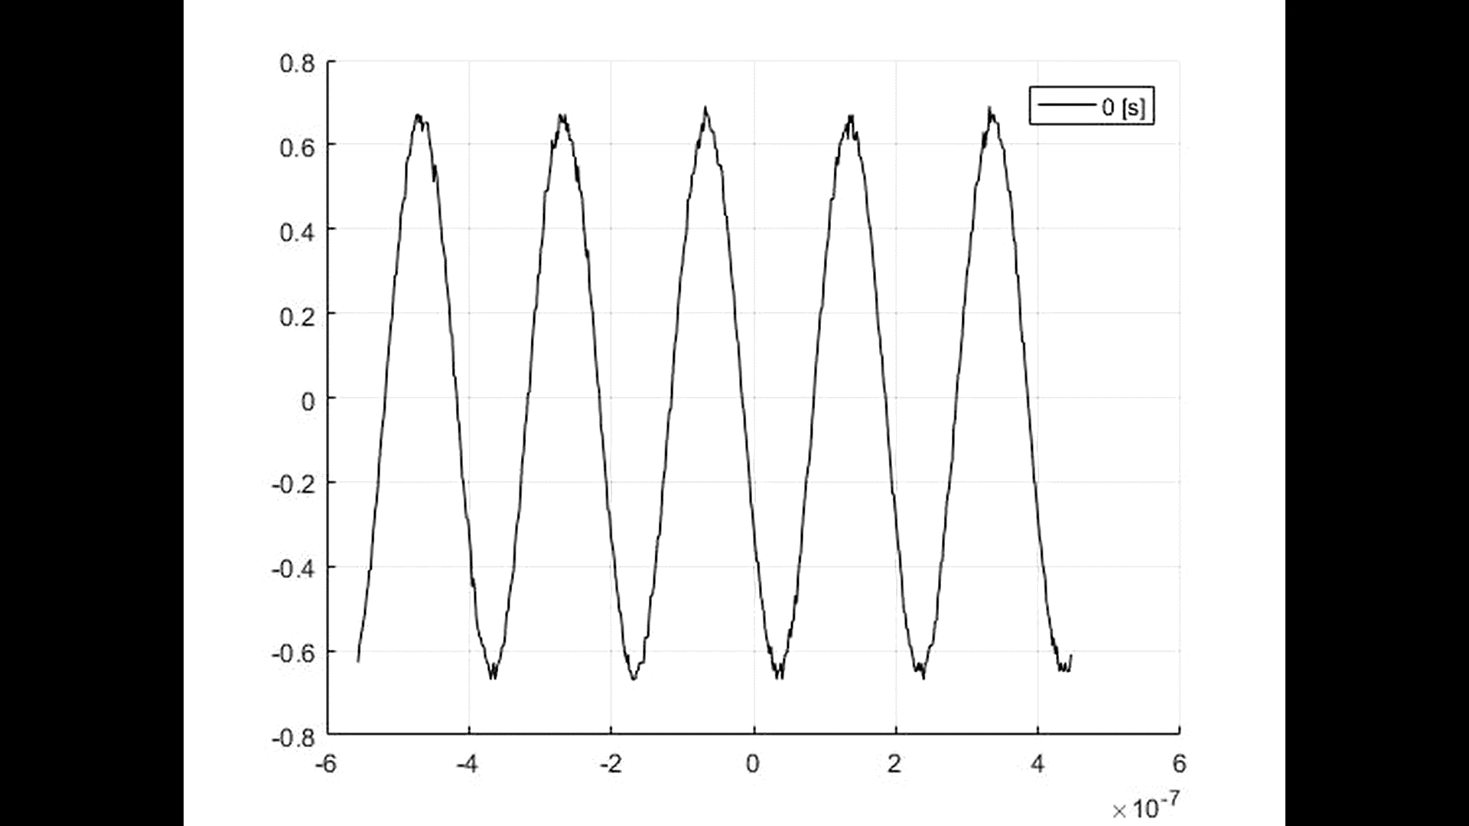
Phase Drift Sped Up

Slide 9
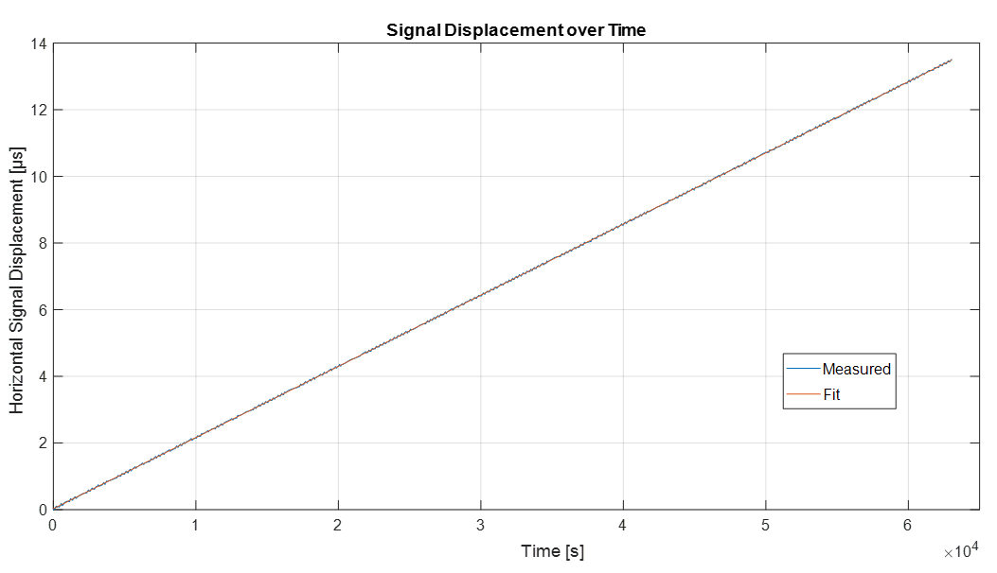
Long Term Measurement of Horizontal Shift
Mean drift of 213.55 ps per second
We can likely tune the clock to get rid of linear drift

Slide 10
But Not Perfectly Linear…

Slide 11
Observed Periodicity in Residuals

Slide 12
Test for Periodicity
Creating periodogram we find the two most interesting peaks are
  5.02 mHz (~200 s period)
  1.205 mHz (~14 min period)

Slide 13
Future Plans
Tune atomic clock to get rid of linear phase drift
Investigate the sources of these periodicities
Perform same analysis on an atomic clock more identical to the one use on H1
Take two identical RF Oscillator Sources and have one disciplined by GPS and the other by an atomic clock and analyze the difference

Slide 14
Questions?

