Slide 1
Creating Computer Controls for the Motorized Polarization Controller in LHO’s Arm Length Stabilization System
Caroline Martin
Mentor: Daniel Sigg
SURF Midterm Talk
July 27, 2017

Slide 2
Outline
Arm Length Stabilization
Motorized Polarization Controller
TwinCAT-EPICS-MEDM System
Progress
Remaining Work

Slide 3
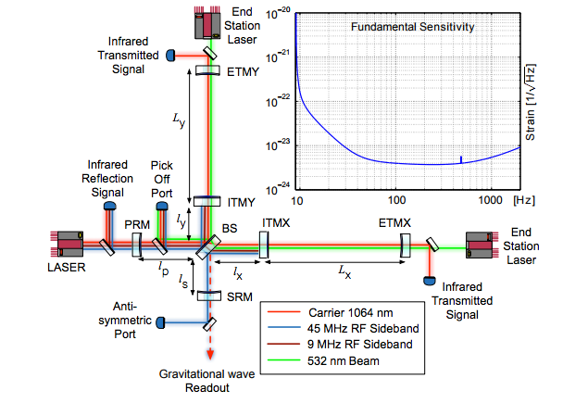
Arm Length Stabilization
ALS locks each arm individually using lasers mounted behind the test mass
Part of this system includes a polarization controller located in corner station to correct for noise and polarization drift along the fiber optic cables
A. Staley et. al. Achieving Resonance in the Advanced LIGO Gravitational-Wave Interferometer. LIGO Document P1400105. 2014.

Slide 4
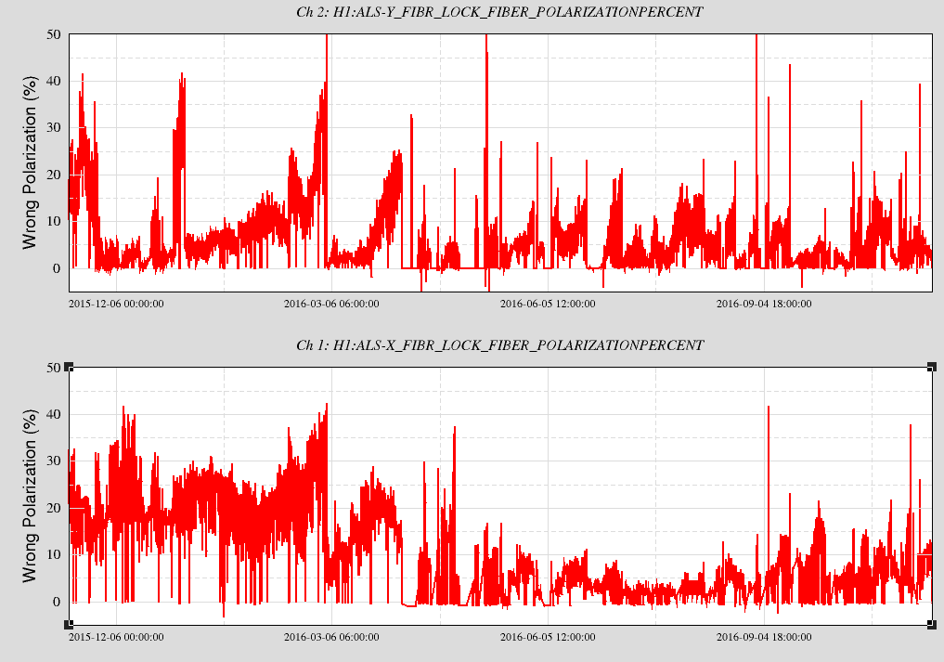
Polarization Drift
Trend of Polarization in ALS Fiber Transmission. Jeffrey Kissel, LHO Logbook, 11/18/2016
Notes:
Ideal amount of rejected light is less than 5% . If polarization is “high” high percent is rejected

Slide 5
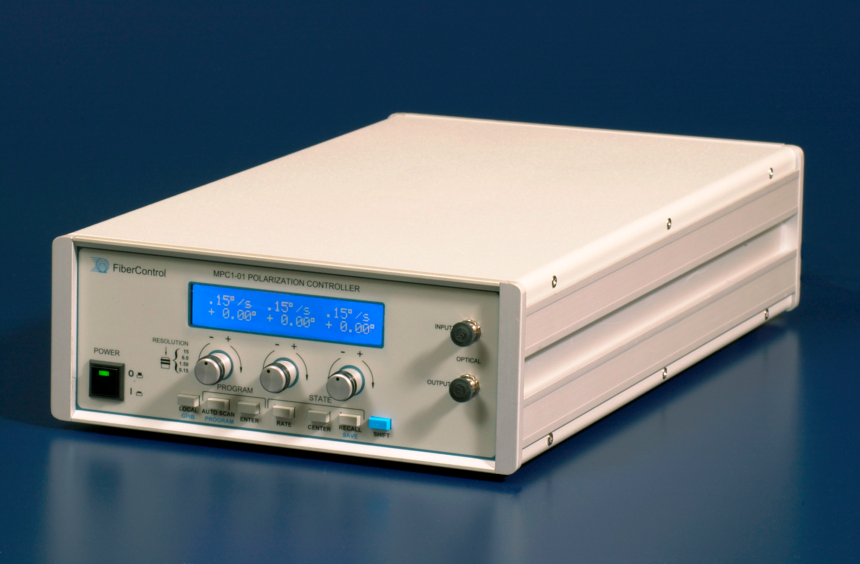
Motorized Polarization Controller
Dual channel to alter both X and Y arm
Changes the state-of-polarization using stress induced birefringence
FiberControl. MPC-1 User and Programming Manual, Version 2-2. LIGO Document T1200496- v1. 2003.

Slide 6
Motorized Polarization Controller

Slide 7
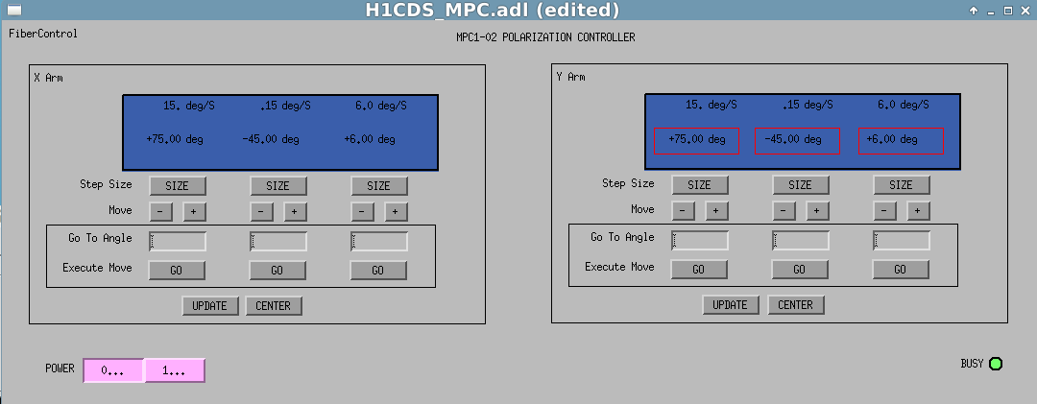
Goal of Project
David Barker, Model of user interface, LIGO Wiki, Motorized Polarizer Controller EPICS Remote Control

Slide 8
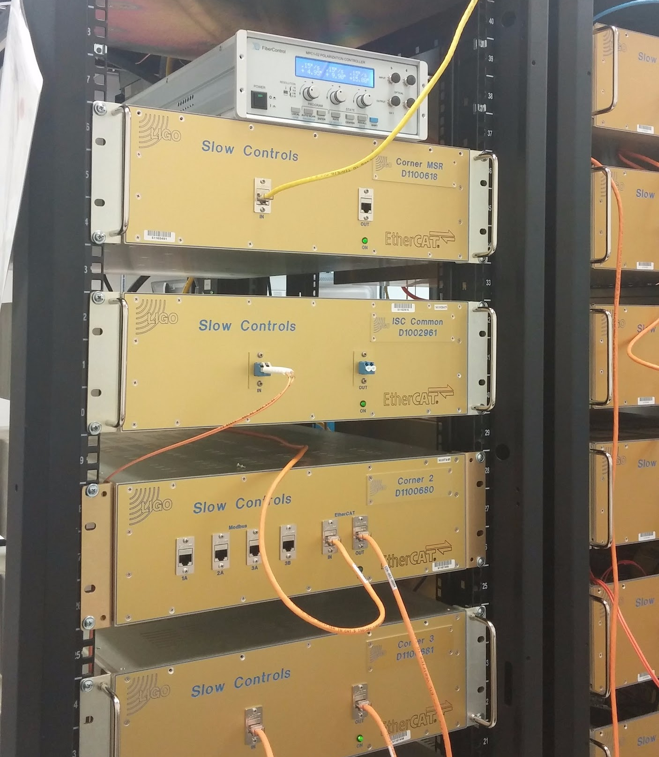
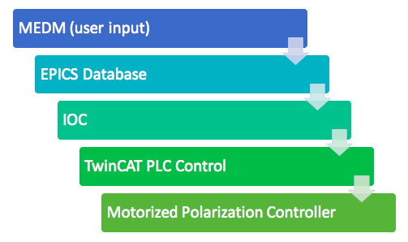
Chain of Communication
Notes:
EPICS- Experimental physics and industrial control system
MEDM- motif editor and display manager
EPICS IOC (input output controller) synchronizes TwinCAT variables with EPICS channels
IOC parses tpy files to generate EPICS database, which is then used to update MEDM
.adl files (Ascii display list)

Slide 9
Chain of Communication
Notes:
EPICS- Experimental physics and industrial control system
MEDM- motif editor and display manager
EPICS IOC (input output controller) synchronizes TwinCAT variables with EPICS channels
IOC parses tpy files to generate EPICS database, which is then used to update MEDM
.adl files (Ascii display list)

Slide 10
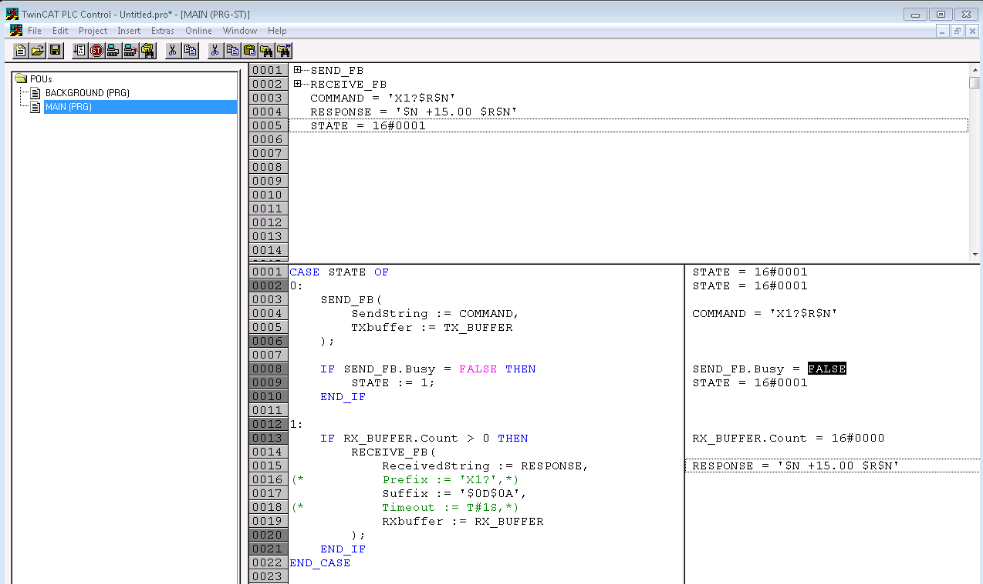

Slide 11
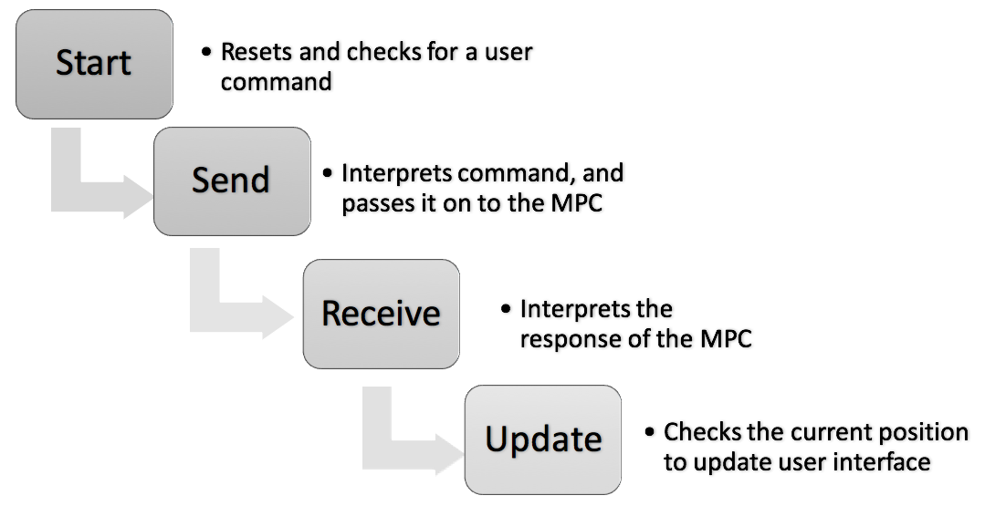
Case State Diagram

Slide 12
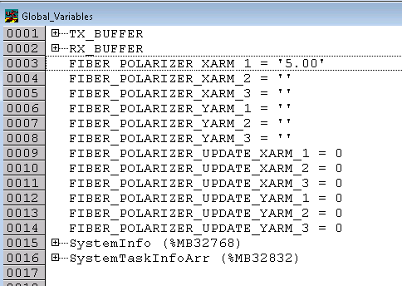
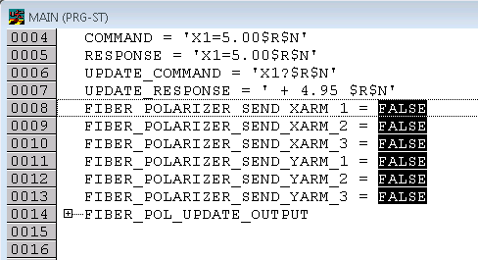
Does it work?

Slide 13
Does it work?

Slide 14
Does it work?

Slide 15
Does it work?

Slide 16
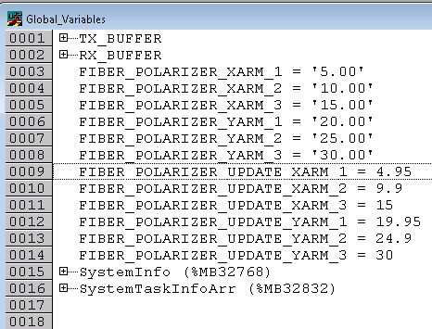
Does it work?

Slide 17
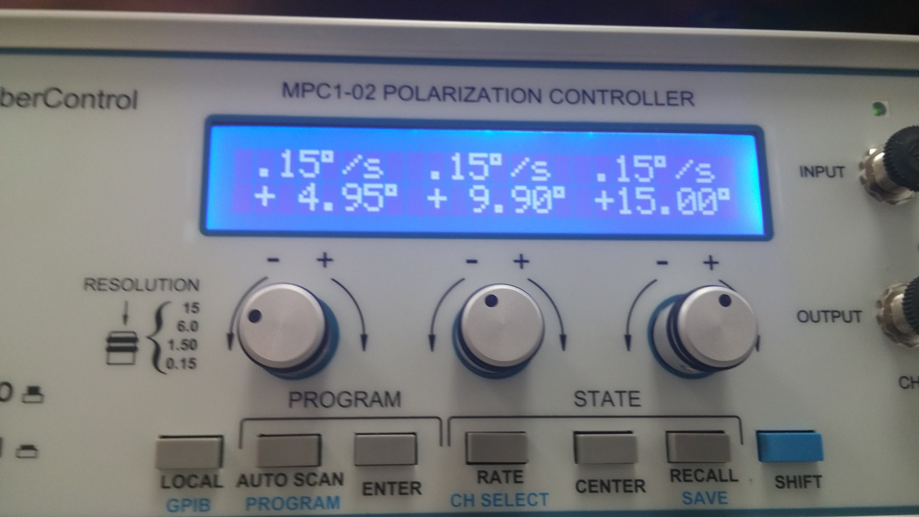
Does it work?

Slide 18
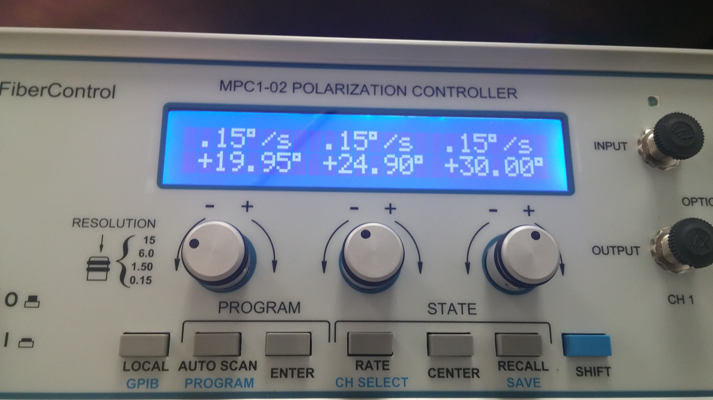
Does it work?

Slide 19
Future Goals
Error and error classification
Add more robust controls- rescan function, power on/off, scrolling mechanism, centering
MEDM/EPICS- user interface
Upgrade to TwinCAT 3

Slide 20
Conclusion
Basic communication and controls established
Still a long way to go before it’s ready to be used
Opens up the potential not only for digital controls, but also automation of polarization correction

Slide 22
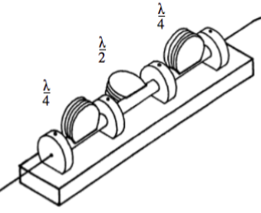
Motorized Polarization Controller
Input
𝛌/4
𝛌/2
𝛌/4

