Slide 1
Developing Remote Controls for the Motorized Polarization Controller in LHO’s Arm Length Stabilization System
Caroline Martin
Mentor: Daniel Sigg
SURF Final Presentation
August 24, 2017

Slide 2
Outline
Arm Length Stabilization
Motorized Polarization Controller
TwinCAT-EPICS-MEDM System
Results
Future Work and Applications

Slide 3
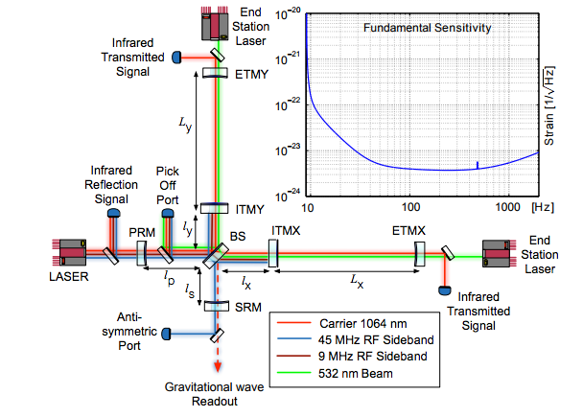
Arm Length Stabilization (ALS)
ALS locks each arm individually using lasers mounted behind the test masses
Includes a polarization controller to correct for noise and polarization drift along the fiber optic cables
A. Staley et. al. Achieving Resonance in the Advanced LIGO Gravitational-Wave Interferometer. LIGO Document P1400105. 2014.

Slide 4
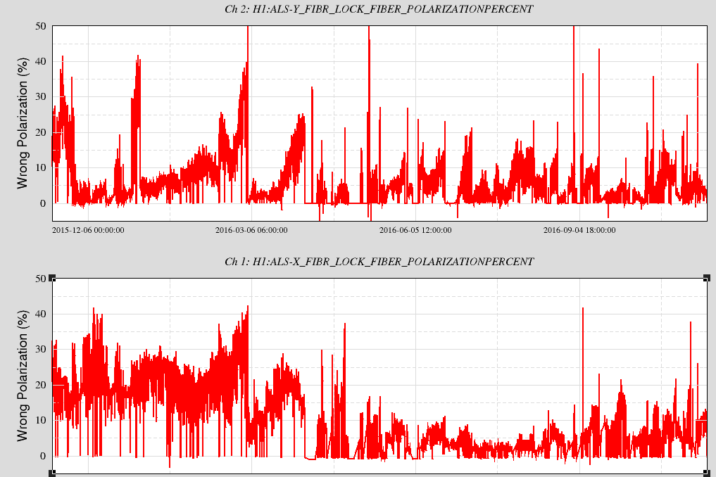
Polarization Drift
50
Y Arm
0
Wrong Polarization (%)
December 2015
September 2016
50
X Arm
Trend of Polarization in ALS Fiber Transmission. Jeffrey Kissel, LHO Logbook, 11/18/2016
0
Notes:
Ideal amount of rejected light is less than 5% . If polarization is “high” high percent is rejected

Slide 5
Polarization Drift
50
Y Arm
0
Wrong Polarization (%)
December 2015
September 2016
50
X Arm
Trend of Polarization in ALS Fiber Transmission. Jeffrey Kissel, LHO Logbook, 11/18/2016
0
Notes:
Ideal amount of rejected light is less than 5% . If polarization is “high” high percent is rejected

Slide 6
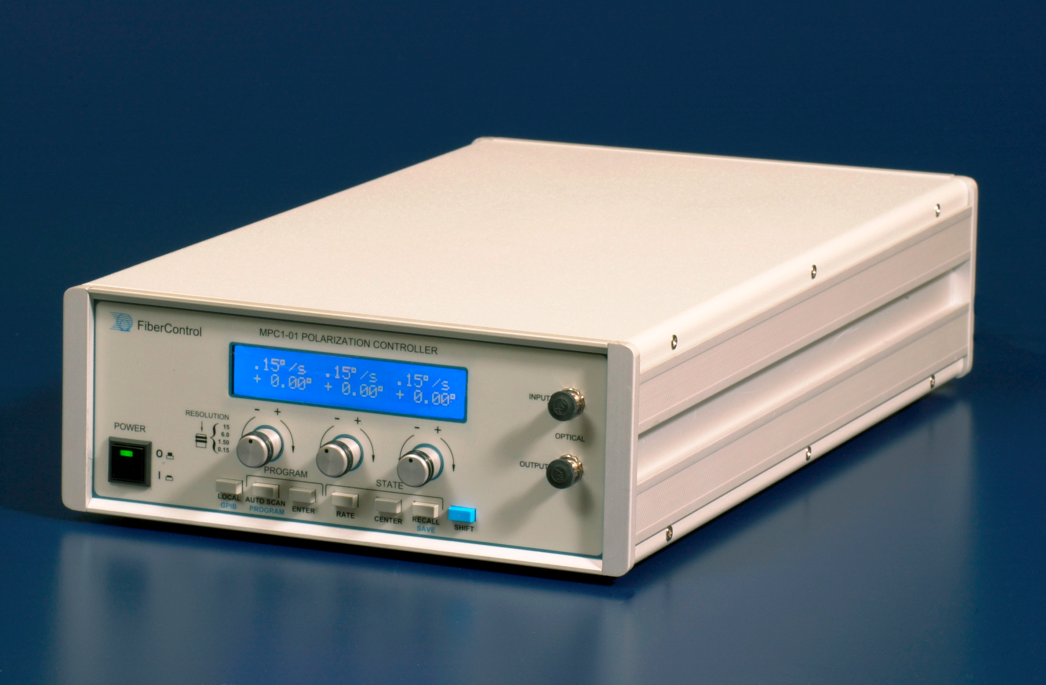
Motorized Polarization Controller
Located in the corner station, with dual channel controls (for altering X and Y arm)
Changes the state-of-polarization using stress induced birefringence
FiberControl. MPC-1 User and Programming Manual, Version 2-2. LIGO Document T1200496- v1. 2003.

Slide 7
Motorized Polarization Controller
ThorLabs Fiber Paddle Polarization Controller. Overview of Manual Fiber Polarization Controller. 3/14/14

Slide 8
Stress Induced Birefringence
Bend
Twist
2
$$θ$$

Slide 9
Polarization Adjustment
Complications make it difficult to calculate exact orientation needed
Temperature fluctuations, imperfections in fibers, unintended mechanical stress, imperfections of ‘effective waveplates’
Instead, corrected using random walk to minimize percent rejected
This has potential for automation, but first remote controls must be developed
Notes:
This needs to be a transition slide from the math of how it works, why it’s too complicated to just say go to this angle, etc.
How it’s currently adjusted- random walk by twiddling some knobs (on a side note, one of them is kinda broken) Best way to do that is to have a computer do it for you. First though, you need to establish remote controls for a baseline

Slide 10
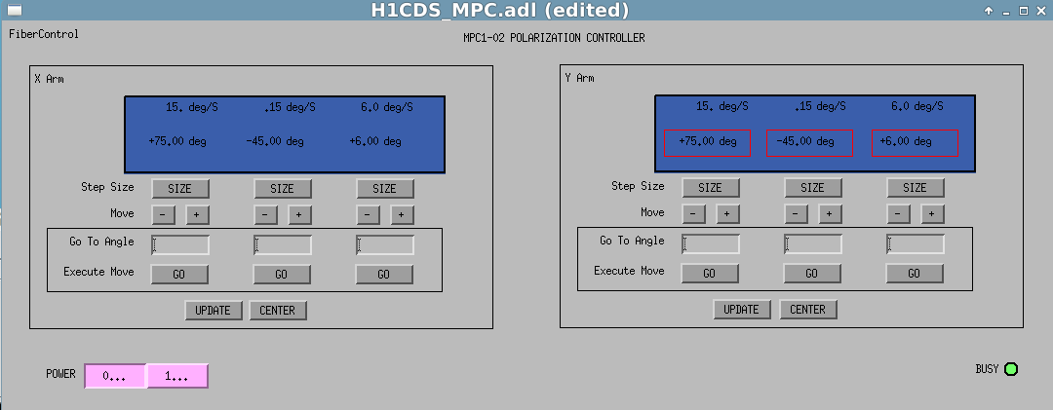
Goal of Project
David Barker. Model of User Interface. LIGO Wiki, Motorized Polarizer Controller EPICS Remote Control. 2017.

Slide 11
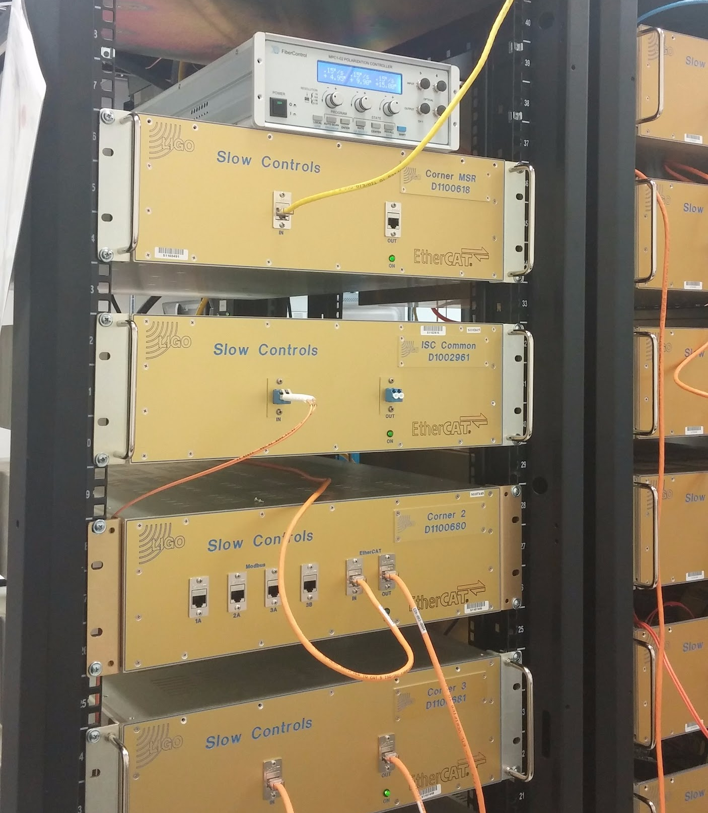
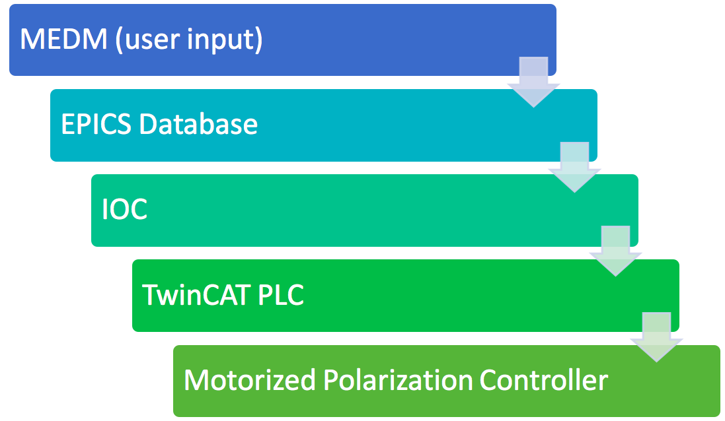
Chain of Communication
Notes:
EPICS- Experimental physics and industrial control system
MEDM- motif editor and display manager
EPICS IOC (input output controller) synchronizes TwinCAT variables with EPICS channels
IOC parses tpy files to generate EPICS database, which is then used to update MEDM
.adl files (Ascii display list)

Slide 12
Chain of Communication
Notes:
EPICS- Experimental physics and industrial control system
MEDM- motif editor and display manager
EPICS IOC (input output controller) synchronizes TwinCAT variables with EPICS channels
IOC parses tpy files to generate EPICS database, which is then used to update MEDM
.adl files (Ascii display list)

Slide 13
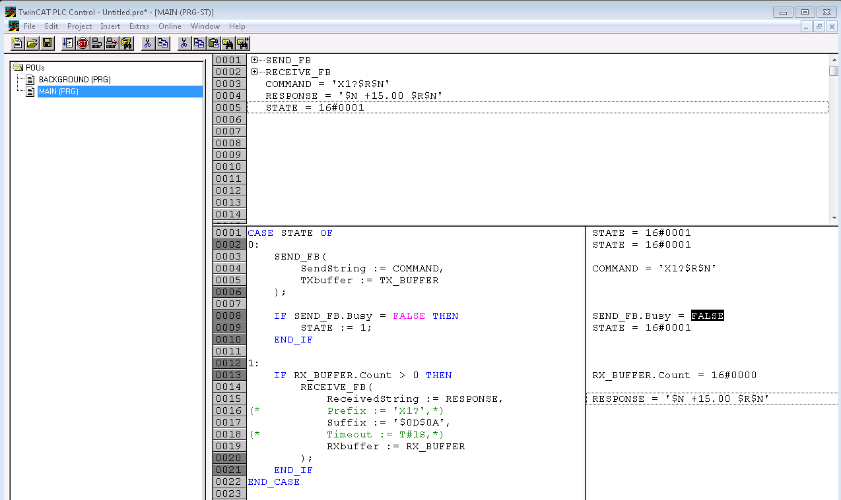

Slide 14
State Machine
Start
Interpret
Communicate
Check
Update

Slide 15
State Machine
Start
X1_Position = 5.00
Send_X1_Position = TRUE
Interpret
Communicate
Check
Update

Slide 16
State Machine
Start
X1_Position = 5.00
Send_X1_Position = TRUE
Interpret
“X1=5.00$R$N”
Communicate
Check
Update

Slide 17
State Machine
Start
X1_Position = 5.00
Send_X1_Position = TRUE
Interpret
“X1=5.00$R$N”
Communicate
Send: “X1=5.00$R$N”
Response: “X1=5.00$R$N”
Check
Update

Slide 18
State Machine
Start
X1_Position = 5.00
Send_X1_Position = TRUE
Interpret
“X1=5.00$R$N”
Communicate
Send: “X1=5.00$R$N”
Response: “X1=5.00$R$N”
Check
Send: “X1?$R$N”
Response: “ X1 = + 4.95 ”
Update

Slide 19
State Machine
Start
X1_Position = 5.00
Send_X1_Position = TRUE
Interpret
“X1=5.00$R$N”
Communicate
Send: “X1=5.00$R$N”
Response: “X1=5.00$R$N”
Check
Send: “X1?$R$N”
Response: “ X1 = + 4.95 ”
Update
X1_Update_ Position = 4.95

Slide 20
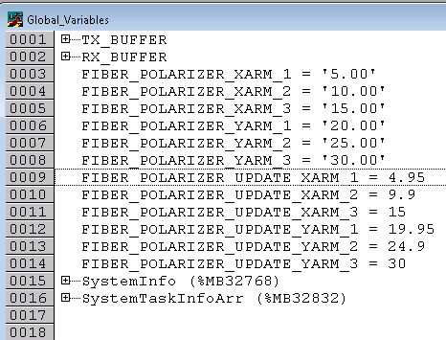
Does it work?

Slide 21
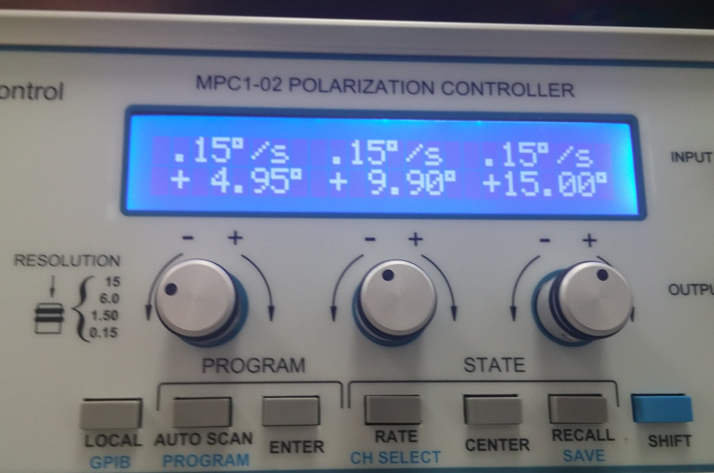
Does it work?

Slide 22
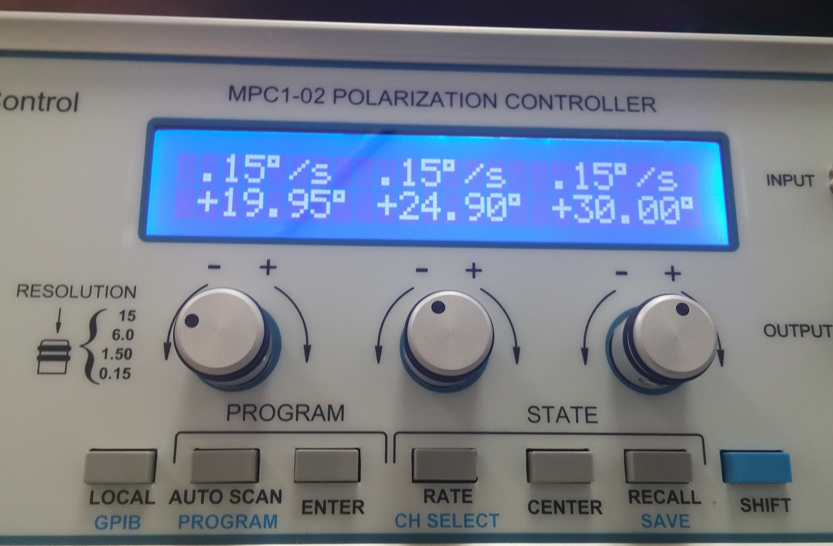
Does it work?

Slide 23
Added Functionality
To mirror functionality of the physical MPC, we need:
Scrolling
Center
Step size adjustment for coarse and fine adjustment
Speed adjustment
Additional features are also needed specifically for remote controls:
Rescan
Busy monitor
Remote power controls
Robust error handling

Slide 24
Error Handling
Start
Interpret
Communicate
Send / Receive Error
Check
Update

Slide 25
Chain of Communication
Notes:
EPICS- Experimental physics and industrial control system
MEDM- motif editor and display manager
EPICS IOC (input output controller) synchronizes TwinCAT variables with EPICS channels
IOC parses tpy files to generate EPICS database, which is then used to update MEDM
.adl files (Ascii display list)

Slide 26
Chain of Communication
Notes:
EPICS- Experimental physics and industrial control system
MEDM- motif editor and display manager
EPICS IOC (input output controller) synchronizes TwinCAT variables with EPICS channels
IOC parses tpy files to generate EPICS database, which is then used to update MEDM
.adl files (Ascii display list)

Slide 27
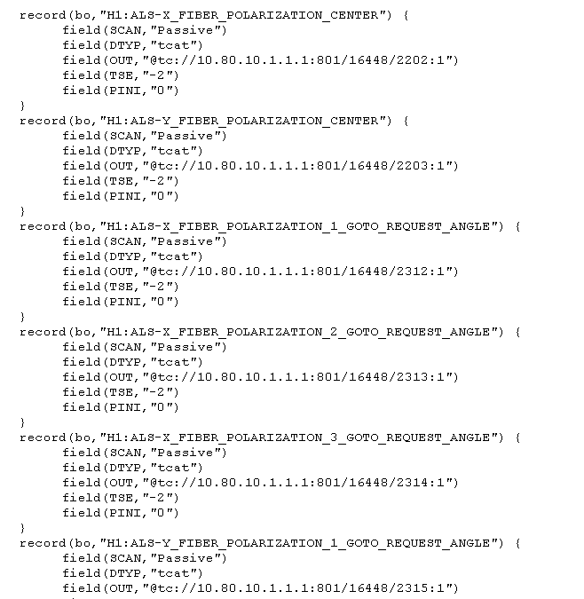
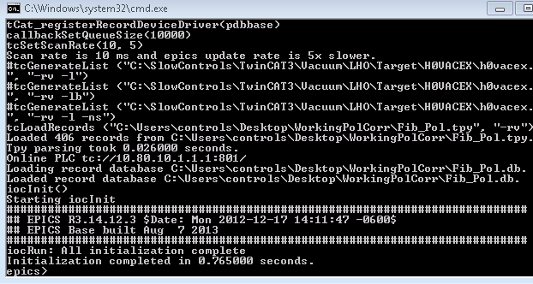
EPICS / IOC

Slide 28
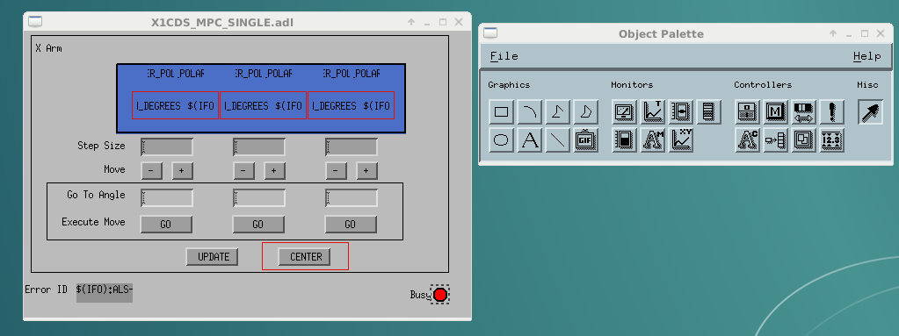
MEDM

Slide 29
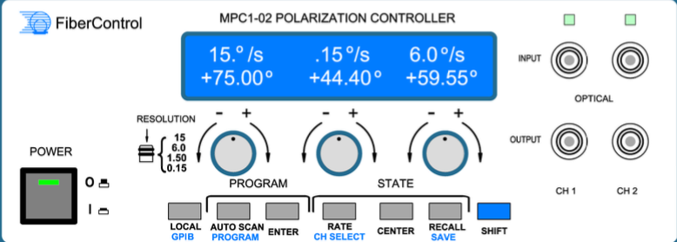
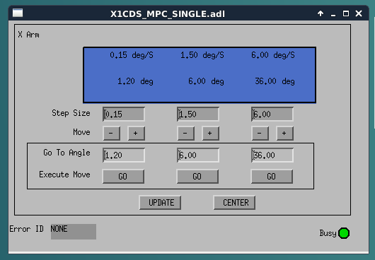
MEDM
FiberControl. MPC-1 User and Programming Manual, Version 2-2. LIGO Document T1200496-v1. 2003.

Slide 30
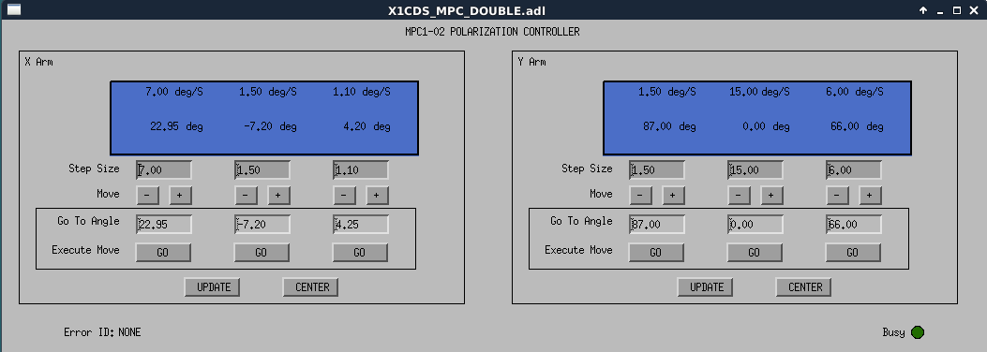
Complete MEDM

Slide 31
Future Applications and Work
Immediate future work:
Adding power button to MEDM screen and power control to box
Near future applications:
Automation of search for paddle position that minimizes light rejection
Possible investigations:
Discrepancy between speed of paddles and busy monitor
Exact effective retardance of each paddle for given wavelength

Slide 32
Conclusion
Basic communication and controls established
User interface developed for simple and intuitive operation of remote controls
Allows for DAQ storage of numeric channels
Opens up the potential not only for digital controls, but also automation of polarization correction

Slide 33
Acknowledgments
Daniel Sigg
Dave Barker
Patrick Thomas
Richard McCarthy
Support provided by Caltech SURF, funded by the NSF

Slide 35
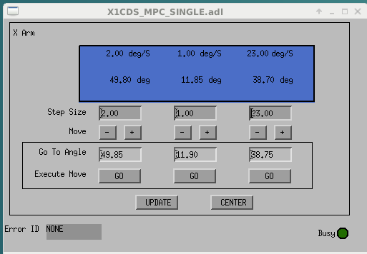
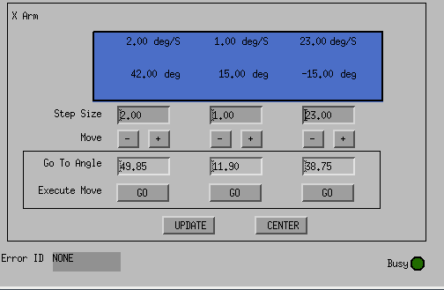
Update Command
Update command run after the MPC was
Power cycled (turned on and off)
Previous settings lost because remote setting not saved in non-voltile memory

Slide 36
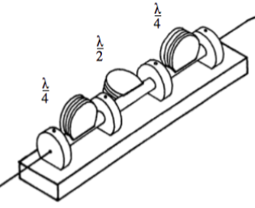
Motorized Polarization Controller
Input
𝛌/4
𝛌/2
𝛌/4

