Slide 1
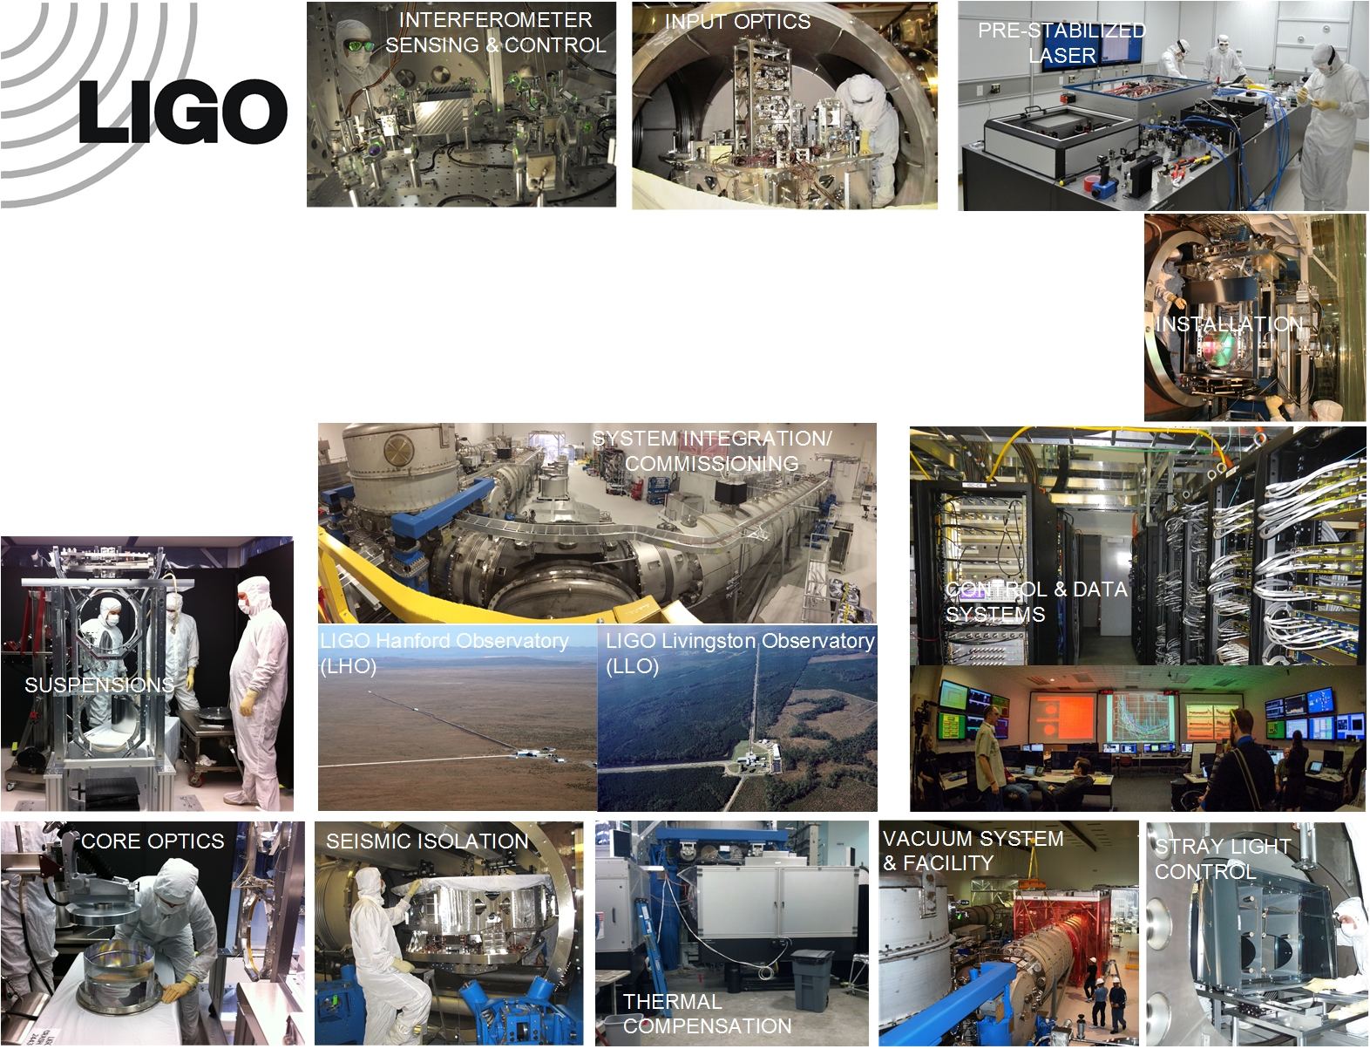
Brief LIGO Controls Overview
Dennis Coyne
LIGO Laboratory, Caltech
26 Aug 2017

Slide 2
outline
Hardware architecture
Software architecture
“Plants” to be controlled
Control group focus areas/priorities
Overall references on the Advanced LIGO detector:
Advanced LIGO, LIGO-P1400177, https://arxiv.org/abs/1411.4547
The Sensitivity of the Advanced LIGO Detectors at the Beginning of Gravitational Wave Astronomy, LIGO-P1500260, https://arxiv.org/abs/1604.00439, Phys. Rev. D 93, 112004,June 2016.

Slide 3
Control & Data System
Hardware Architecture Overview
Timing derived from GPS
Front-End Computers
  hard, real-time
  Linux real-time OS
  multi-core, server class
Fiber-linked PCIe I/O bus with 18-bit ADC/DAC
Servo loop rates up to 65 kHz
Synchronous, deterministic operation to within a few microseconds
AdvLIGO CDS Design Overview, LIGO-T0900612
New Control and Data Acquisition System in the AdvLIGO Project, LIGO-P1100052

Slide 4
Control & Data System
Software Architecture Overview
Real-Time Code Generator (RCG)
  Matlab Simulink graphical interface used to sketch control
EPICS
  Interface for setting parameters
Guardian
  State machine for sequencing
aLIGO, DAQ, Software Design Documentation, LIGO-T1000625

Slide 5
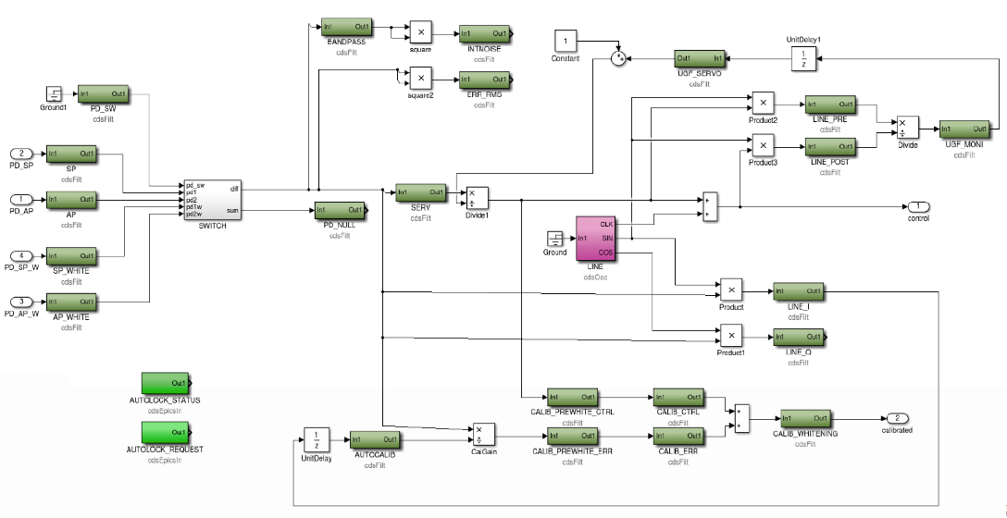
Real-time digital control
Matlab/Simulink used as a graphical interface to sketch control system using standard blocks
Generates real-time code to run on linux front-end machine
Real-time Code Generator (RCG) Software Component Overview, LIGO-T1200291

Slide 6
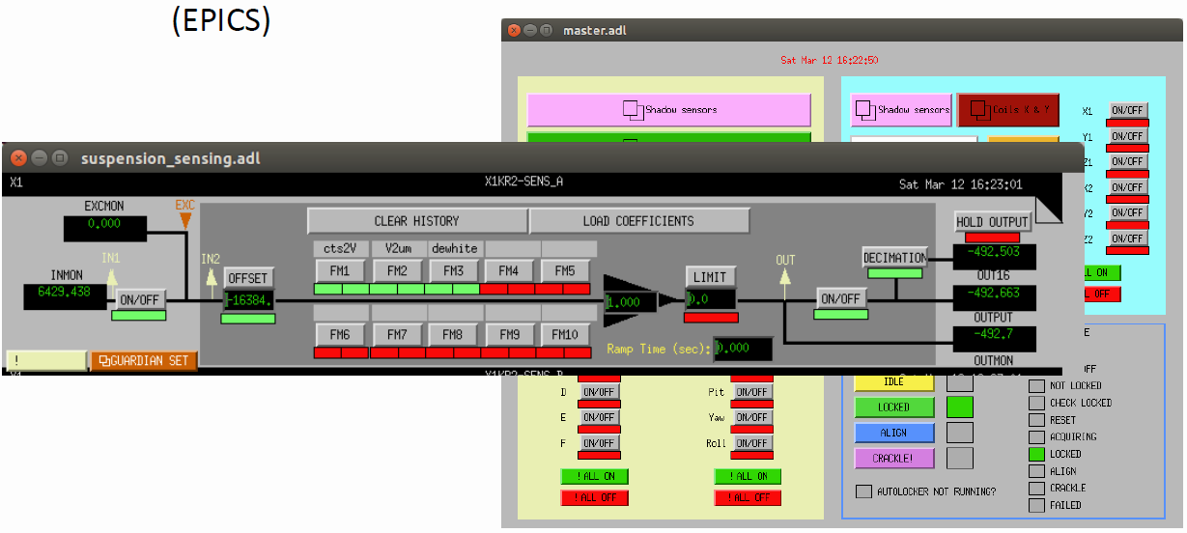
Real-time digital control
Interface to the front-end, real-time “models” is via EPICS
Change filters, gains, parameters
Set Point Definition/Monitor software automates configuration control for the ~100k servo system parameters
Real-Time Code Generator (RCG) SDF Software, LIGO-T1500115

Slide 7
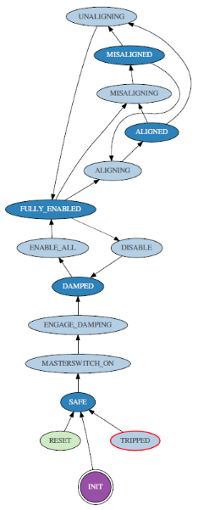
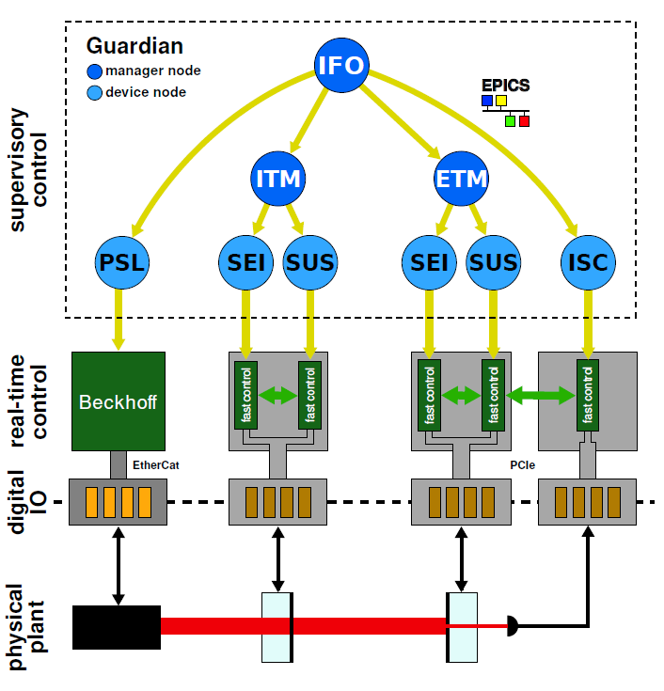
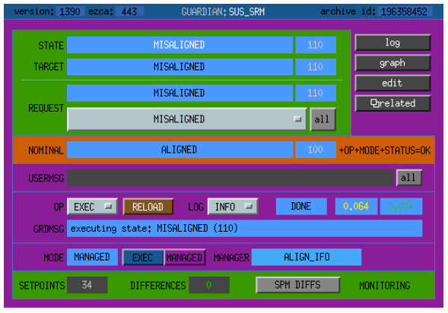
the Guardian
Robust framework for automation of the interferometer & all subsystems
Hierarchical, distributed, finite state machine
Each node executes a state graph for its subsystem
Supports commissioning & operation
EPICS interface
Python code
Adopted & adapted by Virgo
State Graph
Advanced LIGO Guardian Documentation, LIGO-T1500292
Distributed State Machine Supervision for Long-baseline Gravitational-wave Detectors with the Guardian Automation Platform, LIGO-P1600066, https://arxiv.org/abs/1604.01456, Rev. Sci. Instrum. 87 (2016) 094502

Slide 8
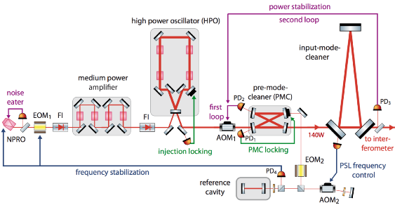
The principal “Plants”
Pre-Stabilized Laser (PSL)
  Frequency, pointing & intensity stabilization
Seismic Isolation System (SEI)
  Isolated platforms for optics
  3 stages x 6 dof each = 18 dof
  EM actuators inner stages
  Hydraulic, actuator outer
  Blended position & velocity sensing
  MIMO, feed-forward and feedback control
Suspensions (SUS)
  Single, double, triple & quadruple pendulum suspensions
  Quad Test Mass (TM) suspensions with reaction chain
  2 x 4 x 6 = 48 degrees of freedom each TM SUS
  Position sensors & EM actuators on upper stages
  Electro-static actuation at TM stage
  Damped at low frequency with rapid roll-off to prevent control loop noise injection in-band
  SUS are length and angle actuators for global interferometer control
Interferometer Sensing & Control (ISC)
  Length
  Angle
Multi-stage frequency isolation. Initial frequency stabilization has 400 kHz BW (PZT, EOM, Crystal heating)
Control topology for each SEI dof.
(40 dB of isolation with bandwidths ~25 Hz, dof dependent)
Stabilized high-power laser system for the gravitational wave detector Advanced LIGO, LIGO-P1100192, Optics Express, Vol. 20 Issue 10, pp.10617-10634 (2012)
Seismic Isolation of Advanced LIGO: Review of Strategy, Instrumentation, and Performance (CQG 2015), LIGO-P1200040, https://arxiv.org/abs/1502.06300
Noise and Control Decoupling of Advanced LIGO Suspensions, LIGO-P1400085, 2015 Class. Quantum Grav. 32 015004 doi:10.1088/0264-9381/32/1/015004

Slide 9
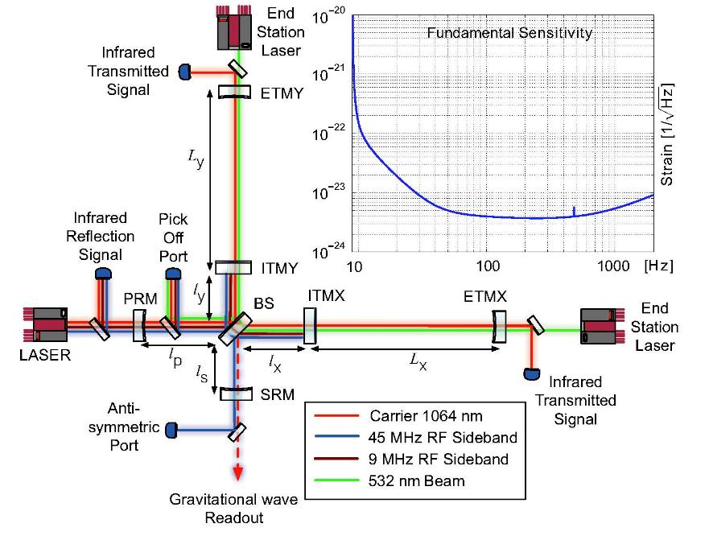
Interferometer Length
Sensing & Control
Nonlinear cavity lock acquisition control
Length derived from RF demodulated signals
Five resonant cavity lengths
Arm Length Stabilization (ALS)
  Acquire lock with lower finesse at doubled frequency (green wavelength) first
Mode | Definition
Common arm length (CARM) | (Lx+Ly)/2
Differential arm length (DARM) | Lx-Ly
Power recycling cavity length (PRC) | lp+(lx+ly)/2
Signal recycling cavity length (SRC) | ls+(lx+ly)/2
Michelson length (MICH) | lx-ly
Achieving Resonance in the aLIGO Interferometer, LIGO-P1400105, Class. Quantum Grav. 31 (2014) 245010
CARM/ALS Electro-Optical Controls Diagram, LIGO-G1500456

Slide 10
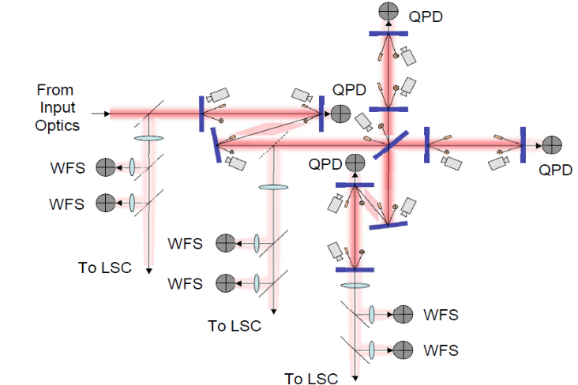
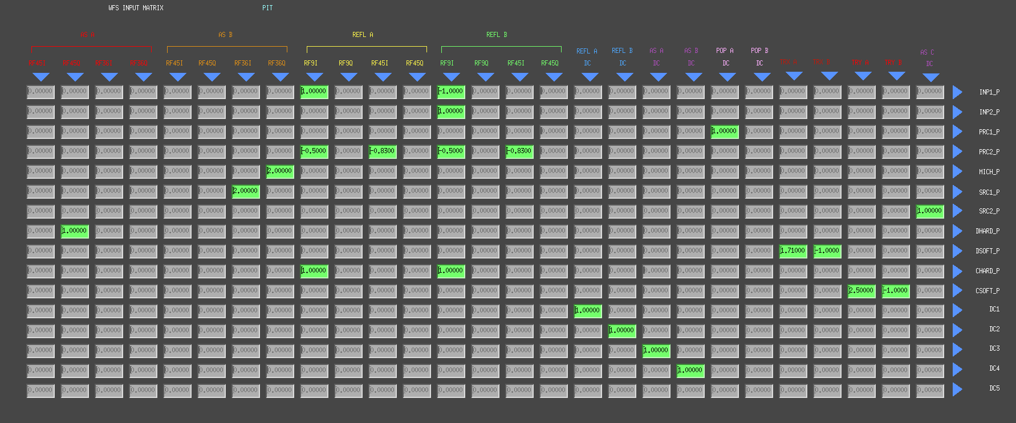
Interferometer Angle
Sensing & Control
Modulation sidebands:
  9 MHz mostly sees PRC
  45 MHz seeS PRC and SRC
Quadrant Photo-Diodes (QPD)
  Relative position → pitch & yaw
Wavefront Sensors (WFS)
  RF QPD yields In-Phase and Quadrature Phase pitch & yaw
  Placed at different Gouy phases (near vs far field)
26 degrees-of-freedom
  Input beam (pos + angle)
  11 optics form the PRC, SRC, FP arm cavities (yaw, pitch)
20 dof controlled
  IMC pointing
  SR3, PR3 are just damped
Input & Output Matrices are used to project the sensing to the controlled dofs
From Input Mode Cleaner (IMC) cavity
PR3
SENSORS
SR3
INPUT MATRIX
DOF
Alignment Sensing and Control in Adv. LIGO, LIGO-P0900258, Class. Quantum Grav. 27 (2010) 084026
Advanced LIGO Angular Control System (ASC), LIGO-G1500923

Slide 11
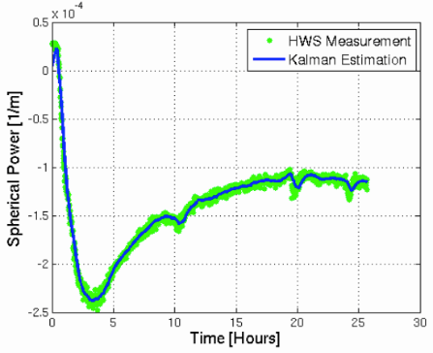
Auxiliary Loops
Many additional, essential loops, many of which are not completely independent of the global interferometer controls:
Earth tidal correction
Output Mode Cleaner (OMC) alignment
Wavefront Sensor (WFS) centering
Input Mode Cleaner (IMC) alignment
Arm Length Stabilization (ALS)
Thermal Compensation System (TCS)
Fiber “violin” mode damping loops
…
Wavefront sensor measurement and Kalman estimator
The Adv. LIGO Input Optics, LIGO-P1500076, http://dx.doi.org/10.1063/1.4936974,
Rev Sci Instrum vol. 87 pg. 014502.
Locking the Advanced LIGO Gravitational Wave Detector: with a focus on the Arm Length Stabilization Technique, LIGO-P1500273, http://dx.doi.org/10.7916/D8X34WQ4
Kalman Filter for the Thermal Compensation System, LIGO-G1501532

Slide 12
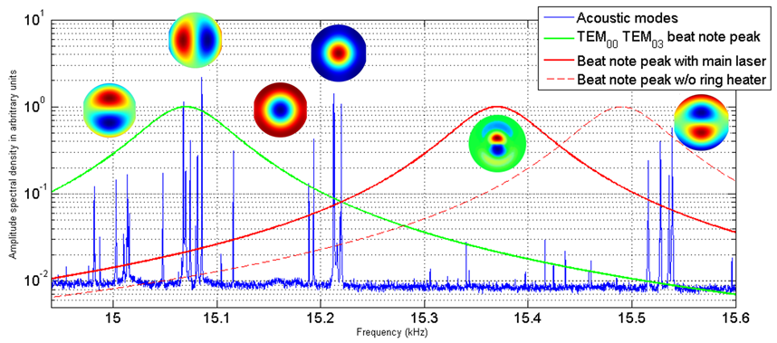
Interferometer Plant
Changes with Optical Power
“Stiff” and “Soft” modes
  Radiation pressure in the Fabry-Perot arm cavities can result in instability
  Control Hard modes with ETMs only at high bandwidth
  Control Soft modes with ITMs only, at low bandwidth
Parametric Instabilities
  Overlap of high order optical modes & test mass acoustic modes
  Shift off resonance with thermal tuning (ring heaters)
  Damp with electro-static actuators
  Research on passive, broadly tuned dampers
Angular instability due to radiation pressure in LIGO, LIGO-P0900086, https://arxiv.org/abs/0909.0010, Applied Optics, Vol. 49, No. 18
First Demonstration of Electrostatic Damping of Parametric Instability at Adv. LIGO, LIGO-P1600090, https://arxiv.org/abs/1611.08997, Phys. Rev. Lett. 118, 151102 (2017)

Slide 13
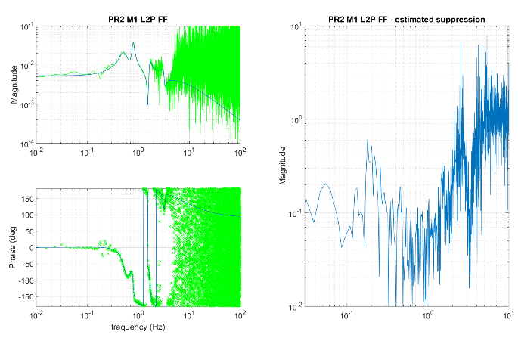
LSC Control Systems Working Group (CSWG¹) Priorities/Focus Areas
Applications of Machine Learning (ML) to Controls
  Lock Maintenance
  Lock Acquisition²
Length to Angle (L2A) decoupling
Feedback optimization
(esp. applied to angular controls)
System Identification
Interferometer robust configuration for earthquakes³
State space control for the Real-Time Code Generator (RCG) Software
More generally, we are working to inject more modern control techniques to improve performance & robustness
CSWG wiki page: https://wiki.ligo.org/viewauth/CSWG/WebHome
LSC-Virgo August 2017 Meeting @CERN, Deep leaning applied to lock acquisition, LIGO-G1701589
LSC-Virgo August 2017 Meeting @CERN, Earthquake early warning & response, LIGO-G1701593

