Slide 1

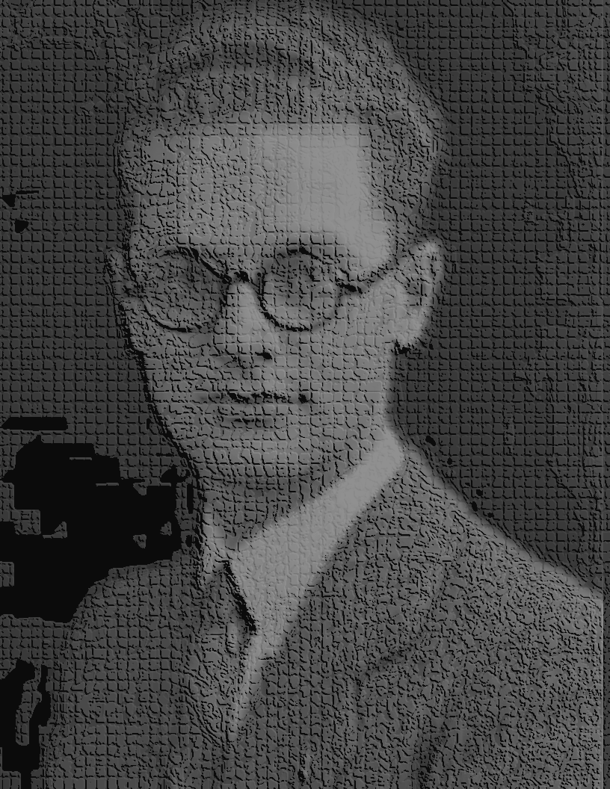
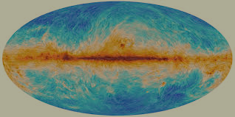
Cmb Searches for PRIMORDIAL gravitational waves
Suzanne Staggs
Princeton University
@ 12th Edoardo Amaldi Conference on Gravitational Waves
12 July 2017
Notes:
Photo is of edoardo amaldi

Slide 2
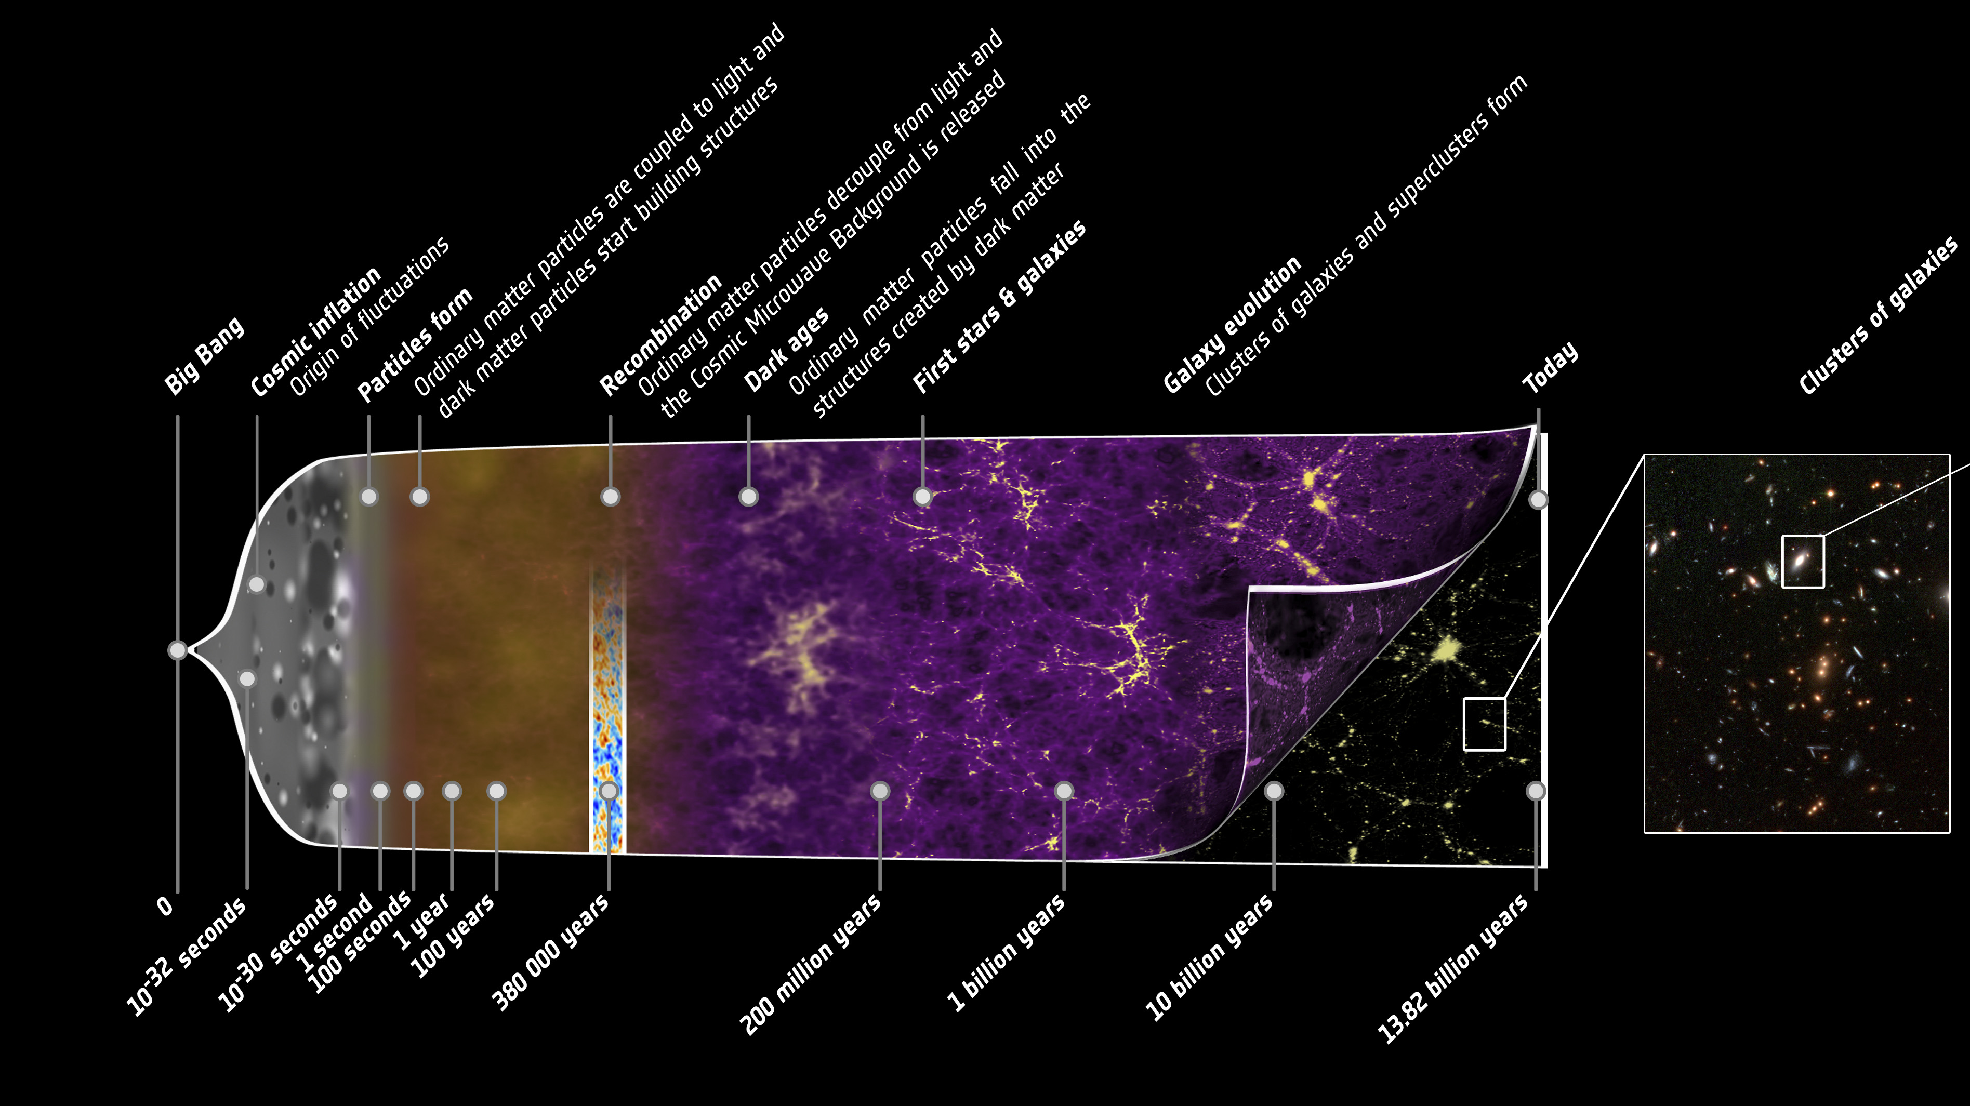
The Cosmic Microwave Background in CONTEXT
CMB DECOUPLING!
NOW
Structures form via gravitational collapse in expanding universe
ln (t) → -∞
PLASMA
Base image courtesy of Planck science team

Slide 3
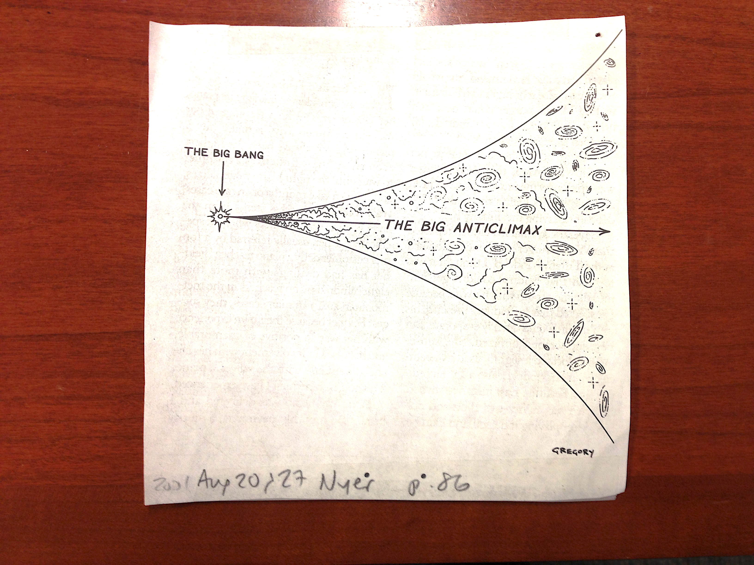
A little more context
THE NEW YORKER, 21 & 27 AUGUST 2007

Slide 4
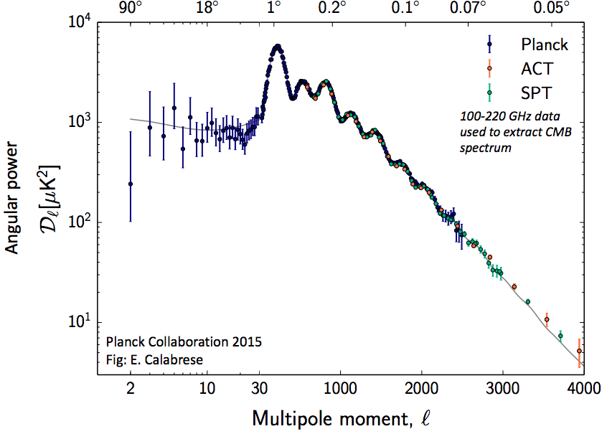
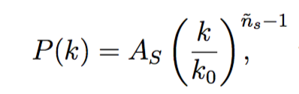
Angular Power SPECTRUM OF THE CMB TEMPERATURE
For a Gaussian random field with no preferred direction, there is no more than this!
Underlying 3d power spectrum:
Acoustic oscillation structure from well-understood physics in the primordial plasma
Planck likelihood paper
1507.02704
Notes:
This is like a 2d power spectrum, in which you consider only magnitudes of wavevectors, not their orientation, AND you ignore the phases of the complex wavevectors.

Slide 5
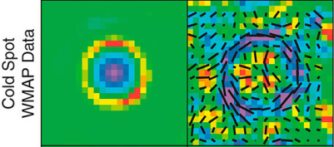

Angular Power SPECTRUM OF THE CMB TEMPERATURE
Acoustic oscillation structure from well-understood physics in the primordial plasma
TEMPERATURE
Planck likelihood paper
1507.02704
WMAP7 stacking on cold spots
Komatsu et al, 2011.
Notes:
Overdensity of plasma is a cold spot – newtonian potential is negative – Sachs Wolfe says Delta T/T goes as newtonian potential/3. First consider being pretty far out (but no more distant than the information/light horizon lets you be – about 1.2 degs) cf the sound horizon – then only gravity matters – and the plasma is flowing inward. This As you get closer, like near the sound horizon at 0.6 degs, the inward flow of the photons is compressing the fluid and so raising their temperature and you get a temperature reversal … this is confusing in the context of having chosen what now looks like a cold spot – but the rings represent having had fluid flow in and then out again – the outer ring is flowing in right now b/c it doesn’t care about teh sound physics – the inner ring is flowing back out which is why the center is low density now ..
in 3d, photons are flowing into it, so that means the ones in front of it are flowing into it and so Doppler shifted a bit

Slide 6
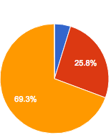
Angular Power SPECTRUM OF THE CMB TEMPERATURE
Acoustic oscillation structure from well-understood physics in the primordial plasma
ordinary matter
baryons
Planck likelihood paper
1507.02704
dark matter
dark energy
6 parameters:
Ω_{b}h², Ω_{c}h², Θ, τ, n_{s}, A_{s}
From the six, derive Ω_{Λ}, Ω_{m,} σ₈, t₀, H_{0.}
Notes:
Theta = angular scale of acoustic horizon @decoupling
where H₀ = h * 100 km/s/Mpc, the geometry is taken as flat, and n_{s} and A_{s} are defined at a pivot scale of 0.05 Mpc⁻¹.

Slide 7
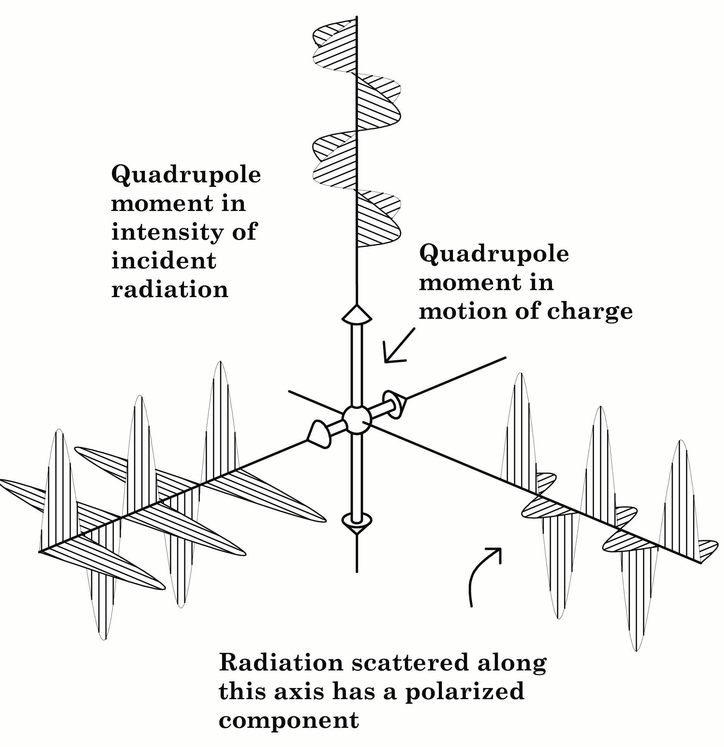
CMB Polarization SCHEMATICALLY
Unpolarized anisotropic incident radiation.
Charge reradiates dipole pattern(s)
Outgoing partially polarized radiation
Figure courtesy of M. Hedman
Acoustic oscillations create local quadrupoles (Doppler effect)

Slide 8

ACOUSTIC OSCILLATIONS & POLARIZATION PATTERNS
Consider a mass overdensity as plasma begins flowing in
Unpolarized anisotropic incident radiation.
Charge reradiates dipole pattern(s)
Outgoing partially polarized radiation
Figure courtesy of M. Hedman
Acoustic oscillations create local quadrupoles (Doppler effect)

Slide 9
ACOUSTIC OSCILLATIONS & POLARIZATION PATTERNS
Consider a mass overdensity as plasma begins flowing in
Unpolarized anisotropic incident radiation.
Charge reradiates dipole pattern(s)
Outgoing partially polarized radiation
Figure courtesy of M. Hedman
Acoustic oscillations create local quadrupoles (Doppler effect)

Slide 10
ACOUSTIC OSCILLATIONS & POLARIZATION PATTERNS
Consider a mass overdensity as plasma begins flowing in
Unpolarized anisotropic incident radiation.
Charge reradiates dipole pattern(s)
Outgoing partially polarized radiation
Figure courtesy of M. Hedman
Acoustic oscillations create local quadrupoles (Doppler effect)

Slide 11
ACOUSTIC OSCILLATIONS & POLARIZATION PATTERNS
Consider a mass overdensity as plasma begins flowing in
Unpolarized anisotropic incident radiation.
Charge reradiates dipole pattern(s)
Outgoing partially polarized radiation
Figure courtesy of M. Hedman
Acoustic oscillations create local quadrupoles (Doppler effect)

Slide 12
ACOUSTIC OSCILLATIONS & POLARIZATION PATTERNS
Consider a mass overdensity as plasma begins flowing in
Unpolarized anisotropic incident radiation.
Charge reradiates dipole pattern(s)
Consider an electron in this part of the flowing plasma
Outgoing partially polarized radiation
Figure courtesy of M. Hedman
Acoustic oscillations create local quadrupoles (Doppler effect)

Slide 13
ACOUSTIC OSCILLATIONS & POLARIZATION PATTERNS
Consider a mass overdensity as plasma begins flowing in
Unpolarized anisotropic incident radiation.
Charge reradiates dipole pattern(s)
Consider an electron in this part of the flowing plasma
In its restframe, it sees a quadrupole in the velocity field.
Outgoing partially polarized radiation
Figure courtesy of M. Hedman
Acoustic oscillations create local quadrupoles (Doppler effect)

Slide 14
ACOUSTIC OSCILLATIONS & POLARIZATION PATTERNS
Consider a mass overdensity as plasma begins flowing in
Unpolarized anisotropic incident radiation.
Charge reradiates dipole pattern(s)
Consider an electron in this part of the flowing plasma
In its restframe, it sees a quadrupole in the velocity field.
Outgoing partially polarized radiation
Figure courtesy of M. Hedman
Doppler shifts provide the requisite intensity quadrupole.
Acoustic oscillations create local quadrupoles (Doppler effect)

Slide 15
ACOUSTIC OSCILLATIONS & POLARIZATION PATTERNS
Consider a mass overdensity as plasma begins flowing in
Unpolarized anisotropic incident radiation.
Charge reradiates dipole pattern(s)
Tangential l polarization in this case!
Consider an electron in this part of the flowing plasma
In its restframe, it sees a quadrupole in the velocity field.
Outgoing partially polarized radiation
Figure courtesy of M. Hedman
Doppler shifts provide the requisite intensity quadrupole.
Acoustic oscillations create local quadrupoles (Doppler effect)

Slide 16

CMB Polarization SCENARIO
WMAP7 stacking on cold spots
Komatsu et al, 2011.
Unpolarized anisotropic incident radiation.
Charge reradiates dipole pattern(s)
TEMPERATURE
POLARIZATION
Outgoing partially polarized radiation
Figure courtesy of M. Hedman
Acoustic oscillations create local quadrupoles (Doppler effect)

Slide 17
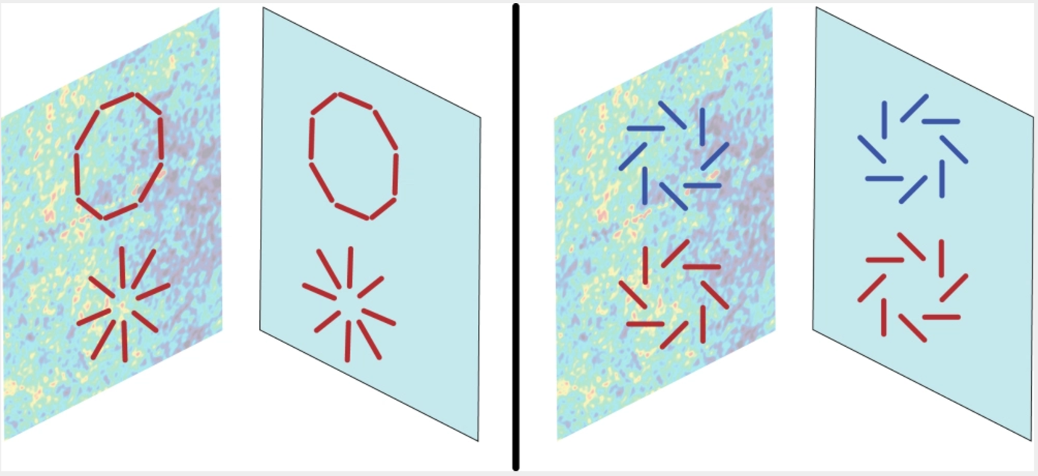
Acoustic oscillations produce e-Modes (with Even parIty symmetry)
Radial & tangential polarization patterns around cold/ hot spots
POLARIZATION
Mirrored image
Mirror artwork from Shane L. Larson: https://writescience.wordpress.com/tag/gravitational-waves/
Notes:
https://writescience.wordpress.com/tag/gravitational-waves/
Shane L. Larson did the mirror images slide – sweet!!

Slide 18
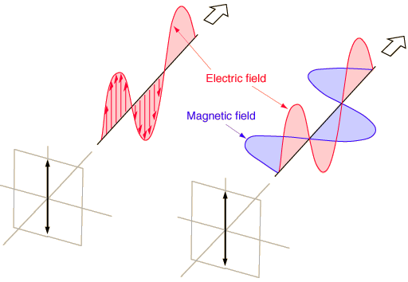
CMB Polarization: E & B Defined
TEMPERATURE IS A SCALAR
Nice form!
LINEAR POLARIZATION IS A TENSOR Requires a magnitude and a direction.
STOKES PARAMETERS
Step 1: Define x,y,z system
Notes:
This is like a 2d power spectrum, in which you consider only magnitudes of wavevectors, not their orientation, AND you ignore the phases of the complex wavevectors.

Slide 19



E & B: Scalars for Polarization)
Spin-weighted harmonics
Seljak & Zaldarriaga 1997
Kamionkowski, Kosowsky, Stebbins 1997 (E→ G, B → C)
Nice forms!
But: experiments measure Q & U…
Notes:
Note, you have to expand In the spin-weighted harmonics instead of just spherical harmonics because Q and U transform under rotation by psi as a spin-2 field, so that Q+/-iU → exp(+/-2i psi)(Q+/-iU).
SYMMETRIC TRACE-FREE (STF) → STF Tensor Spherical Harmonics for KKS instead of spin-weighted spherical harmonics for SZ; lead to identical expressions for E & B up to a factor of 2.

Slide 20
Cartoon visualization of E & B mODES
E & B are GLOBAL rather than LOCAL since they are fundamentally defined in the harmonic (rather than position) space.

Slide 21
Cartoon visualization of E & B mODES
ACOUSTIC OSCILLATIONS (SCALAR MODES) PRODUCE ONLY E-MODES! Kamionkowski, Kosowsky & Stebbins; 1997; Seljak & Zaldarriaga 1997
GRAVITATIONAL WAVES PRODUCE E AND B...

Slide 22
Cartoon visualization of E & B mODES
ACOUSTIC OSCILLATIONS (SCALAR MODES) PRODUCE ONLY E-MODES! Kamionkowski, Kosowsky & Stebbins; 1997; Seljak & Zaldarriaga 1997
INFLATION (OR OTHER P(k) PROGENITOR) COULD CAUSE PRIMORDIAL GRAVITATIONAL WAVES
GRAVITATIONAL WAVES PRODUCE E AND B...
Notes:
AND THERE WAS GREAT REJOICING! Only .. Maybe not *so* much among experimentalists b/c of 1) lensing and 2) foregrounds!!

Slide 23
Acoustic oscillations produce e-Modes (with Even partiy symmetry)
Radial & tangential polarization patterns around cold/ hot spots
POLARIZATION
Mirrored image
Mirror artwork from Shane L. Larson: https://writescience.wordpress.com/tag/gravitational-waves/
Notes:
https://writescience.wordpress.com/tag/gravitational-waves/
Shane L. Larson did the mirror images slide – sweet!!

Slide 24
Acoustic oscillations produce ONLY e-Modes (with Even partiy symmetry)
Mirrored image
Mirrored image
E-modes
B-modes
Mirror artwork from Shane L. Larson: https://writescience.wordpress.com/tag/gravitational-waves/
Notes:
https://writescience.wordpress.com/tag/gravitational-waves/
Shane L. Larson did the mirror images slide – sweet!!

Slide 25
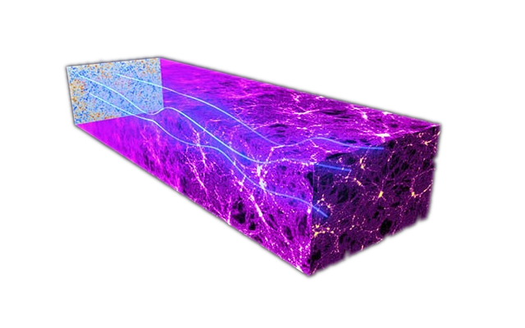
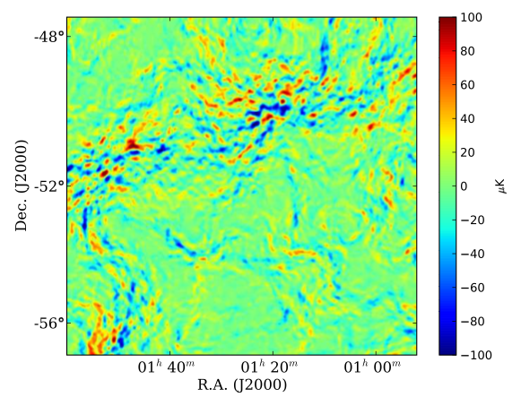
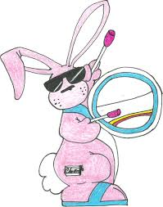
GOOD & BAD NEWS: GRAVITATIONAL LENSING
(GOOD): EVOLVING STRUCTURES LEAVE SIGNATURES
Simulated difference between lensed and unlensed CMB in 10ºx10º patch
CMB PHOTONS ARE DEFLECTED BY MASS CONCENTRATIONS AS THEY TRAVERSE THE UNIVERSE
(BAD): POLARIZATION PATTERN SYMMETRY IS NOT RESPECTED IN THE ENSUING RESHUFFFLING.
Large & small scales are coupled.
RULE OF 2-3: Typically ~ fifty deflections random-sum to 2-3’, coherent over 2-3º, mainly coming from redshifts of 2-3.
CMB
Das et al, 2011, 1103.2124 ( PRL 107, 021301.)
Notes:
Leads to signal with RMS of 5 uK arcmin with a characteristic angular scale of a few arcminues...

Slide 26
Primordial GRAVITATIONAL WAVES
ACOUSTIC OSCILLATIONS ARE SCALAR (DENSITY) FLUCTUATIONS
GRAVITATIONAL WAVES ARE TENSOR FLUCTUATIONS IN THE METRIC
PGWs IMPACT TT, TE & EE SOMEWHAT.
…. but BB OPENS UP A NEW FUNDAMENTAL OBSERVABLE!
INFLATIONARY MODELS GENERICALLY PREDICT PGWs
VERIFIICATION OF INFLATION? QUANTUM NATURE OF GRAVITY?
GRAND UNIFICATION SCALE?
LENSING SCRAMBLES E INTO B…
Notes:
For inflation, QUANTUM

Slide 27


Primordial GRAVITATIONAL WAVES
ACOUSTIC OSCILLATIONS ARE SCALAR (DENSITY) FLUCTUATIONS
GRAVITATIONAL WAVES ARE TENSOR FLUCTUATIONS IN THE METRIC
TERMS:
Primordial power spectrum in terms of the 3d wavevector k
Relating tensor fluctuations to primordial fluctuations giving rise to most of the structure in the universe!
Notes:
For inflation, QUANTUM

Slide 28
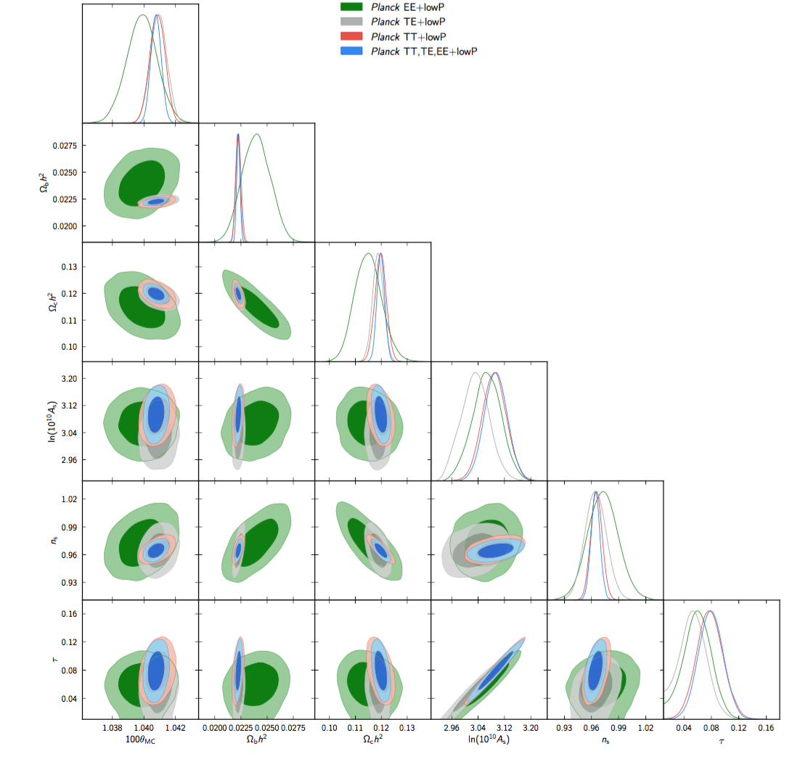
CMB POLARIZATION SPECTRA ~NOW
  SIX PARAMETER FIT:
  epoch, baryons, DM, reinoization, power spectrum normalization, tilt – <~1% except τ (15%) & n_{s} (5%)
Ω_{b}h²
Ω_{c}h²
ln(10¹⁰A_{s})
n_{s}
τ
TT
TE
EXAMPLE RESULTS from Planck 2015 XIII
EE
BB
100θ_{MC} Ω_{b}h² Ω_{c}h² ln(10¹⁰A_{s}) n_{s} τ
Plot fom Planck 2015 results XIII Cosmological Parameters.
Notes:
Check there is not the new tau paper out yet from Planck
Check whether new SPTpol papers are out yet
Check for latest B2K
Check for new PB
Check to see if Planck papers are pubilshed yet
Ask Jo if there is a better plot for likelihoods

Slide 29
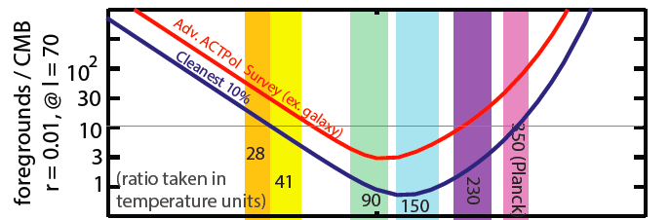
A LITTLE BIT MORE SOBRIETy
GALACTTIC FOREGROUNDS: DUST AND SYNCHROTRON EMISSION ARE OUT THERE!

Slide 30
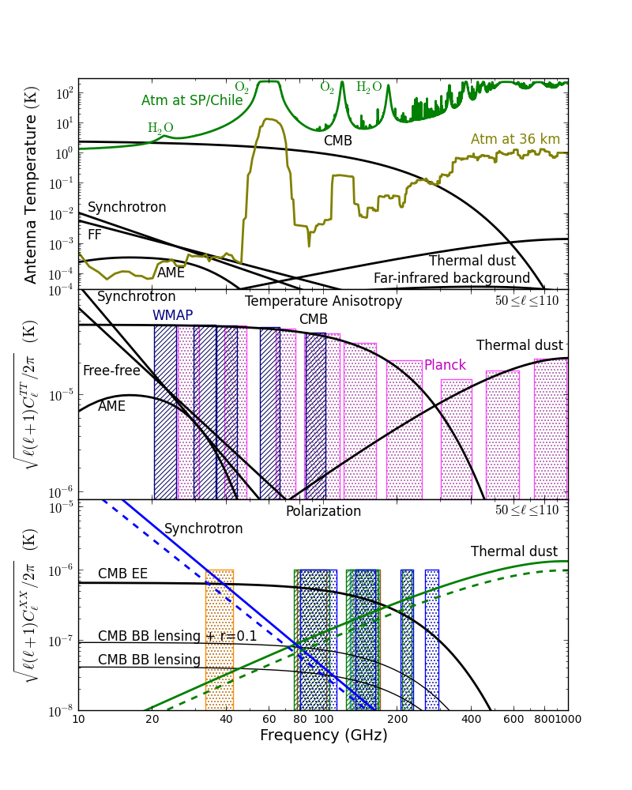
FOREGROUNDS
All the ordinate axes are in terms of antenna temperature, which is proportional to the source power; thus the CMB signals vary with frequency.
Lower two panels are anisotropy estimates.
Extragalactic sources are not included.
From Staggs, Page & Dunkley, RoPP, 2017

Slide 31
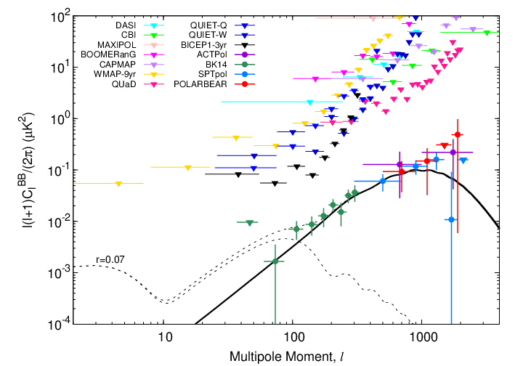
B-MODE DATA STATUS
10º
1º
0.1º
LENSING B-MODES DETECTED (FIRST THROUGH OTHER TRACERS OF THE DM, AND NOW DIRECTLY)
Slide credit: Yuji Chinone

Slide 32
B-MODE DATA STATUS
10º
1º
0.1º
GALACTIC FOREGROUNDS ARE NOT NEGLIGIBLE!
BUT: lots of information from Planck, multiple frequencies help; lots of simulation work going on.
dust @ 95 GHz
Lensing sample variance adds noise; higher resolution maps of the CMB can delens.
synch @ 95 GHz
Slide credit: Yuji Chinone
Slide credit: Yuji Chinone
Notes:
The dashed orange and green lines (Copied from science book figure) show the dust and synchrotron (current upper limit) model assumed in the forecasting, at the foreground minimum of 95 GHz. The levels of dust and synchrotron are equal to the ones reported in [BICEP2, Keck Array Collaboration, P. A. R. Ade et al., “Improved Constraints on Cosmology and Foregrounds from BICEP2 and Keck Array Cosmic Microwave Background Data with Inclusion of 95 GHz Band,” Phys. Rev. Lett. 116 (2016) 031302, arXiv:1510.09217 [astro-ph.CO].
DELENSING NEEDED BELOW 5 uK arcmin ROUGHLY; 2-3’ is all you need though.
This B-mode lensing signal has a well-understood amplitude, but the sample variance in these modes in the CMB maps leads to increased noise in estimates of the inflationary B modes. Unlike other sources of astrophysical B- mode fluctuations in the map, it cannot be removed with multifrequency data. Fortunately, this signal can be removed using map-level estimates of both the primordial E-mode map and the CMB lensing potential φ with a technique called delensing. However, this procedure requires precise maps of both the E modes and of the gravitational lensing potential (which can be obtained from the CMB-S4 data itself).

Slide 33
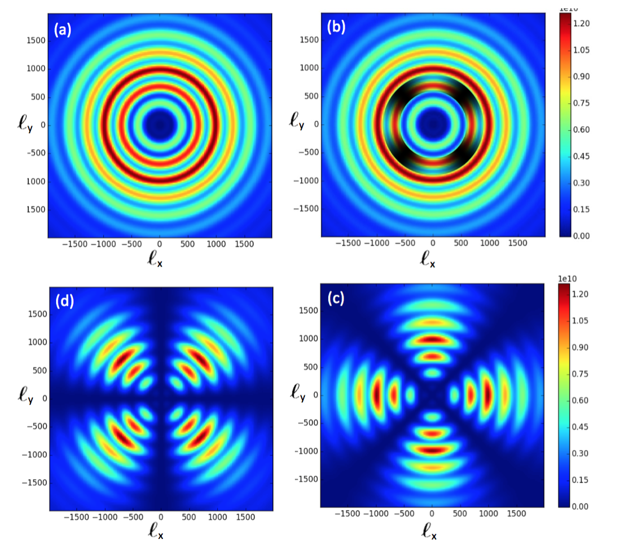

E-MODES & PLAID PATTERNS IN Q & U
EE
BB
E
E
E
2d Fourier Transform equations pick out horizontal and vertical features in an E-only sky.
U
Q
Simulations courtesy T. Louis (from Staggs, Page, Dunkley, 2017.)

Slide 34
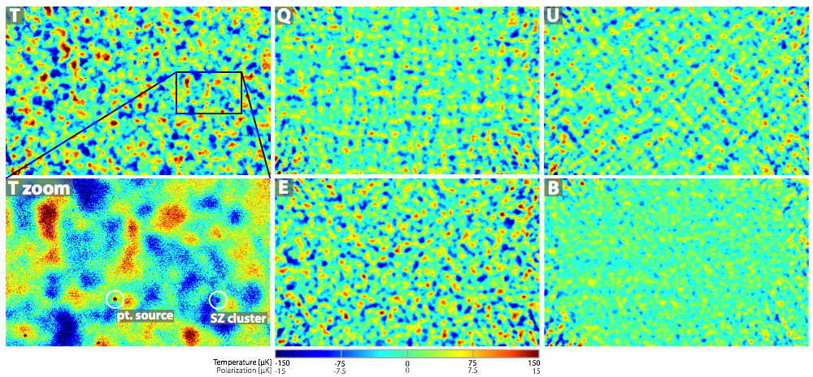
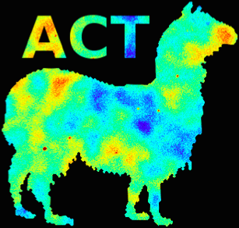
PAROCHIAL EXAMPLE OF E-MODE PLAID PATTERNS
One of the 4 ACTPol fields: D6 (area ~ 60 deg²)
Naess et al, JCAP 10 (2014) 007
Notes:
Go through the plots. Q and U define. Example maps from the region 29.65° < RA < 40.49°, 7.60° < Dec < 0.68°, in the center of patch D6. Panels 1,2,3,5,6 (left to right, top to bottom) show T, Q, U, E and B respectively. Panel 4 is a zoom on a 2.79° × 1.73° subregion of the T map, showing the full map resolution. The maps have been bandpass filtered to maximize signal-to-noise (240 < l for temperature, 260 < l < 1370 for polarization). The visible patterns in the Q and U maps are consistent with a sky dominated by E-mode polarization, as can be seen in the derived E and B maps. The B map is consistent with noise except for a faint m = 0 (constant declination) ground residual. We do not use m = 0 modes in the power spectrum estimation. The circled galaxy cluster candidate, ACT-CL J0205.2-0439, is within 2 0 of a CFHTLS cluster candidate with photometric redshift z = 1.1 and three concordant galaxies with spectroscopic z = 0.97 found in the VIMOS Public Extragalactic Survey. The circled point source may be associated with FBQS J0209-0438, a quasar at z = 1.128. Sievers and Naess.
Note the pattern in Q and U.
This photo shows the site layout -- the telescope sits inside a large ground screen; it also has a large co-moving
ground screen which is difficult to see here. The mirror is made from 72 panels, which we have aligned to a surface rms of 25 microns.
The site is in Northern Chile, right at the nexus of Chile, Bolivia and Argentina, and not far from Peru. Its latitude is 23 deg south.
It is a high and dry site -- the median precipitable water vapor is 0.5 mm during our observing season.
The receiver uses reimaging optics -- silicon lenses - to couple the radiation onto free-space bolometers
based on transition edge sensors.
F3db is median f 3dB from Fowler et al
Beam is 148 GHz beam from Hincks et al with contours every 10 dB and harsh color scale

Slide 35
NEW & PLANNED B-MODE Experiments
GROUND BASED:
BICEP ARRAY (South Pole, refractors, BICEP2 / Keck Array heritage)
CLASS (Chile, 40, 90, 150 GHz)
POLARBEAR2/ SIMONS ARRAY (Chile, 2.5 m dishes)
SPT-3G (South Pole, 8 m telescope)
AdvACT (Chile, 6 m telescope)
SIMONS OBSRVATORY (Chile, suite of instruments)
GroundBIRD (Tokyo, testbed for LiteBIRD)
Bmachine (UCSB)
QUIBIC (Interferometer, Antarctica)
QUIJOTE (11-30 GHz)
BALLOONS & SPACE:
EBEX (balloon)
SPIDER (balloon)
PIPER (balloon)
LSPE (balloon)
LiteBIRD (proposed satellite, JAXA/ NASA)
PIXIE (proposed satellite, NASA)

Slide 36
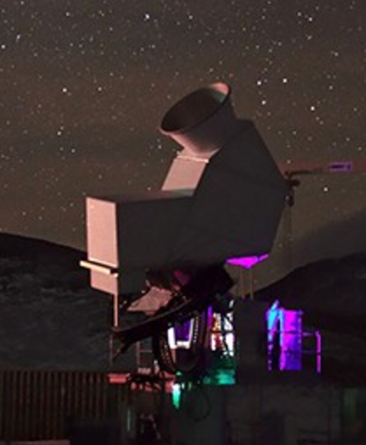
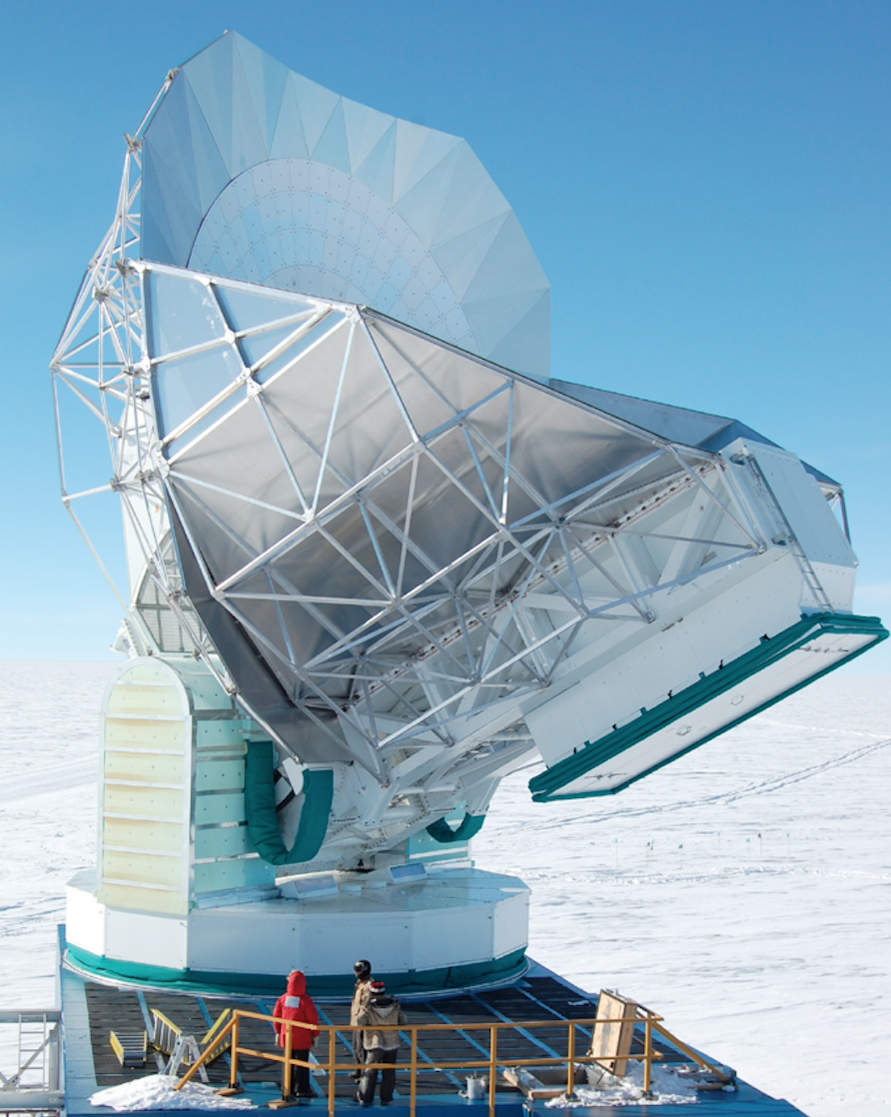
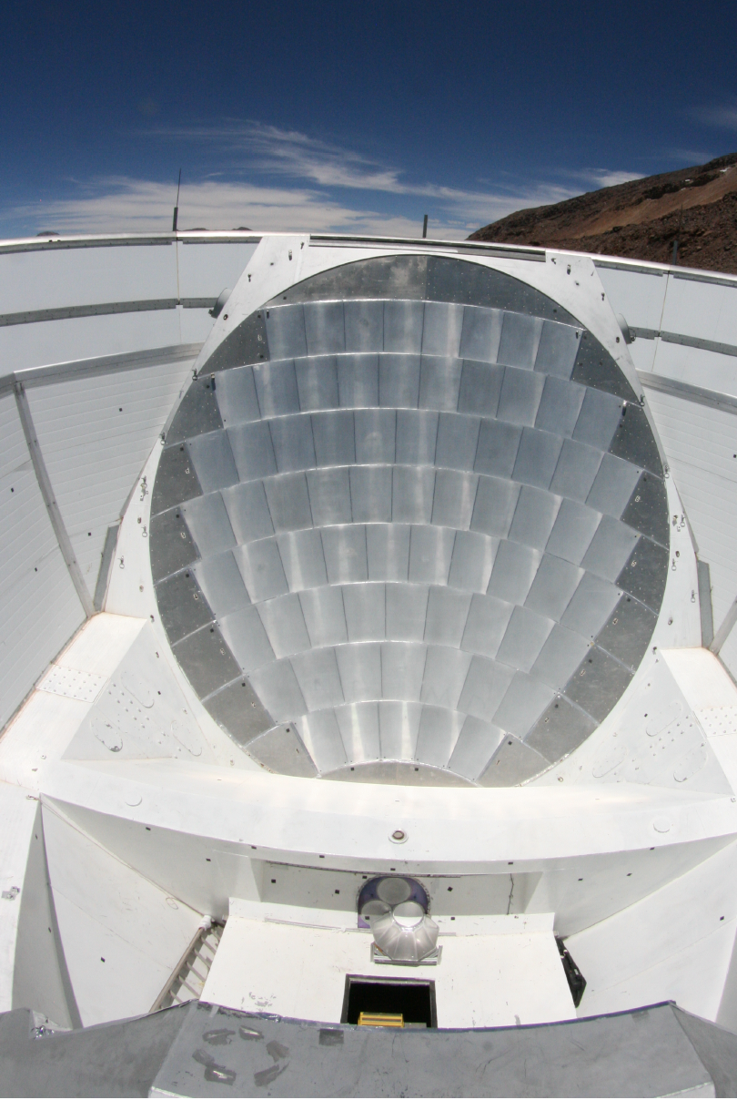
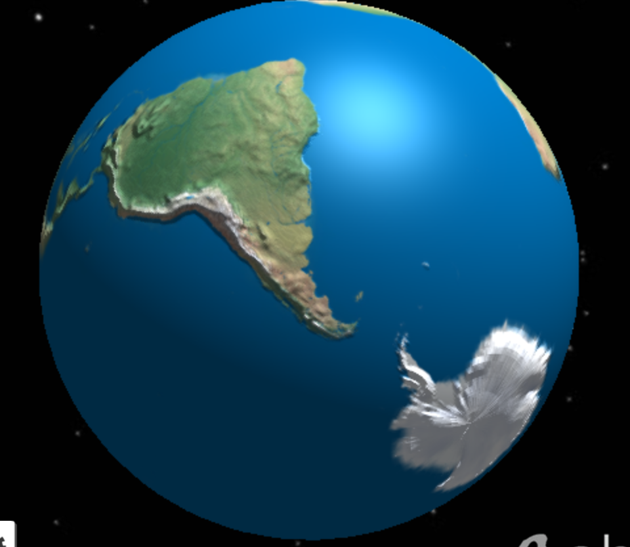
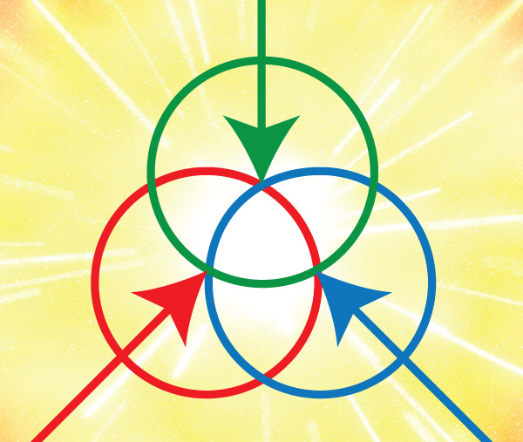
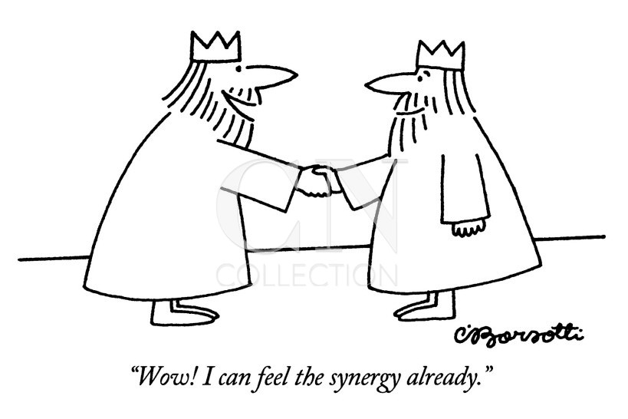
GRAND UNIFICATION OF THE CMB COMMUNITY?
ACT, 6 m
SPT , 10m
BICEP2/Keck Array, 0.5 m
POLARBEAR, 2.5 m
Notes:
Includes CLASS at night and SPIDER, dwg of EBEX, Japan, EU, Chile, China, Socrates statue, Rodin’s the Thnker at the Gates of Hell (center top)

Slide 37


STAGE IV GROUND-BASED CMB EXPERIMENT: CMB-S4
STAGE 3
SNOWMASS PLANNING (2013)
P5:, “Support CMB experiments as part of the core particle physics program. “ (2014)
WORKSHOPS EVERY 6 MONTHS (5 SO FAR)
CMB-S4 SCIENCE BOOK (Aug 2016; google it)
CMB-S4 CONCEPT DEFINITION TASK FORCE (CDT) CHARGED BY AAAC (Nov 2016)
CMB-S4 TECHNOLOGY BOOK (May 2017; google it)
Notes:
Image is for the five intertwined science drivers of the strategy outlined by P5 in May 2014.
https://science.energy.gov/~/media/hep/hepap/pdf/May-2014/FINAL_P5_Report_053014.pdf

Slide 38
CMB-S4 ASPIRATIONS from science book
CDT is still defining the science requirements.
SCIENCE THRUSTS
PRIMORDIAL GRAVITATIONAL WAVES (“r”)
SEARCH FOR LIGHT RELICS (“N_{eff}”)
NEUTRINO MASS (“Σ m_{ν}”)
DARK ENERGY & GR
BARYONS & GALAXY FORMATION ++
CMB-S4 SCIENCE BOOK (google it)
(many figures from it coming up)

Slide 39
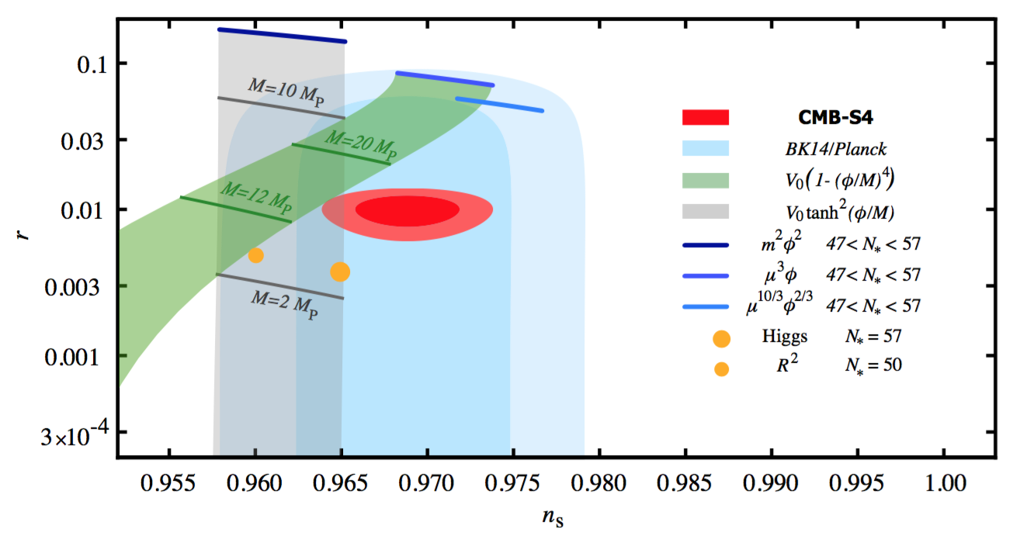
CONSTRAINTS ON EARLY UNIVERSE PARAMETERS SO FAR
Notes:
Forecast of CMB-S4 constraints in the ns–r plane for a fiducial model with r = 0.01. Constraints on r are derived from the expected CMB-S4 sensitivity to the B-mode power spectrum as described in Section 2.3. Constraints on ns are derived from expected CMB-S4 sensitivity to temperature and E-mode power spectra as described in Section 8.10.2. Also shown are the current best constraints from a combination of the BICEP2/Keck Array experiments and Planck [8]. Chaotic inflation with V (φ) = μ4−pφp for p = 2/3, 1, 2 are shown as blue lines for 47 < N⋆ < 57 (with smaller N⋆ predicting lower values of ns ). The Starobinsky model and Higgs inflation are shown as small and large filled orange circles, respectively. The lines show the classes of models discussed in Section 2.5. The green band shows the predictions for quartic hilltop models, and the gray band shows the prediction of a sub-class of α-attractor models [60].

Slide 40
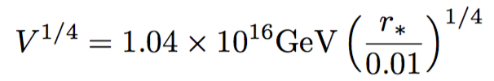
POTENTIAL FOR HIGH S/N DETECTION IF r~ 0.01
Detection = energy scale of inflation fixed to a few %!
Detection = window on quantum gravity
Detection = improved limit on the mass of the graviton by 10⁶ (!)
Notes:
WINDOW ON QUANTUM GRAVITY BECAUSE THEN YOU KNOW YOU HAD A TRANSPLANCKIAN FIELD CHANGE DURING INFLATION AND HAVE TO SQUARE Q GRAV WITH THAT – WHICH MIGHT BE TOUGH/ ILLUMINATING!
Graviton with mass much larger than H at recombination would damp out the BB amplitude.
Forecast of CMB-S4 constraints in the ns–r plane for a fiducial model with r = 0.01. Constraints on r are derived from the expected CMB-S4 sensitivity to the B-mode power spectrum as described in Section 2.3. Constraints on ns are derived from expected CMB-S4 sensitivity to temperature and E-mode power spectra as described in Section 8.10.2. Also shown are the current best constraints from a combination of the BICEP2/Keck Array experiments and Planck [8]. Chaotic inflation with V (φ) = μ4−pφp for p = 2/3, 1, 2 are shown as blue lines for 47 < N⋆ < 57 (with smaller N⋆ predicting lower values of ns ). The Starobinsky model and Higgs inflation are shown as small and large filled orange circles, respectively. The lines show the classes of models discussed in Section 2.5. The green band shows the predictions for quartic hilltop models, and the gray band shows the prediction of a sub-class of α-attractor models [60].

Slide 41
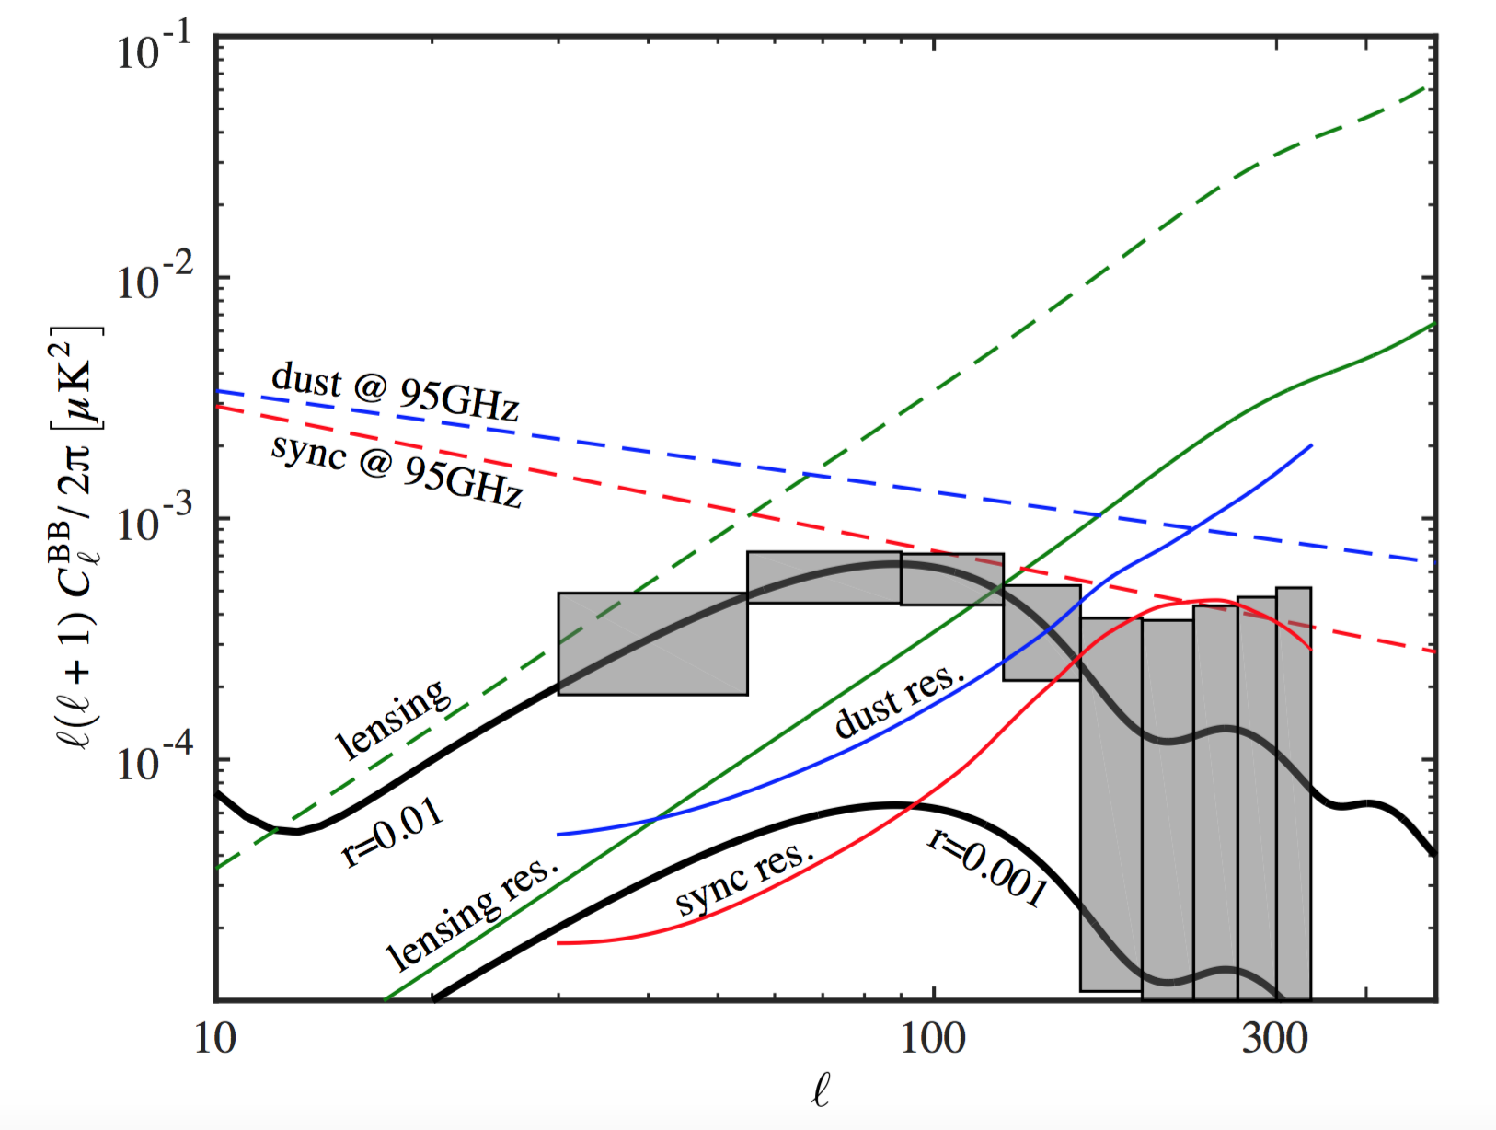
DEAILNG WITH FOREGROUNDS HEAD ON!
PRELIMINARY FORECASTED ERRORS AFTER FOREGROUND CLEANING (from the CMB S4 SCIENCE BOOK)
Notes:
Bin-by-bin forecasted tensor constraints for r=0.01, fsky = 0.03, and the default detector effort (106 detector years). The boxes denote the forecasted CMB-S4 erorr bars. Primordial B-mode spectra are shown for two representative values of the tensor-to-scalar ratio: r=0.001 and r=0.01. The dashed green line shows the ΛCDM expectation for the B modes induced by gravitational lensing of E modes, with the solid line showing the residual lensing power after delensing. The dashed blue and red lines show the dust and synchrotron (current upper limit) model assumed in the forecasting, at the foreground minimum of 95 GHz. The levels of dust and synchrotron are equal to the ones reported in [8]. The contribution of dust and synchrotron to the vertical error bars are shown in solid blue and red lines. Since these are calculated from a multi-frequency optimization, the “effective frequency” at which these foreground residuals are defined varies with each bin, allowing the residual lines to go above the input foreground model lines which are defined at a fixed frequency of 95 GHz. Furthermore, due to the low frequency channels having larger beam sizes than the higher frequency ones, in the higher bins, the primordial CMB component will be constrained at a higher effective frequency. Defining the foreground residuals at these effective frequencies will yield a higher amplitude for the dust residual, and a lower amplitude for the synchrotron residual, resulting in the respective shapes of the solid blue and red lines.

Slide 42
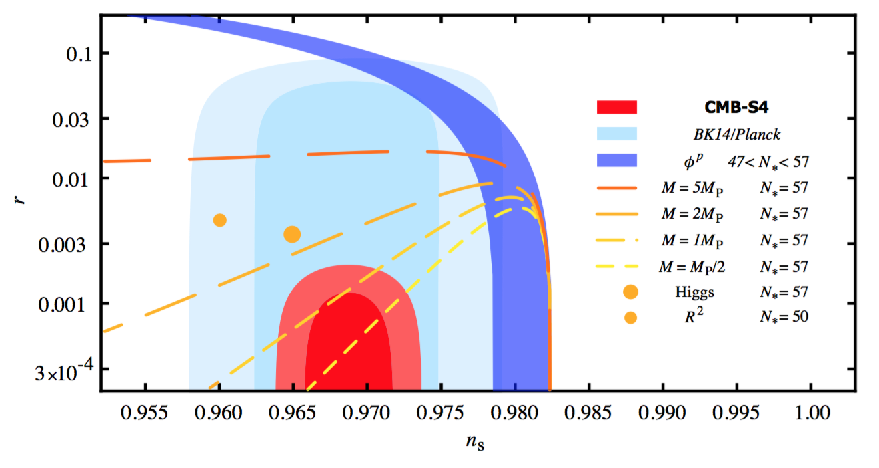
S4 POTENTIAL TO RULE OUT SIMPLEST INFLATION MODELS
Models that naturally explain n_{s} with a characteristic scale above ~ M_{p} could be ruled out.
Notes:
Figure 11. Forecast of CMB-S4 constraints in the ns–r plane for a fiducial model with r = 0. Constraints on r are derived from the expected CMB-S4 sensitivity to the B-mode power spectrum as described in Section 2.3. Constraints on ns are derived from expected CMB-S4 sensitivity to temperature and E-mode power spectra as described in Section 8.10.2. Also shown are the current best constraints from a combination of the BICEP2/Keck Array experiments and Planck [8]. The Starobinsky model and Higgs inflation are shown as small and large filled orange circles. The lines show the classes of models discussed in Section 2.5 that naturally explain the observed value of the scalar spectral index for different characteristic scales in the potential (see eq. (2.28)), M = MP/2, M = MP, M = 2MP, and M = 5MP. Longer dashes correspond to larger values of the scale M.

Slide 43
GRAND UNIFICATION OF THE CMB COMMUNITY!
ACT, 6 m
END SLIDE
SPT , 10m
BICEP2/Keck Array, 0.5 m
POLARBEAR, 2.5 m
Notes:
Includes CLASS at night and SPIDER, dwg of EBEX, Japan, EU, Chile, China, Socrates statue, Rodin’s the Thnker at the Gates of Hell (center top)

Slide 44
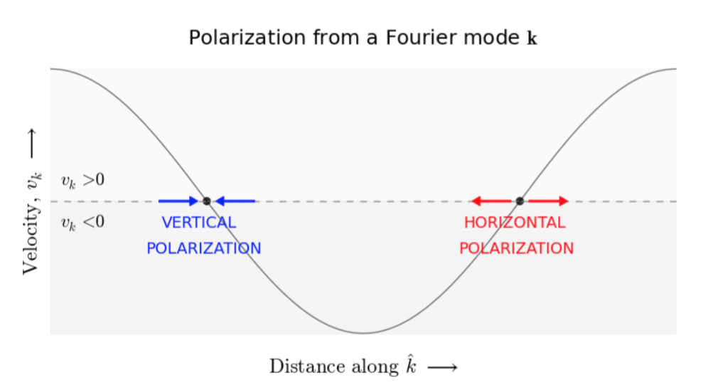
ACOUSTIC OSCILLATION CAUSES E MODES
COLORED ARROWS SKETCH VELOCITY VECTORS IMPINGING ON A COUPLE OF ELECTRONS.
Left: reradiates vertically polarized light. Right: reradiates horizontally polarized light.
Notes:
The gray line shows the velocity component in the kˆ direction associated with a density mode with wavevector k. The red and blue arrows represent the velocity vectors for the plasma impinging on electrons in two special positions. For example, the left electron sees the radiation along the horizontal axis blueshifted compared to the radiation coming in from the top and bottom, so it will reradiate light polarized vertically, as in figure 5(a). Thus the polarization pattern emerging orthogonal to the plane of the sketch is an E mode with wavevector k like the one shown in figure 6.
(From RoPP 2017, Staggs, Page, Dunkley.)

