Slide 1
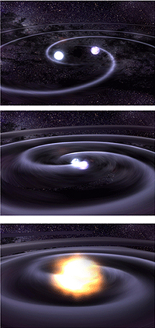
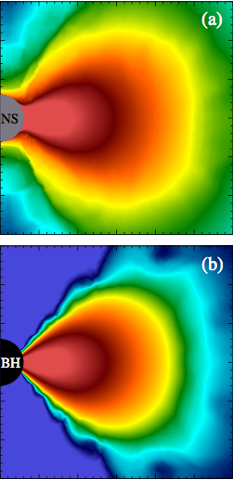
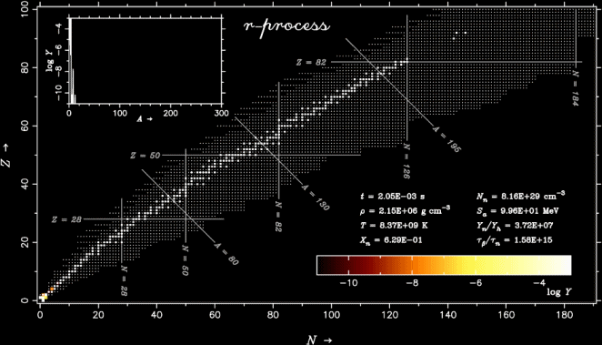
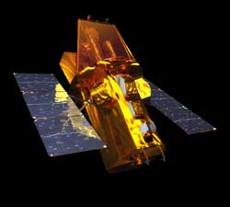
Electromagnetic Counterparts of Compact Binary Mergers
Brian Metzger Columbia University
in collaboration with
Daniel Siegel, Ben Margalit, Andrei Beloborodov, Imre Bartos, Nick Stone, Szabi Marka, Zoltan Haiman
Rodrigo Fernandez (Alberta), Justin Ripley (Princeton), Dan Kasen, Eliot Quataert (Berkeley)
Edo Berger (Harvard), Almudena Arcones, Gabriel Martinez-Pinedo, Meng-Ru Wu (Darmstadt)
Geoff Bower (Hilo), Andreas Bauswein (Thessaloniki), Stephane Goriely (U Brussels)
Tony Piro (Carnegie), Wen-Fai Fong (Arizona), Dan Perley (Liverpool) , Charles Zivanecv (CU)
Amaldi Conference on Gravitational Waves; Pasadena, CA; July 11, 2017
Notes:
Teamwork, thank TAC

Slide 2
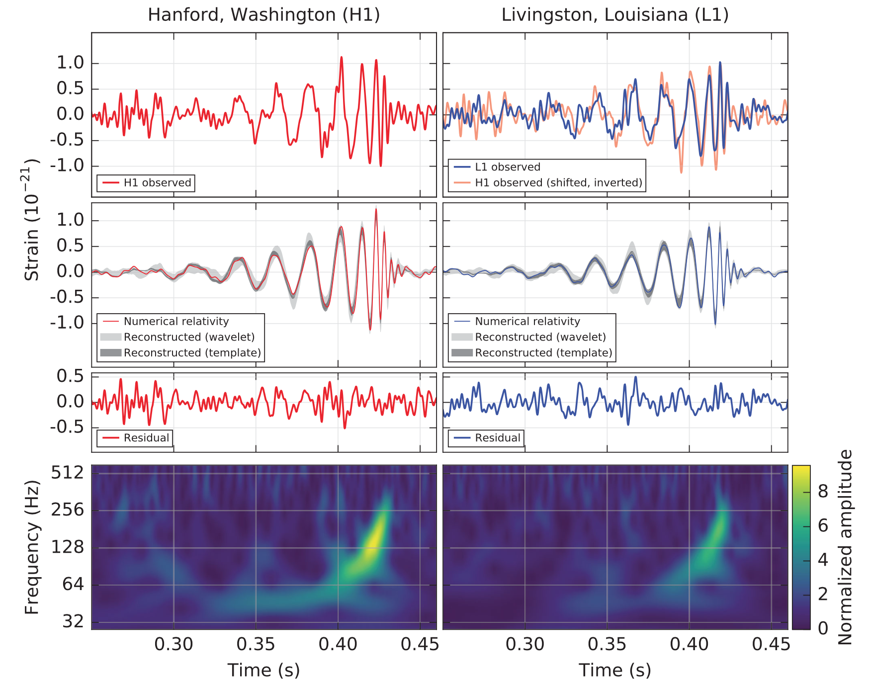
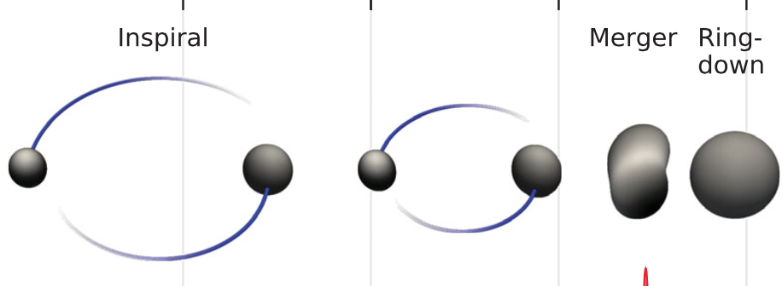
The Dawn of Gravitational Wave Astronomy
GW150914
LIGO 2016

Slide 3
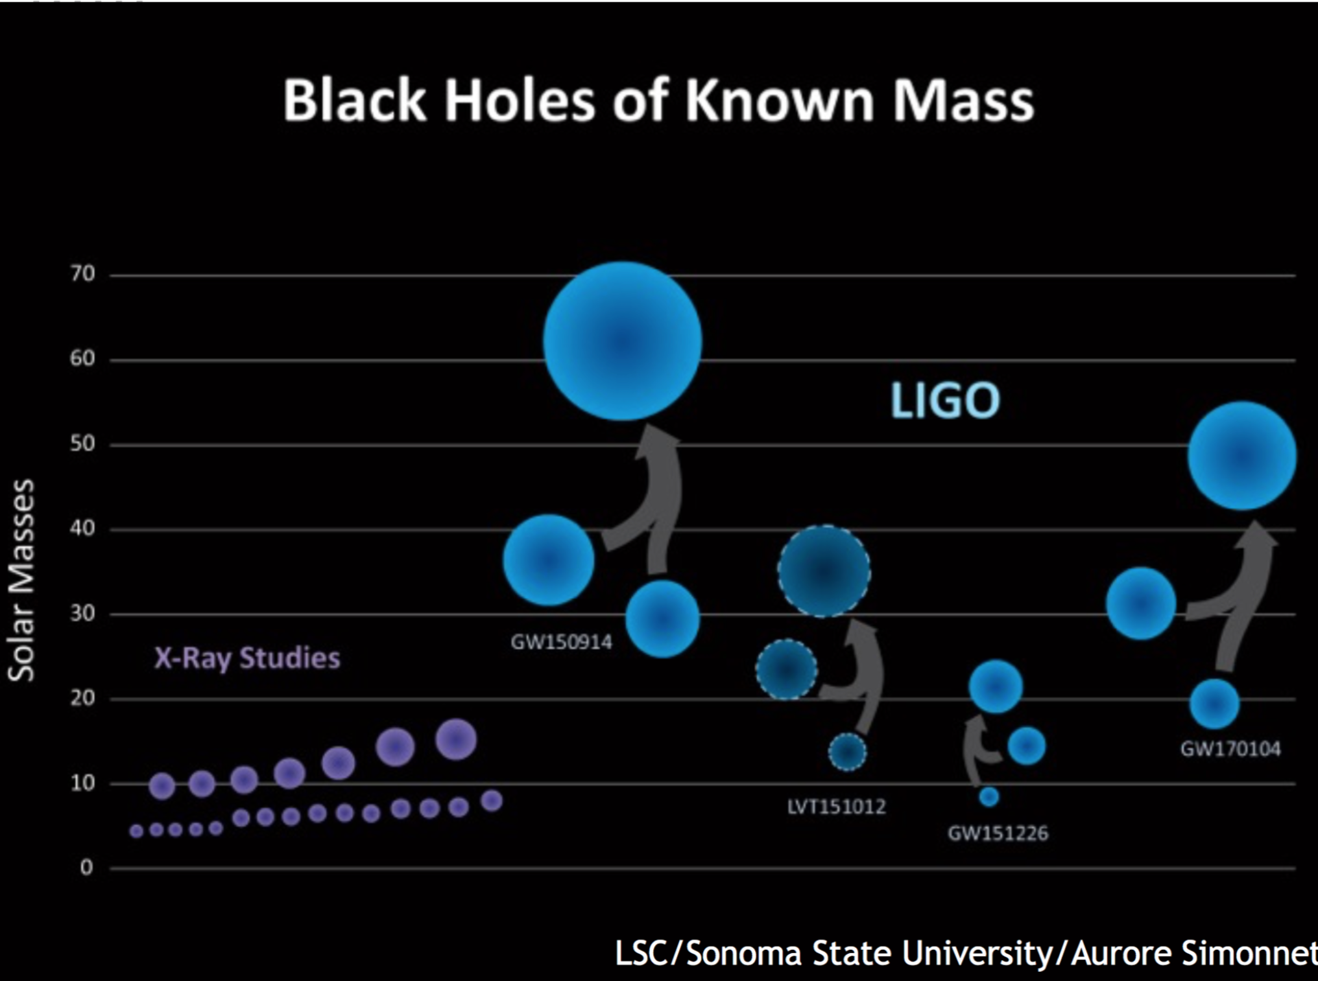
Where did these come from?
LSC/Sonoma State/Aurore Simonnet
Field Binaries (“Standard”, Chemically Homogeneous)?
Dynamical (Globular Clusters, Nuclear Star Clusters)?
Population III Stars?
Gas Disks in Active Galactic Nuclei?

Slide 4
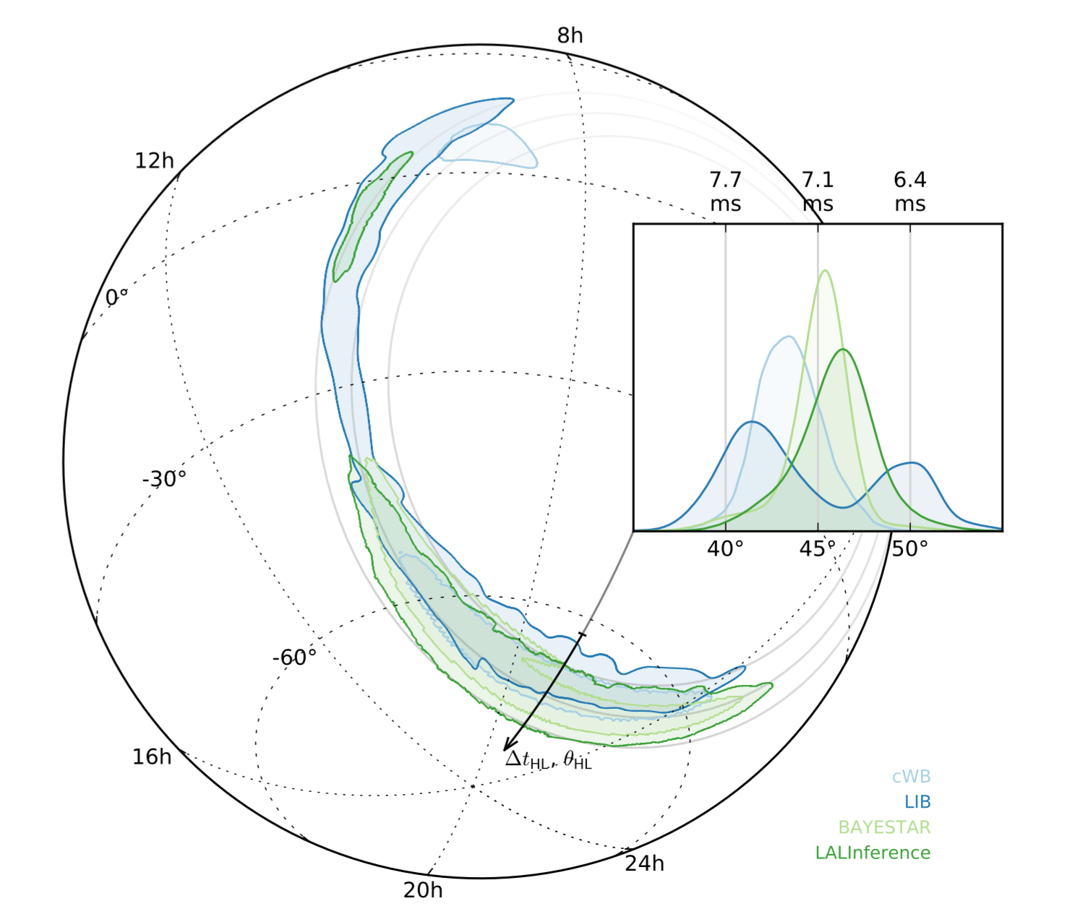
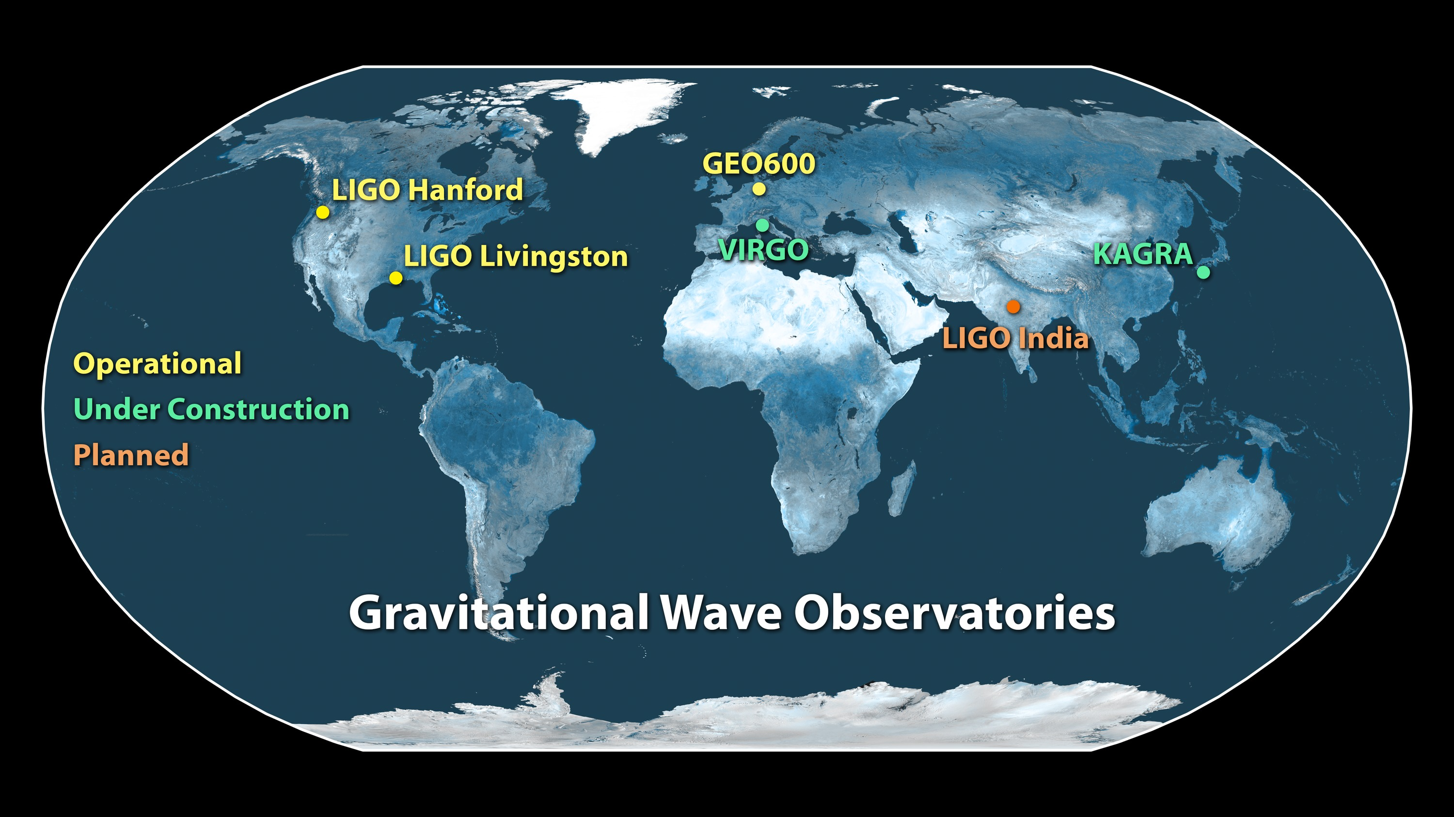
GW150914
Electromagnetic Follow-Up
~600 deg²
Abbott, 1562 others, BDM, 2016

Slide 5
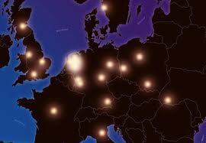

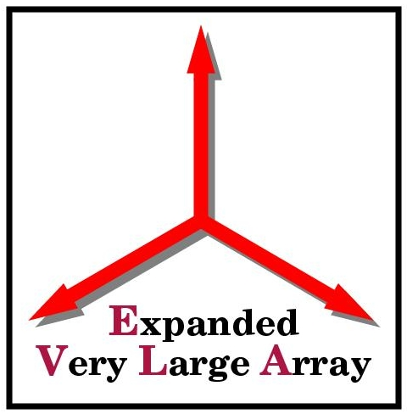



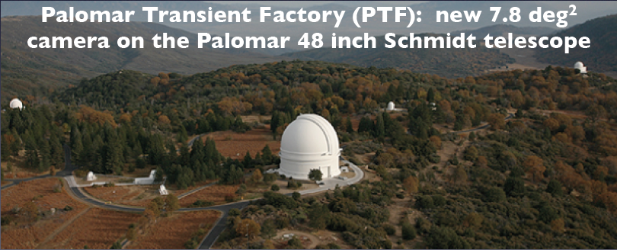
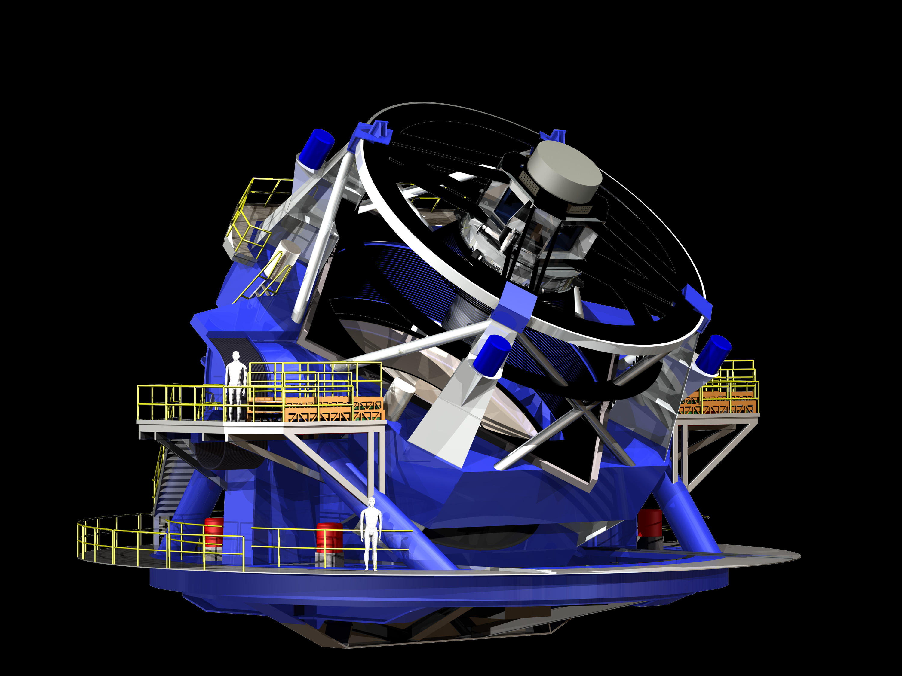
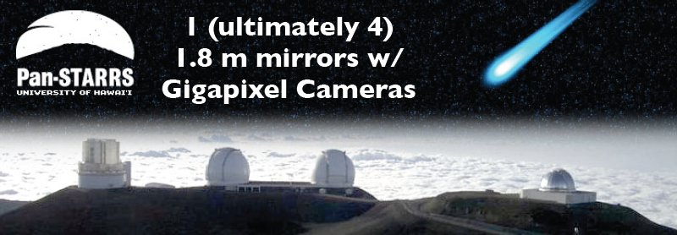
Time Domain Astronomy Revolution
Gamma-Rays
Radio
Swift
LOFAR FOV ~50%
BAT FOV ~ 15%
GBM FOV ~ 60%
Optical
Large Synoptic Survey Telescope (LSST) ~2022
Now ZTF

Slide 6
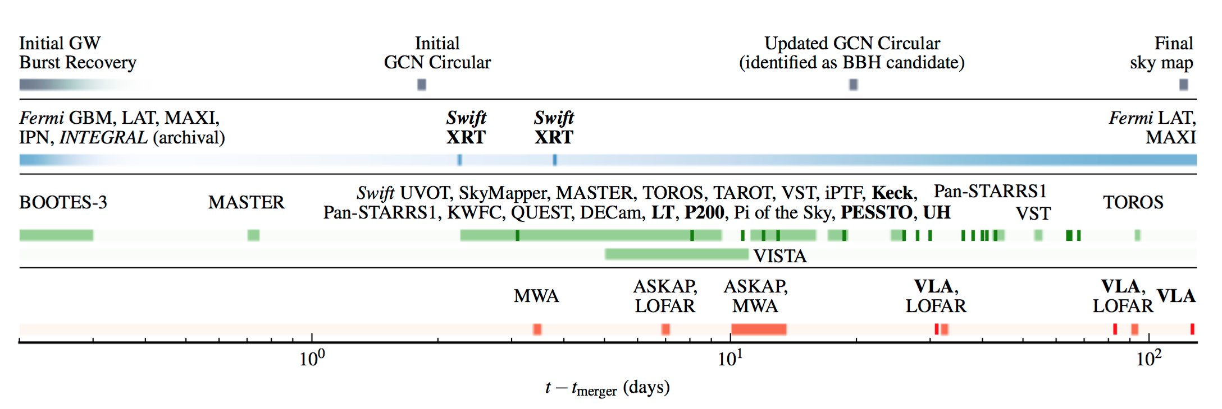
GW150914
Electromagnetic Follow-Up
~600 deg²
Abbott, 1562 others, BDM, 2016

Slide 7
GW150914
Electromagnetic Follow-Up
~600 deg²
Abbott, 1562 others, BDM, 2016

Slide 8
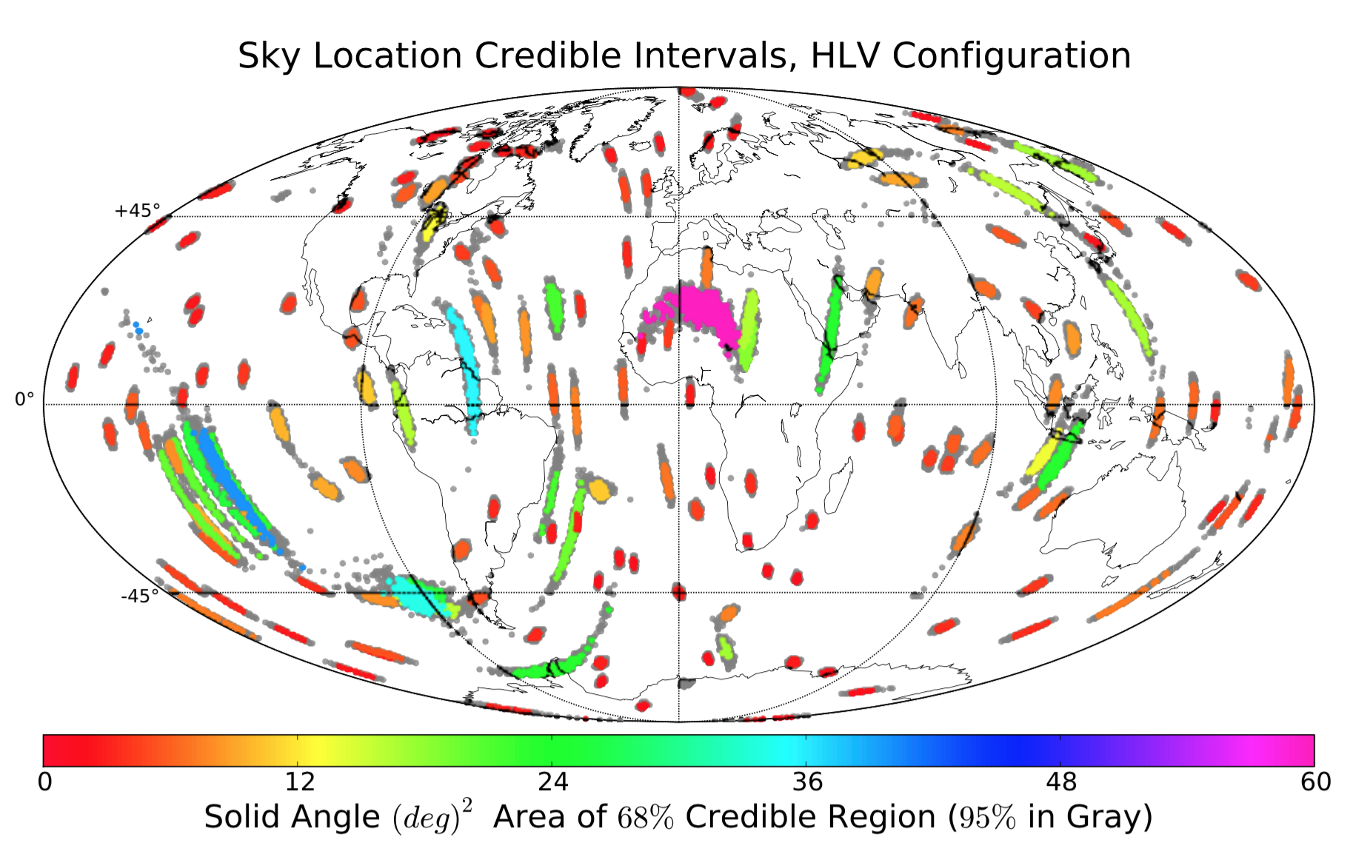
Sky Error Regions ~ 10-100 deg² (~2019)
Rodriguez et al. 2013

Slide 9
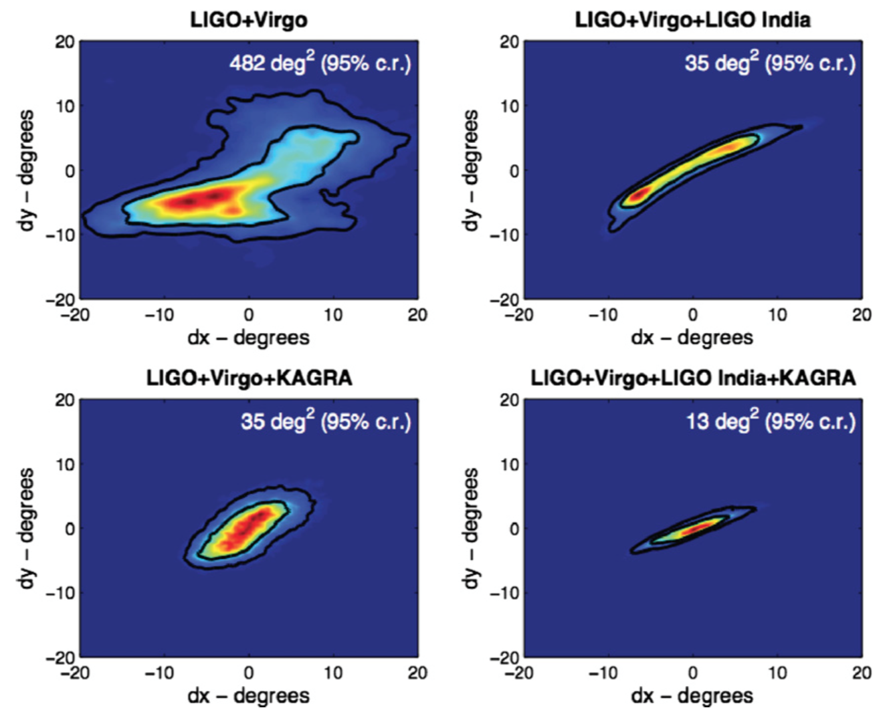
Sky Error Regions ~ 10-300 deg² (~2019)
Nissanke et al. 2013

Slide 10
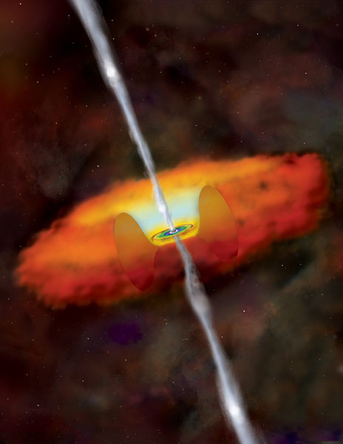
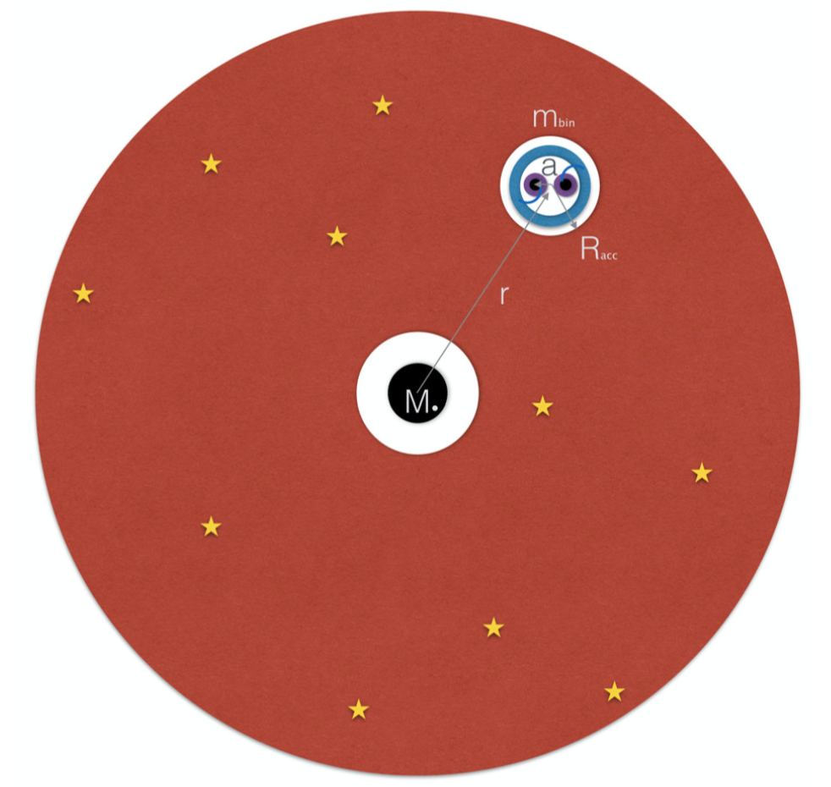
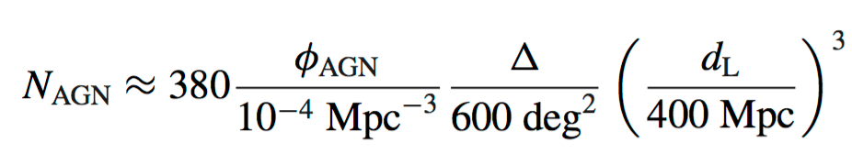
AGN Disks as Black Hole Merger Factories
Stone, BDM, Haiman 17; Bartos+17a, b; McKernan+ submitted
Galactic nuclei replete with black holes (mass segregation, top heavy IMF)
Compact binaries formed (or captured) in AGN disks will merge rapidly due to gas drag torques.
Rates up to ~1-10 Gpc⁻³ yr⁻¹
(but huge uncertainties)
Predicts sky correlation with AGN
  at design sensitivity, association is testable with ~100 BBH detectors
  (see Bartos et al., arXiv:1701.02328)
Top View

Slide 11
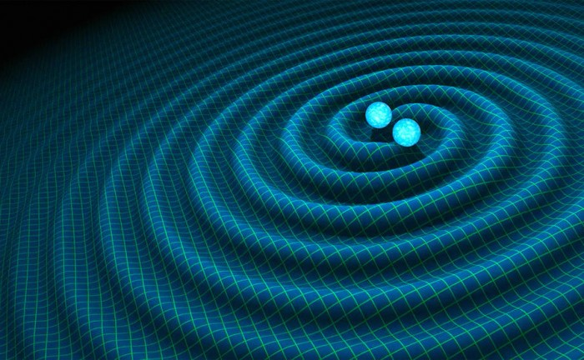
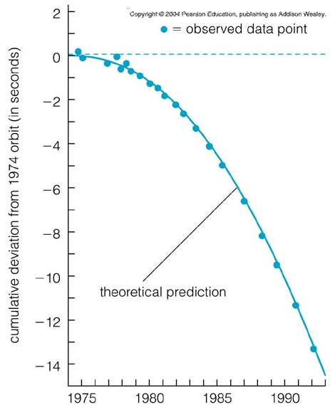
Binary Neutron Stars
NS
NS
a
Hulse-Taylor Binary Pulsar
GR Prediction
T_{merge} = 300 Myr
(e.g. Kalogera et al. 2004, Abadie et al. 2010)

Slide 12
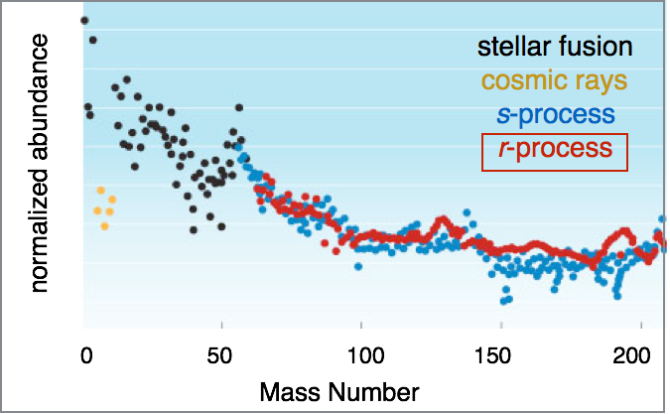
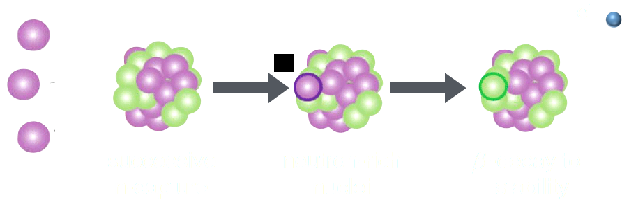
Whence Plutonium?
Supernovae or NS Mergers?
Galactic r-process rate:
(Qian 2000)
Rapid Neutron Capture (r-Process) Nucleosynthesis

Slide 13
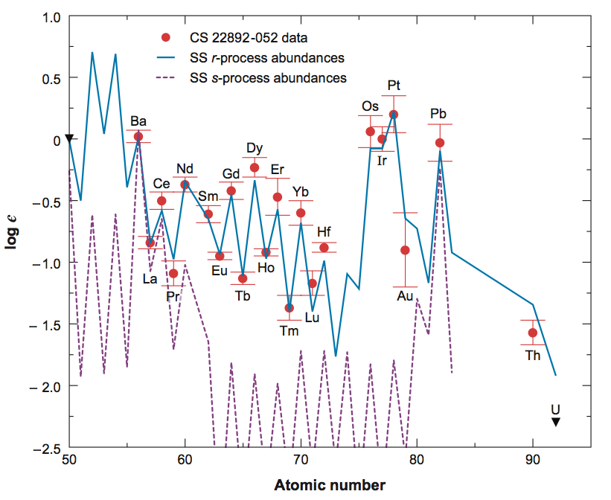
Whence Plutonium?
Sneden et al. 2008
Supernovae or NS Mergers?
Galactic r-process rate:
(Qian 2000)
Rapid Neutron Capture (r-Process) Nucleosynthesis

Slide 14
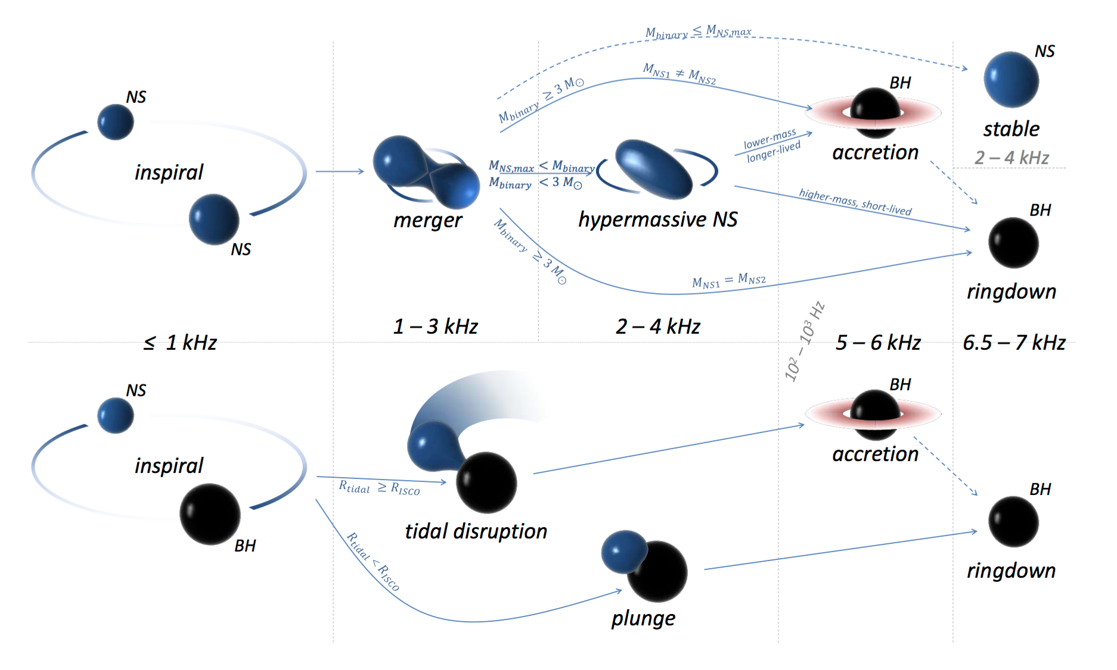
Neutron Star Merger Channels
Bartos, Brady, Marka 2013

Slide 15

GR Hydro Simulation of NS-NS Merger
Courtesy: David Radice, Wolfgang Kastaun, Filippo Galeazzi

Slide 16
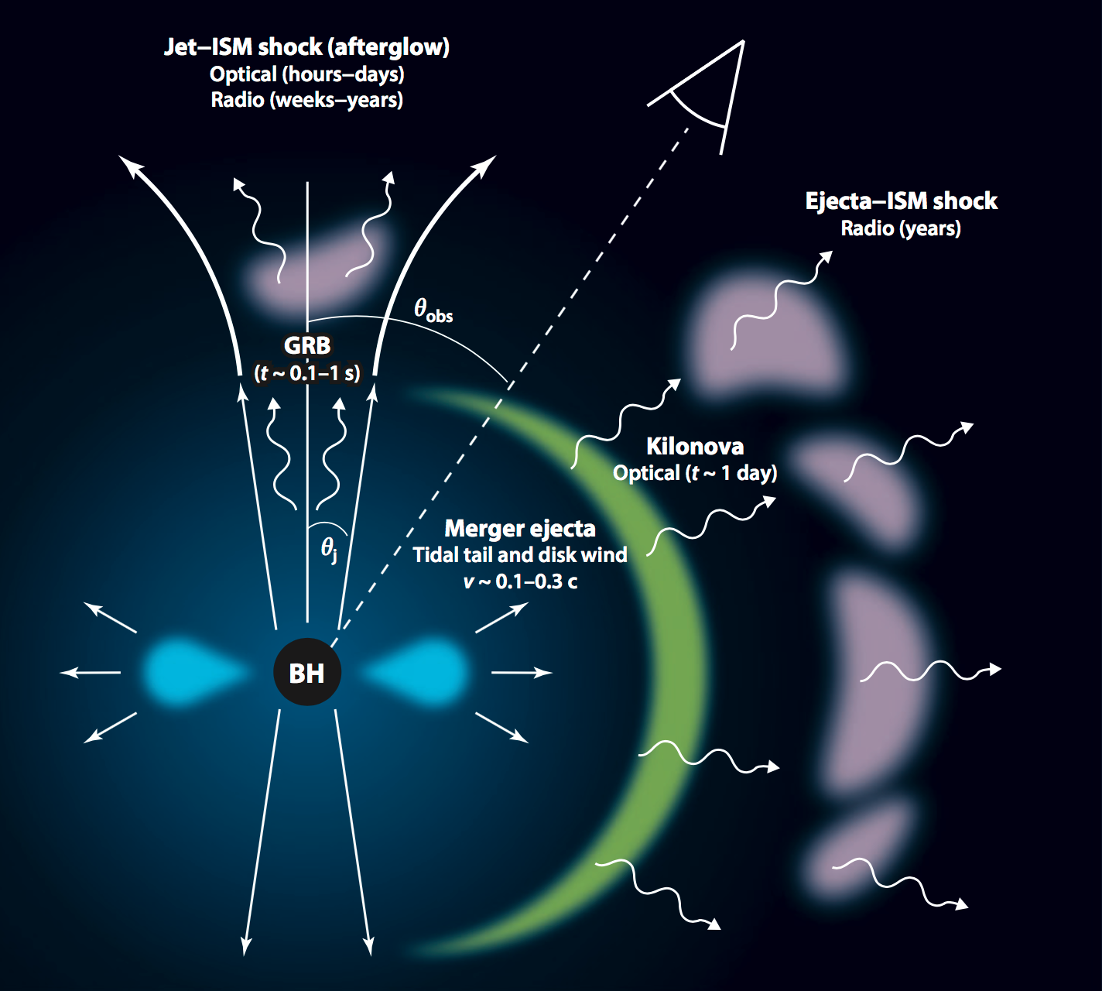
Electromagnetic Counterparts of NS Mergers
Short GRB
BDM & Berger 12
Metzger & Berger 2012
BDM & Berger 12

Slide 17
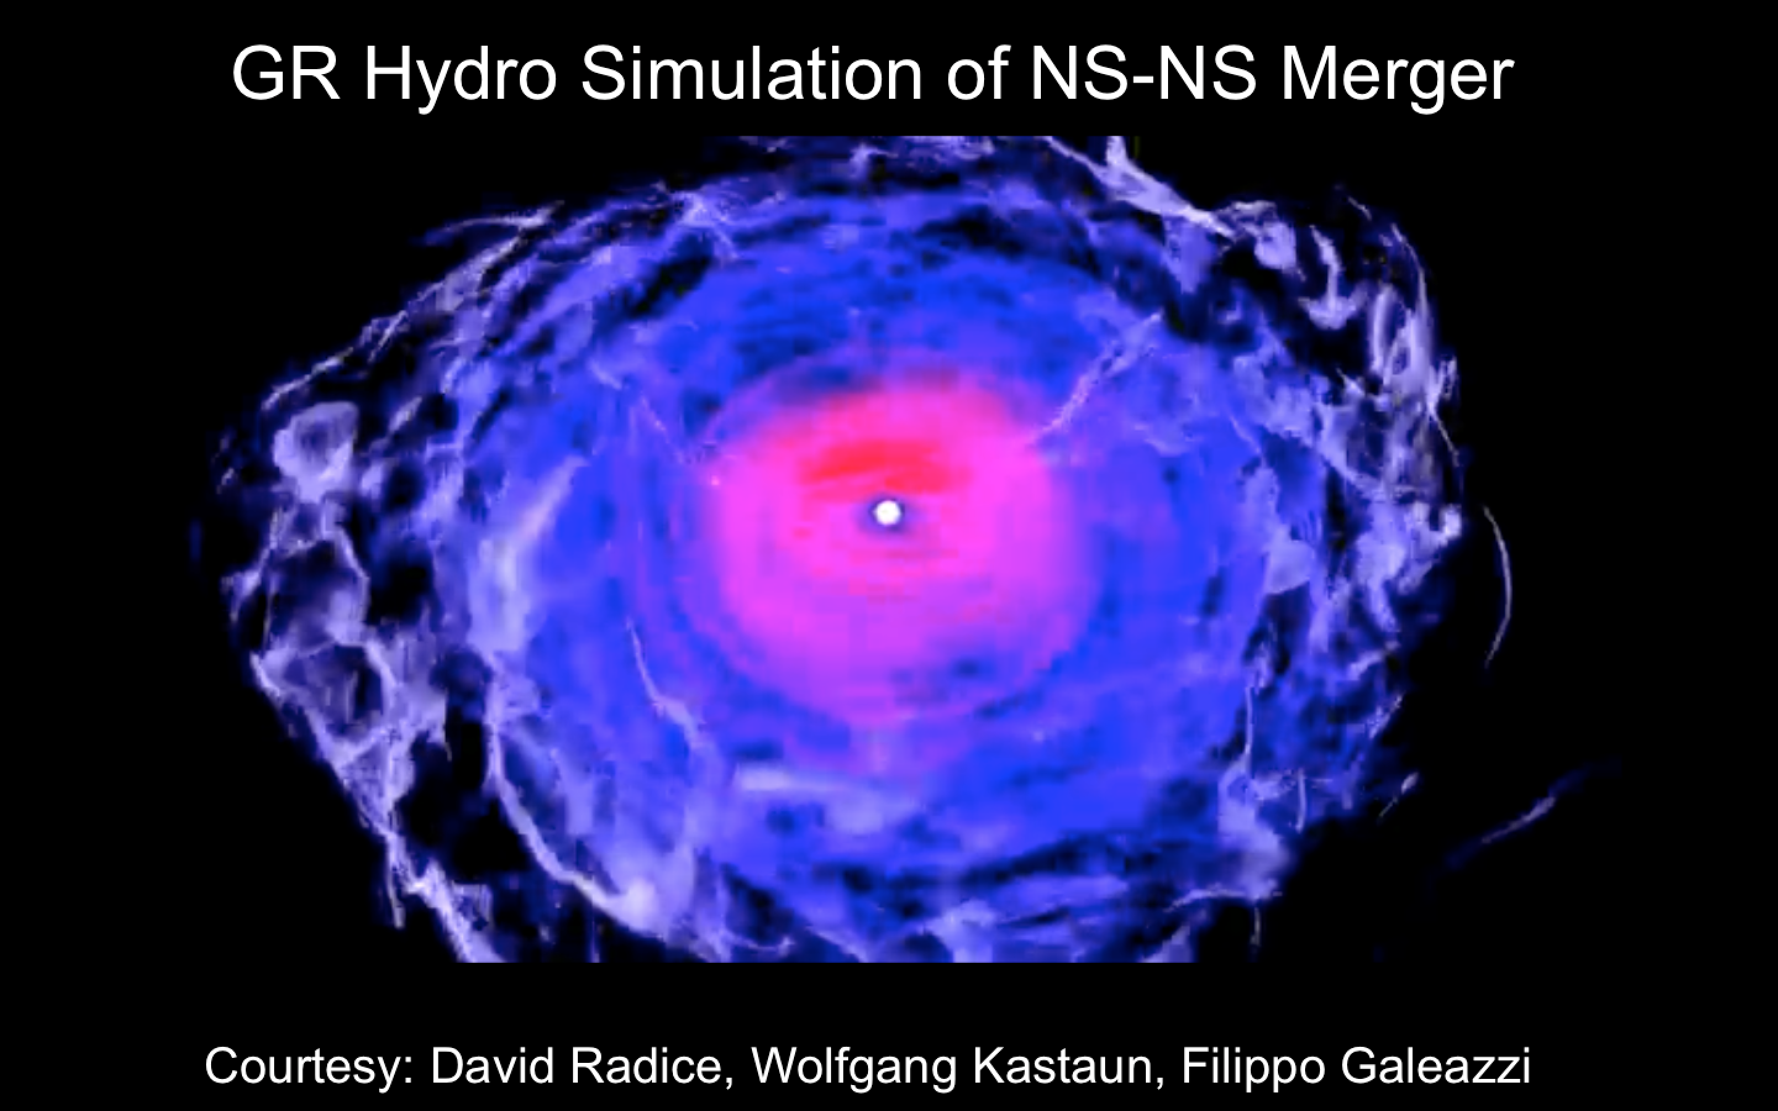

Slide 18
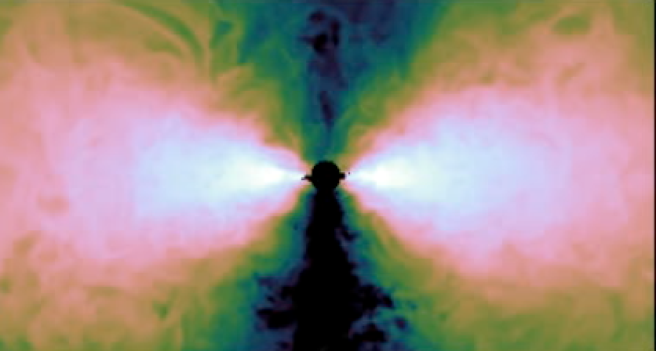
Remnant Accretion Torus
e.g. Chen & Beloborodov 07; BDM, Piro & Quataert 08
H
R_{d}
Siegel & BDM, in prep
Mass ~ 0.1 M & Size ~ 30 km
Hot (T > MeV) & Dense (ρ ~ 10⁸-10¹² g cm⁻³)
Neutrino Cooled: (τ_{ν} ~ 0.01-100)
Mildly Degenerate ⇒ Neutron-Rich (Y_{e} ~ 0.1)
Accretion Rate
Short GRB Engine?

Slide 19
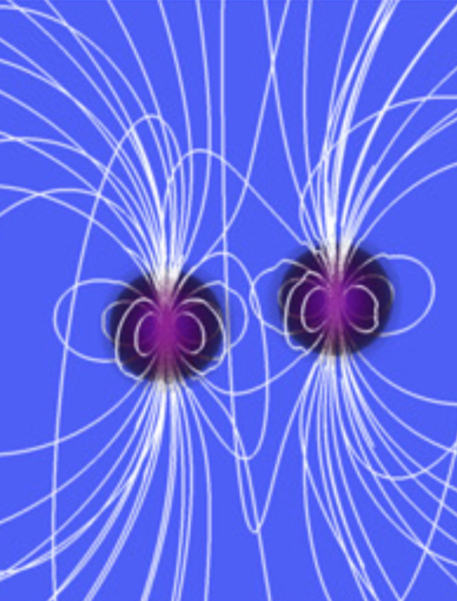
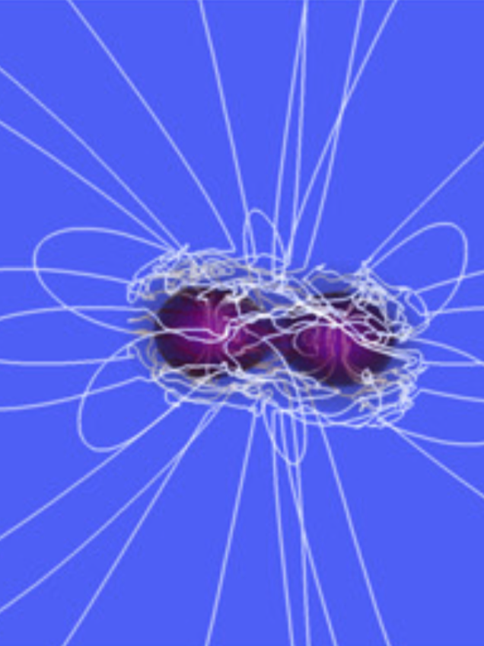
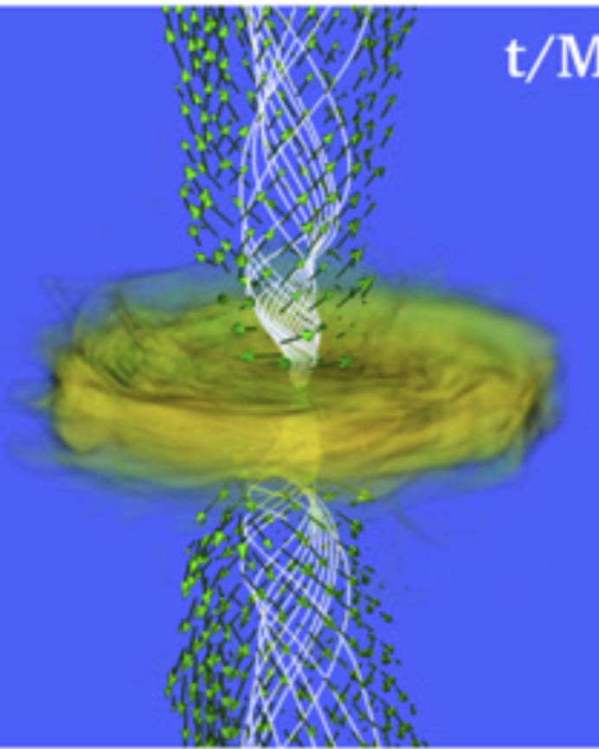
Relativistic Jets & Gamma-Ray Bursts
Ruiz et al. 2016
10¹² G
10¹⁵ G
Relativistic particles in jet may experience photo-hadronic interactions, producing ultra-high energy neutrinos
(e.g. Asano & Murase 2015)

Slide 20
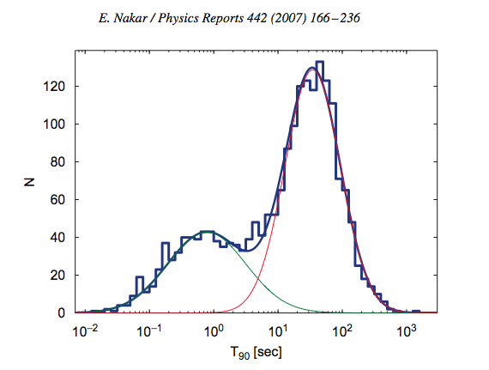
Short & Long Gamma-Ray Bursts
BATSE Bursts
Nakar 07

Slide 21
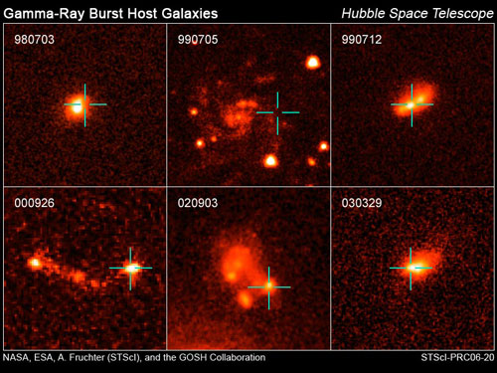
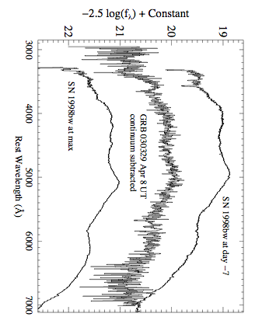
Short & Long Gamma-Ray Bursts
Long GRBs: Death of Massive Stars
BATSE Bursts
Star-Forming Host Galaxies (z_{avg}~2-3)
Supernova Connection
GRB 030329 ⇔ SN 2003dh
Nakar 07
Stanek et al. 2003

Slide 22
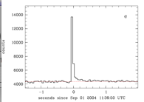
Short & Long Gamma-Ray Bursts
Long GRBs: Death of Massive Stars
BATSE Bursts
Star-Forming Host Galaxies (z_{avg}~2-3)
Supernova Connection
GRB 030329 ⇔ SN 2003dh
Nakar 07
Short
???
Stanek et al. 2003

Slide 23
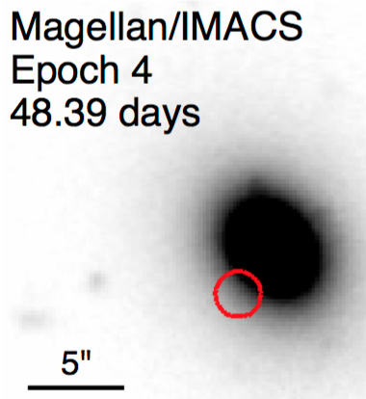
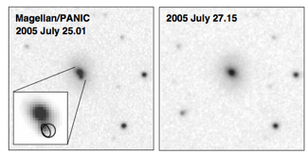
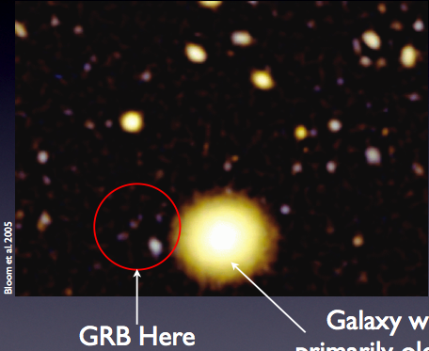
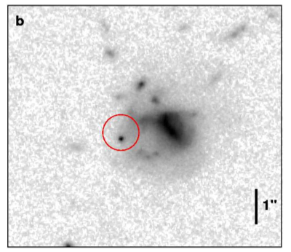
Short GRB Host Galaxies
GRB050724
Fong+16
z = 0.134 SFR < 0.4 M yr⁻¹
z = 0.258 SFR < 0.03 M yr⁻¹
Berger+05
GRB050509b
GRB050709
z = 0.16 SFR = 0.2 M yr⁻¹
Bloom+06
z = 0.225 SFR < 0.1 M yr⁻¹
KECK Bloom+06
Fox+05

Slide 24
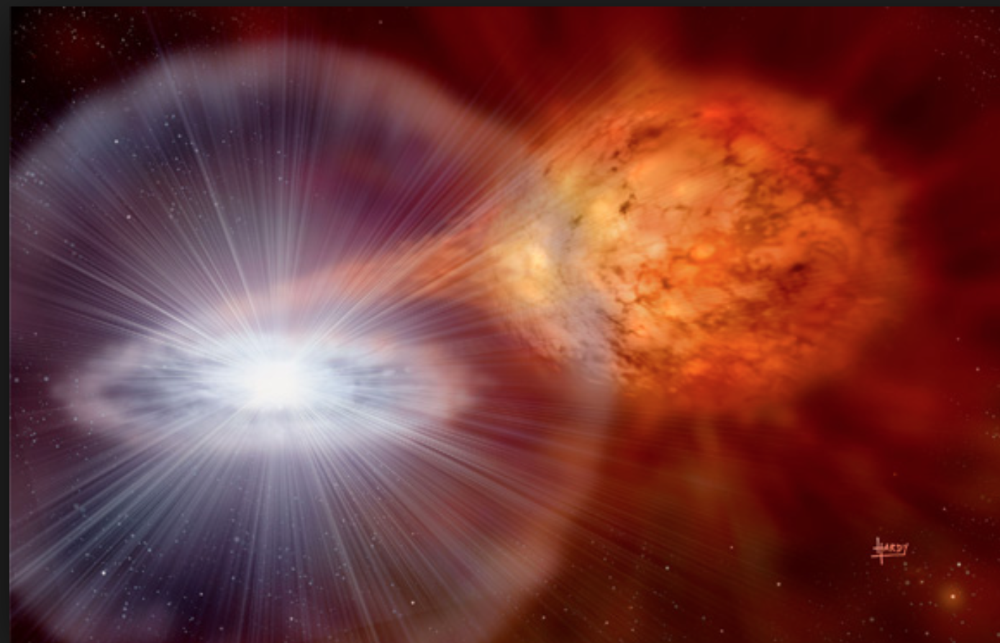
Alternative Short GRB Models?
Neutron Star Accretion-Induced Collapse
MacFadyen et al. 2005, Dermer & Atoyan 2006, Giocomazzo & Perna 2012
Ω
NS
Q: Does collapse of a rotating NS leave a disk around the new BH (of the same mass and angular momentum)?
???
BH
Margalit, Metzger, Beloborodov 15

Slide 25
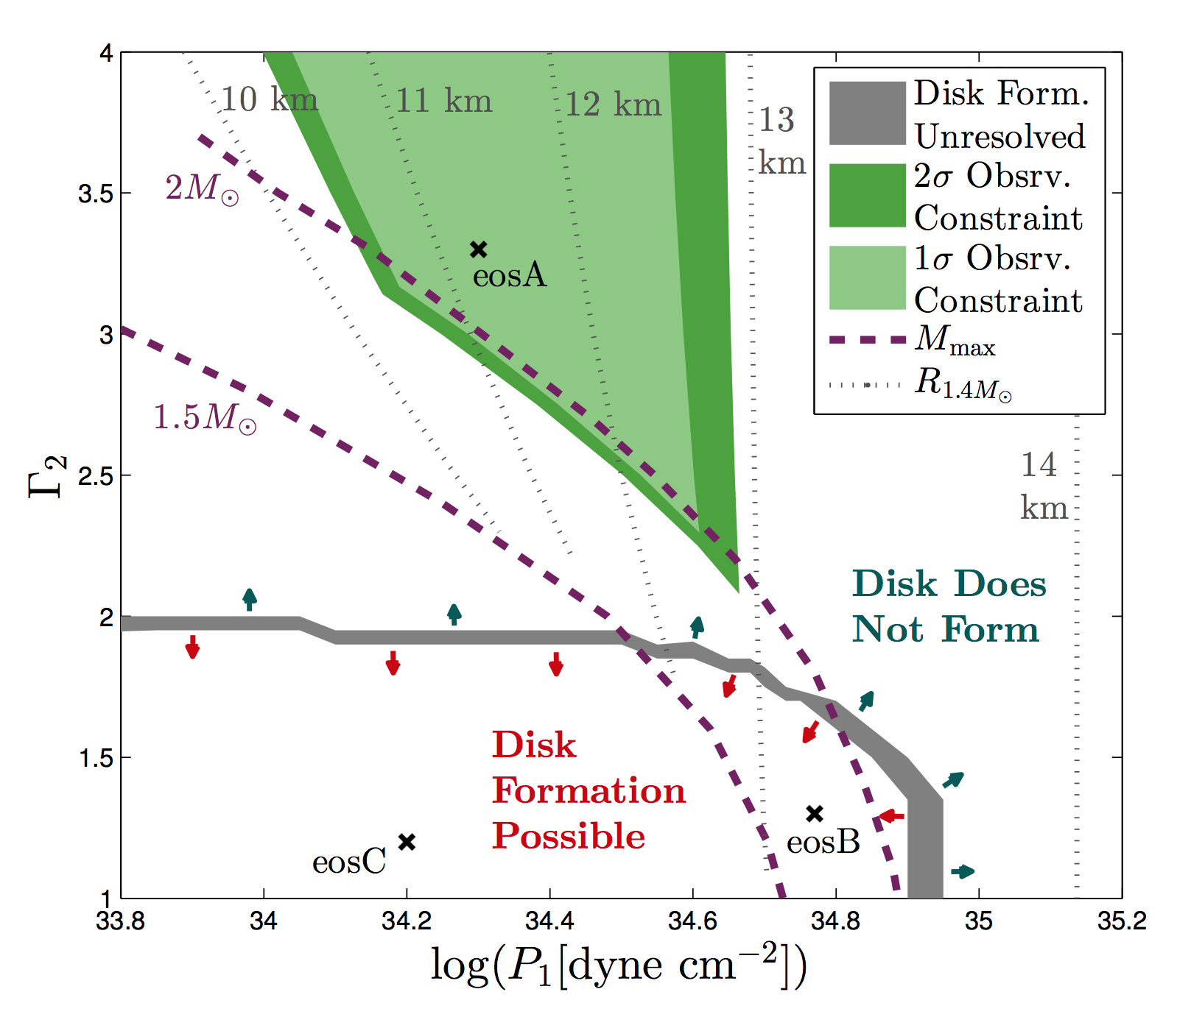
Dog
Dog
Dog
Dog
Dog
ALLOWED
NO DISK
Inner Power-Law Index
DISK POSSIBLE
Pressure Normalization
Margalit et al. 2015

Slide 26
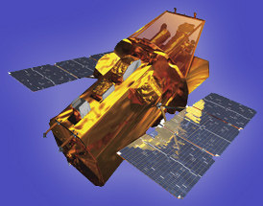
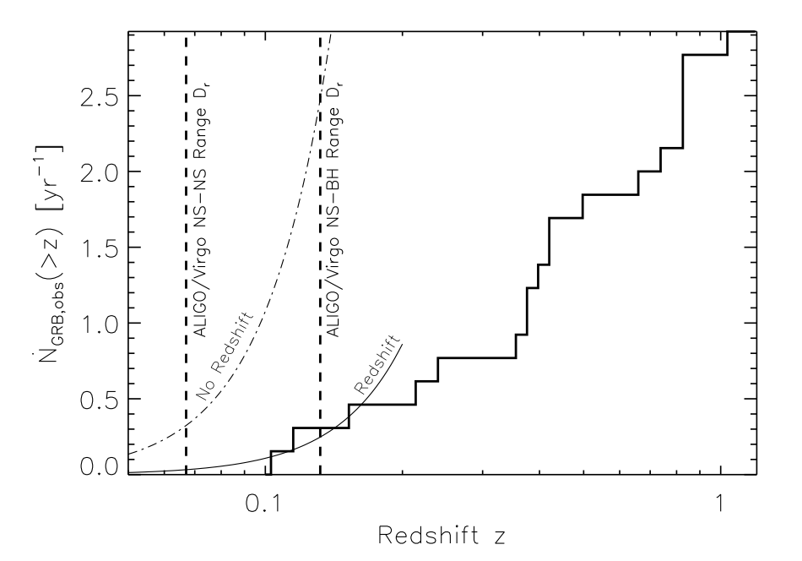
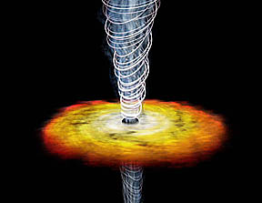
Short GRBs are Rare in the LIGO Volume
θ_{j}
Swift Short GRBs
Detection Rate >z (yr ⁻¹)
!!!
BDM & Berger 2012
Redshift z
Fraction observed by all sky γ-ray telescope

Slide 27
Electromagnetic Counterparts of NS Mergers
Short GRB
Fraction of GWs with GRB
BDM & Berger 12
Metzger & Berger 2012
BDM & Berger 12

Slide 28
Electromagnetic Counterparts of NS Mergers
Short GRB
Fraction of GWs with GRB
BDM & Berger 12
Metzger & Berger 2012
BDM & Berger 12

Slide 29
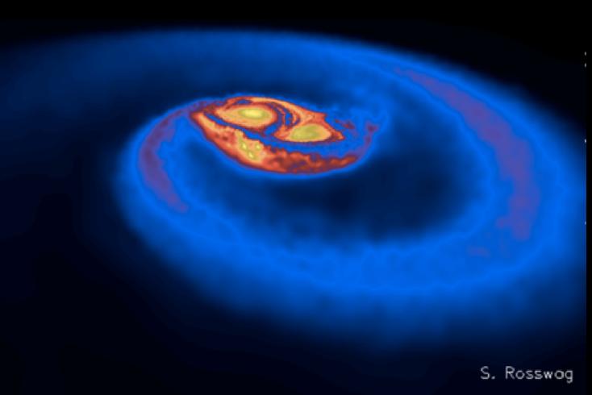
Neutron-Rich Ejecta
“Dynamical” Ejecta
M_{ej} ~ 10⁻³ - 10⁻² M
τ_{exp} ~ ms

Slide 30
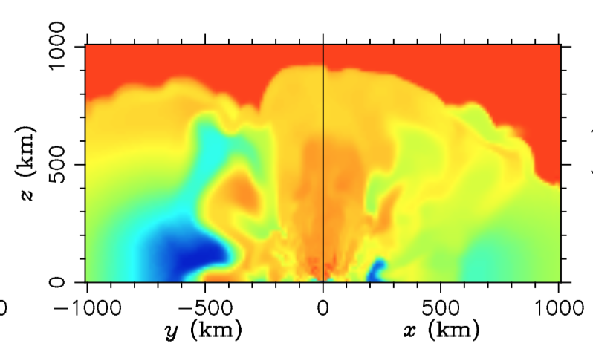
Neutron-Rich Ejecta
“Dynamical” Ejecta
M_{ej} ~ 10⁻³ - 10⁻² M
τ_{exp} ~ ms
Wanajo 14, Sekiguchi+16

Slide 31
Neutron-Rich Ejecta
“Dynamical” Ejecta
M_{ej} ~ 10⁻³ - 10⁻² M
τ_{exp} ~ ms
Wanajo 14, Sekiguchi+16
Disk Outflows
Neutrino-Powered
Nuclear Recombination-Powered
M_{ej} = f_{w}M_{d} ~ 10⁻² (f_{w}/0.1) M
τ_{exp} ~ seconds
Siegel & BDM 17

Slide 32

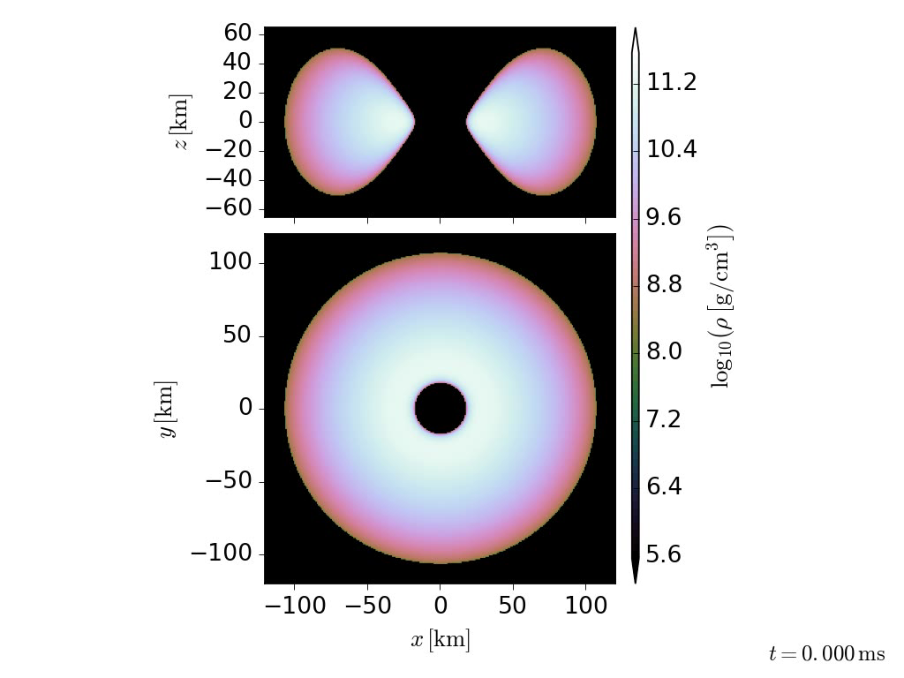
GRMHD Torus Simulations
BH spin a ~ 0.8
Initial mass
M_{t} ~ 0.03M₈
fastest MRI
growing mode
resolved
by >10 cells
Total runtime
~ 400 ms
Daniel Siegel
Siegel & BDM,
submitted

Slide 33
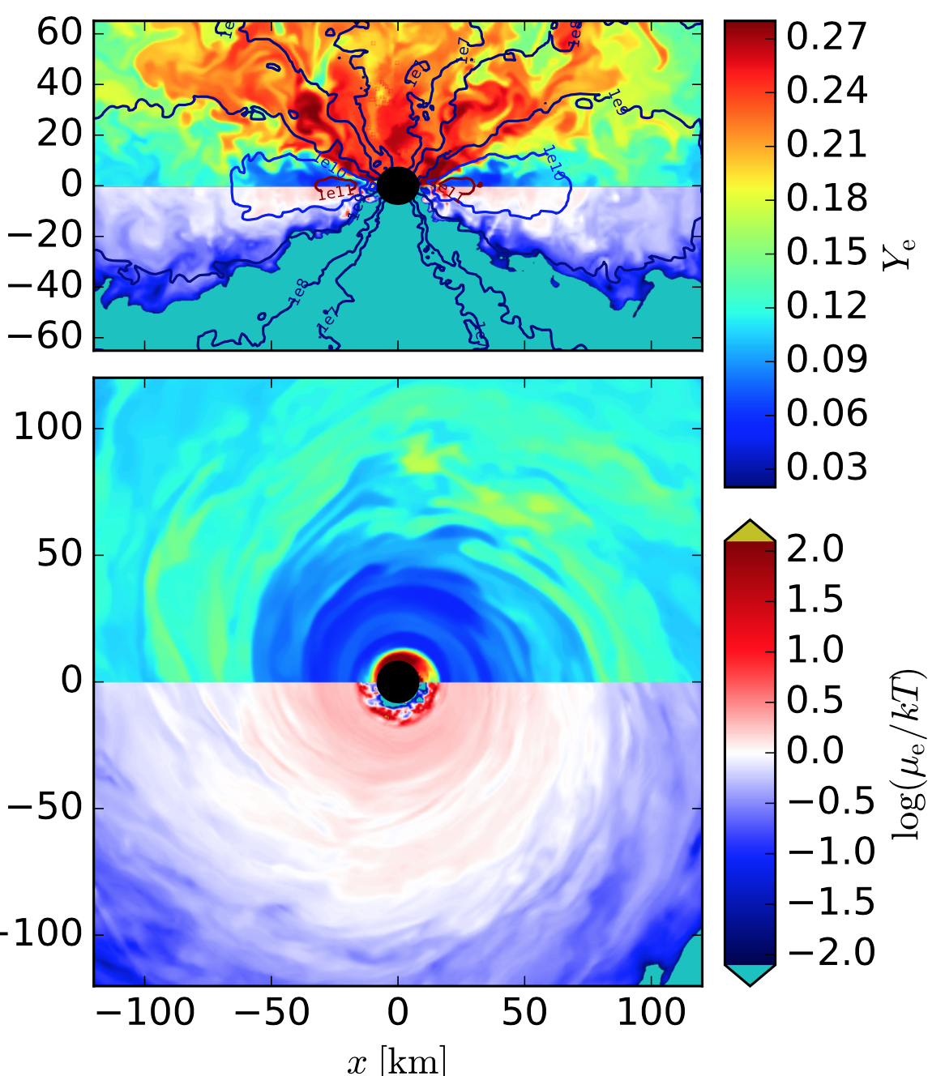
GRMHD Torus Simulations
Y_{e}
Y_{e} increases as matter flows out of midplane
μ_{e}
Disk midplane
self-regulated to be mildly degenerate (Beloborodov 2003)
~20-40% of initial torus mass unbound
Siegel & BDM

Slide 34
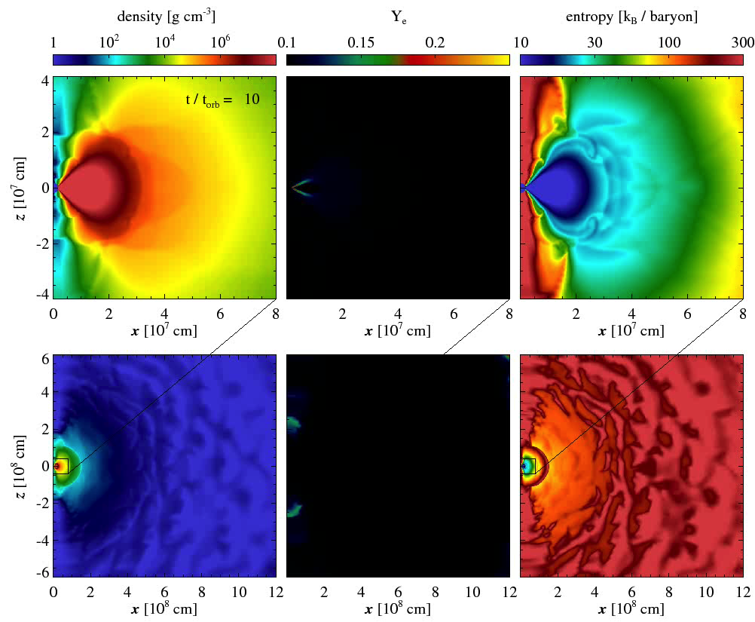
Remnant Torus Evolution
(Fernandez & BDM 13; BDM & Fernandez 14; Just et al. 2015; Fernandez et al. 14)
M_{ej} ~ 0.05-0.2 M_{t} V_{ej} ~ 0.05 c
Fernandez & BDM 13

Slide 35


Test Particle Trajectories
Wu, Fernandez, Martinez-Pinedo, BDM 16

Slide 36

R-Process Network (neutron captures, photo-dissociations, α- and β-decays, fission)
β decay
neutron capture
Courtesy Gabriel Martinez-Pinedo as used in BDM et al. 2010

Slide 37

Final Abundance Distribution
Xe
2nd/3rd peaks
Pt
BDM et al. 2010
Wu, Fernandez, Martinez-Pinedo, BDM 16

Slide 38

Final Abundance Distribution from MHD Disk Winds
CCSNe or additional merger site?
Xe
Pt
2nd/3rd peaks
BDM et al. 2010
Siegel & BDM

Slide 39

Long β-decay times near magic neutron numbers N = 82, 126 produce local abundance peaks

Slide 40

Radioactive Heating of Ejecta
∝ t^{-1.2}
BDM et al. 2010

Slide 41
How Supernovae Shine (Arnett 1982)
spherical ejecta - mass M, velocity v, thermal energy E = f Mc², & opacity κ
}
R
M
V

Slide 42
How Supernovae Shine (Arnett 1982)
spherical ejecta - mass M, velocity v, thermal energy E = f Mc², & opacity κ
}
R
M
V
Type Ia Supernova: v ~10⁴ km s⁻¹, M_{ej} ~ M, f_{Ni→Co} ~ 10⁻⁵ ⇒ t_{peak} ~ week, L ~ 10⁴³ erg s⁻¹
NS Merger: v ~ 0.1 c, M_{ej} ~ 10⁻² M, f ~ 10⁻⁶ ⇒ t_{peak}~ 1 day, L ~ 3 10⁴¹ erg s⁻¹

Slide 43

“Kilonova” Light Curves
Fe Opacity
Blackbody Model
Metzger et al. 2010

Slide 44


“Kilonova” Light Curves
Fe Opacity
Metzger et al. 2010
Li & Paczynski 98
Earlier models with parametrized radioactive heating predicted much higher luminosities or used incorrect heating (“macronova”)
~10⁴⁴ erg/s superluminous!

Slide 45

High Opacity of the Lanthanides (Kasen et al. 2013; Barnes & Kasen 2013; Tanaka & Hotokezaka 2013)
Slide courtesy D. Kasen

Slide 46

High Opacity of the Lanthanides (Kasen et al. 2013; Barnes & Kasen 2013; Tanaka & Hotokezaka 13)
lanthanides
Kasen et al. 2013
Fe

Slide 47

Slide from D. Kasen

Slide 48



(Tanvir+13; de Ugarte Postigo+13 ; Fong+13 )
Tanvir et al. 2013
0.1 M
0.01 M

Slide 49
(Tanvir+13; de Ugarte Postigo+13 ; Fong+13 )
Tanvir et al. 2013
0.1 M
0.01 M

Slide 50




Gravitational Wave Follow-Up

Slide 51

Gravitational Wave Follow-Up
10⁻² M₈, v = 0.1 c
K band (2.2 μm)
I band (0.8 μm)

Slide 53
Gravitational Wave Follow-Up
10⁻² M₈, v = 0.1 c
K band (2.2 μm)
TAP
I band (0.8 μm)

Slide 54


EM follow-up of GW150914 (Abbott et al. 2016b)

Slide 55
Slide from D. Kasen

Slide 56
Y_{e} > 0.27
Y_{e} < 0.27
Slide from D. Kasen

Slide 57
Neutron-Rich Ejecta
“Dynamical” Tidal Tails
M_{ej} ~ 10⁻³ - 10⁻² M
τ_{exp} ~ ms
Disk Outflows
Neutrino-Driven
Recombination-Powered
M_{ej} = f_{w}M_{d} ~ 10⁻² (f_{w}/0.1) M
τ_{exp} ~ seconds

Slide 58

Two Component Light Curve
☺
BDM & Fernandez 2014
Blue
Red
disk winds: blue or red?
Barnes & Kasen 2013
NS
tidal tail: red
ν
ν

Slide 59
Two Component Light Curve
☺
BDM & Fernandez 2014
Blue
Red
disk winds: blue or red?
Barnes & Kasen 2013
BH
tidal tail: red

Slide 60


Remnant Torus Evolution
(Fernandez & Metzger 2012, 2013; Fernandez et al., in prep)
P-W potential with M_{BH} = 3,10 M
hydrodynamic α viscosity
NSE recombination 2n+2p ⇒ ⁴He
run-time Δt ~ 1000-3000 t_{orb}
neutrino self-irradiation: “light bulb” + optical depth corrections:
M_{t} ~ 0.01-0.1 M R₀ ~ 50 km uniform Y_{e} = 0.1
BH
neutrino emission pattern
R ∈ [2,2000] R_{g}
N_{r} = 64 per decade N_{θ} = 56

Slide 61


Delayed Disk Outflows
OUT
Fernandez et al. 2015
Time (s)
outflow robust
M_{ej} ~ 0.05-0.2 M_{t} V_{ej} ~ 0.1 c

Slide 62







Effect of Hyper-Massive Neutron Star
BDM & Fernandez 2014

Slide 63

Kasen, Fernandez, BDM 15

Slide 64

Kasen, Fernandez, BDM, 2015

Slide 65

Viewing Angle Dependence
Kasen, Fernandez, BDM 2015
Kilonova light curves probe composition & geometry of merger ejecta ⇒ info on viewing angle and neutron star equation of state

Slide 66



Slide 67
Challenge of Gravitational Wave Follow-Up
10⁻² M₈, v = 0.1 c
K band (2.2 μm)
I band (0.8 μm)
LCs from Barnes+16

Slide 68

Bauswein et al. 2013

Slide 69

Velocity Distribution of Merger Ejecta

Slide 70



Free Neutrons in Outermost Ejecta
Radioactive Heating
r-nuclei (τ_{r} ~ 1 s)
free n’s (τ_{n} ~ 10³ s)
~10⁻⁴ M

Slide 71

Neutron-Powered Precursor
BDM, Bauswein, Goriely, Kasen 2015 (see also Kulkarni 2005)
no neutron heating

Slide 72

Does a Black Hole Always Form?
Requires low mass binary and stiff nuclear EOS to support massive NS
Remnant rotating at maximum centrifugal break-up limit, spin period P ~ 1 ms
Magnetic field amplified by rotational energy + convection ⇒ “Magnetar”?
Ω

Slide 73



Short GRBs with Extended Emission
20% short GRBs possess X-ray Tails
Rapid Variability ⇒ Ongoing Engine Activity
Energy up to ~30 times Burst Itself!
GRB 050709
Extended Emission
GRB080503
S_{EE}/S_{GRB} ~ 30
Perley, BDM et al. 2009
BATSE Examples (Norris & Bonnell 2006)

Slide 74

Short GRBs with Extended Emission
1/5 Swift Short Bursts have X-ray Tails
Rapid Variability ⇒ Ongoing Engine Activity
Energy up to ~30 times Burst Itself!
GRB 050709
Extended Emission
GRB080503
S_{EE}/S_{GRB} ~ 30
Rowlinson et al. 2010
Perley, BDM et al. 2009

Slide 75


Stable Merger Remnant?
spin-down luminosity
spin-down time
Magnetar wind confined by merger ejecta
theoretical light curves vs. observed X-rays
P₀ = 1.5 ms, B_{dip} = 2×10¹⁵ G
Merger Ejecta
Jet
Magnetar Wind
Bucciantini, BDM et al. 2012

Slide 76


Magnetar-Boosted Kilonova
(Yu et al. 2013, BDM & Piro 14, Siegel & Ciolfi 2016a,b)
Nebula X/γ-rays either
absorbed by ejecta and reprocessed into optical emission
ionize ejecta and escape directly to observer
L_{X} / L_{opt} (erg s⁻¹)
BDM & Piro 14

Slide 77

UHE Neutrinos from Long-Lived Magnetars
Feng & BDM, submitted (see also Piro & Kollmeier 16)
ARA-37
IceCube
Individual source detectable at <30 Mpc w/ Askaryan Radio Array

Slide 78

UHE Neutrinos from Long-Lived Magnetars
Feng & BDM, submitted (see also Piro & Kollmeier 16)
Cosmological background close to current IceCube limits
(assumes fiducial NS merger rate and 100% magnetar fraction)

Slide 79



Radio Constraints on Merger Remnants
(BDM & Bower 13, Horesh+16, Fong+16)
Rotational energy
transferred to ISM ⇒ bright radio shock
Fong, BDM + 2016

Slide 80

Timeline of EM Counterparts
Fernandez & BDM 2016

Slide 81
What I hope to learn in next decade
Are short GRBs produced by NS-NS mergers?
Black hole – NS mergers?
  Angular structure of the relativistic jet?
  When does the GRB arrive relative to the GW chirp/BH formation?
Are neutron star mergers the dominant source of r-process elements in the Universe?
  Range/diversity of synthesized elements?
  What is the geometry of the nucleosynthesis products?
What fraction of mergers leave stable NS remnants?
  What is the maximum mass of a NS?
    Implications for supra-nuclear density equation of state?
  Are magnetars responsible for X-ray activity after short GRBs?
  How does nucleosynthesis yield of the merger depend on the NS lifetime before collapsing to a black hole?

