Slide 1



Status of the Monolithic Suspensions for Advanced VIRGO
Flavio Travasso on behalf of VIRGO Collaboration
VIR-0409A-17

Slide 2
Outlines
Monolithic issue
Vacuum issue
New tools
Next steps

Slide 3
Monolithic issue

Slide 4
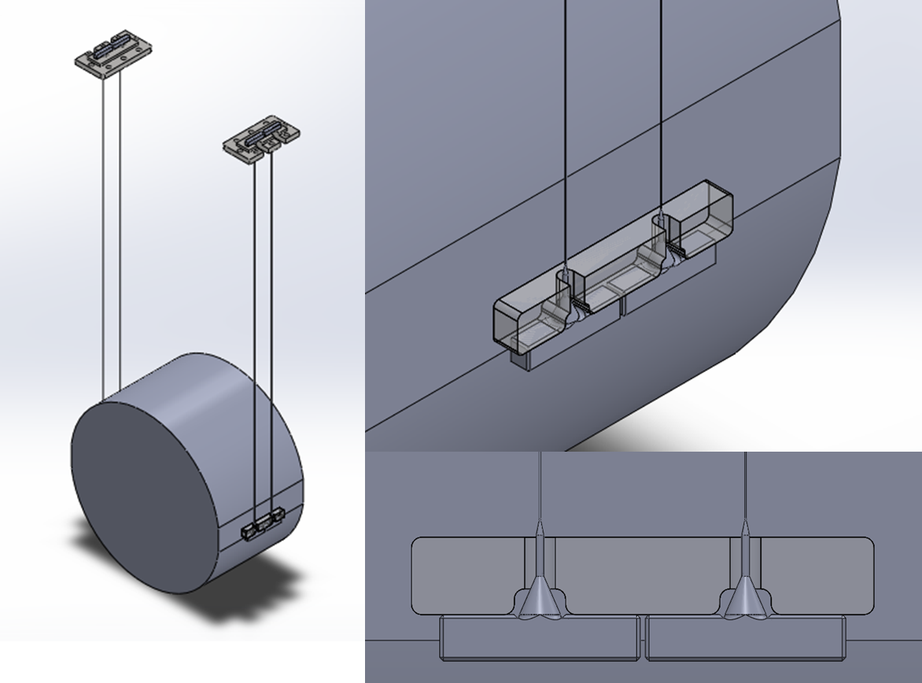
Overview of monolithic suspension assembly

Slide 5
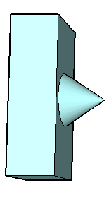
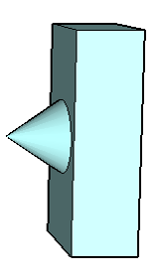
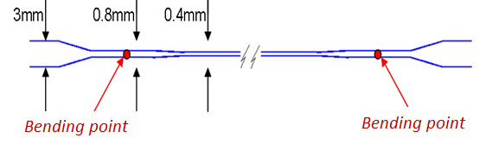
Overview of monolithic suspension assembly
200 W CO2 laser
Dumb-bell shaped fiber (aLIGO)
fiber diameter 0.4mm
bouncing mode < 10Hz
violins modes > 400Hz
working load ~780MPa (reasonably safe, about the same of VIRGO+)
Laser pulling of 1.5 mm thick silica bars:
Welding
Annealing
Controlled pulling

Slide 6
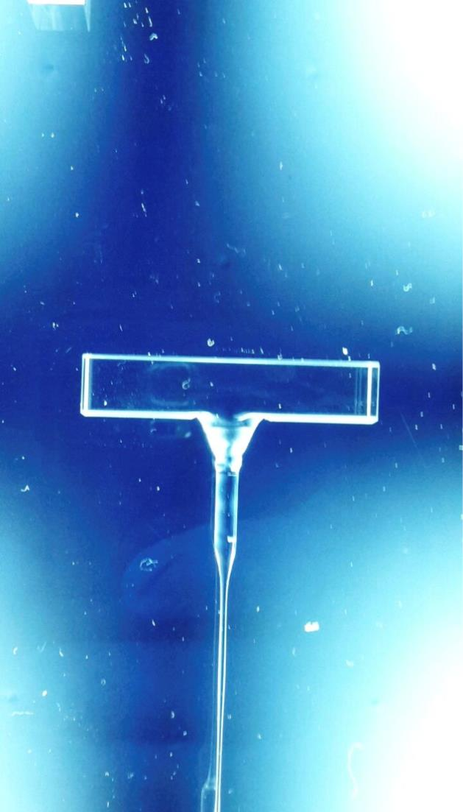
Overview of monolithic suspension assembly
The dumbell shaped fiber is produced and welded to the anchors.
Groove, necessary for polishing procedure
lambda/10 zone for silica bonding
The fibre with the anchors is tested with a load of 18/20 kg (nominal load is 10.5 kg).
The monolithic suspension is assembled, the tilt of the mirror verified.
The anchors are silica bonded to the mirror ears and to the steel support.

Slide 7
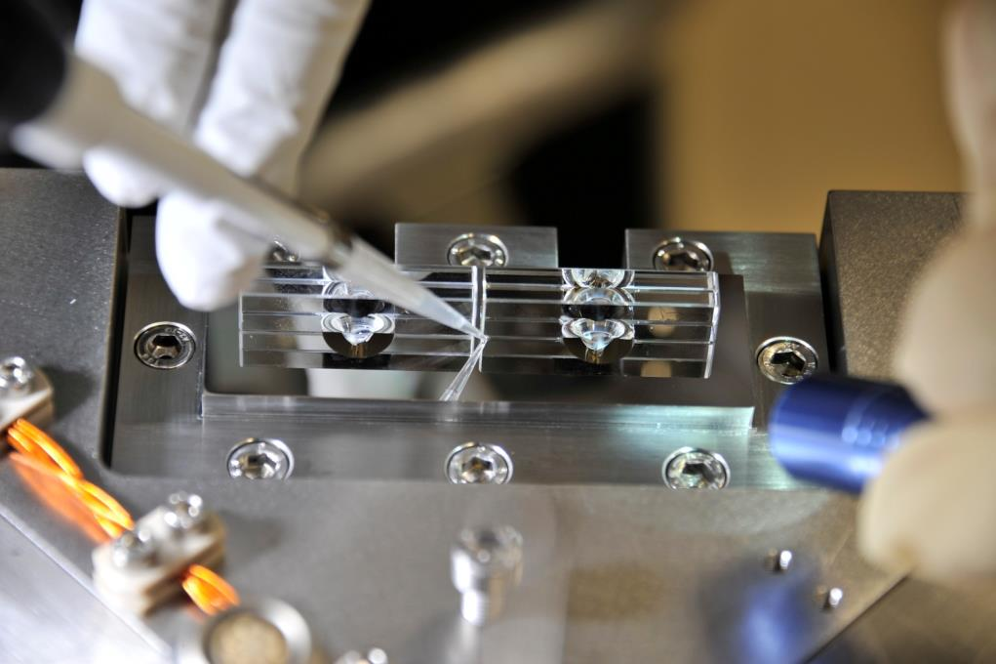
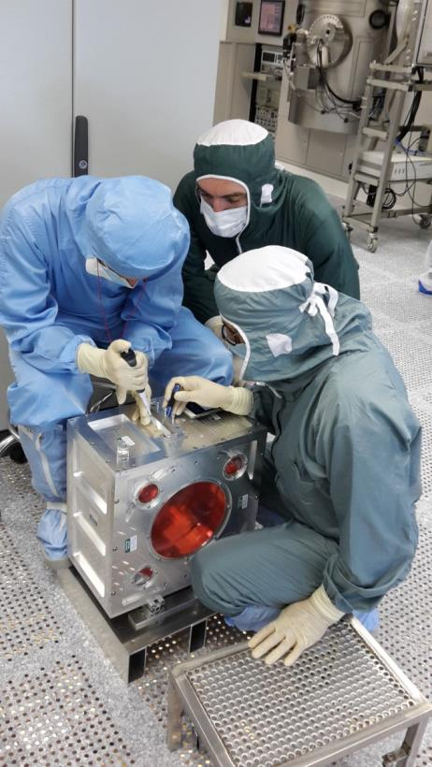
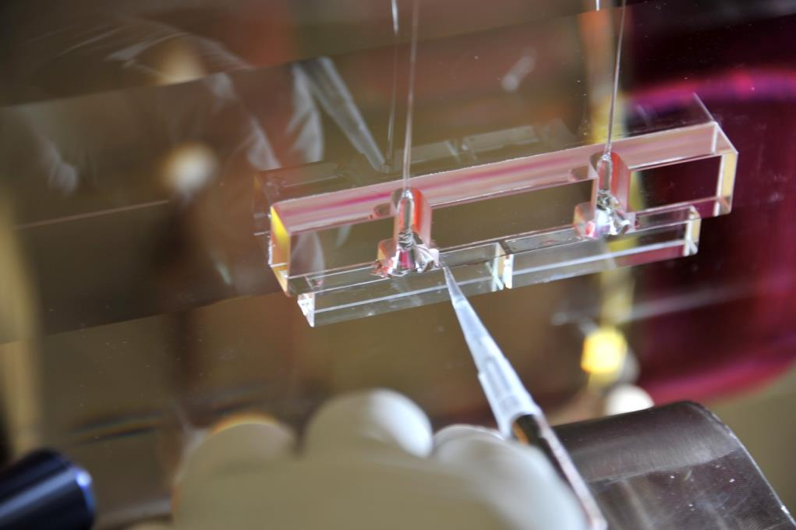
Gluing procedure
To reduce the losses due to the friction between the parts, all the them are glued through the silicate bonding. The upper clamp system is a steel plate with a l/10 quality surface. For this kind of gluing, we measured a minimum breaking strength of 5MPa.

Slide 8
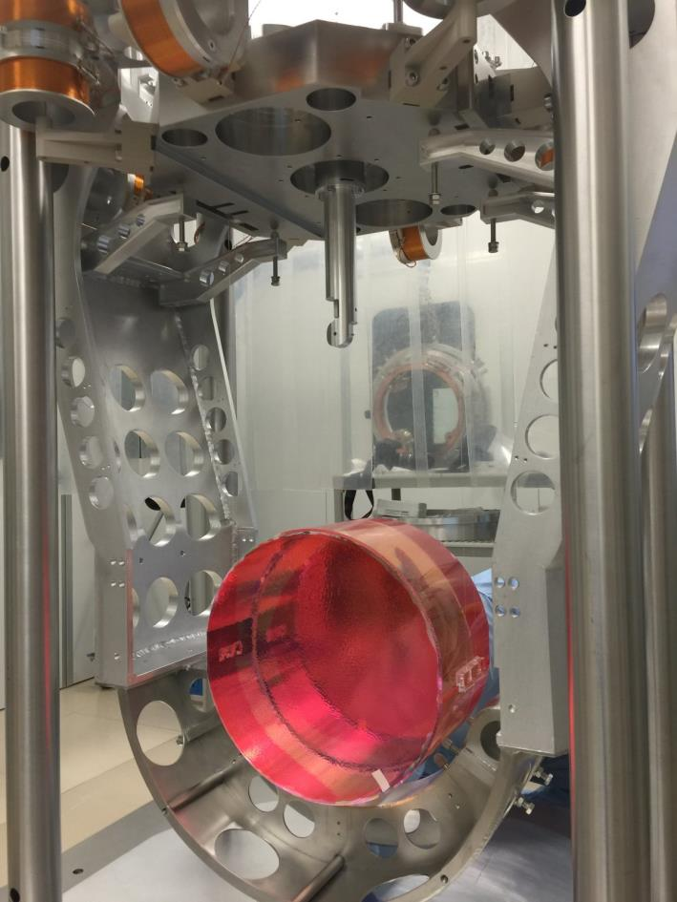
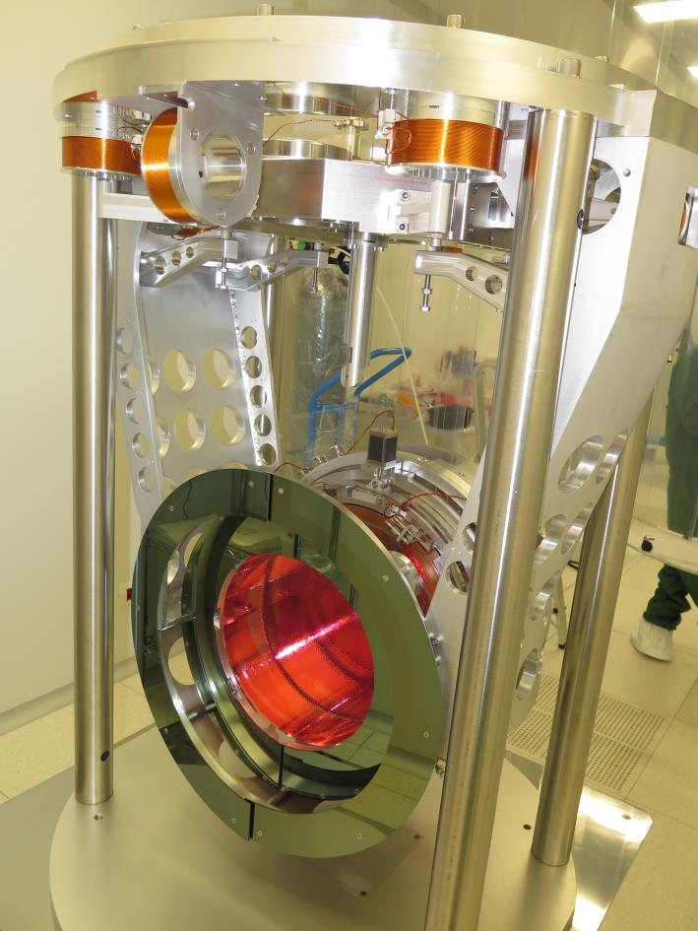
Mirror payload

Slide 9
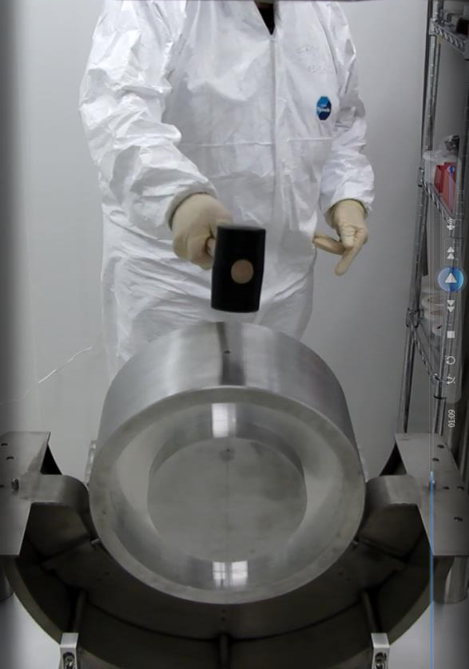
Pre-installation tests
Dozens of tests were performed in the VIRGO labs on each single part of the suspension/payload system and all of them were OK.
Maybe the most peculiar one was the hammer test that was performed in November 2014 successfully
To download the video: https://www.youtube.com/watch?v=qlJ0o7R4-LU

Slide 10
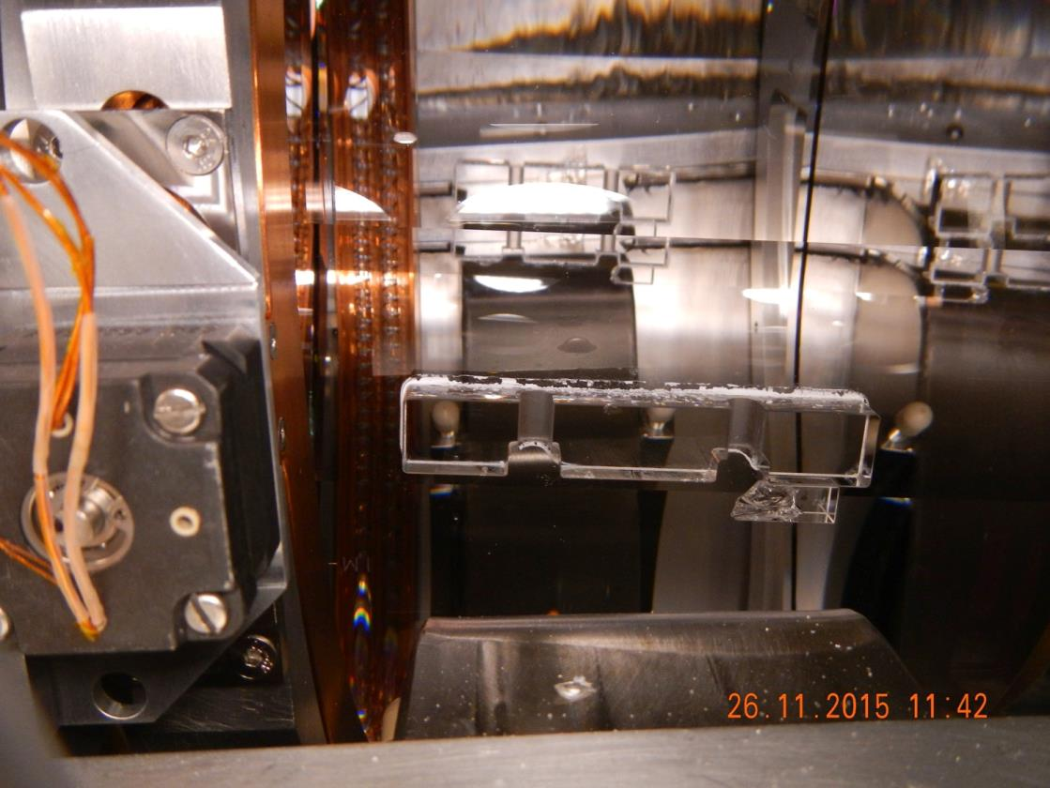
WI failure
The WI was in air for 5 months under the tower to be balanced (SA and Marionetta) => big mechanical stress/excitation without any problem. After 9 days in vacuum it failed

Slide 11
Failures history
AR
1
View from the top
4
All suspensions failed in vacuum even if 3 of them survived few months (4-7 months) under load in air
All of them passed standard compliance tests in air
2
3
HR
Mirror failed | Failure date | Logbook | Time in air | Time in | Failed Fiber
 |  | entries |  | vacuum
WI | Nov 18th, 2015 | 32908 | 5 months | 7 days | 3
NI | Dec 18th, 2015 | 33028, 33035 | 4.5 months | 5 days | 2
NI | Mar 1st, 2016 | 33330 | 1 week | 5 days | 2
WI dummy | Apr 26th, 2016 | 33591, 33676 | 1 week | 11 days | 2
WI dummy | No failure |  | 2 days | 2 weeks
WI | Jun 25th, 2016 | 34132, 34153 | 1 month | 30 days | 3
WE | Jun 28th, 2016 | 34158 | 7 months | 18 days | 3
NE | Oct 13th, 2016 | 33676, 35038 | 6 months | 4 months | 2
Mirror Reference System

Slide 12
Project choices
Involvement of LSC experts (thanks to all of them!)
  First discussions with the LIGO team
  Close relationship with the LIGO collaboration and in particular with Glasgow group: e.g. A Bell and G Hammond were at VIRGO site to follow the assembly/integration phases of a payload, M. Van Veggel tested the anchors and the SB (we are really thankful to the whole collaboration)
PL/commissioning coordinator pushed to use a backup option (steel wires) allowing to start real commissioning
The collaboration analyzed all the possible sources of the failures: mechanical tests, vacuum tests, thermal tests, chemical tests, radioactivity tests and so on (see the VIRGO note VIR-0383A-16) => each single part showed better results than expected

Slide 13
Vacuum issue

Slide 14
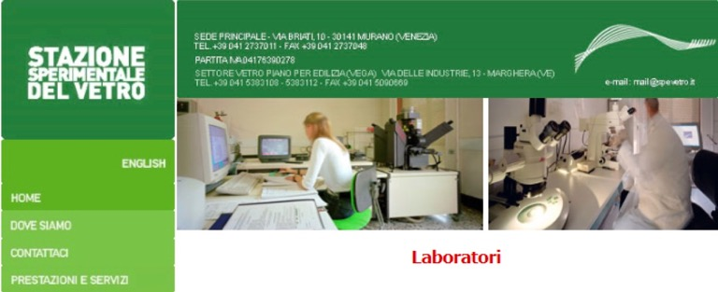
Summary of a long story
On October 13th, 2016, the NE payload failed during a venting operation. It was 6 months in air and 4 months in vacuum: we finally realized that we had a contamination problem coming from the pumping system
This was confirmed by:
the failure started always (6 on 7 failures) from the fibers close to the venting side
the report of SSV, stating that all our failures started from the thin part of the fibers: something from the venting pipe hitted the fibers

Slide 15
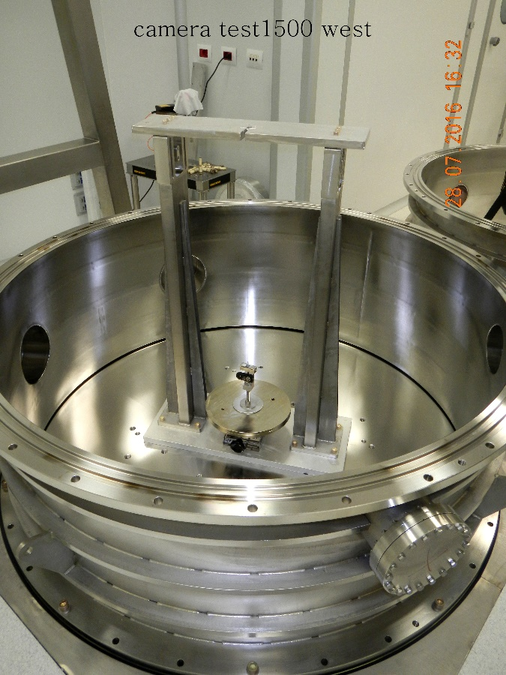
Vacuum tests at VIRGO site
To study the pumping system, we developed two facilities at VIRGO site to test single fibers or a whole payload. We observed several failures on the single suspended fibers (nominal load) due to particles coming from the scroll pumps: the scroll pump and the venting system shared the same pipe
run | Id | Aim of the test | Failure type | Other notes
1 | Fiber #0 20160216_1 | Vacuum cycle ‘normal’ | No failure | Aug-Oct under vacuum
2 | Fiber #1 20161027_1 | Venting test – first run | A few sec after venting start (7/11) | 4 days of vacuum , quantity of test ventings = 1
3 | Fiber #2 20161027_2 | Venting test – confirmation 2 | 9 hr after venting (28/11 ) | 11 days of vacuum , quantity of test ventings = 3
4 | Fiber #3 20161129_4 | Venting test – confirmation 3 | A few sec after venting start (18/12) | 10 days of vacuum , quantity of test ventings = 2
5 | Fiber #4 20161219_5 | Clean cycling - indirect test | No failure – Dec-Jan’17 | 18 days of vacuum, 6 ventings, No pumping of the venting duct
6 | 2°chamber 20161129_1 20161129_2 20161129_3 | Pumping only | Visual monitoring, breaking has been discovered days after an accidental venting | To be repeated

Slide 16
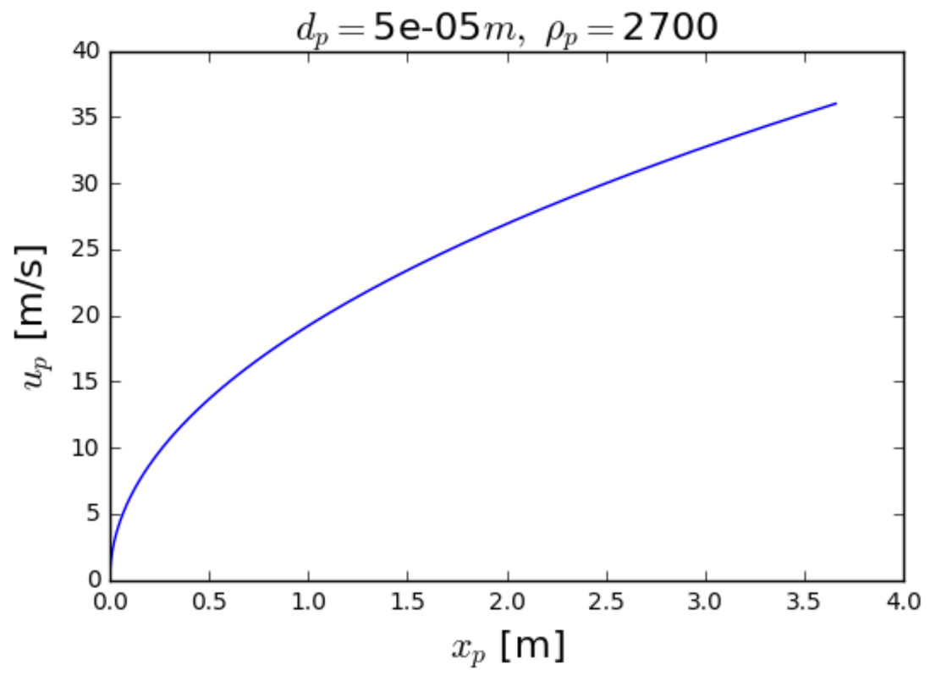
Venting simulation/calculation
Because the scroll pumps and the venting system shared the same pipe, the failures were probably due to the dust produced by the scroll, stored in the pipe and then injected in the main vacuum chamber during the venting process, hitting the fibers.
Calculations by A. Viceré showed that during a venting, air shock waves can accelerate 50 - 100 micron particles to speeds up to 20-50
m/s for a 2 m travel:
the kinetic energy of these particle is well in the range necessary to cause the breaking of a fiber.
50 μm spherical particle in Al
~ 20 m/s in 1 m
At the beginning of the venting process, when inside the tower the gas is still rarefied, high travelling speeds of particles could be reached.

Slide 17
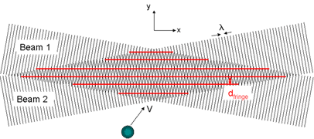
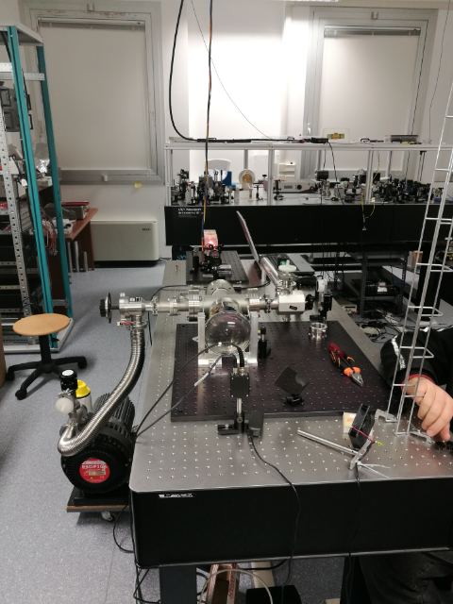
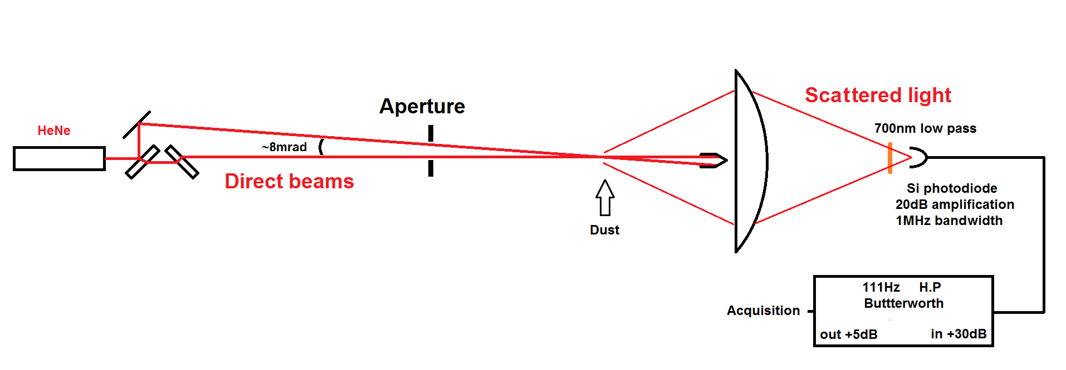
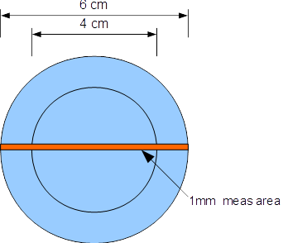
Vacuum test - velocimeter
Gabriel Pillant developed a velocimeter, based on the interference of two coherent laser beams, to measure the velocity of particles injected by the pumping system
Fringes distance 85µm
Optical scheme
Apparatus tested on a small volume pumped by a scroll in the Optics Lab.

Slide 18
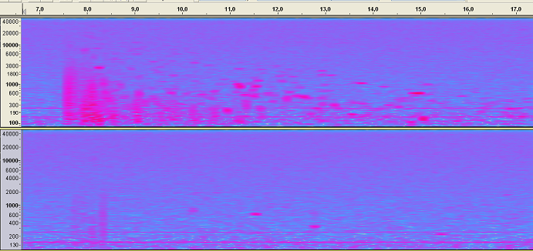
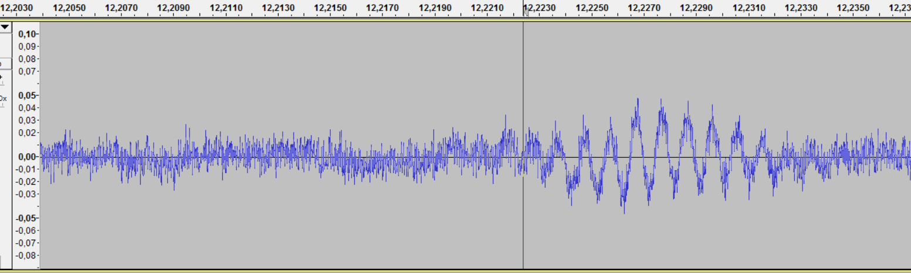

Clean vs dirty venting
Measured velocity of particles ~ 1 m/s after few centimeters: compatible with model by A.Viceré

Slide 19
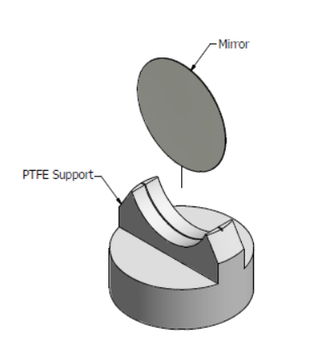
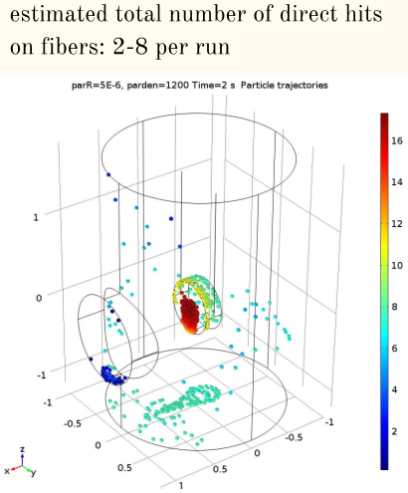
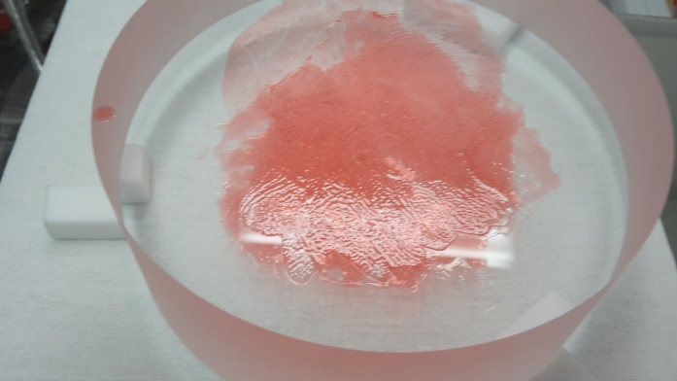
Electrostatic effect
A. Chincarini simulated an electrostatic field on the fibers, showing that it could increase the effective cross section of the fibers for incoming particles.
To show qualitatively the effect
of electrical force and to understand
if it has a role in fiber breaking mechanism,
2 Si-wafers, vertically mounted, were put in the little vacuum chamber, one charged at 3kV and the other not: ~ 5 times more dust on charged wafer w.r.t. the other (F. Sorrentino, A. Pasqualetti)
The electrostatic effect of the first contact was studied in LIGO coll, we are trying to understand how to remove the residual charge in our environment
This effect would also affect the contamination of the mirror

Slide 20
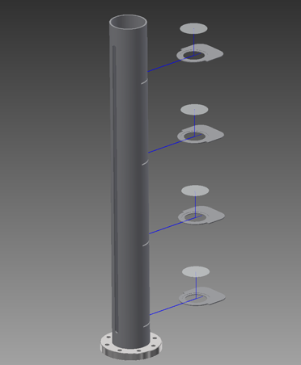
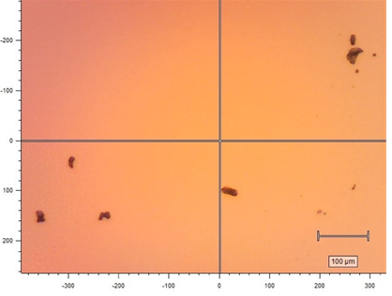
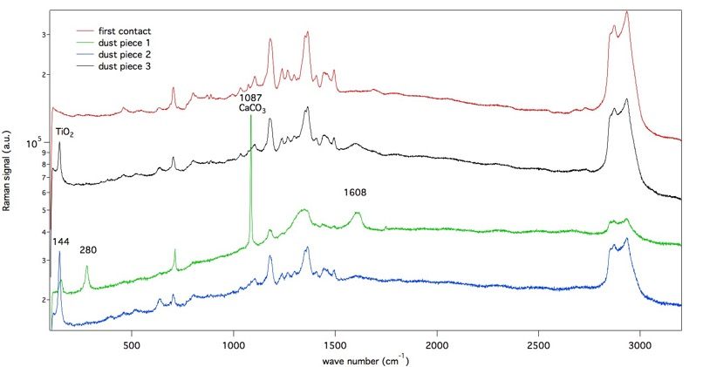
Dust analysis
Dust samples have been collected on Si-wafers: analysis is done by optical microscope, SEM and Raman spectroscopy on materials taken from in-tower components and vacuum equipment
The dust abundance on Wafer in a small vacuum chamber evacuated by a scroll is ~0.7 particles/mm²
SEM and µ-Raman analysis were performed on materials from towers and test chambers: few materials matched with the part of the pumping system that we were able to inspect, for others materials there is no a clear matching => a deeper investigation in on going

Slide 21
Summary of MS failures
Our current understanding is that some particles coming from the scroll pumps were injected into the vacuum during venting. The particles traveled in vacuum, so they could move with high velocity, and there was no obstacle that prevented them hitting the fibers.
The amount, size and kind of particles varied in an unpredictable way over time and from one tower to the other, resulting in different kind of damages to the fibers and, consequently, in different times of failure.
This scenario seems to be confirmed by all tests performed up to now: clean vs dirty tests (see next slides)

Slide 22
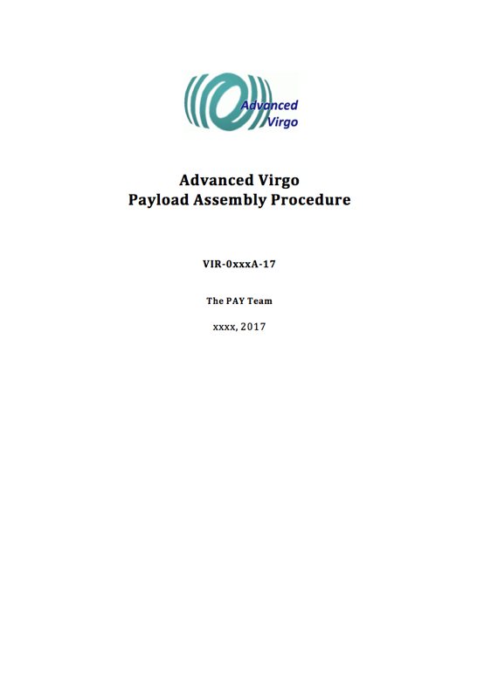
Next steps toward monolithic suspensions re-installation
Upgrade of our Vacuum set-up (VAC subsytem):
  New venting circuit design Done
  New pump choice Done
  Towers cleaning procedure Underway
  Implementation plan Underway
Upgrade of Fibers Production procedures
  Upgrade fiber lab Done
  New tools to validate the fiber production Done
Design, test and implementation of Fiber Guards Done
Production of a Document on Procedures
  - Description of the production of a working payload, starting from fiber production to a full operational and suspended mirror. Done
Production of a detailed planning for preparing the monolithic suspensions re-assembly (before the end of AdV-O2). Done
Production of a detailed planning for monolithic suspension re-assembly (after the end of AdV-O2) Underway

Slide 23
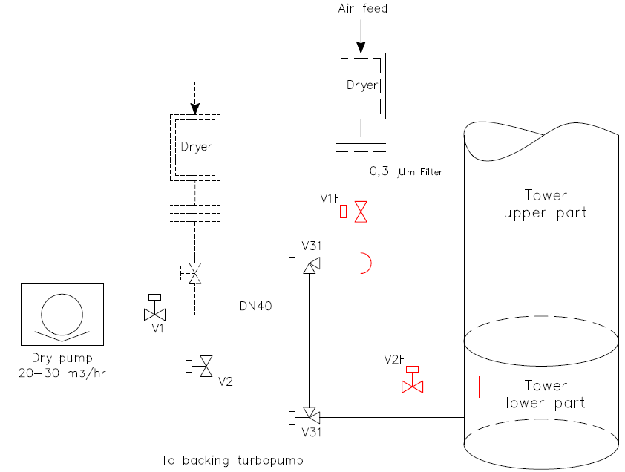
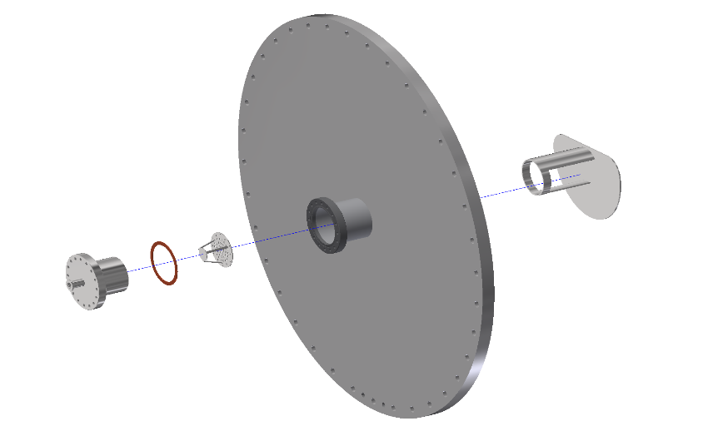
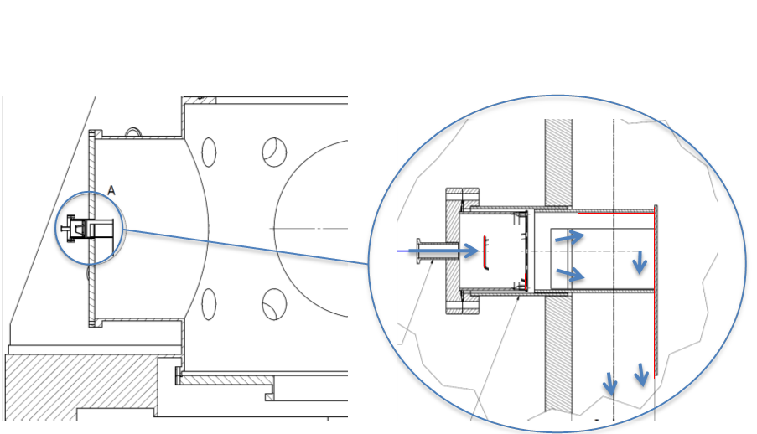
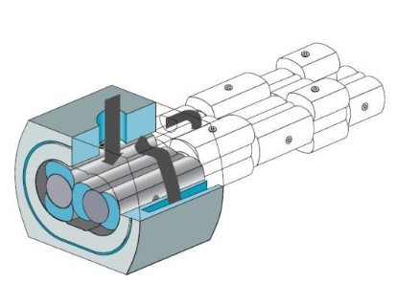
Upgrade of our Vacuum set-up
New features have been discussed with external experts of clean vacuum applications (from CERN, LASA, DESY):
Remote pumps: new filters and new clean and longer pipes
Venting circuit separation: few scratches under revision
Equalizer pipe
Inner shield: The entering air flow is
slowed down and directed along the wall
Scroll pump substitution: multistage root pumps, specifically built to avoid
dust production (no friction/wearing inside vacuum)

Slide 24
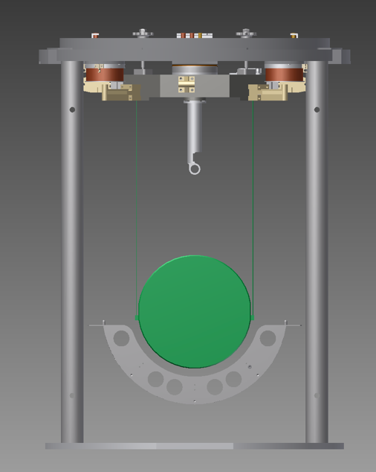
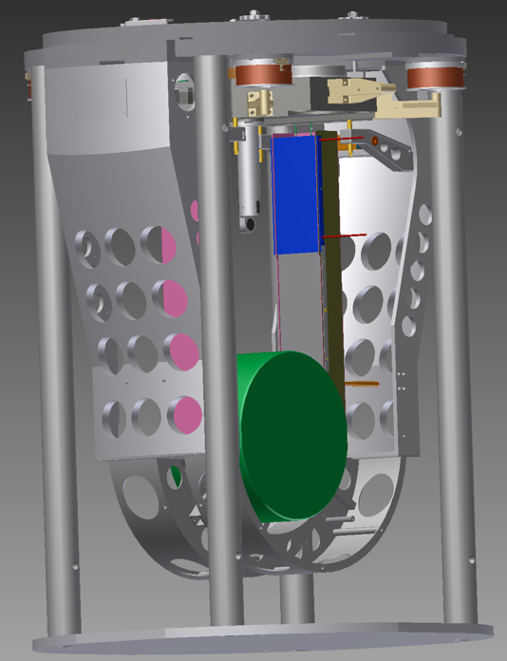
Fiber guards: Talk of Luca Naticchioni

Slide 25
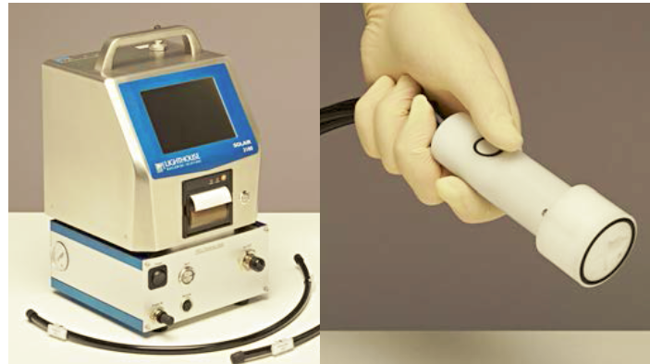
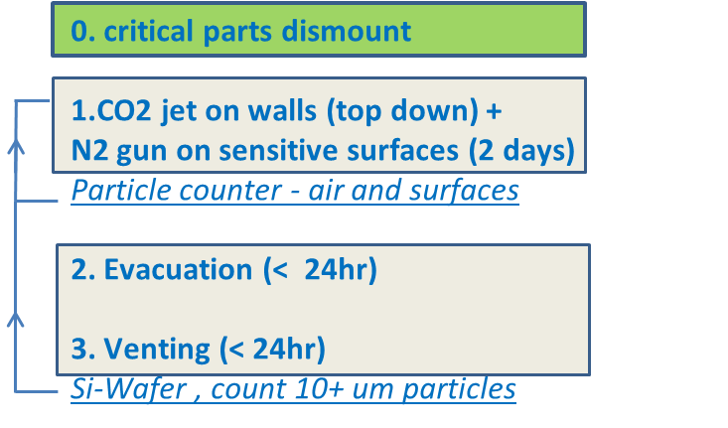
Upgrading of towers cleanliness
Extraordinary cleanliness of tower chambers:
‘Usual’ operations but more intense (Clean Operation Team)
Existing parts shall be cleaned (valves, small parts) or replaced (longer parts)
Monitoring the concentration of dust particles on surfaces will be implemented
  - volumetric particle counters with a special pipe-collector in order to allow surface sampling
Procedures discussed with experts and revised:
Phases duration to be adapted to meas. results
First tower could be installed during maintenance breaks, as a prototype
To put in evidence residual migration effects of particles

Slide 26
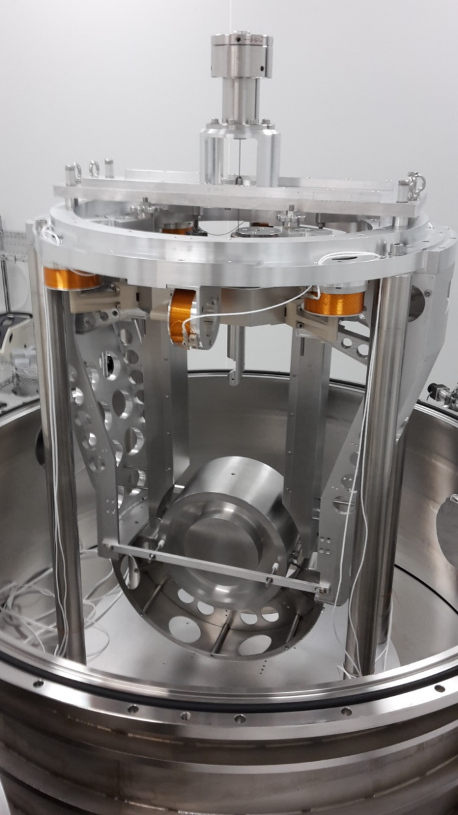
Validation of new vacuum clean procedures
The payload test facility at VIRGO site is used to validate all the solutions developed to solve the vacuum issue:
New pump and pipe
Different venting pipe
Shield
Fiber guards
Diffusers
Silicon wafers and velocimeter to measure the residual contaminants
The test of this clean procedure gave a result totally different from the dirty tests performed on single fibers: after 6 pumping/venting cycles the payload survived without any problem

Slide 27
New tools

Slide 28
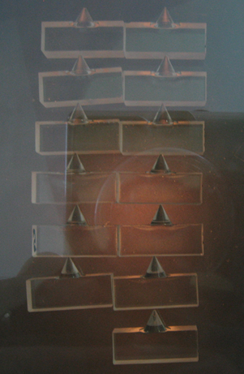
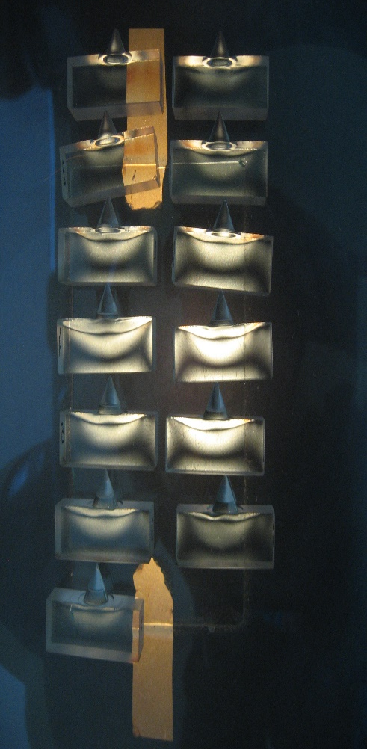
New procedure for the anchors production
As we showed in the last year, the anchors never were an issue but we spent a lot of time simulating and analyzing them to find their weak points and so we decided to upgrade the design to reduce their weaknesses
The new procedure was developed taking into account all the discussions that we had in the LIGO-VIRGO community:
substrate in Suprasil 2
flame polishing of the groove/cone
annealing at 1100°C for few hours
picture through a polariscope of each annealed part before the polishing lambda/10 in order to evaluate the residual stress (if any)
polishing lambda/10
interferogram of each polishing lambda/10
Pictures through a polariscope of anchors before and after the annealing

Slide 29
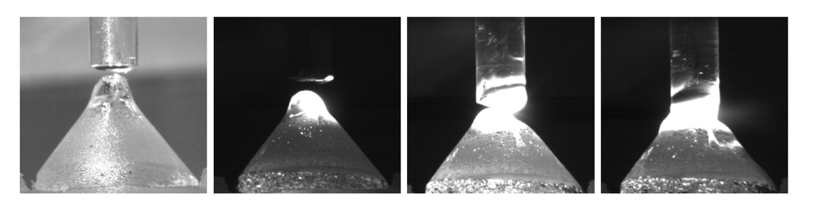
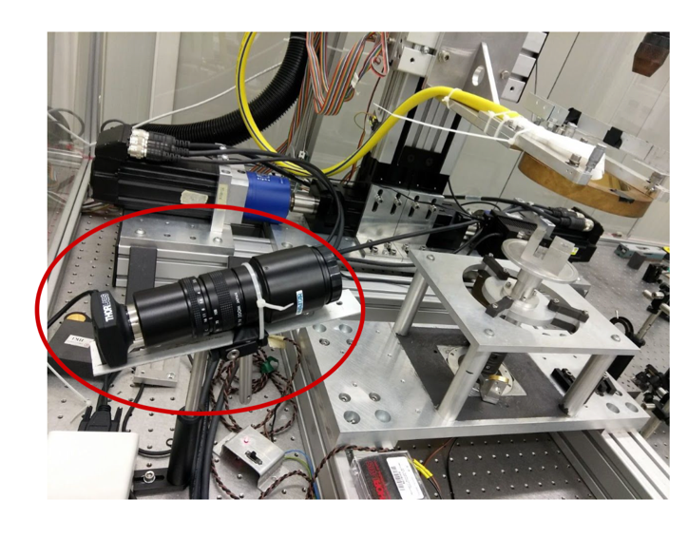
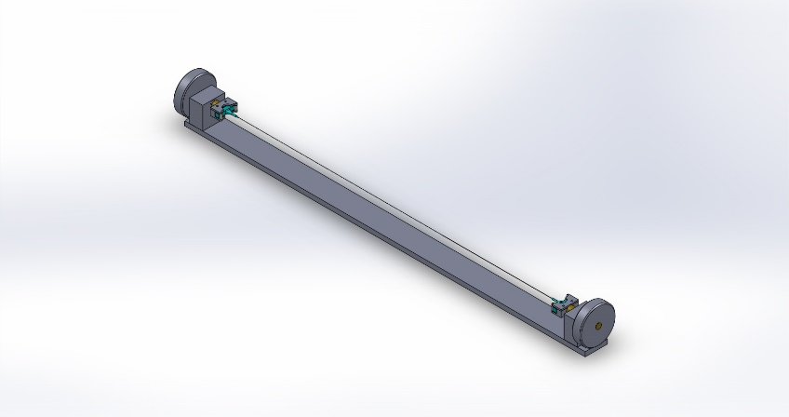
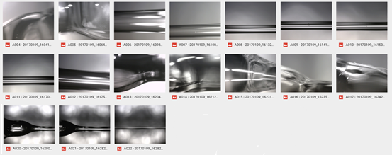
Updating of the tools for validating the fiber production
A new welding procedure was defined in collaboration with Glasgow group: lower temperature, longer time, camera to monitor and to control the welding profile
An accurate microscope scan of the fibers is done looking for any defects. All the characteristics and the validation test results are filed for each produced fiber

Slide 30
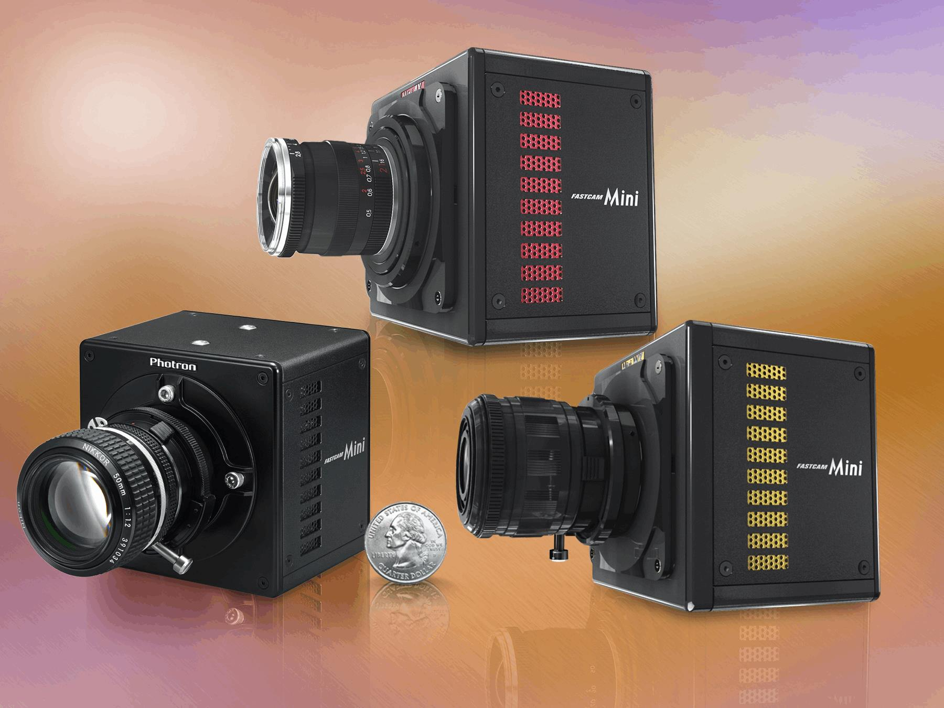
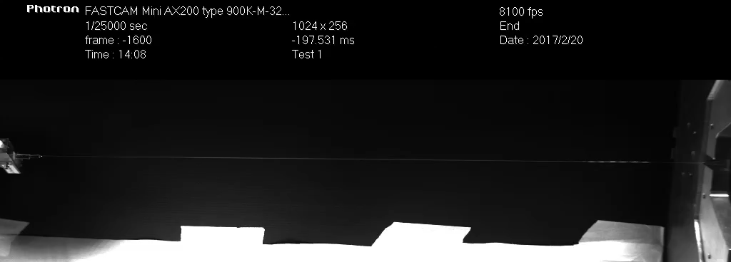
High speed camera
The high speed camera (Photron AX50) is a very useful tool to study the behavior/dynamics of the fibers and to understand if an eventual failure is due to the anchor, to the welding or to the fiber itself.

Slide 31
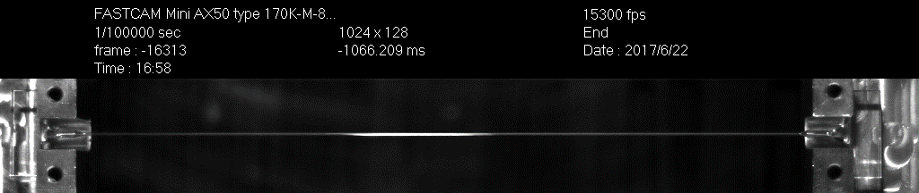
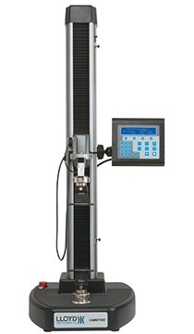
Breaking test with High Speed Camera
Two new anchors (Suprasil2, flame polishing and low annealing) were welded by a fiber with a diameter of 0.8mm.
The tests were performed using a Lloyd Instruments testing machine: the fiber/anchors system reached 160kg before breaking (about 3MPa). The same fiber was loaded with 70kg for half an hour

Slide 32
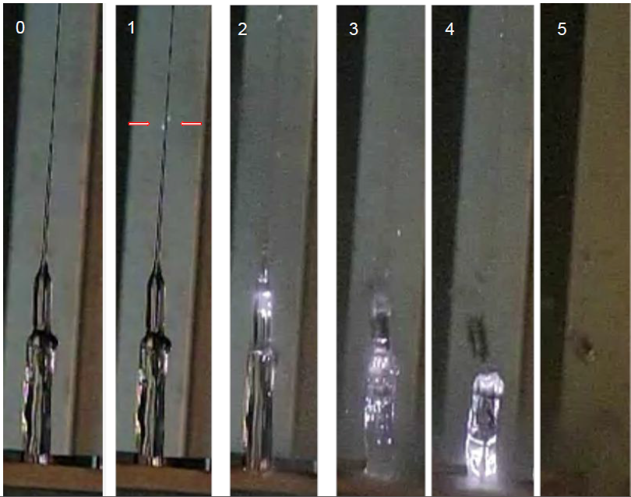
Breaking light emission
Breaking sequence:
1. The fiber explodes
2. The 3 mm rod is broken by the shock wave
3. The shock propagates in the 5mm nailhead.
4. The nailhead is broken down to the clamp and even inside it.
5. Even if the rupture starts from the fiber all the silica parts are destroyed included the nailhead

Slide 33
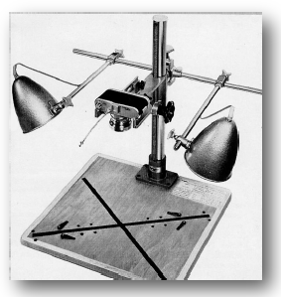
Optical system for dust contamination monitoring via Si wafer inspection
• A high-resolution digital camera, equipped with a high resolution objective lens, is rigidly mounted above a wafer holder
• Wafer illumination (dark field) with large angle to avoid direct reflection into the camera
• Mechanical mount should insure that wafer positioning, camera alignment and focusing are kept along repeated measurements
• An automatic signal processing retrieves the number of particles in the image (free software)
• The camera+lens resolution and magnification are chosen to reach a resolution of 10 μm over an area of about 4 cm²

Slide 34
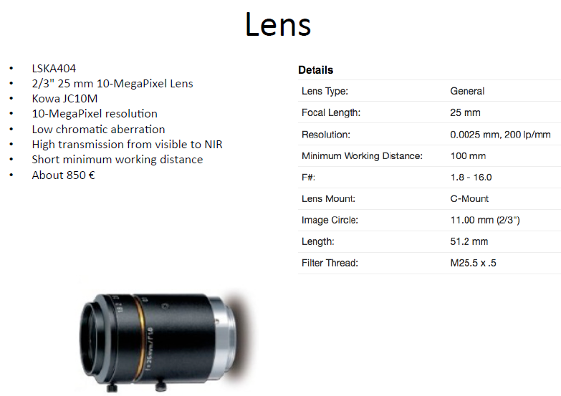


Slide 35

A new collaboration
Recently a very useful collaboration has been set up with the group of Nicholas Lockerbie of Strathclyde University in Glasgow. They have given us all their expertise and their high sensitivity shadow meter
This instrument will be an important asset in our further development of monolithic suspensions, e.g.: studies of Q of violin modes as a function of bonding to the marionette and the mirror at the 1500W test facility

Slide 36



Mirror box
The EGO staff, using a Leica AT403, was able to measure the tolerance of the mirror box in different configuration. The worst result was about 0.3mm

Slide 37
Next steps

Slide 38

Installation of monolithic suspensions
The ears were damaged during the failure due to the glued anchors

Slide 39

Installation of monolithic suspensions
If the thickness is greater than 8.5 mm, the thermal noise of the anchors bonding starts to dominate on the overall thermal noise of the mirrors
P.Puppo simulated defects with an area of 19 mm² (10% of glued area) and the predicted thermal noise at 100Hz is:
- all the glue filling the defect and attached to the ear => 7.7*10⁻²² m/Hz^{1/2}
- all the glue filling the defect but detached from the ear => 2.3*10⁻²² m/Hz^{1/2}
- all the glue filling the defect but attached on the lateral surface of the cylinder => 3.7*10⁻²² m/Hz^{1/2}
The recommendation is not to fill the holes with the glue

Slide 40
Possible integrated planning
Before the first integration, we would like to make a test with a dummy payload covered with wafers, to validate the cleaning procedure. Discussion is ongoing.
Week 1-2 | NE disassembly from tower
 | NE transport to clean room
 | NE payload disassembly
 | NE payload: modification of parts (if needed, e.g. for guards)
 | NE monolithic suspension
 | NE tower: cleaning and upgrade of vacuum system
Week 3-4 | dummy payload suspension/cleanliness test
Week 5-6 | NE payload reinstallation in tower (balancing, alignment, first contact, TCS)
 | NE tower: begin of the vacuum (2 weeks)
 | NI payload disassembly (in parallel with NE reinstallation in tower)
 | NI transport clean room
 | NI payload: modification of parts
 | NI monolithic suspension
 | NI tower: cleaning and upgrade of vacuum system
Week 7-9 | NI payload reinstallation in tower (balancing, alignment, first contact, TCS)
 | NI tower: begin of the vacuum (2 weeks)
Basic Idea
- Planning dominated by MS + vacuum installation
  - N arm -- W arm
  - Other upgrades in parallel
  - Distribute changes evenly – reduce risk
North arm: duration 9-10 weeks
West arm: 2 weeks less
For a more detailed plan see the talk of G.Losurdo

Slide 41
Extra

Slide 42

Possible integrated planning
Before the first integration, we would like to make a test with a dummy payload covered with wafers, to validate the cleaning procedure.
Discussion is ongoing.
6 months of commissioning time after upgrades and before O3
+ 1 month of recycling cavity characterization

Slide 43

North arm installation plan
Start date TBC
Only for first payload
North arm: duration 9-10 weeks
West arm: 2 weeks less

Slide 44
Fibers Production and Validation
Procedure
a) The two anchors are welded to the 3 mm silica rod;
b) The rod is laser polished (speed 0.03 mm/s, power about 50 W)
c) The fiber is pulled with a power 60 W.
Validation, length measurement:
d) The fiber is loaded with a loading rate of 0.2 kg/s up to 18/20 kg and then quickly unloaded;
e) Measurement of the lengths at 0 and 10.5 kg are extrapolated.
Bending points and violin mode measurements:
f) The fiber is loaded with 10.5 kg for about 30 minutes while the bending length and the violin frequency are measured.
Validation test just before suspension mounting:
g) Each fiber is loaded with a loading rate of 0.2 kg/s up to 12 kg and then quickly unloaded;

Slide 45
Fused Silica Breaking Strength
In literature we found that the material breaking strength of fused silica (due to the molecular force) is about 7GPa.
For all our testes and designs, we used the nominal breaking strength of 50MPa that is about 100 times less than the material breaking strength: it is the quality of the surface to dominate (cracks)
e.g. the breaking strength of the fiber is 4GPa because without any crack is present on its surface (laser production). But if someone touches the fiber, he produces a little crack that reduces immediately its breaking strength and destroys the fiber

