Slide 1
Using NSBH Tidal Deformation for GW Cosmography with 3G Detectors
Shreya Anand
under the guidance of
Dr. Alex Urban, California Institute of Technology
Caltech Summer Undergraduate Research Fellowship
August 25, 2017

Slide 2
Cosmography
Satyaprakash, Schutz, and Van den Broeck, 2010
Image Credit: David W. Hogg
Cosmological Parameters:
H₀: Hubble constant
Ω_{M}: matter density parameter
Ω_{Λ}: dark energy density parameter
ω: determines dark matter equation of state
Necessary tools: independent measures of luminosity distance (D_{L}) and redshift (z)
Notes:
Just as in cartography, in cosmography we describe the universe using distance measures. However, in a universe accelerating in its expansion, The comoving distance, or the unchanging (proper) distance between two objects moving in the Hubble flow, does not maintain a simple linear relationship with the source redshift, a proxy for how fast the source is moving away from us. Luminosity distance is simply the comoving distance divided by 1+z. Thus the relationship depends on the properties of the universe, which we call cosmological parameters, and these are { … }. As shown by the plot, in the local universe, the relationship between dL and z is approximately linear. However, the relationship between dL and z changes based on the values of cosmological parameters. So if we want to measure the properties of the universe (def. cosmography), we must obtain independent measures of luminosity distance and redshift, and use these two measures to constrain parameters.

Slide 3
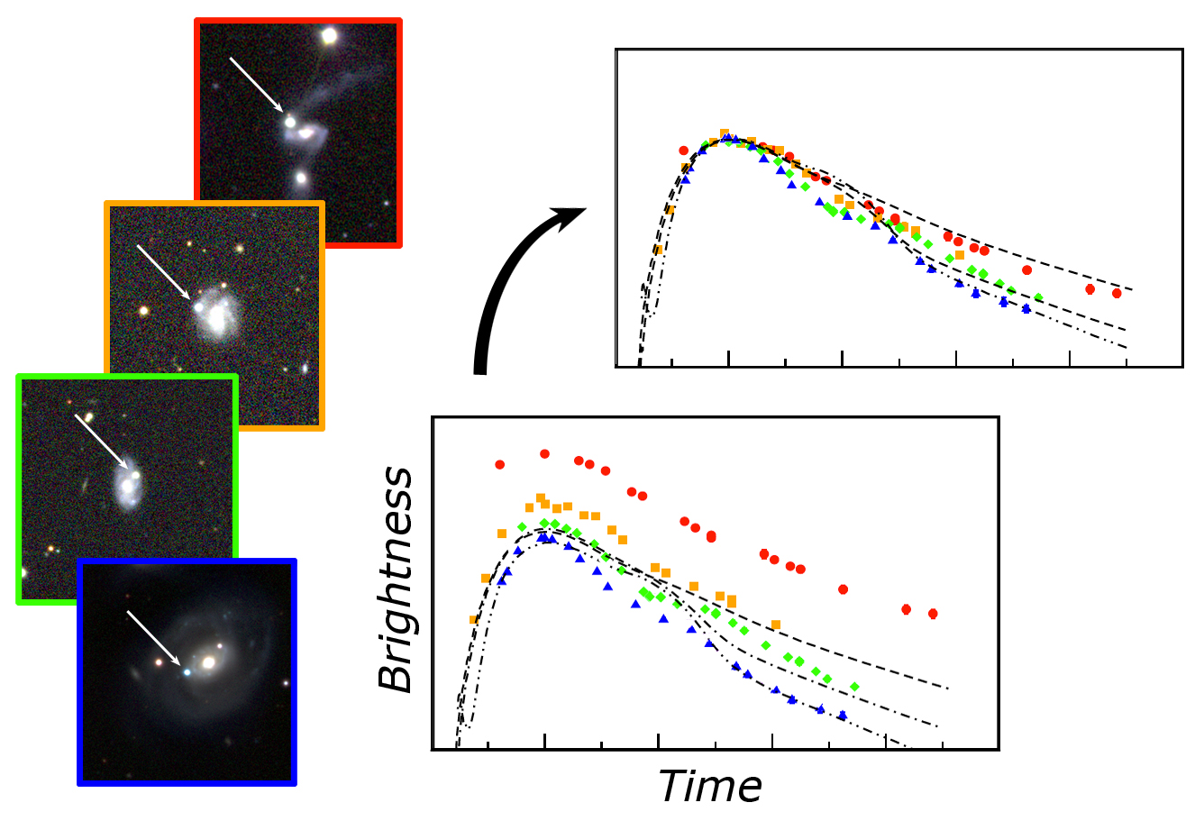
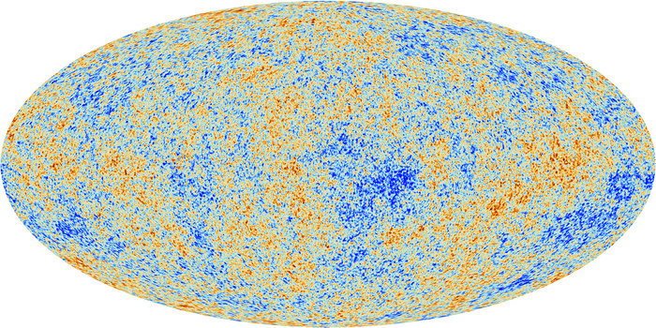
Why Cosmography?
Disagreements between our best models:
Planck: H₀ = 67 ± 1.2 km/s/Mpc
Type Ia Supernovae: H₀ = 73 ± 0.7 km/s/Mpc
Better constraints on cosmological parameters: Ω_{M}, Ω_{DE}, ω
Planck CMB image
Type Ia Supernovae lightcurves
Notes:
Currently, the two most reliable methods of performing cosmography are by using measurements from the CMB Power spectrum, and the standard candles Type Ia Supernovae. However, the two methods don’t fall within each other’s uncertainties – so we need other methods to measure and reconcile this longstanding conflict.
Secondly, the more measurements we obtain, the better we will be able to understand the properties of our universe, and the roles of dark energy and dark matter.
Specific to GW: If we can independently measure the redshift to a source, we can resolve the large distance uncertainties we obtain, as well as potentially identify the host galaxy without EM observation.

Slide 4
Standard Siren Cosmography
Use GW as an independent measure of the luminosity distance to source
Get redshift from one of these methods:
Method 1: Joint GW-EM observations (currently ongoing!)
(Satyaprakash, Schutz, and Van den Broeck, 2010)
Method 2: host galaxy statistical averaging methods
(Chen and Holz, 2016)
Method 3: frequency of tidal deformation
(Messenger et al., 2013)
How well can we determine the frequency of tidal deformation in GW using 3G detectors?
Notes:
Recent detection was exciting, but it’s rare
Host galaxy – subject to incomplete galaxy catalogues
3. As indicated by the title of my presentation, we focused on the 3rd method, using deformability signatures of BNS or NSBH signals to obtain source redshift. IMPORTANT: For GW systems with a neutron star involved, in many cases we anticipate there to be a tidal interaction between the two compact objects when they are close enough in their inspiral. The deformation of the neutron star(s) during this interaction leaves imprints in the GW waveforms that could be used to get the source redshift.

Slide 5
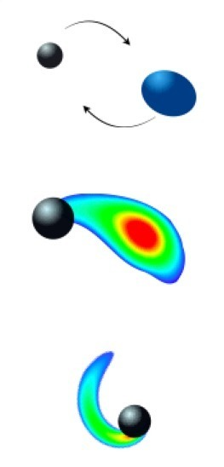
Conditions for Tidal Deformation
0.00 ≤ χ_{NS} ≤ 0.05, 1 M_{SUN} ≤ M_{NS} ≤ 2 M_{SUN} 0.00 ≤ χ_{BH} ≤ 0.99, 5 M_{SUN} ≤ M_{BH} ≤ 15 M_{SUN}
χ = J / (GM / c²)² 3 ≤ q =M_{BH} / M_{NS} ≤ 5
Foucart, 2012
Image Credit: T. Hinderer, F. Foucart
Notes:
Initially, we had planned our analysis for both BNS and NSBH merger scenarios, but due to the time crunch we focused only on NSBH mergers. In general, systems with a higher NS mass and lower mass ratio have a tendency to deform (as shown by Jocelyn’s students at Fullerton). If the BH mass is more than 5 times NS mass, the NS may just fall straight into the BH without being disrupted (we treat it as a point particle when constructing waveform templates). On the other hand, systems between mass ratios of 3-5 are far more likely to result in tidal deformation of the neutron star at a certain radius away from the black hole (before it is disrupted). Using these restrictions as well as previous observational constraints on these systems, we prepared the parameters for our waveform simulations.

Slide 6
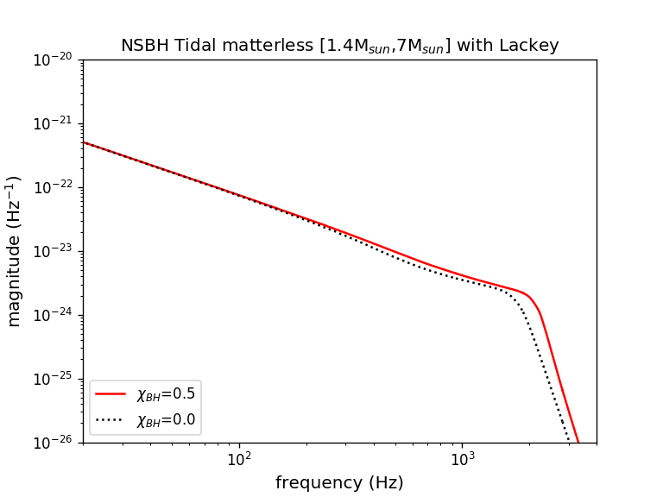
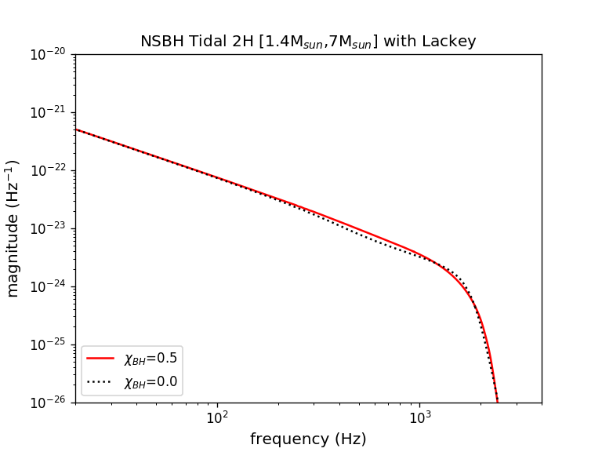
Tidal Deformation: breaking the mass-redshift degeneracy
Masses are redshifted: m_{z} = m(1+z)
TD frequency redshifted: f_{TD, z} = f_{TD} / (1+z)
Use EOS to relate TD frequency to mass
Notes:
Masses and frequencies redshifted, but knowing the EOS we can relate mass to radius, and thereby to frequency, and break the degeneracy
You might be thinking: but wait, don’t we already have at least the chirp mass of the source? And for that matter, haven’t we determined redshifts for past detections already?
Well, that’s because we currently ASSUME a relationship between D_L and z based on previous work. But if we want to do cosmography, we need to determine the unknown relationship between D_L and z that relies on these cosmological parameters.

Slide 7
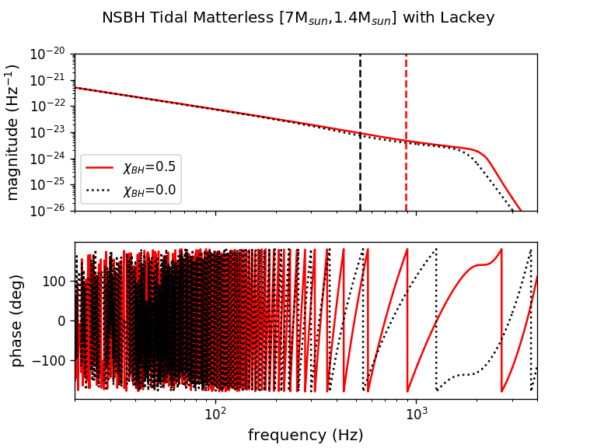
Waveform Visualization: No Matter Effects
Notes:
From now onwards, I’ll try to tell a mostly pictographic story of how we approached this problem of breaking the mass-redshift degeneracy. We chose three main systems of mass ratio 3, 4 and 5 for our simulation, and looked at the tidal effects present in the waveforms for the EOS models 2H and APR, keeping all other parameters except for the EOS fixed in the waveform simulations. First, however, we plot the frequency domain waveforms in magnitude and phase for system with a black hole spin of 0.5 and without black hole spin. We did not specify a cutoff frequency for these waveforms models, and so the break from the power law indicates the true value of ISCO, while the black and red lines show our predicted ISCO from an approximation.

Slide 8
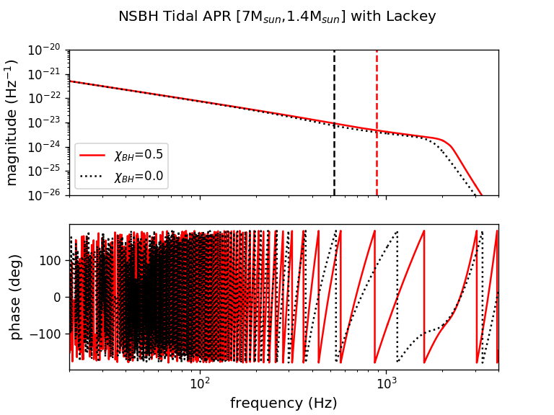
Waveform Visualization: APR Moderate Equation-of-State
Notes:
From now onwards, I’ll try to tell a mostly pictographic story of how we approached this problem of breaking the mass-redshift degeneracy. We chose three main systems of mass ratio 3, 4 and 5 for our simulation, and looked at the tidal effects present in the waveforms for the EOS models 2H and APR, keeping all other parameters except for the EOS fixed in the waveform simulations. First, however, we plot the frequency domain waveforms in magnitude and phase for system with a black hole spin of 0.5 and without black hole spin. We did not specify a cutoff frequency for these waveforms models, and so the break from the power law indicates the true value of ISCO, while the black and red lines show our predicted ISCO from an approximation.

Slide 9
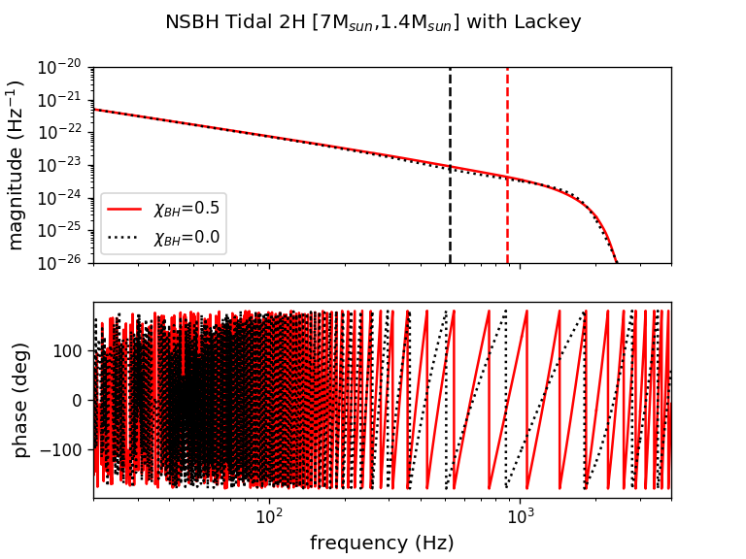
Waveform Visualization: 2H Extreme Equation-of-State
Notes:
From now onwards, I’ll try to tell a mostly pictographic story of how we approached this problem of breaking the mass-redshift degeneracy. We chose three main systems of mass ratio 3, 4 and 5 for our simulation, and looked at the tidal effects present in the waveforms for the EOS models 2H and APR, keeping all other parameters except for the EOS fixed in the waveform simulations. First, however, we plot the frequency domain waveforms in magnitude and phase for system with a black hole spin of 0.5 and without black hole spin. We did not specify a cutoff frequency for these waveforms models, and so the break from the power law indicates the true value of ISCO, while the black and red lines show our predicted ISCO from an approximation.

Slide 10
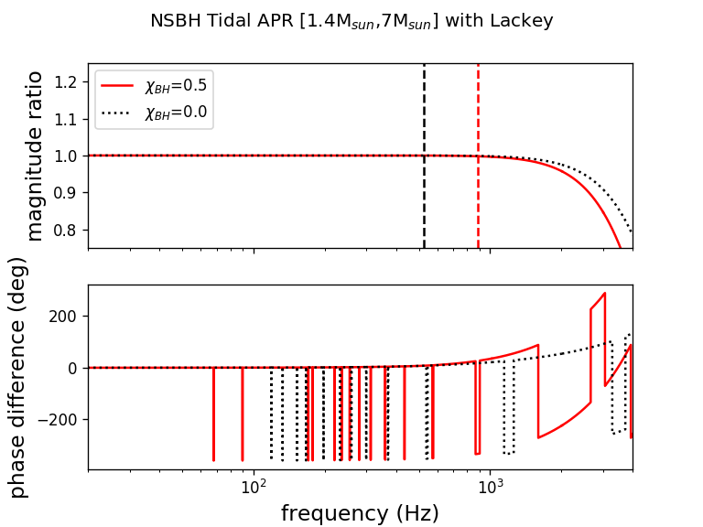
Tidal Deformation Signatures: Ratios Between Waveforms for APR
Notes:
And we can also see the distinct difference between the APR and 2H EOS models for the NS, in terms of deformability signatures! For the 2H model, the first deformations occur earlier in magnitude and phase in band than for the APR model (this will be relevant later!).

Slide 11
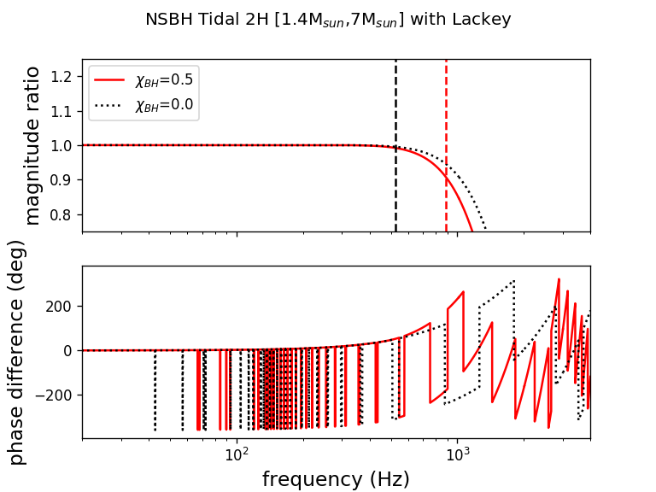
Tidal Deformation Signatures: Ratios Between Waveforms for 2H
Notes:
And we can also see the distinct difference between the APR and 2H EOS models for the NS, in terms of deformability signatures! For the 2H model, the first deformations occur earlier in magnitude and phase in band than for the APR model (this will be relevant later!).

Slide 12
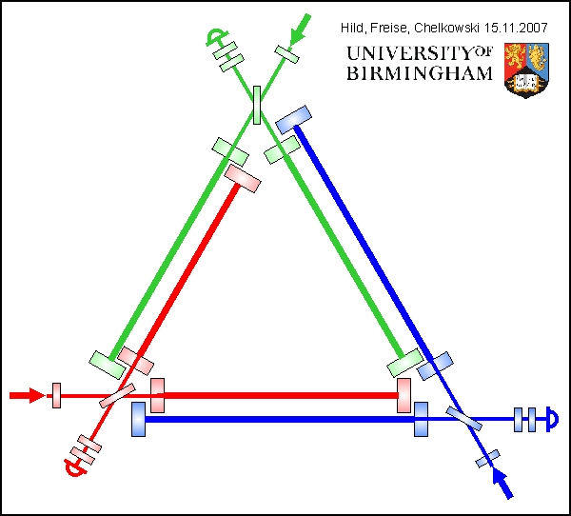
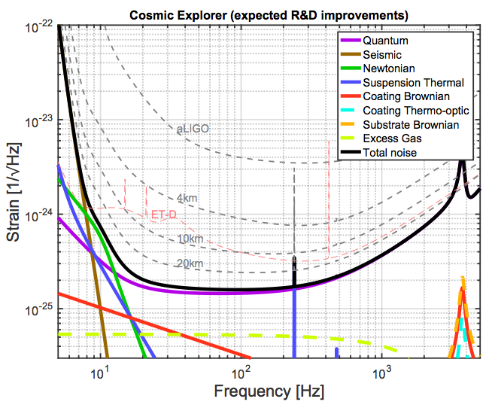
Modeling the Next Generation
Recolor the aLIGO datastream with ET and CE noisecurves
Inject signals into datastreams to retrieve signatures
Einstein Telescope: 10 km arms
Three interferometers
Located in Europe
Cosmic Explorer: 40 km arms
Located in the United States
Notes:
So we can see the deformation signatures in the signal models we have, but will actually be able to identify them, buried in the noise of the detector datastream? Since our intent is to see these deformation signatures in order to do cosmography, we began looking into next generation detectors to see how well

Slide 13
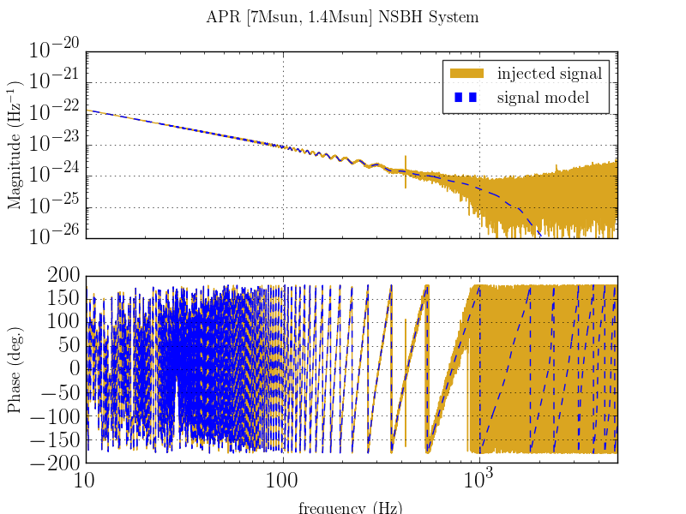
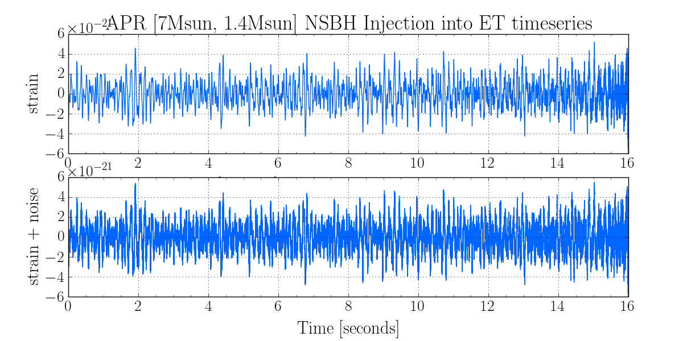
Signal Injection and Retrieval
Notes:
Finally, the moment of truth: We injected signals of NSBH systems of mass ratio 3,4, and 5 with EOS models APR, 2H, and without matter signatures into the ET datastream. As we can see by comparing the top with the bottom plot, in the injected timeseries, the signal is quite loud and noticeable compared to the noise level! (it experiences some thickening as a result of the noise). And, on the right we graph the magnitude and phase of the FFTs of the timeseries, and see that this is simply a noisier version of the theoretical signal we looked at earlier!

Slide 14
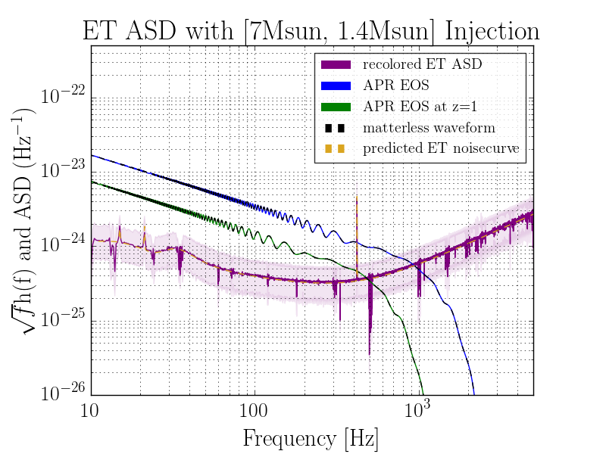
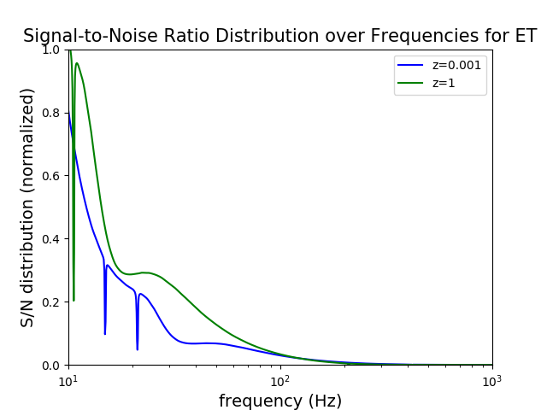
Detecting deformability signatures with ET for APR
Notes:
Finally, we plot our FFTs in magnitude and phase along with the noisecurves of ET for the APR and 2H EOS models. The bottom shows the recolored ASD for ET, and the top shows the signal+noise. Plotted in red (barely visible) is the waveform without matter signatures.
We choose one of our systems with a mass ratio of five to demonstrate our analysis. The SNR distributions are not a strong function of mass or spin…
The good news: NSBH systems will be visible quite above the noise floor of ET, especially for nearby sources!
The bad news: we’ll be hard-pressed to find signatures of matter by eye in magnitude, if we assume the same amount of white noise in aLIGO as in ET. But this makes sense, considering that the frequency of deformability in magnitude is generally ABOVE 1.5 kHz, and we don’t expect to have great sensitivity at those high frequencies.

Slide 15
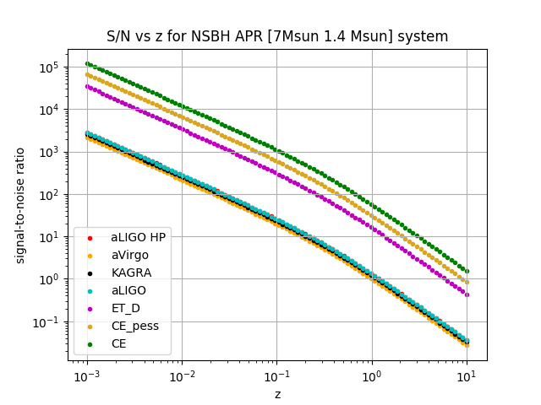
Signal-to-Noise Ratio Scaling with Redshift
Notes:
However, the analysis we have done thus far is done assuming that the NSBH system is 10 Mpc away from the Earth. Realistically, these types of systems live much farther away from us. How does the observability of the tidal parameter scale with the redshift of the source?
We can calculate the signal SNR from the waveform using this integral formula. Here, we get the horizon distance to the signal using the Planck13.luminosity_distance(z) function, and then scale the amplitude by the horizon distance to the source. However, in a true analysis we would use PE to get the horizon distance to the source from the amplitude of the gravitational wave signal.
aLIGO: z=1 corresponds to rho=1; z=0.3 corresponds to rho=10. ET: z=1 corresponds to rho=11; z=0.3 corresponds to rho~100.
This is why we need next generation detectors!

Slide 16
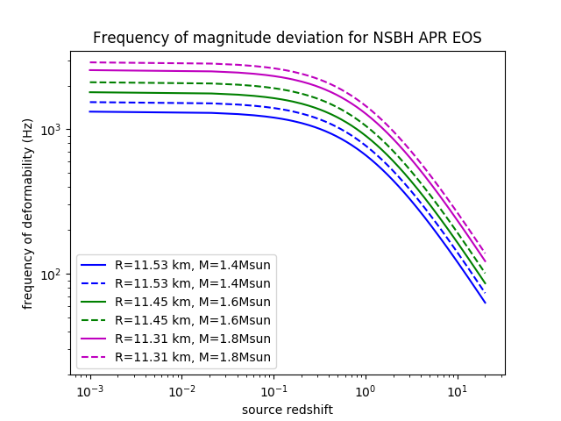
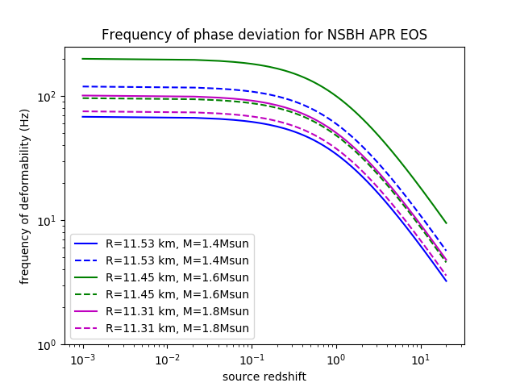
Deformation signatures as a function of redshift for APR EOS
Notes:
The neat thing is, redshift is on our side! What we see is that for sources around redshifts of 0.5, the deformability frequency will be redshifted into the detector band, so those signatures in magnitude that were previously masked by the high frequency noise levels in ET could be detectable above the noise floor!
Of course, this requires that we can accurately identify this deformation signature…and thereby we consult 1) statistical amplitude uncertainty and 2) calibration uncertainties in magnitude and phase.

Slide 17
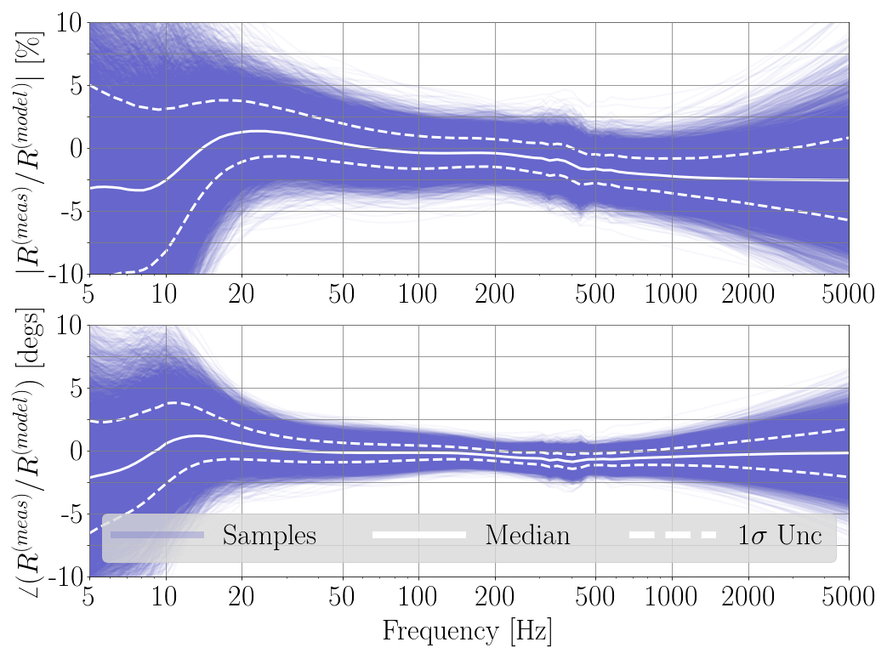
Calibration Uncertainty Budget for L1
Notes:
The calibration uncertainty budget for L1 is shown here (magnitude is shown as a percentage, and phase shown in degrees). What we see is that at both low and high frequencies there is much greater calibration uncertainty..

Slide 18
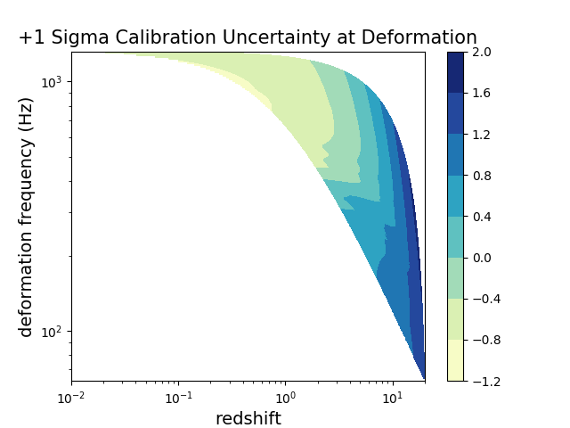
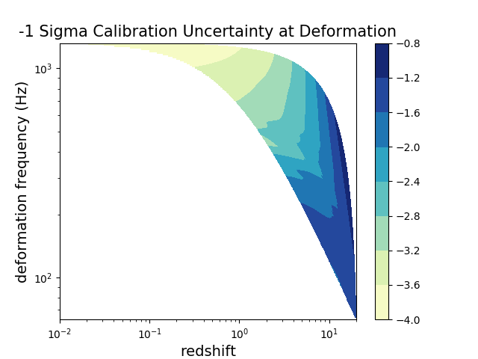
Statistical Calibration Uncertainty at Deformation Signatures
Notes:
Using our previous plots as a guide for determining the redshift of the source, we can then determine what the calibration uncertainty will be at the deformation frequency, as a function of source redshift. For searching out BNS and NSBH mergers, we are only interested in redshifts spanning 10^(-2) to about redshifts of 10. The main takeaway from these plots are that low redshift sources have lower calibration uncertainty in phase, but high calibration uncertainty in magnitude due to the frequency at which deformation occurs, for the APR EOS. For the 2H EOS, both high and low redshift sources will experience higher calibration uncertainty in magnitude at fTD.

Slide 19
Systematic biases
Distance / inclination angle degeneracy will affect distance estimates to source
Clearly, EOS matters, but we should know this by the 3G era!
Waveform uncertainty: might be greater than calibration uncertainty
We assume calibration uncertainty will be lower for ET than aLIGO
Notes:
Used Lackey Tidal SEOBNRv2 Reduced Order Model calibrated to numerical relativity

Slide 20
Future Work: Cosmography with 3G detectors
Repeat signal injection for different cases:
BNS mergers
More realistic EOS models
CE recolored datastream
Calculate luminosity distance to source using parameter estimation methods
Address systematic biases*
Mock calculation of H₀
Fisher analysis to determine uncertainties on H₀
Translate these to science requirements for 3G detectors
Notes:
Needless to say, this project is just the beginning (for me) and the continuation of a much larger undertaking. Performing cosmography successfully relies on the intersection between various disciplines in GW astrophysics; as we continue to constrain EOS, build future detector networks, improve calibration uncertainty, reduce noise levels, and construct more accurate waveforms, we’ll improve our ability to measure cosmological parameters from gravitational wave observations alone.

Slide 21
Thank You
To Alex, for being such a fantastic mentor…
To Alan, Craig, TJ and all the members and SURFs of LIGO Lab at Caltech for all your help…
To Jocelyn and the Fullerton GWPAC group for collaborating with us…
And to NSF and LIGO Scientific Collaboration for making the LIGO Caltech SURF program possible!

Slide 22
Observability of Tidal Signatures with APR EOS
Calibration uncertainty:
Magnitude: < 5% uncertainty at deformation frequency for sources with z < 2
Phase: < 2 deg. uncertainty at deformation frequency for sources with z < 2
Injection:
NSBH waveforms clearly visible above ET noisecurve for a nearby source
NSBH waveforms with matter barely distinguishable from those without matter in magnitude (noise floor at f_{TD})
SNR as a function of z:
ET can see NSBH sources out to z ~ 2 with SNR ~ 10
Notes:
So, to summarize the results from our analysis:

Slide 23
Observability of Tidal Signatures with 2H EOS
Calibration uncertainty:
Magnitude: < 3.5 % uncertainty at deformation frequency for sources with z < 2
Phase: < 2 deg. uncertainty at deformation frequency for sources with z < 2
Injection:
NSBH waveforms clearly visible above ET noisecurve for a nearby source
NSBH waveforms with matter barely distinguishable from those without matter in magnitude (noise floor)
SNR as a function of z:
ET can see NSBH sources out to z ~ 2 with SNR ~ 10
Notes:
The 2H EOS model is not much different, except for the calibration uncertainty levels at the frequencies we care about.

Slide 24
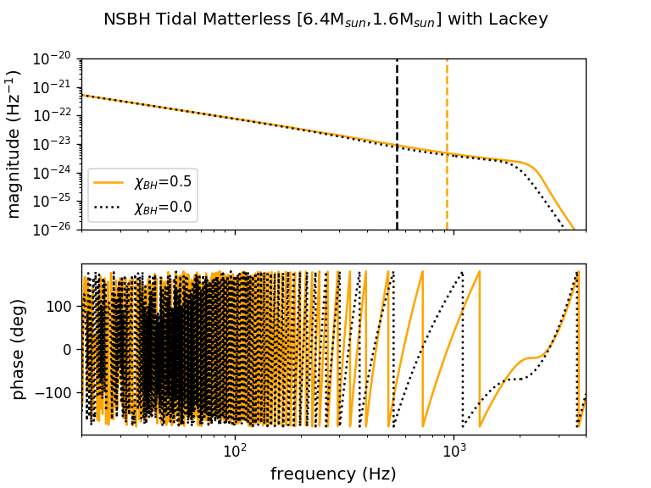
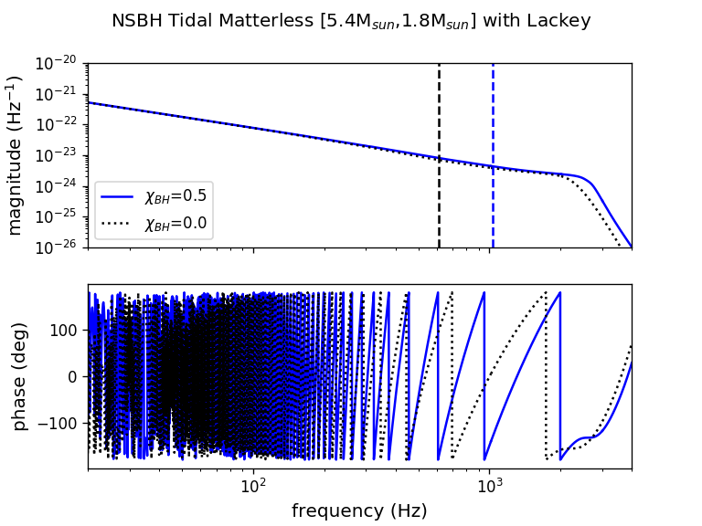
Waveform Visualization: No Matter Effects
Notes:
From now onwards, I’ll try to tell a mostly pictographic story of how we approached this problem of breaking the mass-redshift degeneracy. We chose three main systems of mass ratio 3, 4 and 5 for our simulation, and looked at the tidal effects present in the waveforms for the EOS models 2H and APR, keeping all other parameters except for the EOS fixed in the waveform simulations. First, however, we plot the frequency domain waveforms in magnitude and phase for system with a black hole spin of 0.5 and without black hole spin. We did not specify a cutoff frequency for these waveforms models, and so the break from the power law indicates the true value of ISCO, while the black and red lines show our predicted ISCO from an approximation.

Slide 25
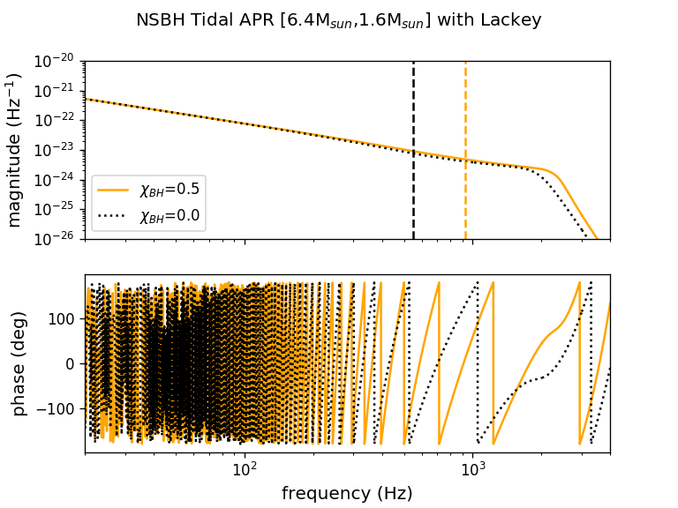
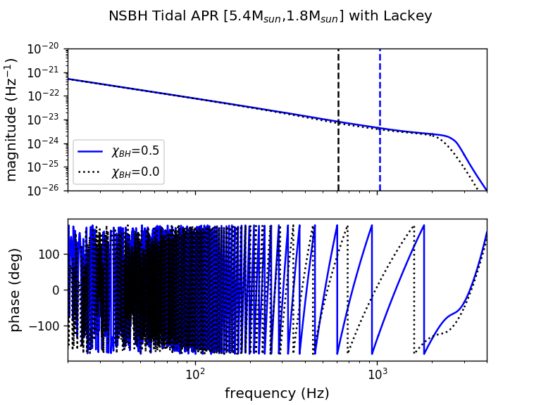
Waveform Visualization: APR Equation-of-State
Notes:
For the the APR EOS the difference between waveforms with and without matter effects is more apparent in the phase behavior than in the magnitude. The magnitude shows a slight, nearly unnoticeable shift in magnitude, but one can clearly see tidal signatures in phase!

Slide 26
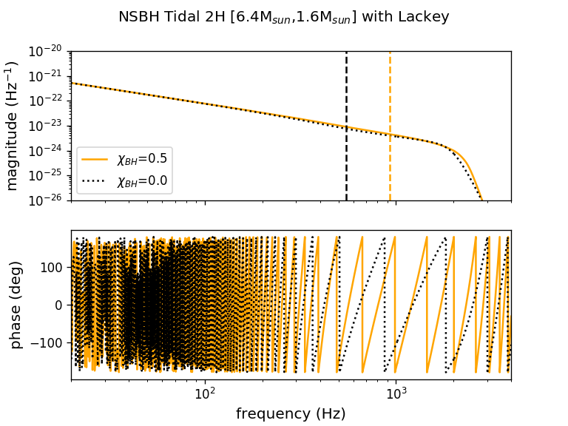
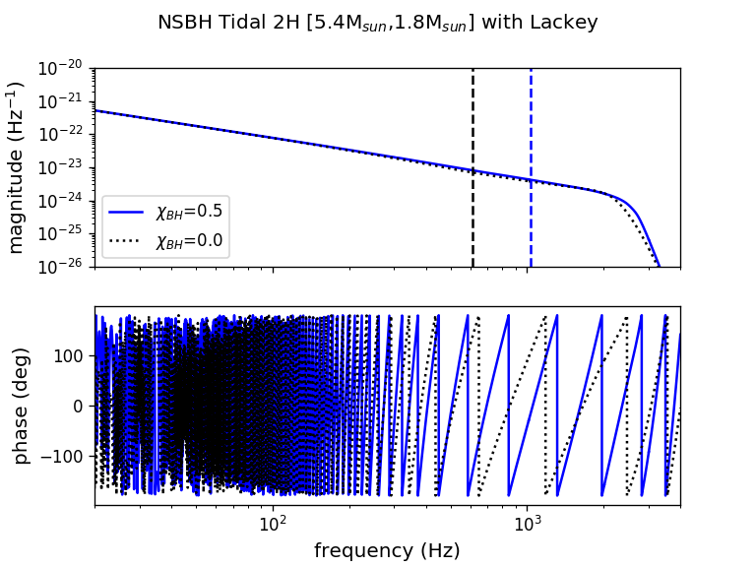
Waveform Visualization: Extreme 2H Equation-of-State
Notes:
For the the 2H EOS the difference between waveforms with and without matter effects is clearly visible in both the magnitude and in the phase. The frequency at which there is a break in the power law behavior in magnitude occurs earlier for the 2H EOS, and in the phase, there is a lot more going on!

Slide 27
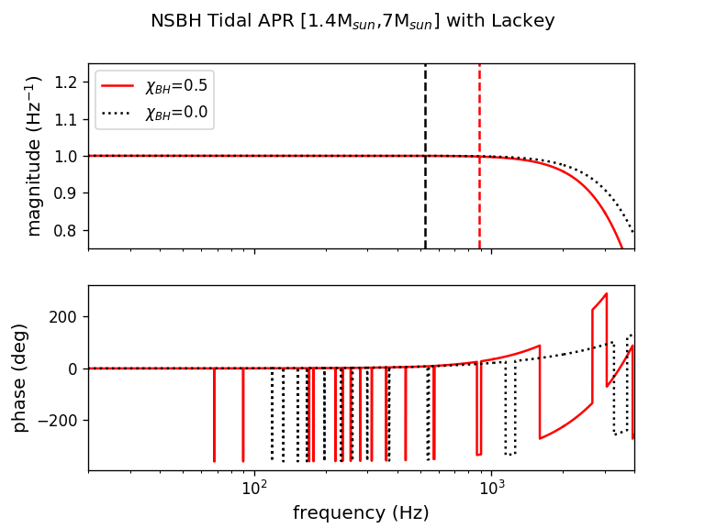
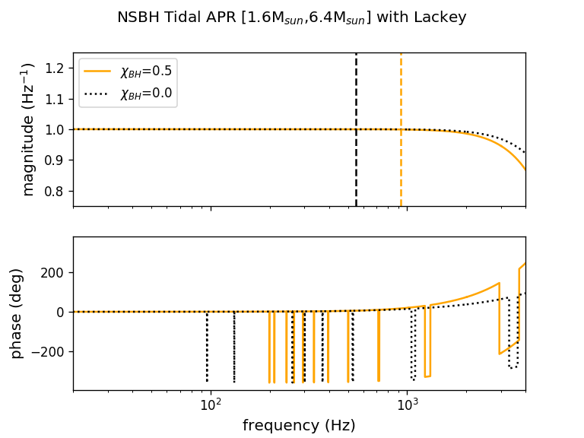
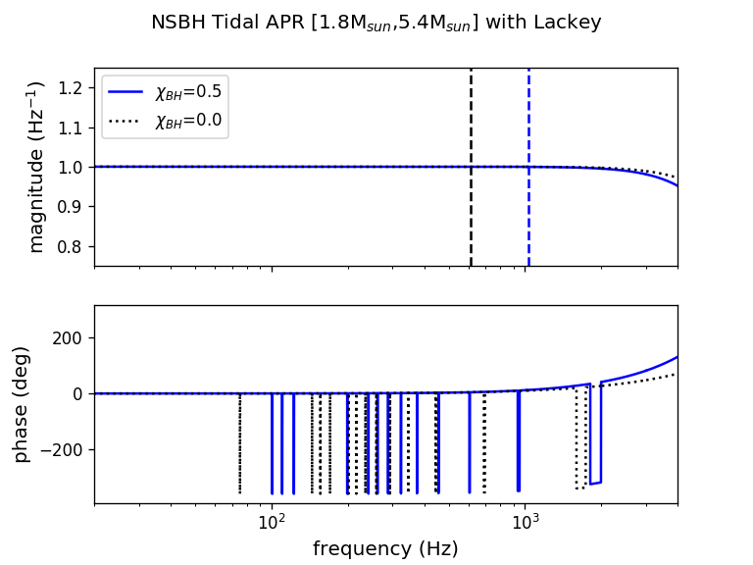
Tidal Deformability Signatures: Ratios Between Waveforms for APR
Notes:
And we can also see the distinct difference between the APR and 2H EOS models for the NS, in terms of deformability signatures! For the 2H model, the first deformations occur earlier in magnitude and phase in band than for the APR model (this will be relevant later!).

Slide 28
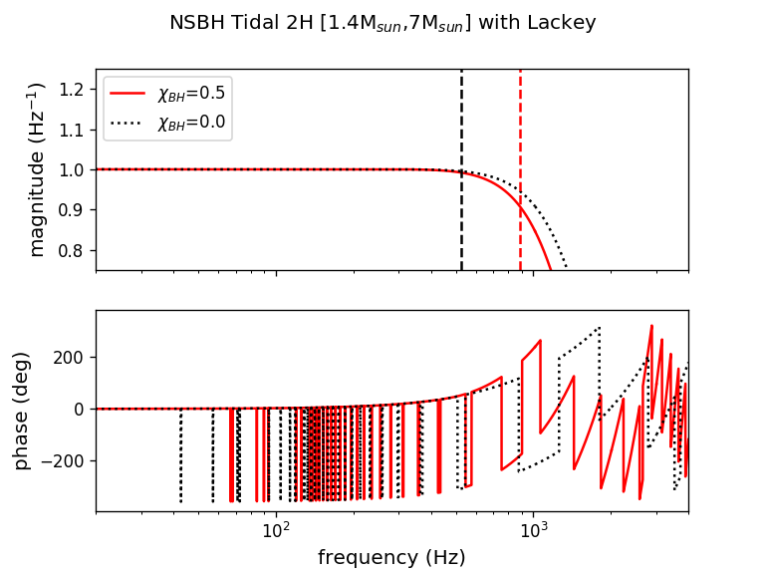
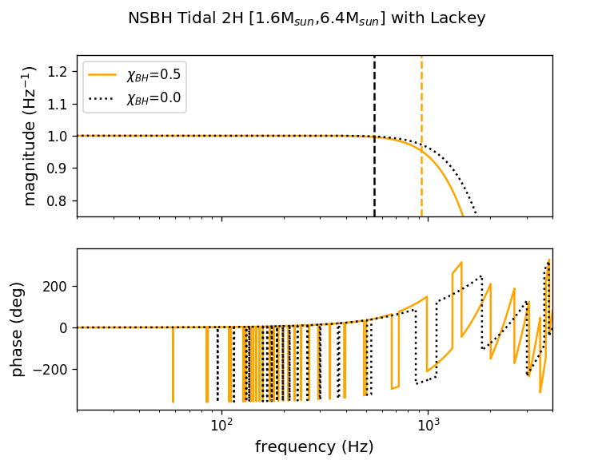
Tidal Deformability Signatures: Ratios Between Waveforms for 2H
Notes:
And we can also see the distinct difference between the APR and 2H EOS models for the NS, in terms of deformability signatures! For the 2H model, the first deformations occur earlier in magnitude and phase in band than for the APR model (this will be relevant later!).

Slide 29
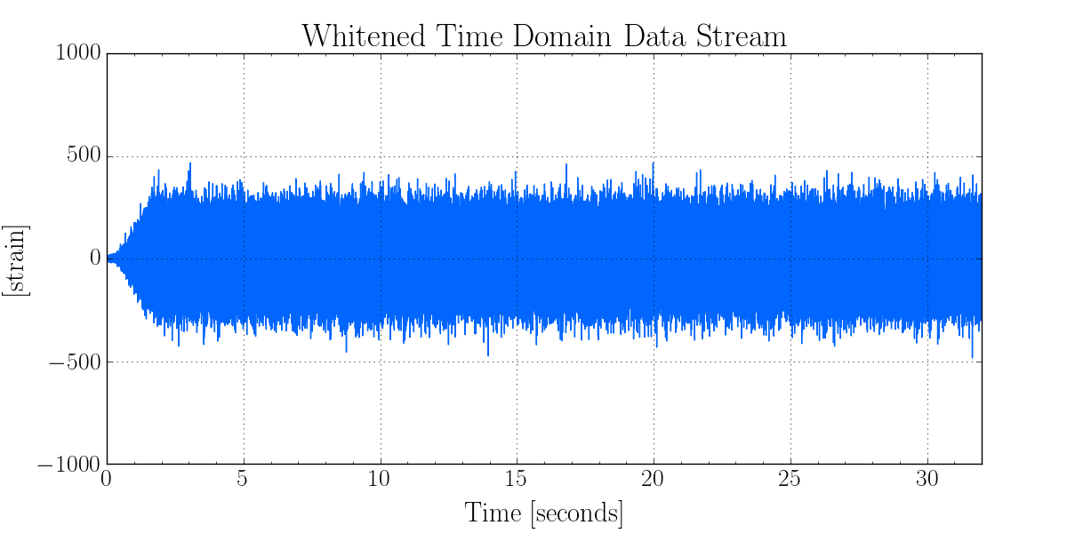
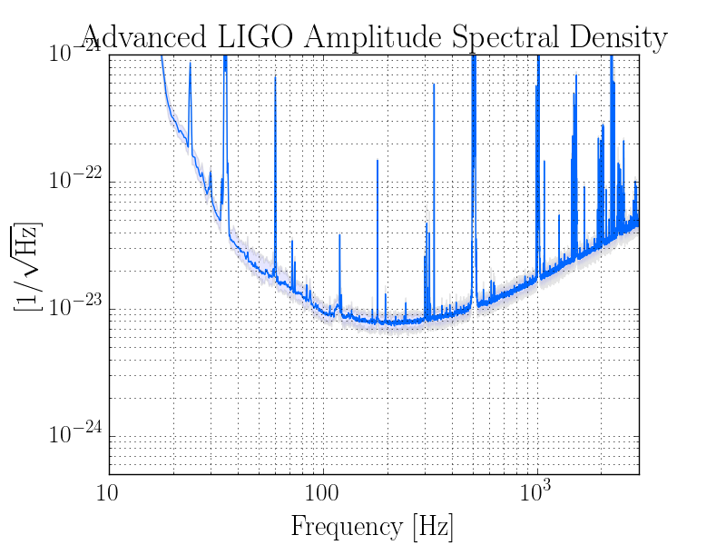
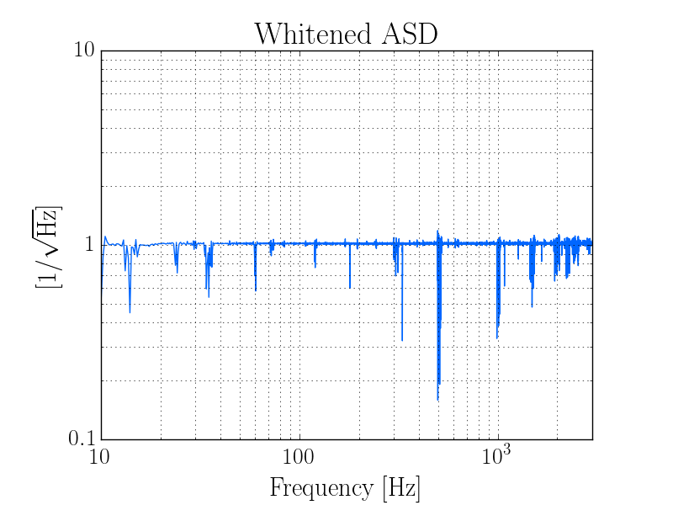
Whitening aLIGO datastream
Notes:
So, theoretically, we can see the signatures of matter in NSBH waveforms for systems of different mass ratios. But what about in practice? In order to answer this question, we examined ET as a potential detector in which we might be able to see the signatures of matter in NSBH waveforms. But instead of simply using the theoretical noisecurve of ET, we decided to perform a more realistic analysis by whitening the Advanced LIGO datastream and recoloring it with the predicted noisecurve of ET. We chose a 30 minute long chunk of raw h(t) data from the GDS-CALIB-STRAIN channel, and whitened it with the ASD of Advanced LIGO to remove any detector-correlated noise. Then, we check ourselves by plotting the whitened ASD of this chunk of data, and confirm that the noise is uncorrelated (ASD centered around 1).

Slide 30
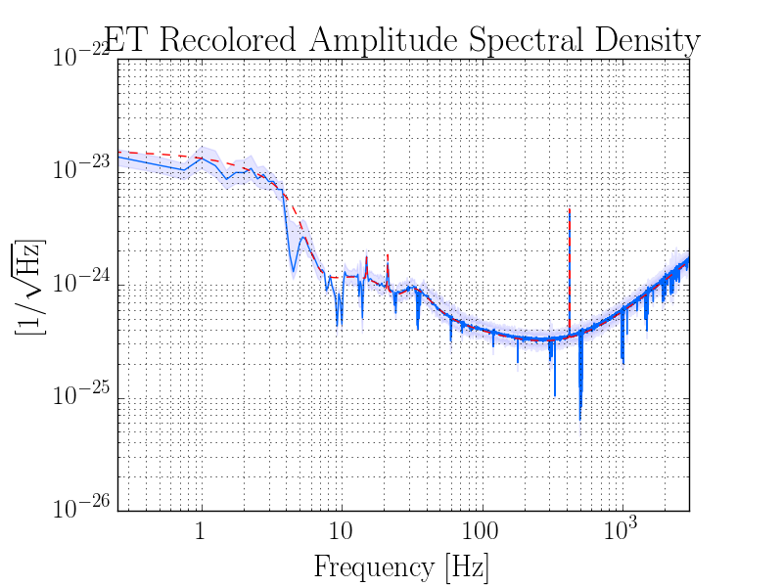
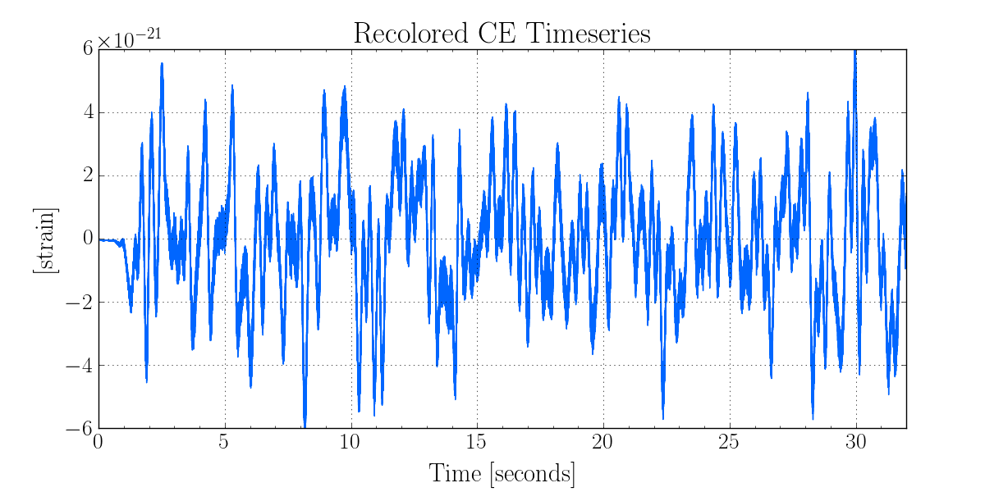
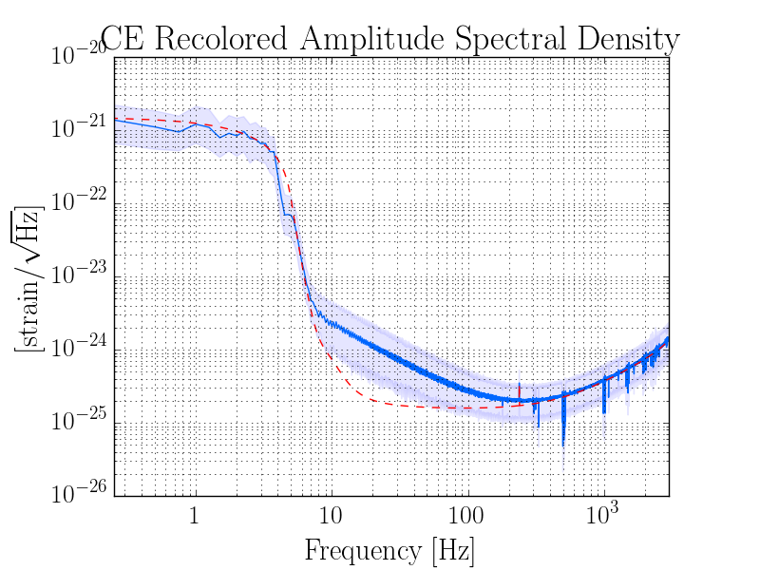
Recoloring datastream for ET-D and CE
Notes:
In order to recolor the datastream with ET’s noisecurve, we must essentially reverse the process we did before, so instead of dividing out aLIGO’s noise correlation, we multiply in ET’s noisecurve. We see that the noise level is now on the scale of 10^-21, much less than that of aLIGO. On the right, we plot the recolored ASD (an ASD you might see in the era of ET) and overplot the theoretical noisecurve of ET to confirm that indeed we correctly simulated a recolored ASD with ET for our original timeseries.
Repeating this exercise with CE, we see that the amplitude of the raw data is greater. Looking at the ASD, we clearly see some spectral leakage in the “bucket” (most likely caused by windowing issues). For time’s sake, we decide to use the ET simulated datastream for our purposes.

Slide 31
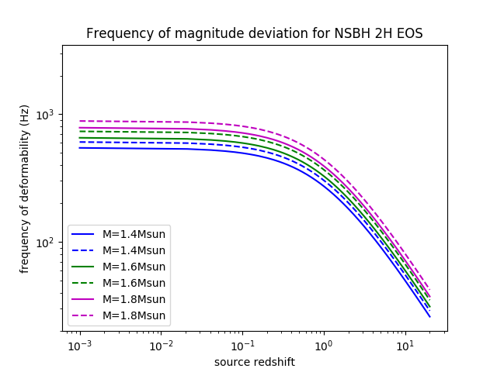
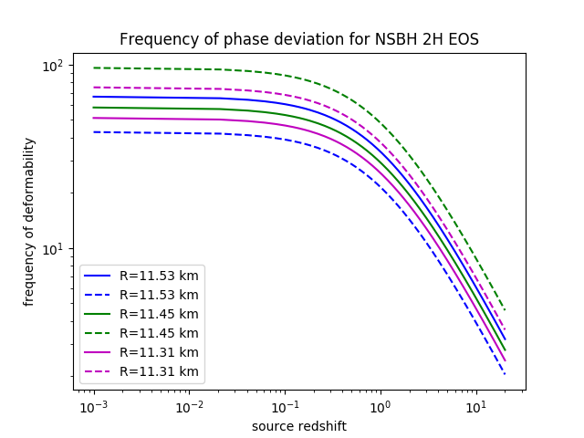
Deformation signatures as a function of redshift
Notes:
Magnitude: the signature frequency decreases as a function of the source redshift, as given by these curves. Thereby, knowing the EOS of the system, we can determine the redshift of the source entirely INDEPENDENTLY from the distance to the source!!
We can get the *redshifted* mass directly from signal parameter estimation, and we can also get the frequency at which we observe deformability (NOTE: this is ALSO mass-dependent). Then, we can use these two to construct a system of equations to calculate the redshift to the source.
The neat thing is, redshift is on our side! What we see is that for sources around redshifts of 0.5, the deformability frequency will be redshifted into the detector band, so those signatures in magnitude that were previously masked by the high frequency noise levels in ET could be detectable above the noise floor!
Of course, this requires that we can accurately identify this deformation signature…and thereby we consult 1) statistical amplitude uncertainty and 2) calibration uncertainties in magnitude and phase.

Slide 32
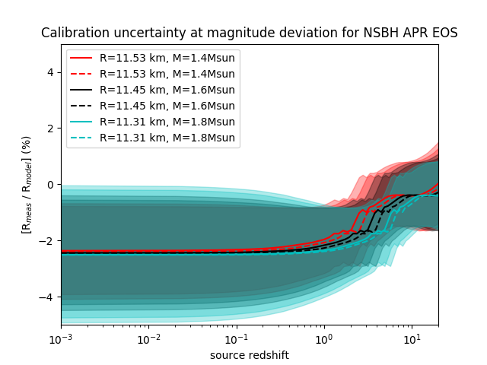
Calibration Uncertainty at Deformation Signatures
Notes:
Using our previous plots as a guide for determining the redshift of the source, we can then determine what the calibration uncertainty will be at the deformation frequency, as a function of source redshift. For searching out BNS and NSBH mergers, we are only interested in redshifts spanning 10^(-2) to about redshifts of 10. The main takeaway from these plots are that low redshift sources have lower calibration uncertainty in phase, but high calibration uncertainty in magnitude due to the frequency at which deformation occurs, for the APR EOS. For the 2H EOS, both high and low redshift sources will experience higher calibration uncertainty in magnitude at fTD.

