Slide 1
Planning for the Next Generation
Dawn 3

Slide 2
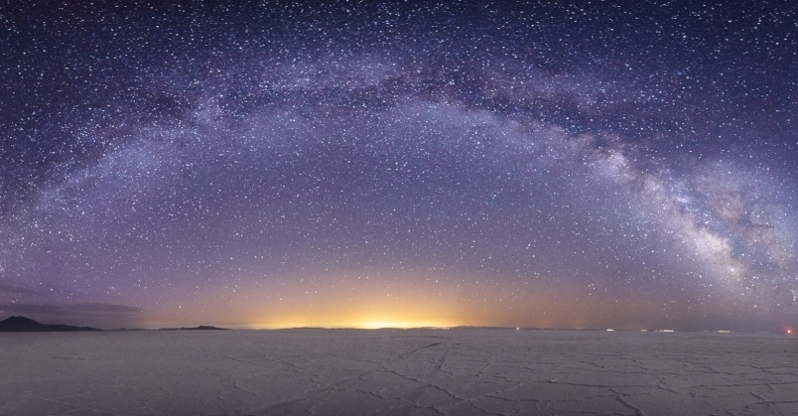
Expanding our Vision
It is time to rethink and refine our ideas about the next generation of ground-based gravitational wave detectors
Coordinated through GWIC, we are preparing to update our understanding of 3G
the science we can do
the technology we have available
and the power of a network based approach

Slide 3
Cosmic Explorer
The US contribution to the design of a future ground-based 3G network is taking shape
Cosmic Explorer is a new look at what can be done with a ground-based interferometer
unlike the Einstein Telescope, the focus of this study is on an above ground facility which houses a single interferometer

Slide 4
Astronomical Excitement about 3G
Recent LSC paper about CE has already been cited 14 times
tests of GR and alternate theories of gravity with black hole binaries
exploration of neutron star equation of state
astrophysical “backgrounds” from BBH and BNS
parameter estimation with 3G networks
…
but there are holes and we lack a coherent picture

Slide 5
Tricky Open Questions
How many 3G detectors do we need?
Should they all be the same?
Will 2G detectors still be useful?

Slide 6
Answer: “It Depends”
Good localization of the majority of detectable sources, for example, requires at least 3 detectors of comparable sensitivity
but do we need to localize the majority?
maybe EM counterparts are only available for low red-shift events, which will be the minority
maybe there are enough events that we can afford to cherry-pick the best ones

Slide 7
Is 40km necessary? Optimal?
This is part of the 3G science case work
We will search for the best science per dollar design
There is no attachment to 40km, though first indications are that it is not far from optimal

Slide 8
Is 40km possible?

Slide 9
Is 40km possible?

Slide 10
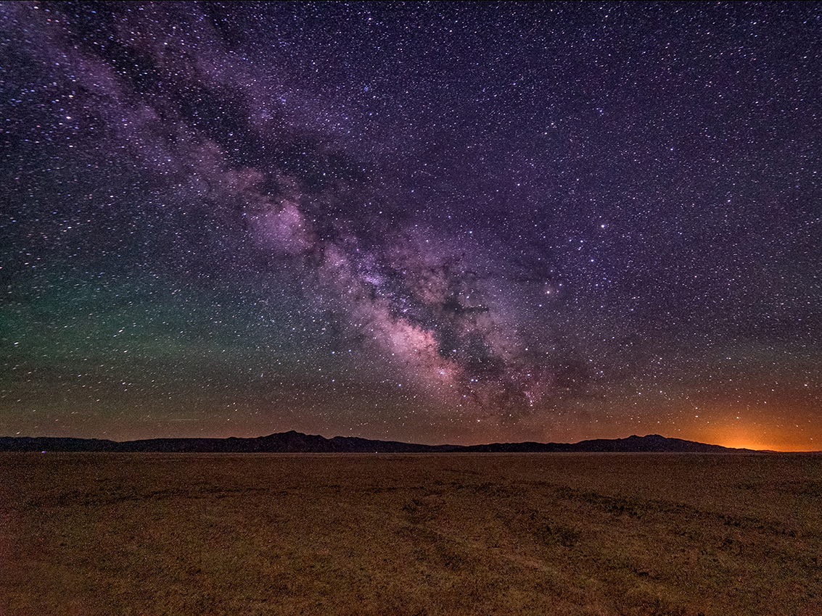
Is 40km possible?

Slide 11
Other Questions
L or triangle shape?
above ground or underground?
we will leverage the significant work that went into the ET conceptual design study to answer many such questions
How much will this cost?
we need professional studies, combined with LIGO lab experience, to make a reliable estimate of facility construction cost (similar to what has been done and is happening now for ET)

Slide 12
Now is the time to move forward
Excitement for 3G is high, so there are many interested parties thinking about 3G science
The lead-time on new facilities is long (>15y)
Proposal to NSF for CE conceptual development will be submitted this year
Work will be coordinated within the LSC, and with international partners in Europe and Australia through GWIC and GWAC

Slide 13
The Message
An international 3G network has huge science potential
The details of how to best realize the science potential are still not known
Many studies from broader community are available, or will be soon
we need to put them together, and fill some holes, to form a coherent picture
(dedicated effort required)
It is time for a real cost estimate for CE

