Slide 1


Shear and Bulk Mechanical Loss in Titania-Doped Tantala
Gregory Harry
American University
Amaldi Conference 2017
LIGO-G1701225

Slide 2
Limitation from Coating Noise
Coating thermal noise decreases Advanced LIGO design sensitivity between 40-300 Hz
Reduces astronomical reach
Coating/Inspiral | Binary Neutron Stars | GW150914 Black Holes
aLIGO Coating | 190 Mpc | 1740 Mpc
No Coating Noise | 230 Mpc | 2110 Mpc

Slide 3
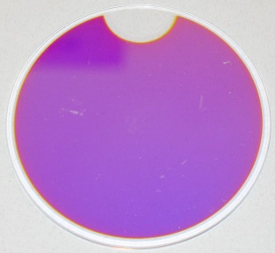
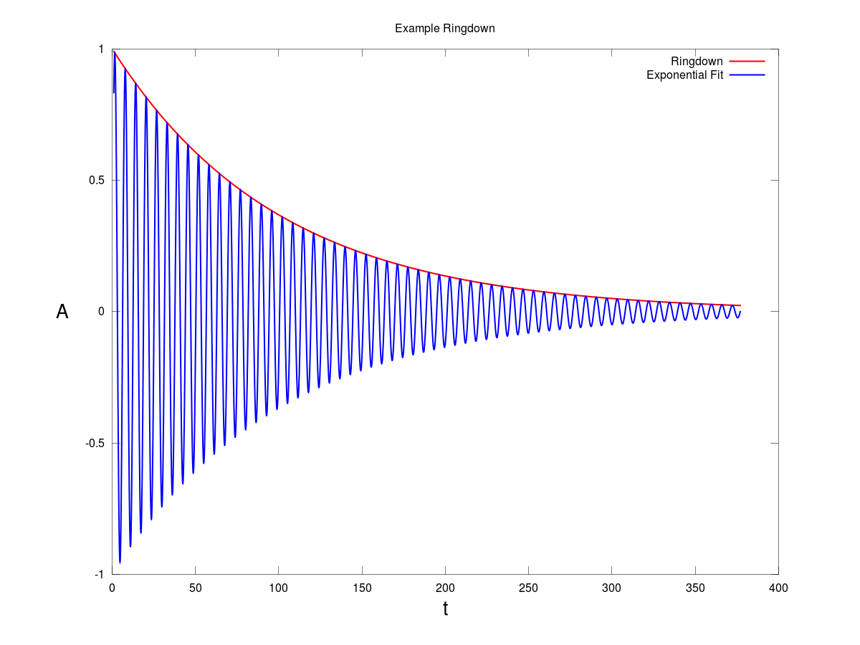
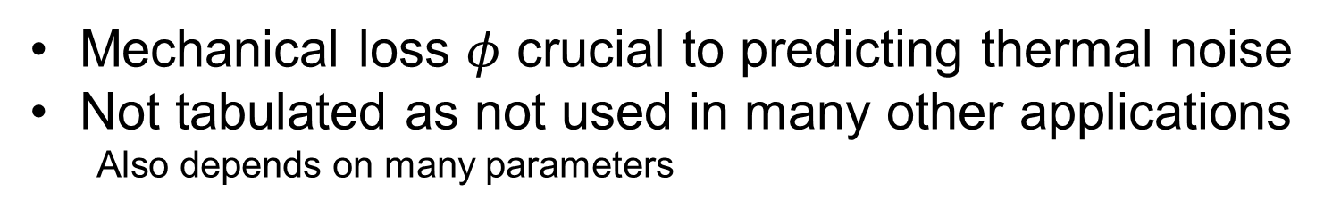
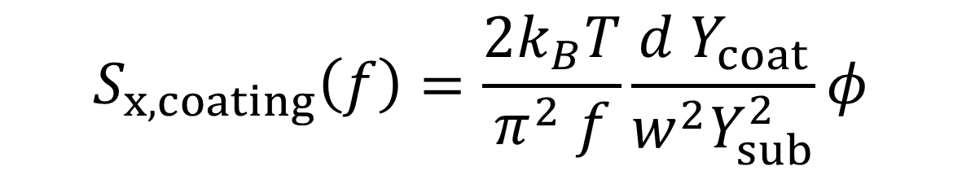
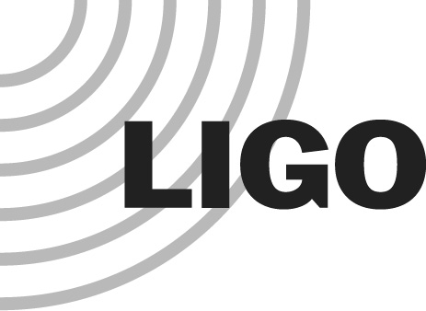
Coating Thermal Noise
$$S_{x,coating}\left(f\right)=\frac{2k_{B}T}{π^{2} f}\frac{d{ Y}_{coat}}{w^{2}Y_{sub}^{2}}φ$$
Mechanical loss $φ$ crucial to predicting thermal noise
Not tabulated as not used in many other applications
  Also depends on many parameters
Measured from quality factor Q of normal modes of coated disks
Mechanical loss of coating contributes to overall energy loss
Energy loss in silica substrate typically negligible
Generally no interaction between coating and substrate

Slide 4
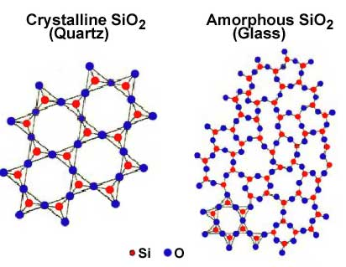
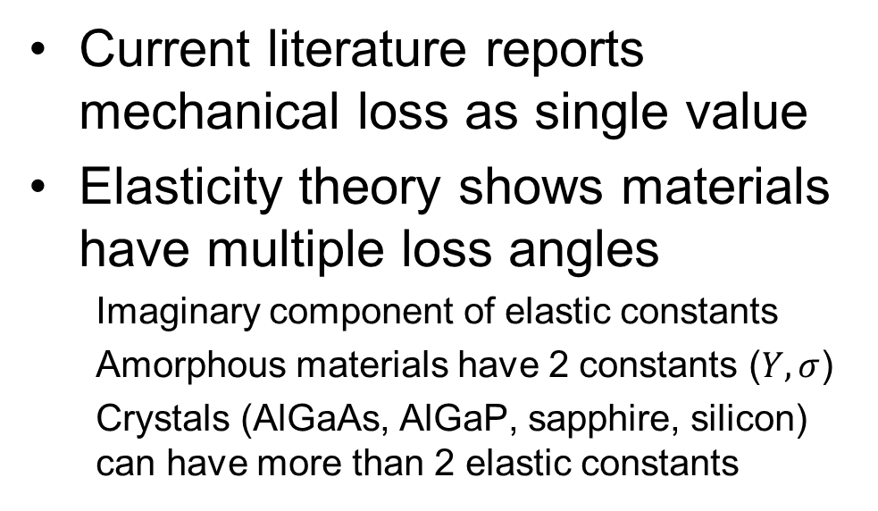
Multiple Loss Angles
Current literature reports mechanical loss as single value
Elasticity theory shows materials have multiple loss angles
  Imaginary component of elastic constants
  Amorphous materials have 2 constants ($Y,σ$)
  Crystals (AlGaAs, AlGaP, sapphire, silicon) can have more than 2 elastic constants
Hong et al Phys. Rev. D 87 (2013) 082001 showed how to calculate thermal noise from loss associated with shear and bulk strains

Slide 5
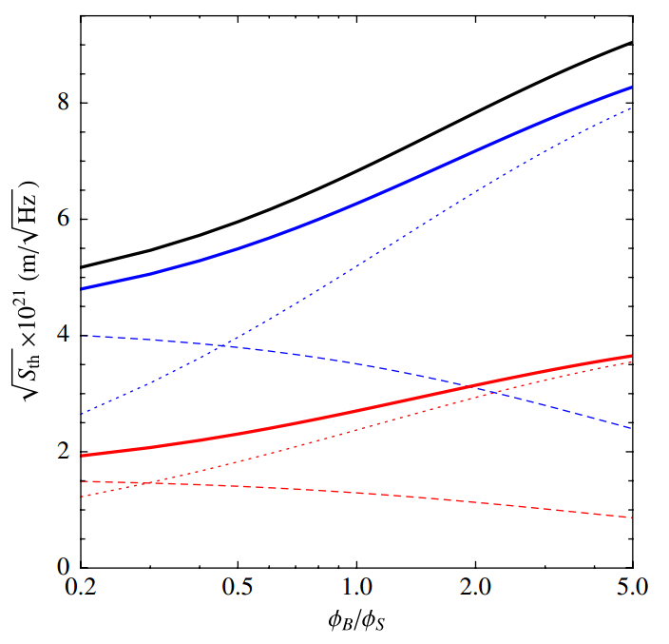
Hong Model
Bulk
±30%
Shear

Slide 6
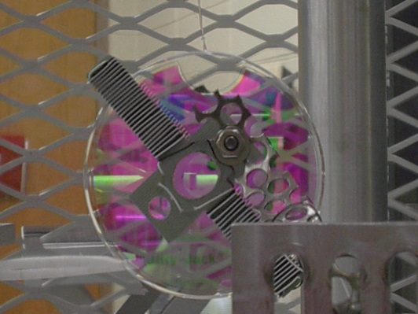
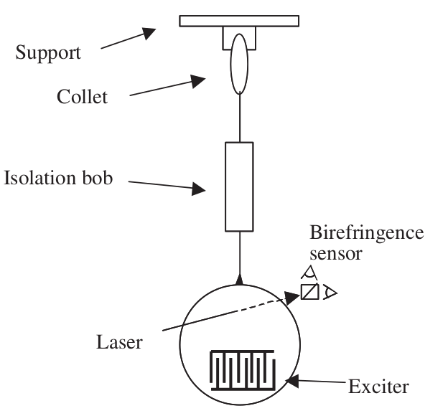
Q Measurements
2.5 mm thick silica disk
Unannealed 25% ti-ta coating from CSIRO
500 nanometer thick
Q measuring
  Silica suspension
  Electrostatic exciter
  Birefringence readout
Also measured Young’s modulus

Slide 7
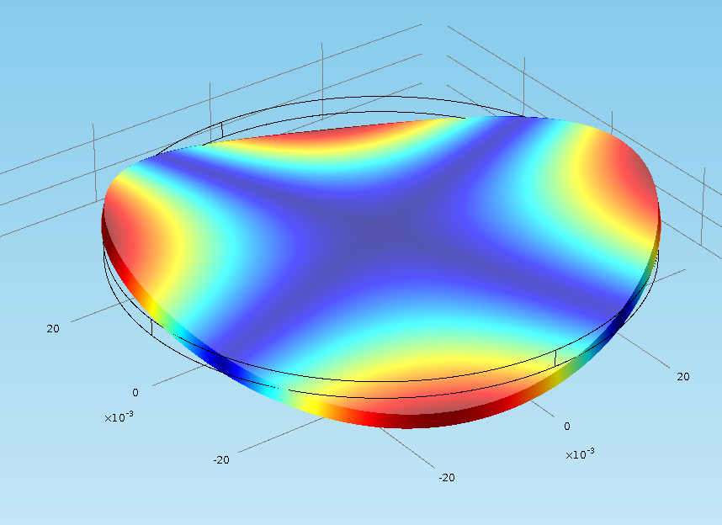
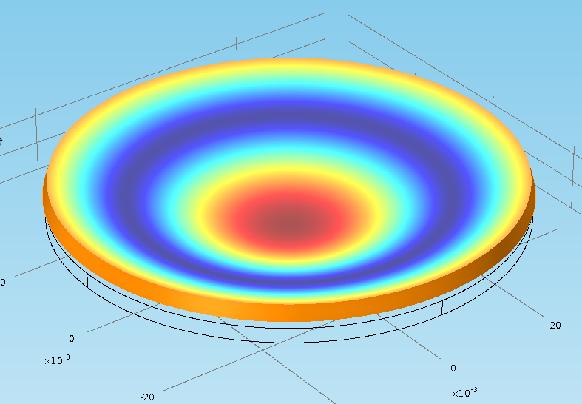
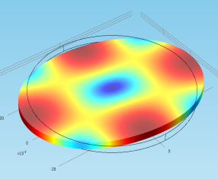
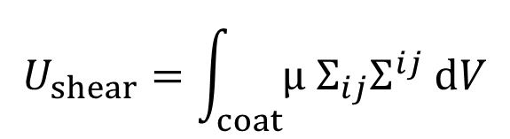
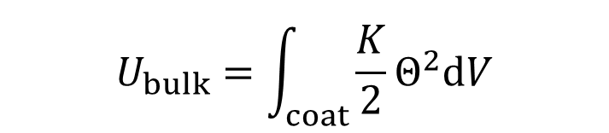
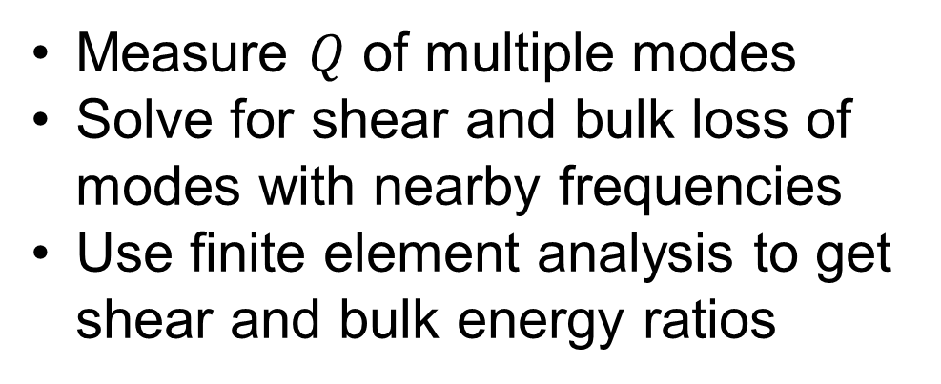
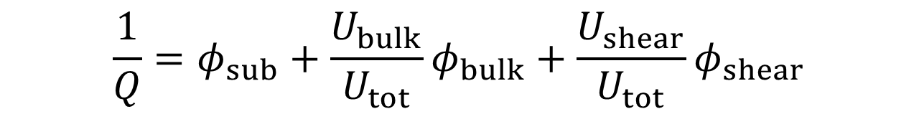

Modes and Energies
$$\frac{1}{Q}=φ_{sub}+\frac{U_{bulk}}{U_{tot}}φ_{bulk}+\frac{U_{shear}}{U_{tot}}φ_{shear}$$
Measure $Q$ of multiple modes
Solve for shear and bulk loss of modes with nearby frequencies
Use finite element analysis to get shear and bulk energy ratios
$$U_{bulk}=\int_{coat}{\frac{K}{2}Θ^{2}dV}$$
$$U_{shear}=\int_{coat}{μ Σ_{ij}Σ^{ij} dV}$$
$$U_{tot}=U_{shear}+U_{bulk}+U_{sub}$$

Slide 8

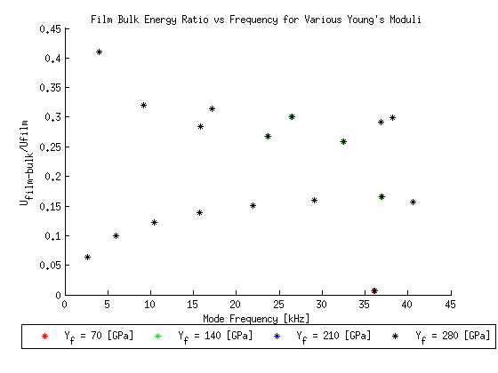

Energy Ratios

Slide 9
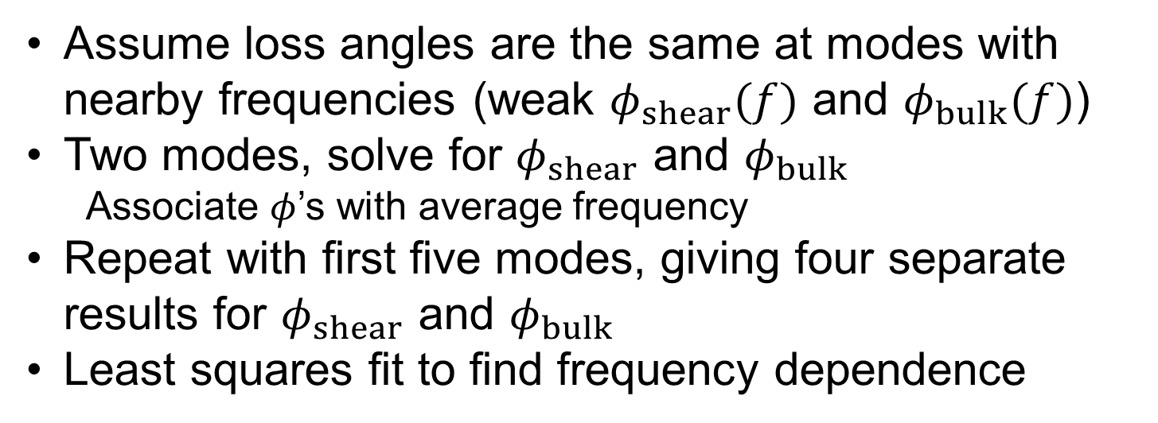
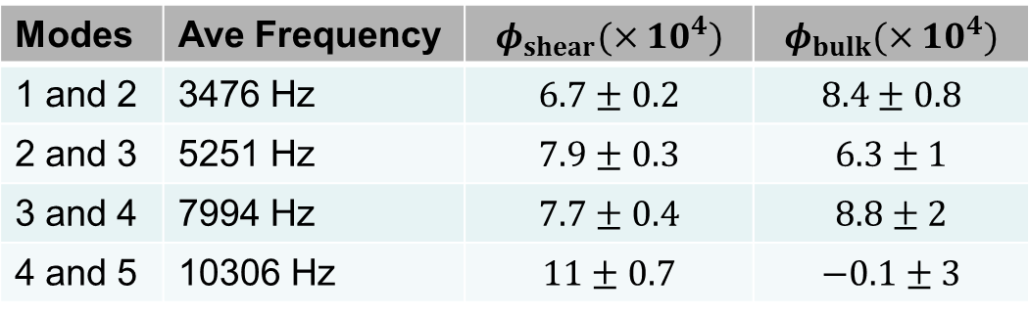
Fit Procedure
Assume loss angles are the same at modes with nearby frequencies (weak $φ_{shear}(f)$ and $φ_{bulk}(f)$)
Two modes, solve for $φ_{shear}$ and $φ_{bulk}$
  Associate $φ$’s with average frequency
Repeat with first five modes, giving four separate results for $φ_{shear}$ and $φ_{bulk}$
Least squares fit to find frequency dependence
Modes | Ave Frequency | $$φ_{shear}(×10^{4})$$ | $$φ_{bulk}(×10^{4})$$
1 and 2 | 3476 Hz | $$6.7±0.2$$ | $$8.4±0.8$$
2 and 3 | 5251 Hz | $$7.9±0.3$$ | $$6.3±1$$
3 and 4 | 7994 Hz | $$7.7±0.4$$ | $$8.8±2$$
4 and 5 | 10306 Hz | $$11±0.7$$ | $$−0.1±3$$

Slide 10

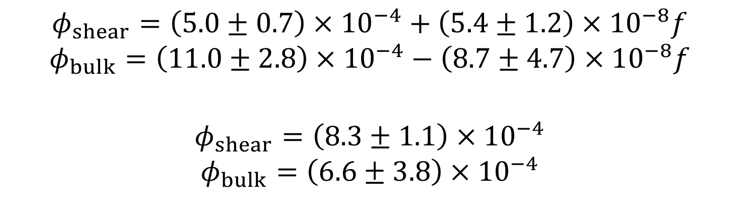
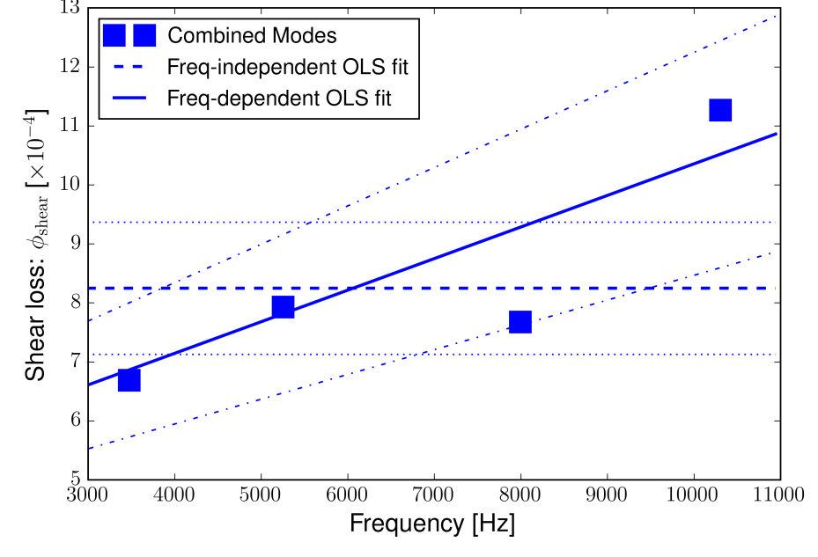


Slide 11
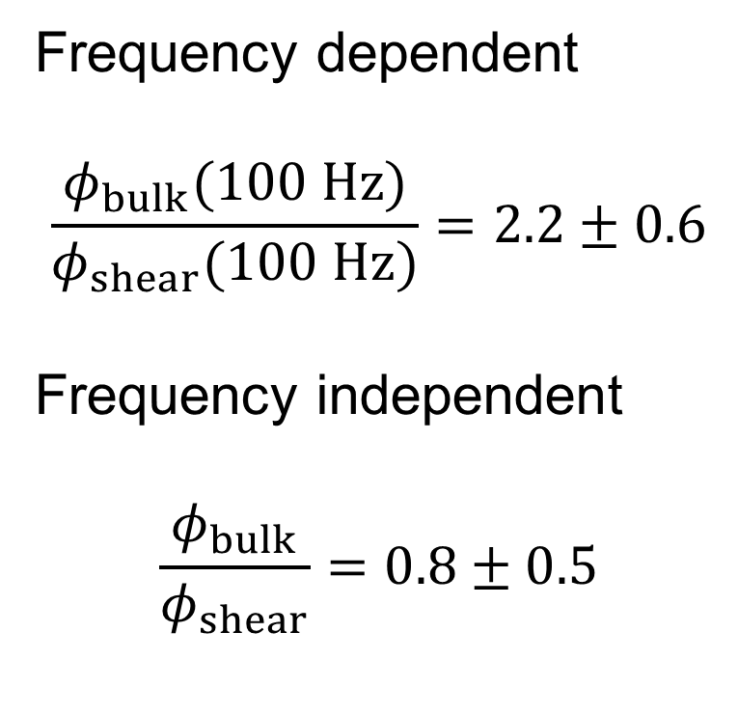
Impact on Thermal Noise
Frequency dependent
$$\frac{φ_{bulk}(100 Hz)}{φ_{shear}(100 Hz)}=2.2±0.6$$
Frequency independent
$$\frac{φ_{bulk}}{φ_{shear}}=0.8±0.5$$

Slide 12
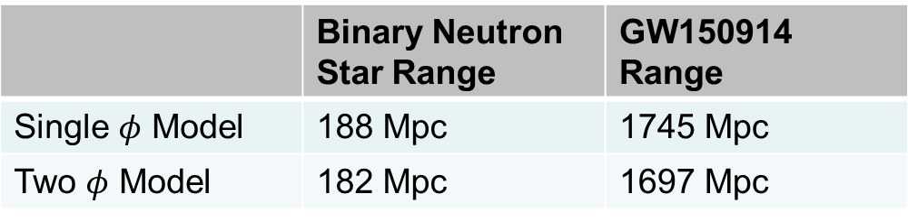
Naïve impact on aLIGO
 | Binary Neutron Star Range | GW150914 Range
 | 188 Mpc | 1745 Mpc
 | 182 Mpc | 1697 Mpc
Predict ~15% increase in coating thermal noise
  Similar to Gras et al. Phys. Rev. D 95 (2017) 022001
About 3% decrease in inspiral ranges
About 10% impact on event rates
Measured coating was not Advanced LIGO coating: CSIRO, not annealed vs LMA annealed

Slide 13
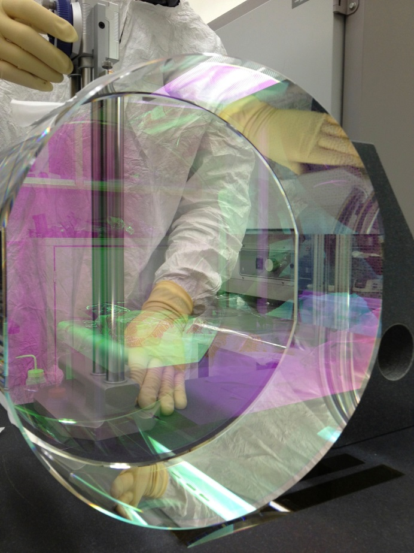
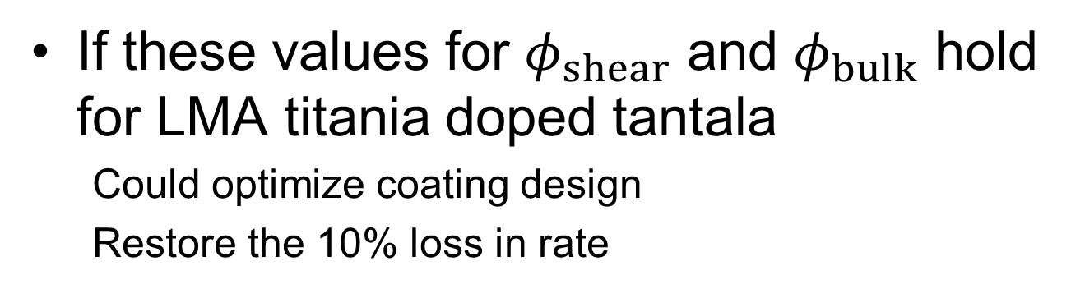
Possible LIGO A+ Improvement
If these values for $φ_{shear}$ and $φ_{bulk}$ hold for LMA titania doped tantala
  Could optimize coating design
  Restore the 10% loss in rate
Optimize to actual values
  Possible fallback LIGO A+ strategy
  No new technology
  Layer thickness changes
  Some impact on performance
  Maybe up to ~10% in noise, ~30% rate (?)

Slide 14
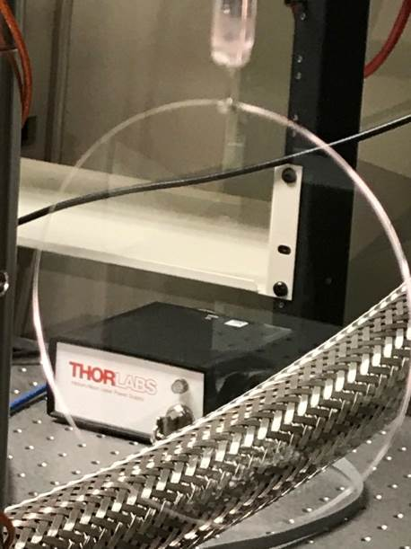
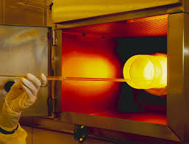
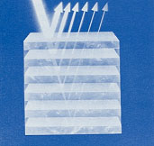
Follow Up Work
Anneal this sample and remeasure
Measure LMA annealed sample
  Thinner substrate
  Lower mode frequencies
  More energy in coating
Improve Q and energy ratio uncertainties
Measure thin film silica
Measure other amorphous materials
Develop optimization code
Further theory work for crystals
  Lovelace et al working on this
Direct thermal noise measurements
  AEI results with AlGaAs

Slide 15



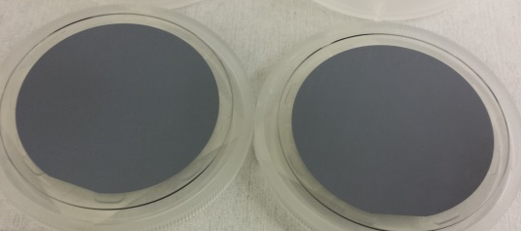
Summary
Experimental technique works
  Thin disks have shear and bulk energy
Suggestive of frequency dependence
Need lower uncertainties/more measurements
2nd Gen detector noise may be higher than expected
Possible improvement with LIGO A+
  Not full 2X improvement
Explore more materials
Important issue for crystals
  Sapphire, silicon, AlGaAs, AlGaP, etc.

