Slide 1

LIGO Detectors in O2 and Beyond
Pretty pictures here
Should this be LVC?
Keita KAWABE, LHO/Caltech for LSC

Slide 2
TOC
  Exciting things from O2, very, very briefly (go to Giovanni’s talk)
  Where we stand
    What worked and didn’t in O2
    Known and mystery noise
  What’s going to happen after O2
  Not necessarily in this order

Slide 3
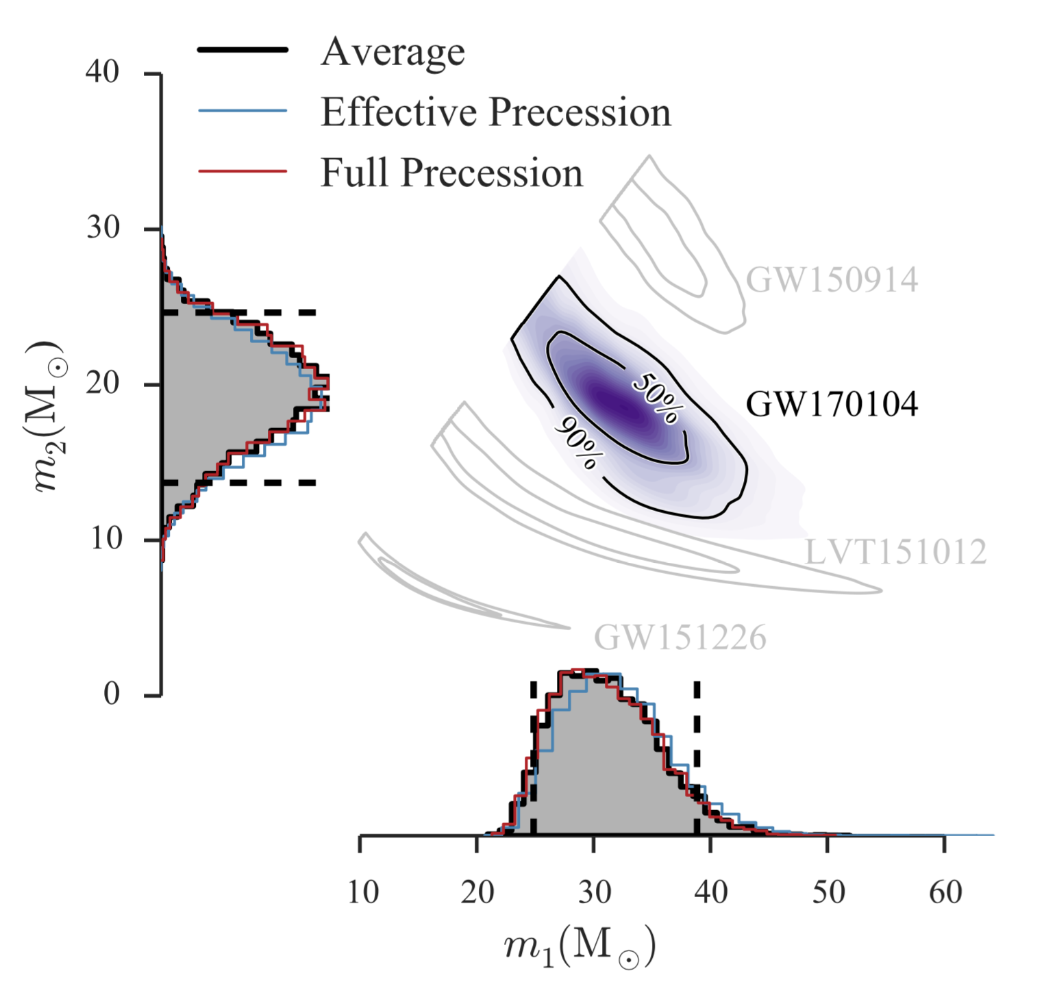
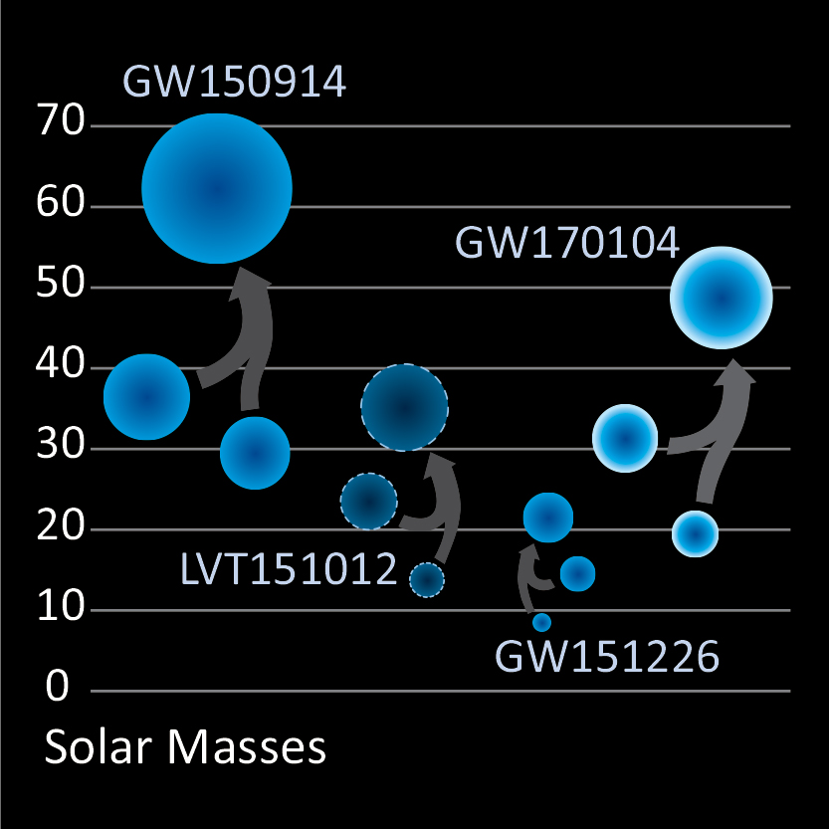
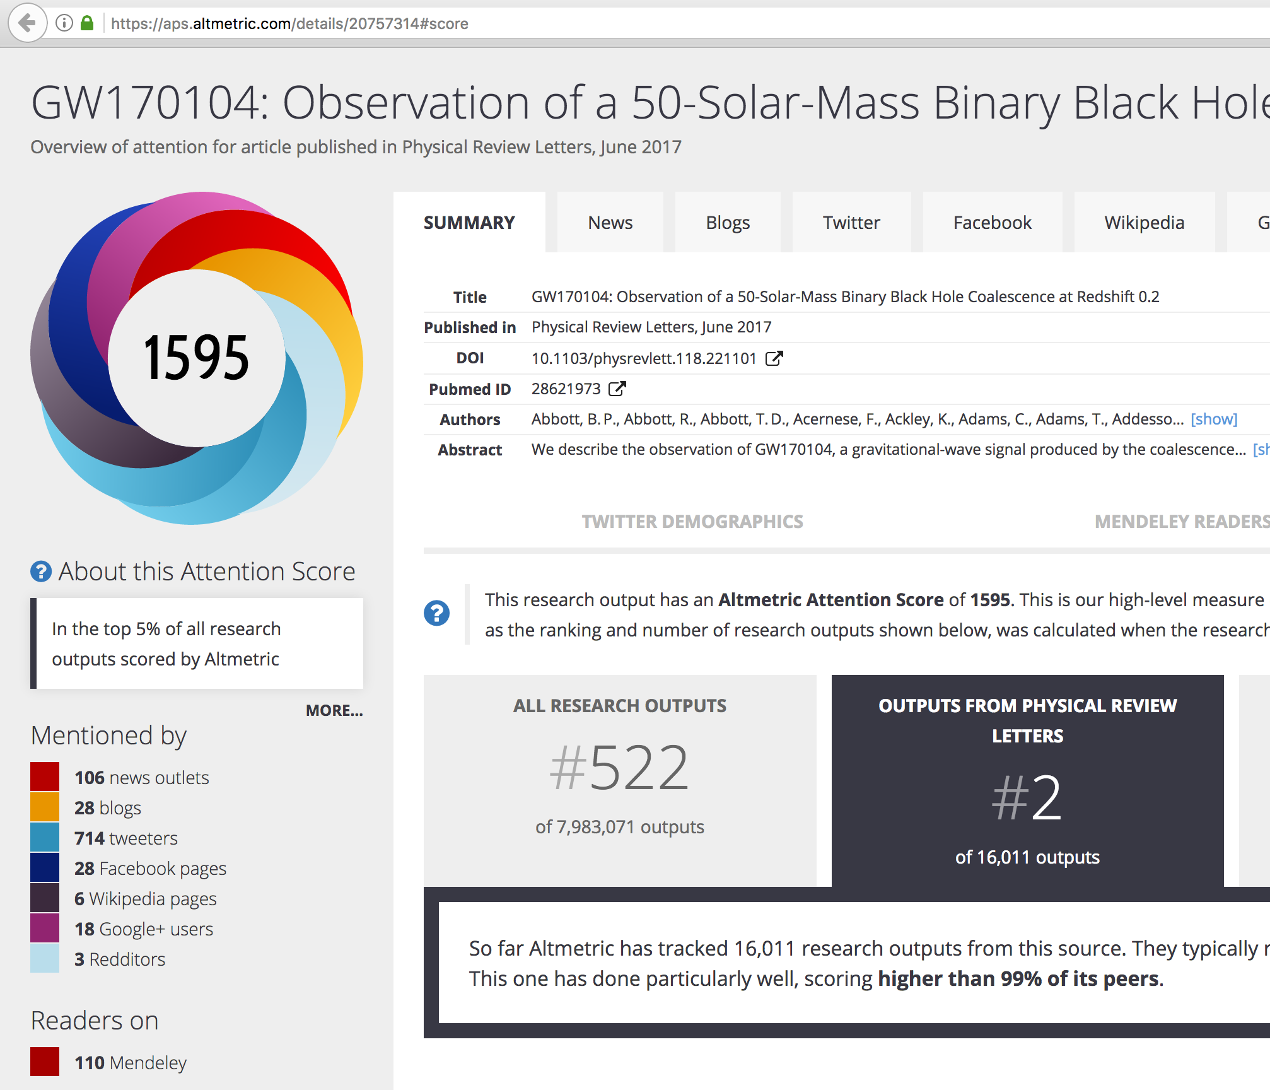
Exciting things from O2, very, very briefly
(Go back to Giovanni’s talk for details)
One confirmed detection (GW170104) in O2
  O1: Two confirmed and a “candidate” with smaller statistical significance.
Spend about 15 sec
Notes:
15 seconds

Slide 4
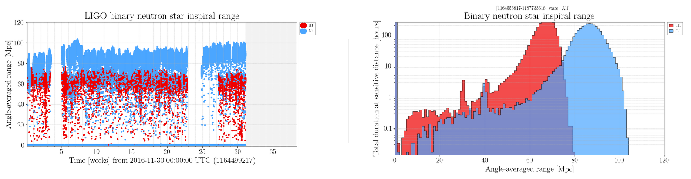
Exciting things from O2, very, very briefly
(Go back to Giovanni’s talk for details)
One confirmed detection (GW170104) in O2
~81 days H-L coincidence Nov/30/2016 – Jun/23/2017
~70 Mpc average reach for 1.4+1.4 Msun, 700 Mpc for 30+30 Msun merger
about 10 sec
Notes:
10 seconds

Slide 5
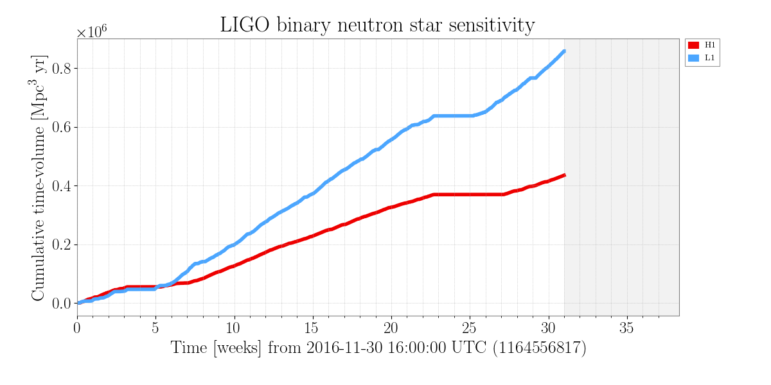
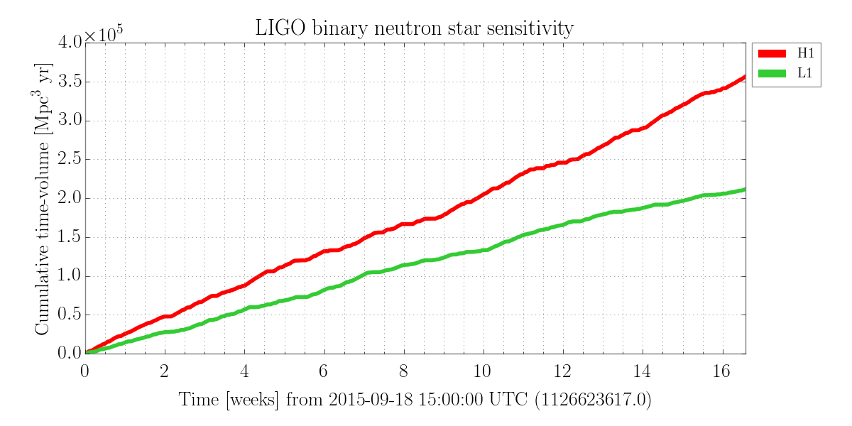
Exciting things from O2, very, very briefly
(Go back to Giovanni’s talk for details)
One confirmed detection (GW170104) in O2
~81 days H-L coincidence Nov/30/2016 – Jun/23/2017
~70 Mpc average reach for 1.4+1.4 Msun, 700 Mpc for 30+30 Msun merger
Each detector acquired larger cumulative V*T than O1
  ~(4.2, 9.6) M_{pc}³ yr of O2 VS ~(3.6, 2.1) of O1
about 5 sec
Notes:
10 seconds

Slide 6
Exciting things from O2, very, very briefly
(Go back to Giovanni’s talk for details)
One confirmed detection (GW170104) in O2
~81 days H-L coincidence Nov/30/2016 – Jun/23/2017
~70 Mpc average reach for 1.4+1.4 Msun, 700 Mpc for 30+30 Msun merger
Each detector acquired larger cumulative V*T than O1
Data analysis and data taking still ongoing
about 5 sec
Notes:
10 seconds

Slide 7
That’s really cool.
1 sec
Notes:
2 seconds

Slide 8
That’s really cool.
But we want more.
Who’s the CBC speaker? Any stochastic and burst talk?
More BBHs.
We haven’t detected NSBH nor NSNS.
  Would be particularly interesting for EM
CW (Goetz). Stochastic. Unknown source.
Better/tighter PE for events we detect.
Pretty graphics?
about 20 sec

Slide 9
That’s cool. Really.
But we want more.
Who’s the CBC speaker? Any stochastic and burst talk?
More BBHs.
We haven’t detected NSBH nor NSNS.
  Would be particularly interesting for EM
CW (Goetz). Stochastic. Unknown source.
Better PE for events we detect.
Smaller noise (reachable volume ∝ 1/noise^3)
Better reliability (N_{events} ∝ time*volume)
about 10 sec
Notes:
15 seconds

Slide 10
What we wanted in O2 (VS O1)
Smaller noise in “money band” by scattering mitigation for L1
Smaller noise in higher frequency by commissioning high power laser for H1 (L1 postponed)
Better duty factor (seismic isolation, better control scheme)

Slide 11
What we wanted in O2 (VS O1)
Smaller noise in “money band” by scattering mitigation for L1: Worked!
Smaller noise in higher frequency by commissioning high power laser for H1 (L1 postponed): Not really, it worked for high frequency but some problem in lower frequency.
Better duty factor (seismic isolation, better control scheme): Worked!

Slide 12
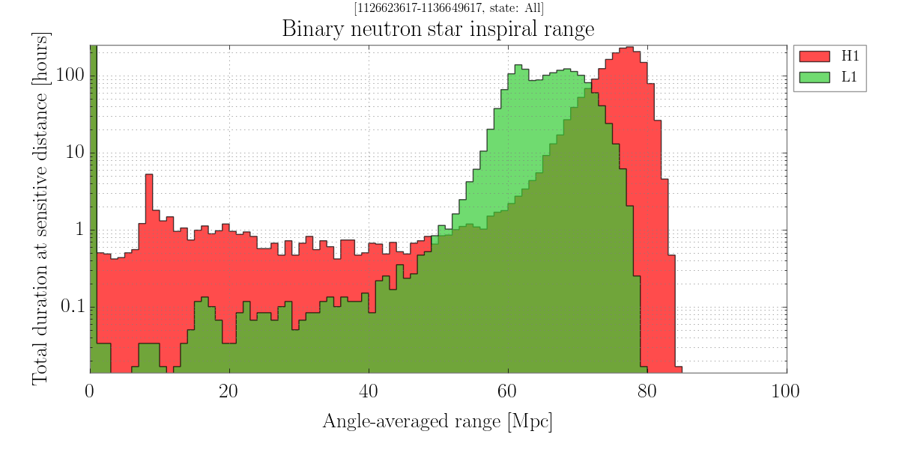
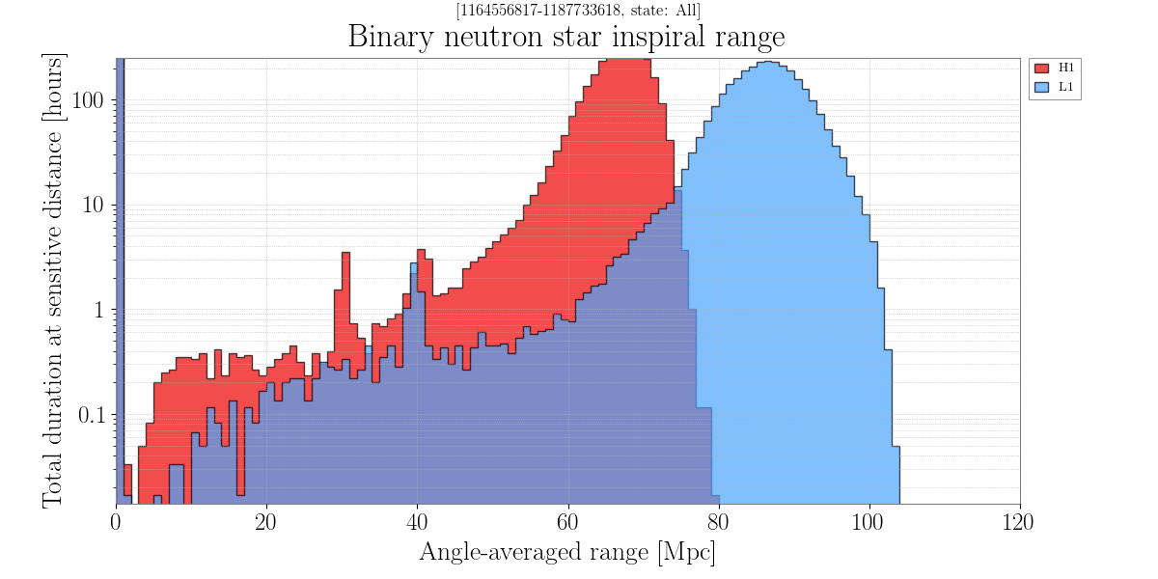
BNS range
L1 better, H1 somewhat worse.
No real change in the average network reach
O1
O2

Slide 13
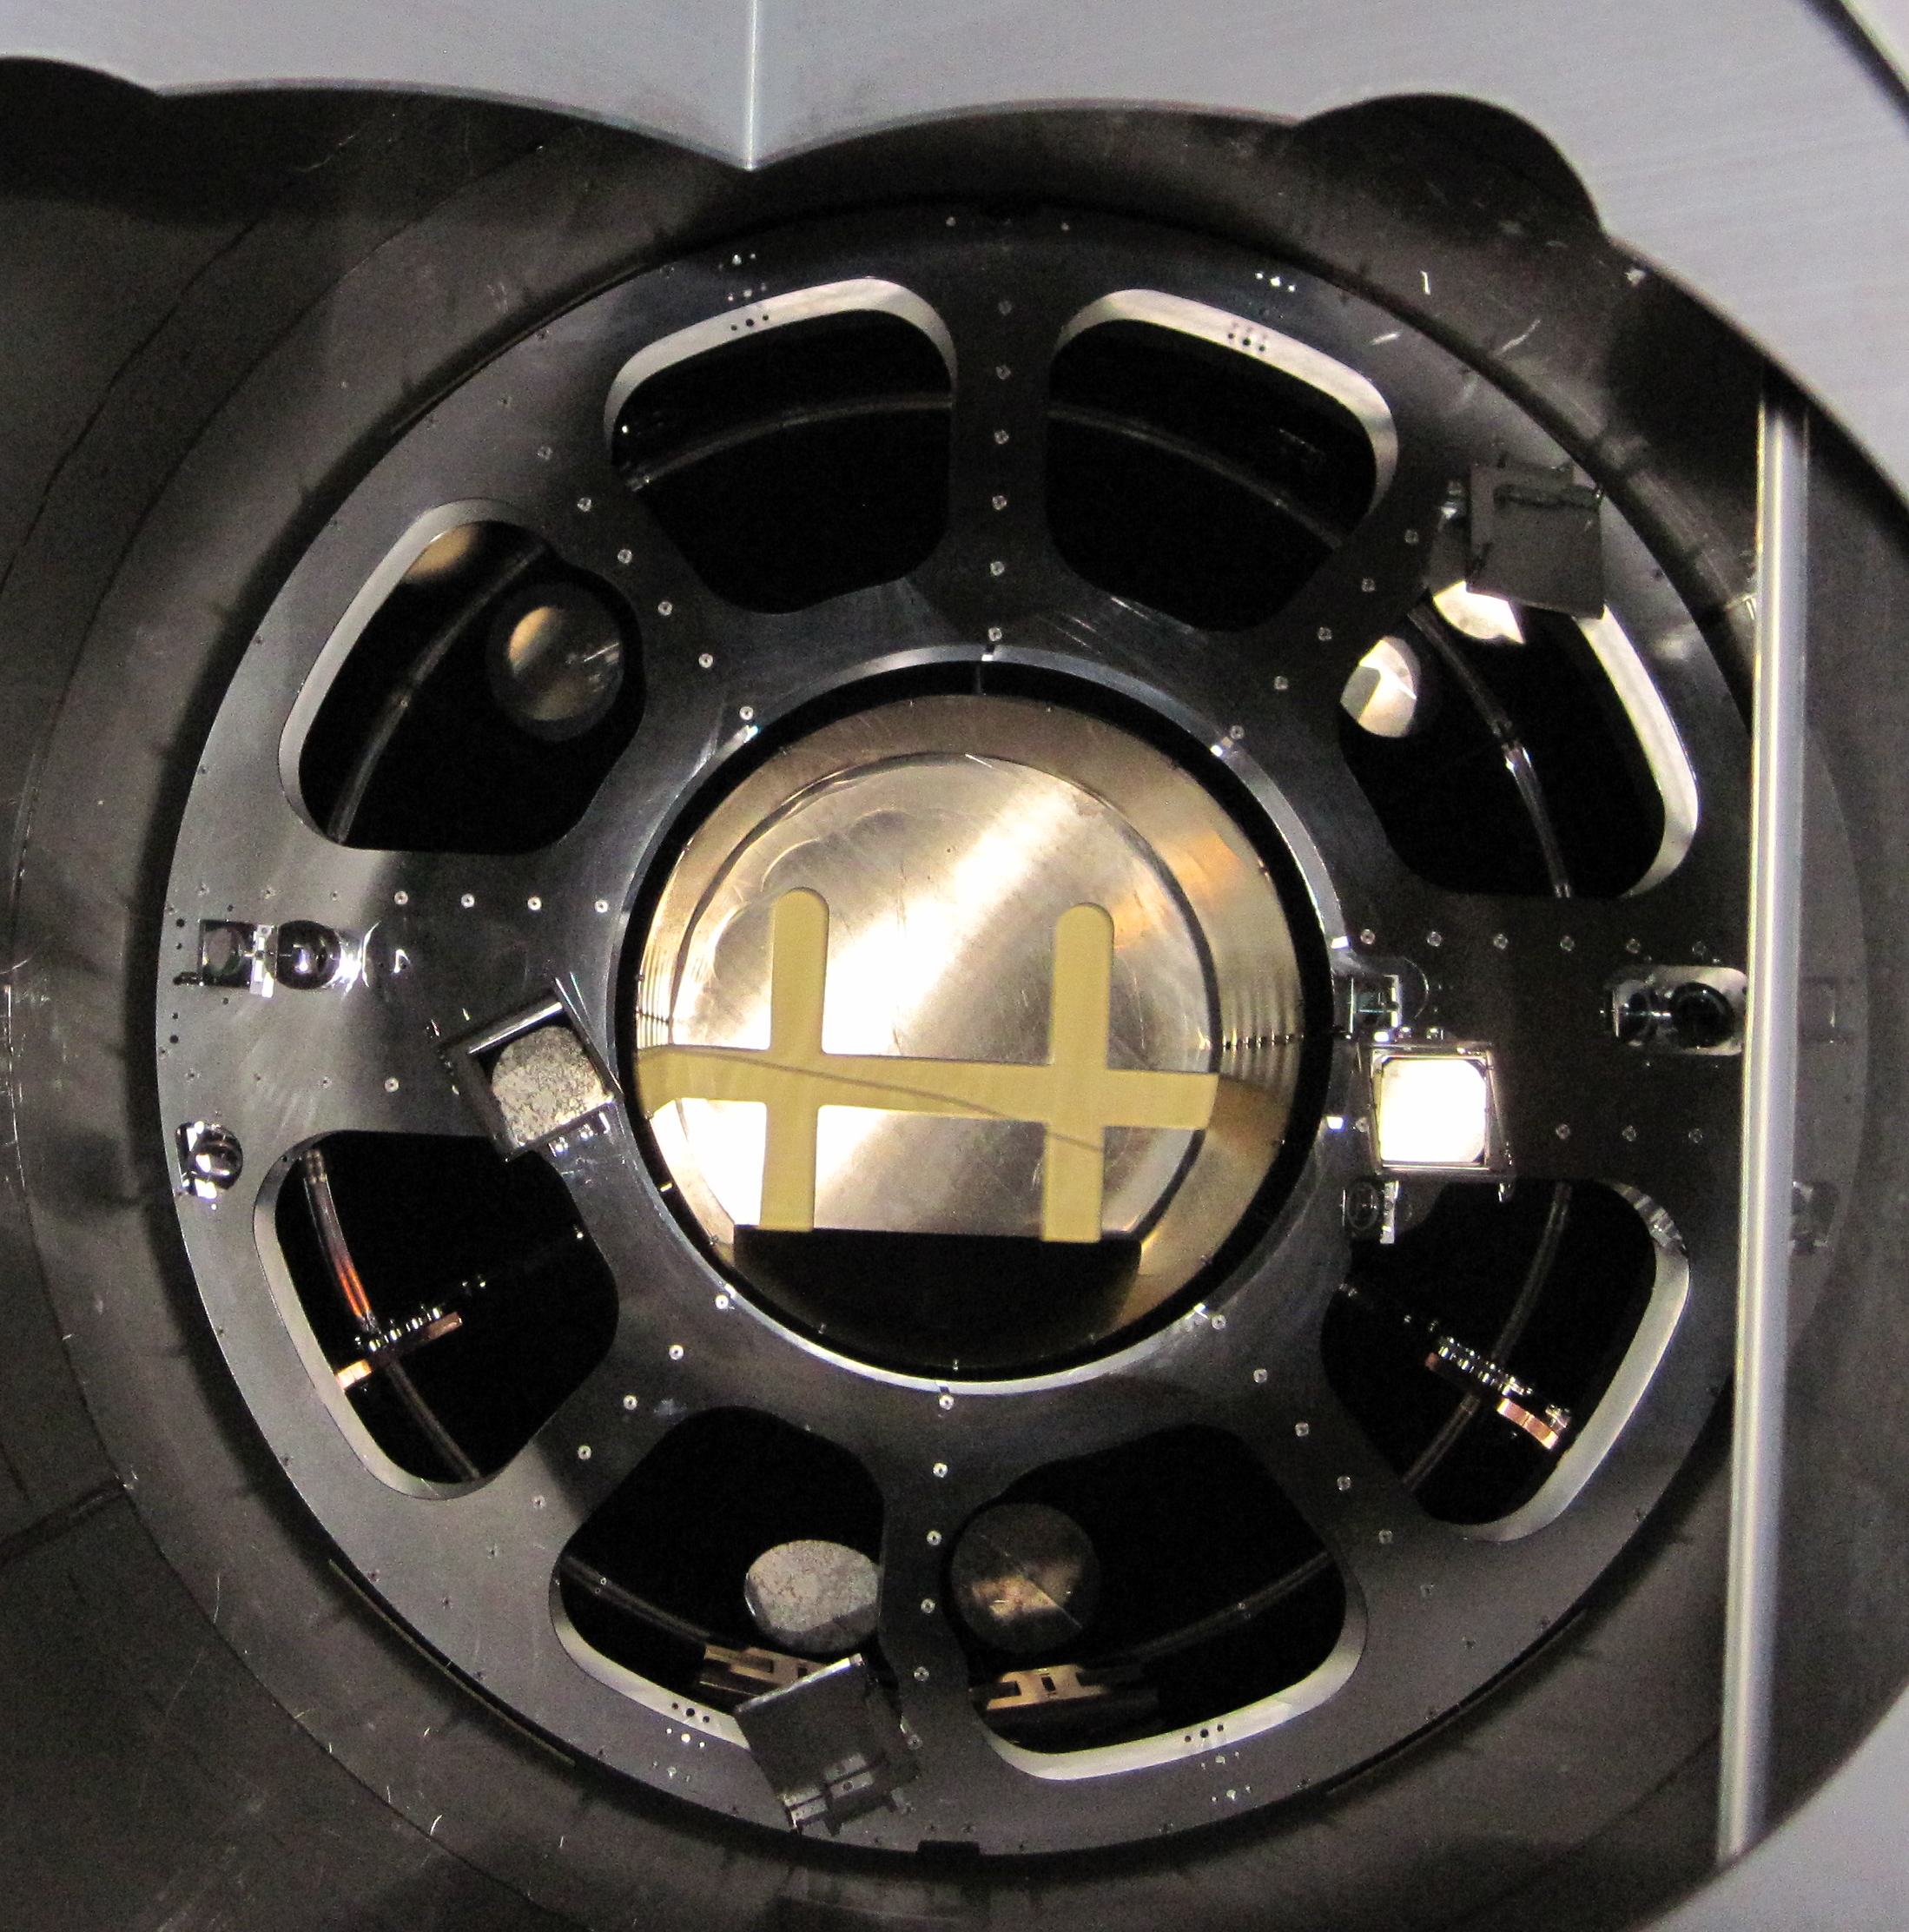
L1: Scattering mitigation worked, e.g. ETM scattering via Pcal periscope
Photon calibrator: amplitude-modulated laser to give the mirror a calibrated displacement via radiation pressure.
laser -> VP -> peri -> ETM -> peri -> VP -> receiver
10 seca

Slide 14
L1: Scattering mitigation worked, e.g. ETM scattering via Pcal periscope
Photon calibrator: amplitude-modulated laser to give the mirror a calibrated displacement via radiation pressure.
laser -> VP -> peri -> ETM -> peri -> VP -> receiver
ETM scattering could follow the same path and be scattered back
Vibration of Pcal periscope mirrors problematic
Installation of vibration damper, fixing potential mechanical interference with cryo baffle
10 sec

Slide 15
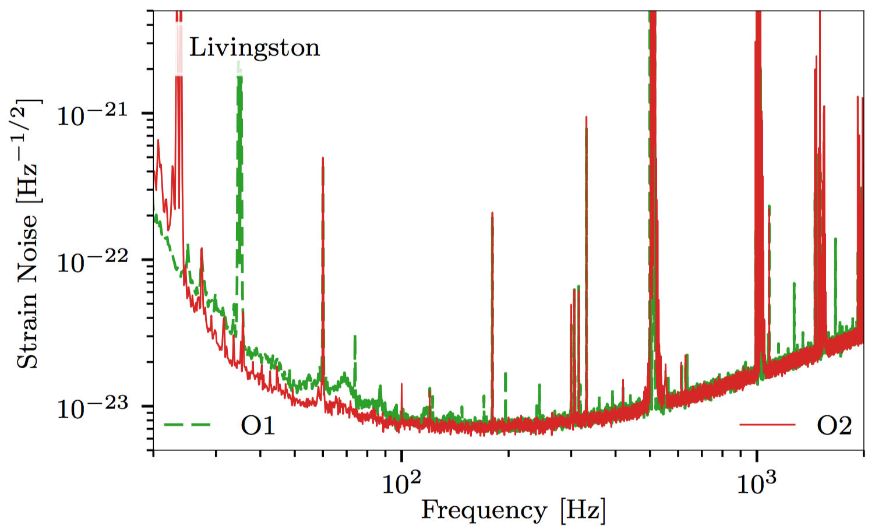
L1: Scattering mitigation worked, e.g. ETM scattering via Pcal periscope
(That’s only one example of scattering mitigation)
More scattering mitigation campaign after O2 for L1, H1 will follow.
10 sec

Slide 16
H1 High power laser:
We got the power, sure.
Were able to operate up to 50W. Good.
  Parametric Instability (interaction between optical higher order mode and mirror’s acoustic mode) was OK.
  Clearly worse noise.
  Pointing jitter and size jitter coupling.
Pretty HPO picture here.
Maybe pretty PI plot here.

Slide 17
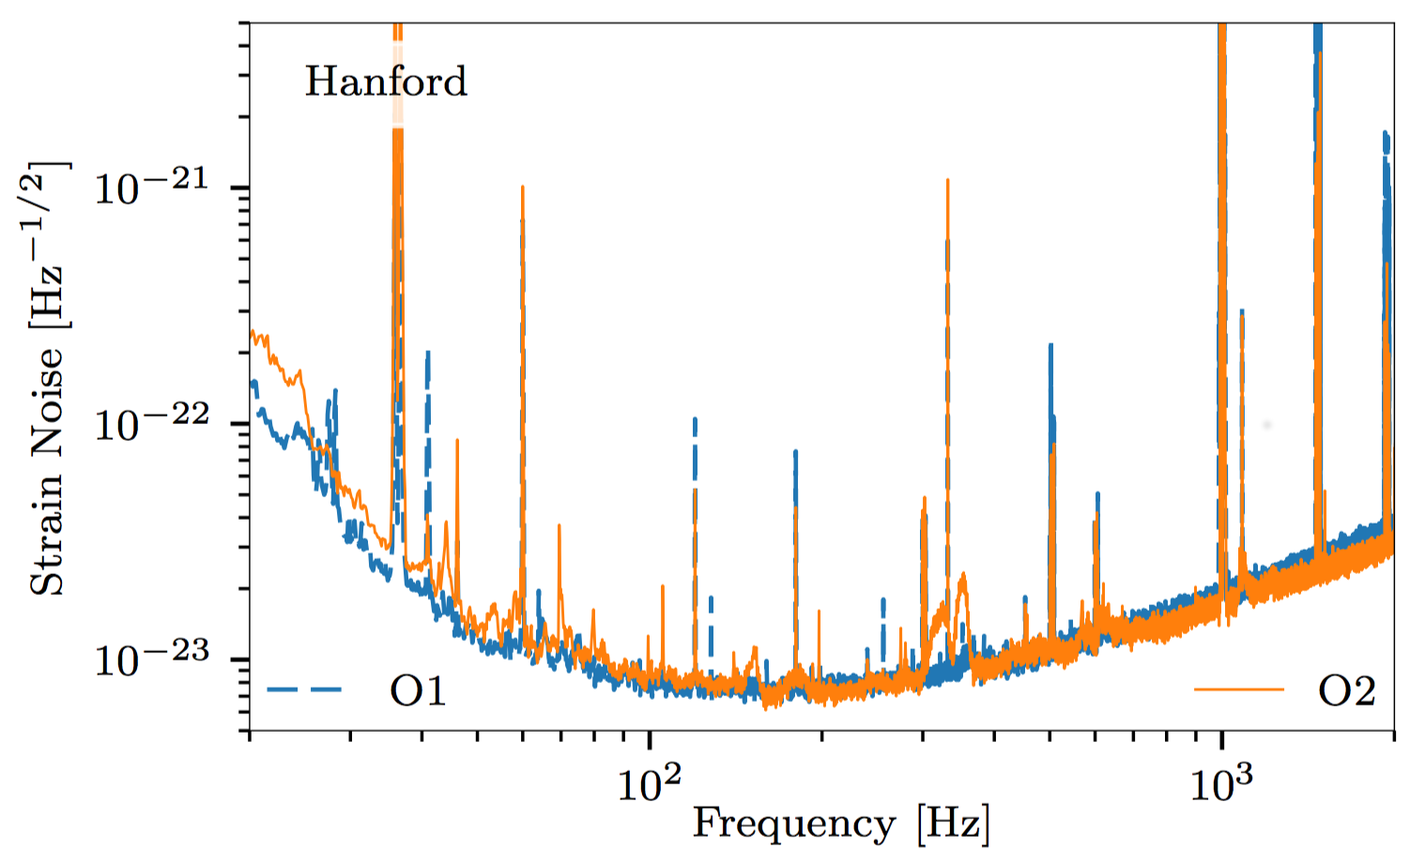
Compromise, given the use of HPL
30W (VS 22 of O2)
          Better shot-noise limited performance
Worse pointing jitter itself due to HPL
Worse beam size jitter due to HPL (most likely but without a proof, no sensor until mid-O2).
Worse jitter coupling (depends on the alignment)
ASC difficulty
Similar performance to O1.

Slide 18
H1 high power difficulty suspect:
H1 ITMX point absorber
~10mW absorption for ~150kW circulating power
~XXnm wave front distortion over YYmm, ~ZZ diopter
Will cause RF SB imbalance -> ASC difficulty
Beam size jitter coupling via differential lensing
(Pointing jitter coupling?)
Vent in May for cleaning this, didn’t remove it unfortunately.
          H1 ITMs will be replaced after O2.
HWSX plot here
Smaller HWSY plot here

Slide 19
Pointing jitter coupling
H1 typically has a larger coupling than L1
  In H1 it depends on alignment, agrees qualitatively with a model without point absorber.
  Does the absorber skew the alignment? Or some other mechanism?

Slide 20
Pointing jitter coupling
H1 typically has a larger coupling than L1
  In H1 it depends on alignment, agrees qualitatively with a model without point absorber.
  Does the absorber skew the alignment? Or some other mechanism?
HPL (an injection locked laser) has larger jitter.
  A 70W optical amplifier is under testing.
  Even then the coupling should be reduced in the future, not for O3.
Picture of 70W amp here

Slide 21
Pointing and size jitter coupling
Kiwamu’s coupling simulation plot
Couples via differential misalignment or differential lensing on ITMs (in these plots it’s equivalent of XXnrad).
Coupling TF shape for pointing and size jitter are similar, but they’re two different coupling paths.
Coupling measurement plot

Slide 22
Let’s see noise budget.

Slide 23
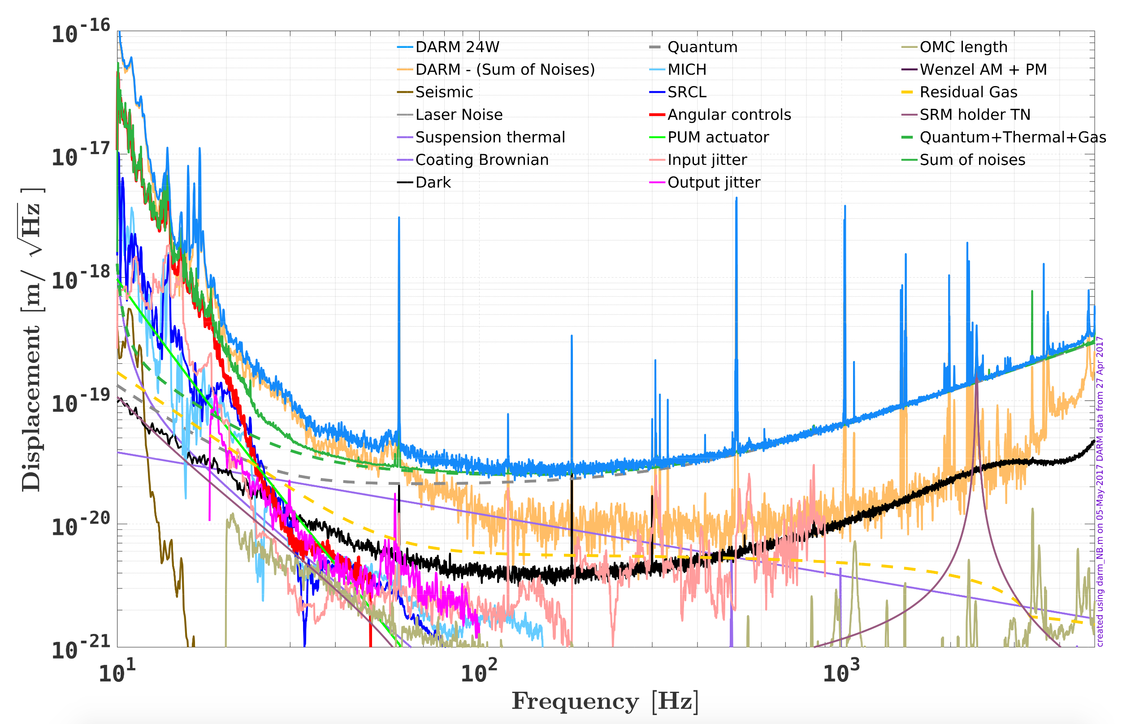
L1 O2 Noise, 24W
Unexplained 20-60Hz
Measured strain
Residual = strain – Sum(identified noise)
Sum(identified noise)

Slide 24
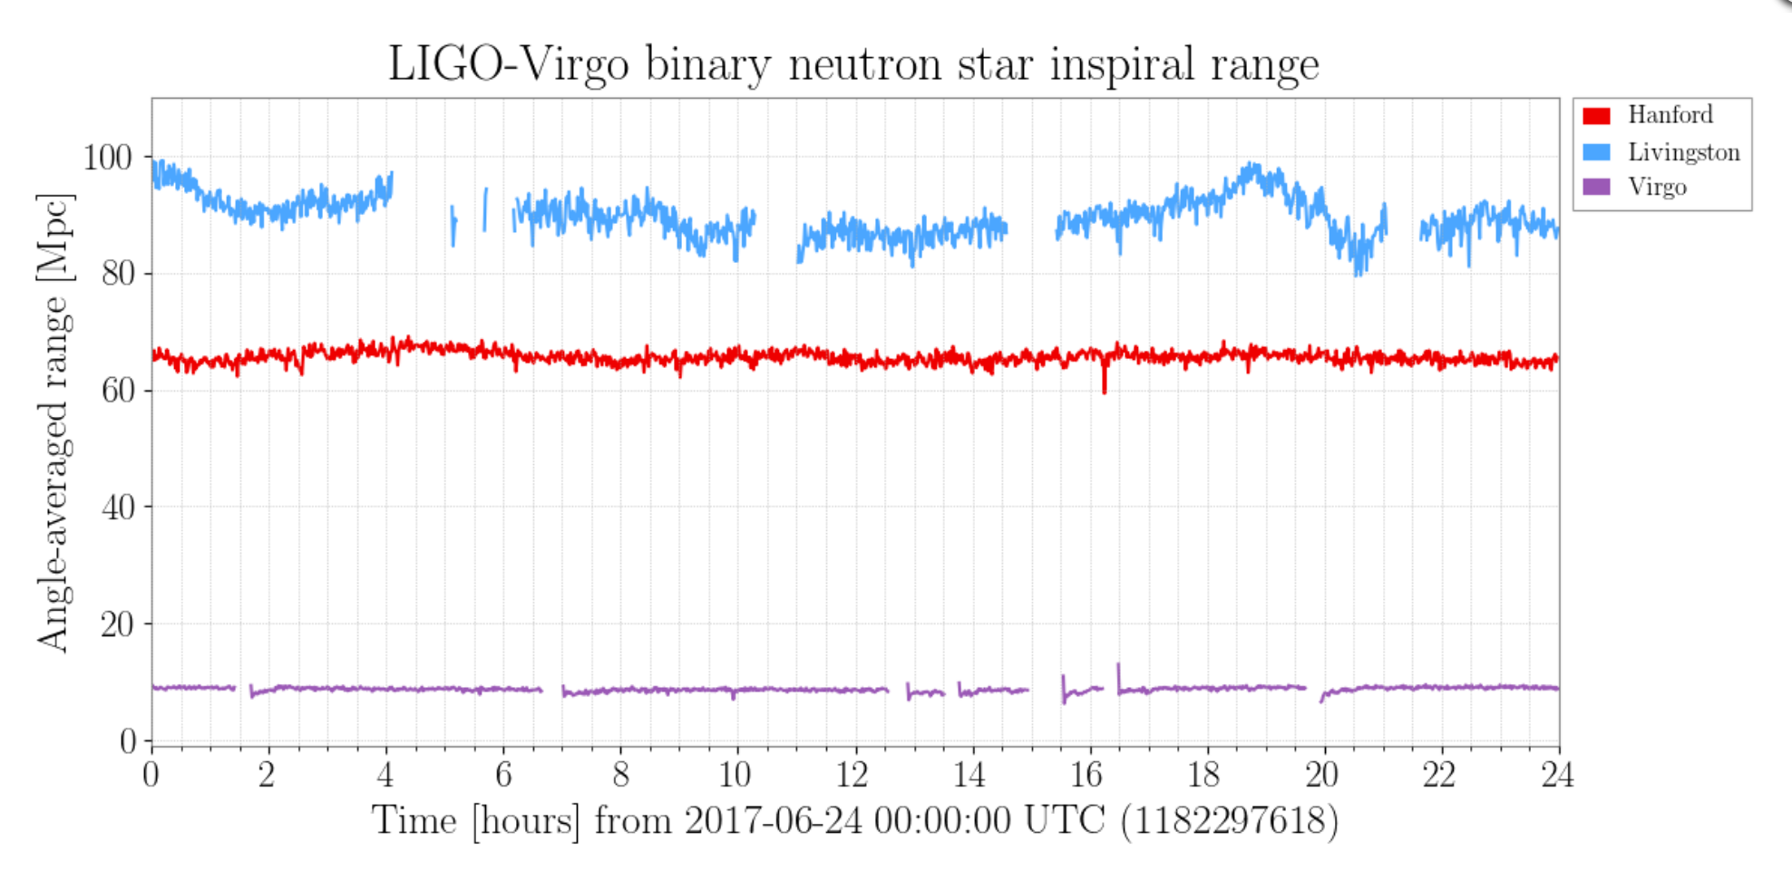
L1 Noise
L1 up-down of the noise comes from 20-60Hz region.
More scattering suspected.

Slide 25
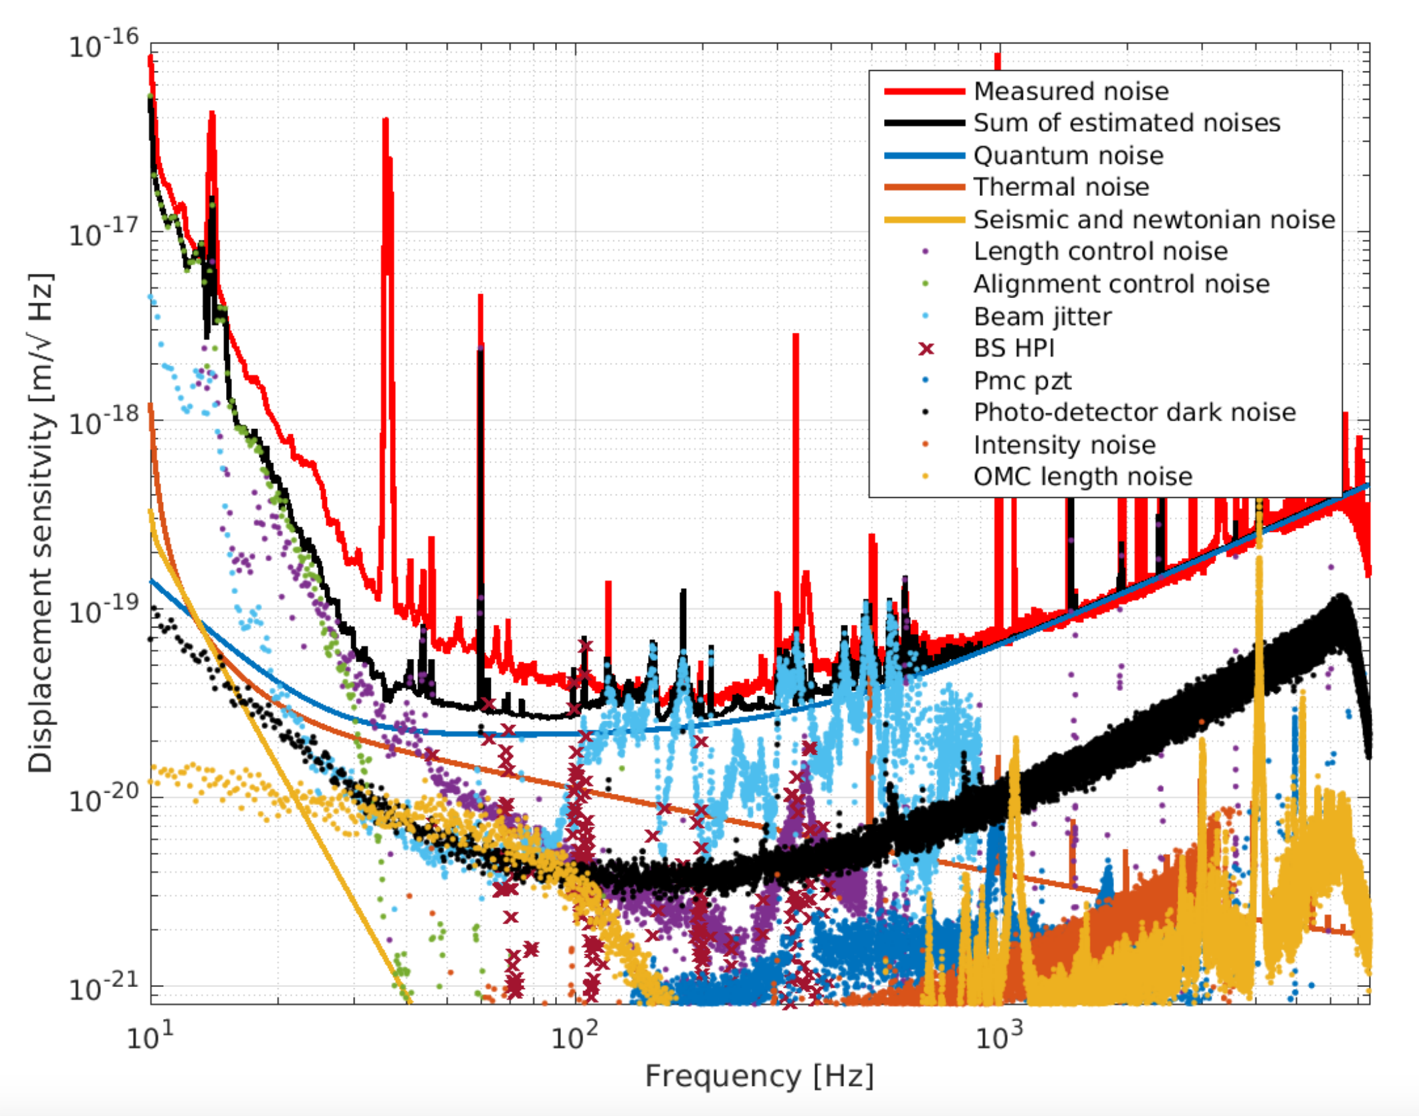
H1 O2 Noise, 30W, HPO
(note: no size jitter on this plot)
Unexplained 20-100Hz
Pointing jitter peaks

Slide 26
Something new and exciting:
Noise subtraction
Subtract pointing jitter, beam size jitter etc. from the strain signal to recover clean strain.
f<500Hz performance is recovered to O1 level without ill effect on shot noise improvement in O2.
(Not much change in unknown region)
(No replacement of the real noise reduction for commissioning.)
Wow this plot is pretty.

Slide 27
L1 Noise
H1 noise remarkably stable across locks in “unknown” band.
  “Unknown” should be covered by something that is not scattering.
  Need to revisit electronics and DAQ?
Jitter coupling also very stable within single lock but seems to change with initial alignment.
  Need to reassess initial alignment procedure.
DAQ of course includes up and down conversion observed in pcal, similar thing could happen to ESD or upper stages, though in broad band. Initial alignment refers to e.g. monitor differential green spot position change in the green transmission.

Slide 28
If I have time: Duty factor improvement
O2 network: 51% excluding holidays and vent down time (VS 43% of O2)
Nice example of H1 seismic isolation improvement: M6.0 EQ in NZ
Nice plot of H1 and L1 lock status VS seismic RMS

Slide 29
Other things to come after O2
ERM swap (both) -> Squeezed film damping
Squeezed light (first L1) -> Small shot noise
Vacuum fix/decommissioning (both)
Monolithic SRM -> helps SRC control
New in-vac ASC sensing for more reliable SRC and PRC alignment (H1)
Jitter mitigation using an in-vac optical cavity???
AM I forgetting anything? Is there a recent-ish gant chart that I can steal?

Slide 30
New ERM
Pretty picture

Slide 31
Squeezing
Smaller shot noise without using high power!
Already demonstrated in GEO and iLIGO.
aLIGO design in place, aiming for 3dB improvement.
Pretty design pictures. Nag Daniel

Slide 32
If I have time:
~120MHz WFS for SRC
Hang-yu’s simulation plot(s)

Slide 33
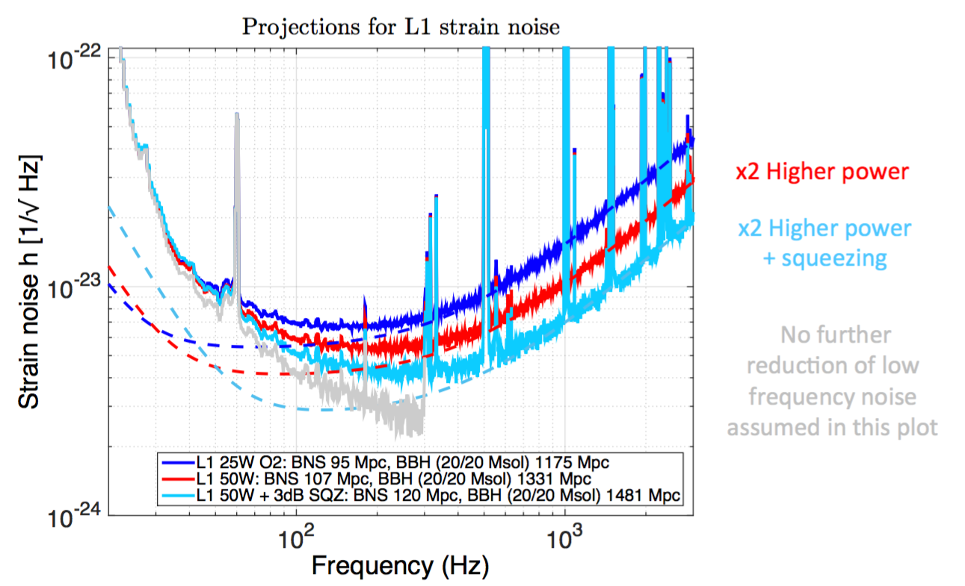
Borrowed from Giovanni’s slide:
Who made this?

Slide 34
Summary
O2 noise: improvement in L1, not in H1
Many problems are identified, mitigation/fix campaign after O2.
Some other enhancements like squeezing, ring ERM etc.
O2 will end on 25/Aug/2017.
Will resume observation (O3) after a significant improvement in the noise performance.
  ~a year or more of down time.

