Slide 1
ESD on CP and ITM Elliptical Baffle aperture
H. Yamamoto
ESD simplified as
4 rings with 10mm width and 10mm spacing
Almost perfect reflector

Slide 2
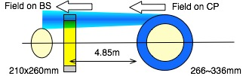
Field on BS reflected by arm+CP with ESD
log(power) vs r²
224mm : current ITM elliptical baffle size (224x274mm)
250mm : region with little effects by ESD
260mm : Beam splitter elliptical baffle size (210x260mm)
266mm : inner aperture size of ESD ring
phase vs r
ITM elliptical baffle size : 260x260mm
From BS side, nothing useful coming outside of 260mm
From arm side, outside of 266mm are hidden by ESD
Diffraction of reflected field by ESD makes field noisy outside of 260mm
Clipping noise, ~exp(2a²/w²), will be reduced by order of magnitude by increasing 224mm to 260mm

Slide 3



Fields with BS baffle
E to CP
E from CP
E to BS

Slide 4
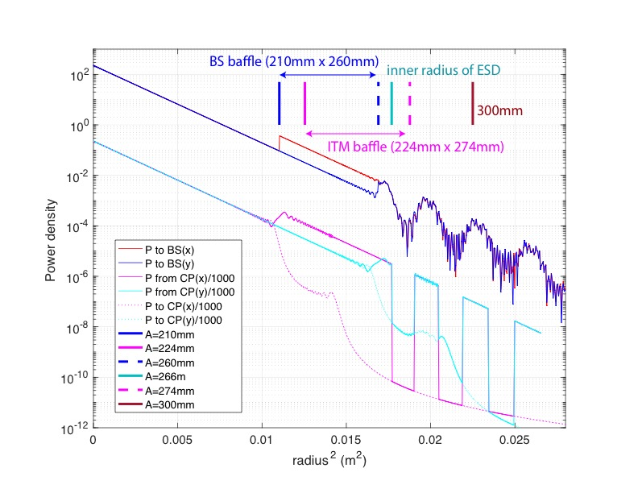
ITM baffle > BS baffle and no clipping effect
Outside of 260mm is bumpy
E from CP

