Slide 1
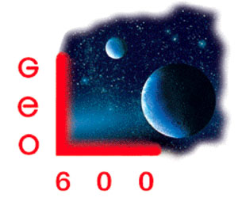
Optical properties of SIlicon for cryogenic Gw detectors
Zeno Tornasi
11/07/2017 - Hilton hotel, Pasadena, ca, U.S.A.
LIGO-G1700998

Slide 2
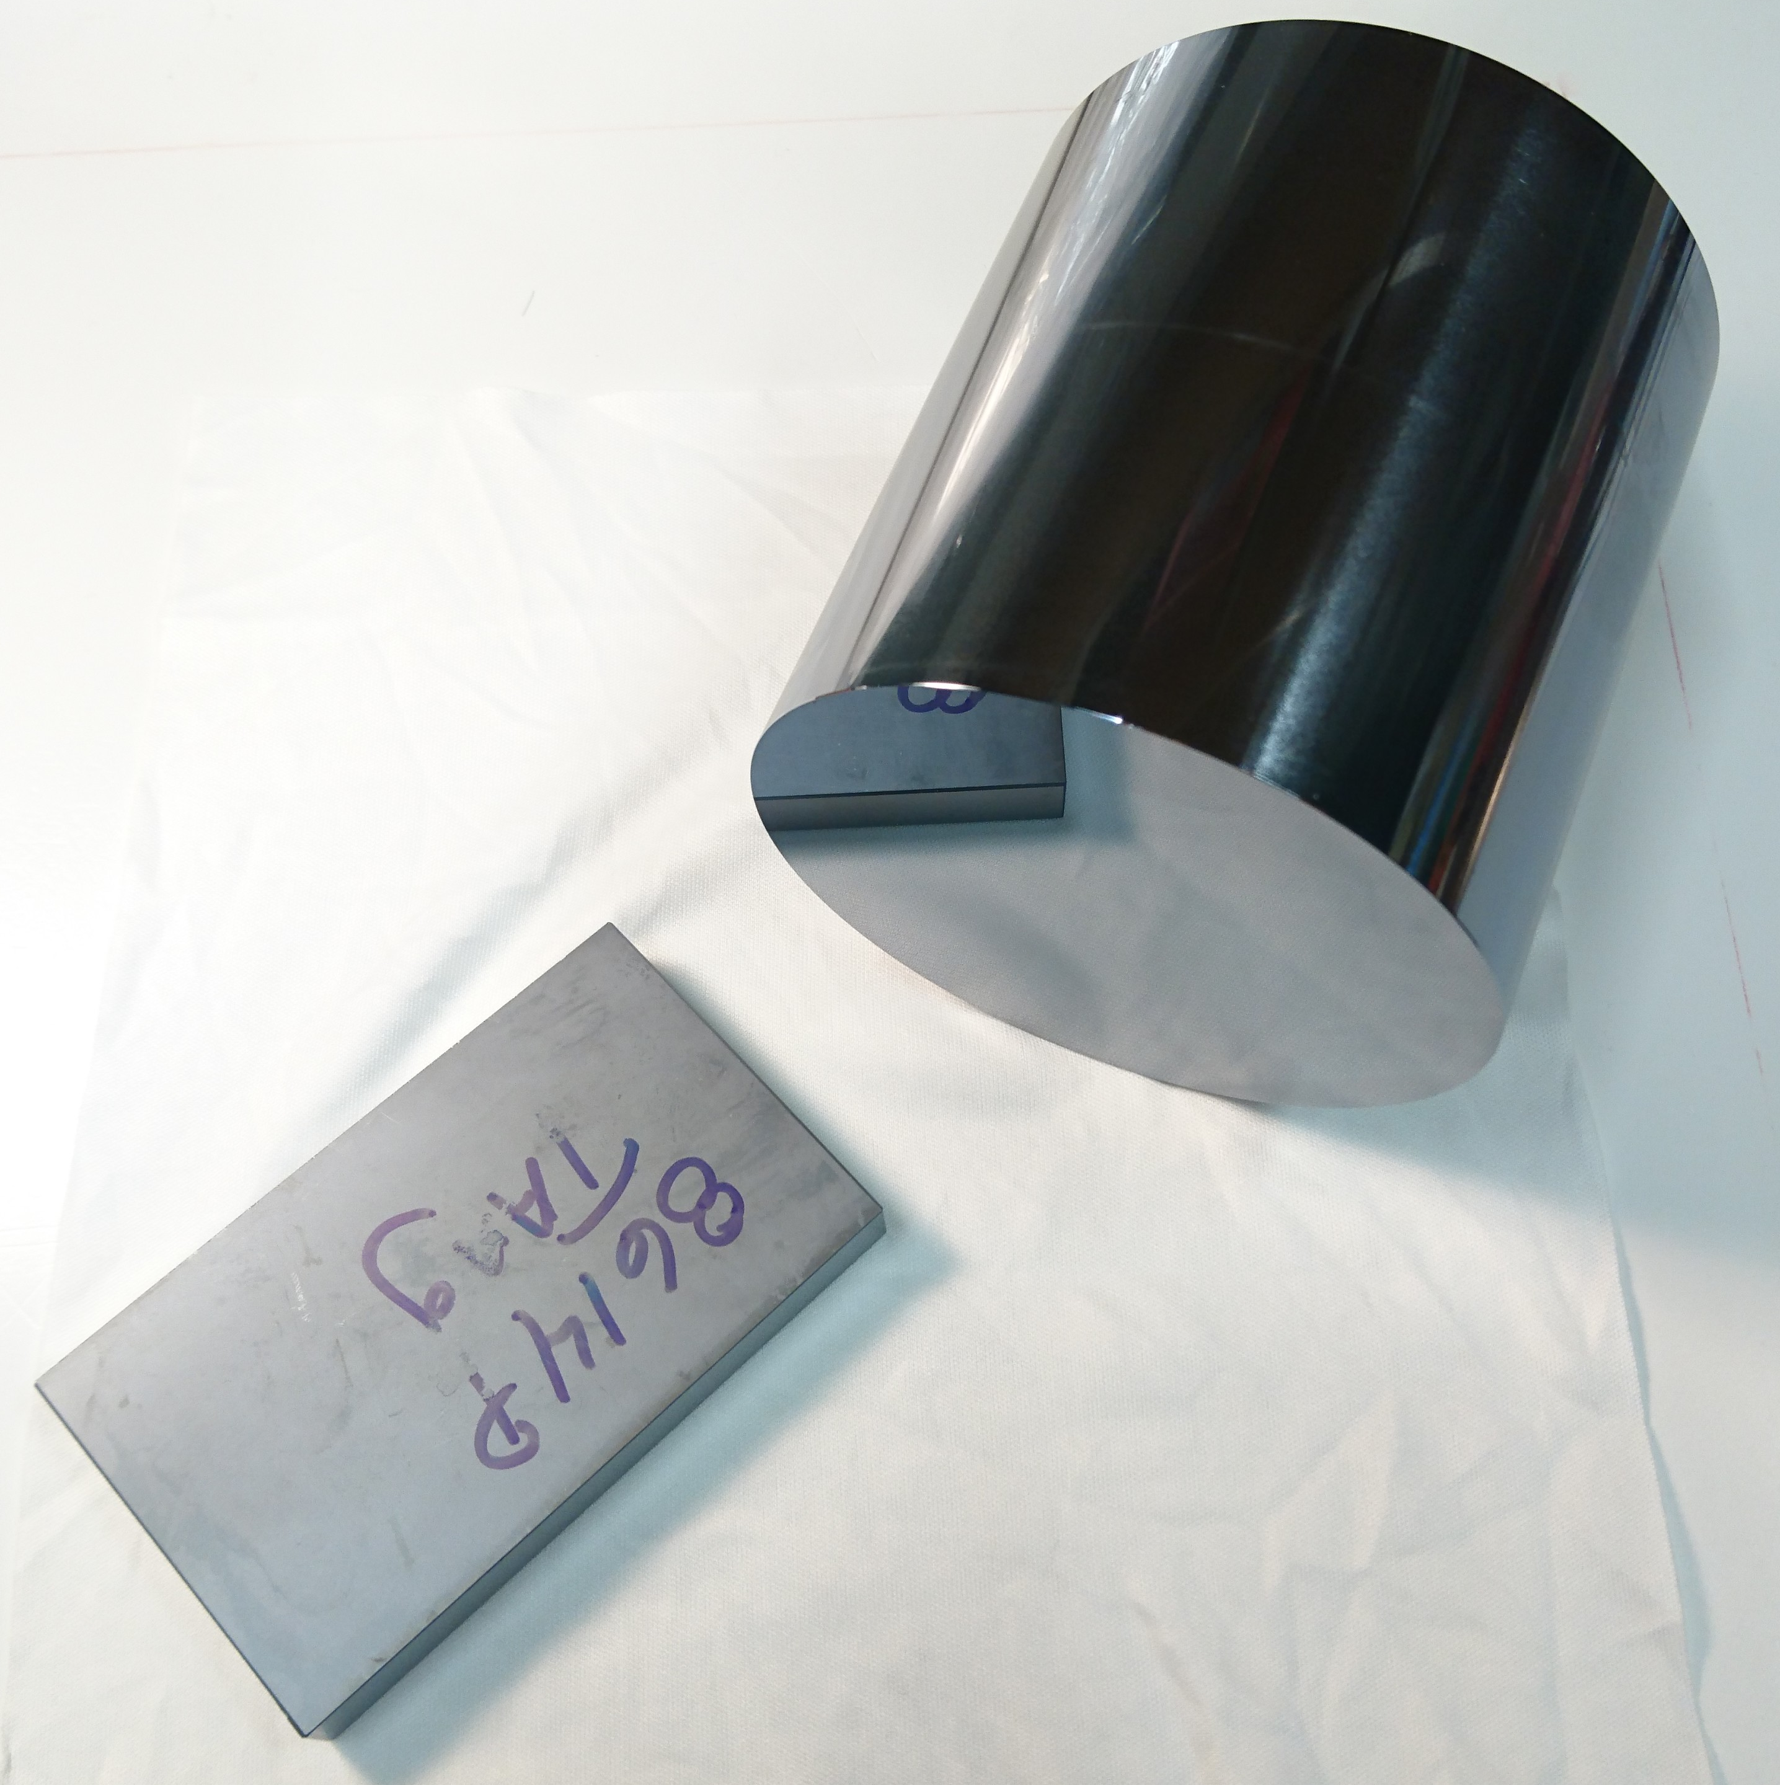
Crystalline silicon
Optical scattering
Amorphous silicon coatings
Optical absorption
Topics

Slide 3
Why silicon?
Introduction

Slide 4
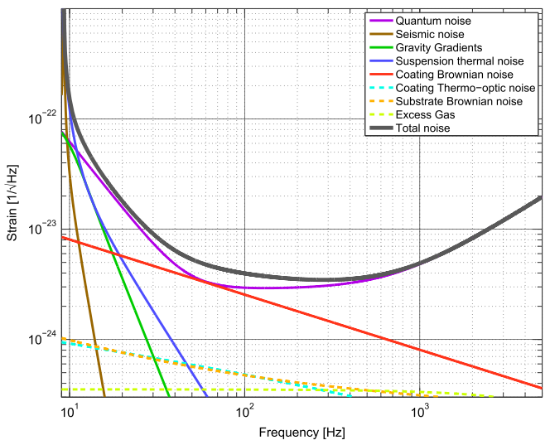
Coating Brownian noise
The LIGO Collaboration, Class. Quantum Grav. 32 (2015) 074001
Noise in a gravitational wave detector

Slide 5
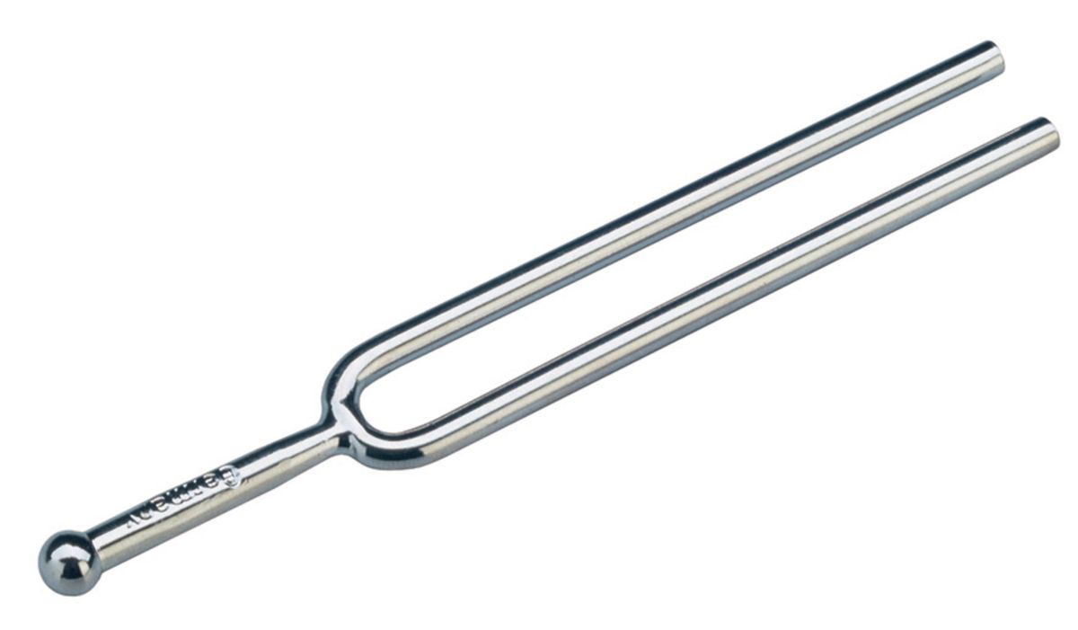
$$S_{x}\left(f\right)∝\frac{T φ d}{f Y w^{2}}$$
Temperature
Mechanical loss
Coating thickness
Young’s modulus
Beam width
Property of the material
Can vary by orders of magnitude
Can be engineered to some extent
Limited room for improvement
Substrate engineering constraints
Property of the coating material
Not much to do about it
Current detectors operate at room T
Can we just go cryogenic then? Not yet…
High refractive index materials
Coating Brownian noise (similar idea for substrates)

Slide 6
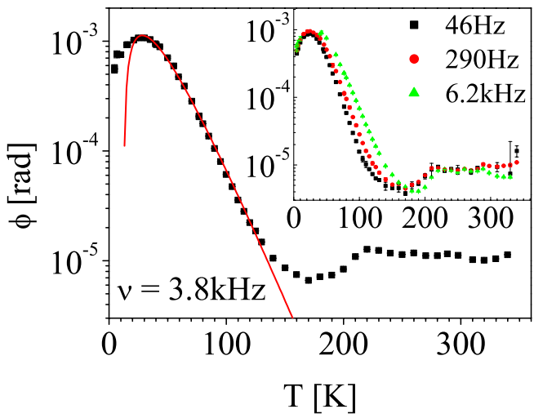
In general
$$S_{x}\left(f\right)∝\frac{T φ d}{f Y w^{2}}$$
$$S_{x}\left(f\right)∝\frac{T φ(T) d}{f Y w^{2}}$$
Currently LIGO optics are made of fused SiO₂
How does the mechanical loss change with T in SiO₂?
Travasso F. et al. (2007) Europhys. Lett. 80 50008
Fused silica has a high mechanical loss at low T

Slide 7
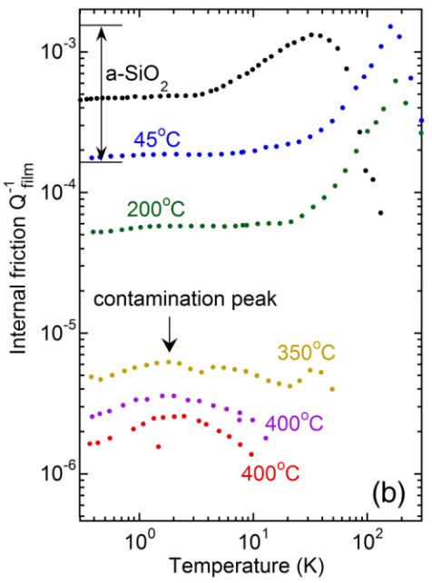
SiO₂
For coatings, a high refractive index helps (Silicon: 3.47)
aSi
Amorphous silicon looks promising

Slide 8
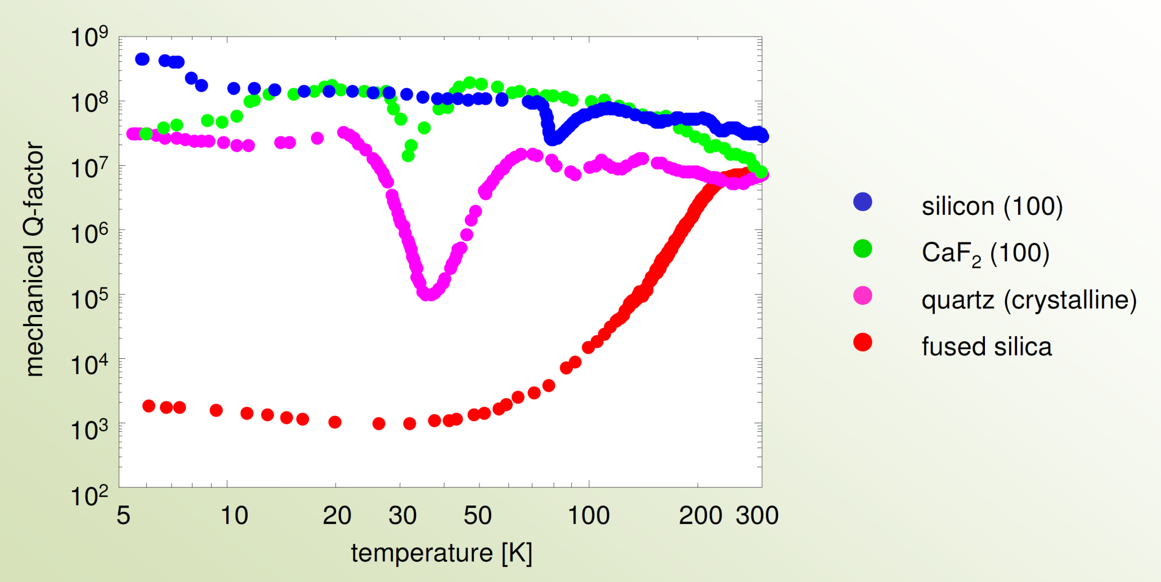
Christopher Wipf / LIGO-G1700602
Low mechanical loss at low temperature.
Credits: Ronny Nawrodt
Crystalline silicon looks great too

Slide 9
Both cSi and aSi have low mechanical loss at low temperature
But what about optical properties?
 | cSi (bulk) | cSi (surface) | aSi
Absorption | Bell, A. Markosyan | Ongoing (A. Bell) | This work
Scattering | This work | Future work? | Future work
Recap

Slide 10
Standard Czochralski grown silicon (Cz Si)
Too impure for application in GW detectors
because of high optical absorption
Float-zone silicon (FZ Si)
Very pure and low absorbing: 2 ppm/cm @ 1550 nm
Available in crystals of maximum diameter 20 cm
Magnetic field-grown Czochralski silicon (MCz Si)
Available up to 45 cm in diameter
Bulk absorption can be as low as 5 ppm/cm @ 1550 nm, albeit inhomogeneous
Occasional surface absorption still under investigation
A. Markosyan, A. Bell / LIGO-G1700480
A. Bell / LIGO-P1700134
Crystalline silicon absorption

Slide 11
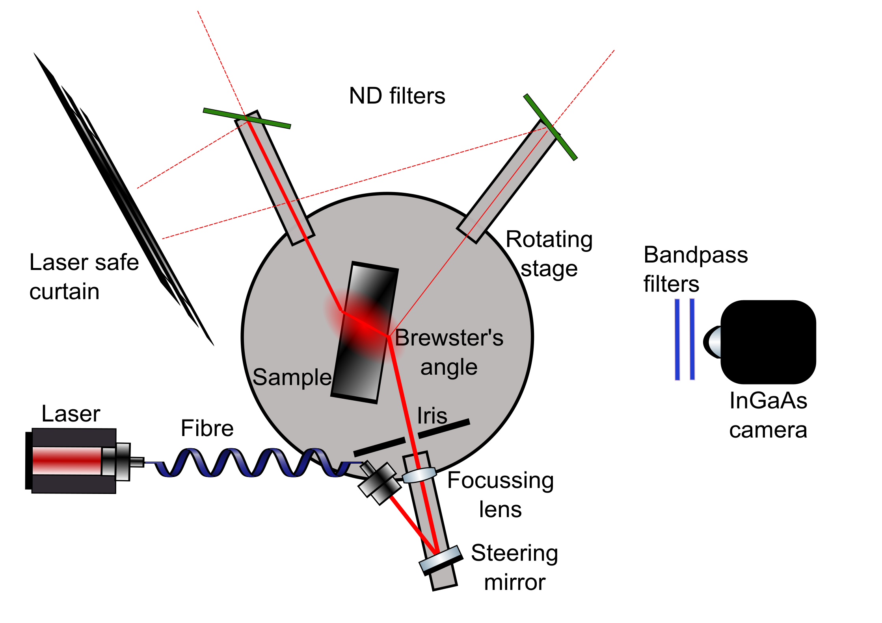
Polariser
The Glasgow scatterometer

Slide 12
Very lumpy beam despite centrifuging and filtering through 0.2 μm filters
It still looks much better than unfiltered carbon tetrachloride
The peaks sit on a baseline, whose value was used
Obtained scattering ratio 3.5x larger than the value in literature
I had previously performed a rough calibration using the laser itself
“Engineering run 1”: looking at CCl₄

Slide 13
Smooth beam
Scattering ratio obtained is 2.16x larger than literature, according to my rough calibration
Or it’s 0.6x literature, taking CCl4 as a reference
TAKE AWAY MESSAGES
Still “commissioning” the scatterometer, plenty of things to understand better
BUT
2. It’s NOT off by orders of magnitude!
Heraeus Suprasil 3001
fused silica cylinder
(same silica used in LIGO)
“Engineering run 2”: fused silica

Slide 14
Smooth beam
Difficult to isolate the main beam from the many strong reflections (high refr. index, small polished sample)
Images 10 times brighter than fused silica under similar conditions.
With the current understanding of the instrument, MCz Si scatters
at 1550 nm, at 16° observation angle:
0.11 - 0.17 ppm cm⁻¹ sr⁻¹
0.99 - 1.6 ppm cm⁻¹
Magnetic Czochralski silicon slab
“O1”: magnetic Czochralski silicon

Slide 15
Slides coutesy of prof. Stuart Reid
aSi films were made at UWS

Slide 16
Dangling bonds - absorption correlation

Slide 17
Deposition temperature - absorption correlation

Slide 18
Silicon is a promising material for cryogenic GW core optics.
It has low mechanical loss at low temperature, zeros of expansion coefficient, high refractive index
In Glasgow a scatterometer is active
It is able to take measurements to better than order of magnitude level but we’re working hard towards a fully reliable instrument
Preliminary measurement of MCz Si suggest values compatible with use in ET.
45-74 ppm bulk scatter for a 46 cm thick test mass would likely be dominated by coating scattering
Heat deposited aSi coatings show absorption comparable with annealed ones.
A clear link has been established between absorption and dangling bonds, and absorption and deposition temperature.
Conclusions

Slide 19
Optimise the scatterometer, understand its noise sources and discrepancies with literature
Carry out systematic angle-dependent measurements to verify to which extent the scattering observed is really only Rayleigh
Find a way to reliably calibrate the system
Work towards understanding surface absorption (not discussed here)
Integrate the aSi coatings study with other analyses such as Raman spectroscopy
Future

Slide 20
Thank you!

Slide 21
Photothermal common-path interferometry (PCI)

