Slide 1


Searches for continuous gravitational waves in the advanced detector era
Evan Goetz
University of Michigan
for the LIGO Scientific Collaboration and Virgo Collaboration
Amaldi 12, Pasadena, 2017
LIGO-G1700925

Slide 2
Transient vs continuous gravitational wave signals
Compact binary coalescence gravitational wave signals are strong but transient
Cannot perform long duration studies of particular source
Continuous gravitational wave signals are weak but persistent enabling long term studies of a source

Slide 3
Continuous gravitational waves (1)
Radiation generated by time-varying quadrupolar mass-moment
Rapidly-rotating neutron star with equatorial ellipticity (tri-axial ellipsoid)
Moment of inertia tensor
Distance to source
Equatorial ellipticity
P. Jaranowski, A. Królak, B. Schutz, Phys. Rev. D 58 063001

Slide 4
Continuous gravitational waves (2)
Continuous GWs are nearly monochromatic sinusoidal waves
Plausible breaking strain of NS matter:
  Normal nuclear matter
  Hybrid (hadron-quark core)
  Quark star
Gravitational wave emission strength and frequency depends on mechanism, ex:
  Tri-axial ellipsoid
  r-mode fluid oscillations
  Free-precession
N. Johnson-McDaniel and B. Owen, PRD 87 129903

Slide 5

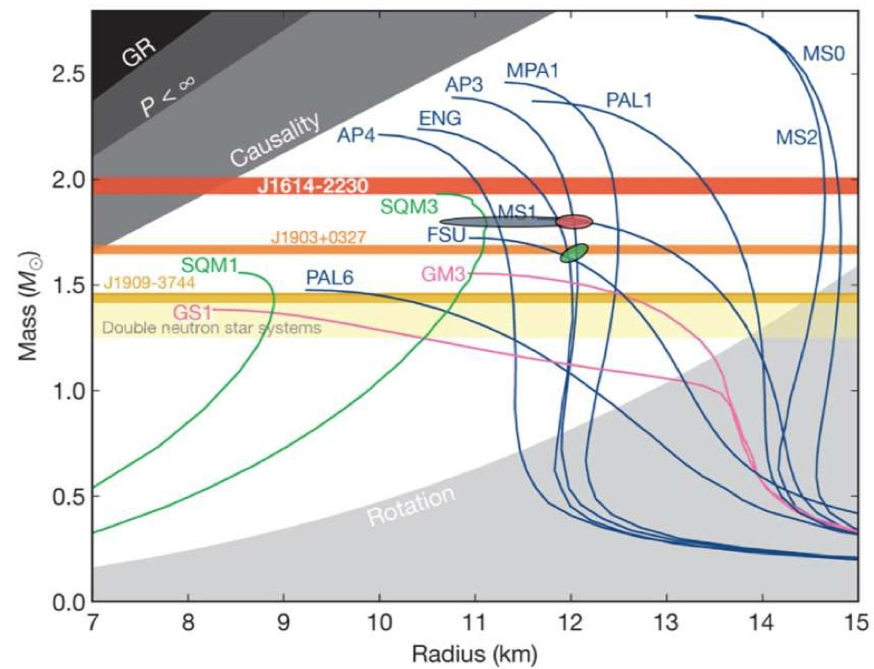
Why we search for continuous gravitational waves
Just one system would provide a rich laboratory!
  Neutron star equation of state?
  Maximum ellipticity?
  Does NS have exotic states of matter?
  Maximum mass of a neutron star?
  How fast can a neutron star spin?
  Other tests of General Relativity
  NS dynamics
  Implications for population models
  Stochastic background of GWs from
  spinning neutron stars
Images:
http://www.mpifr-bonn.mpg.de/research/fundamental/forces
http://sci.esa.int/loft/49338-equation-of-state-for-neutron-stars/

Slide 6
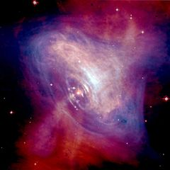
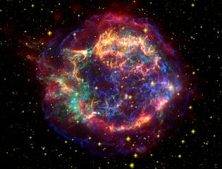
Continuous wave search strategies
Targeted search (known pulsars)
  “Know everything” (in principle)
Directed search (Cas A, galactic center, Sco X-1, etc.)
  “Know something”
All-sky (“blind”) search
  “Know nothing”
?
Increasing
computational
costs
Images: NASA/STSci/ESA

Slide 7
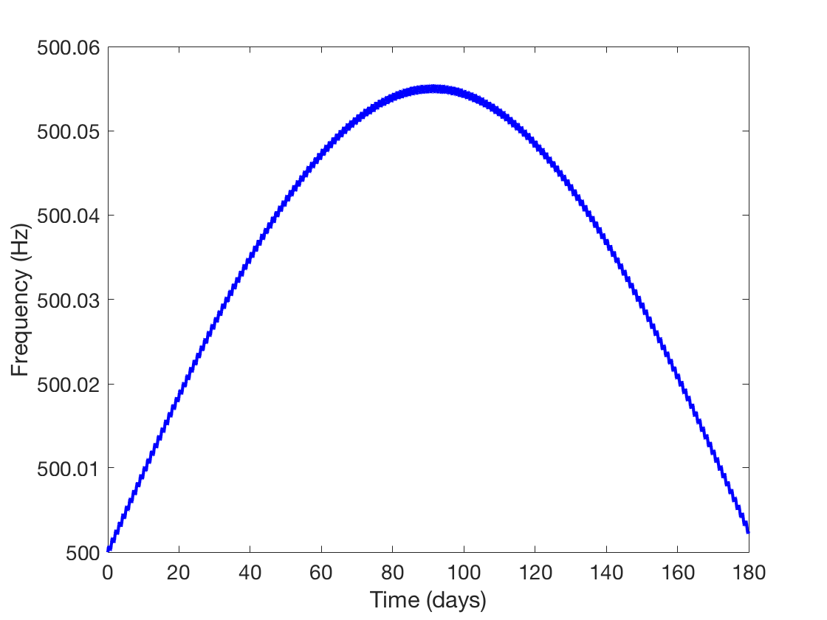
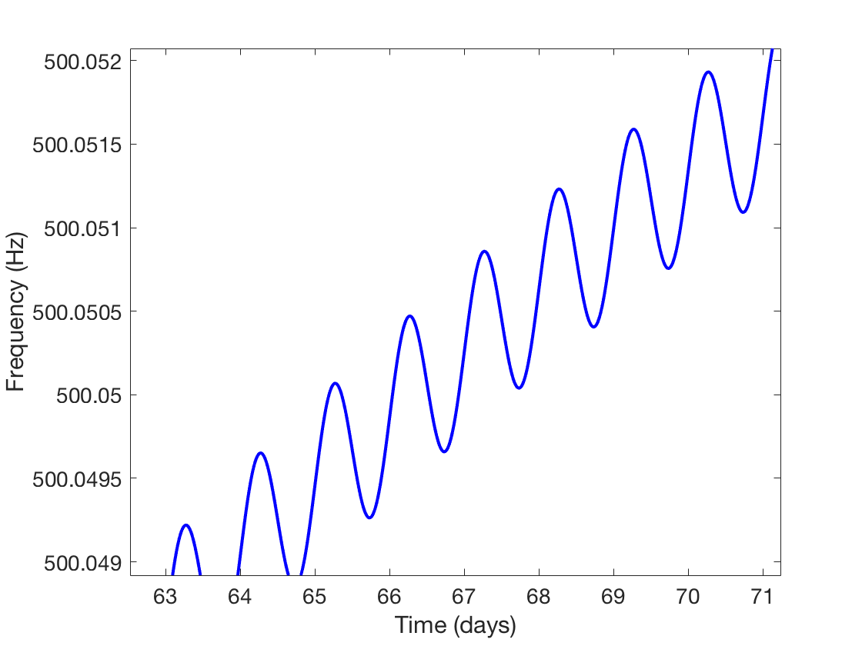
Continuous wave analysis considerations
GW detectors are on the Earth: Doppler effect
  Correct for the rotation and orbit of the Earth for every sky location you want to observe

Slide 8
Electromagnetically observed pulsars
ATNF catalog (as of July 2017): 623 pulsars spinning faster than 5 Hz
Of these, 258 are in binary systems (>40%)
Emission of gravitational waves (>10 Hz) is in the most sensitive region of the LIGO/Virgo frequency band
Crab pulsar
Vela pulsar
J0537-6910
Advanced detectors
Source: ATNF pulsar catalog (July 2017)

Slide 9
Spin-down limit on GW emission
Neutron stars spin down (lose energy)
Equate rate of radiated energy to the energy of a gravitational wave from tri-axial ellipsoid
Useful benchmark “spin-down limit”

Slide 10
Recent results: O1 targeted search
Targeted search of 200 known pulsars in first Advanced LIGO observing run
Results for 8 pulsars beat the “spin-down” limit
Overall, 2x better than initial LIGO/Virgo results
Crab limit at 0.2% of total energy loss
Vela limit at 1% of total energy loss
Smallest ellipticity limit:
One of several targeted analyses
B. P. Abbott, et al. ApJ 839 12

Slide 11
Torque-balance limit
For actively accreting NS, the in-falling matter spins up the NS <--> GW emission spins down the NS
Assume the two mechanisms are in balance for a tri-axial ellipsoid NS
Those NS accreting most rapidly would have the largest amplitude GWs
Brightest (non-solar) x-ray source is Sco X-1

Slide 12
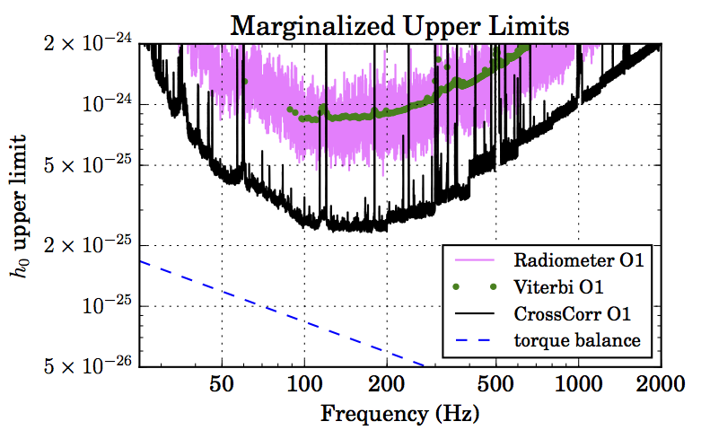
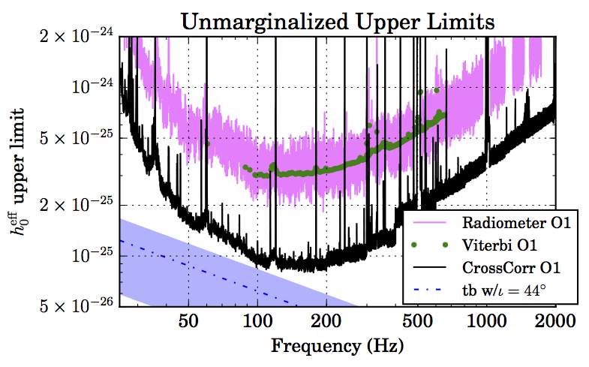
Recent results: O1 searches for Sco X-1
Three different methods:
  Unmodeled cross-correlation (radiometer)
  Hidden Markov model tracking of spin-wandering signal (Viterbi)
  Model-based cross-correlation (CrossCorr)
Tightest limits nearly reach the torque-balance limit near 100 Hz
Anticipate refined limits with additional data / improved detectors / advancements in methods
arXiv:1706.03119 [astro-ph.HE]

Slide 13
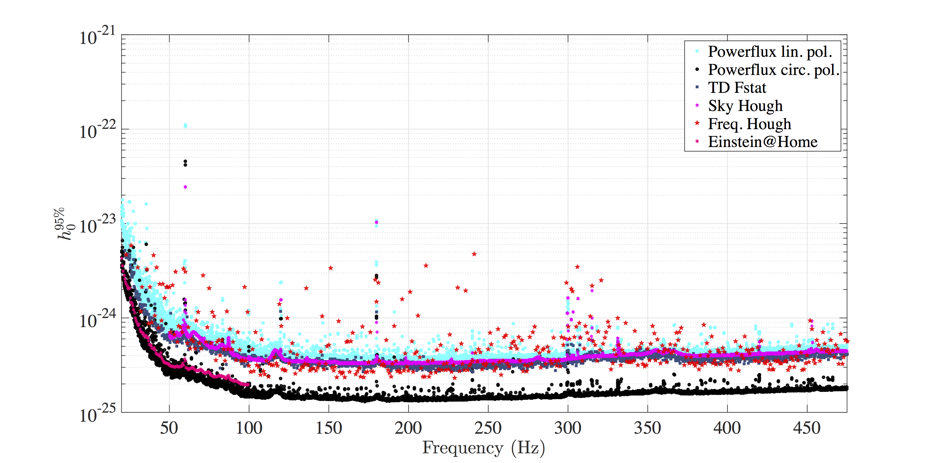
Recent results: O1 all-sky, isolated neutron star search
4 different pipelines: PowerFlux, time-domain F-statistic, Sky Hough and Frequency Hough (+ comparison to F-stat on Einstein@Home)
Pipelines provide consistent results; confidence nothing has been missed
Tightest limits (circular polarization) near 170 Hz
arXiv:XXXX.XXXXX

Slide 14
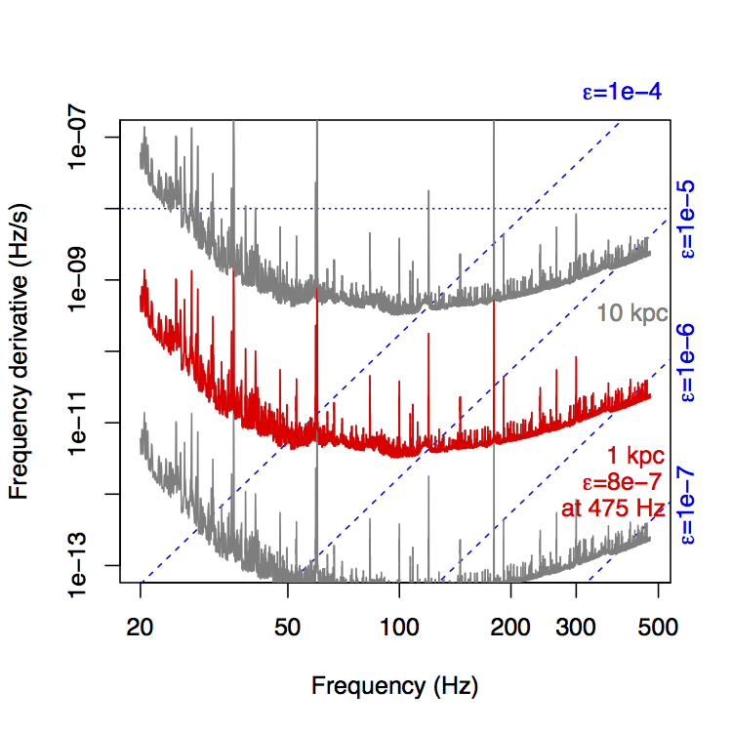
Recent results: O1 all-sky isolated neutron star search reach
Ellipticity of a NS at a given distance for which circularly polarized waves could be detected using, e.g. PowerFlux algorithm
Ex: at 1 kpc, can exclude sources emitting at
with
Tightest constraint
at
arXiv:XXXX.XXXXX

Slide 15
Recent results: O1 all-sky isolated low-frequency Einstein@home search
Einstein@home distributed computing project results
20 – 100 Hz, “deep search” (restricted spindown search compared with other searches)
Tightest limits: (marginalized over NS orientation); above 55 Hz, can exclude sources with within 1 kpc of Earth
arXiv:XXXX.XXXXX

Slide 16
Other works in progress
O1 analyses in the pipeline:
  Searches for SNRs (plausible NSs)
  High-frequency all-sky searches
  All-sky searches for NSs in binary systems
  “Narrowband” searches for GWs from known pulsars
  “Spotlight” directional searches (e.g. Orion spur, galactic center)
  Searches for non-tensoral GWs from known pulsars

Slide 17
Outlook
Currently planned LIGO O2 observing run longer than O1 (9 months vs 4 months)
  LIGO site hardware changes have mitigated some of the combs of lines present in O1 data
  Sensitivity improvements, especially at low frequency at LIGO Livingston
Investigations of algorithm enhancements, e.g. narrowband, Viterbi, TwoSpect search algorithms
See talk by K. Kawabe
S. Mastrogiovanni, et al. CQG 34 135007
E. Goetz and K. Riles, CQG 33 085007

Slide 18
Conclusions
LIGO and Virgo Collaborations have set forth a robust program to detect continuous gravitational waves
Detecting one source would provide rich laboratory
Critically important: improved detectors, sensitive algorithms, and continued collaboration with EM partners
No detections yet, but we are searching hard
Non-detections are probing interesting astrophysics

