Slide 1
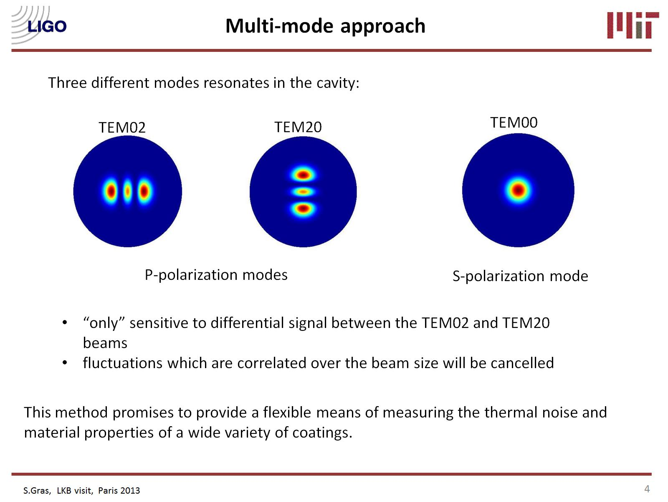
Multi-Mode Thermal Noise
Experiment, MIT
G1700820
a different way of looking
at Coating thermal noise
Slawek Gras, Matthew Evans

Slide 2
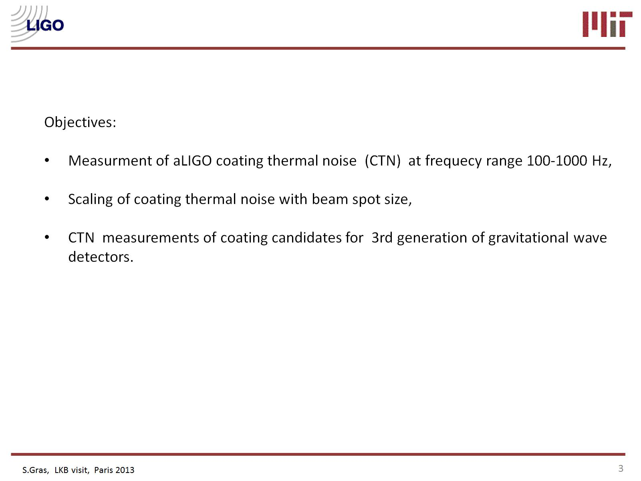
Objectives:
Refine thermal noise estimates for current aLIGO coating,
Test of coating candidates for 3rd generation gravitational wave detectors
S. Gras, GWADW 2017
S. Gras, GWADW 2017
8
13

Slide 3
Multi-mode approach
(ties laser frequency to cavity length)
(even modes used to avoid alignment sensitivity)
mirror motion, clamping losses, …
S. Gras, GWADW 2017
3

Slide 4
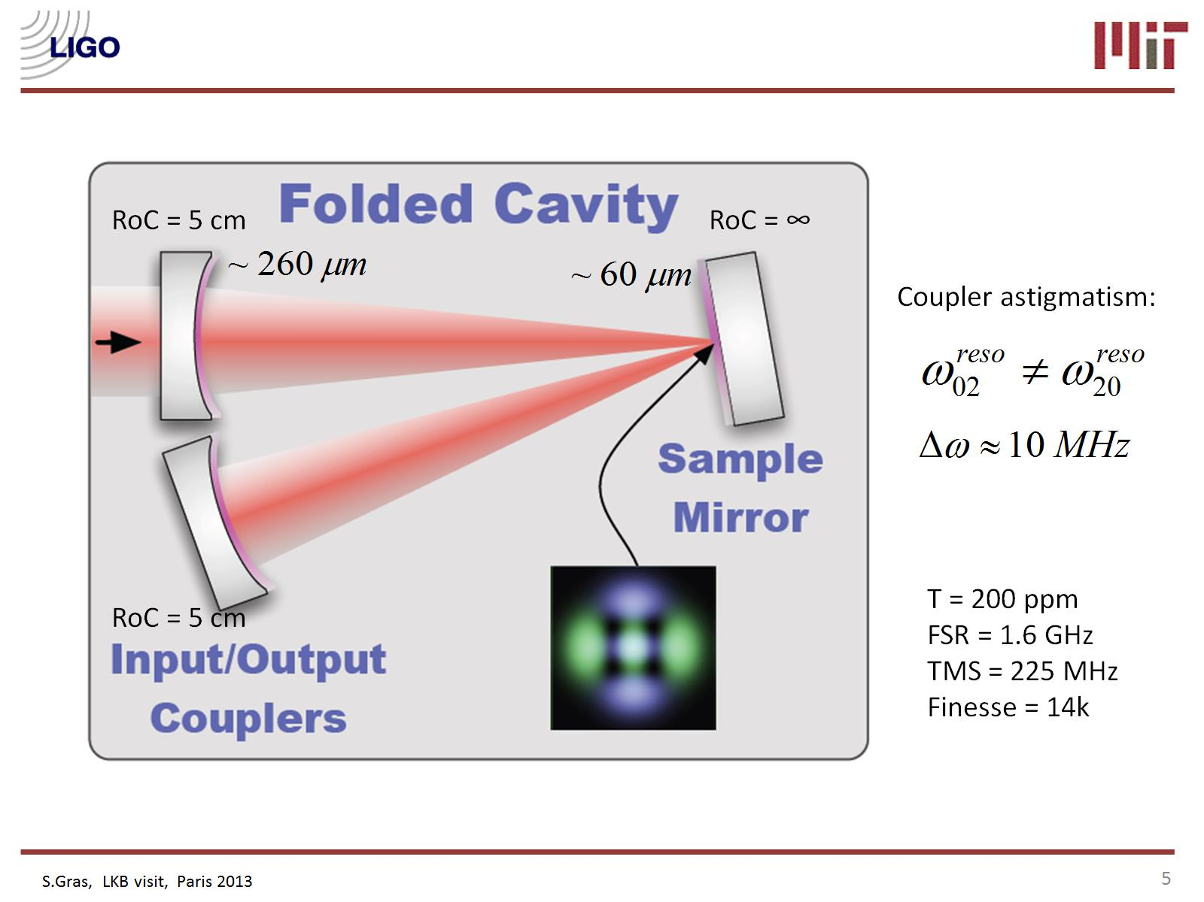
Cavity design
large spots on non-sample optics, sample is any 1” HR flat (e.g., typical witness sample)
S. Gras, GWADW 2017
4

Slide 5
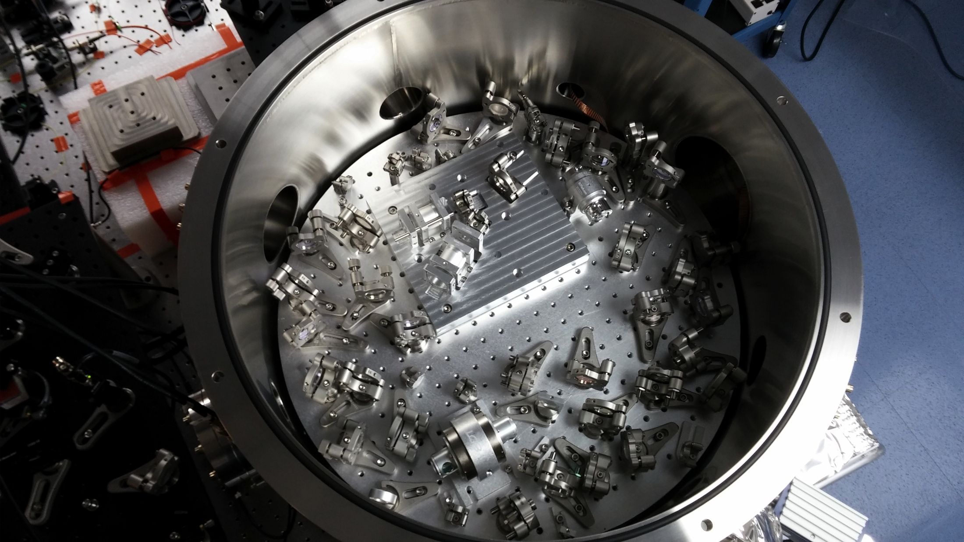
The Experiment
S. Gras, GWADW 2017
5

Slide 6
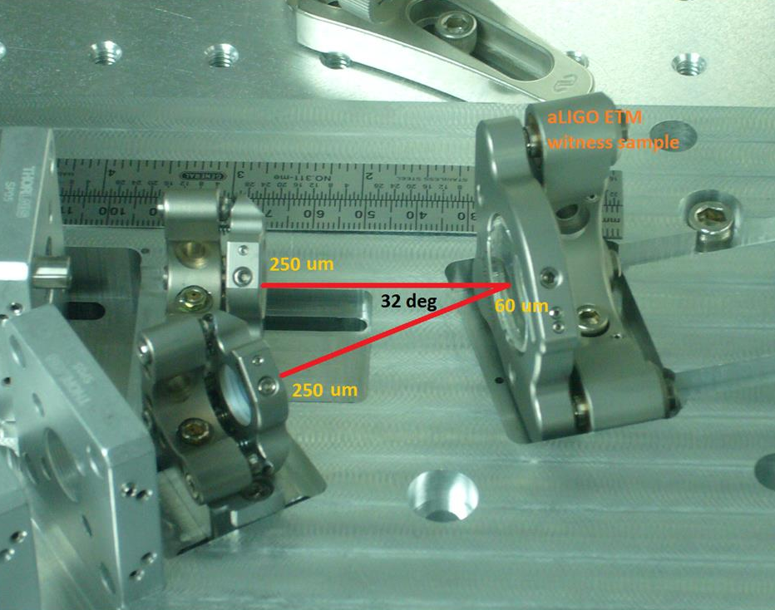
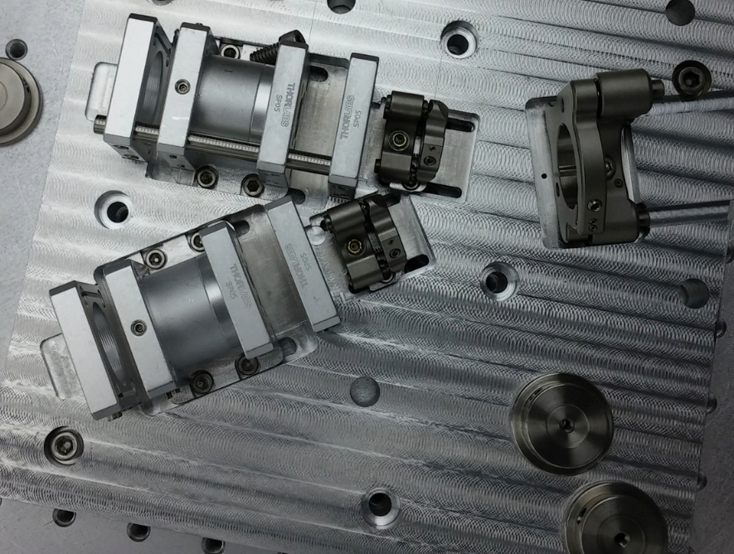
The Folded Cavity
S. Gras, GWADW 2017
S. Gras, GWADW 2017
6

Slide 7
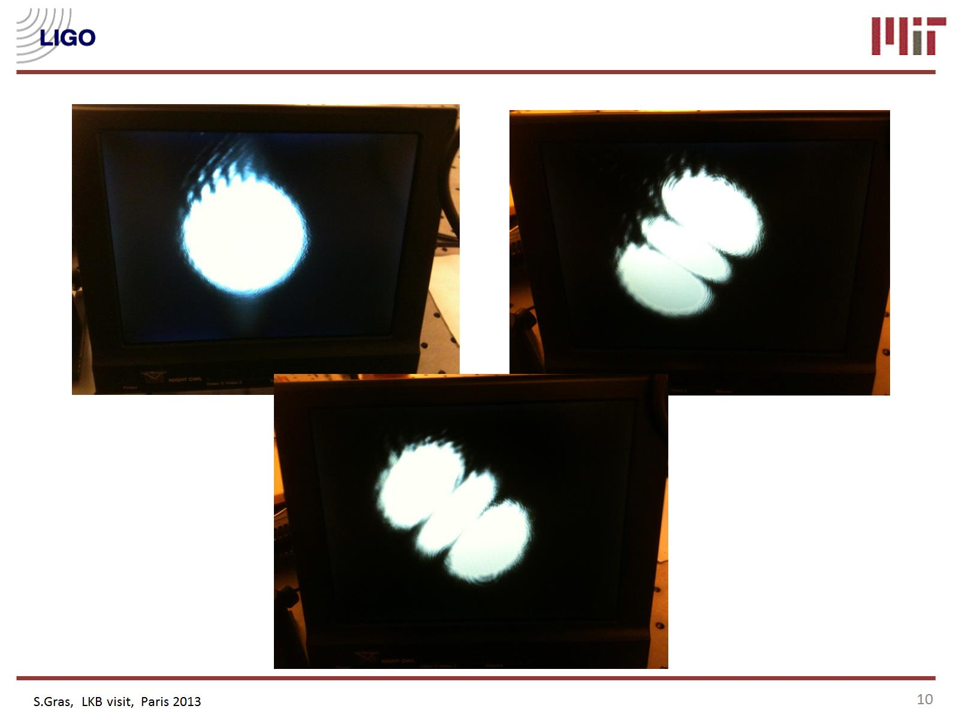
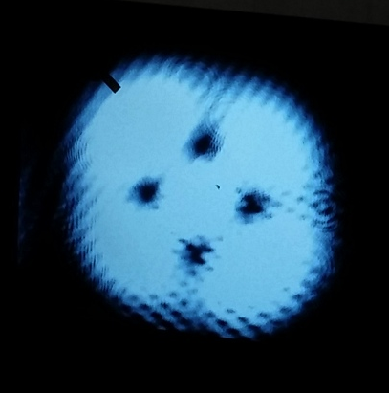
Resonant modes
Theory
S. Gras, GWADW 2017
7

Slide 8
Advanced LIGO End Test Mass witness sample:
last year measurement
S. Gras, H. Yu, W. Yam, D. Martynov, and M. Evans
Phys. Rev. D 95, 022001 (2017)
30 Hz
300Hz
S. Gras, GWADW 2017
S. Gras, GWADW 2017
8

Slide 9
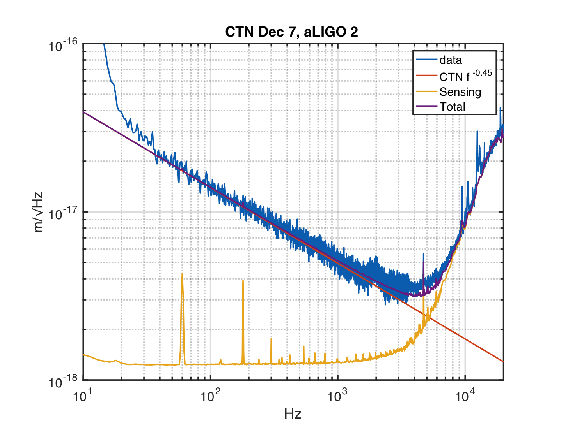
Advanced LIGO End Test Mass witness sample:
better measurement with upgraded readout
Upgraded readout: sensing noise reduced, better signal-to-noise
30 Hz
3kHz
S. Gras, GWADW 2017
9

Slide 10
Advanced LIGO End Test Mass witness sample:
higher SNR allows us to measure CTN slope
Slope
measured!
2 different aLIGO samples measured, similar results
S. Gras, GWADW 2017
S. Gras, GWADW 2017
10

Slide 11
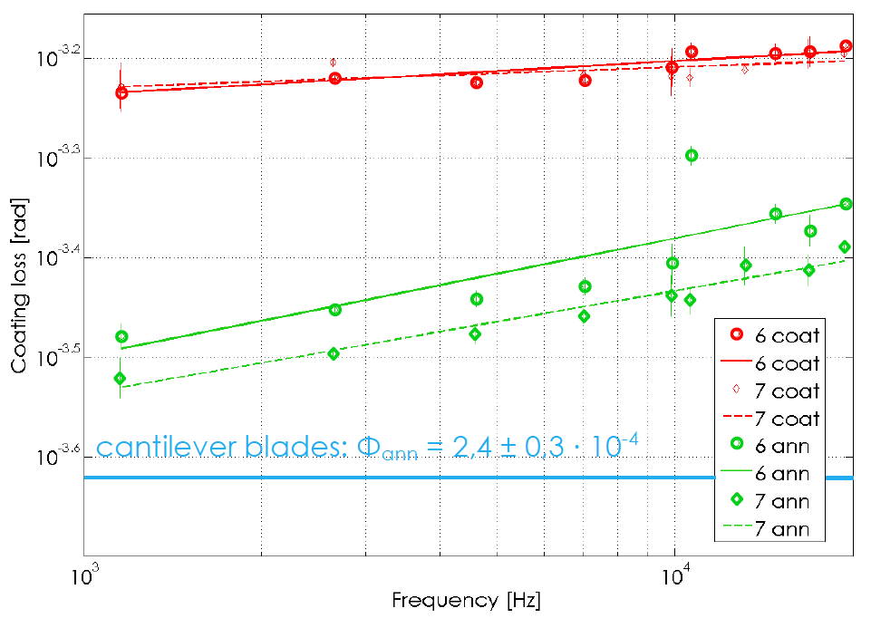
Measured CTN slope consistent with
LMA measurements of tantala loss angle
M. Granata
Tantala Loss Angle
~ f ^{0.1}
4.0
3.2
2.5
S. Gras, GWADW 2017
11

Slide 12
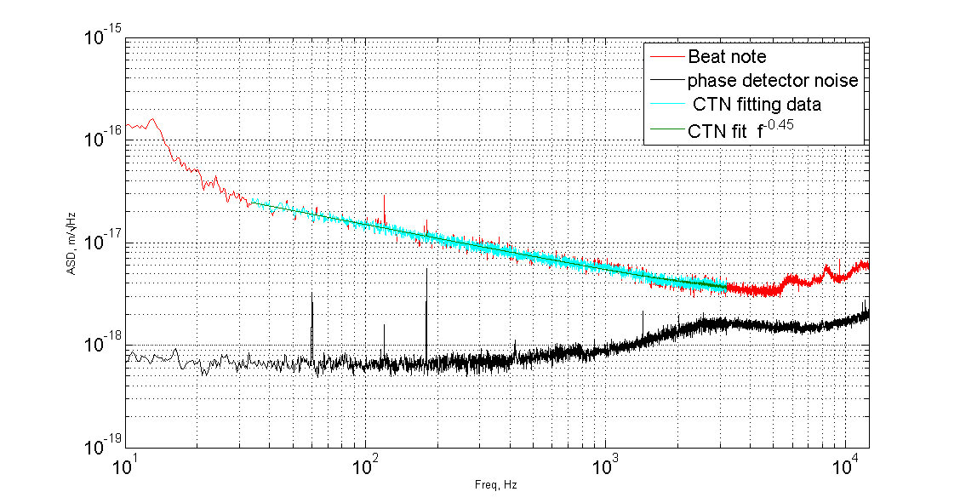
Measurement on LMA coating 'x2-doped' (see Granata’s talk)
Same slope (~ f ^{0.45}) as Advanced LIGO witness sample
S. Gras, GWADW 2017
12

Slide 13
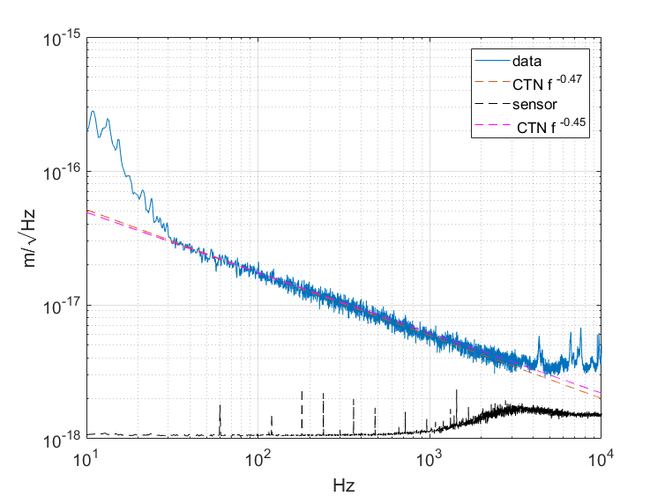
Measurement on Lincoln Lab coating
Coating: λ/4, (1H 1L)18 1H 2L @1064nm
T dep. = 120 C, 1.885 A/sec for SiO₂
1.934 A/sec for Ta₂O₅
Ta₂O₅ n=2.10099
SiO₂ n=1.47987
Different slope (~ f ^{0.47}) , CTN ~25% higher than aLIGO witness sample
S. Gras, GWADW 2017
S. Gras, GWADW 2017
8
13

Slide 14
On-going collaborations and future plans
MIT Lincoln Laboratory:
  coating machine that allows production of new coating designs
  Quick turnaround of coating production
LMA (more details in Granata’s talk)
Coming next:
  study of CTN vs beam spot size
  study of interface losses
  measurement of crystalline coatings
S. Gras, GWADW 2017
S. Gras, GWADW 2017
8
13

Slide 15
Summary
  So far the MIT multi-mode coating thermal noise experiment has measured two aLIGO samples, one LMA sample, and one test coating from Lincoln Lab
Improved experiment readout allows measurements with high SNR
Recent results
  improved measurement of Advanced LIGO samples shows slope ~ f ^{0.45}
  same slope observed in new LMA coating design (4% higher noise in amplitude over Advanced LIGO sample)
Transitioning to “facility” mode:
  We can measure any 1” flat high reflector
  Mirror swap + measurement now take one day, very quick
  IF YOU HAVE A NEW COATING TO TEST, LET ME KNOW!
S. Gras, GWADW 2017
S. Gras, GWADW 2017
8
14

Slide 16
Thanks!

Slide 17
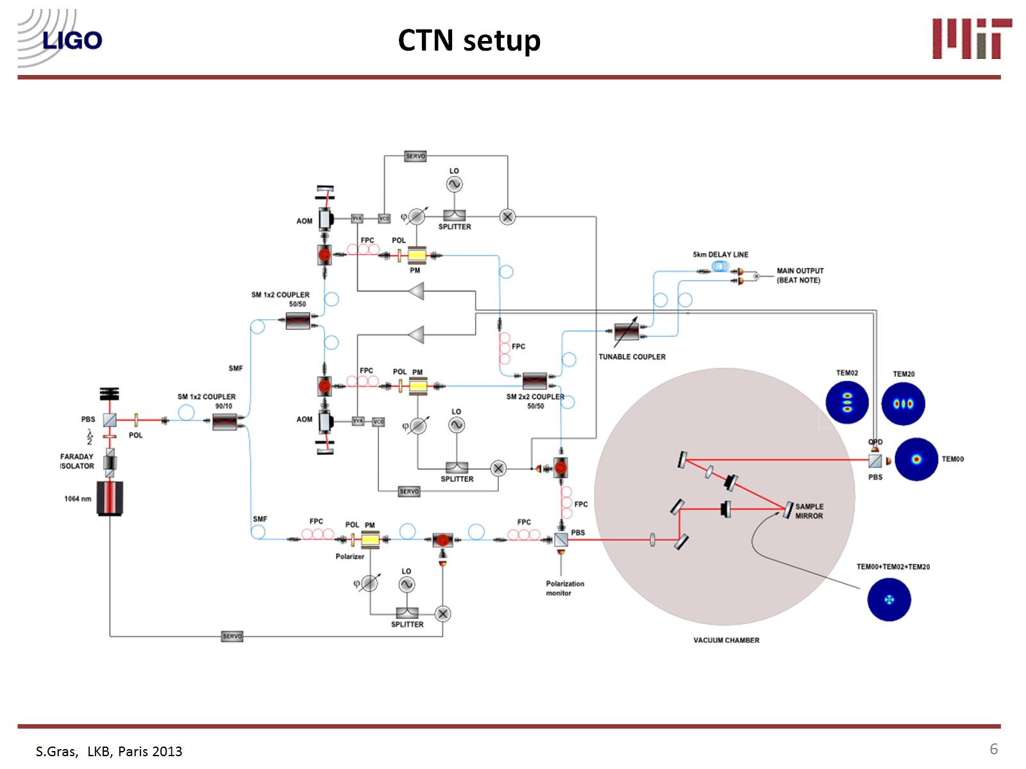
CTN readout is HOM
light beat-note
HOM readout is
transmission PDH
one laser, 2 AOMs: 3 different frequencies
mix of fiber and free space optics
W. Yam, S. Gras, M. Evans, Budapest 2015
11

Slide 18
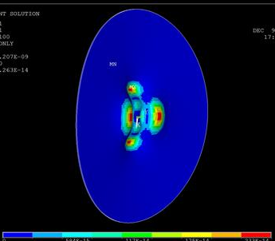
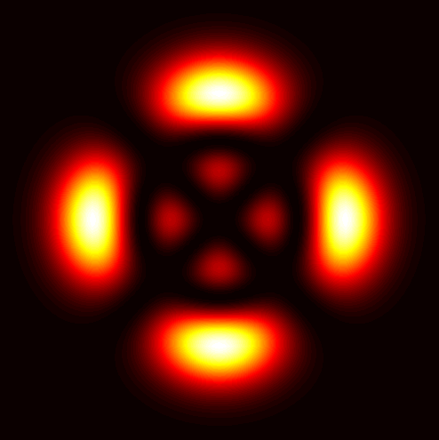
Coating Thermal Noise in TEM02 - TEM20 signal
(for our beam size, coating thickness,
and substrate material)
Intensity
(Intensity Difference)²
Levin Pressure

Slide 19
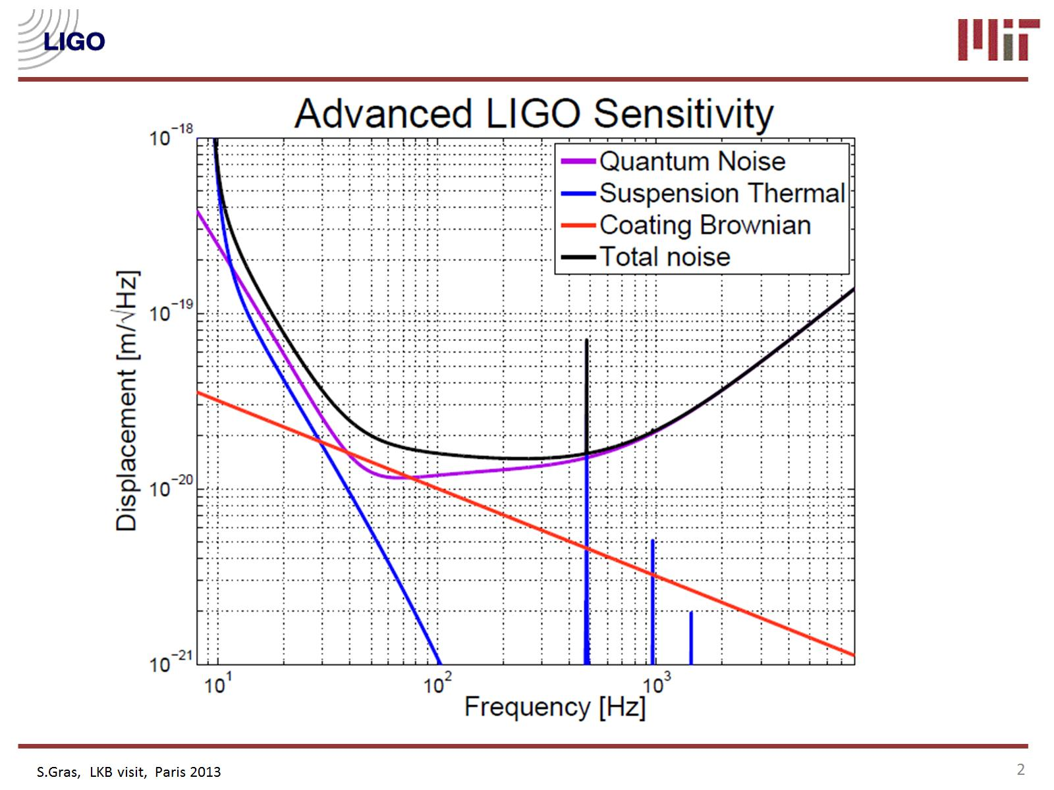
Why do we care
about CTN?

