Slide 1

Calibration Considerations for the 3G Detector Era
J. Kissel, for the LSC

Slide 2
Calibration Considerations for the 3G Detector Era
Open questions about 2G+/3G Requirements
The State of the Art in 2G calibration
The Seven Commandments of Calibration
Recommendations for the future

Slide 3
What Will Be Your Requirements?
Amplitude Uncertainty
Phase Uncertainty
XX %
YY deg
Sky Localization (3+ detectors)
Neutron Star Equations of State
Tests of General Relativity
Non-22 “Higher Order” Modes
Mass and Spin Parameters
Distance / Redshift Estimates
CBC rate (relies on volume estimate)
Continuous Wave and Stochastic Upper Limits
Sky Localization (for 2 detectors)
For GW150914 | 50% C.I. | 90% C.I
No CAL Uncertainty [deg²] | 48 | 150
With CAL Uncertainty [deg²] | 150 | 610
PRL 116, 241102 (2016)
Impacts are still open questions (quantitatively) – astrophysical searches and parameter estimators are just becoming sophisticated enough to include / marginalize over calibration uncertainty (e.g. PRD 85 064034 (2012))

Slide 4
Where are you now with 2G Detectors?
Systematic
Error
Perfect Calibration
Magnitude | Phase
5% | 3 deg
Statistical Uncertainty
(+ Systematic Error)
Perfect Calibration
CBC Search Freq Range
PRD 95.6 (2017): 062003.
LIGO-P1600139, in prep!

Slide 5

Assumptions about Your 2G+/3G Detector
Since requirements aren’t clear, let’s say you want 1% / 1 deg
You’re using the similar 2G IFO topology / readout
  a Dual Recycled, Fabry Perot Michelson,
  hoping for Resonant Sideband Extraction
  using homodyne readout
  with squeezed light injection
You need data calibrated from 10 Hz to 5000 Hz
  Which means you really need to understand from 5 to 7000 Hz
You’re comparing your results against an international network
With these, I bring you the Seven Commandments of Calibration

Slide 6
1) Your GW Response Will Be More Complicated than You Want It To Be
To calibrate the digital loop error signal, d_{err}, back into differential arm length change,
response to differential arm length change in the absence of a control loop
Buonnano and Chen (2001) , with the help of Rob Ward , and Evan Hall , taught us that, for resonant side-band extraction (RSE), depends on
The ITM transmission
The SRM transmission
The one-way SRC gouy phase
The homodyne readout angle
The optical gain, which depends on these and
The power on the Beam Splitter
For ideal resonant side-band extraction, with it reduces to

Slide 7
1) Your GW Response Will Be More Complicated than You Want It To Be
But if or are not exactly 90 deg, then it gets ugly:
Open question – squeezing vs detuning?
From E. Hall P1600295

Slide 8
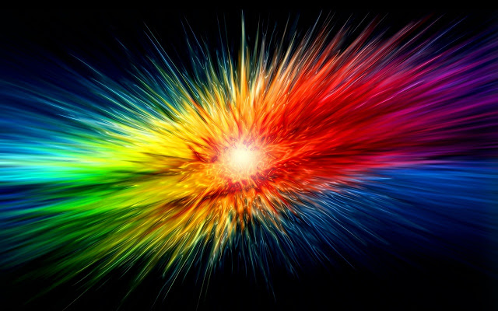
2) And You’ll Have to Invert it…
Electromagnetic partners require low-latency
Need semi-real, if not real-time calibrated data
Can use FIR or IIR filtering, but needs to be virtually causal
Must make a ZPK representation of the ugly …
Luckily, for small detuning we approximate with 5 params…
T1600278, LHO aLOG 31693

Slide 9
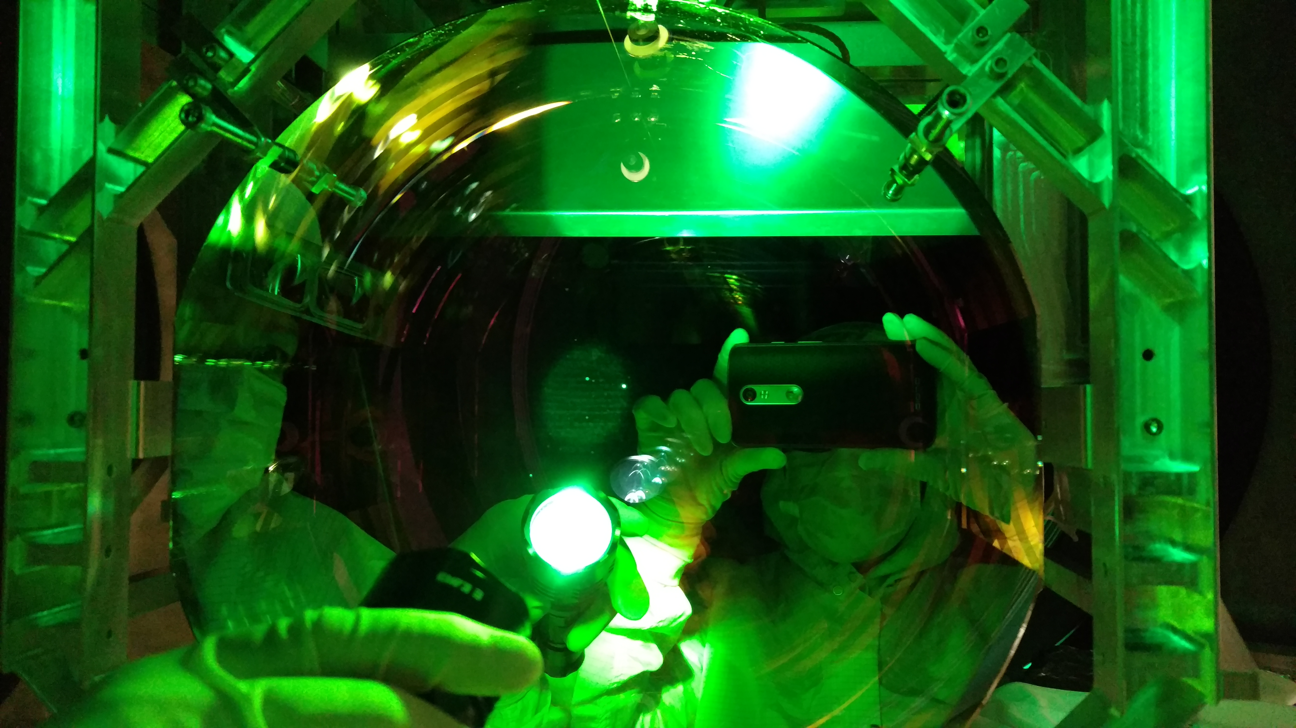
2G Detector Example
Yesterday…
LHO aLOG 36108
Back in April…
LHO aLOG 35327

Slide 10
2G Detector Example
f_{cc}= 343.4 +/- 2.6
f_{cc} (Nominally) = 368Hz
f_{s} = 7.4 Hz +/- 0.04
Q = [poorly measured]
(Nominally None**!)
Measurement from H1 detector on 2017 Apr 27
Measurement Technique
PRD 95.6 (2017): 062003.

Slide 11
3) Your Response Will Be Time Dependent
f_{s} (t) over ER10 / O2
-> 5 Hz spread
f_{cc} (t) over ER10 / O2
-> 20 Hz spread
Measure it at all times (Calibration Lines)!
CQG 34.1 (2016): 015002, LIGO-T1700106
If it matters for your astrophysics,
PRD 93.12 (2016): 122003., G1501407
correct it!

Slide 12
4) You’ll Fight Your Awesome Isolation
Sensing Function is only half of the problem…
Lowest stages of actuator provide in-band control – must be well-calibrated
BUT tough to measure because lowest stage is also typically the weakest actuator
  May have to measure in higher noise / different response configurations
  Don’t forget about early commissioning periods, when sensitivity is poor

Slide 13







5) Your Reference Will Not Be Perfect
Your reference calibration may have systematic error
  Error for aLIGO PCALs = 0.8%RSI 87.11 (2016): 114503
  American NIST Calibration of
  LIGO Power Meter = 0.44%
  But what about other countries?
Systematic Errors within Calibration Methods
  Clipping, laser decay, in Photon Calibrator
  Slow Angular Fluctuations during Free-swinging Michelson
  Non-linearities in RF Oscillator
S Kueck (2010)
4
3
2
1
0
-1
-2
-3
-4
Relative Absolute Power (%)
Relative Actuation Strength
PRD 95.6 (2017): 062003.

Slide 14
6) Your Calibration will change between Runs
Incremental improvements (and unforeseen retrofits) mean the calibration of your instrument will change a lot
Must have a model that’s flexible enough to handle changing details
Must remind colleagues that 1%/1 deg calibration is not just a quick “once before the run” person-power requirement
P1200087

Slide 15
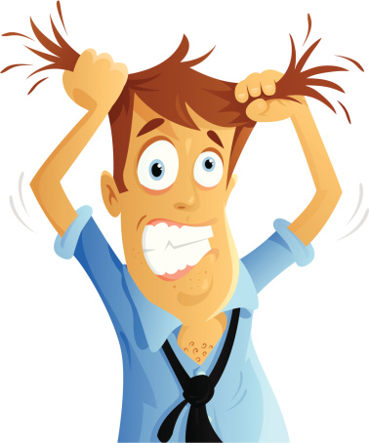
7) During a Run, having confidence in 1% / 1 deg throughout will Stress You Out!
To get 1% overall for, say, 10 terms, you need to know them all to 0.1%
  Similarly, if you’re declaring something “negligible” you better measure it really well.
Must know and watch as many details as possible
  Difficult if detector is built over years by an army of people inconsistently taking and documenting their measurements
  (e.g every peice of LIGO-G1501518)
Measurement & model parameter bookkeeping is a nightmare
  You will forget all the factors that you have to consider
  Physicists are terrible librarians

Slide 16
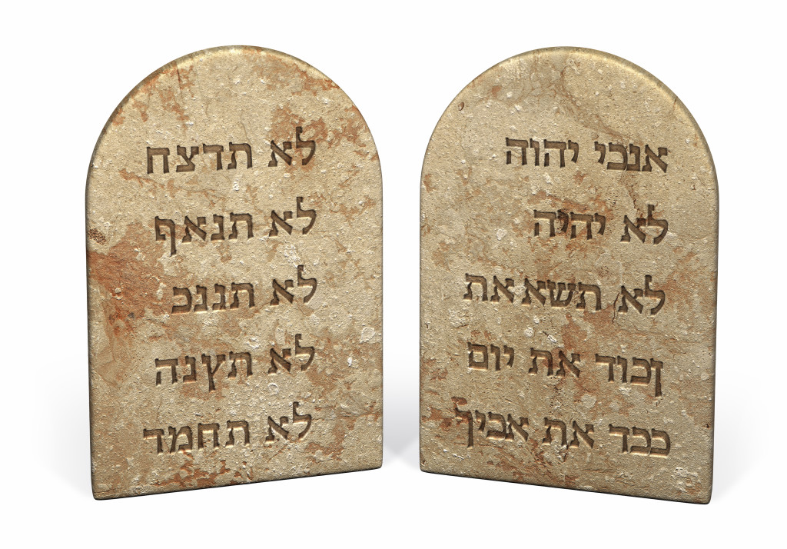
In summary
Any one can build a calibration to within a factor of 2 once.
But can you build a 1% / 1 deg calibration over ~1 year?
Seven Commandments of Calibration
Your GW response will be more complicated than you want it to be
You’ll need to invert it
It will be time dependent
You’ll be fighting your awesome isolators
Your reference will not be perfect
Your calibration will change between runs
1%/1 deg will be a bookkeeping nightmare

Slide 17
What do you need for 2G+/3G?
Calibrators / Actuators capable of
  arbitrary waveform generation with
  strength to actuate over entire (and outside of) detection band
  at all stages of commissioning
Comparisons of absolute reference across continents
Take the time to get to know your detector, and plan for the worst
Librarians (not grad students!) who are adaptable to change
A giant sense of patience, diligence, and adaptability.

Slide 18

Here’s a start…
Thank you!

