Slide 1

Next Generation Low Frequency Control Systems
J. Kissel, for the LSC
GWADW, 2017 May 8

Slide 2
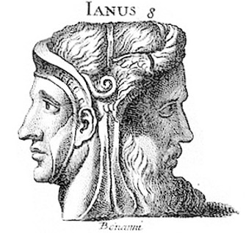
Current 2G Low Frequency Problems
Should consider two types of low frequency problems:
One important for Volume the other for Time.
Excess Low-Frequency Motion Causing In-Band Noise
Low-Frequency/Environmental Impacts on Duty Cycle
Scattered Light
Angular Control
Glitches / Non-Stationarity
Intra-cavity Thermal Mode Evolution
Environmental Thermal Control
Tilt Confusion Noise
Earthquakes

Slide 3
Excess Motion: Scattered Light
As optical configurations get more sophisticated and beams get bigger – there will lot more scattering surfaces in and around the core resonant cavities
  May need more sophisticated math/physics too – see G1700320
aLIGO has learned that one must pay much attention to baffles and dumps early and often in the design
  but somehow without occulting too many views of those optics (optical levers, cameras, photon calibrators, auxiliary interferometers)
2G Examples: Parasitic IFOs and Scattering Ports are everywhere, not just in Arm Cavities
Implications for 2G+ / 3G IFOs: Many suspended / sensed / controlled Baffles
Input Optics Baffle LHO aLOG 35735
PCAL Periscope LLO aLOG 33015
JGW-G1706410
LIGO-G1700404

Slide 4
Excess Motion: Angular Control
2G Examples: You just heard M. Kasprzack’s Talk…
Early commissioning phases are the most challenging for any generation
If shot noise limited, light pickoffs for ASC error signals are a balance of
  how much current can sensors handle
  how much optical loss you are willing to tolerate
If electronics noise limited -- are there areas for electronics noise improvements?
  Rich Abbott says “Not that I know of, if there were I would used them!”
Must be able to account for changes in plant with IFO power (especially during lock acquisition)
Implications for 2G+ / 3G detectors: Elastic Waistband, Belt and Suspenders:
  Reduce the input: We should continue to pay attention to Low-Frequency Seismic control in *all* degrees of freedom
  Increase Observability and Control: Must have excellent noise, stable, local angular sensors to complement global sensors
    Connect seismic platforms with Seismic Platform IFOs LIGO-P1300043
    In-vacuum EUCLIDs? LIGO-P1300051, LIGO-C1600066
    A 3G worthy optical lever?

Slide 5
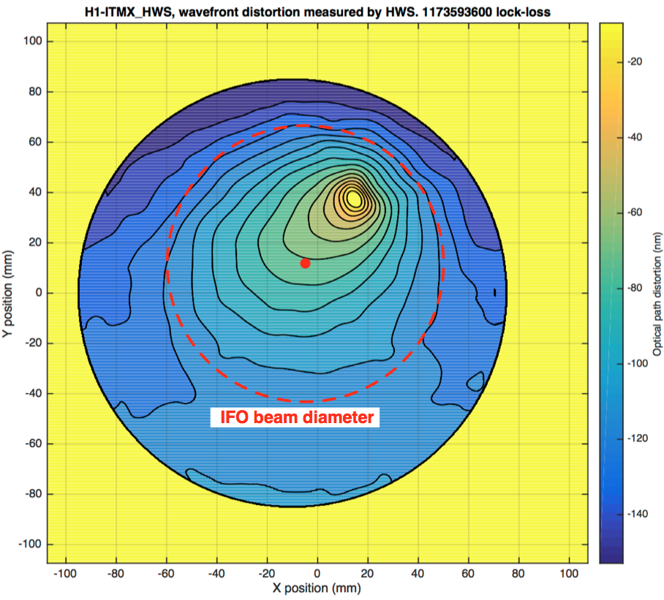
Excess Noise: Intra-Cavity Thermal Control
Optic thermal modal distortions evolve on the time-scales of 1-4 hours impacting (with 2G Examples):
  Interferometric Sensing and Control Signals (LLO aLOG 17792),
  Noise couplings (LHO aLOG 26264),
  Parametric Instabilities (LLO aLOG 17016),
  Response to Gravitational Waves (LHO aLOG 35041)
Spend time with your Optical Mode Sensor Array!
  Sensors for optical mode matching like HWS and bullseye
  WFS should not be an after thought
2G+ / 3G optical layouts hope to push the limits
of matching 5- 10 cavities:
Implications for 2G+ / 3G IFOs: Active wave-front
sensing and control essential
  See talks in Day 5 Plenary Session
LHO aLOG 34900
S
FC
IMC
SQZ
X-arm
PMC JAC IMC (IMC2?) PRC XARM YARM
SRC SQZ FC1 (FC2?) OMC (OMC2?)
PRC
SRC
Y-arm
OMC
LIGO-G1500372
w

Slide 6
Duty Cycle: Environmental Thermal Control
Vacuum Enclosure Area Temperatures evolve on 12 to 24 hour time-scales
2G Examples:
  large changes in DC alignment LHO aLOG 32757
  suspensions sagging and rubbing LHO aLOG 32746
  laser polarizations swing around LHO aLOG 31471
  2G+ / 3G Implications: Suspensions are going to be long with low resonance frequencies
  Low-noise in-vacuum temperature sensing
  Excellent thermal control of Vacuum Enclosure Areas
LIGO-G1500590

Slide 7
Duty Cycle: Tilt Confusion Noise & EQs
2G Examples: An array of ground rotation sensors – Demonstrable Improvements to IFO Duty Cycle at LHO
  Venkateswara, K., et al. RSI 85.1 (2014): 015005.
  Venkateswara, K., et al. BSSA 107.2 (2017): 709-717.
  LIGO-G1700331, LIGO-G1700346, LIGO-G1700246
You just heard Conor’s Talk…
2G+ / 3G Implications:
You better have
  Rotation Sensors -- someone convince Krishna to commercialize!
  Seismic Platform InterferometersLIGO-P1300043, arxiv:1201.4718, LIGO-G1401221
Adaptable local / global control for Eqs
  LIGO-G1700328

Slide 8
Conclusion: Build the Control System into Your Design
Build mechanical elements with intent to control
  Simple plants
  Low-Q at all frequencies
Observe and control as many DOFs as possible
  The ones you don’t control will always give you a headache later!
Don’t forget Early Commissioning Days when you don’t have all the control systems tuned
  Build a large dynamic range into you global control or
  Accept several stages of “integrated testing” and a slow crawl to design sensitivity as you change out hardware
… It’ll still detect Gravitational Waves!

Slide 9
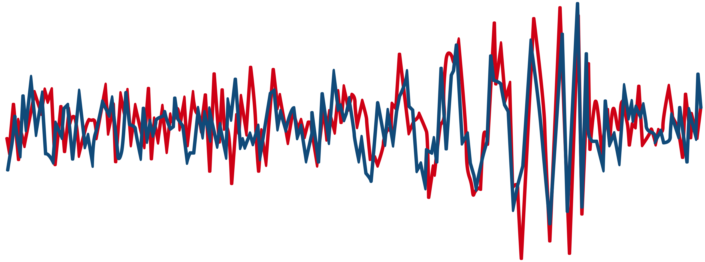
Thank You :: Let’s Discuss!

