Slide 1
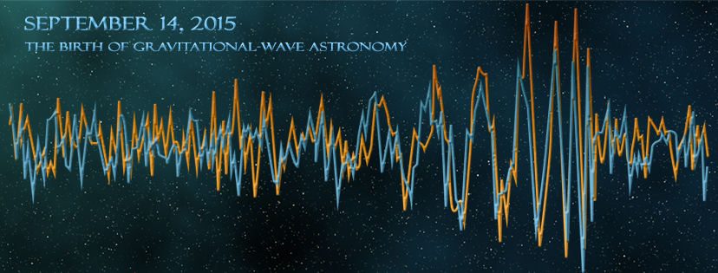
Characterization of Advanced LIGO Core Optics
GariLynn Billingsley, Hiro Yamamoto, Liyuan Zhang
ASPE Topical Meeting
Precision Engineering and Optics
April 24-25, 2017
Notes:
I manage the fabrication and test of the Core Optics,
2 detections
Six triggers

Slide 2

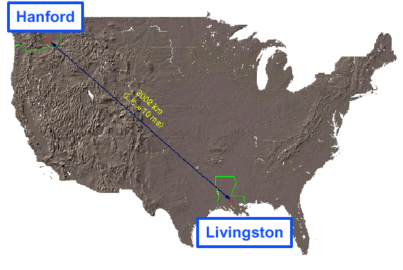

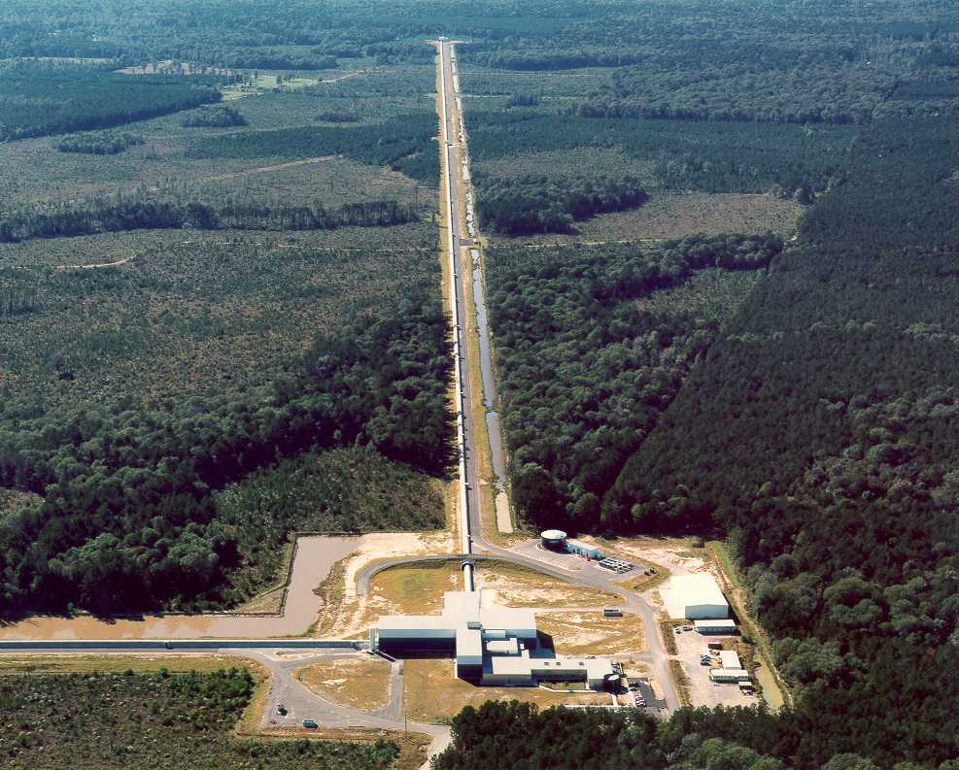
LIGO Laboratory: two Observatories and Caltech, MIT campuses
Mission: to develop gravitational-wave detectors, and to operate them as astrophysical observatories
Jointly managed by Caltech and MIT
Requires instrument science at the frontiers of physics fundamental limits
MIT
Caltech
LIGO Livingston
Notes:
LIGO is actually two observatories.
Describe parameters
Emphasize that the arms are in ultra high vacuum. 8 km of steel 1.2 m dia beam tubes at each site
Separate observatories allow for coincidence detection – since the detectors see uncorrelated noise, only a true gravitational wave would appear on all the interferometers with the correct amplitude.
Emphasize that the LIGO Observatories were designed and are operated by Caltech and MIT

Slide 3
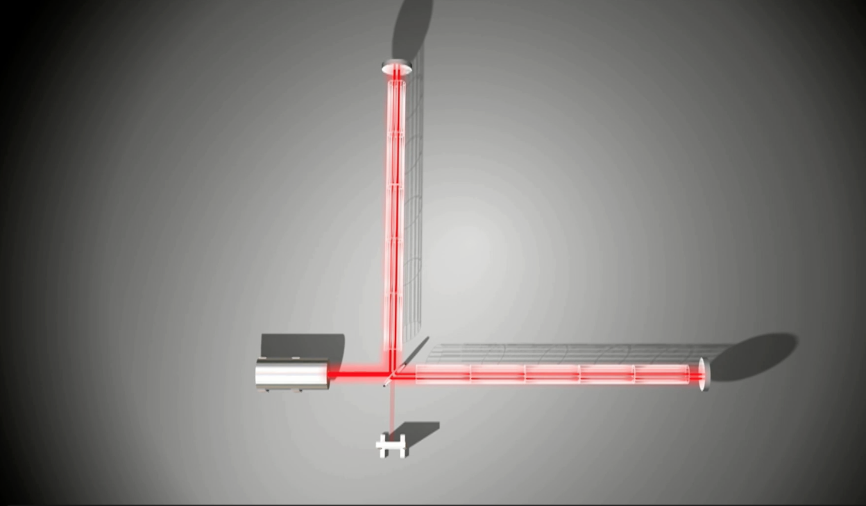
The basic LIGO layout
Notes:
Mirrors that float in space????

Slide 4
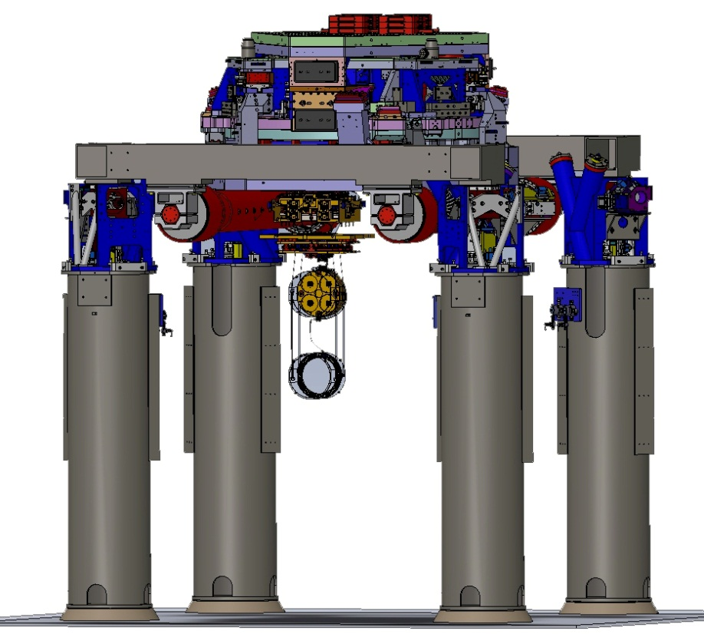
A close approximation of floating
active isolation platform
(2 stages of isolation)
hydraulic external pre-isolator (HEPI)
(one stage of isolation)
quadruple pendulum (four stages of isolation) with monolithic silica final stage
Notes:
Seven stages of isolation!
Betsy and Travis will go into the details of the mirror suspension
Still this is a noisy environment for the mirrors!
Let’s take a look at some noise sources.

Slide 5
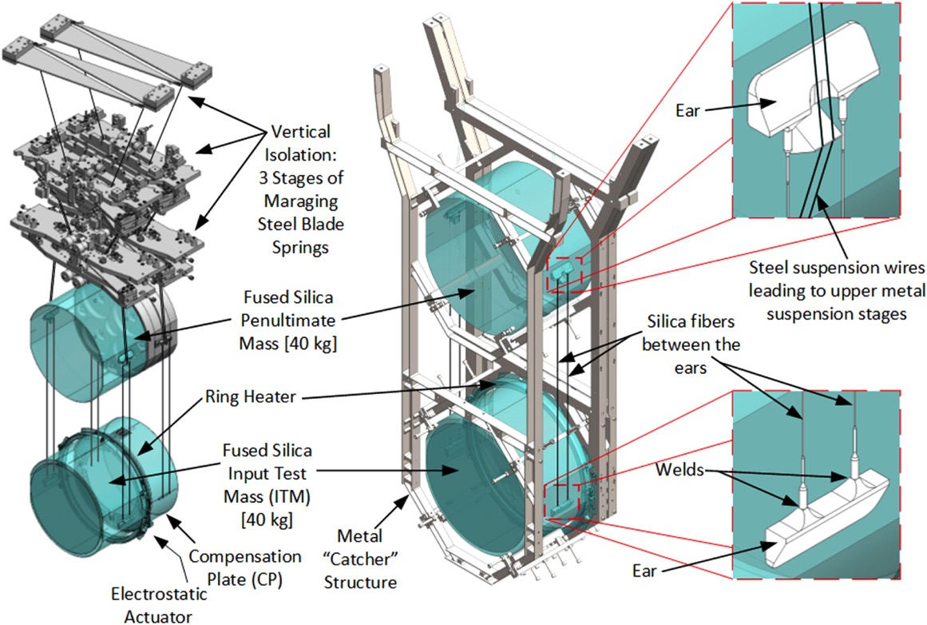
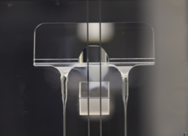
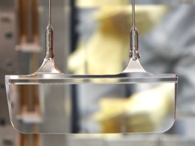
Advanced LIGO Suspensions

Slide 6
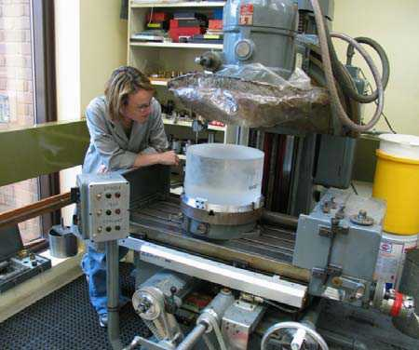
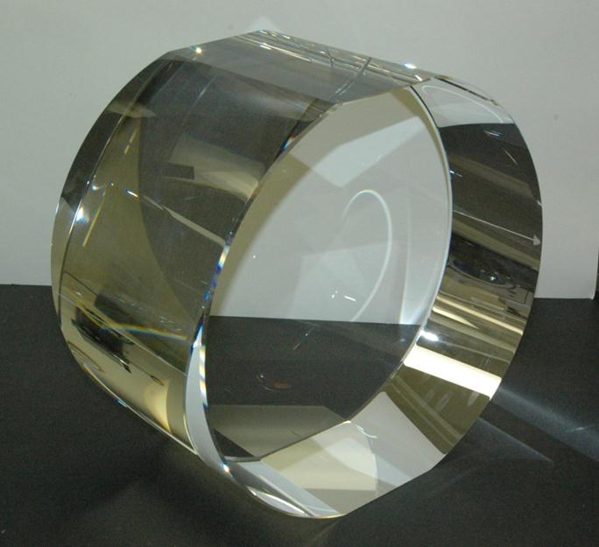
340 mm ⌀, 200 mm thick
40 Kg Fused Silica

Slide 7
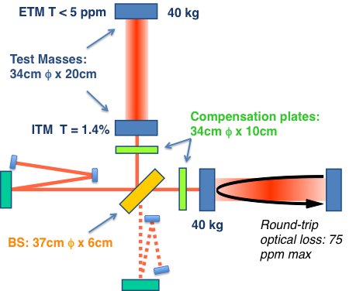
Core Optics
And
Much
More
Notes:
Power recycling – enhance input power by factor of 40
Signal recycling – cleanly extract the GW signal
Fabry-Perot arm – effectively extend the michelson arm length by a factor of 100

Slide 8
Arm Cavity Loss details:
Results are within budget
Round Trip Cavity loss 2 surfaces (ppm) | Design Budget (ppm) | Actuals (modeled) based on average of completed pieces in 2013 (ppm)
Microroughness scatter (>1/mm) | 8 | 4.4; 2.2 Per mirror
Defects (Polish, Coating, Contamination) | 26 | 20; 10 per mirror includes polish and coating
Coating Absorption | 1 | 0.6; 0.3 per mirror
Surface Figure Error & Diffraction | 24 | 16.2
ETM Transmission | 5 | 4.2
Total ( required < 75 ppm) | 64 | 45.4

Slide 9
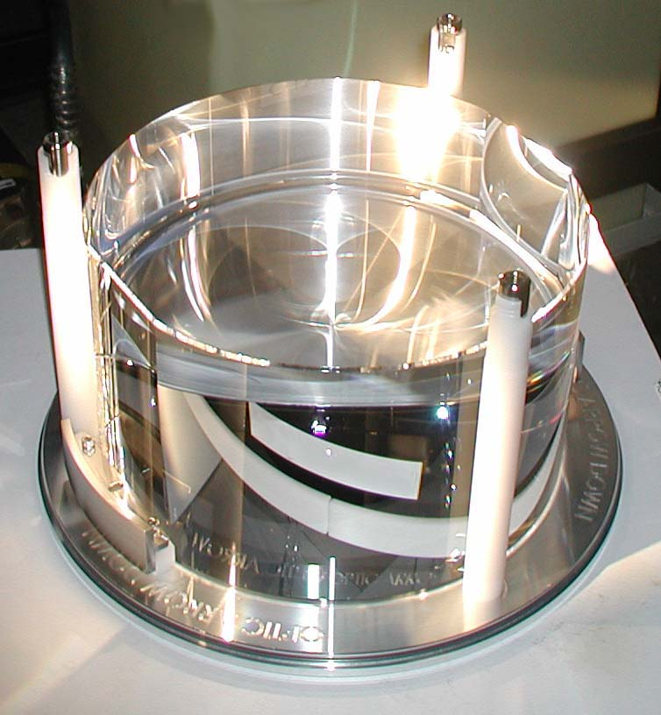
Design approach
Fused silica substrates
  Low OH Fused silica used for in-cavity optics:
    Beam Splitter
    Compensation Plate
    Input Test Mass
Two step polish:
  Superpolish: ~1 Å microroughness, within 100nm of figure
  Ion Beam Figuring: Corrects figure, maintains microroughness
Ion Beam sputtered coating
  Test Masses coated at LMA
  – Lyon France
  Recycling Cavity optics coated at CSIRO
  – Lindfield Australia

Slide 10
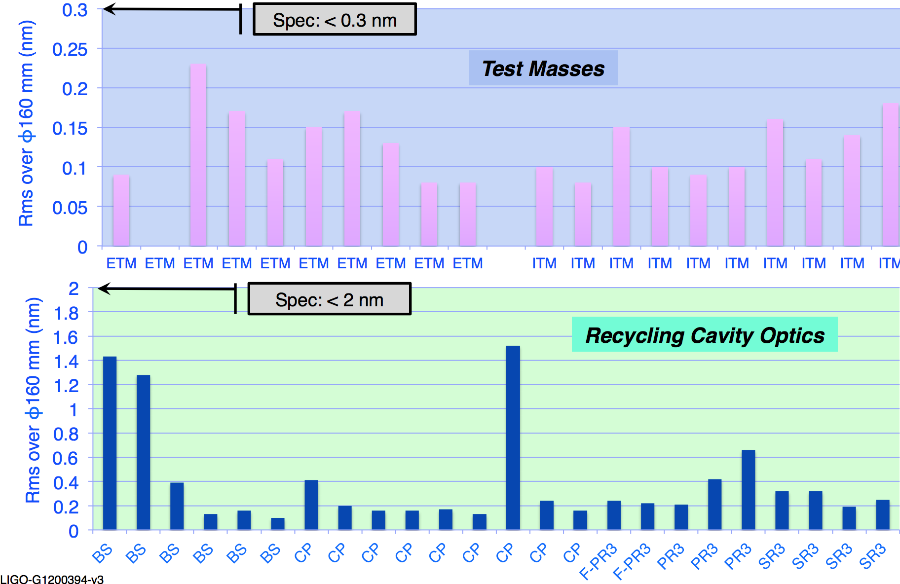
Figure, as polished
Tilt, Power and Astigmatism removed

Slide 11
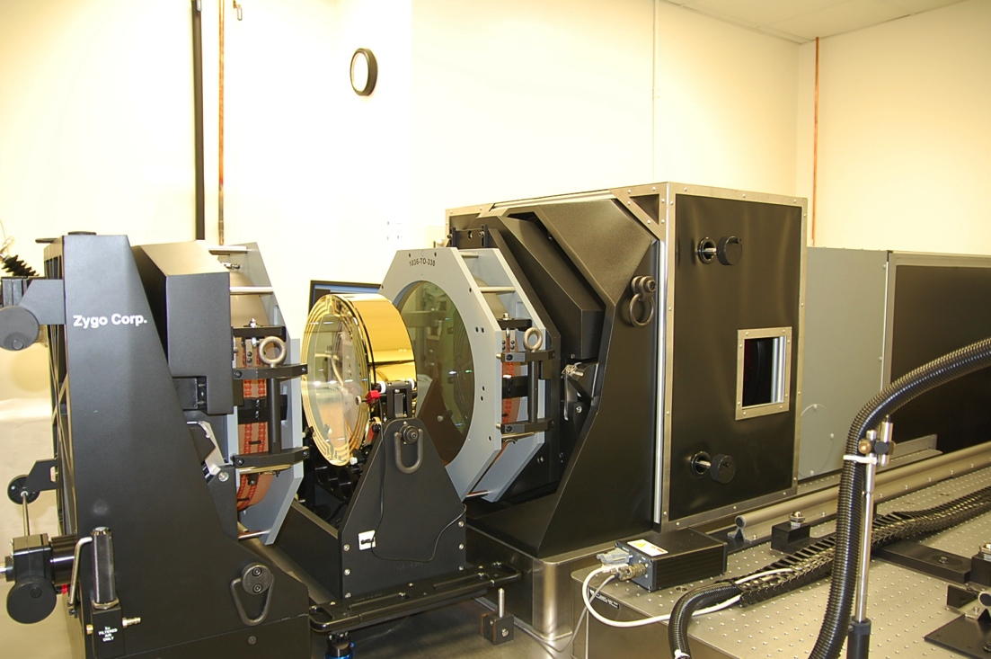
LIGO Figure measurement:
Fizeau Interferometer
Zygo interferometer installed at Caltech, 1064 nm
4 magnifications; 1X, 2X, 10X, 20X
The instrument and environment are quite stable, showing a uniform noise floor of 0.1 to 0.15 nm rms.
  Polishing requirement
  is 0.3 nm rms
  Vendor reports some surfaces at 0.08 nm rms
Good agreement with
Polishing vendor
measurements

Slide 12
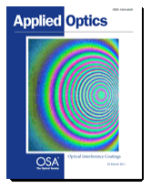
Before and after coating measured on different instruments
300 mm diameter, same color scale, Power subtracted (∆ 3.5nm)
Uncoated (Zygo EPO)
11.4 nm PV 1.7 nm rms
Coated at CSIRO (LIGO)
9.8 nm PV 1.6 nm rms
Mark Gross, Svetlana Dligatch, and Anatoli Chtanov,
"Optimization of coating uniformity in an ion beam sputtering
system using a modified planetary rotation method,”
Appl. Opt. 50, C316-C320 (2011)
Notes:
Not because it’s our best surface, but because it has readily identifiable features – allows us to make a direct comparison

Slide 13
Before and after coating measured on different instruments
Zygo instrument
λ = 632 nm
Res = 267 µm
LIGO instrument
λ = 1064 nm
Res = 400 µm
nm² mm
Spatial Frequency 1/mm

Slide 14
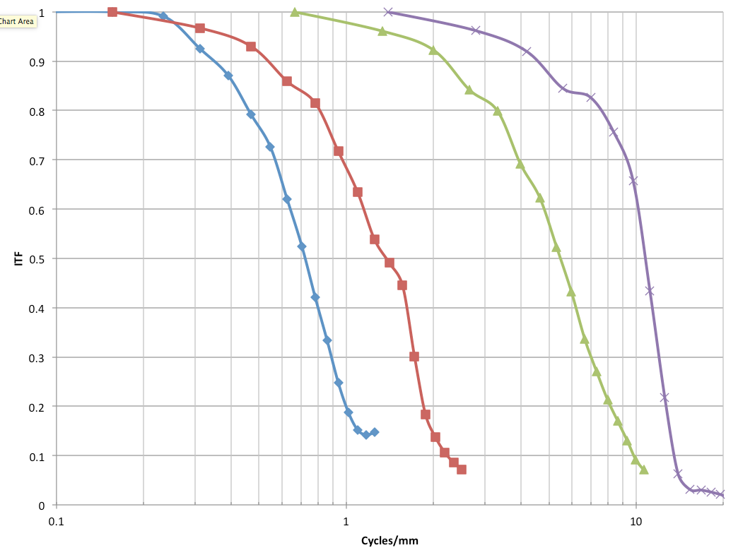
Instrument transfer function
Provided by Zygo Middlefield

Slide 15
Instrument transfer function
Correction?
Coated 1X
Data scaled by
Interferometer transfer function
Uncoated
(measured by Zygo)
Coated 10X

Slide 16
Compare 1x data to 10x using different methods
}30 mm aperture
1 center set minus average of 10 random sets used as reference
nm² mm
2 center sets. Each minus average of 10 random sets (used as reference.) Average using fiducials
Same method as 1X 80 mm cavity
C. Evans and R. Kestner, "Test optics error removal," Appl. Opt. 35, 1015-1021 (1996).
Same method as 1X, but 130 mm cavity
Spatial Frequency 1/mm

Slide 17
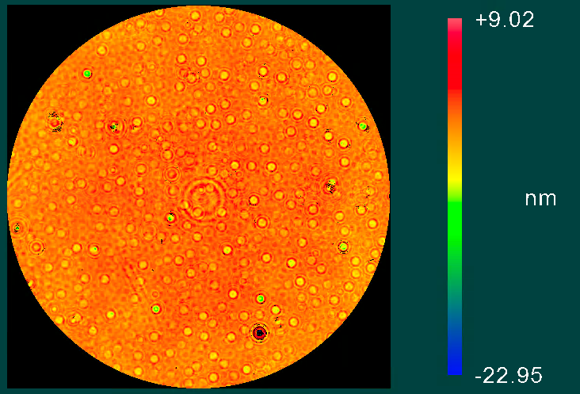
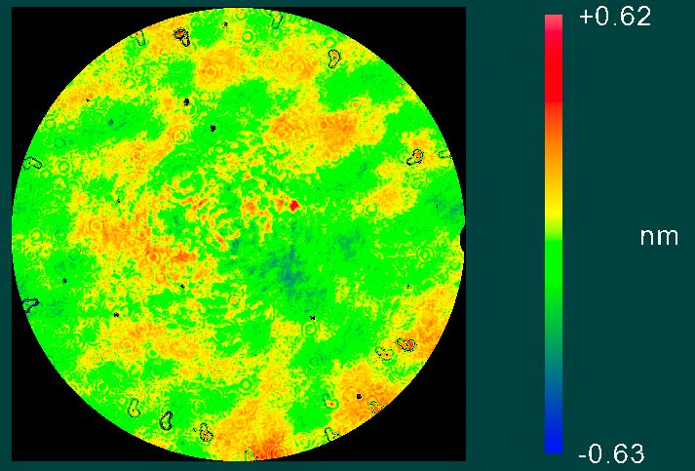
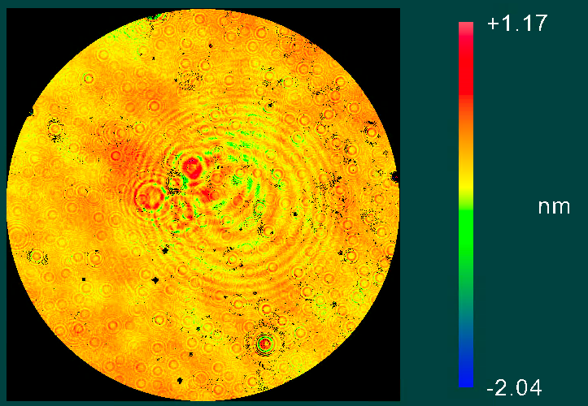
10X taken with a cavity length of 80 mm

Slide 18
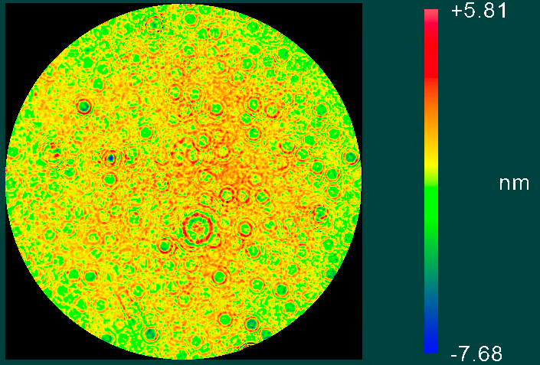
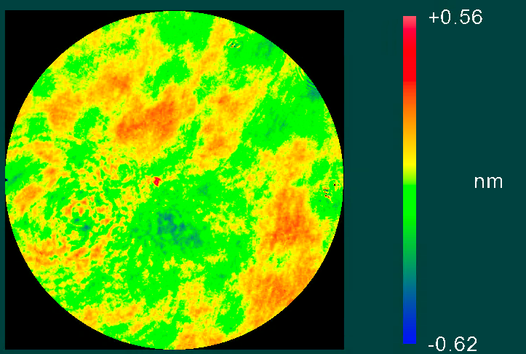
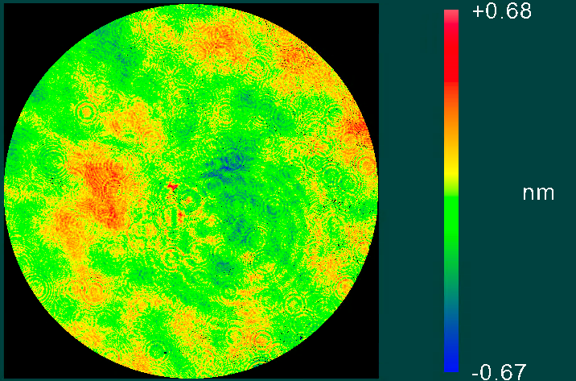
10X taken with a cavity length of 130 mm

Slide 19
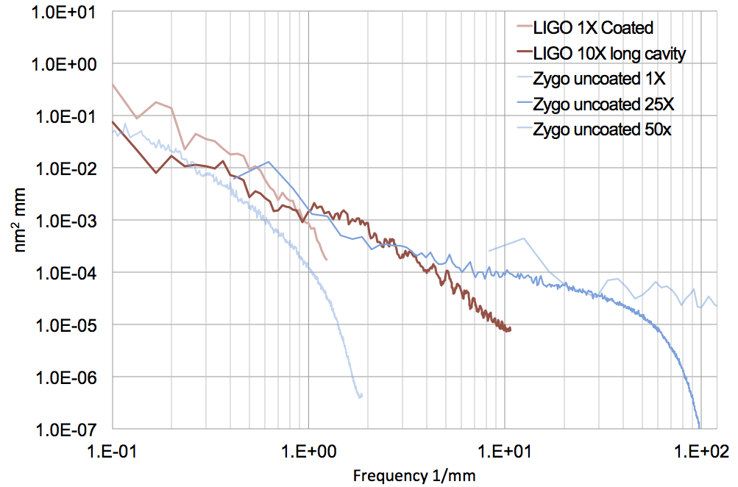
PSDs of ETM11 Compare Coated and Uncoated

Slide 20

















































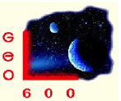




























LIGO Scientific Collaboration

Slide 21
Thank you
See also
losc.ligo.org dcc.ligo.org
Notes:
I manage the fabrication and test of the Core Optics,
I first came to CSIRO 20 years ago when working with
Betsy and Travis then figure out how to integrate those optics into the LIGO detectors.
We are here at CSIRO to assist in the coating of one of the LIGO optics.
There is a LOT of media available
summarize the detection briefly,
then go on to describe the hardware

Slide 22
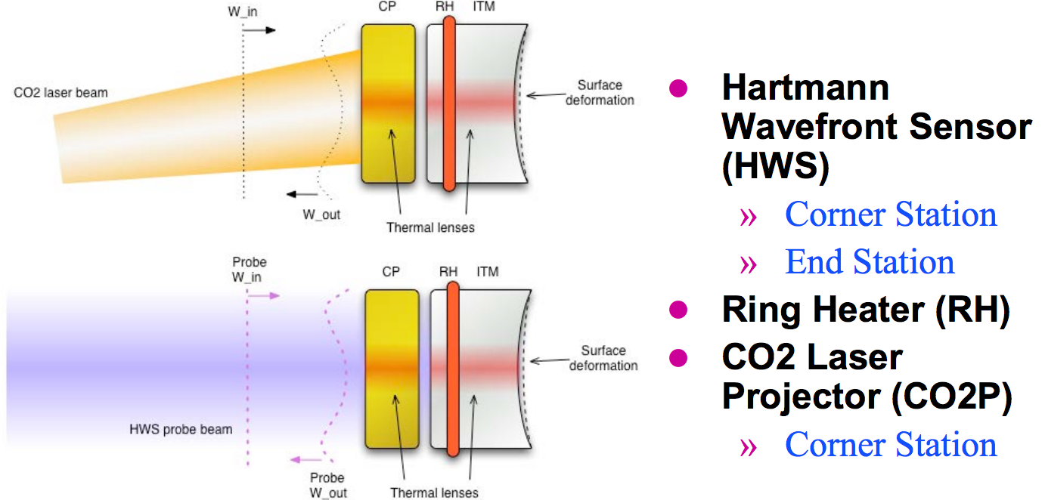
Compensation plate and ITM

Slide 23
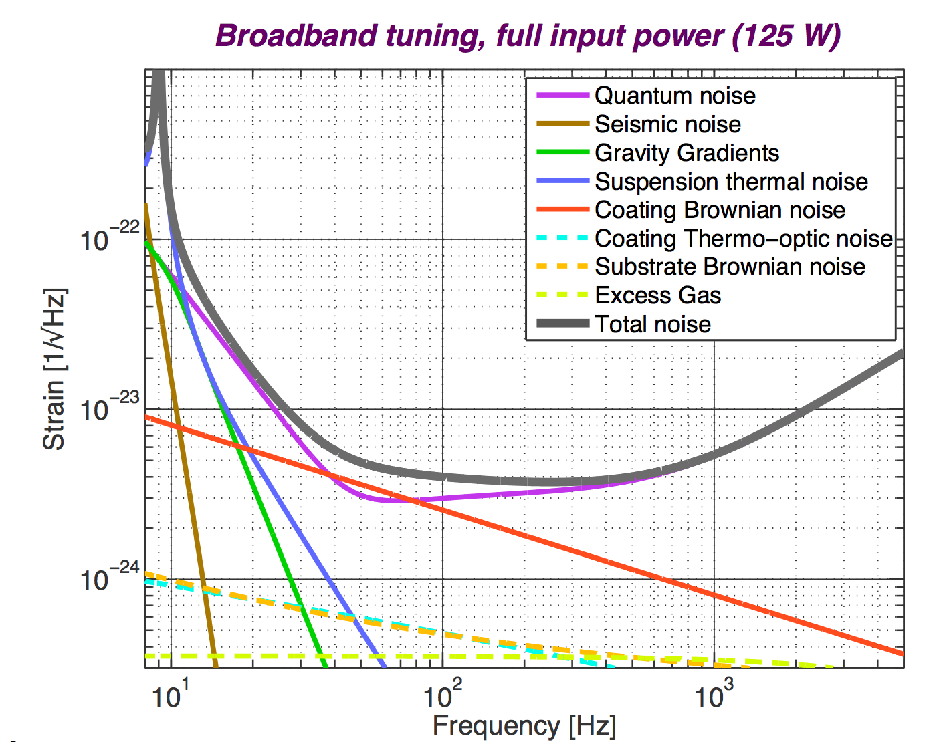
Noise summary
Limiting noise sources at 40 Hz:
Quantum noise
  Shot Noise
  Radiation Pressure
Coating Brownian noise

