Slide 1
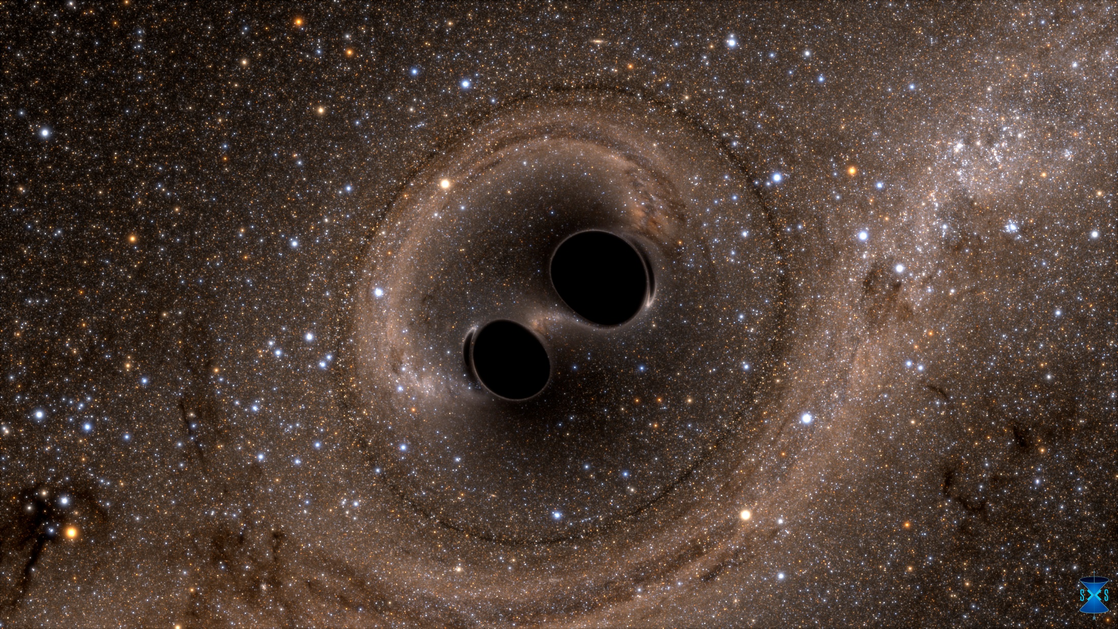
Laser Interferometer
Gravitational-wave Observatory
Where do we stand?
Daniel Sigg
LIGO Hanford
Observatory
California Institute
of Technology
GWADW 2017,
May 8, 2017
For the LIGO Scientific Collaboration and the Virgo Collaboration
LIGO-G1700726-v2

Slide 2
Stated Goals for O2 | How did we do?
Diagnose & reduce low frequency noise (f < 150 Hz) | Only small improvement on L1 Identified scattered light as needing work
Double the laser power (100 kW -> 200 kW arm power) | Got close with H1, but with a noise penalty
Work on transient noises and spectral lines | Some progress
More robust operation (low-noise duty cycle) | Definite payoff from suspensions dampers & seismic (tilt sensors)

Slide 3
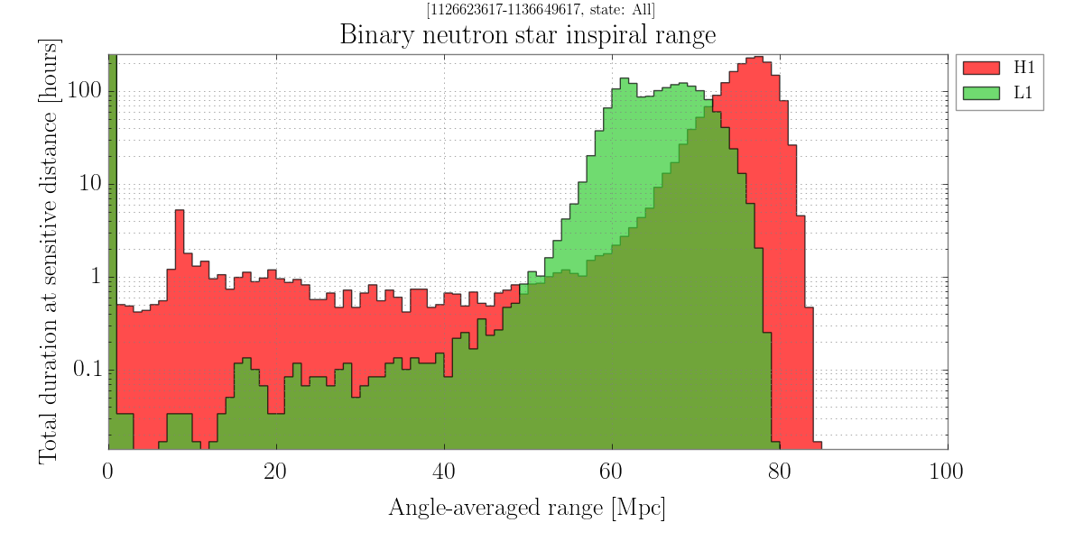
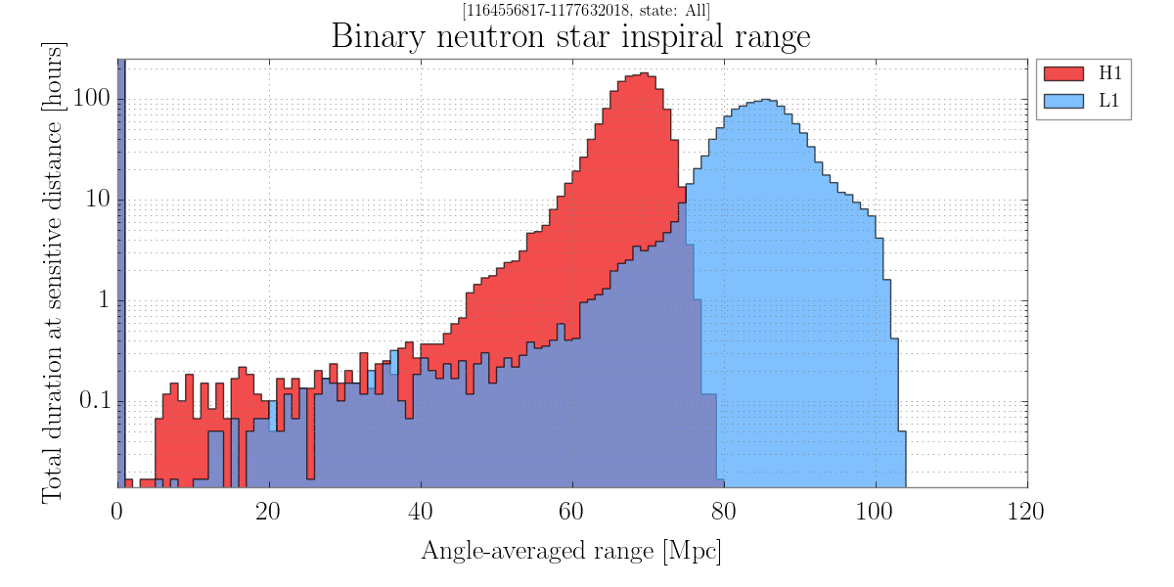
Volume-Time product now about the same for O1 & O2
O1
Start:
Dec 2016
End:
Aug 2017
2nd Observation Run
O2
Goal was 80-120 Mpc

Slide 4
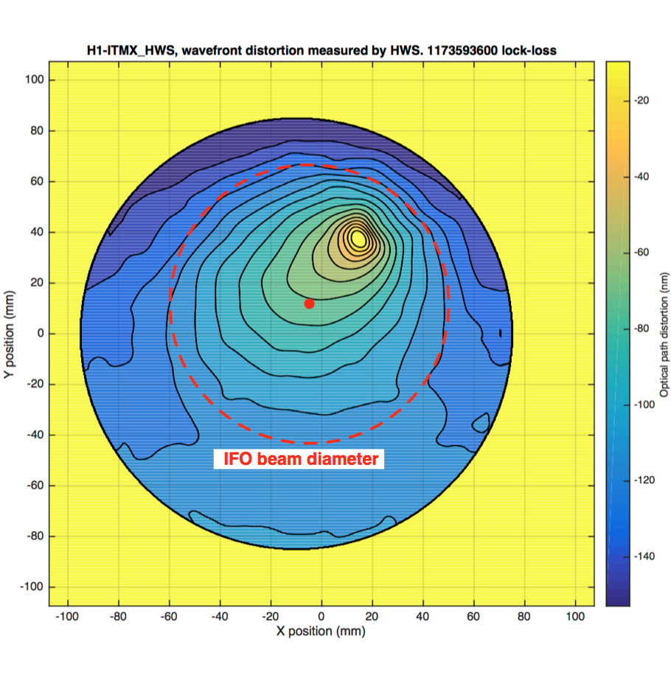
~60 nm distortion over 20 mm
Hartmann Wavefront
Sensor Image of ITMX
Small point absorber (~10mW)
Resulting phase front distortion is problematic:
RF sideband build-up
Wavefront sensing
Noise couplings
Higher-order mode jitter!
PI damping successful
(10 modes at 50W)
Thermal compensation worked
But: Noise worse at 50W
LHO High Power Work

Slide 5
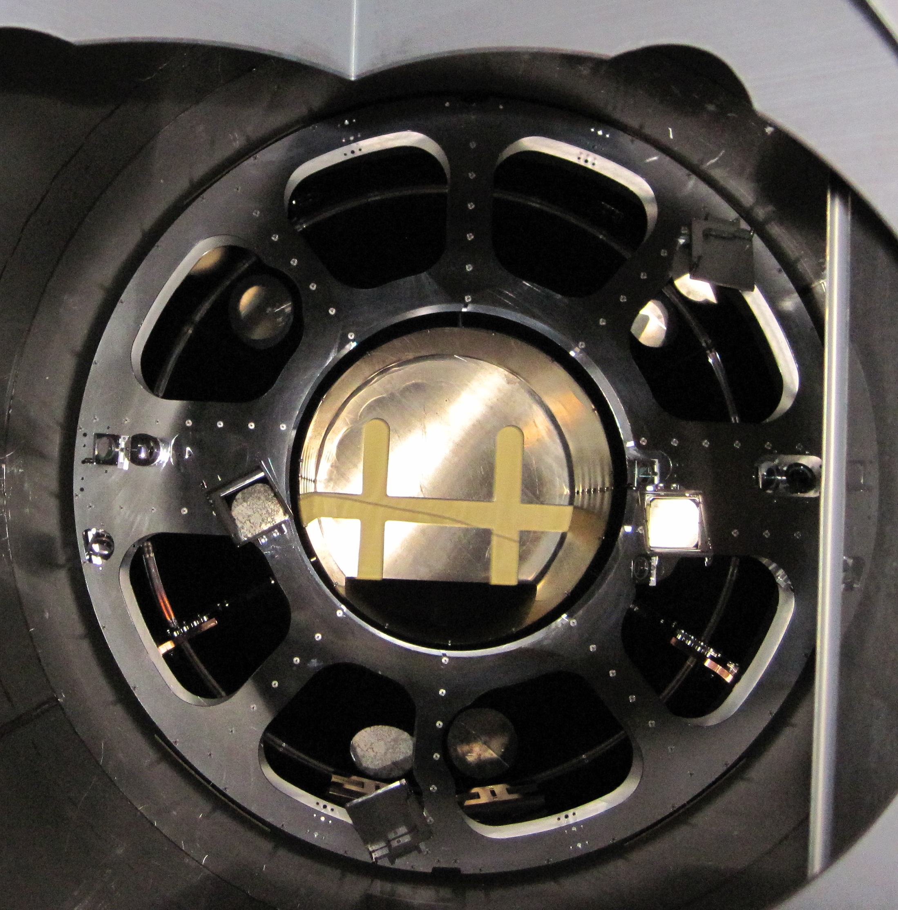
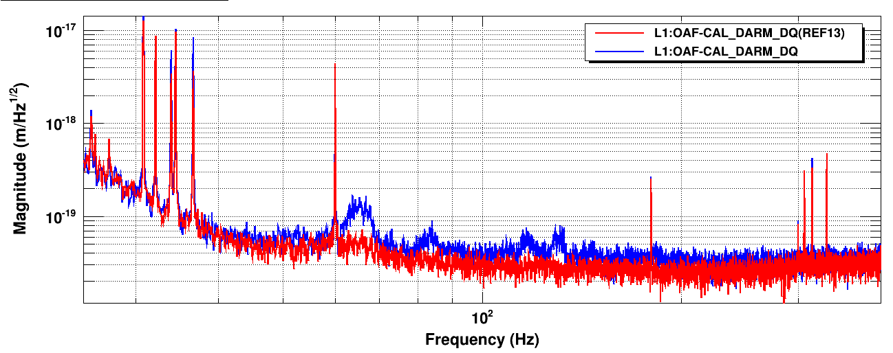
End Stations: ETM wide angle scattering
‘Pcal Periscope Structure scattering’
LLO Scattered Light
Light scattered from the ETM is
directed through a viewport and then scattered/reflected back in –
hitting vibrating components along the way

Slide 6
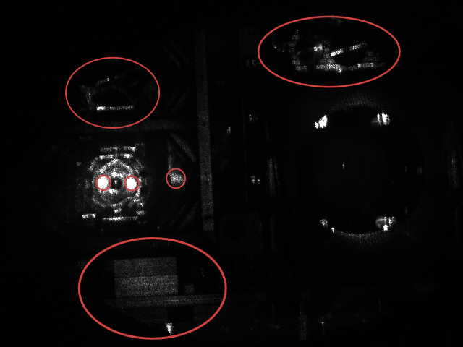
View into HAM5 chamber
Signal recycling mirror
Stray Beams
SR3: folding mirror in SRC
A campaign to improve in-vacuum scattered light baffling in underway this will be one of the main post-O2 upgrades

Slide 7
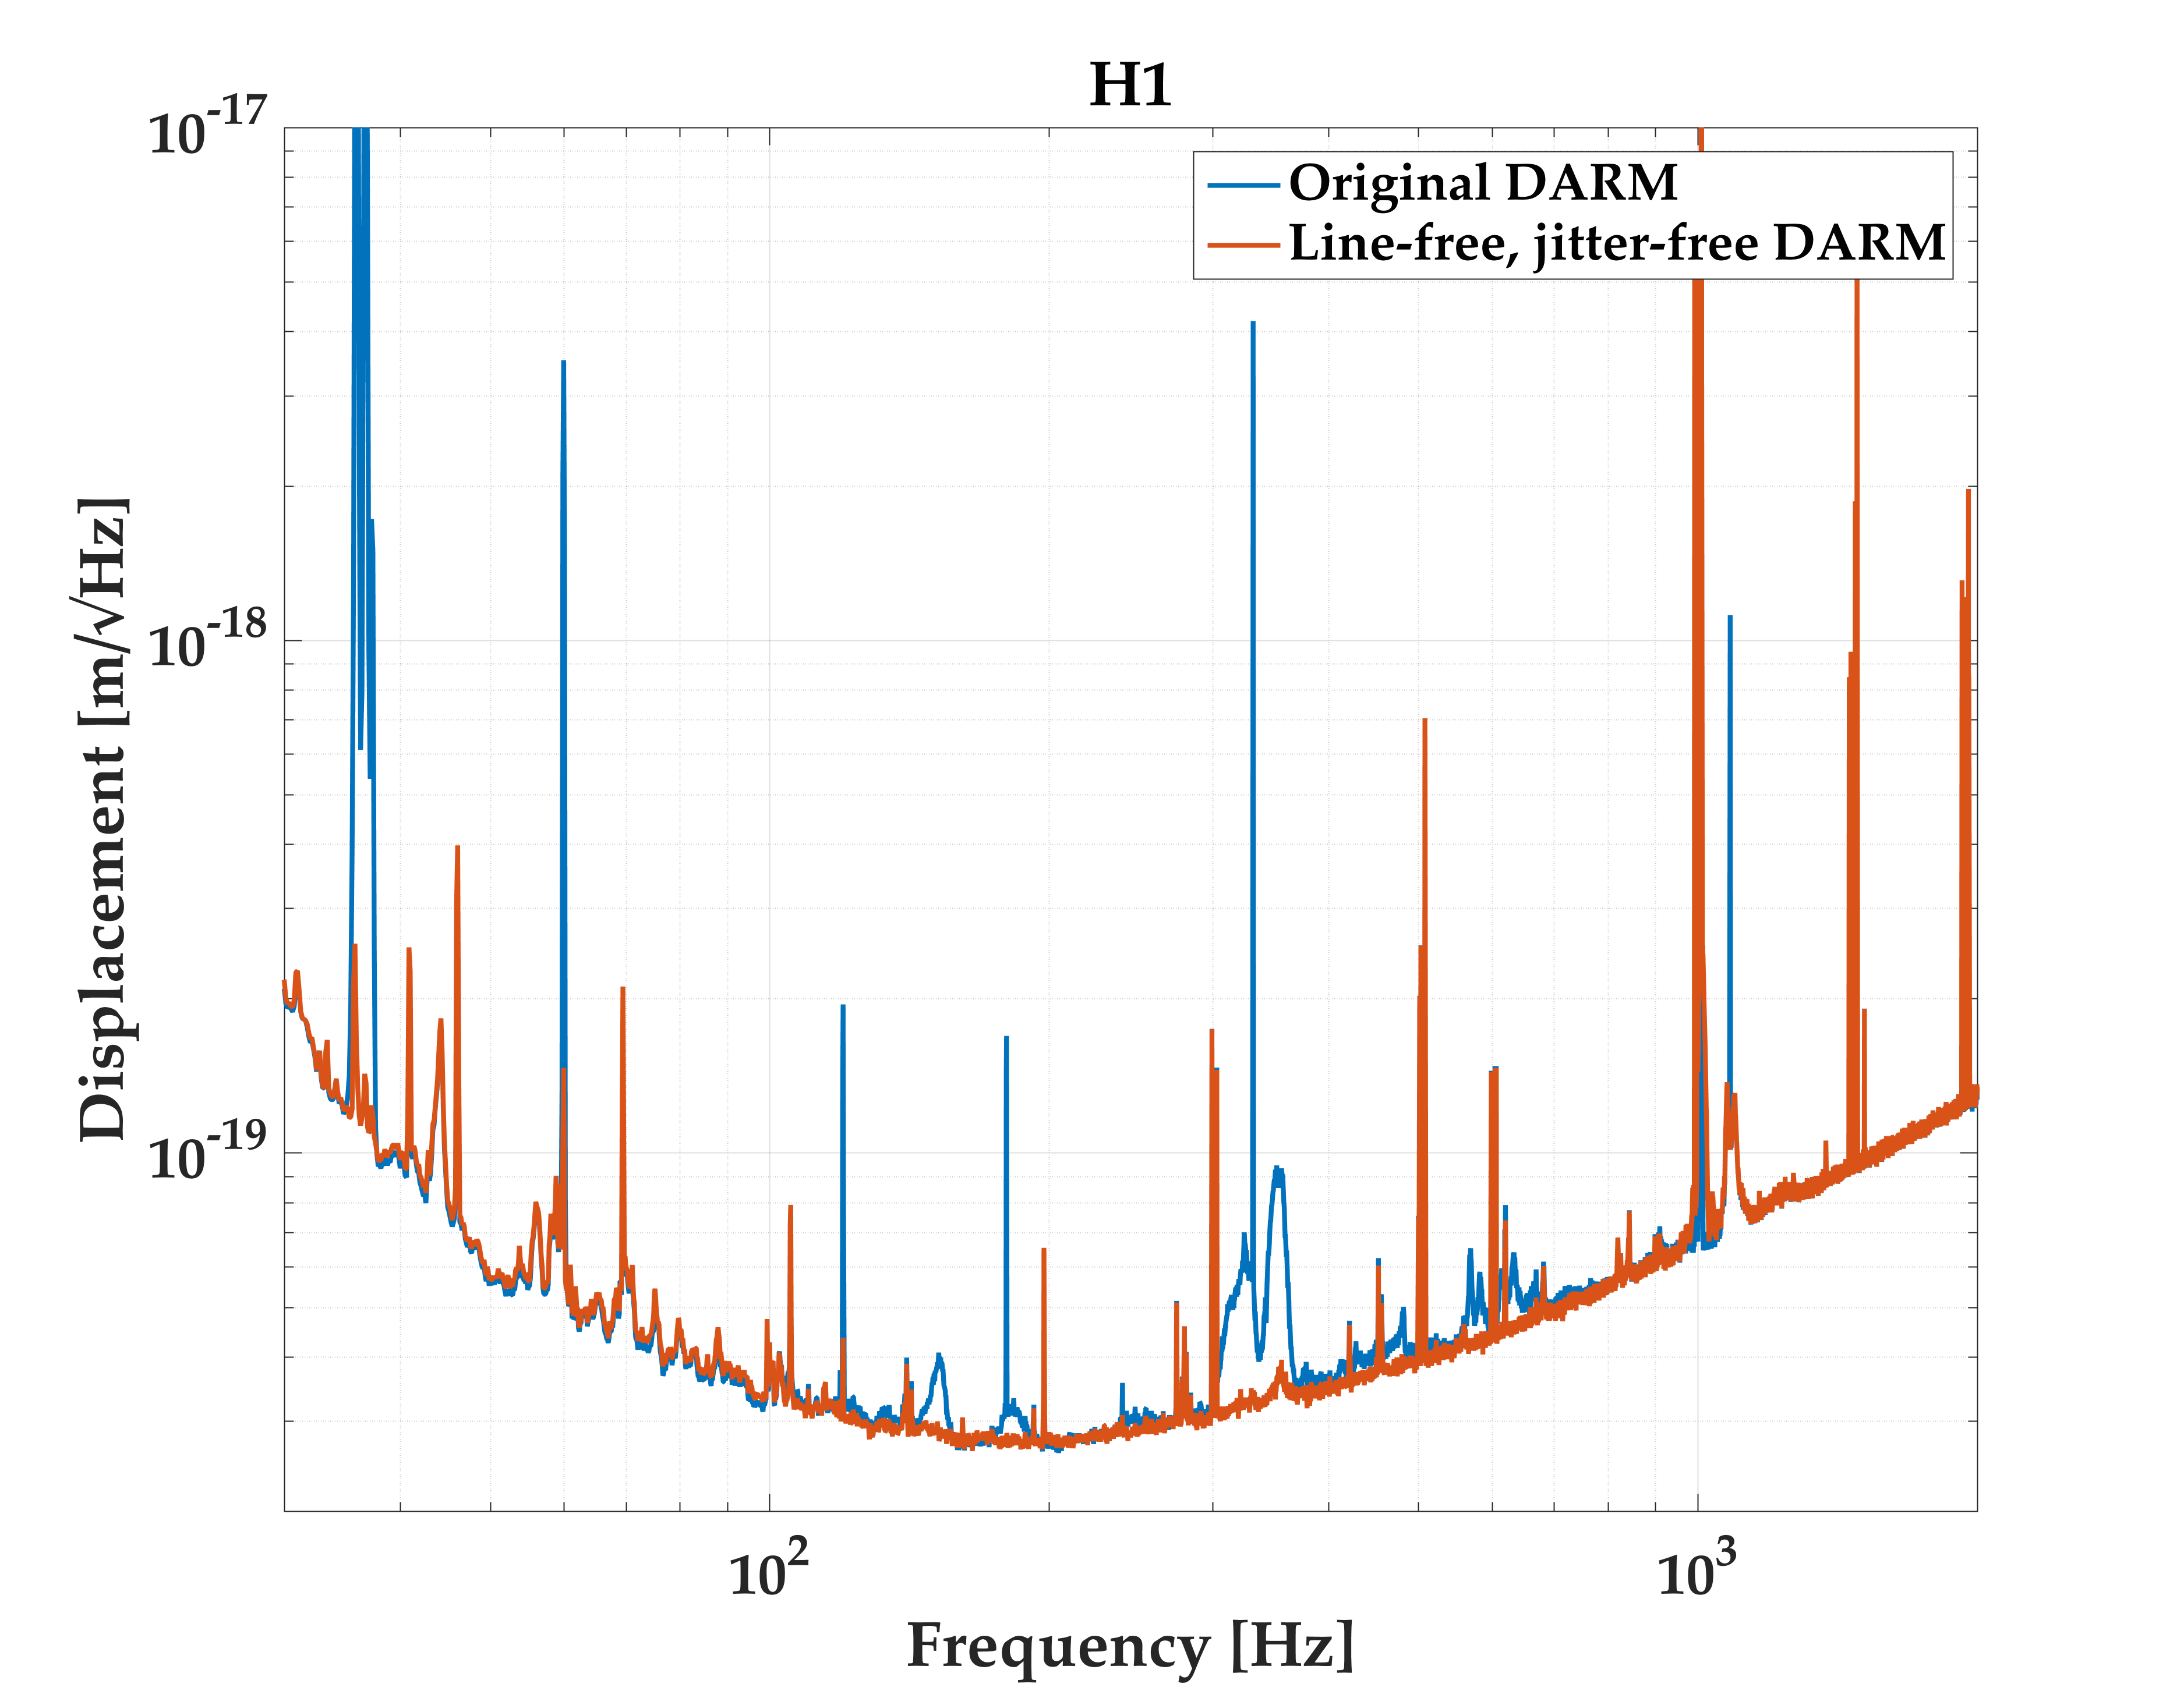
H1
Long term: May require Jitter Attenuation Cavity
  Fixed mirror
  Triangular, in vacuum
Suppression: ~50
L1
Subtraction: J. Driggers
Beam Jitter Coupling
LHO has higher coupling
Injection locked laser generates large amounts of beam jitter
Including higher order modes!
LHO alog 34631

Slide 8
Fix LHO-ITMX Contamination
  Will try to clean ITMX in early now
  If successful, will try to go back to 50W
  If unsuccessful, will require ITMX replacement after O2
Squeezed Light Injection at LLO
  Target is 3 dB of effective squeezing:
  equivalent to doubling the laser power
  Possibly LHO as well?
Stray Light Control Improvements
70 W Amplifier Stage at LLO to Double the Laser Power
  LHO: likely to move from the HPO to a 70 W amplifier as well
Replace End Reaction Masses with Annular Versions
  Squeezed film damping; possibly electro-static charge
  May also replace ETMs at LHO
Monolithic Signal Recycling Mirrors
LHO: Long vent
Next Commissioning After the Run

Slide 9
LLO
70 W amp
GV repair
ERM swap
Noise hunting
Power increase
Squeezed light injection
Corner volume
HAM6 SLU
0
3
6
9
months
Strawman Schedule
Corner volume
vent I
Corner volume vent II
Diagnostics
Noise hunting
Power increase
Thermal characterization
SRC alignment
Jitter Mitigation(?)
70W laser amplifier
Depends on May vent
ERM & ETM replacement
LHO
Cryo-pump decommissioning
O3 readiness will be driven by
achieving a significant sensitivity increase over O2

Slide 10
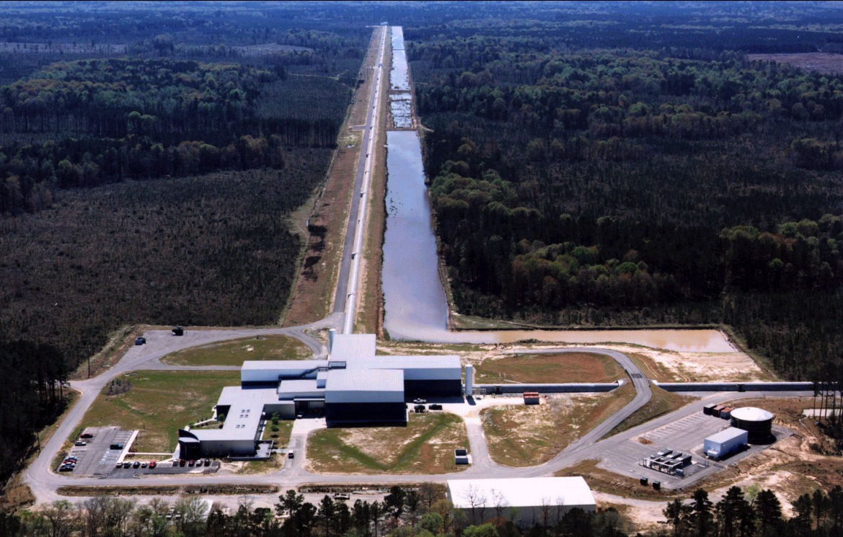
Livingston Observatory

Slide 11
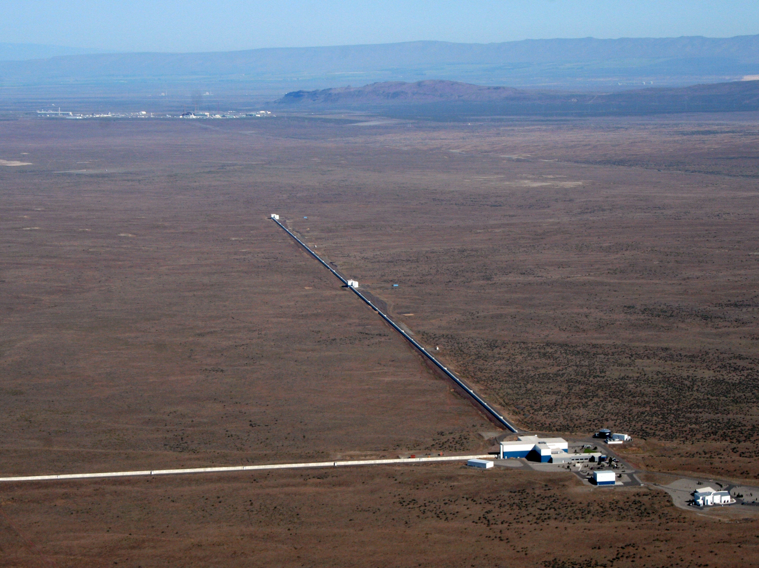
Hanford Observatory

Slide 12
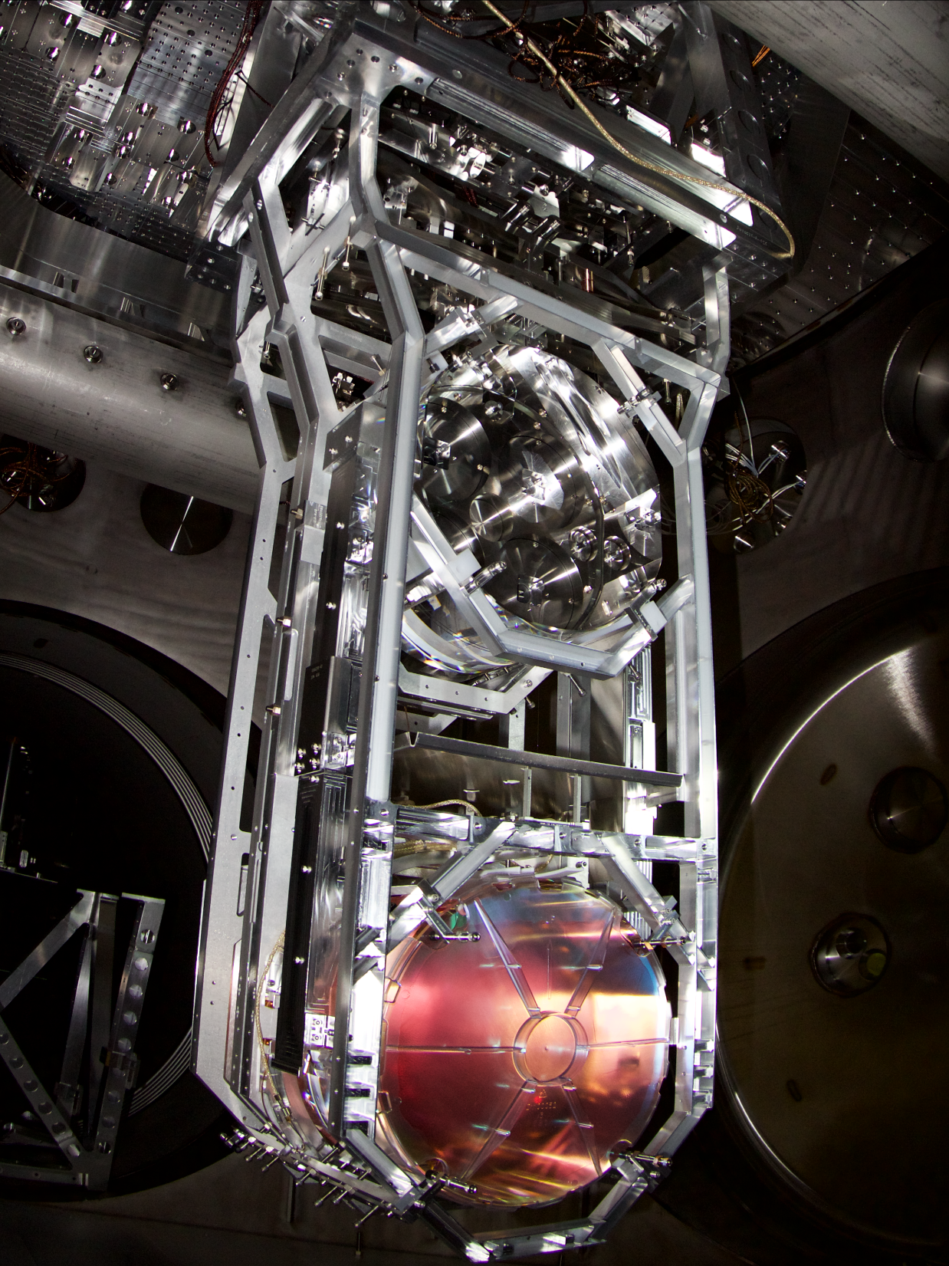

Test Mass Suspension
40 cm

Slide 13
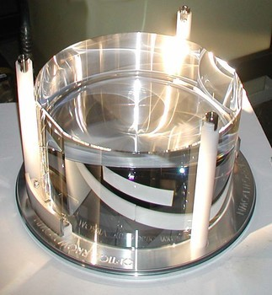
  Specifications:
  Diameter: 340 mm
  Thickness: 200 mm
  Mass: 39.6 kg
  ROC: 2250 m / 1940 m
  Figure: <1 nm rms
  Scatter: ~10 ppm
  Surface absorption: ~0.3 ppm
  Bulk absorption: ~0.2 ppm/cm
  HR transmission: ~4 ppm
  AR reflectivity: ~200 ppm
Large Test Mass Optics

Slide 14
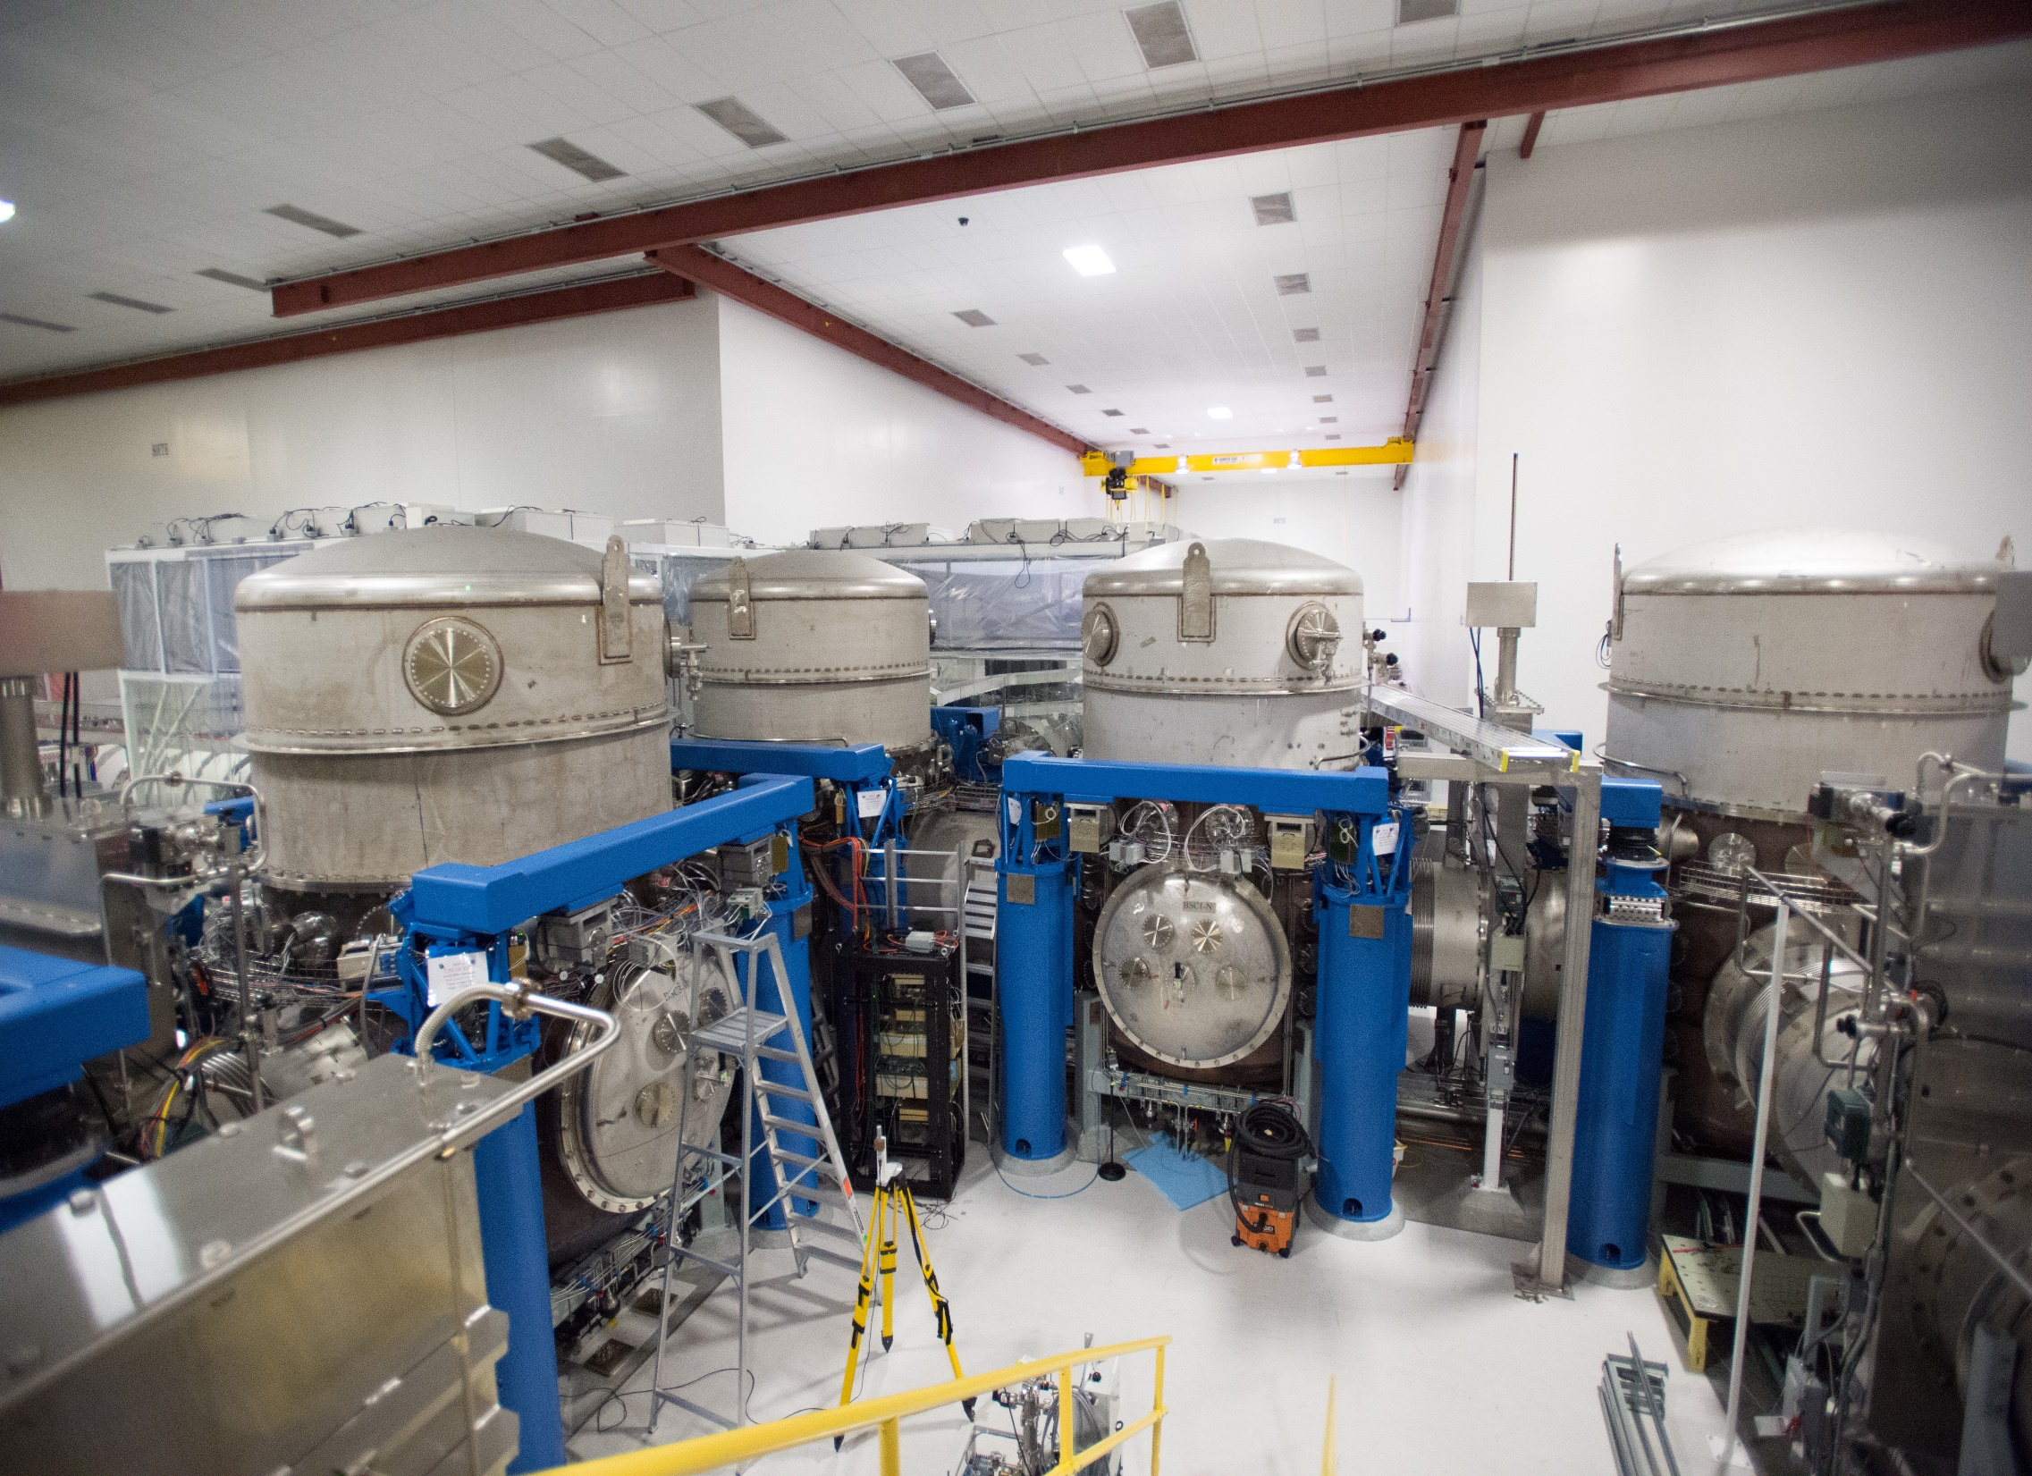
Vacuum System Vertex

Slide 15
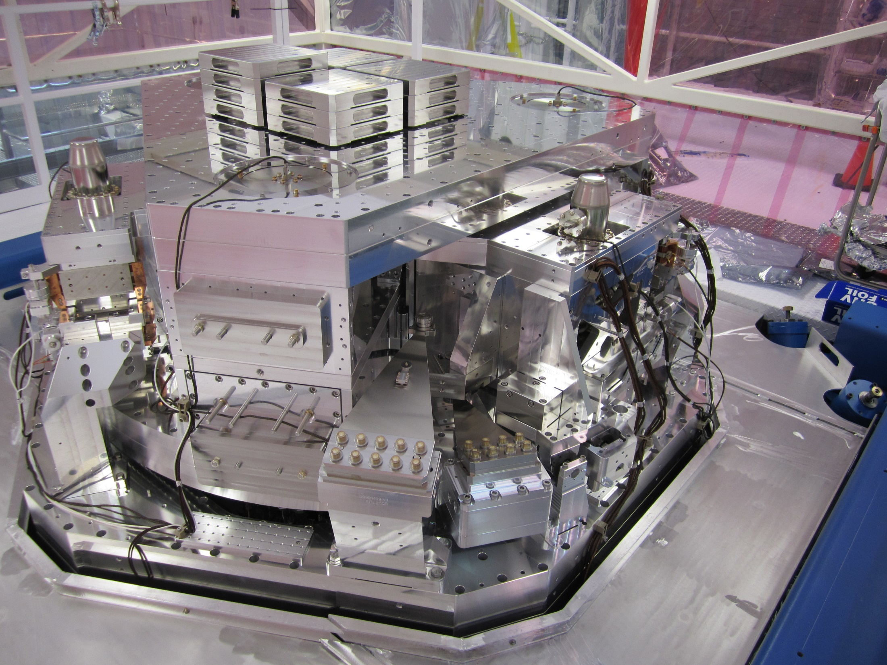
Seismic Isolation Platform

Slide 16
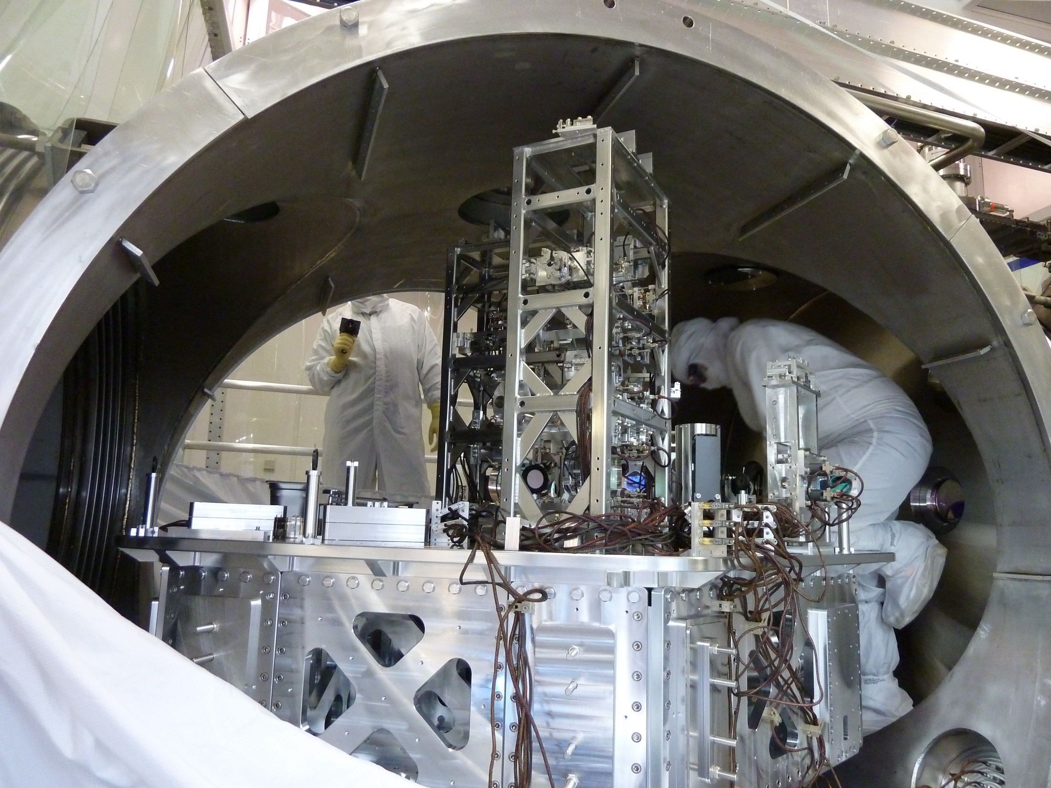
Input Optics Table

Slide 17
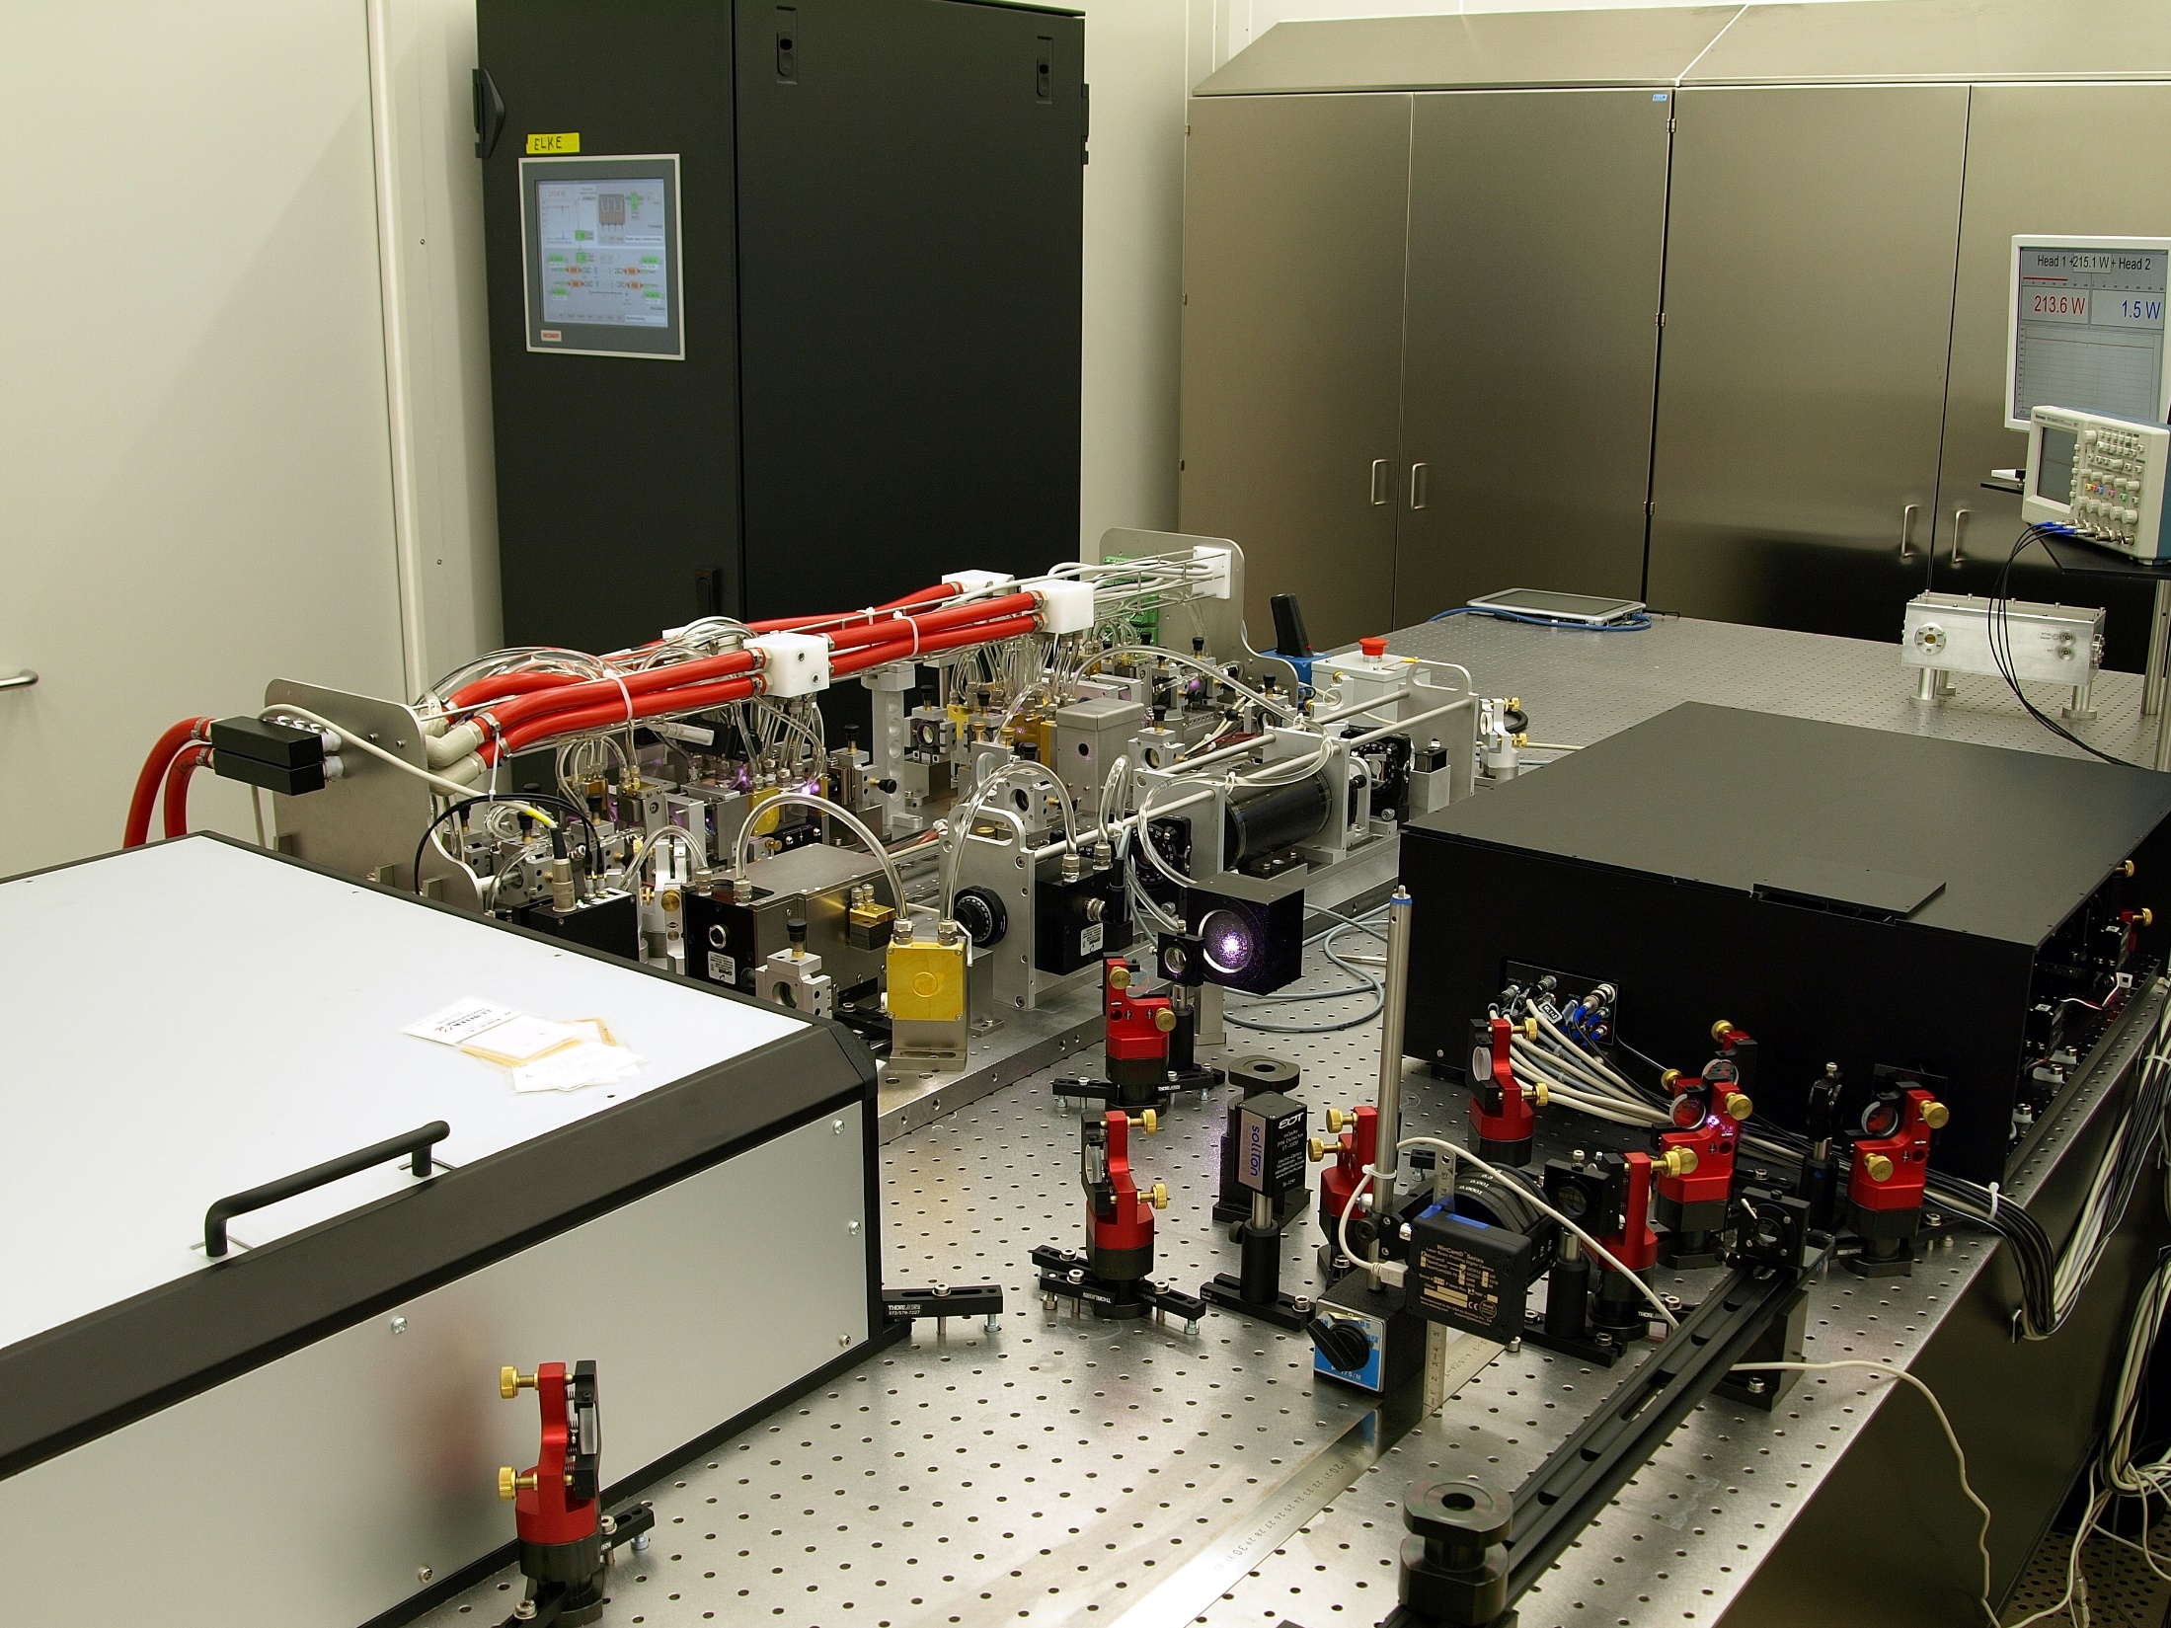
200W Pre-Stabilized Laser

Slide 18
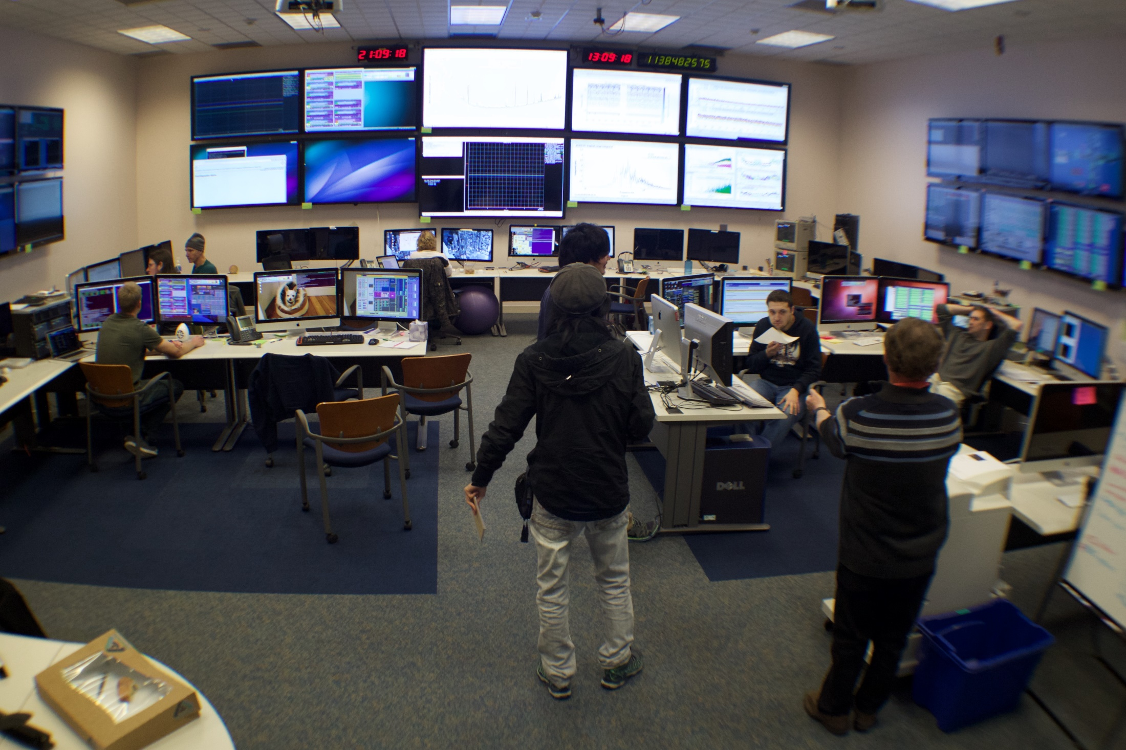
Control Room

