Slide 1


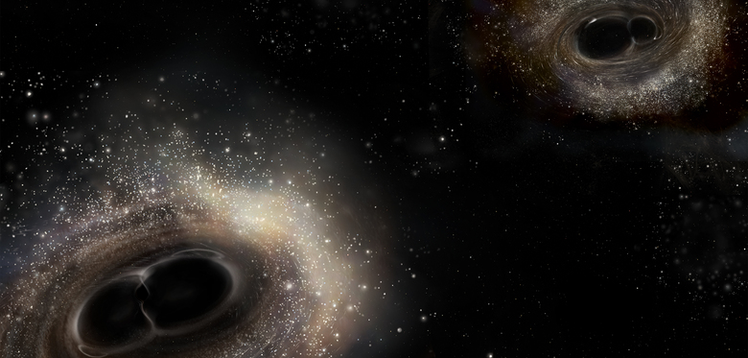

The University of Texas at Austin, September 21, 2016
Colliding Black Holes and Convulsions in Space-time
The First Observations of Gravitational Waves by LIGO
David Reitze
LIGO Laboratory
California Institute of
Technology
For the LIGO Scientific Collaboration and the Virgo Collaboration
LIGO-G1602328-v1
Image Credit: Aurore Simmonet/SSU

Slide 2
Outline
Gravitational Waves
LIGO
The First Observations of Gravitational Waves
Multi-messenger Astronomy with Gravitational Waves

Slide 3
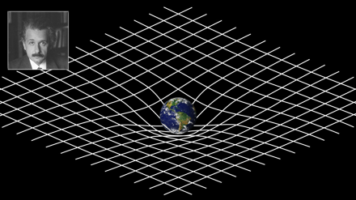
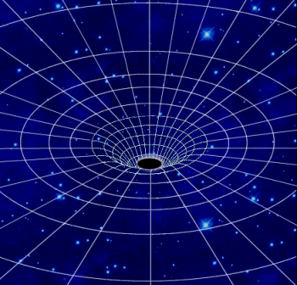
2016: The Centenary of Gravitational Waves
General Relativity:
Einstein Field Equations
The metric: distance in
space-time
Free
Space
(T_{μν} = 0)
Weak field approximation:
space-time is slightly
perturbed from flat space-time
Simple wave equation for the metric perturbation h_{μν}

Slide 4
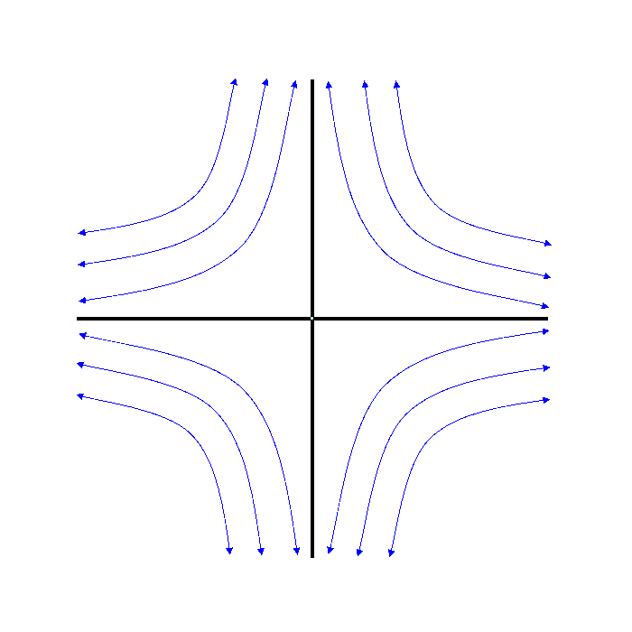
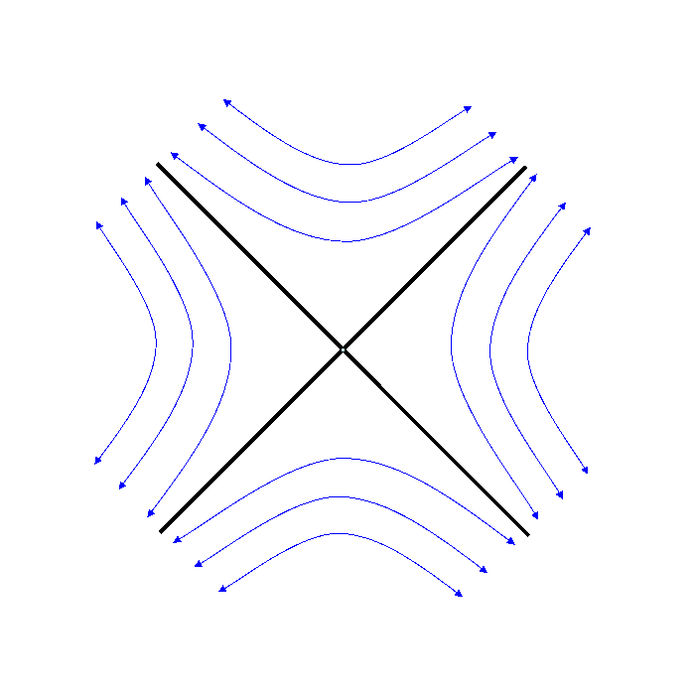
Gravitational Waves
Solution for an outward propagating wave in z-direction:
Physically, h is a strain: ΔL/L
ω_{orb}
h₊
h_{x}
M
R

Slide 5
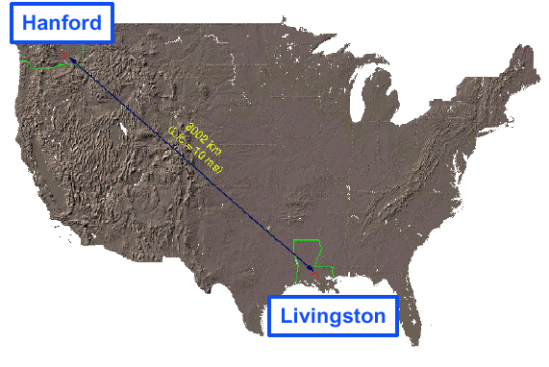
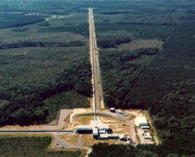
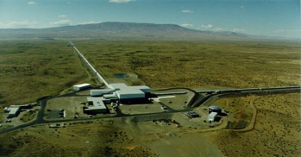

LIGO
LIGO Laboratory is operated by Caltech and MIT
Hanford, WA
LIGO Laboratory:
180 staff located at Caltech, MIT, Hanford, Livingston
LIGO Scientific Collaboration:
~ 1000 scientists, ~80 institutions, 15 countries
LIGO Livingston
Observatory
LIGO Hanford Observatory
Livingston, LA
Notes:
LIGO is actually two observatories and three interferometers.
Describe parameters
Emphasize that the arms are in ultra high vacuum. 8 km of steel 1.2 m dia beam tubes at each site
Separate observatories allow for coincidence detection – since the detectors see uncorrelated noise, only a true gravitational wave would appear on all the interferometers with the correct amplitude.
Emphasize that the LIGO Observatories were designed and are operated by Caltech and MIT

Slide 6
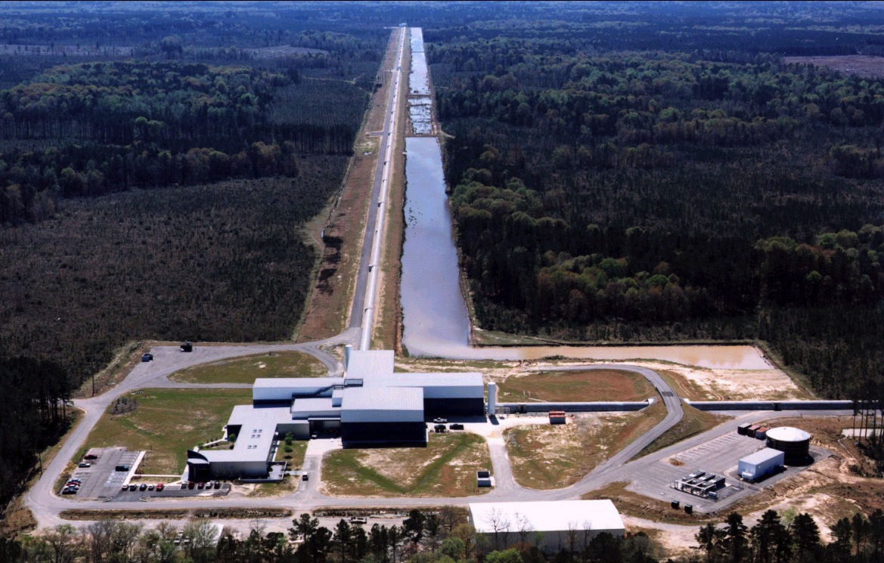
LIGO Livingston Observatory
4 km
4 km

Slide 7
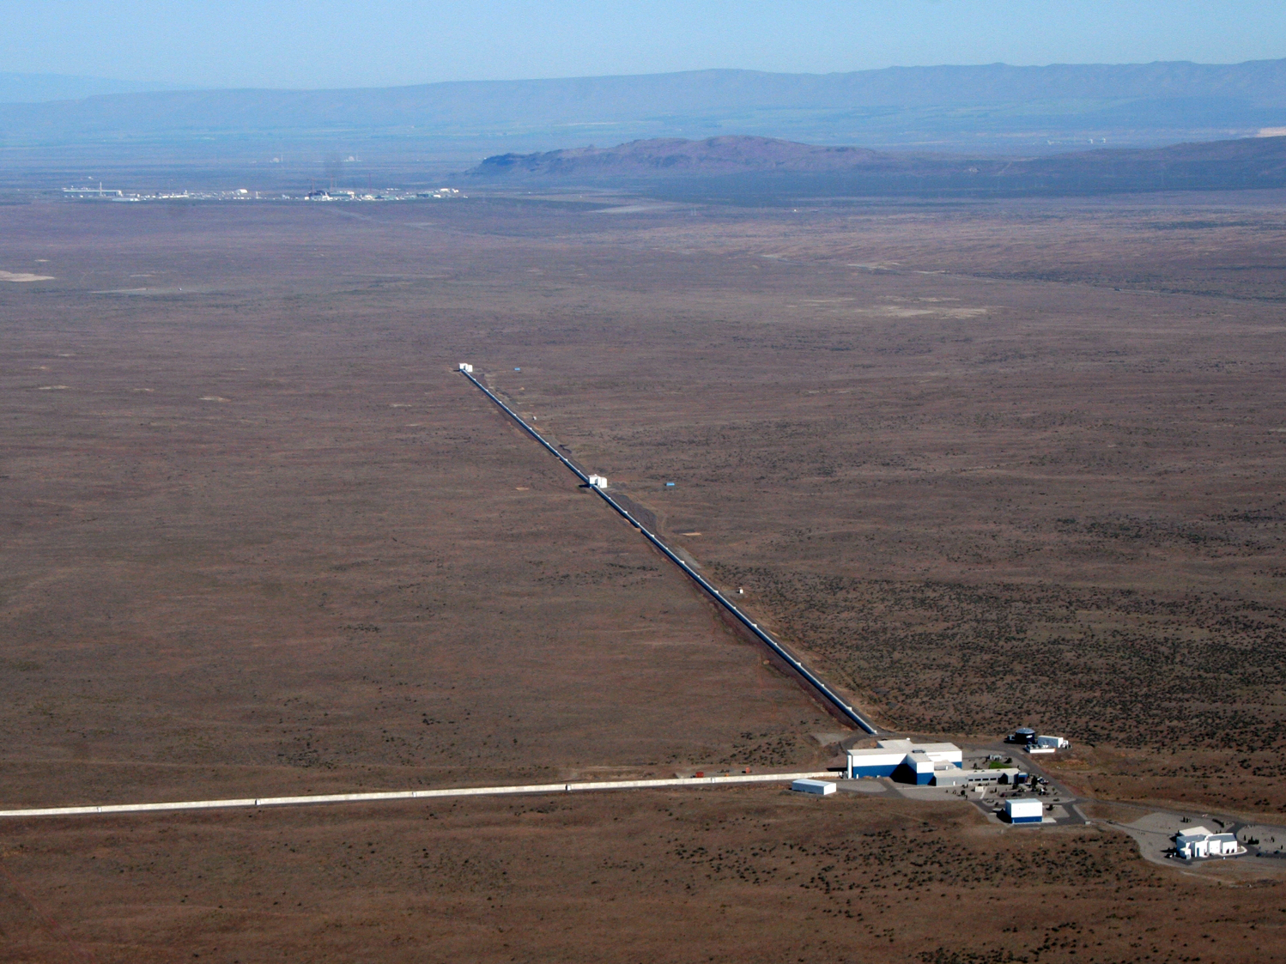
LIGO Hanford Observatory

Slide 8
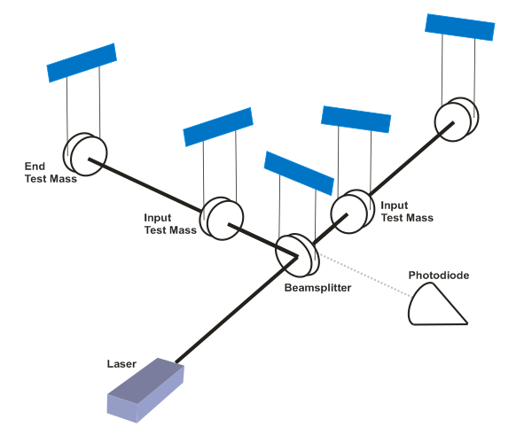
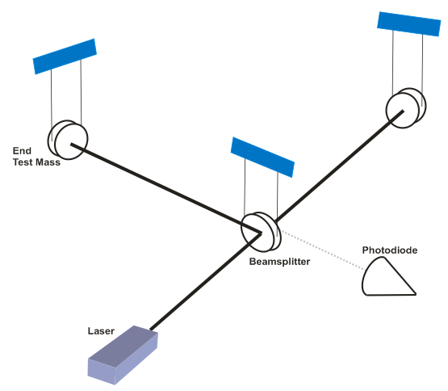
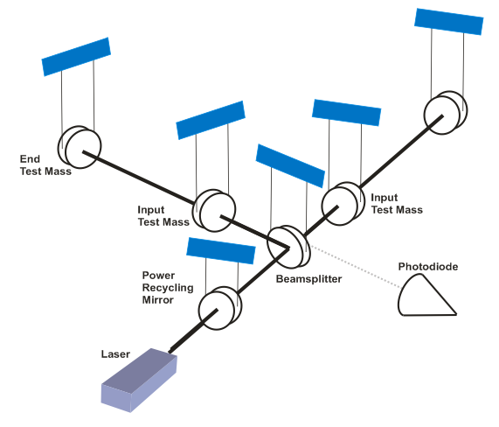
Extreme Precision Interferometry:
The Basics
x
800 kW
800 kW
x
3 kW
125 W
λ=1.064 μm
L = 4000 m
N_{roundtrip} ~ 280
Putting in numbers:
h ~ 10⁻²²
Notes:
So, how big and how sensitive do you have to make an interferometer to get to an astrophysically interesting sensitivity?
Describe sequential steps in sensitivity. For power recycling, mention that the IFO is operated on a dark fringe so that almost no carrier light gets to PD. The reason have to do with amplitude noise in the laser. Also mention that PR is needed since we didn’t have good 250 W stabilized lasers at the time.
Emphasize that for 1E-21, need km scale detectors. That’s a displacement sensitivity of about 1 attometer in the frequency band of interest.
For strain, we want long arms and high displacement sensitivity.

Slide 9


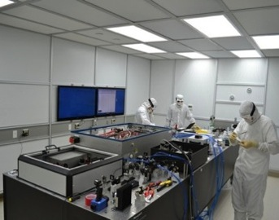
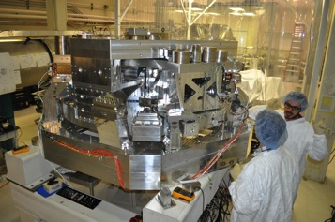
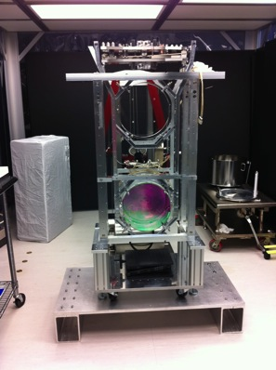
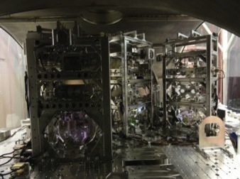
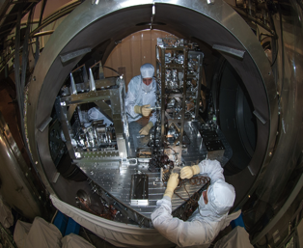
Advanced LIGO Interferometer
Pre-stabilized Laser
200W , 1064 nm
Active Seismic Isolation
40 kg ‘Test Mass’ Mirror
Input Optics
Output Mode Cleaner
Auxiliary Laser
Notes:
Go through the slide from laser forward

Slide 10
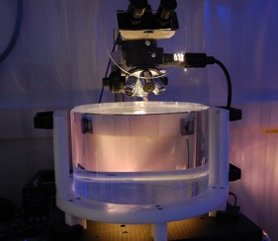
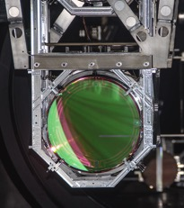
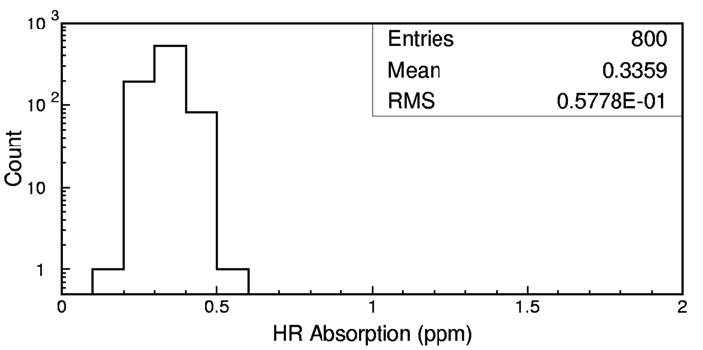
Advanced LIGO ‘Test Mass’ Mirrors
Truly the ‘crown jewels’ of the detector
Physical specifications:
  Ultra-pure, ultra-homogeneous fused silica
  340 mm diameter, 200 mm thick, 40 kg mass
Surface figure: super-polish followed by ion beam ‘spot’ polish
  < 0.15 nm RMS deviation from sphere
Coatings: TiO₂-doped Ta₂O₅/SiO₂
  Reflectivity depends upon type of mirror
  Ultralow absorption (< 0.5 ppm)
Notes:
Mention CSIRO

Slide 11
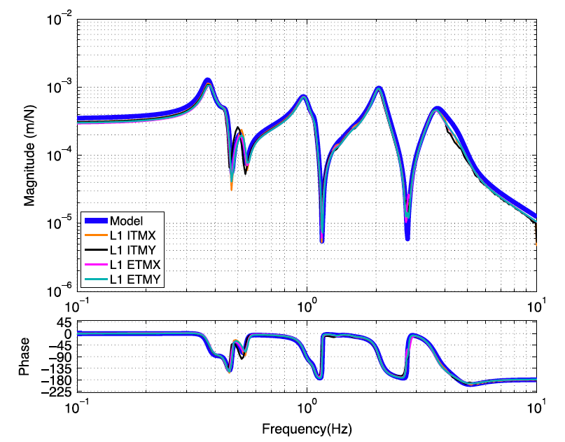
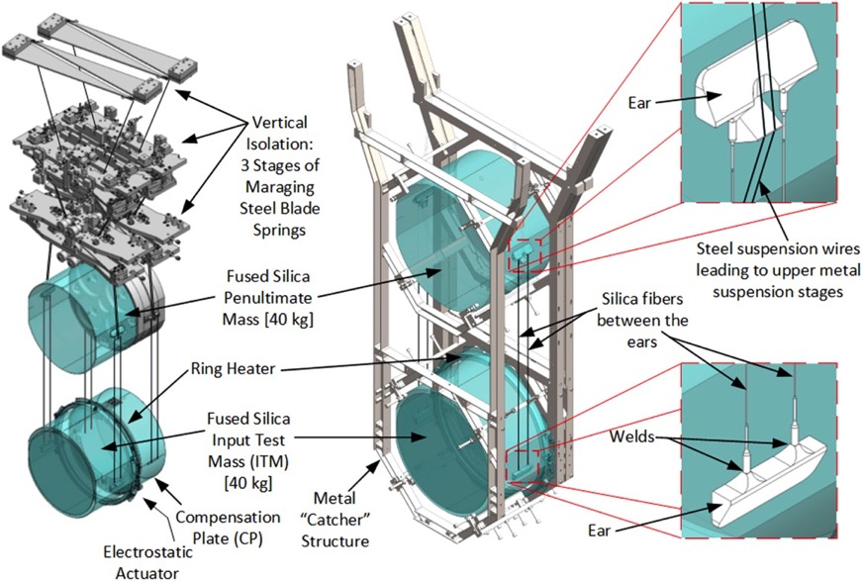
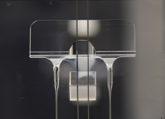
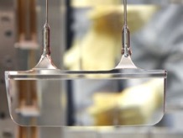
Advanced LIGO Suspensions
Force → Displacement
Transfer Function
Model vs. Measured
Concept:
Implementation:
Upper ‘ear’
Lower ‘ear’

Slide 12
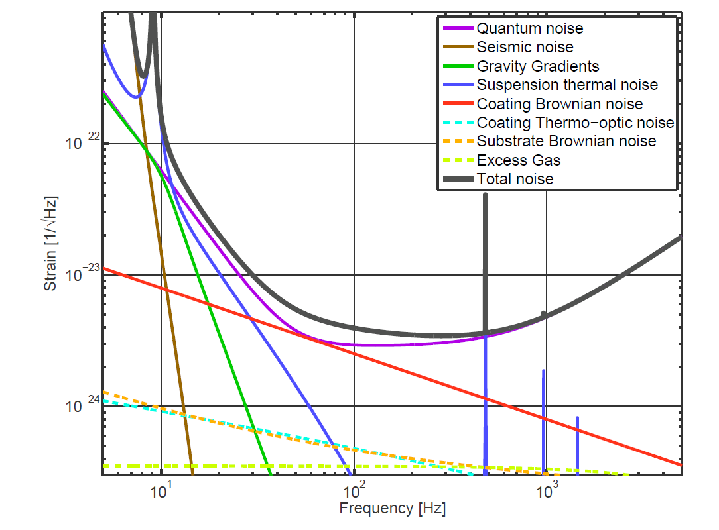
Precision Interferometry = Understanding Measurement Noises
Fundamental Noises:
Displacement Noises
→ ΔL(f)
  Seismic noise
  Radiation Pressure
  Thermal noise
    Suspensions
    Optics
Sensing Noises
→ Δt_{photon}(f)
    Shot Noise
    Residual Gas
Technical Noises
Advanced LIGO Design Noise Budget
Photon Statistics
Radiation Pressure
SNR ~ 1/√P_{Laser}
Dissipative
Dynamics
‘kT physics’
Photon Statistics
Shot Noise
→ SNR ~ √P_{Laser}
→ Lots of them…

Slide 13
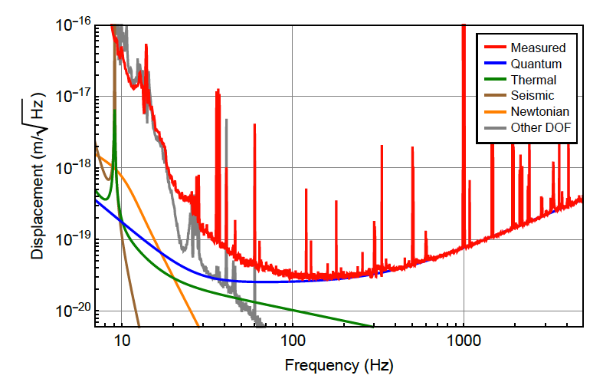
The Advanced LIGO Detector Sensitivity During O1
Abbott, et al. ,LIGO Scientific Collaboration and Virgo Collaboration, “GW150914: The Advanced LIGO Detectors in the Era of First Discoveries”, Phys. Rev. Lett. 116, 131103 (2016).

Slide 14
The First Gravitational Wave Detections

Slide 15
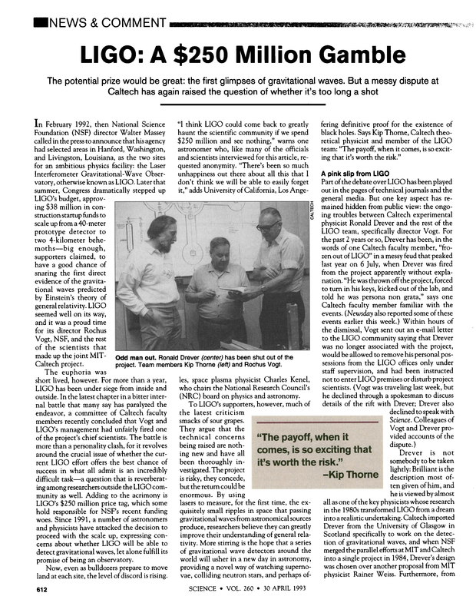
Science 30 Apr 1993

Slide 16
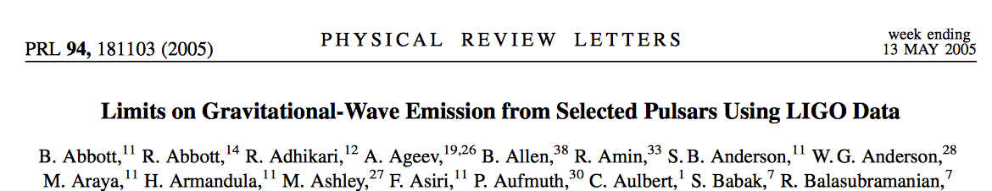
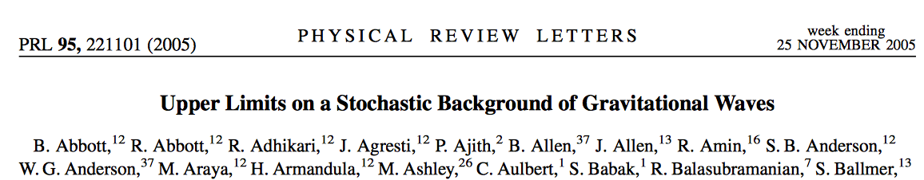
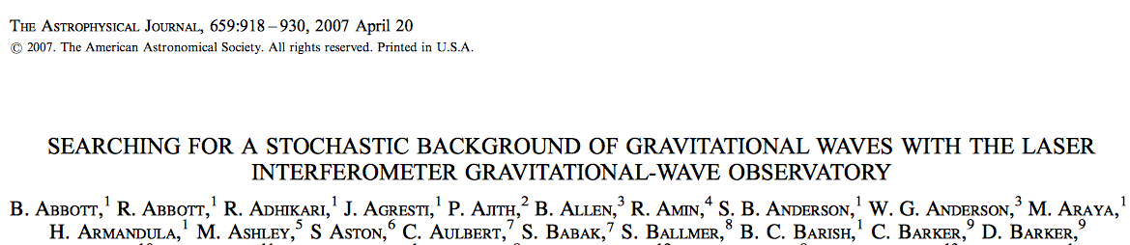
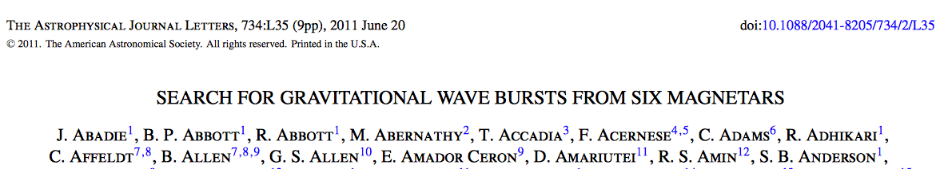
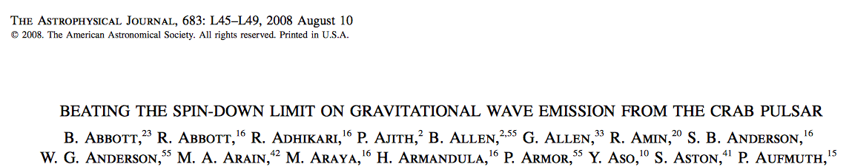
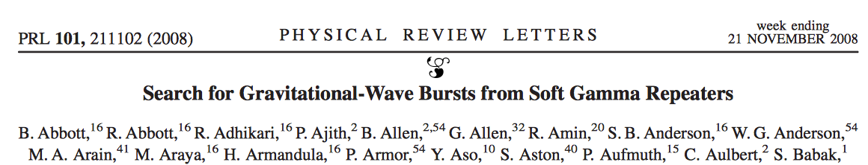
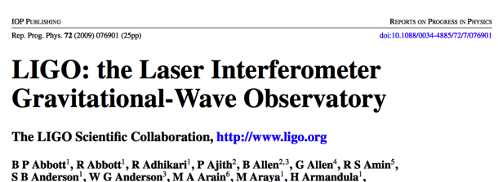
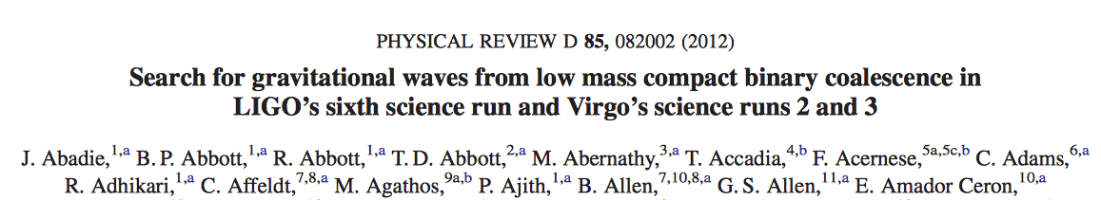
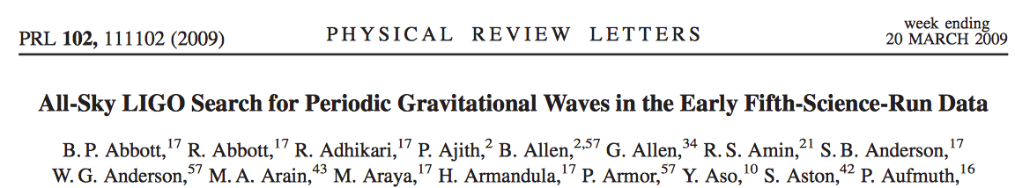
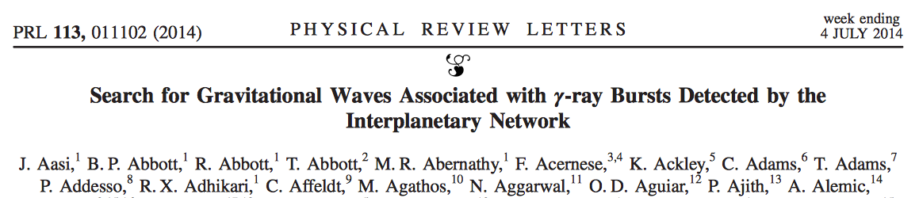
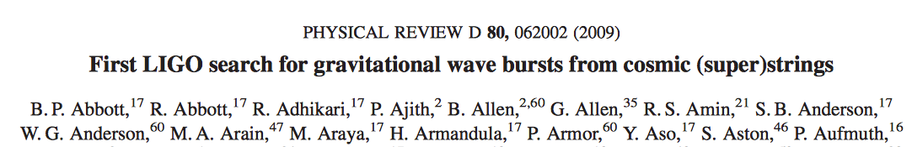
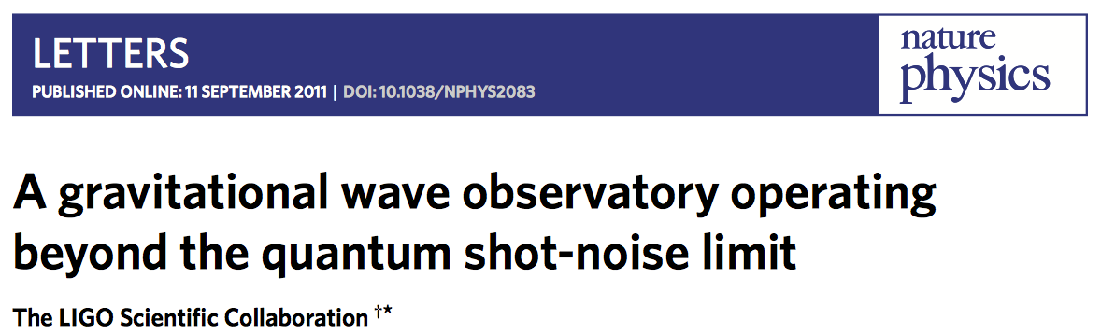
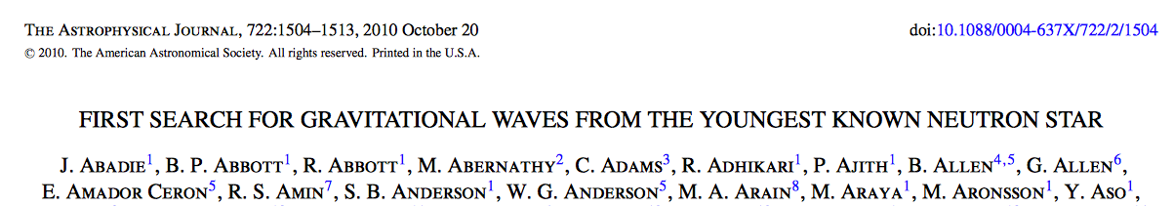
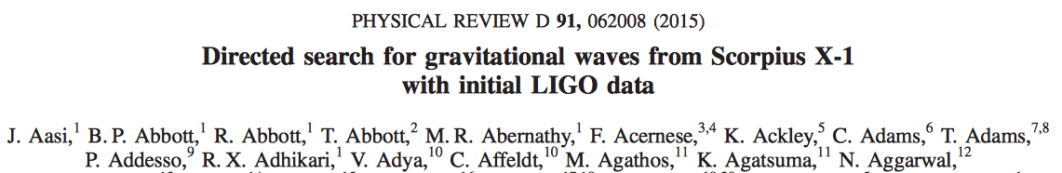
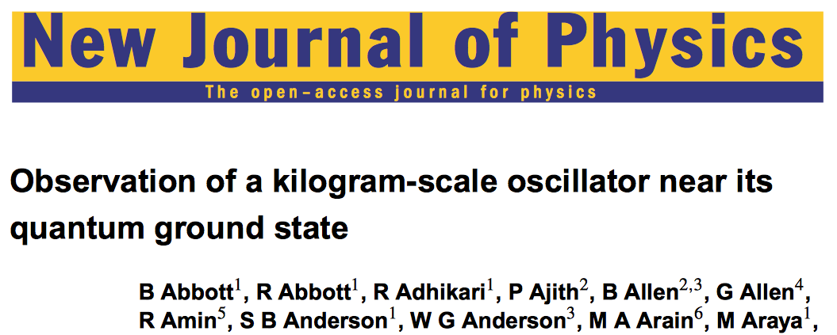
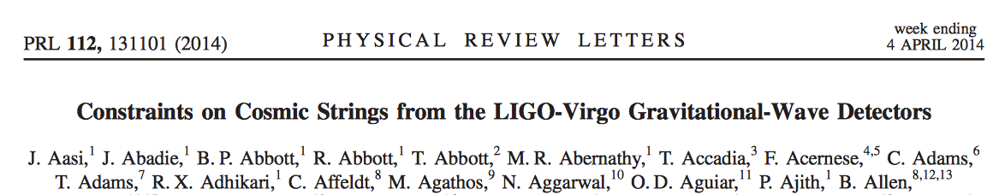
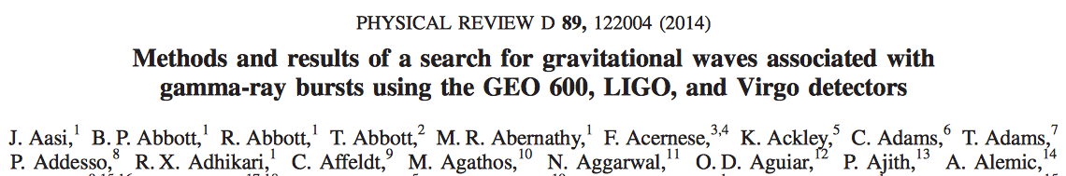
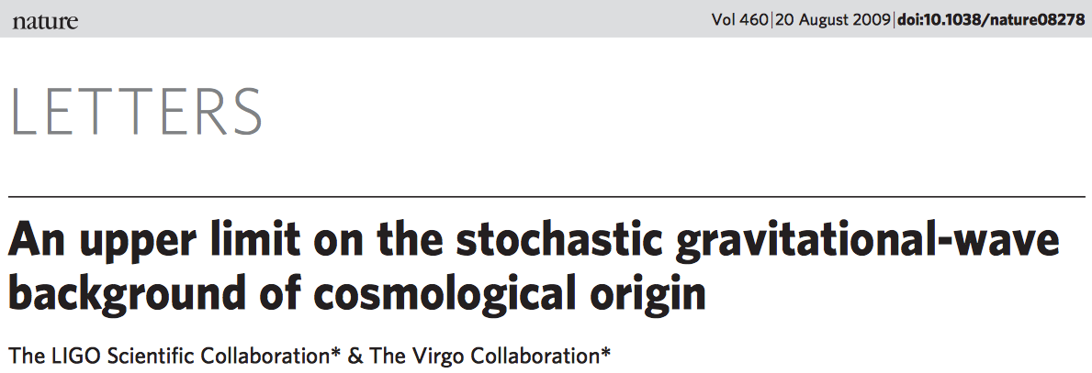
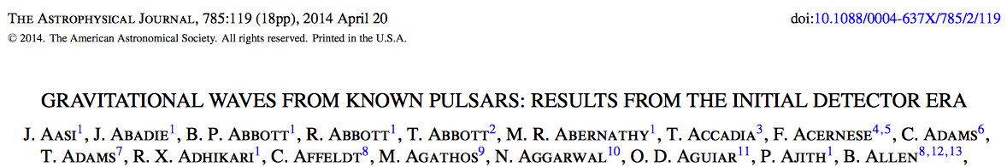
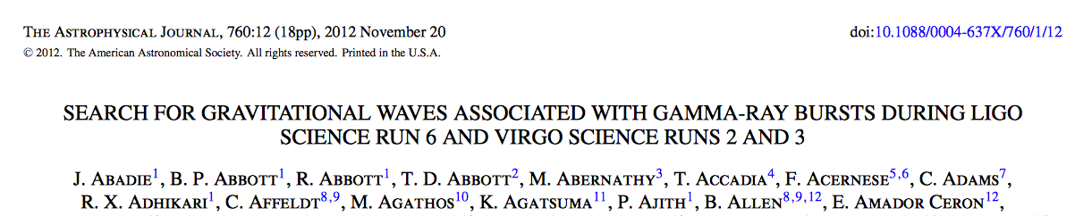
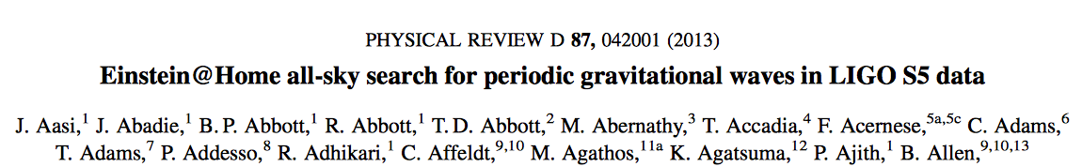
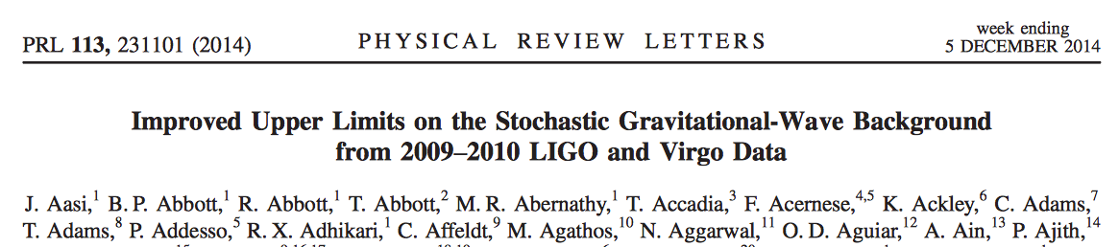

asd
Notes:
First click – what did we detect? Not unexpected since rates of GWs are highly uncertain. Then point out that even in the absence of detections there is lots of interesting science to be done in the form of upper limits and optical science
Second click
Point out Nature stochastic paper and squeezing papers – will com back to that.

Slide 17


Slide 18

Abbott, et al. ,LIGO Scientific Collaboration and Virgo Collaboration, “Observation of Gravitational Waves from a Binary Black Hole Merger” Phys. Rev. Lett. 116, 061102 (2016)
4 x 10⁻¹⁸ m

Slide 19

1.3 Billion Years Ago
(Give or Take)
Abbott, et al. ,LIGO Scientific Collaboration and Virgo Collaboration, “Observation of Gravitational Waves from a Binary Black Hole Merger” Phys. Rev. Lett. 116, 061102 (2016)

Slide 20

Andy Bohn, François Hébert, and William Throwe, SXS Collaboration

Slide 21


Slide 22


Slide 23


Assessing Statistical Significance: Modeled Search
Matched filter search: X-correlation of L1, H1 data streams with 250,000 BH waveform templates covering 1-- 99 M
Total coincident L1, H1 data: 51.5 days
Background computed from time-shifting coincident data in 100 ms steps to produce 5x10⁶ years
Simulation: Reed Essick, LIGO MIT

Slide 24




Extracting Astrophysical
Parameters from Detections
GW150914 GW151226 LVT151012
Hanford
GW150914 GW151226 LVT151012
Livingston
Abbott, et al., LIGO Scientific Collaboration and Virgo Collaboration, “Binary Black Hole Mergers in the first Advanced LIGO Observing Run”, https://arxiv.org/abs/1606.04856, accepted in Phys. Rev. X

Slide 25

The Black Hole Mass Menagerie
4 Months of Gravitational-wave Astronomy!
40 Years of X-ray
Astronomy
Credit: Robert Hurt, IPAC/Caltech

Slide 26



Implications for Astrophysics and General Relativity
First direct observation of a binary black hole merger!
  BBH systems can merge in a Hubble time
  GWs may be the only way to detect BBH mergers
First direct experimental evidence for ‘heavy’ stellar mass black holes
  Implication: assuming direct formation from core collapse of heavy star, favors low metallicity environment (z < ½)
  Implication: ‘kicks’ from core collapse supernova can’t be very large
Binary black hole merger rates are in the range 9 – 240 per Gpc³ per year
BBH mergers are Kerr black holes, consistent with general relativity
First test of general relativity in the dynamical strong field limit:
  Inspiral waveforms consistent with Post-Newtonian expansion
  Limit on graviton mass
Compton Wavelength of the Graviton
Abbott, et al., LIGO Scientific Collaboration and Virgo Collaboration, “Astrophysical Implications of the Binary Black Hole Merger GW150914”, Ap. J. Lett. 818, L22 (2016).
Abbott, et al., LIGO Scientific Collaboration and Virgo Collaboration, “Tests of General Relativity with GW150914” Phys. Rev. Lett. 116, 061102 (2016)

Slide 27





GW150914 in popular culture
David Sipress
New Yorker Magazine
Feb 11, 2016
From The Guardian, Feb 12 2016

Slide 28
Multi-messenger Astronomy
With Gravitational Waves

Slide 29


A LIGO interferometer is a microphone, not a telescope
Sensitivity depends on propagation direction, polarization
“×” polarization
“+” polarization
RMS sensitivity

Slide 30




What powers short gamma ray bursts, the brightest events in the universe?
Binary Neutron
Star Merger
Short Hard Gamma
Ray Bursts/Kilonovae
?
=
Credit: NASA/Swift/Mary Pat Hrybyk-Keith and John Jones
Credit: NASA /Dana Berry
Notes:
Start with BNS mergers and r-process nucleosynthesis here –
Lighter elements (through nickel) can be formed through successive stellar fission in massive stars. “For elements with mass numbers > 100 originate in the rapid neutron capture process or R-process.“ BNS mergers are likely to be elemental foundries of gold, silver, Platinum.
Finish with GRBs – radiating as much energy in a second as the sun does in its entire lifetime
Until we see a GW and a GRB simultaneously, we won’t answer this question.

Slide 31





Enabling multi-messenger astronomy with gravitational waves
Swift
Swift
X-ray, γ-ray
follow-up
LIGO
Hanford
t₁
Coherent
Detector
Network
t₂
Virgo
t₃
LIGO
Livingston
Palomar Transient
Factory
Optical
follow-up
Abadie, et al, (LSC & Virgo Collaborations)
Astron. Astrophys. 541 (2012) A155.
Nissanke, Kalsiwal, Georgieva,
Astrophysical J. 767 (2013) 124.
Singer, Price, et al., Astrophysical J., 795 (2014) 105.
Image:
http://earthobservatory.nasa.gov/

Slide 32

Approved!

Slide 33

GW150914 EM Follow Up
Follow-up observations reported by 25 teams via private Gamma-ray Coordinates Network Circulars
Abbott, et al. ,LIGO Scientific Collaboration and Virgo Collaboration, “Localization and Broadband Follow-Up of the Gravitational-Wave Transient GW150914”, http://arxiv.org/pdf/1602.08492v1.pdf, accepted ApJLett

Slide 34


Improved Localization:
LIGO→Virgo→ LIGO-India
GW150914: LIGO only
GW150914: LIGO → LV → LVI
(Preliminary)
375° → 9.3° → 7.8°
(99% confidence level)

Slide 35
The next Advanced LIGO run
Advanced LIGO’s second ‘O2’ run began on Nov 30, 2016
Run duration: six months
Virgo anticipated to join in Spring 2017
ADD O2 RUN DATA:
Spectra and SensMon

Slide 36


Going Beyond Advanced LIGO
Electromagnetic fields are quantized:
Quantum fluctuations exist in the vacuum state:
H. P. Yuen, Phys. Rev. A13, 2226 (1976)
C. M. Caves, Phys. Rev. D26, 1817 (1982)
Wu, Kimble, Hall, Wu, PRL (1986)
3.5 dB squeezing
(1.5X reduced noise)
Typical noise without squeezing
Squeezing-enhanced sensitivity
Main Laser
Coherent State
PLL
Amplitude squeezing
Faraday
Isolator
Squeezed Vacuum
Source
Squeezed Vacuum
State
│E │
x₂
2.1 dB squeezing
(1.27X reduced noise)
Phase
squeezing
Photodiode
ϕ
x₁
Aasi, et al., (LIGO Scientific Collaboration), Nature Physics, 7, 962 (2011); Nature Photonics 7 613 (2013).
Notes:
Two demonstrations of squeezing!

Slide 37



The Best of Both Worlds: Frequency Dependent Squeezing
PLL
Concept: Kimble, Levin, Matsko, Thorne, Vyatchanin, Phys. Rev. D (2001)
Oelker, et al., “Audio-band Frequency-dependent Squeezing”, Phys. Rev. Lett. 116, 041102 (2016).
Notes:
Walks through badness, and then sketch path to goodness

Slide 38














































































LIGO Scientific Collaboration

Slide 39







Acknowledgments
LIGO Livingston Observatory
LIGO Hanford Observatory
Thanks to:
ligo.caltech.edu
www.ligo.org
Support: National Science Foundation
LIGO Caltech
LIGO Caltech
LIGO MIT
LSC

Slide 40

Advanced LIGO and the Dawn of Gravitational-waves Physics and Astronomy
LIGO has made the first measurement of gravitational wave amplitude and phase
A merging binary black hole system has been observed for the first time
LIGO likely to resume the search for gravitational waves in the Fall of 2016
The next few years will be very interesting ones for the field of gravitational-wave science!
Stay Tuned…

Slide 41
We also want to see binary neutron star mergers, neutron star – black hole mergers
-> rates are more uncertain

Slide 42


Binary Neutron Star Merger Localization: Hanford-Livingston-Virgo
3 site network
x denotes blind spots
S. Fairhurst, “Improved source localization with
LIGO India”, J. Phys.: Conf. Ser. 484 012007
Notes:
Note that this map assumes design sensitivity for LIGO and Virgo

Slide 43

Binary Neutron Star Merger Localization: Hanford-Livingston-Virgo-India
4 site network
S. Fairhurst, “Improved source localization with
LIGO India”, J. Phys.: Conf. Ser. 484 012007

Slide 44


R-processes, Compact Binary Mergers, and Gravitational Waves
Nucleosynthesis of heavy elements (> Fe) occur through r-processes
  rapid successive neutron capture by heavy (Fe) nuclei in neutron-rich environments
Progenitors:
  Core-collapse supernovae
  Neutron star – neutron star or
  neutron star – black hole mergers
Credit: NASA/Swift/Dana Berry

Slide 45



Detector Physics:
Parametric Instabilities
mechanical mode
Q-factor
power in the
arm cavity
Parametric Gain:
spatial overlap
Optical-mechanical mode
Mirror
mass
Acoustic mode
frequency
optical mode
gain
Acoustic mode Optical mode
f_{m} = 15,539 Hz
Theory: V. B. Braginsky, S. E. Strigin, and S. P. Vyatchanin, Phys. Lett. A 305, 111 (2002)
Experiment: C. Zhao, L. Ju, J. Degallaix, S. Gras, and D. G. Blair,
Phys. Rev. Lett. 94, 121102 (2005); M. Evans, et al., “Observation of Parametric Instability in Advanced LIGO”, Phys. Rev. Lett. 114, 161102 (2015).

Slide 46



Observation of Parametric Instabilities in Advanced LIGO
‘Ring Up’ Amplitude vs Time
Anti-symmetric Port Output:
Frequency [Hz]
ASD [counts/√Hz]
Time [min]
(P_{arm} = 50 kW)
How to Suppress Parametric Instabilities?
In situ radii of curvature tuning using ring heaters
Active damping via electrostatic feedback
Passive damping (under development)

