Slide 1
SMEE Project Update
Vincent Roma
2016

Slide 2
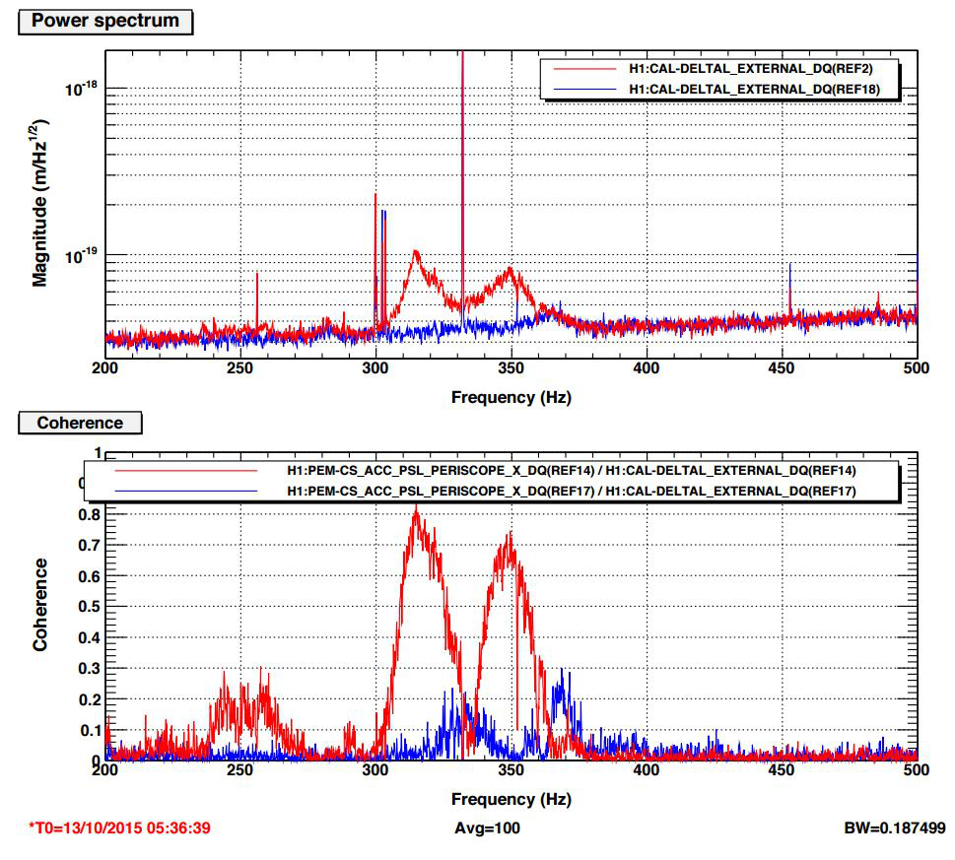
PSL Periscope Noise in O1

Slide 3
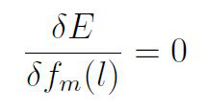
Wiener Filter
Filter applied through convolution in the time domain.
Target data: y(k) with N samples
Witness data: x(k)
Our filter: f(l) with L + 1 coefficients
E represents the mean square error between target data and predicted data.
Create our filter by minimizing the mean square error. That means setting derivative with respect to each filter coefficient to zero.

Slide 4
Derivative constraints lead to the Wiener-Hopf equation.
Rxx is auto-correlation matrix of witness data, x(k) where k = [0,..., L]
c_{yx} is cross-correlation matrix between witness and target data.
Signals are real so the auto-correlation matrix is symmetric, resulting in a Toeplitz structured system of equations. Solution obtained with the Levinson-Durbin algorithm.
Output data, r(k), is predicted data subtracted from target data.

Slide 5
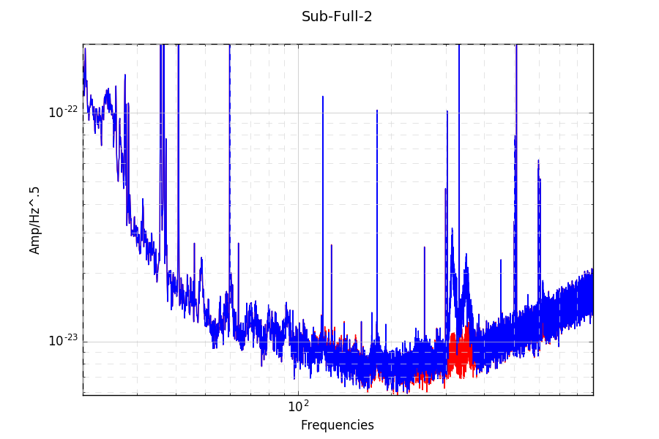
Witness Channel:
H1:IMC-WFS_B_I_YAW_OUT_DQ
1 hour of data used to train filter
Blue: Original, Red: Subtracted Data

Slide 6
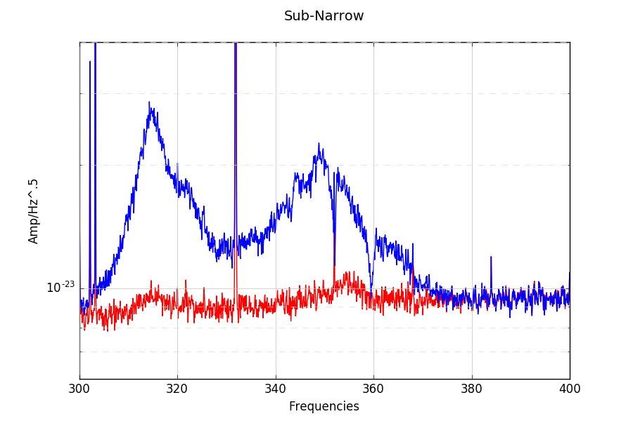
300 – 400 Hz

Slide 7
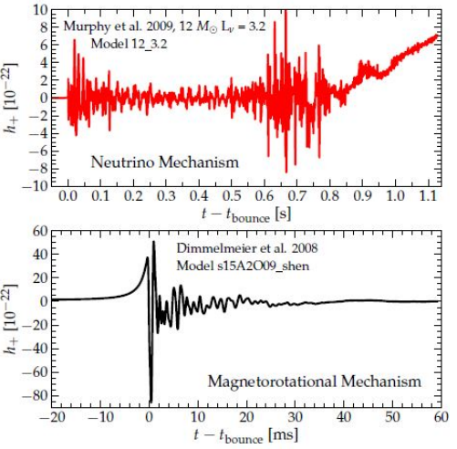
Injections
Injected 16 waveforms from the Murphy catalog (2009) and 128 waveforms from the Dimmelmeier catalog (2008)
Each waveform injected at 10 evenly spaced intervals over a 24 hour period to explore entire antenna pattern. 1440 total injections.
Two sets of PCs, Dimmelmeier and Murphy.
6 PCs for Dimmelmeier, 9 for Murphy

Slide 8
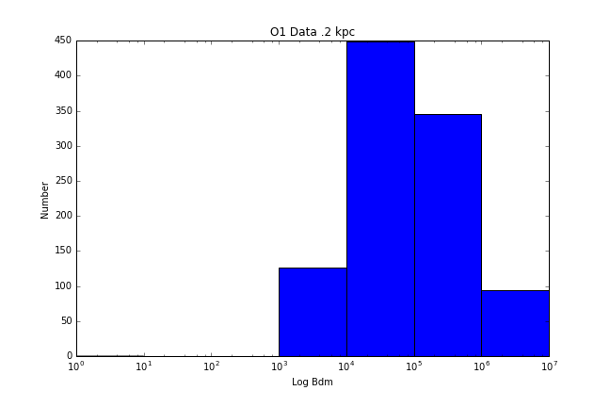
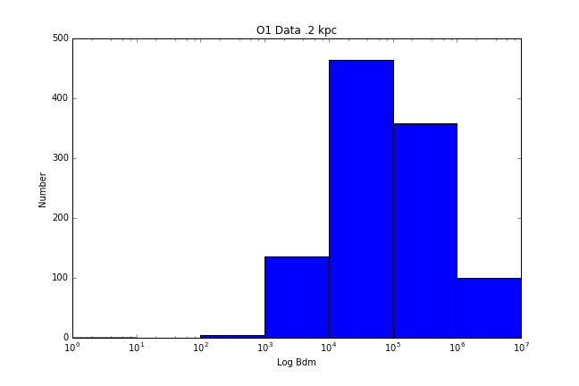
Dimmelmeier .2 kpc
Original Data
Data points: 1016
Avg B_{dm} = 2.7399e5
Correctly Identified: 1016 / 1016 (100%)
Incorrectly identified waveforms: 0 / 1016 (0%)
Undecided: 0 / 1016 (0%)
Filtered Data
Data points: 1063
Avg B_{md} = 2.7481e5
Correctly Identified: 1063 / 1063 (100%)
Incorrectly Identified: 0 / 1063 (0%)
Undecided: 0 / 1063 (0%)

Slide 9
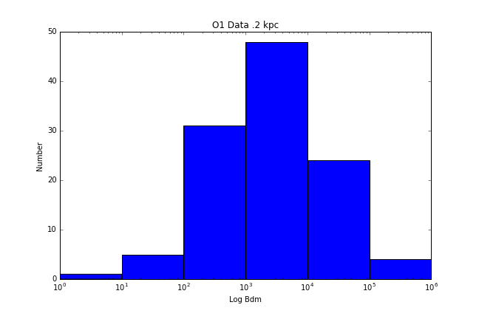
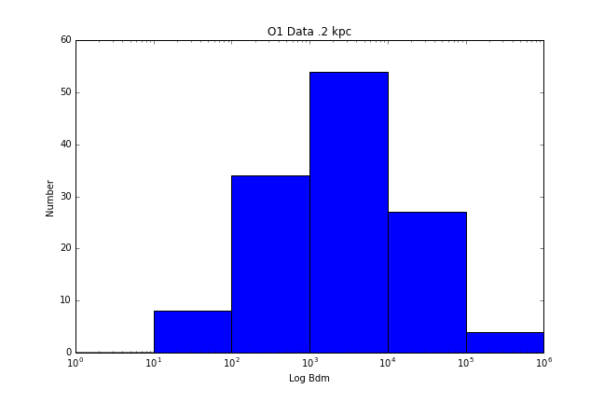
Murphy .2 kpc
Original Data
Data points: 128
Avg B_{dm} = 1.4e4
Correctly Identified: 112 / 128 (88%)
Incorrectly identified waveforms: 15 / 128 (12%)
Undecided: 1 / 128 (<1%)
Filtered Data
Data points: 145
Avg B_{md} = 1.3663e4
Correctly Idenified: 127 / 145 (88%)
Incorrectly Identified: 16 / 145 (11%)
Undecided: 2 / 145 (1%)

Slide 10
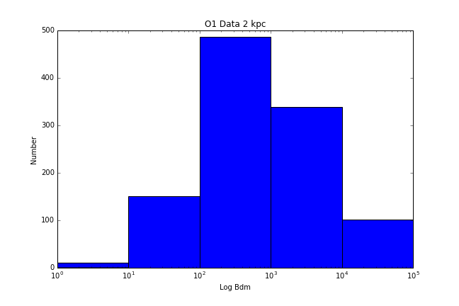
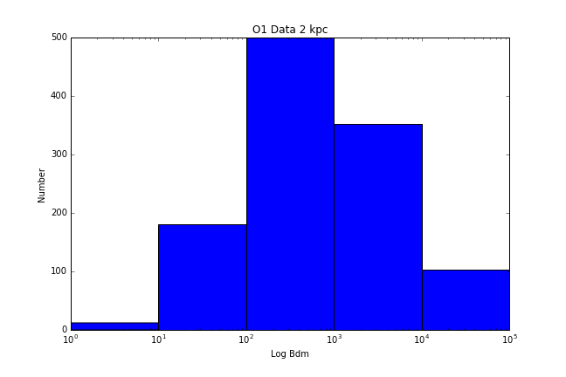
Dimmelmeier 2 kpc
Original Data
Data points: 1090
Avg B_{dm} = 2.657e3
Correctly Identified: 1078 / 1090 (99%)
Incorrectly identified waveforms: 0 / 1016 (0%)
Undecided: 12 / 1090 (1%)
Filtered Data
Data points: 1153
Avg B_{md} = 2.552e3
Correctly Identified: 1137 / 1153 (99%)
Incorrectly Identified: 0 / 1153 (0%)
Undecided: 16 / 1153 (1%)

Slide 11
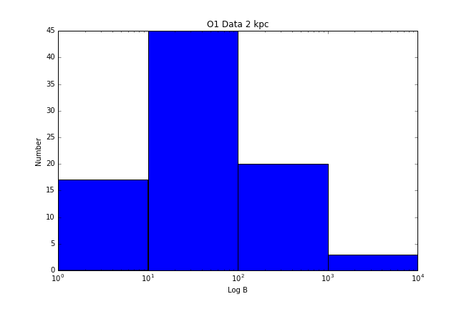
Murphy 2 kpc
Original Data
Data points: 145
Avg B_{dm} = 115
Correctly Identified: 68 / 145 (47%)
Incorrectly identified waveforms: 9 / 145 (6%)
Undecided: 68 / 128 (47%)
Filtered Data
Data points: 145
Avg B_{md} = 119
Correctly Idenified: 69 / 145 (48%)
Incorrectly Identified: 11 / 145 (8%)
Undecided: 65 / 145 (45%)

Slide 12
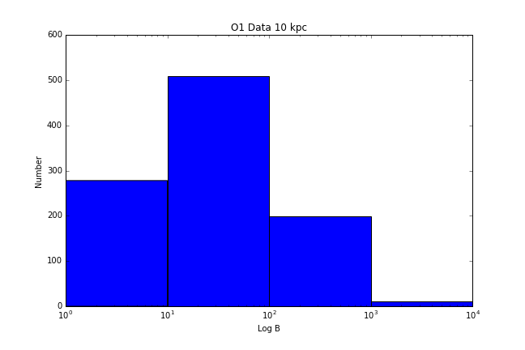
Dimmelmeier 10 kpc
Original Data
Data points: 1152
Avg B_{dm} = 96
Correctly Identified: 719 / 1152 (62%)
Incorrectly identified waveforms: 0 / 1052 (0%)
Undecided: 433 / 1152 (38%)
Filtered Data
Data points: 1153
Avg B_{md} = 98
Correctly Identified: 719 / 1153 (62%)
Incorrectly Identified: 0 / 1153 (0%)
Undecided: 434 / 1153 (38%)

Slide 13
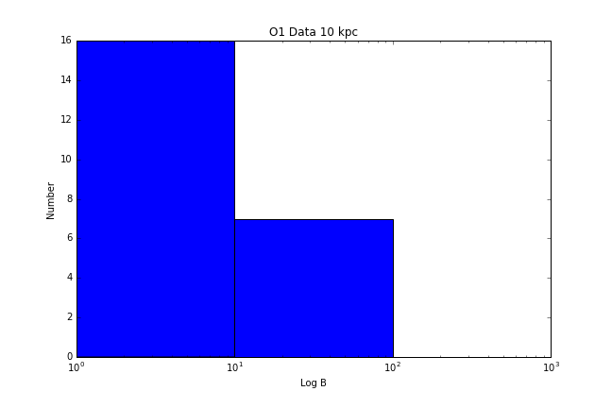
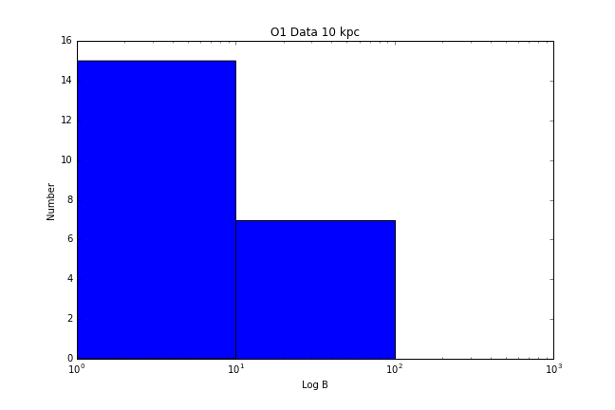
Murphy 10 kpc
Original Data
Data points: 145
Avg B_{dm} = -1.5
Correctly Identified: 7 / 145 (5%)
Incorrectly identified waveforms: 16 / 145 (11%)
Undecided: 122 / 145 (84%)
Filtered Data
Data points: 145
Avg B_{md} = -1.32
Correctly Idenified: 7 / 145 (5%)
Incorrectly Identified: 16 / 145 (11%)
Undecided: 122 / 145 (84%)

Slide 14
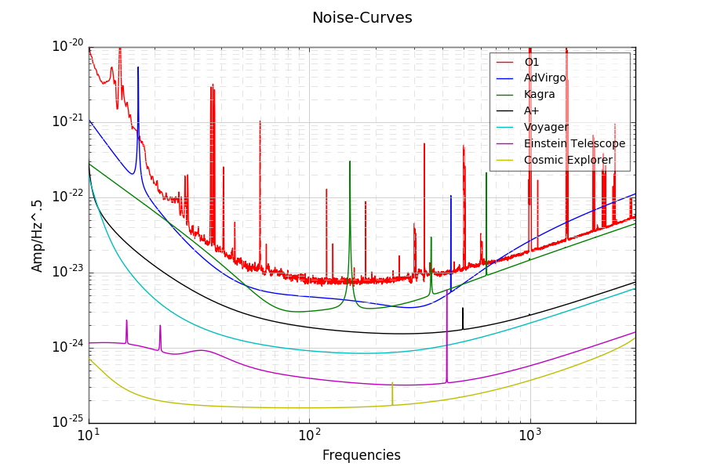

Slide 15
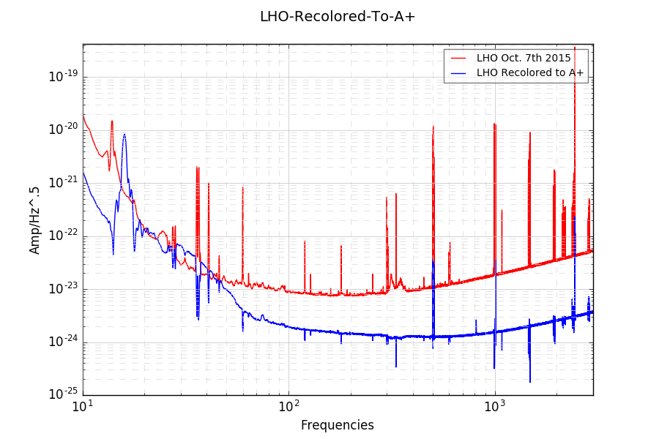

Slide 16
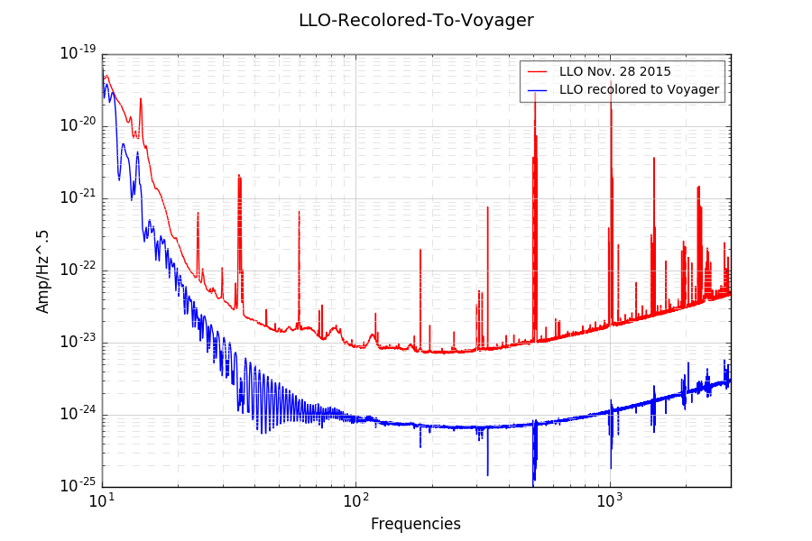

Slide 17
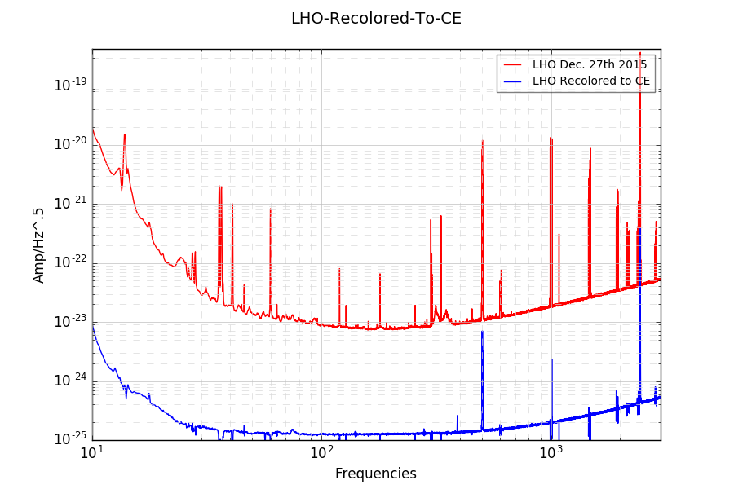

Slide 18
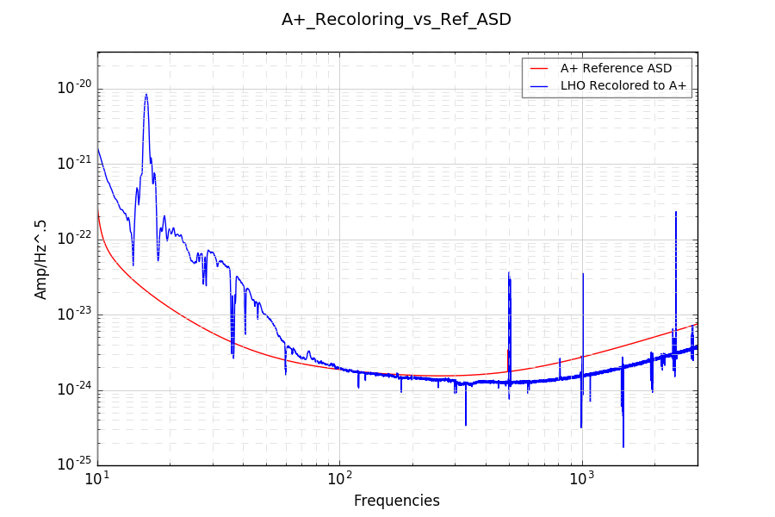

Slide 19
Current/Next Steps
Fix recoloring issues
Study future detectors in depth
Try Multi-Coherence method
Examine other noise sources (LLO noise breathing, current LHO jitter, etc)
Add new non-catalog waveforms

