Slide 1


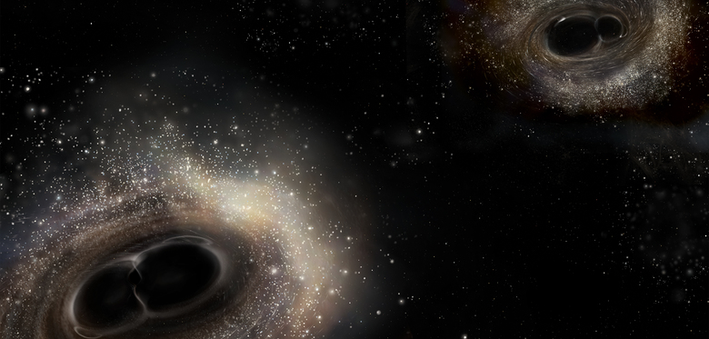

APS Division of Laser Science Business Meeting, Rochester, NY, Oct 19, 2016
Seeing Black: Detecting Gravitational Waves From Binary Black Hole Mergers for the First Time Ever using LIGO
David Reitze
LIGO Laboratory
California Institute of Technology
For the LIGO Scientific Collaboration and the Virgo Collaboration
LIGO-G1602149-v1

Slide 2
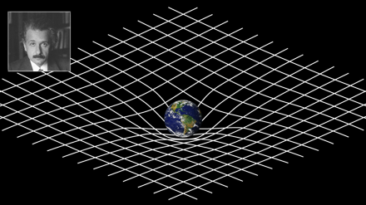
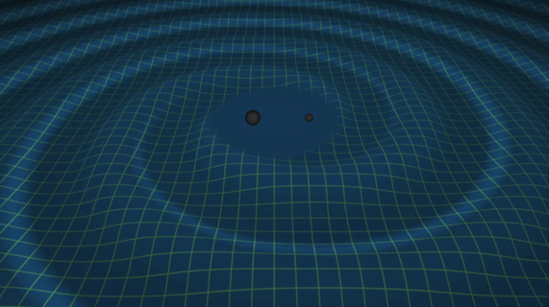
2016: Also the Centenary of Gravitational Waves!
General Relativity:
Einstein Field Equations
Weak field approximation --
space-time is slightly
perturbed from flat space-time:
Free Space:
T_{μν} = 0
Wave equation for h_{μν} !

Slide 3
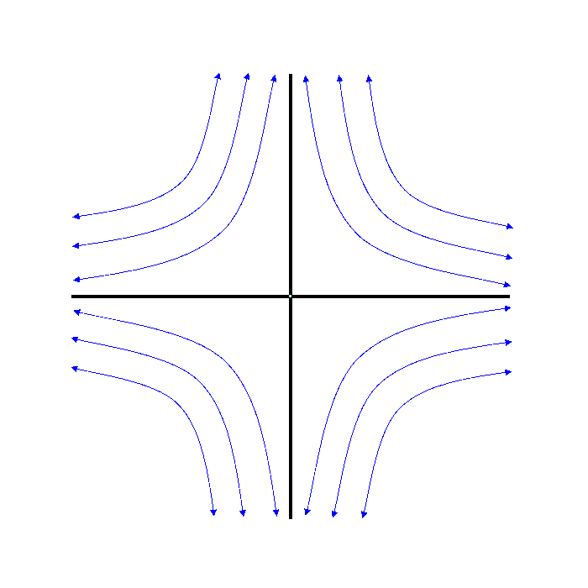
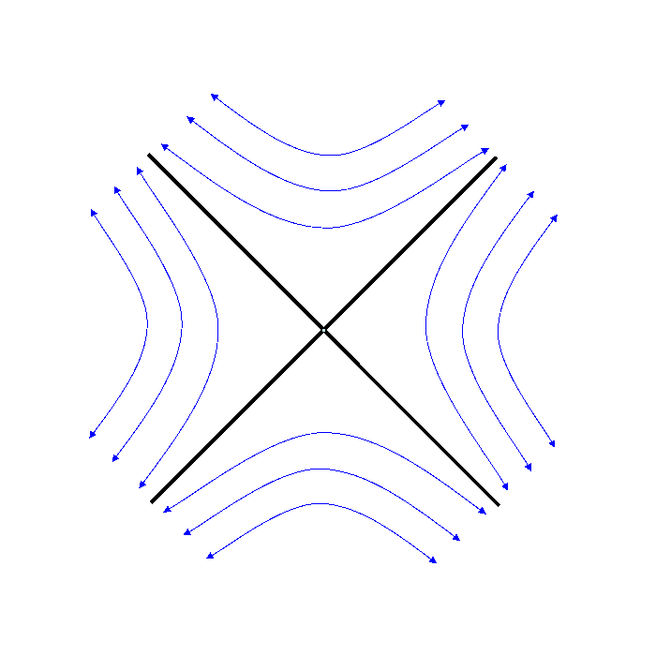
Producing Gravitational Waves
Physically, h is a strain: ΔL/L
ω_{orb}
M
R
h₊
h_{x}
Mass: Stellar Mass Black Holes
Distance: 200 - 600 Mpc
Orbital Frequency: 100-500 Hz
Separation: 3 Schwarzschild radii

Slide 4
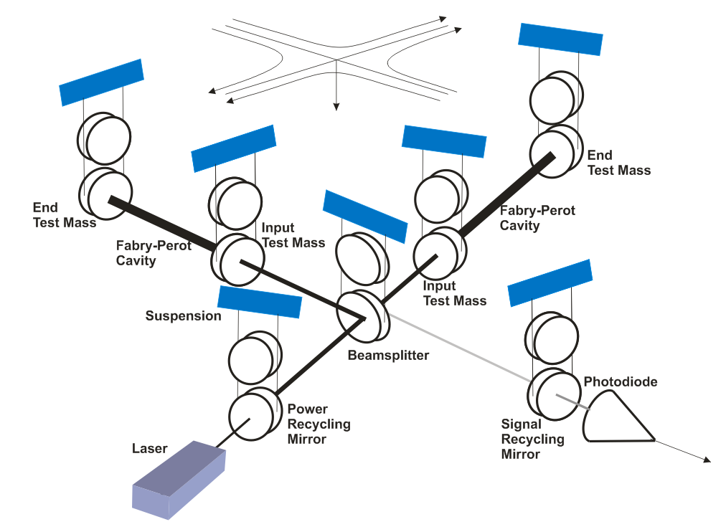
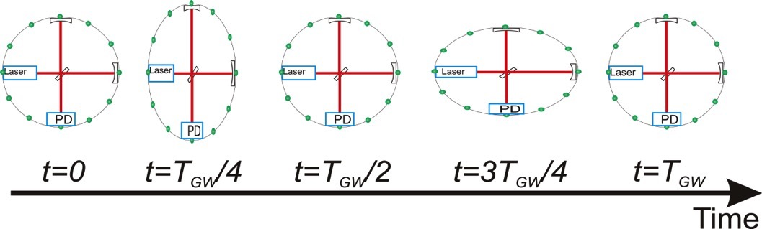
LIGO Interferometry
Advanced LIGO
LIGO uses enhanced Michelson interferometry
  suspended (‘freely falling’) mirrors
Passing GWs stretch and compress the distance between the end test mass and the beamsplitter
The interferometer acts as a transducer, turning GWs into photocurrent
  A coherent detector
4 km

Slide 5

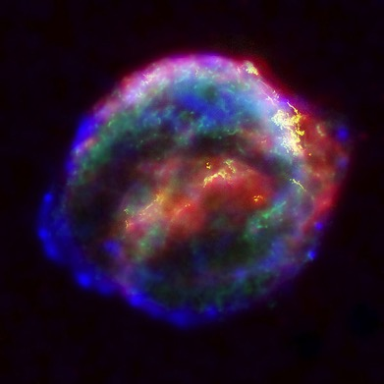

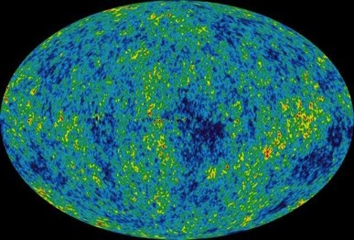
The astrophysical gravitational wave source catalog
Coalescing Binary Systems
Neutron stars, black holes
‘chirped’ waveform
‘Bursts’
asymmetric core collapse supernovae
cosmic strings
???
Credit: Chandra X-ray Observatory
Credit: AEI, CCT, LSU
Cosmic GW background
residue of the Big Bang
probes back to 10⁻²¹ s
stochastic, incoherent background
Difficult (impossible?) for LIGO to detect
Continuous Sources
Spinning neutron stars
monotone waveform
NASA/WMAP Science Team
Casey Reed, Penn State
Notes:
LIGO is designed to be an observatory, not a one-off proof that GWs exist. What do we look for?
There are number of predicted astrophysical sources of gravitational radiation, and most of them involve cataclysmic events.
Binary systems – NSs and BHs, most likely source, theoretically well understood with known waveforms
Bursts – GW emissions that are not well modeled or understood. These include asymmetrically core collapse supernova, cosmic strings, and perhaps unknown sources
The residual GW background
Continuously emitting sources such as spinning neutron stars, which have a pure monotone emission.

Slide 6
The Advanced LIGO Detector

Slide 7
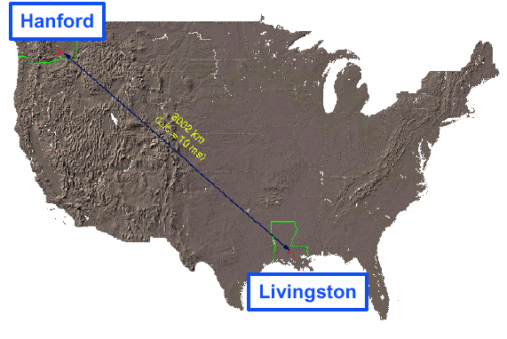
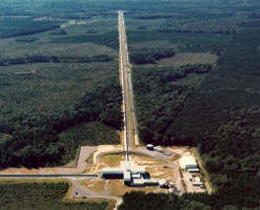
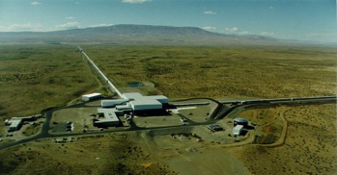

LIGO
Hanford, WA
LIGO Laboratory:
180 staff located at Caltech, MIT, Hanford, Livingston
LIGO Scientific Collaboration:
~ 1000 scientists, ~80 institutions, 15 countries
LIGO Livingston
Observatory
LIGO Hanford Observatory
Livingston, LA
The LIGO Observatories are operated by Caltech and MIT
Notes:
LIGO is actually two observatories and three interferometers.
Describe parameters
Emphasize that the arms are in ultra high vacuum. 8 km of steel 1.2 m dia beam tubes at each site
Separate observatories allow for coincidence detection – since the detectors see uncorrelated noise, only a true gravitational wave would appear on all the interferometers with the correct amplitude.
Emphasize that the LIGO Observatories were designed and are operated by Caltech and MIT

Slide 8

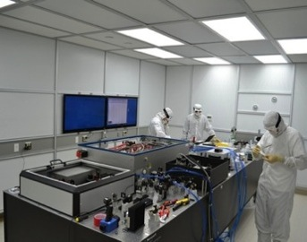
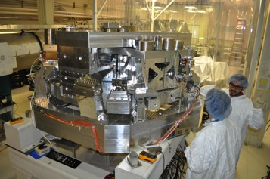
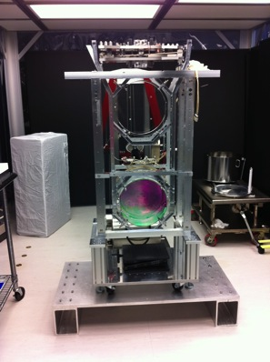
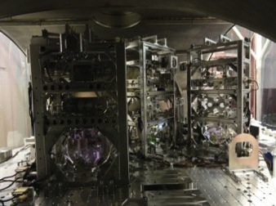
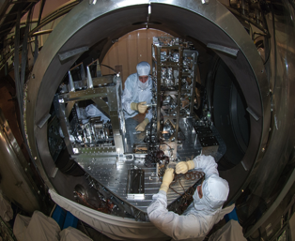
Advanced LIGO Interferometer
Pre-stabilized Laser
Active Seismic Isolation
40 kg ‘Test Mass’ Mirror
Quadruple Suspension
Input Optics
Output Mode Cleaner
Auxiliary Laser

Slide 9
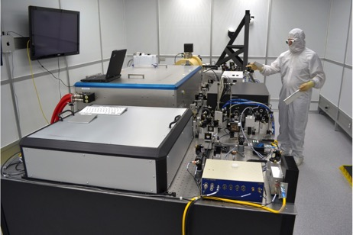
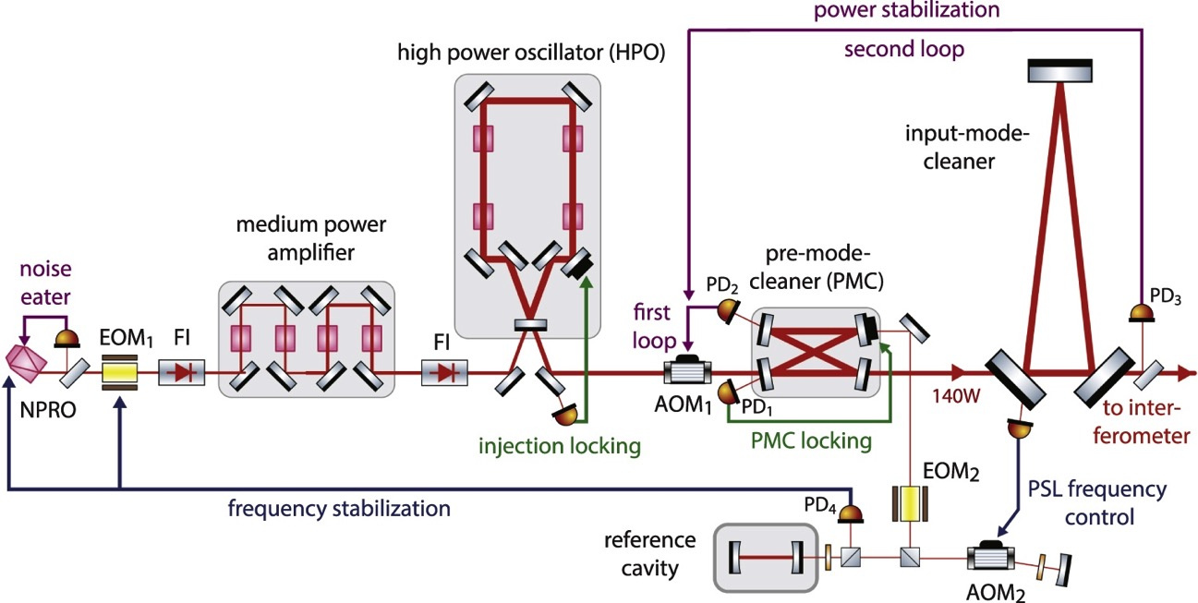
Advanced LIGO Pre-Stabilized Laser
Multi-stage Nd:YAG, λ=1.06 μm laser
Max Power | 180 W
Power Noise | 10⁻⁷ W/Hz^{-1/2} @ 10 Hz
Frequency Noise | 0.1 Hz/Hz^{-1/2} @ 10 Hz
180W
165W
2W
35W
P. Kwee, et al., Opt. Exp. 20, 10619 (2012)
Notes:
Take out premode cleaner
Take out the NPRO pictures
3 Tera Hz stabilized to 0.1
Get rid of iLIGO stuff

Slide 10
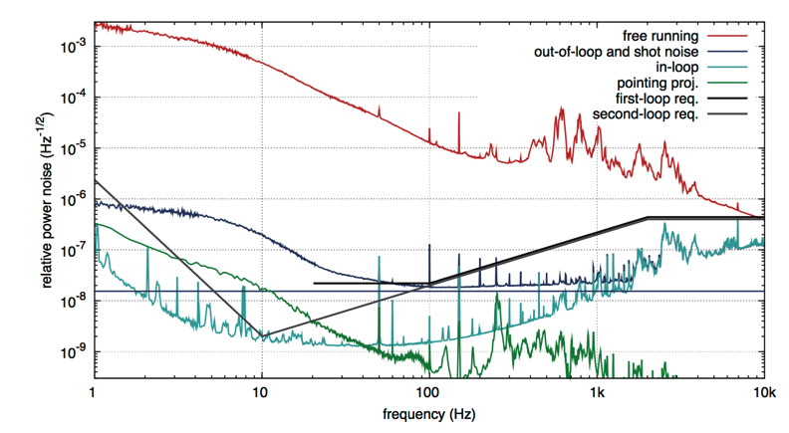
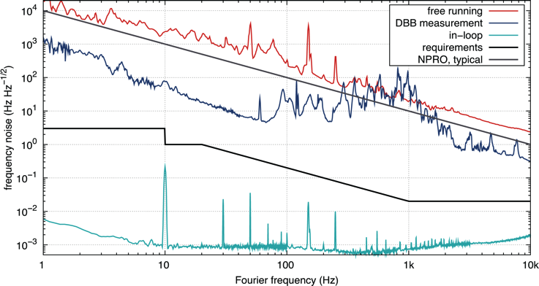
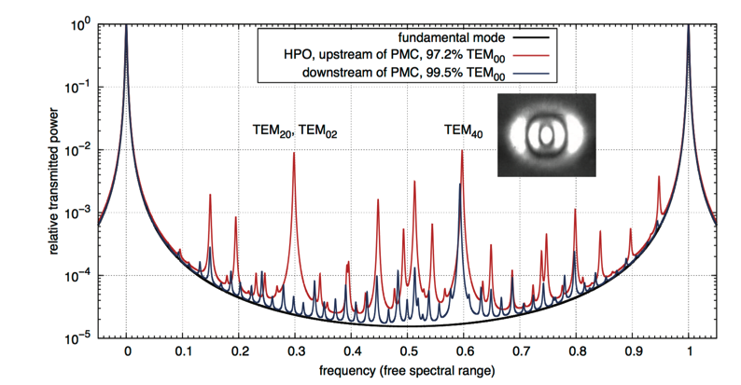
Advanced LIGO Pre-Stabilized Laser
Laser Frequency Noise
Laser Intensity Noise
High Power Mode Quality (200 W)
P. Kwee, et al.,
Opt. Exp. 20, 10619 (2012)
Notes:
Take out premode cleaner
Take out the NPRO pictures
3 Tera Hz stabilized to 0.1
Get rid of iLIGO stuff

Slide 11
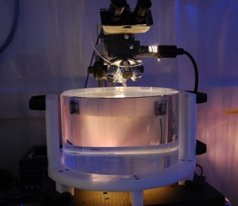
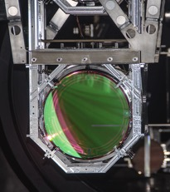
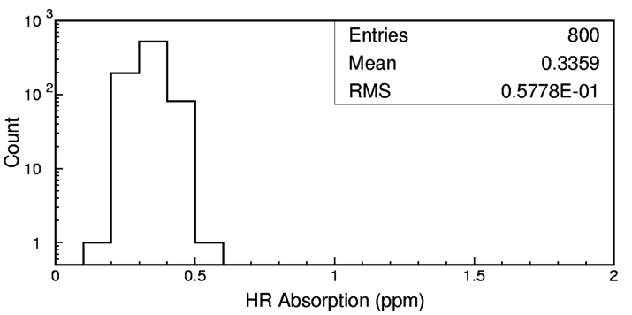
Advanced LIGO ‘Test Mass’ Mirrors
Truly the ‘crown jewels’ of the detector
Physical specifications:
  Ultra-pure, ultra-homogeneous fused silica
  340 mm diameter, 200 mm thick, 40 kg mass
Surface figure: super-polish followed by ion beam ‘spot’ polish
  < 0.15 nm RMS deviation from sphere
Coatings: TiO₂-doped Ta₂O₅/SiO₂
  Reflectivity depends upon type of mirror
  Ultralow absorption (< 0.5 ppm)

Slide 12
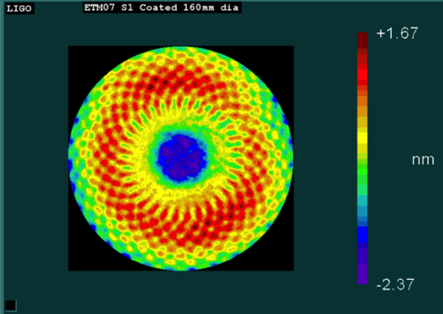
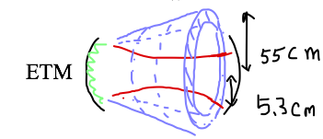
The Challenge of Producing LIGO Test Mass Optical Coatings
Figure loss by two mirrors
~ 15-20ppm
micro roughness, point scattering
~ 20 ppm
7.83mm

Slide 13
Advanced LIGO = Mirror Sensing & Control
Length Sensing and Control: multiple Pound-Drever-Hall length locking
(sensing paths only, actuation paths not shown)
NB: Diagram does not include angular
sensing and control!

Slide 14
Noises
Fundamental Noises:
Displacement noise
→ ΔL(f)
  Seismic noise
  Radiation Pressure
  Thermal noise
    Suspensions
    Optics
Sensing Noise
→ Δt_{photon}(f)
    Shot Noise
    Residual Gas
Technical Noises:
    Loads of them…

Slide 15
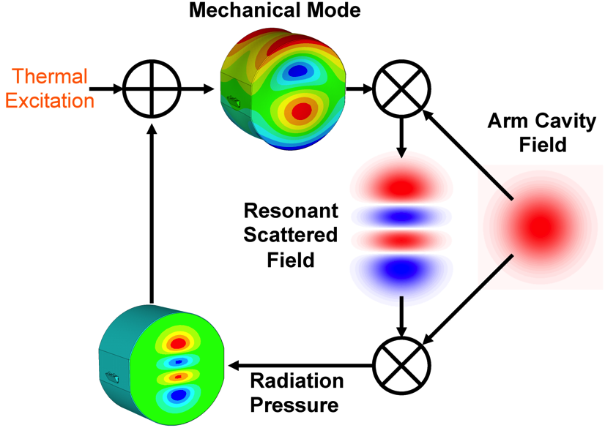
Nonlinear Effects in Interferometers: Parametric Instabilities
Theory: V. B. Braginsky, S. E. Strigin, and S. P. Vyatchanin, Phys. Lett. A 305, 111 (2002)
Experiment: C. Zhao, L. Ju, J. Degallaix, S. Gras, and D. G. Blair,
Phys. Rev. Lett. 94, 121102 (2005); M. Evans, et al., “Observation of Parametric Instability in Advanced LIGO”, Phys. Rev. Lett. 114, 161102 (2015).

Slide 16
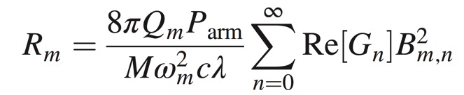
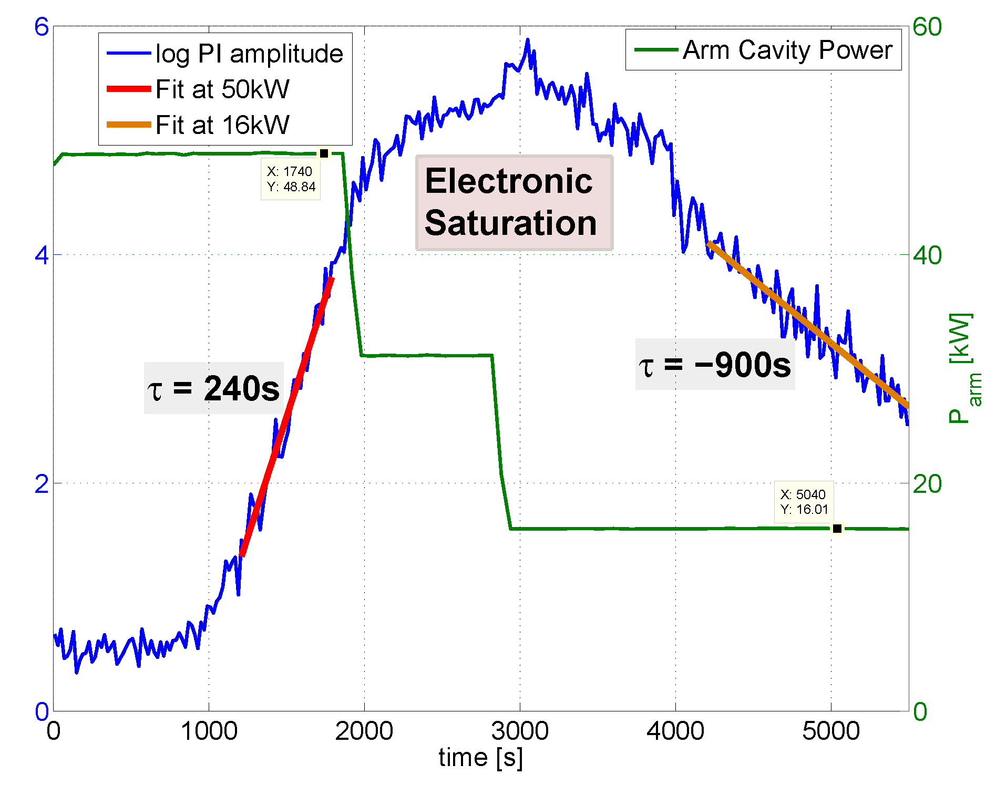
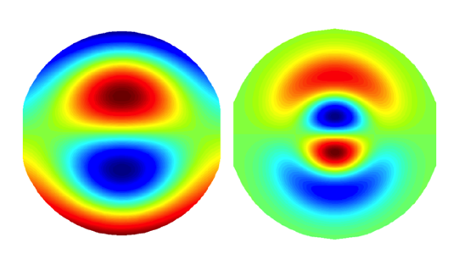
Observation of Parametric Instabilities in Advanced LIGO
Parametric Gain:
mechanical mode
Q-factor
power in the
arm cavity
spatial overlap
Optical-mechanical mode
(P_{arm} = 50 kW)
‘Ring Up’ Amplitude vs Time
Acoustic mode
frequency
optical mode
gain
Acoustic mode Optical mode
f_{m} = 15,539 Hz

Slide 17
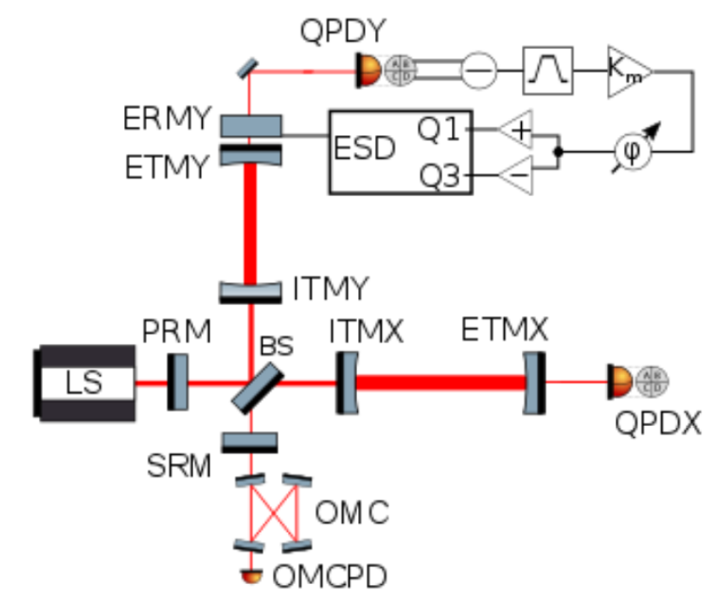
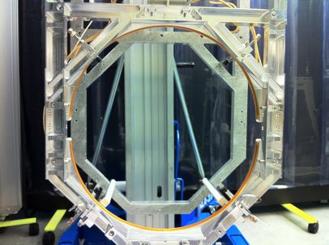
Tranquilizing Parametric Instabilities
Thermal Tuning of the Mirror
Radii of curvature via Ring Heater
Electrostatic Damping of PI modes

Slide 18
The First Gravitational Wave Detections

Slide 19
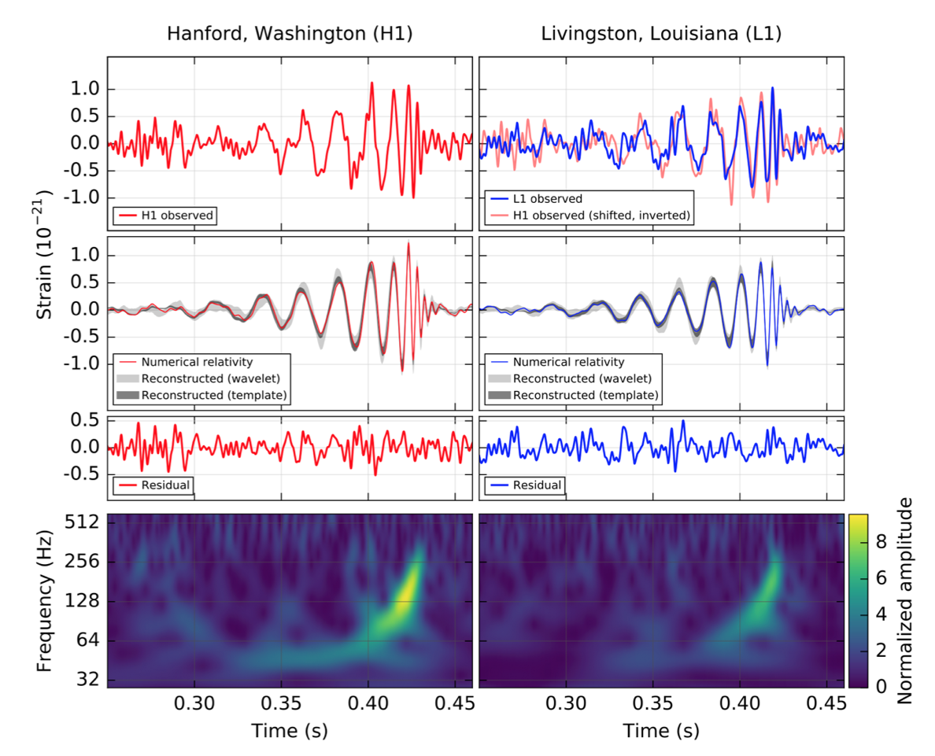
The First Detection: GW150914
4 x 10⁻¹⁸ m
Abbott, et al. ,LIGO Scientific Collaboration and Virgo Collaboration, “Observation of Gravitational Waves from a Binary Black Hole Merger” Phys. Rev. Lett. 116, 061102 (2016)

Slide 20
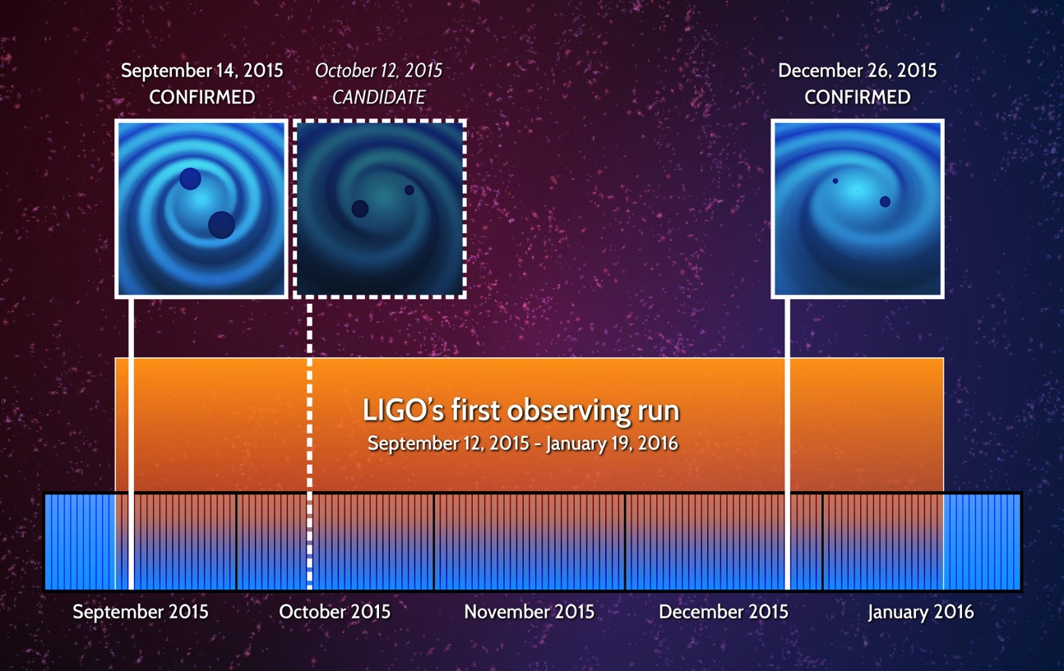

Slide 21
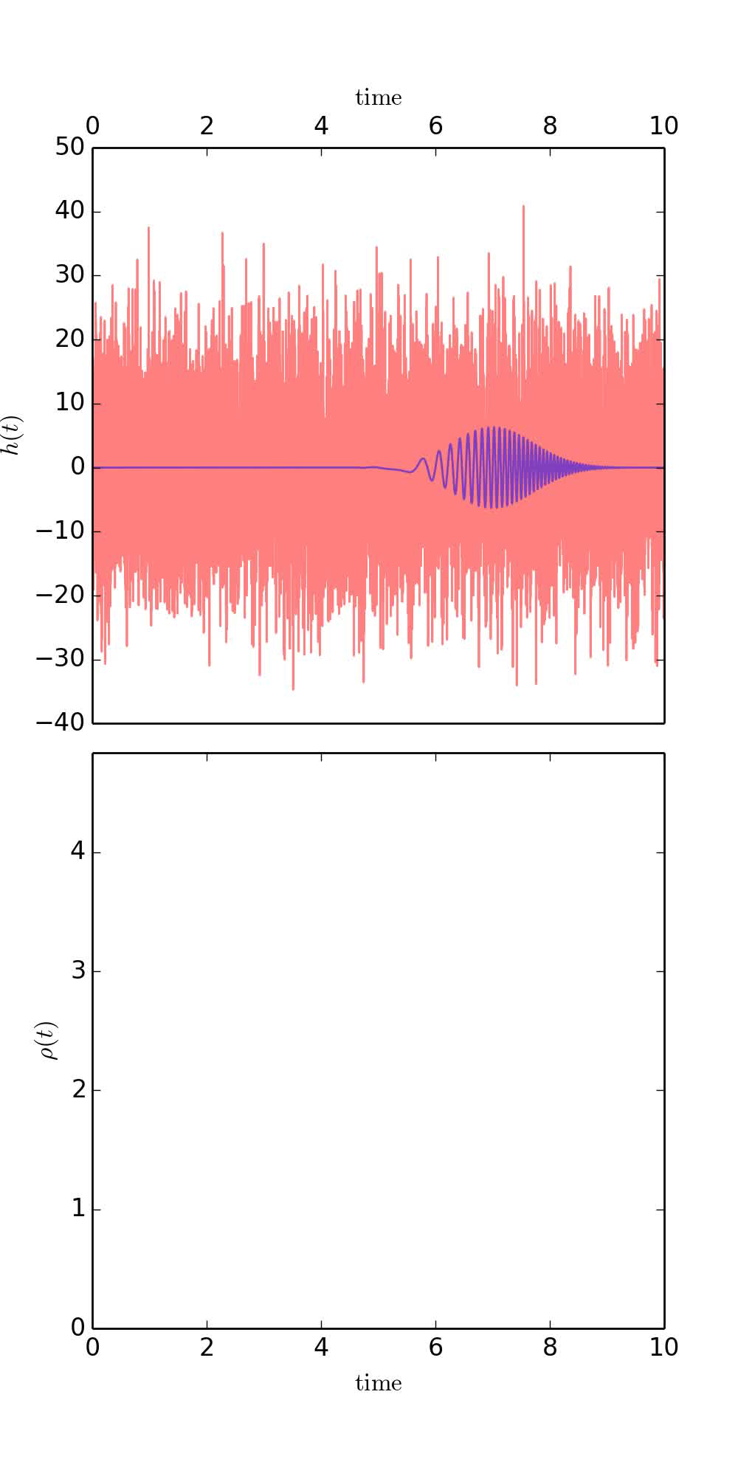
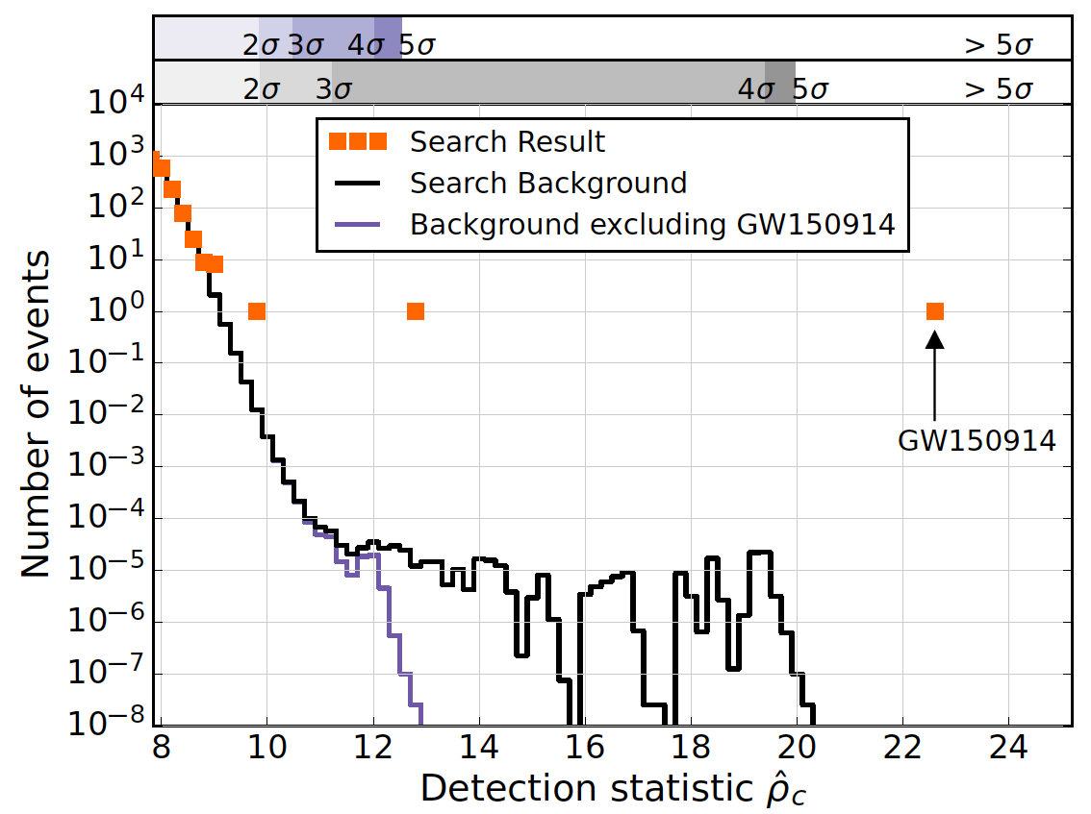
Assessing Statistical Significance: Modeled Search
Matched filter search: X-correlation of L1, H1 data streams with 250,000 BH waveform templates covering 1-- 99 M
Total coincident L1, H1 data: 51.5 days
Background computed from time-shifting coincident data in 100 ms steps to produce 5x10⁶ years
Simulation: Reed Essick, LIGO MIT

Slide 22

The Sounds of Space-Time

Slide 23
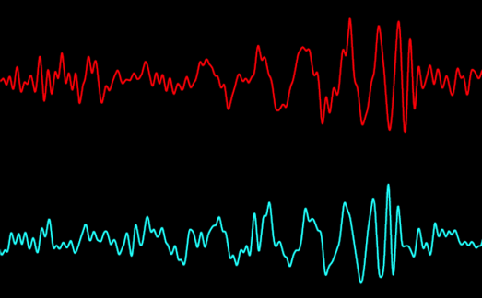
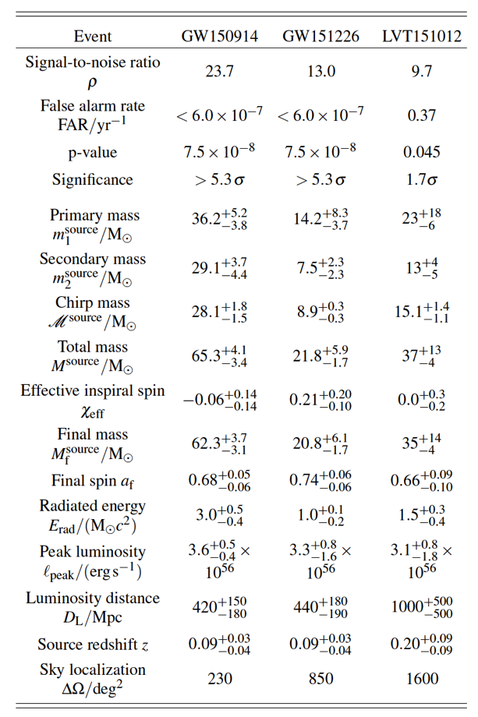
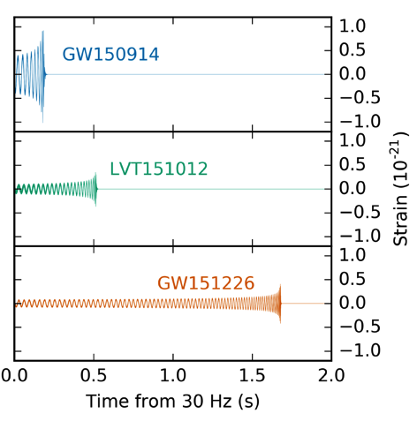
Parameter Estimation
Hanford
Livingston
Abbott, et al. ,LIGO Scientific Collaboration and Virgo Collaboration, “Binary Black Hole Mergers in the first Advanced LIGO Observing Run”, arXiv:1606.04856, Phys. Rev X (to appear)

Slide 24
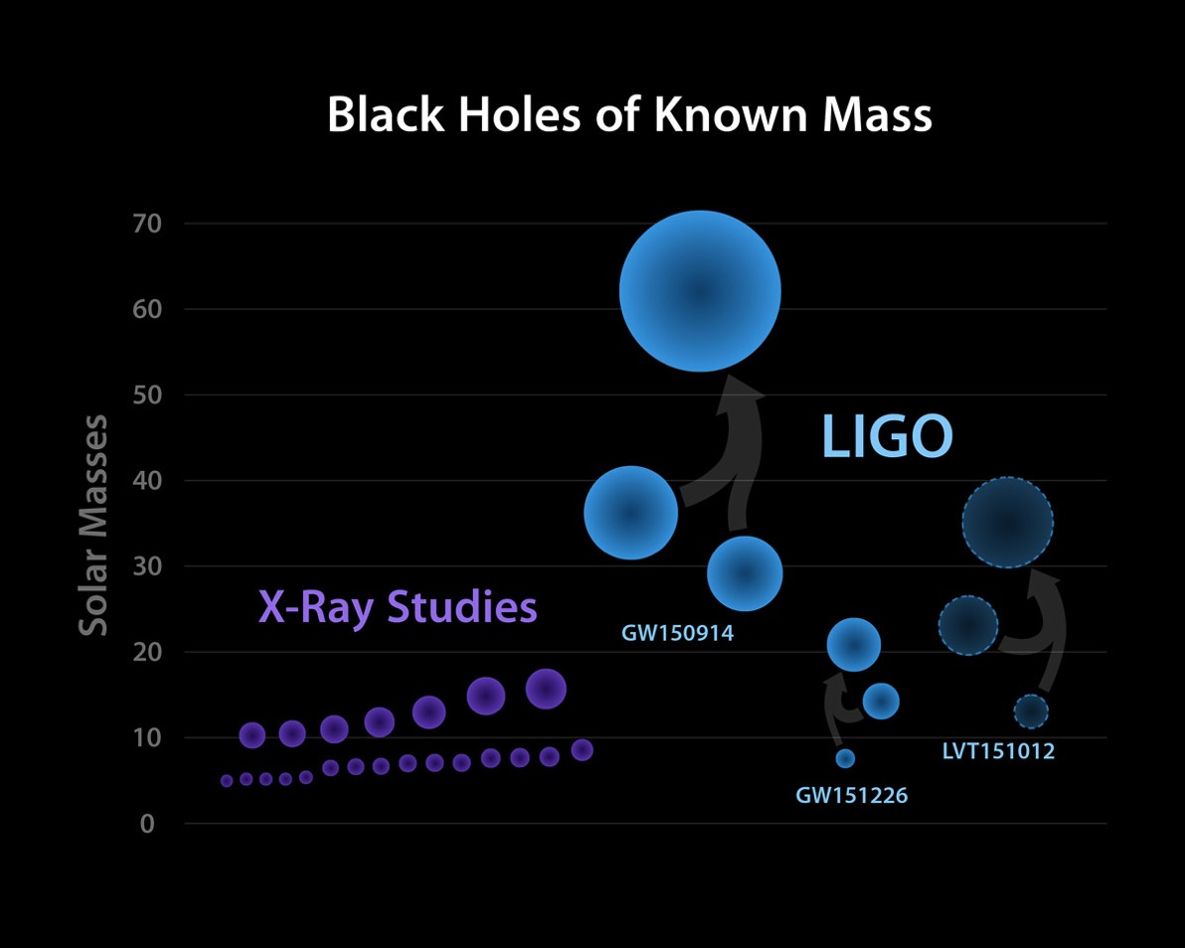
The Black Hole Mass Menagerie
4 Months of Gravitational-wave Astronomy
40 Years of X-ray
Astronomy

Slide 25
What Comes Next For LIGO?

Slide 26
Coming Soon: ‘A+’
(A Mid-scale Upgrade of Advanced LIGO)

Slide 27
Coming Soon: ‘A+’
(A Mid-scale Upgrade of Advanced LIGO)
Quantum (Radiation
Pressure) Noise
Quantum (Shot) Noise
Coating Thermal Noise

Slide 28

Squeezing: Beating the Quantum Noise Limit
H. P. Yuen, Phys. Rev. A13, 2226 (1976); C. M. Caves, Phys. Rev. D26, 1817 (1982); Wu, Kimble, Hall, Wu, PRL (1986)
3.5 dB squeezing
(1.5X reduced noise)
Typical noise without squeezing
Squeezing-enhanced sensitivity
Main Laser
PLL
Faraday
Isolator
Squeezed Vacuum
Source
Squeezed Vacuum
State
x₂
2.1 dB squeezing
(1.27X reduced noise)
Photodiode
x₁
Aasi, et al., (LIGO Scientific Collaboration), Nature Physics, 7, 962 (2011); Nature Photonics 7 613 (2013).
Notes:
Two demonstrations of squeezing!

Slide 29
The Problem: Thermal Noise in Optical Coatings
ω₀
Δx
Y. Levin Phys. Rev.
D 57 659 (1998)
<Δx(ω)>²
low Q
signal
band
∝ 1/Q
high Q
ω /ω₀
Simple picture: kT of energy per mechanical mode, viscous damping
For coating dominated noise and structural damping:
coating thickness
coating elastic loss
Slide Credit:
Marty Fejer, Stanford
beam radius
Compare: Bulk Silica φ ~ 10⁻⁶-10⁻⁸

Slide 30
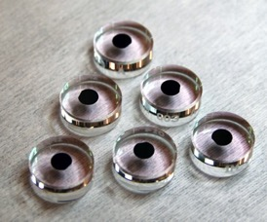
Routes to Improved Coatings with Low Thermal Noise
Goal: 2X – 4X reduction in coating thermal noise
  Path#1: Ultrastable Glasses
  Glasses prepared by physical vapor deposition show extraordinary stability
    slower cooling liquid reaches lower energy states
  Path#2: Crystalline Coatings
  molecular beam epitaxy to generate crystalline GaAs/AlGaAs multilayer
  mirror disc lithography and etch, substrate removal, and direct bonding on substrate
  φ ~ 2x10⁻⁶ vs ~10⁻⁴
annealed 350°C
X. Liu, F. Hellman, et al, Phys. Rev. Lett. 113, 025503 (2014)
deposition temperatures, T_{s}
G. D. Cole, W. Zhang, M. J. Martin, J. Ye, and M. Aspelmeyer, Nature Photonics (2013)

Slide 31
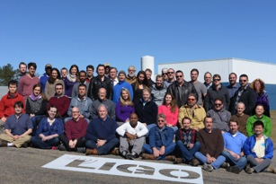
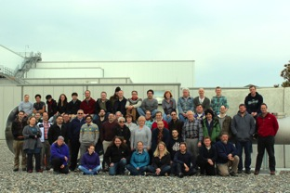
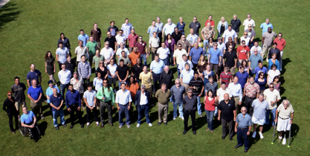
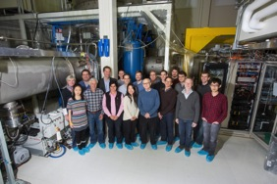
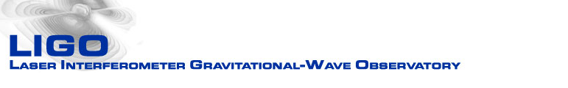

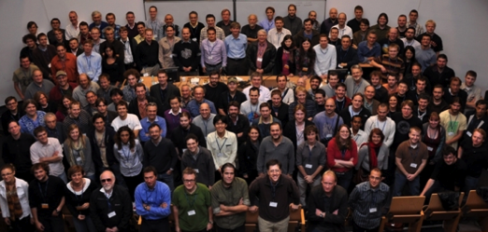
Acknowledgments
LIGO Livingston Observatory
LIGO Hanford Observatory
Thanks to:
ligo.caltech.edu
www.ligo.org
Support: National Science Foundation
LIGO Caltech
LIGO MIT
LSC

Slide 32
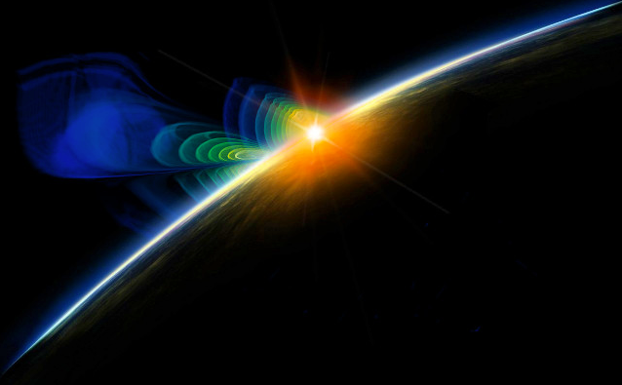
Advanced LIGO and the Dawn of Gravitational-waves Physics and Astronomy
LIGO has made the first measurement of a gravitational wave amplitude and phase
  Merging binary black holes have been observed for the first time
The Advanced LIGO detector is operating at 50% of its design sensitivity
  Will begin running again in late 2016
Upgrades to Advanced LIGO using frequency-dependent squeezing anticipated to begin soon after 2020

Slide 33
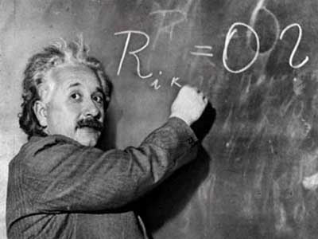

100th Anniversaries
“Don't do anything that someone else can do. Don't undertake a project unless it is manifestly important and nearly impossible.” Edwin Land
….. Then [gravitational wave amplitudes ] must have a virtually vanishing value in all imaginable cases.” Albert Einstein, 1916
Inspiration: Eric Gustafson

Slide 34



Some of the Fundamental Questions That Gravitational Waves Can Address
Fundamental Physics
  Is General Relativity the correct theory of gravity?
  How does matter behave under extreme conditions?
  Are black holes truly bald?
Astrophysics, Astronomy, Cosmology
  Do compact binary mergers cause GRBs?
  What is the supernova mechanism in core-collapse of massive stars?
  How many low mass black holes are there in the universe?
  Do intermediate mass black holes exist?
  How bumpy are neutron stars?
  Is there a primordial gravitational-wave residue?
  Can we observe populations of weak gravitational wave sources?
  Can binary inspirals be used as “standard sirens” to measure the local Hubble parameter?
Black Hole Merger and Ringdown
Image credit: W. Benger
Neutron Star Formation
Image credit: NASA
GW Upper limit map
Credit: LIGO Scientific Collaboration

Slide 35
Phase and Amplitude Squeezing
Coherent State
Amplitude squeezing
│E │
Phase
squeezing
ϕ

Slide 36



The Best of Both Worlds: Frequency Dependent Squeezing
PLL
Concept: Kimble, Levin, Matsko, Thorne, Vyatchanin, Phys. Rev. D (2001)
Oelker, et al., “Audio-band Frequency-dependent Squeezing”, Phys. Rev. Lett. 116, 041102 (2016).
Notes:
Walks through badness, and then sketch path to goodness

Slide 37

Suppressing Parametric Instabilities
Thermally tuning the test mass radii of curvatures using ring heaters
Active damping via electrostatic feedback through the reaction masses
Passive damping via viscous acoustic mass damping (under development)
Had to avoid this mode in the first run
unstable region

Slide 38

Low-frequency losses in amorphous dielectrics
Loss mechanism: conventionally associated with low energy excitations (LEEs)
  conceptualized as two-level systems (TLS); Distribution of TLSs arising from disordered structure
  Simple physical mechanism: bond flopping in amorphous materials, e.g. SiO₂
V
E₂
E₁
Δ
Single TLS
Distribution of TLSs
Figures: B.S. Lunin

Slide 39




Advanced LIGO Suspensions
Force → Displacement
Transfer Function
Model vs. Measured

Slide 40

https://mediaassets.caltech.edu/gwave

Slide 41


