Slide 1
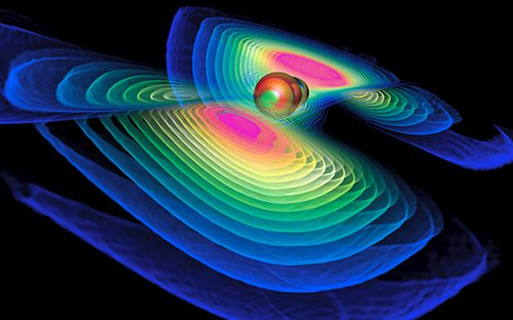
Gravitational Wave Astronomy Begins!
J. Kissel
on behalf of the
LIGO Scientific Collaboration

Slide 2
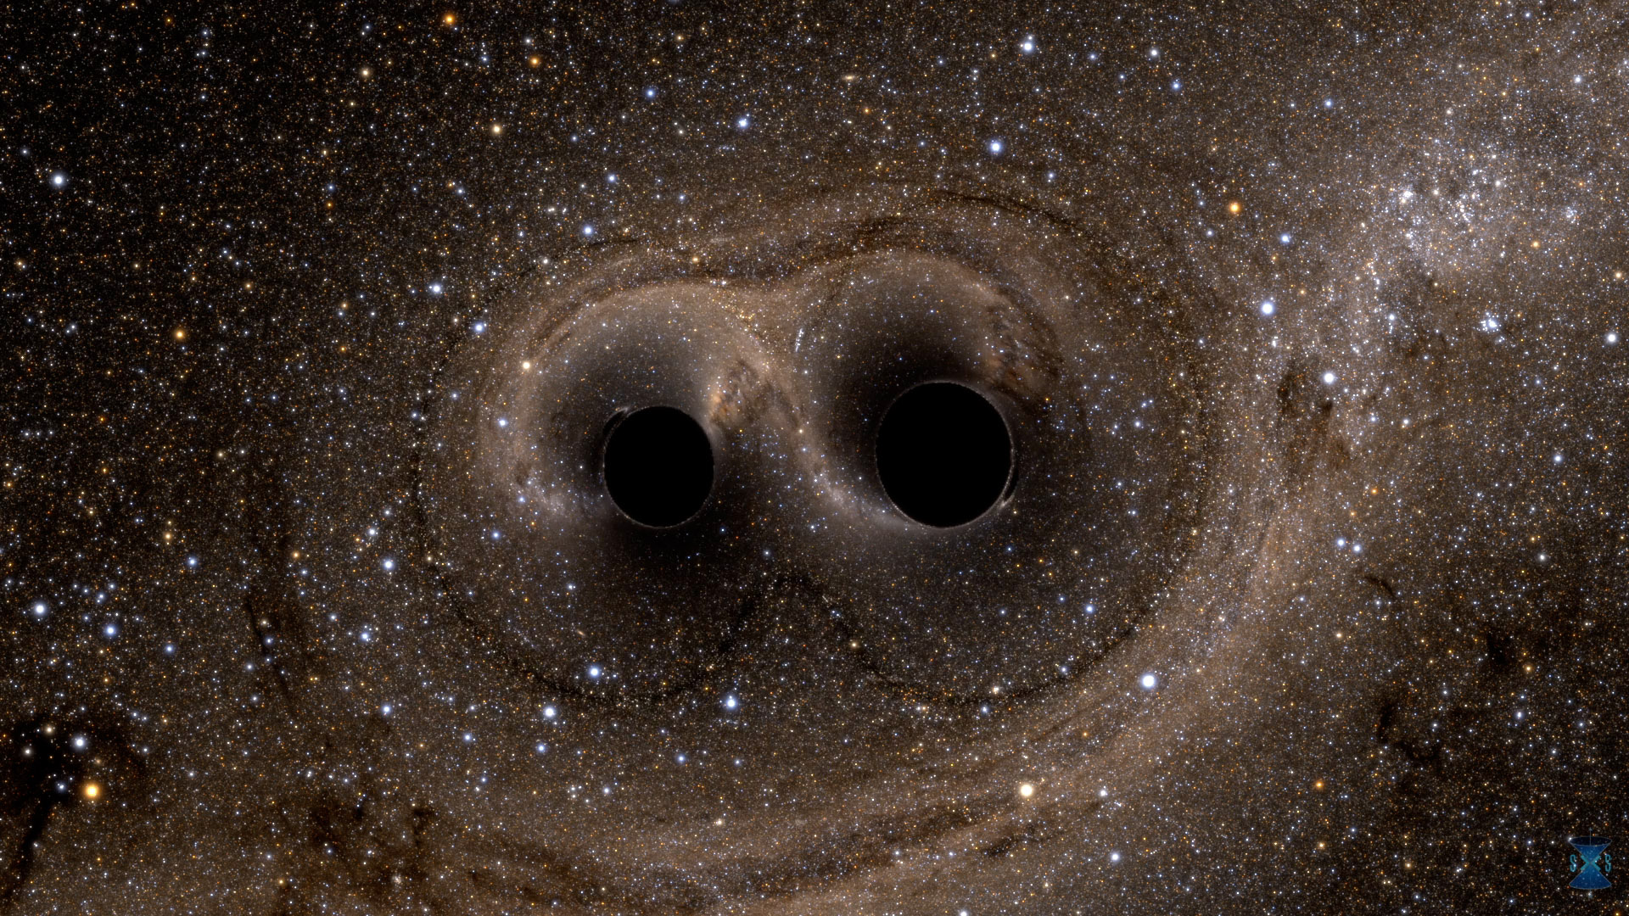
1.3 Billion Years Ago
(Give or Take)

Slide 3
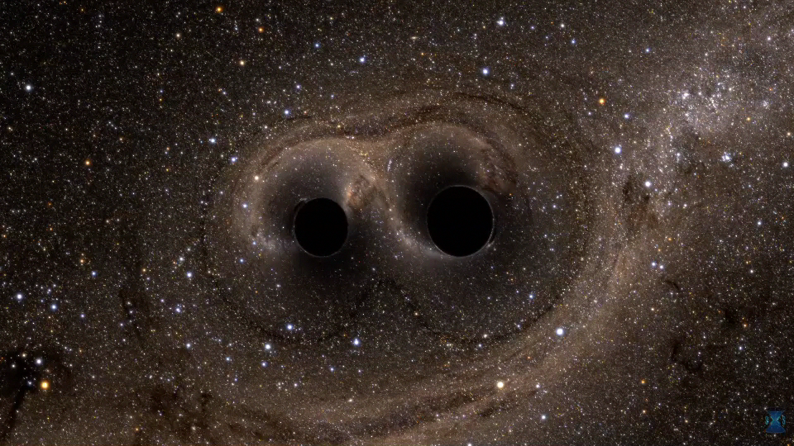
Slowed down ~100x: this lasts 1/3 sec in real time
One 36 M black hole
One 29 M black hole
Final black hole 62 M

Slide 4
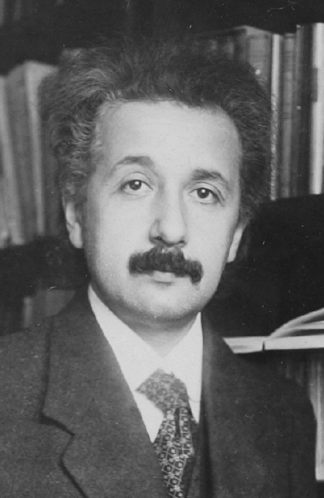
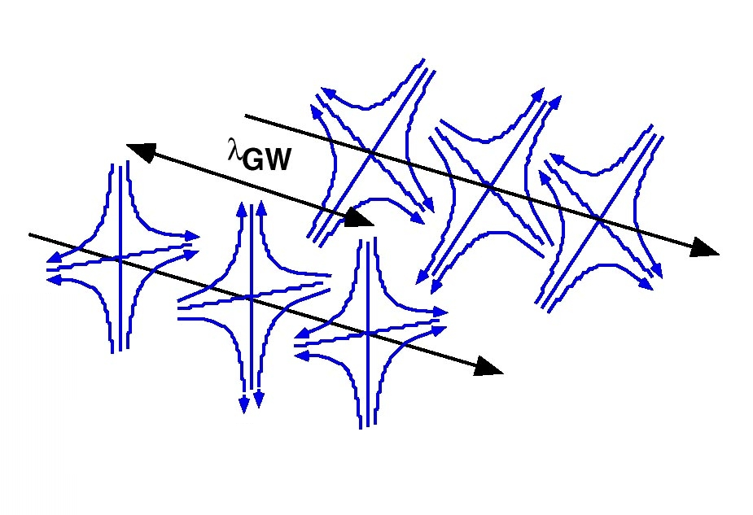
Gravitational Wave Basics
Gravitational Waves from binary black hole merger are passing the tip of the handle in the Big Dipper…
Einstein, in 1916, recognized gravitational waves in his theory of General Relativity
  Necessary consequence of Special Relativity with its finite speed for information transfer
  Distinctive departure from Newtonian theory
Time-dependent distortions of space-time created by the acceleration of masses
  Propagate at the speed of light
  Pure quadrupolar waves, with two
  orthogonal polarizations

Slide 5
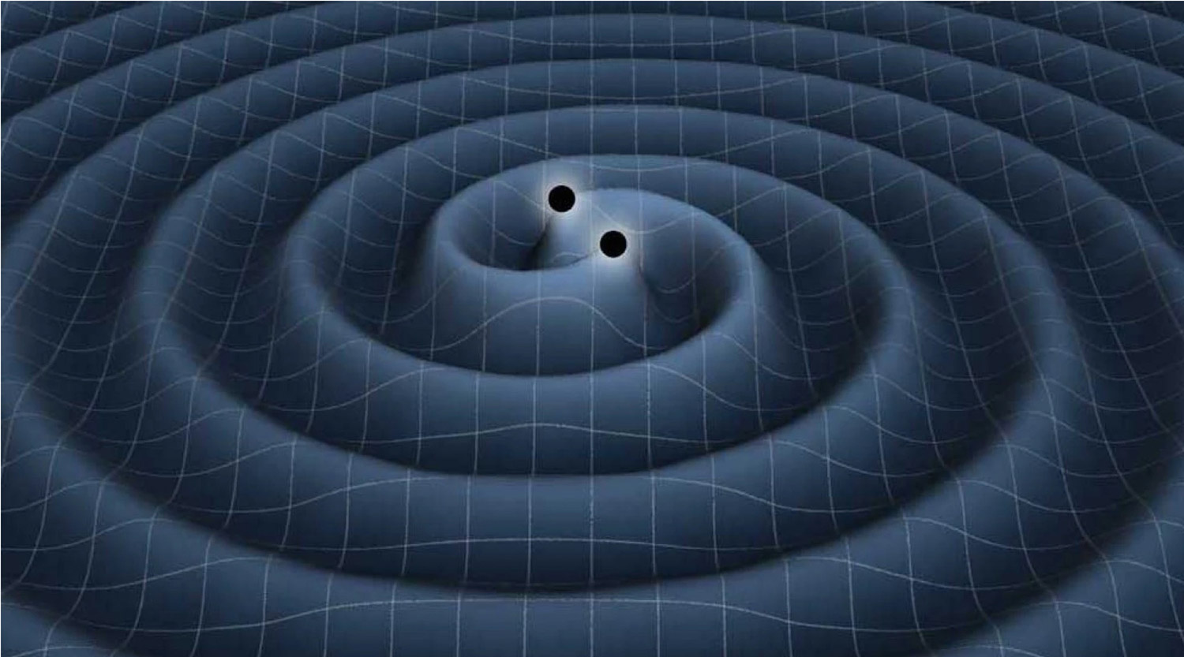
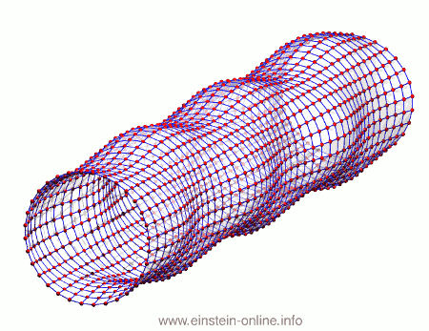
Gravitational Wave Properties
GW generation: quadrupole formula
quadrupole moment
metric perturbation
f_{gw} = 2 x f_{orbital}
Two BIG masses m in a circular orbit:
Typical h = 1.5e-21 !!
1/1000 of proton diameter!!
GW detection: effect on free masses
Time
Here, strain
h = 0.4 !

Slide 6
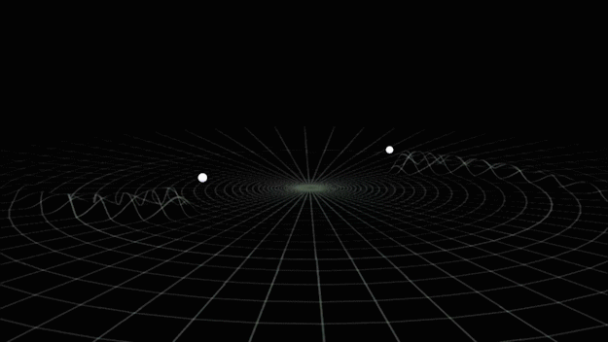
For Colliding Black Holes…
Gravitational Wave Signature

Slide 7
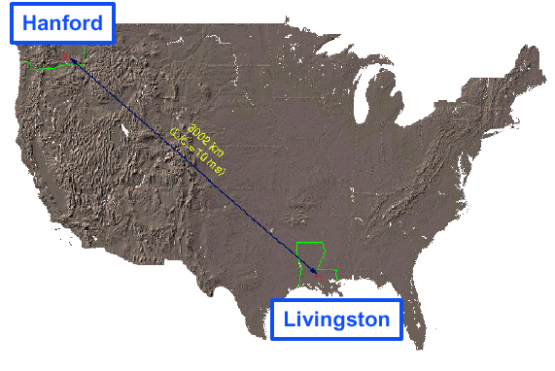

Brief History of LIGO
Gravitational wave from the merger pass…
1972
Original concept:, Rai Weiss
1994 – 2000
Two LIGO observatories constructed
2002 – 2007
Initial LIGO
2008 – 2010
Enhanced LIGO operated
2014
Advanced LIGO upgrade construction completed
Arcturus
in Bootes
3000 km (10 ms)
Sirius A&B
in Canis Major
MIT
Caltech
Proxima Centauri

Slide 8
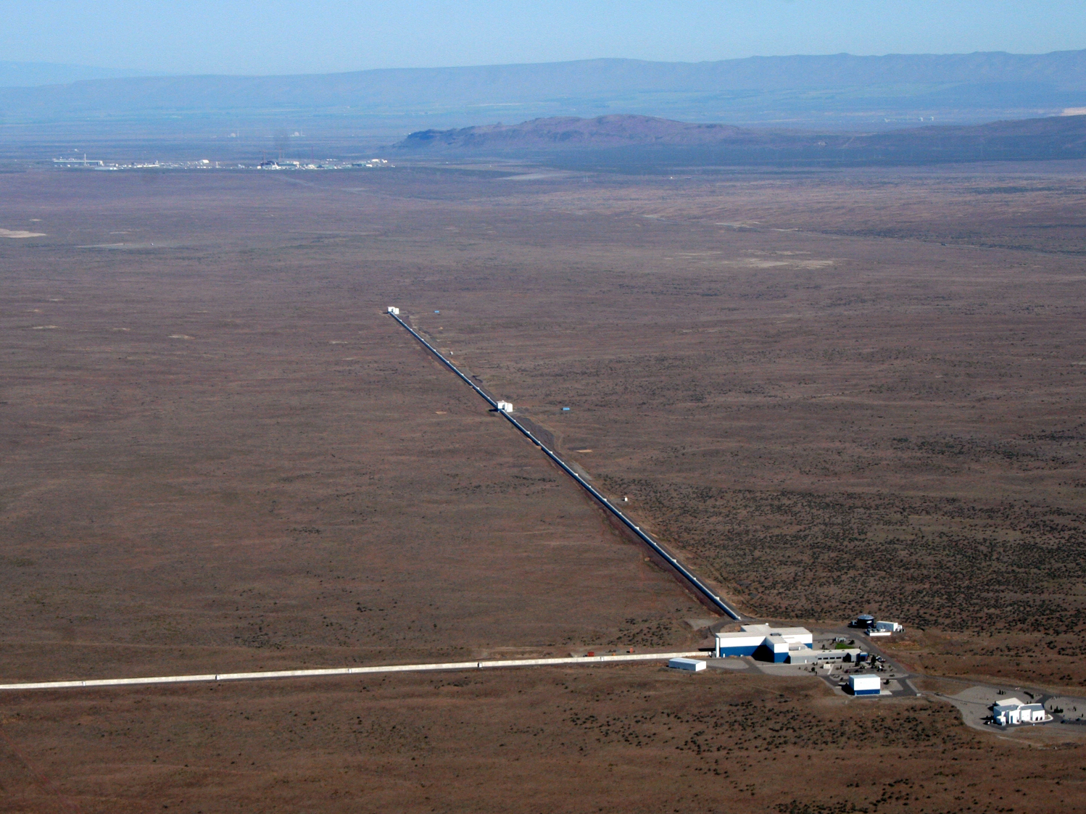
LIGO Hanford Observatory
H1 detector

Slide 9
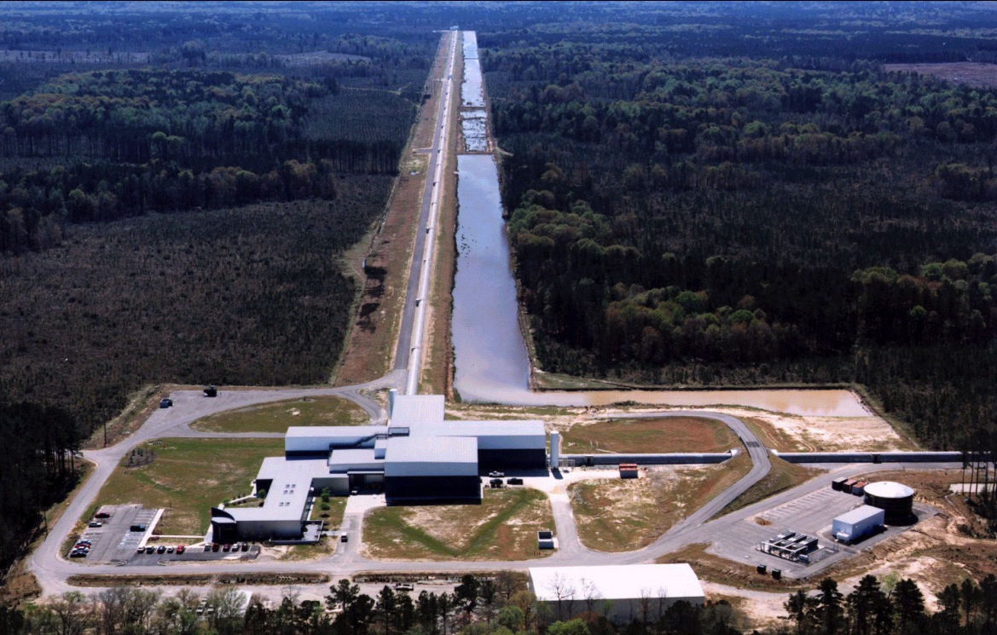
LIGO Livingston Observatory
L1 detector

Slide 10
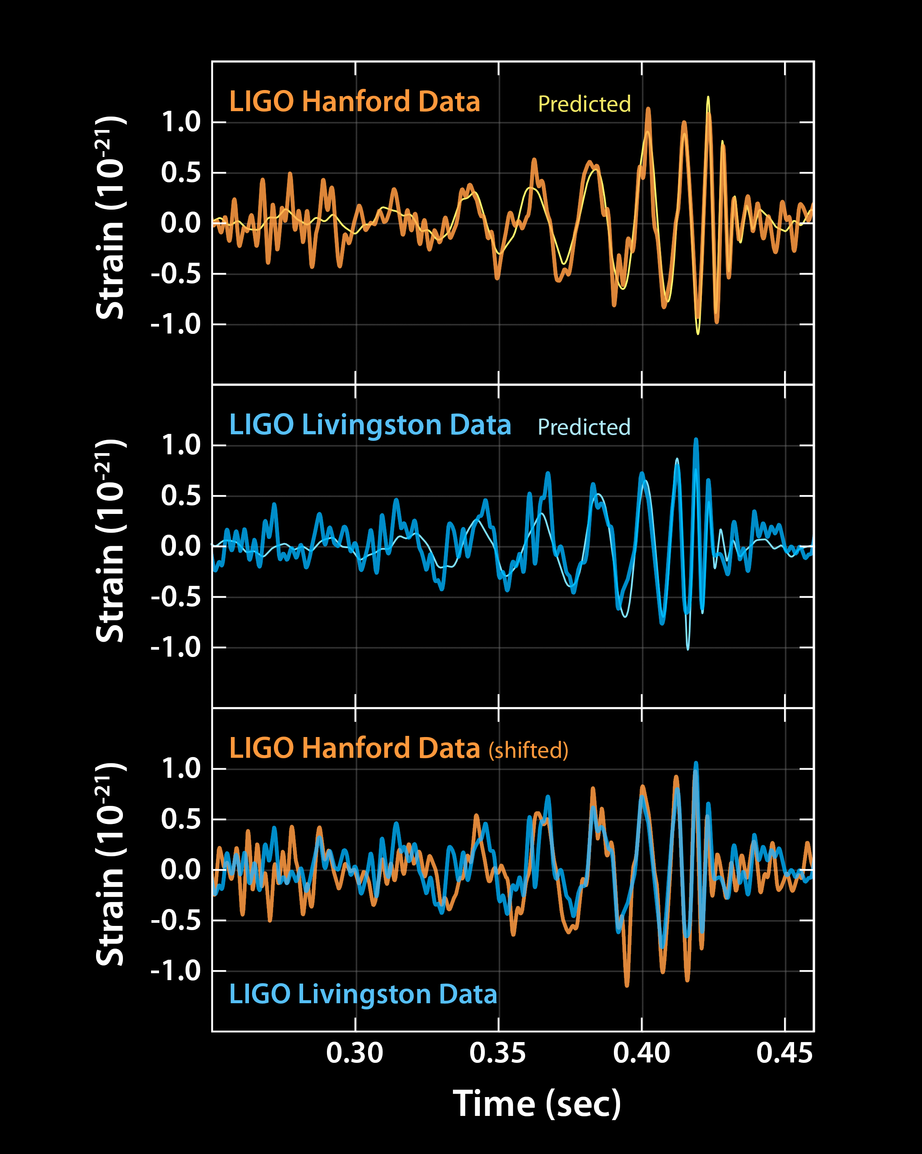
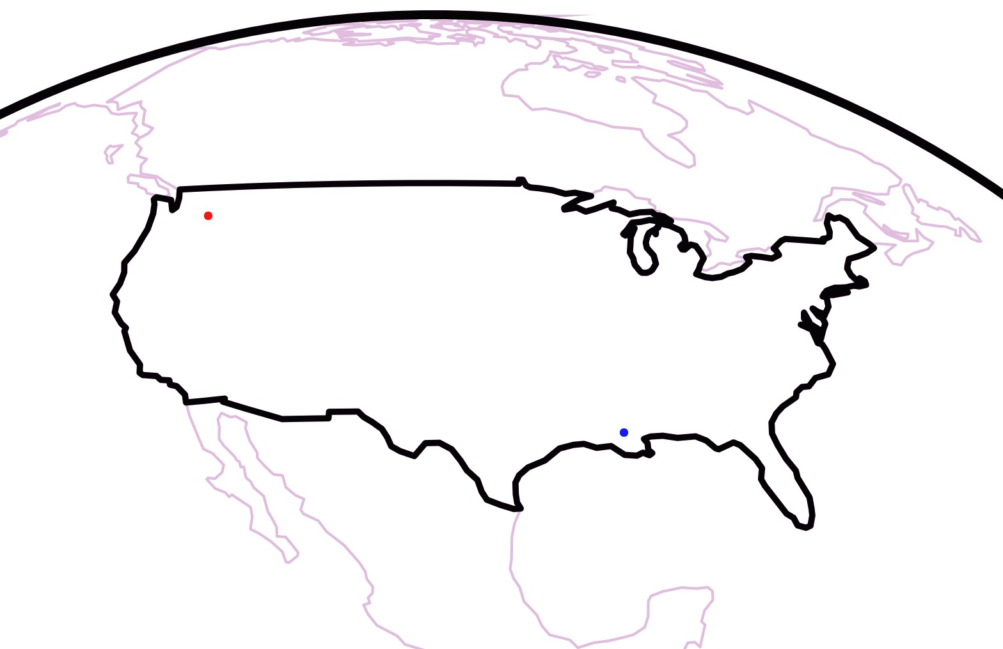
Then, on 14 September 2015 …
The gravitational waves from this merger passed through the LIGO detectors!
https://dcc.ligo.org/LIGO-P150914/public

Slide 11
Then Again (Twice!) in 4 months
36 M + 29 M
1.3 billion ly away
Detected: Sep 14th 2015
23 M + 13 M
3.3 billion ly away
Detected: Oct 12th 2015
14 M + 7.5 M
1.4 billion ly away
Detected: Dec 26th 2015
https://dcc.ligo.org/LIGO-P1600088/public

Slide 12
Gravitational Wave Astronomy Has Begun!
Direct
LIGO Gravitational Wave
Observations
Indirect
Electromagnetic
Observations
(X-Ray Binaries)

Slide 13
The Future of Gravitational Wave Astronomy
Electromagnetic Wave Periods
GW151225
GW150914
Merging ~solar mass compact stars and black holes,
galactic supernovae and pulsars
Quantum Fluctuations of the Early Universe
Galactic Nuclei swallowing ~solar mass stars
Supermassive Black Holes in Galactic Nuclei
Ground-based
Interferometers
Space-based
Interferometers
Pulsar Timing
Arrays
Cosmic
Microwave
Background

Slide 14
The Future of Gravitational Wave Astronomy
Merging ~solar mass compact stars and black holes,
galactic supernovae and pulsars
Quantum Fluctuations of the Early Universe
Galactic Nuclei swallowing ~solar mass stars
Supermassive Black Holes in Galactic Nuclei
Ground-based
Interferometers
Space-based
Interferometers
Cosmic
Microwave
Background
Pulsar Timing
Arrays

Slide 15
Gravitational Wave Astronomy is HERE!
Stick around for more about the LIGO detectors with Dr. Jenne Driggers
and
Stay tuned for more excitement from the Universe!

