Slide 1
Exploring the New Frontier of Gravitational-Wave Astronomy
Fred Raab, for the LIGO Scientific Collaboration and the Virgo Collaboration
9 Jan 2017
Fred Raab, for the LIGO Scientific Collaboration and the Virgo Collaboration

Slide 2
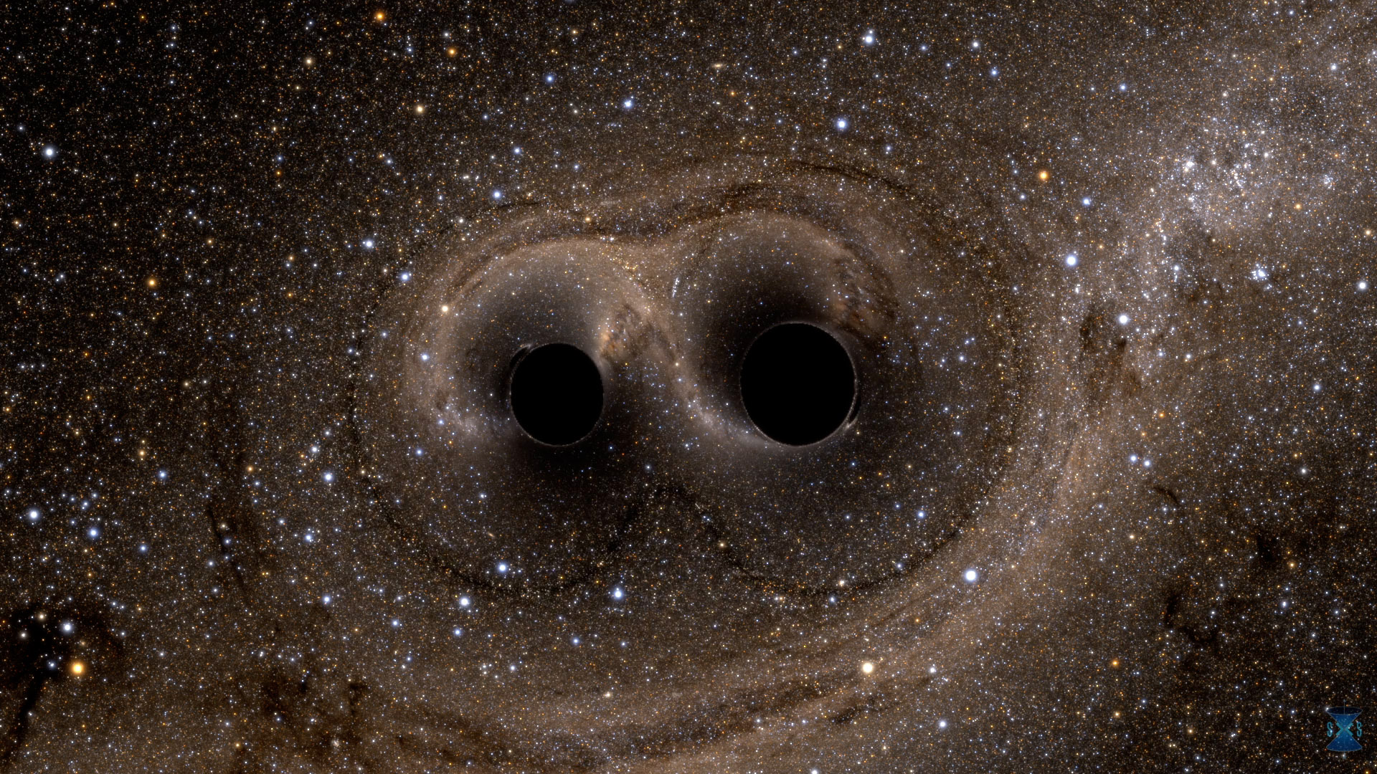
Two Black Holes
1.3 Billion Years Ago
(Give or Take)
Black Hole #1
36X more massive than the Sun
210 km in diameter
Black Hole #2
29X more massive than the Sun
170 km in diameter
Andy Bohn, François Hébert, and William Throwe, SXS

Slide 3
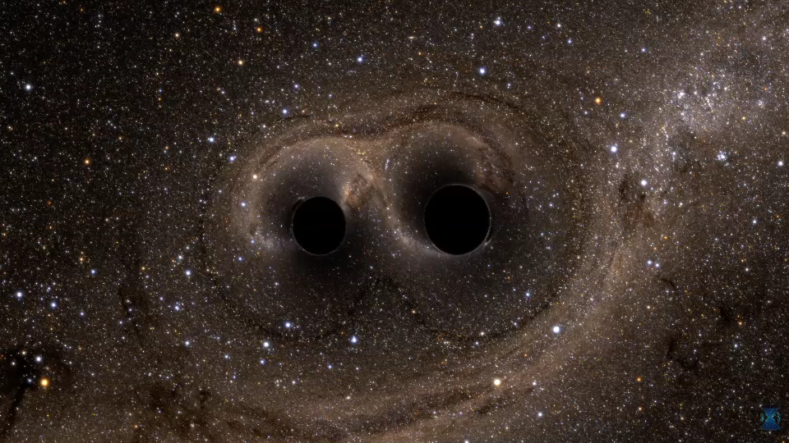
The story starts a long time ago in a part of our universe far, far away…
Notes:
3
3

Slide 4
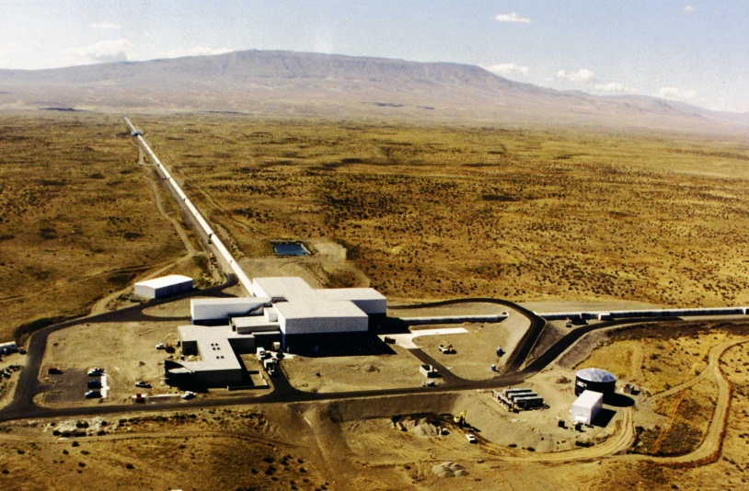
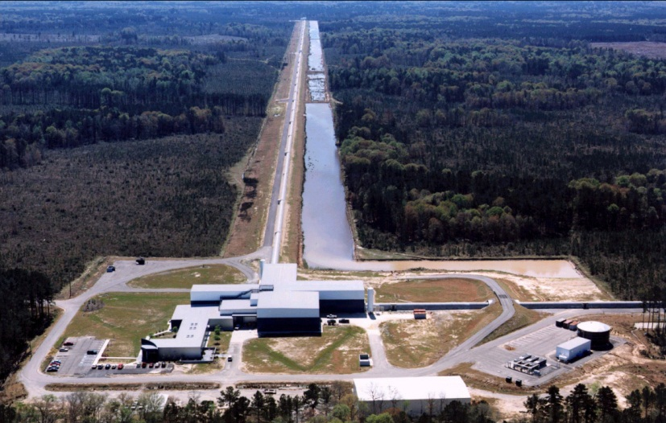
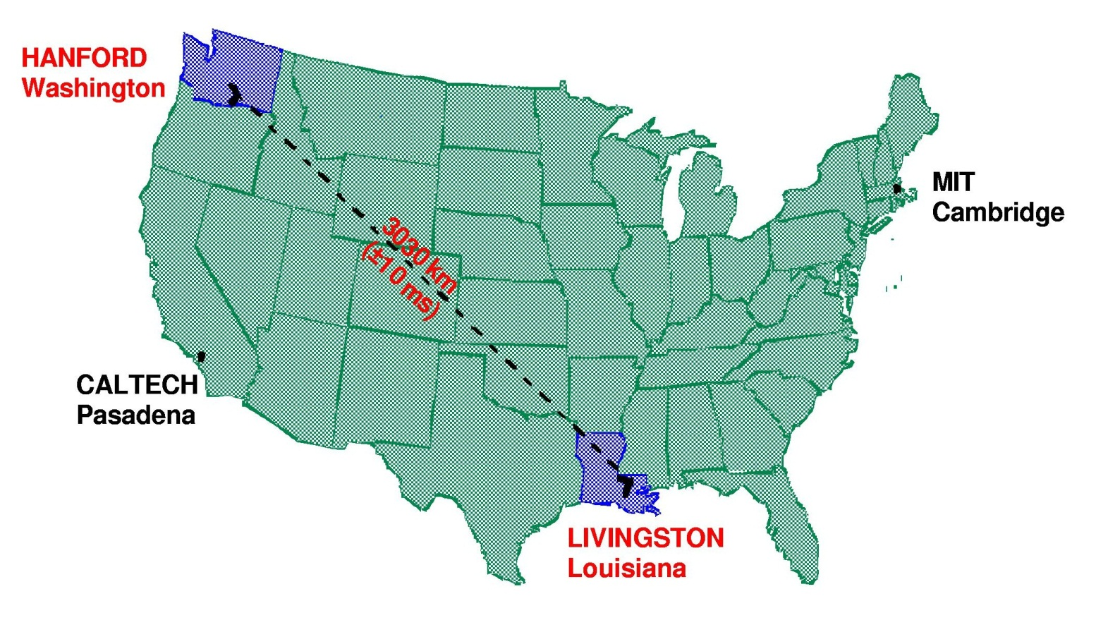

Then on 14 September 2015, at the LIGO sites…

Slide 5
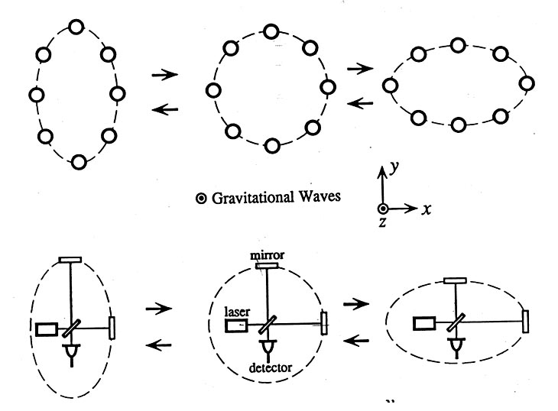
Basic idea is simple
GW amplitude h = (R_{x}-R_{y})/R
Spatial asymmetry induces relative phase shifts on light in arms

Slide 6
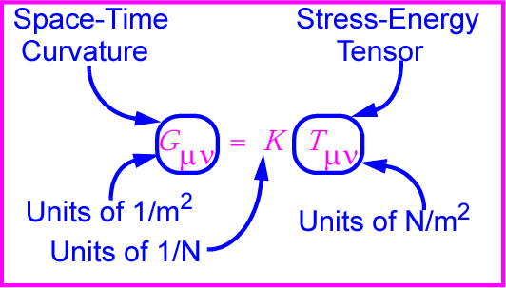
Gravitational waves: hard to find because space-time is stiff!
Following I.R. Kenyon, General Relativity
K~[G/c⁴] is combination of G and c with units of 1/N
K ~ 10⁻⁴⁴ N⁻¹
⇒ Wave can carry huge energy with miniscule amplitude!

Slide 7
Expected strength
Sense of scale: strain from a binary neutron star pair
  M = 1.4 M,
  r = 10²³ m (15 Mpc, Virgo),
  R = 20 km
  f_{orb} = 400 Hz

Slide 8
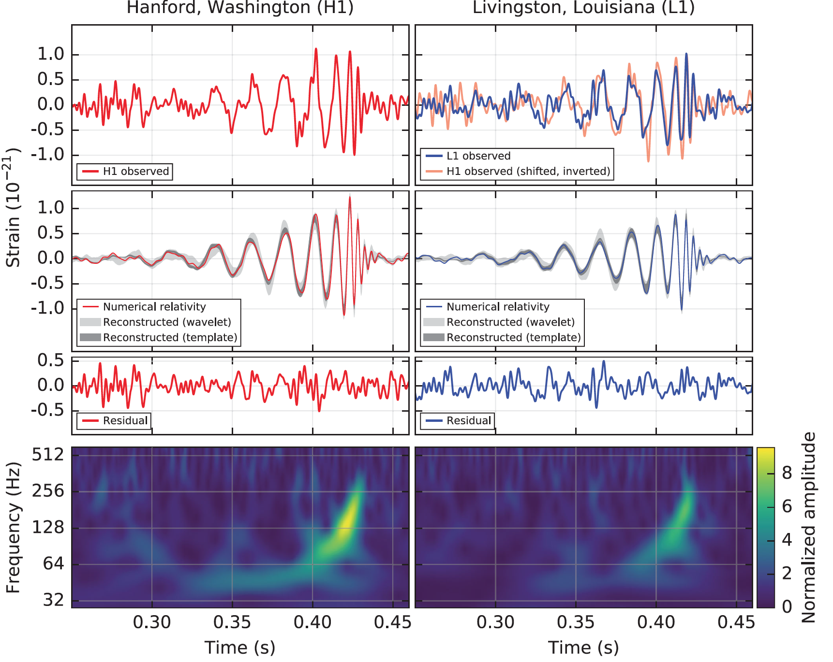
B. P. Abbott et al. (LIGO Scientific Collaboration and Virgo Collaboration), Observation of Gravitational Waves from a Binary Black Hole Merger, Phys. Rev. Lett. 116, 061102 (2016)

Slide 9
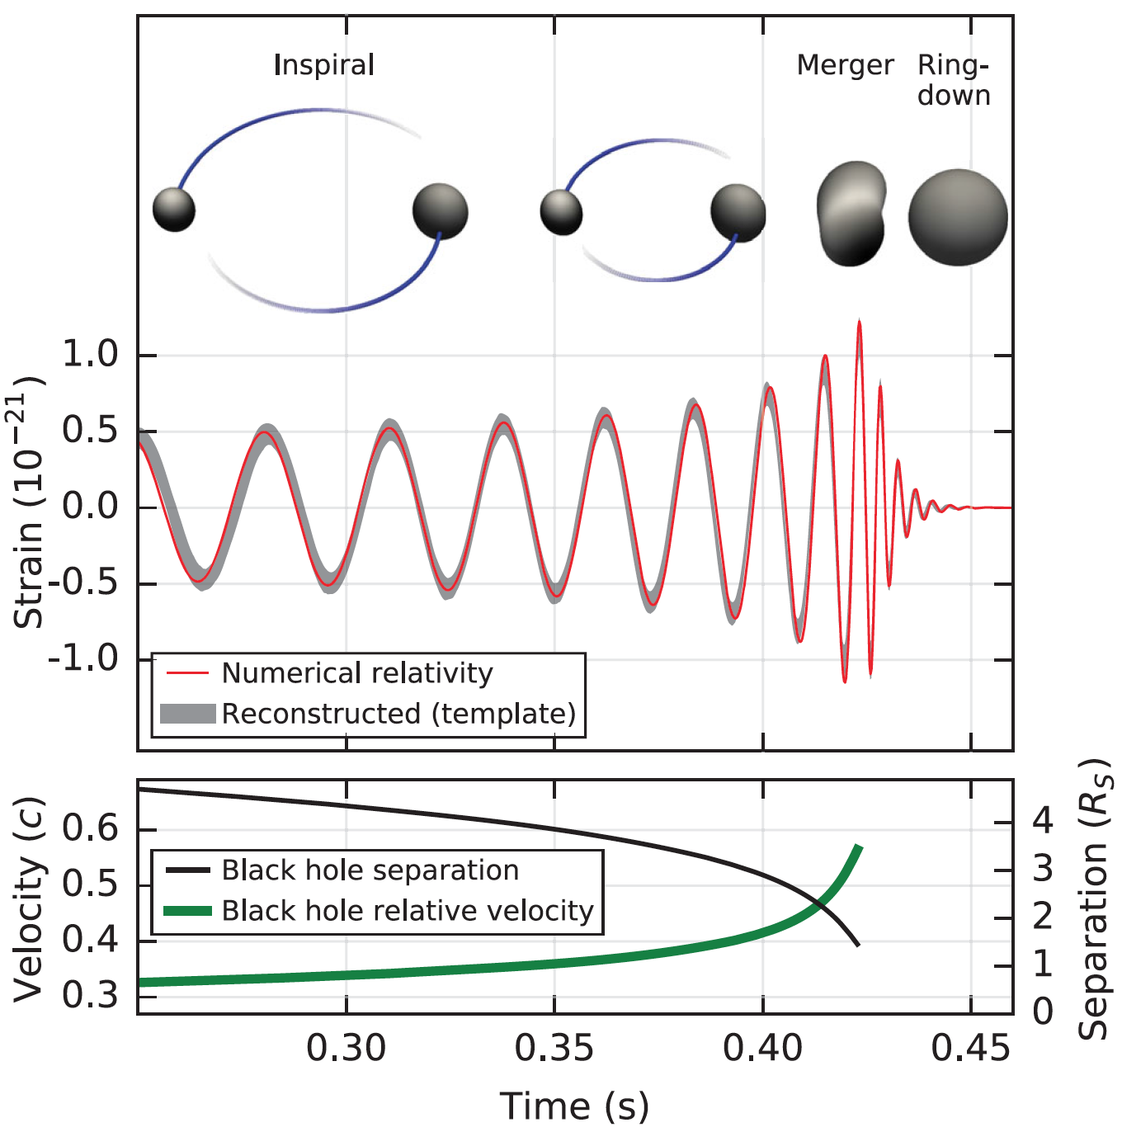
What can we learn from h(t)?
Phase evolution gives chirp mass and aligned components of spin
Ringdown frequency and Q
give mass and spin
of final black hole
Modulation of amplitude gives nonaligned spin components
B. P. Abbott et al. (LIGO Scientific Collaboration and Virgo Collaboration), Observation of Gravitational Waves from a Binary Black Hole Merger, Phys. Rev. Lett. 116, 061102 (2016)

Slide 10
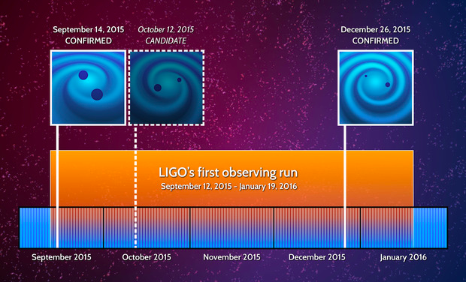
Discovery Timeline – Advanced LIGO’s 1st Observations
Courtesy Caltech/MIT/LIGO Laboratory

Slide 11
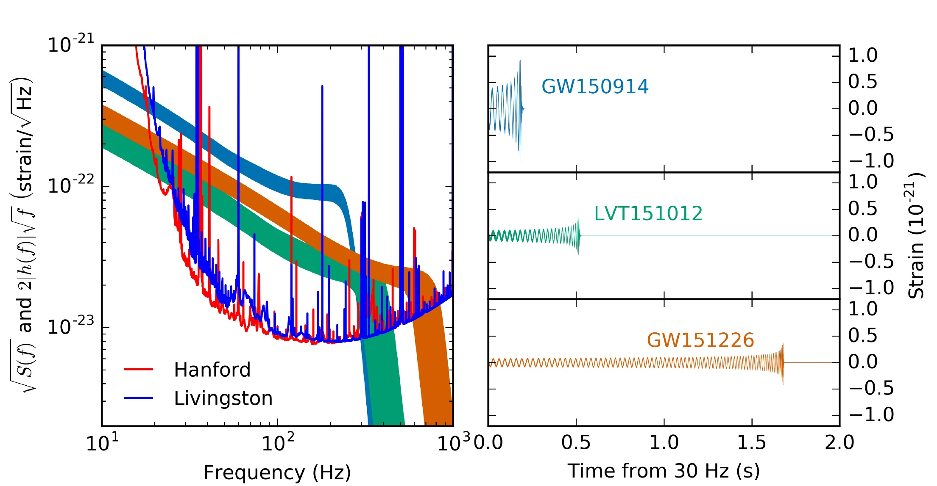
Advanced LIGO’s First Observations
ArViv:1606.04856; see also PRL 116, 241103 (2016) for GW151226.

Slide 12
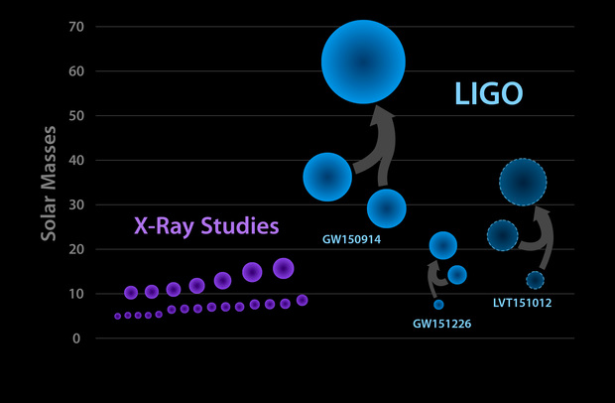
Known Stellar-Mass Black Holes – June 2016
Courtesy Caltech/MIT/LIGO Laboratory

Slide 13
Now what?
These first observations open up access to a vast new frontier for exploration
Initial observations indicate that stellar-mass or “heavy” black hole binaries merge hourly somewhere in the universe
What can these mergers teach us?
How and where have these objects been formed?
Where is the matter?
  No “known” form of matter can explain LIGO’s early discoveries, and they behave like black holes.
  Can we prove that these objects are black holes?
  Where are the neutron stars and how do they behave?

Slide 14
Multi-Messenger Astronomy
These first observations of dynamic extreme spacetimes show us that GR is reasonably accurate in this regime and can be used as a tool for examining and interpreting extreme states of matter.
There are a rich collection of sources still to be examined!

Slide 15

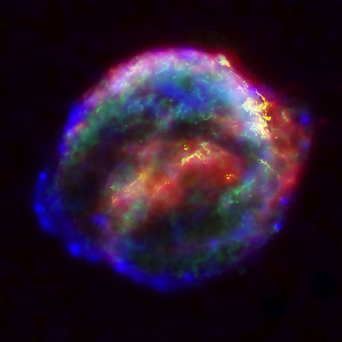

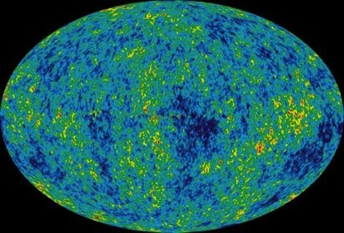
Astrophysical Sources of Gravitational Waves
Coalescing Compact Binary Systems: Neutron Star-NS, Black Hole-NS, BH-BH
- Strong emitters, well-modeled,
- (effectively) transient
Asymmetric Core Collapse Supernovae
- Weak emitters, not well-modeled (‘bursts’), transient
Credit: Chandra X-ray Observatory
Credit: AEI, CCT, LSU
Cosmic Gravitational-wave Background
- Residue of the Big Bang
- Long duration, stochastic background
Spinning neutron stars
- (nearly) monotonic waveform
- Long duration
NASA/WMAP Science Team
Casey Reed, Penn State
Notes:
LIGO is designed to be an observatory, not a one-off proof that GWs exist. What do we look for?
There are number of predicted astrophysical sources of gravitational radiation, and most of them involve cataclysmic events.
Binary systems – NSs and BHs, most likely source, theoretically well understood with known waveforms
Bursts – GW emissions that are not well modeled or understood. These include asymmetrically core collapse supernova, cosmic strings, and perhaps unknown sources
The residual GW background
Continuously emitting sources such as spinning neutron stars, which have a pure monotone emission.

Slide 16
Astrophysical Sources of Gravitational Waves
Coalescing Compact Binary Systems: Neutron Star-NS, Black Hole-NS, BH-BH
- Strong emitters, well-modeled,
- (effectively) transient
Asymmetric Core Collapse Supernovae
- Weak emitters, not well-modeled (‘bursts’), transient
✓
Credit: Chandra X-ray Observatory
Credit: AEI, CCT, LSU
Cosmic Gravitational-wave Background
- Residue of the Big Bang
- Long duration, stochastic background
Spinning neutron stars
- (nearly) monotonic waveform
- Long duration
NASA/WMAP Science Team
Casey Reed, Penn State
Notes:
LIGO is designed to be an observatory, not a one-off proof that GWs exist. What do we look for?
There are number of predicted astrophysical sources of gravitational radiation, and most of them involve cataclysmic events.
Binary systems – NSs and BHs, most likely source, theoretically well understood with known waveforms
Bursts – GW emissions that are not well modeled or understood. These include asymmetrically core collapse supernova, cosmic strings, and perhaps unknown sources
The residual GW background
Continuously emitting sources such as spinning neutron stars, which have a pure monotone emission.

Slide 17
Frequency-Time
Characteristics of GW Sources
time
Ringdowns
Broadband Background
Bursts
frequency
CW (quasi-periodic)
Chirps
Earth’s orbit
Earth’s rotation
frequency
frequency
time
time

Slide 18
The rate of future discovery in gravitational-wave astronomy will be determined by the number and sensitivity of gravitational-wave detectors and the number and skill of GW experimentalists.

Slide 19
Building Out the Terrestrial Gravitational-Wave Network
A greater number of detector facilities around the world improves:
  Sky localization
  Polarization information
  CBC orbital inclination
  CBC Distance information
  CBC precession information
  Network robustness

Slide 20
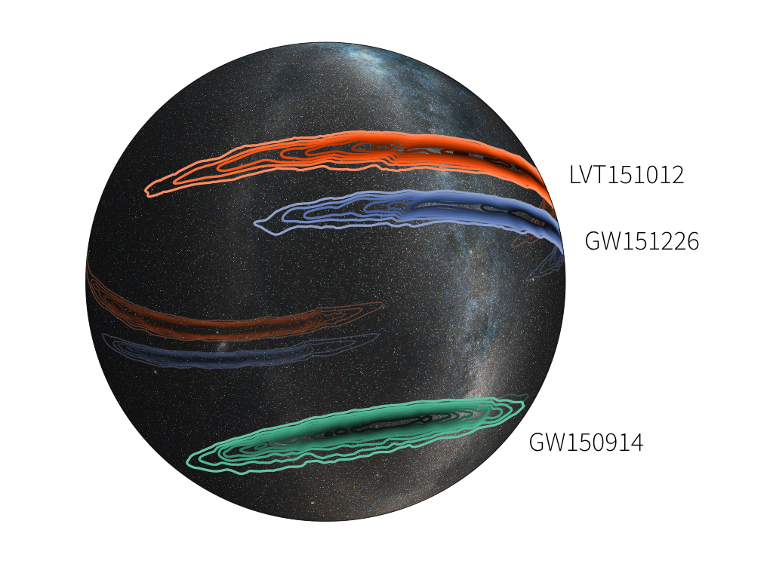
Sky Localization Is Poor With Only Two Detectors
Image credit: LIGO (Leo Singer) /Milky Way image (Axel Mellinger)

Slide 21


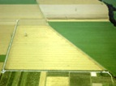

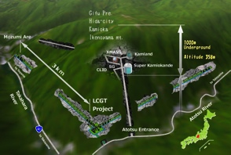



The advanced GW detector network:
2015-2025
Advanced LIGO
Hanford
2015
GEO600 (HF)
2011
KAGRA
>2018
Advanced LIGO
Livingston
2015
Advanced
Virgo
2017
LIGO-India
2024
21
21

Slide 22
LIGO-India Concept
Started as a partnership between LIGO Laboratory and IndIGO collaboration to build an Indian interferometer
  LIGO Lab (with its UK, German and Australian partners) provides components for one Advanced LIGO interferometer (H2) from the Advanced LIGO project
  LIGO Lab provides designs and design assistance for facilities and vacuum system and training for Indian detector team
  India provides the infrastructure (site, roads, building, vacuum system), staff for installation & commissioning, operating costs
LIGO-India would be operated as part of LIGO Global Network to maximize scientific impact
Major enhancement to the global network and to the capabilities for GW astrophysics and Multi-messenger Astronomy

Slide 23
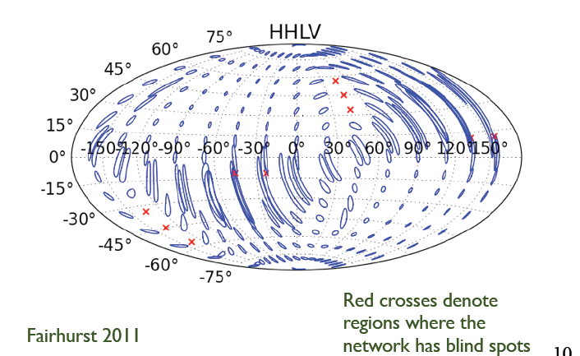
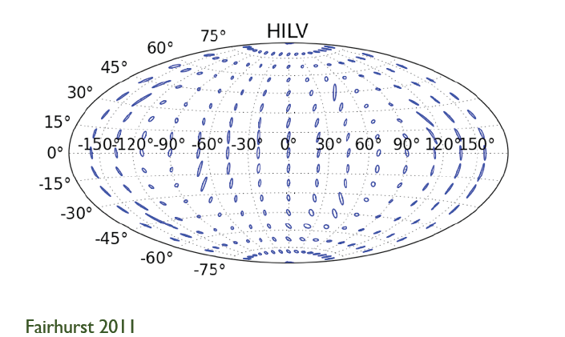
Effect of Adding LIGO-India to the LIGO+Virgo Network
LIGO+Virgo only
With LIGO-India

Slide 24
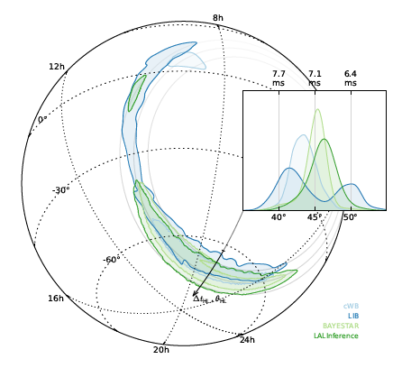
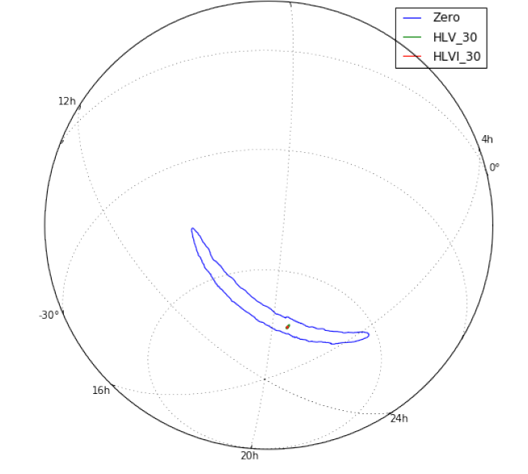
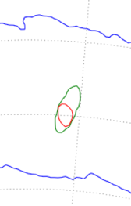
Improved Localization:
LIGO→Virgo→LIGO-India
GW150914: LIGO →LV →LVI
(Preliminary)
GW150914: LIGO only
375° → 9.3° → 7.8°
(99% confidence level)
LSC/Virgo et al. 2016, ApJL
arXiv:1602.08492
LSC/Virgo, L. Singer, S. Gaebel

Slide 25
Sensitivity of Detectors is Determined by Noise and Background
The key to improving detectors is sensitivity which is improved by reducing noise and background.
Range is proportional to sensitivity.
Event rate is proportional to volume, which is proportional to range cubed.
Thus a factor of 2 in sensitivity gives a factor of 8 in event rate (nearly an order of magnitude).

Slide 26
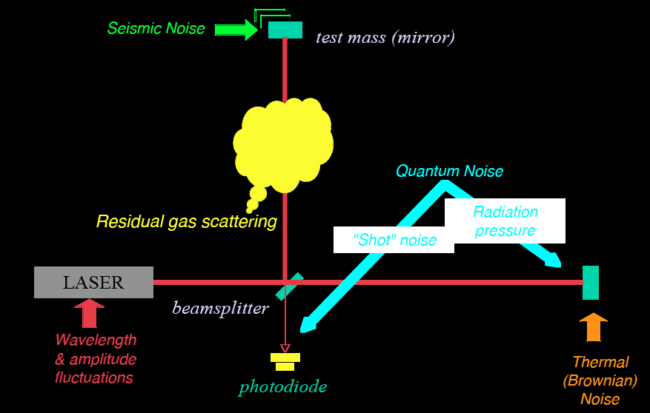
Noise and background cartoon
R. Adhikari

Slide 27
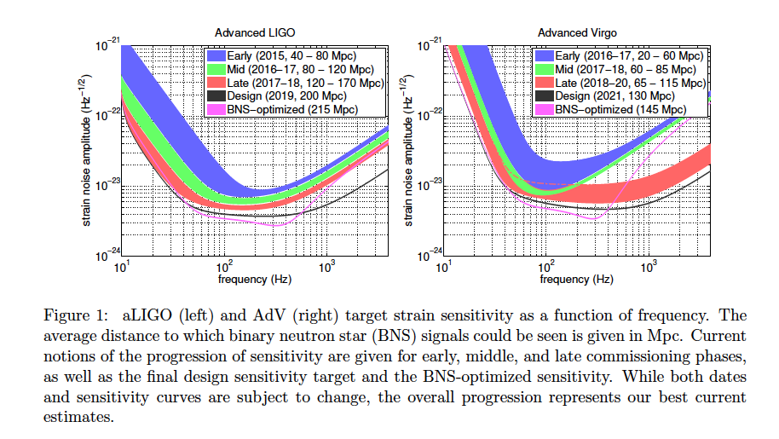
LVC Observing Scenario
(arXiv:1304.0670)

Slide 28
Initial S6 / Advanced O1
Design / A+ Upgrade
https://dcc.ligo.org/public/0113/T1400316/004; https://dcc.ligo.org/LIGO-G1500623
~3 x the sensitivity
made the difference
And we can
go beyond
~3 x to go!

Slide 29
Science drives Requirements
Stellar Evolution at High Red-Shift: Black Holes from the first stars (Population III)
  Reach z > ~10
  At least moderate GW luminosity distance precision
Independent Cosmology and the Dark Energy Equation of State
  Needs precision GW luminosity distance and localization for EM follow-ups (for redshift)
Checking GR in extreme regime
  High SNR needed
  GW luminosity distance and localization not essential

Slide 30
What will it take to improve detectors?
Clever experimental physicists and engineers, capable of solving multi-dimensional problems at the forefront of basic measurement science
Advanced LIGO detectors are complex:
  Approximately 350 high-performance servomechanisms
  Many of these are multiple-input, multiple output
  Sensors and actuators for these are operating at or beyond commercial limits
Developing ways to work around fundamental limitations:
  Quantum nature of light
  Atomic nature of matter
A single example: working around the classical and quantum nature of light

Slide 31
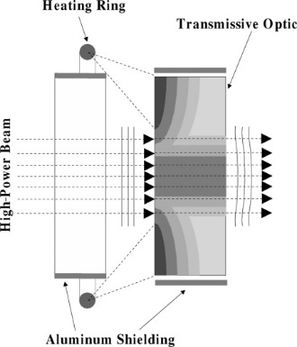
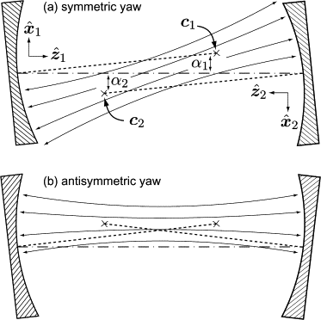
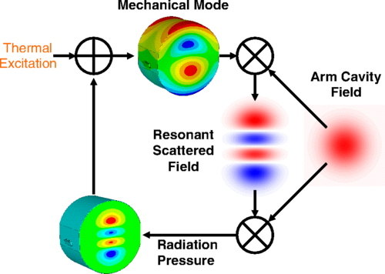
Nothing Is Easy: Classical Challenges to High-Power Operation
Thermal lensing and compensation
Angular radiation pressure
instabilities
Parametric instabilities
M Evans et al (2015) Phys. Rev. Lett. 114, 161102
R Lawrence et al (2004)
Opt Lett 29(22)2635-2637
J Sidles, D Sigg, Phys. Lett. A.
354, 167-172 (2006)

Slide 32
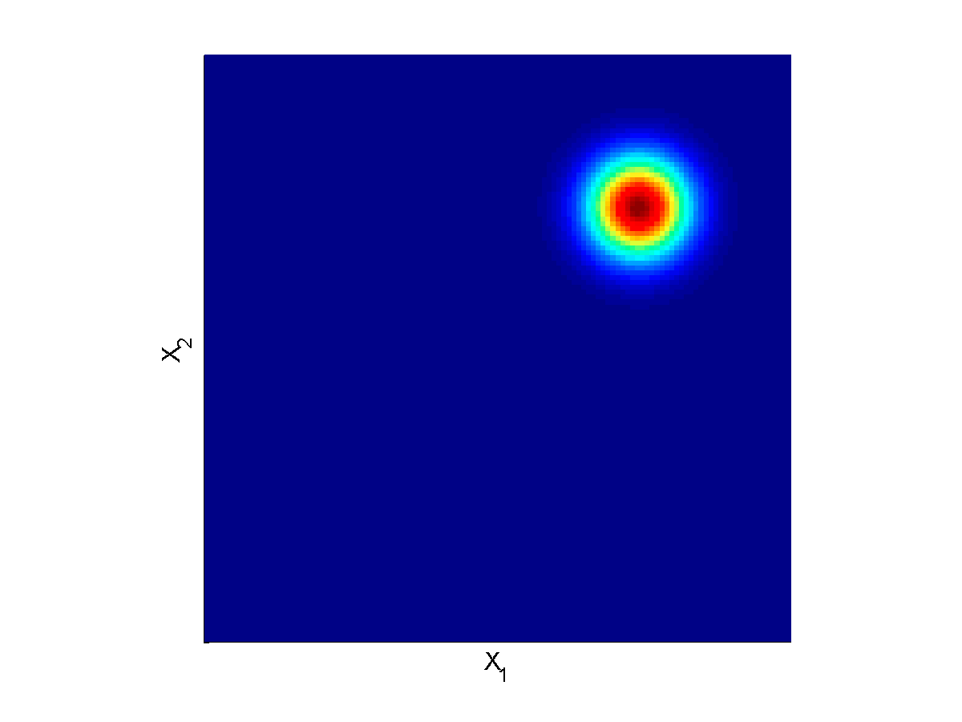
Quantum Noise is Fundamental, Caused by Vacuum Fluctuations
EM Vacuum Fluctuations Cause Shot Noise and Radiation Pressure Noise
Laser
C Caves (1981) Phys. Rev. D 23, 1693

Slide 33
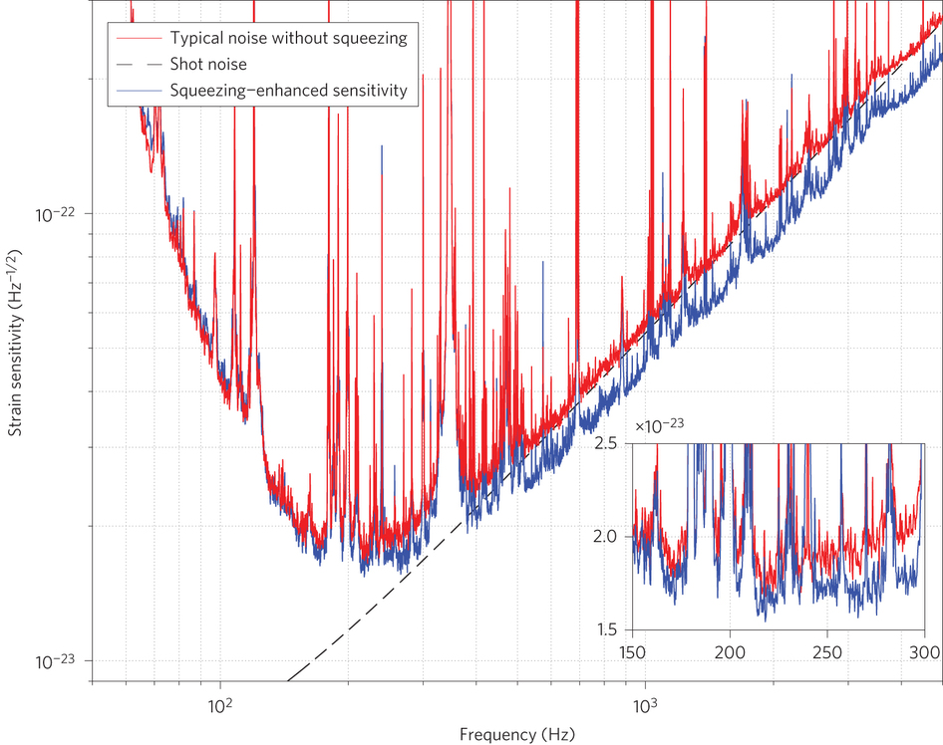
Vacuum squeezing: a partial work-around
Laser
LIGO Scientific Collaboration, Nature Photonics 2013
doi:10.1038/nphoton.2013.177

Slide 34
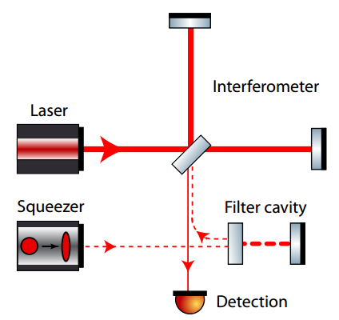
A better work-around: frequency-dependent squeezing
Original idea: J Kimble et al (2001) Phys. Rev. D 65, 022002
Practical designs: T Corbitt et al (2004) Phys. Rev. D 70, 022002
Demonstration in regime applicable to LIGO: E Oelker et al (2016) Phys. Rev. Lett. 116, 041102
M Evans et al, (2013) PRD 88 022002

Slide 35
Advanced LIGO upgrade path
Advanced LIGO is limited by
quantum noise & coating thermal noise
Squeezed vacuum to reduce quantum noise
Options for thermal noise:
  Better coatings
  Cryogenic operation
  Longer arms (new facility)

Slide 36
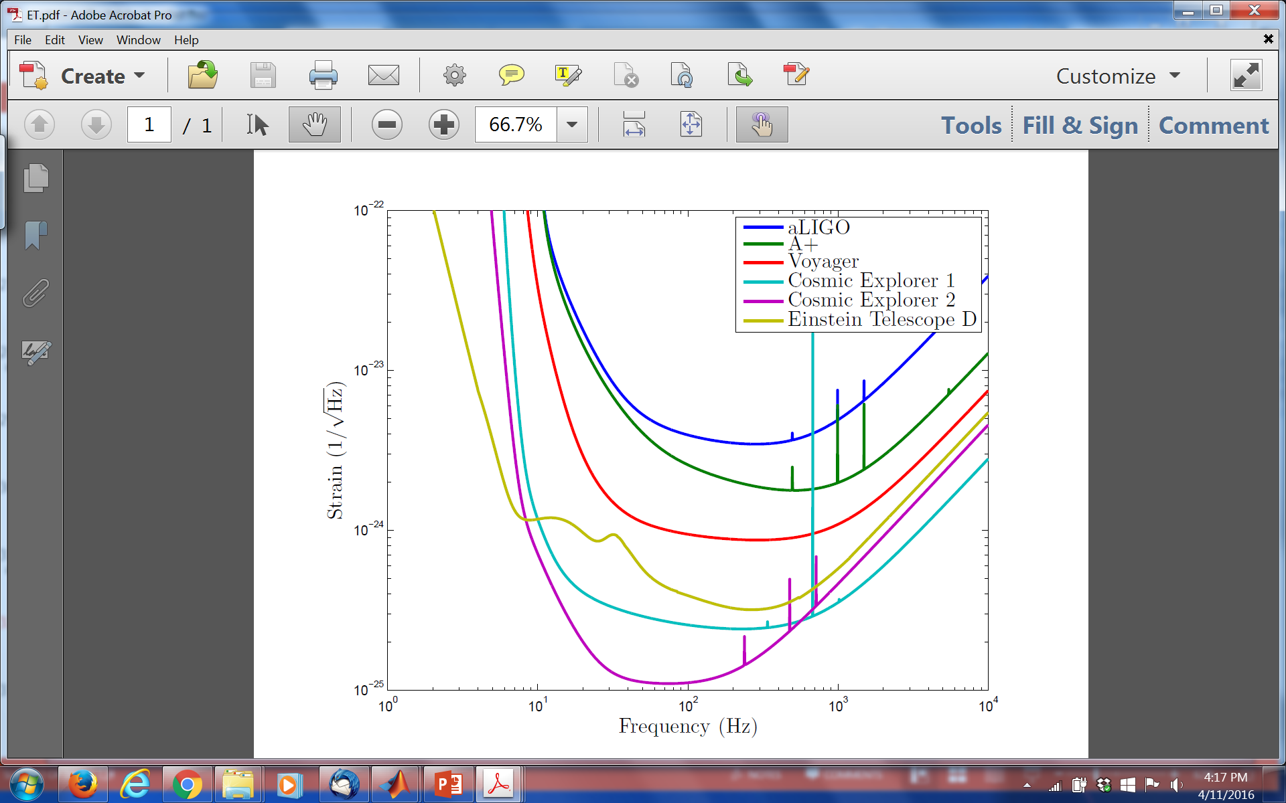
Upgrade possibilities
https://dcc.ligo.org/public/0113/T1400316/004; www.et-gw.eu

Slide 37
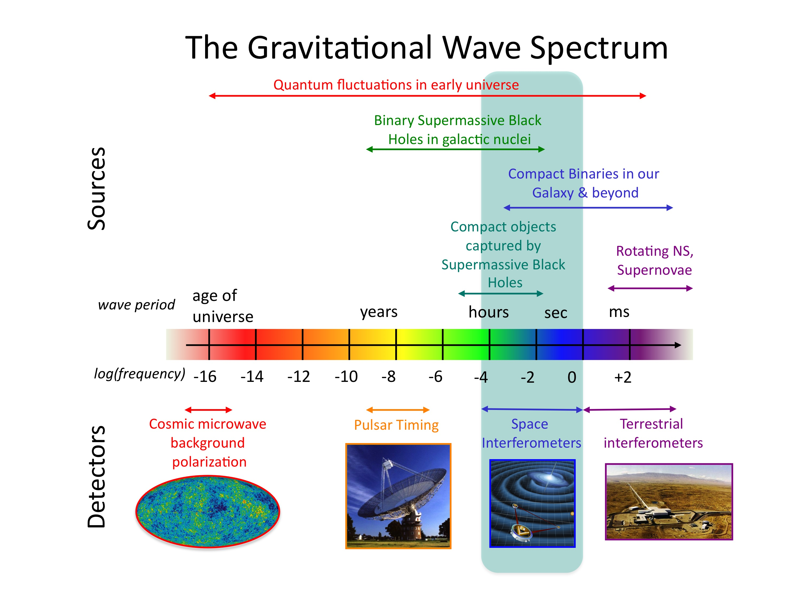
Credit: NASA

Slide 38
Summary
1st observing run of LIGO’s 2nd-generation detectors have initiated Gravitational-Wave Astronomy, opening a vast new frontier for exploration.
An emerging international network of detectors soon will provide more accurate positions of sources to enable EM follow-ups of GW events.
There is still room within the laws of physics to develop more powerful generations of detectors and much physics still to be harvested from their observations.

Slide 39
Extra slides

Slide 40
Principal noise terms
Radiation-Pressure Dominated Background
Shot-Noise Dominated Phase Noise

