Slide 1
ISS second loop update
Daniel Sigg, Ben Abbott, Keita Kawabe

Slide 2
Why we needed a new one: Shortcomings of the original 2nd loop
Didn’t allow us to change power after it is engaged.
Need AC coupling.
Horrible ad-hoc hack job for the 3rd loop against dP/dθ instability.
Need for a proper built-in support for the 3rd loop.
Design document for a new one by Gabrielle: T1600064

Slide 3
New board (after LOTS of mods)
Drawings updated by Ben: D1600298 and D1600193
AD797 shall not be used
1st-loop style whitening upfront in 2nd loop PD, zp=[78mHz;482],[3.6^2;21]
Some gain reshuffling so nothing saturate.
Usable boosts.
Test points available on the front panel.
40dB suppression at 1kHz, UGF~20kHz.

Slide 4
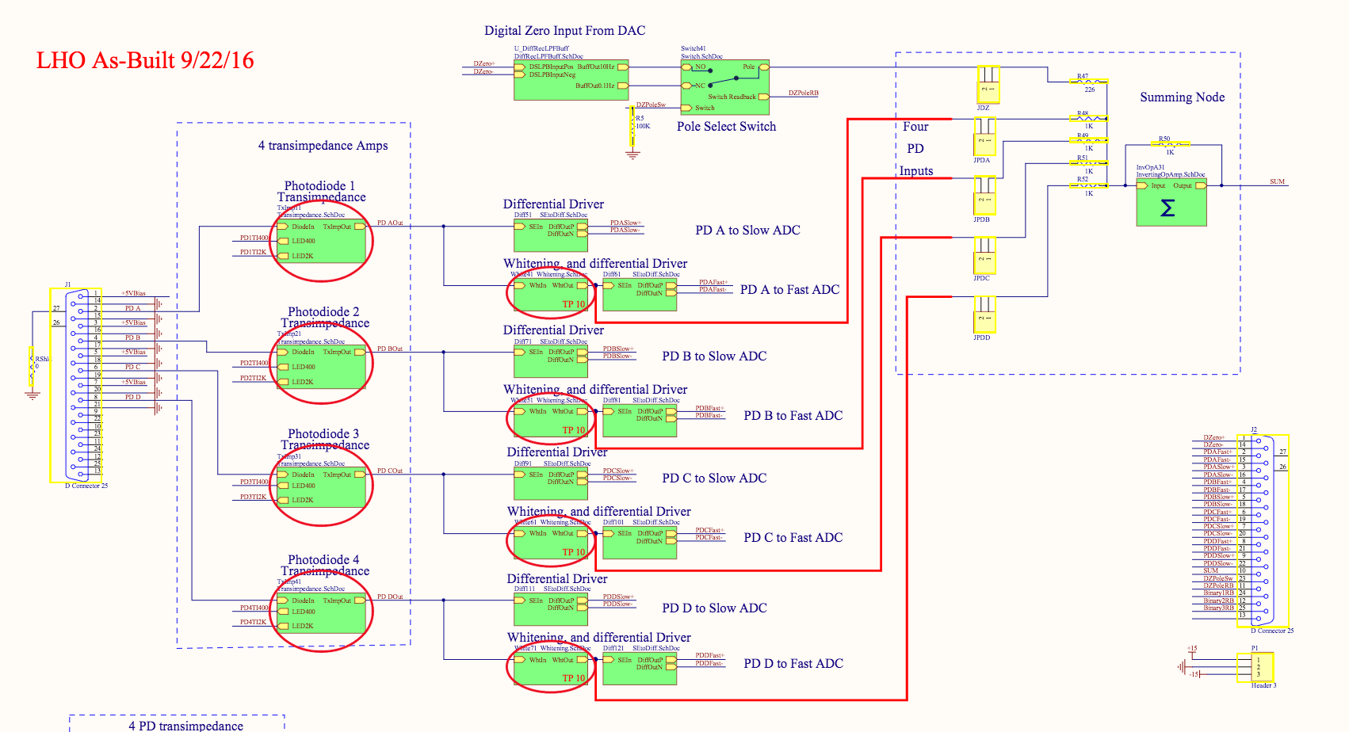
Transimpedance board mod: Purge AD797, Add 1st loop style whitening.

Slide 5
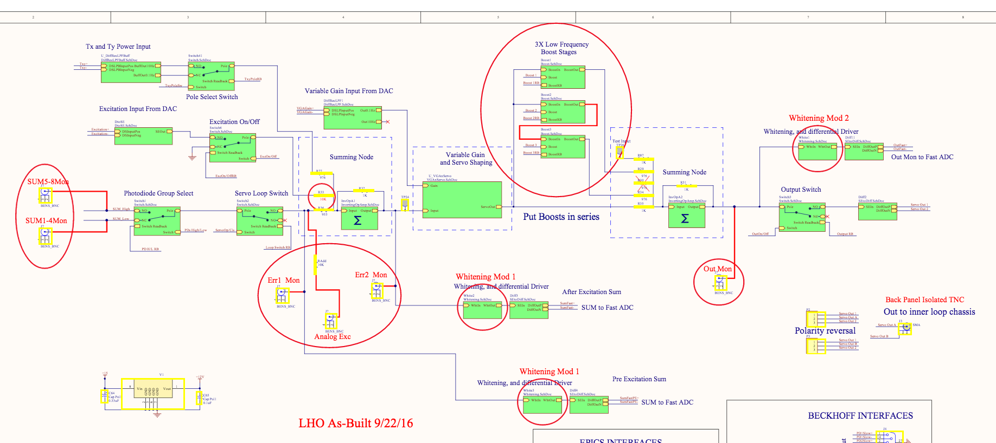
Servo board mod:
Add lots of analog test points on the front panel
Reshuffle gains, zeros and poles for noise and saturation reasons
Usable boost
No “whitening” on the monitor point whitening because the signals are already whitened.
Diff out should go to isolated connector.

Slide 6
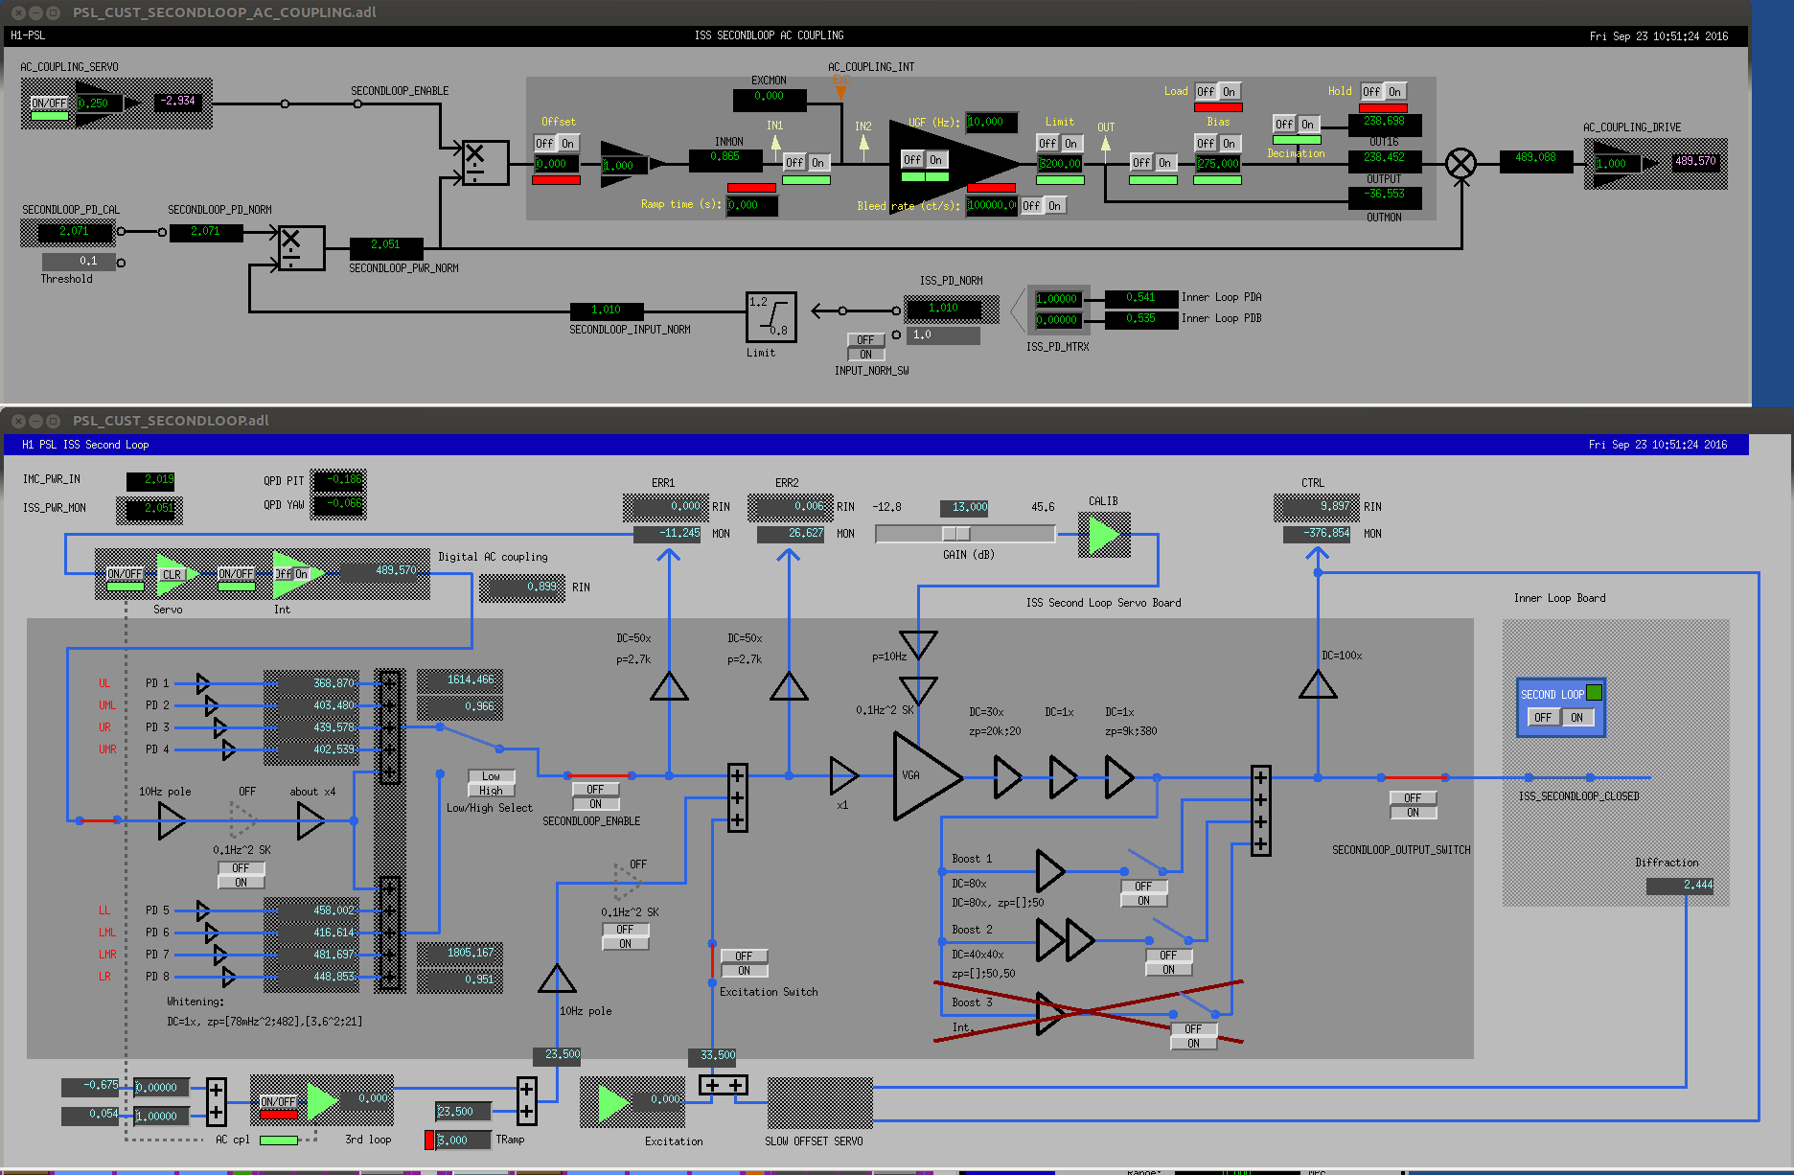
AC coupling and power feed forward
Whitening upfront
BOOST
3rd loop

Slide 7
2nd loop is always ON after MC is locked.
No modification for auto-locker.
Guardian(s) should do the following:
Switch off 2nd loop, disable boosts, and enable AC coupling when MC unlocks.
Enable 2nd loop and make sure that AC coupling is ON when MC locks.
At the end of power up process, should disable the AC coupling, turn off power scaling FF, and turn boosts on.

Slide 8
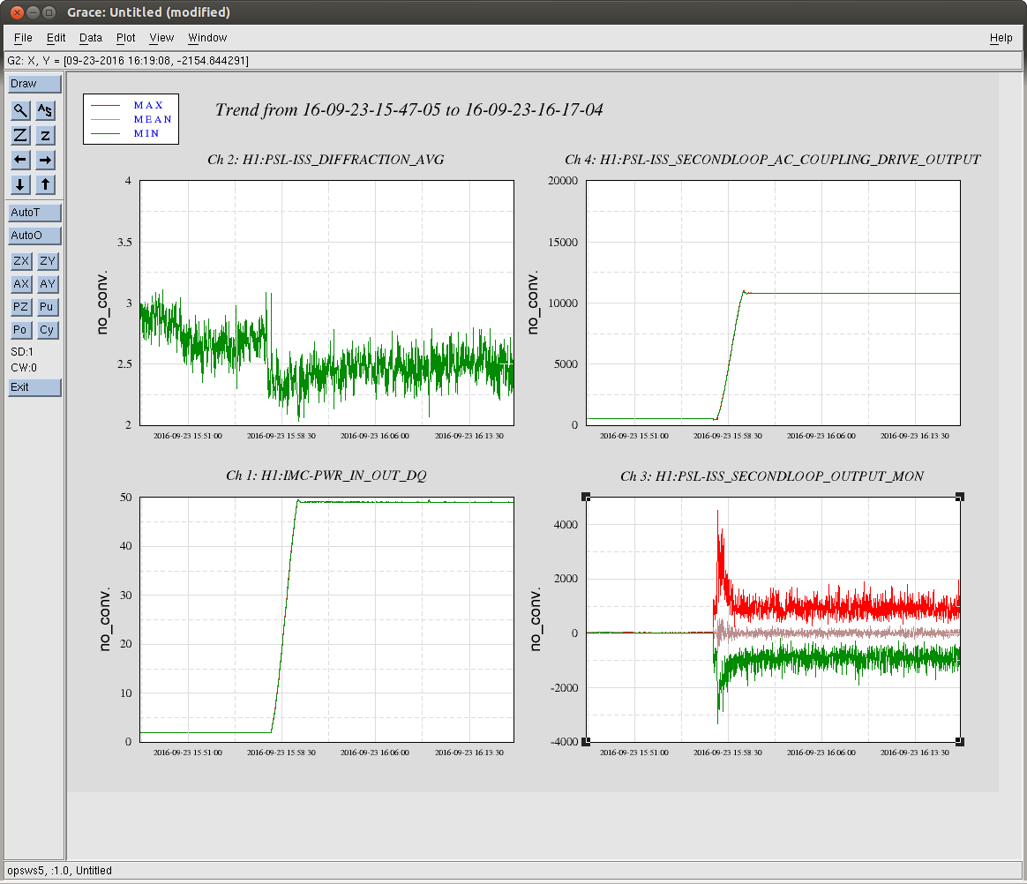
Powering up with 2nd loop AC coupled

Slide 9
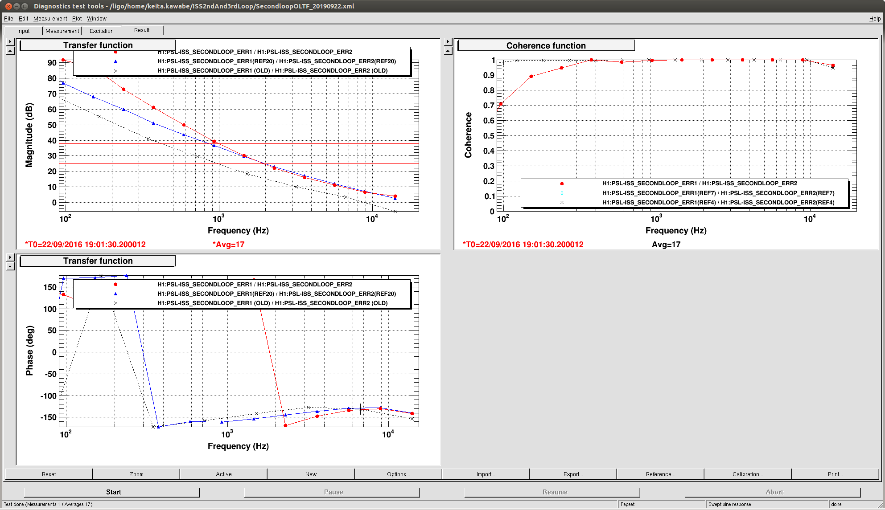
OLTF

Slide 10
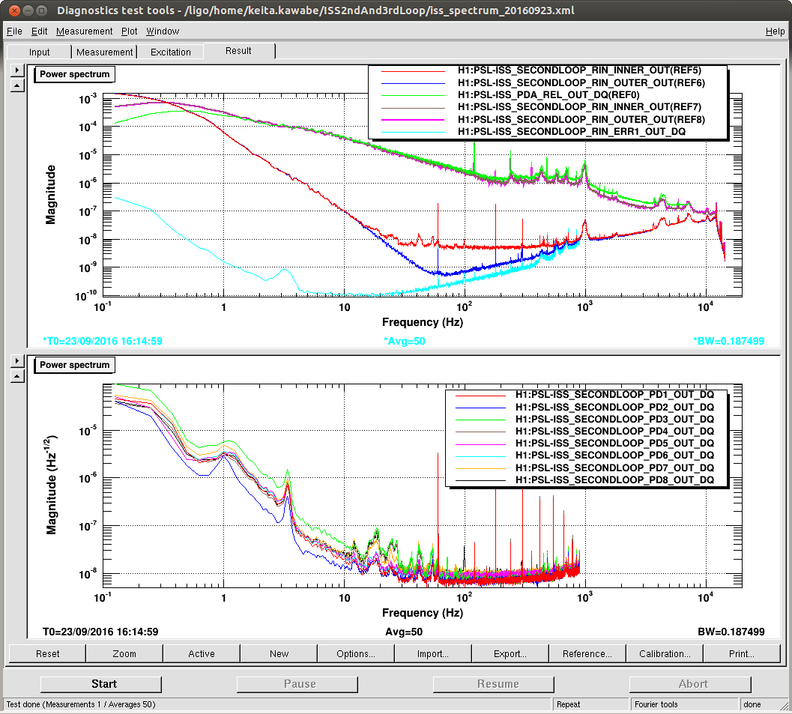
Noise at 50W
Disregard red and blue at f<50Hz or so for now.

Slide 11
Changes in the iss model
ISS, second loop, and third loop are all common library parts.
Some channel assignment change.
Inner loop ISS parameters that only represent binary status (ON/OFF) are now binary (0 or 1) instead of 16bit integer (-32000 etc.)
E1600204
Needs some change in guardian as well as medm (done at LHO).

Slide 12
ISS Summary
ISS performance is probably already adequate.
Jitter is totally different but related problem.
Some of the major structures come from HPO itself, not in intensity but in jitter.
TBD: See if the measured jitter at various QPD sensors are compatible with DBB measurements for HPO.

Slide 13
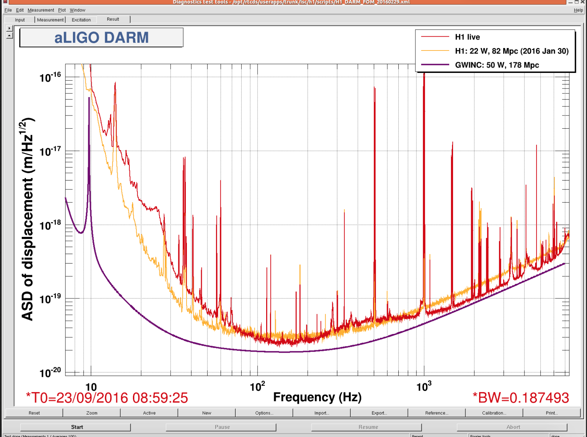

Slide 14
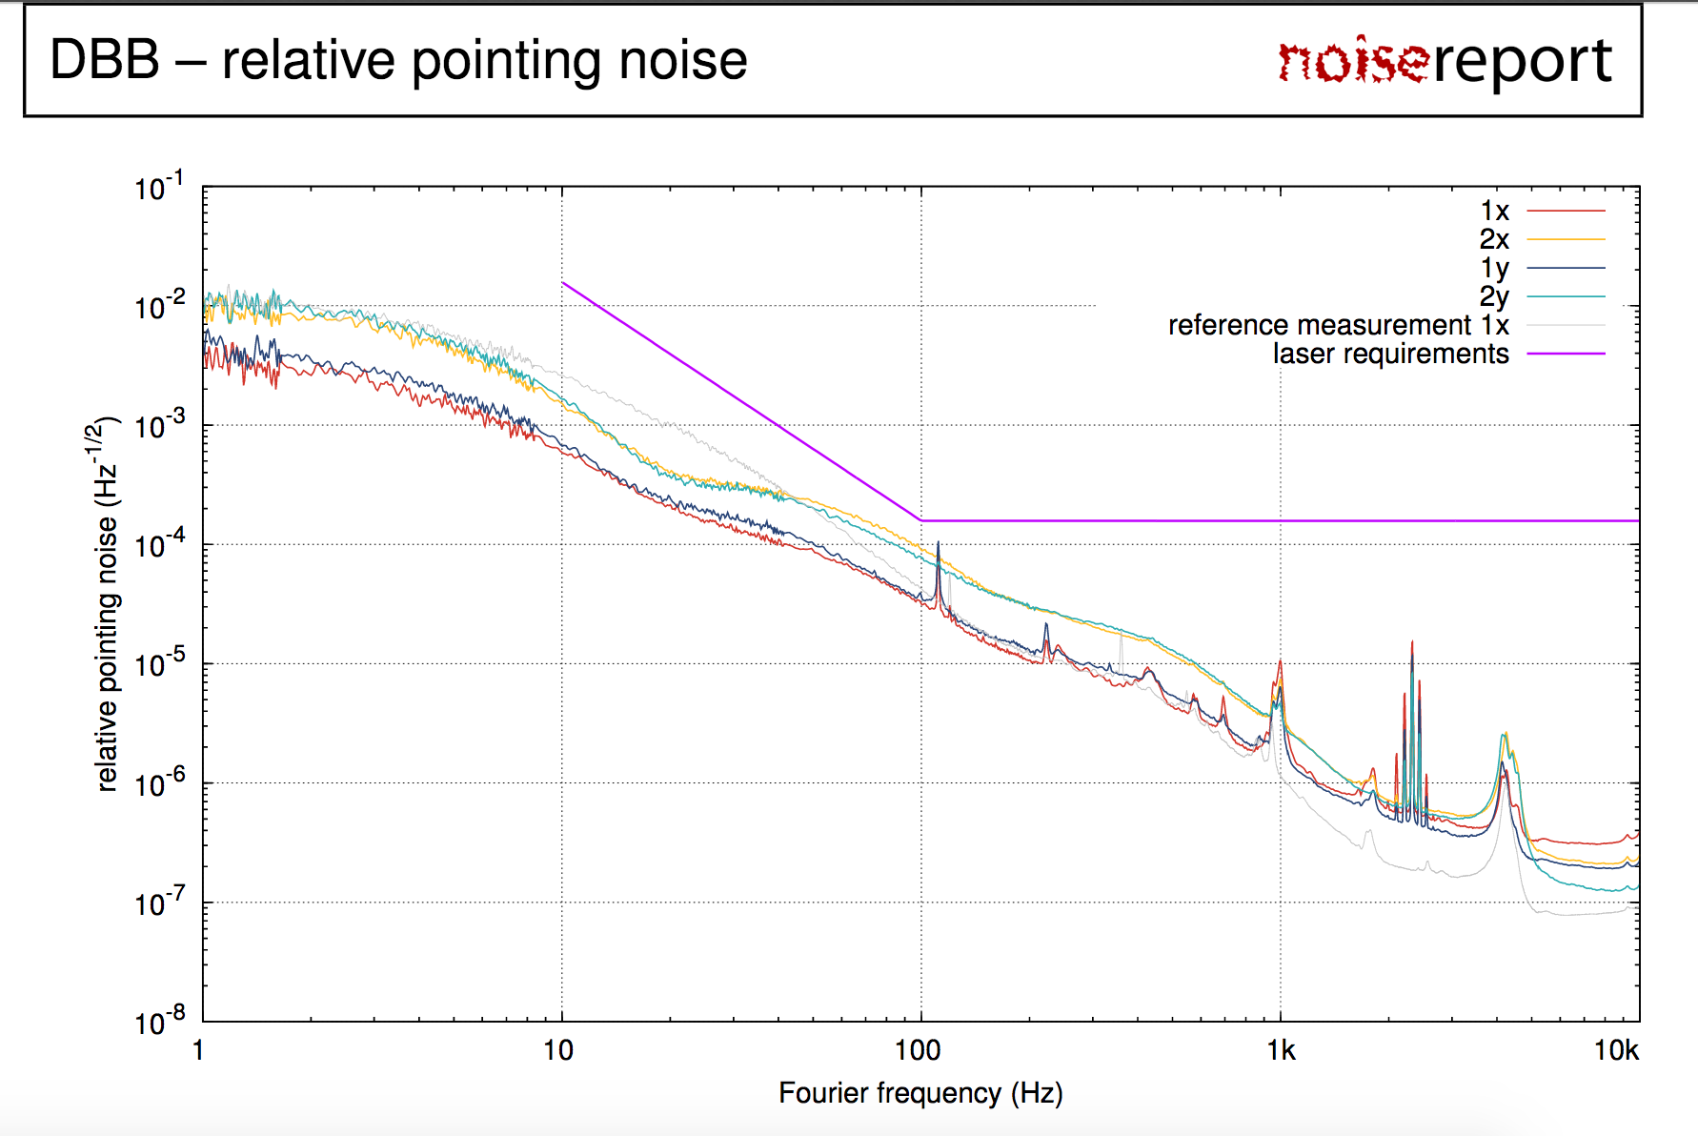
HPO jitter from 16/09/2016

Slide 15
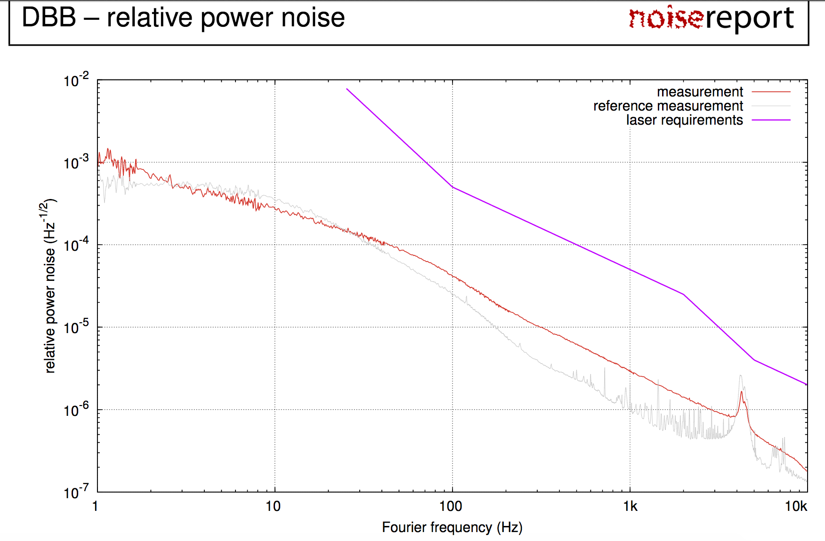
HPO RIN from 16/09/2016

