Slide 1
Vacuum At LLO
2016 SURF
Udochu, Ogbonnaya
LIGO-T1600389

Slide 2
Introduction
LIGO is a large physics experiment that detects and observes gravitational waves at a cosmic and astronomical level
An interferometer is a device that merges light sources to create interference
The interferometer is operated under ultra high vacuum (UHV) conditions, which is the pressure region less than 10⁻⁹ torr
An RGA allows one to know the chemical species involved in gas phase reactions

Slide 3
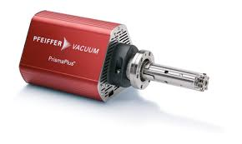
Residual Gas Analyzers (RGA)
A Residual Gas Analyzer (RGA) allows the user to measure the gases present in low-pressure environments.
The principle of operation is the same for all RGA instruments: A small fraction of the gas molecules are ionized (positive) and the resulting ions are separated, detected and measured according to their molecular masses.
www.scitek.com.au

Slide 4
RGA Cont.
Parts of RGA
Filament/ Analyzer
Calibrated leak
O ring valve
All metal bellow valve
Baking of the RGA is to remove hydrocarbons and other impurities.
Baked at 150 degrees Celsius
Baked for 4 days

Slide 5
Leak Detection
Helium is the best choice of tracer gas to find leaks
Due to its small atomic size helium passes easily through leaks.
Methods of Leak Checking are;
Vacuum Testing
Pressure Testing

Slide 6
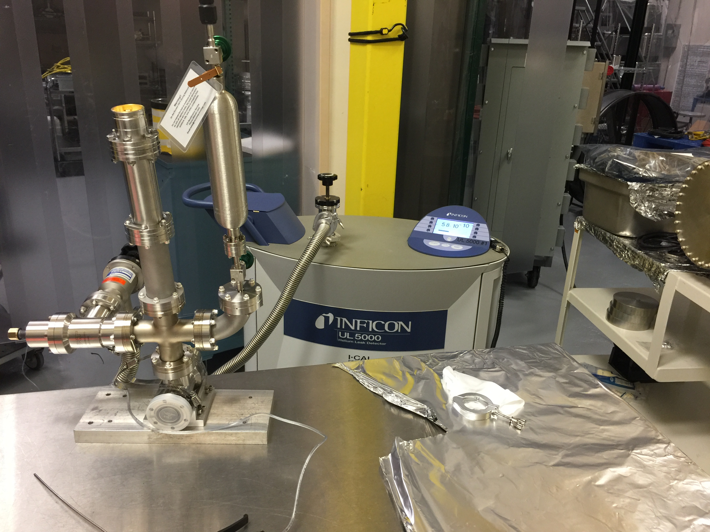
Leak Check of RGA
Leak checked after manifold was built
Used Helium leak detector
Used Vacuum Testing Method

Slide 7
Pump Down (Roughing Down)
Processed used to take the pressures closer to vacuum pressures from atm.
Scroll pumps used
Used to get to molecular flow in a system

Slide 8
Scans and Trends

Slide 9
RGA pre-bake Scan

Slide 10
References
https://www.ligo.caltech.edu/page/what-is-interferometer
https://www.ligo.caltech.edu/page/ligos-ifo
http://www.heliumleakdetection.net/Helium-Leak-Testing/what-is-helium-leak-detection.html

Slide 11
Questions

