Slide 1
Noises in Gravitational Wave Detectors
引力波
LIGO-G1601927-v1
Koji Arai (新井宏二) – LIGO Laboratory / Caltech
GW mini-school: Beijing Normal University 2016/9/15~18

Slide 2
Introduction ~ Noise?
GW detection
Data stream of differential arm strain
Once recorded:
Signals and noises are indistinguishable
What we can do is to catch “likely” features
Reduce any kind of noises!

Slide 3
Introduction ~ Noise?
Time domain vs frequency domain
Noise
Reduction
Time domain: transient noises
Frequency domain: stationary noises

Slide 4
Introduction ~ Noise?
Power Spectral Density (PSD)
Double sided PSD (-Infinity < f < Infinity)
Single sided PSD (0 <= f < Infinity)
[x_{unit}² / Hz]
Linearized PSD or Amplitude Spectral Density (ASD):
[x_{unit}/ sqrtHz]

Slide 5
Introduction ~ Noise?
Parseval’s Theorem for signal RMS and PSD
Root Mean of x(t):
average signal power density (per sec)
(cf. variance, std deviation)
PSD Sx(f):
power density per frequency (per sec)

Slide 6
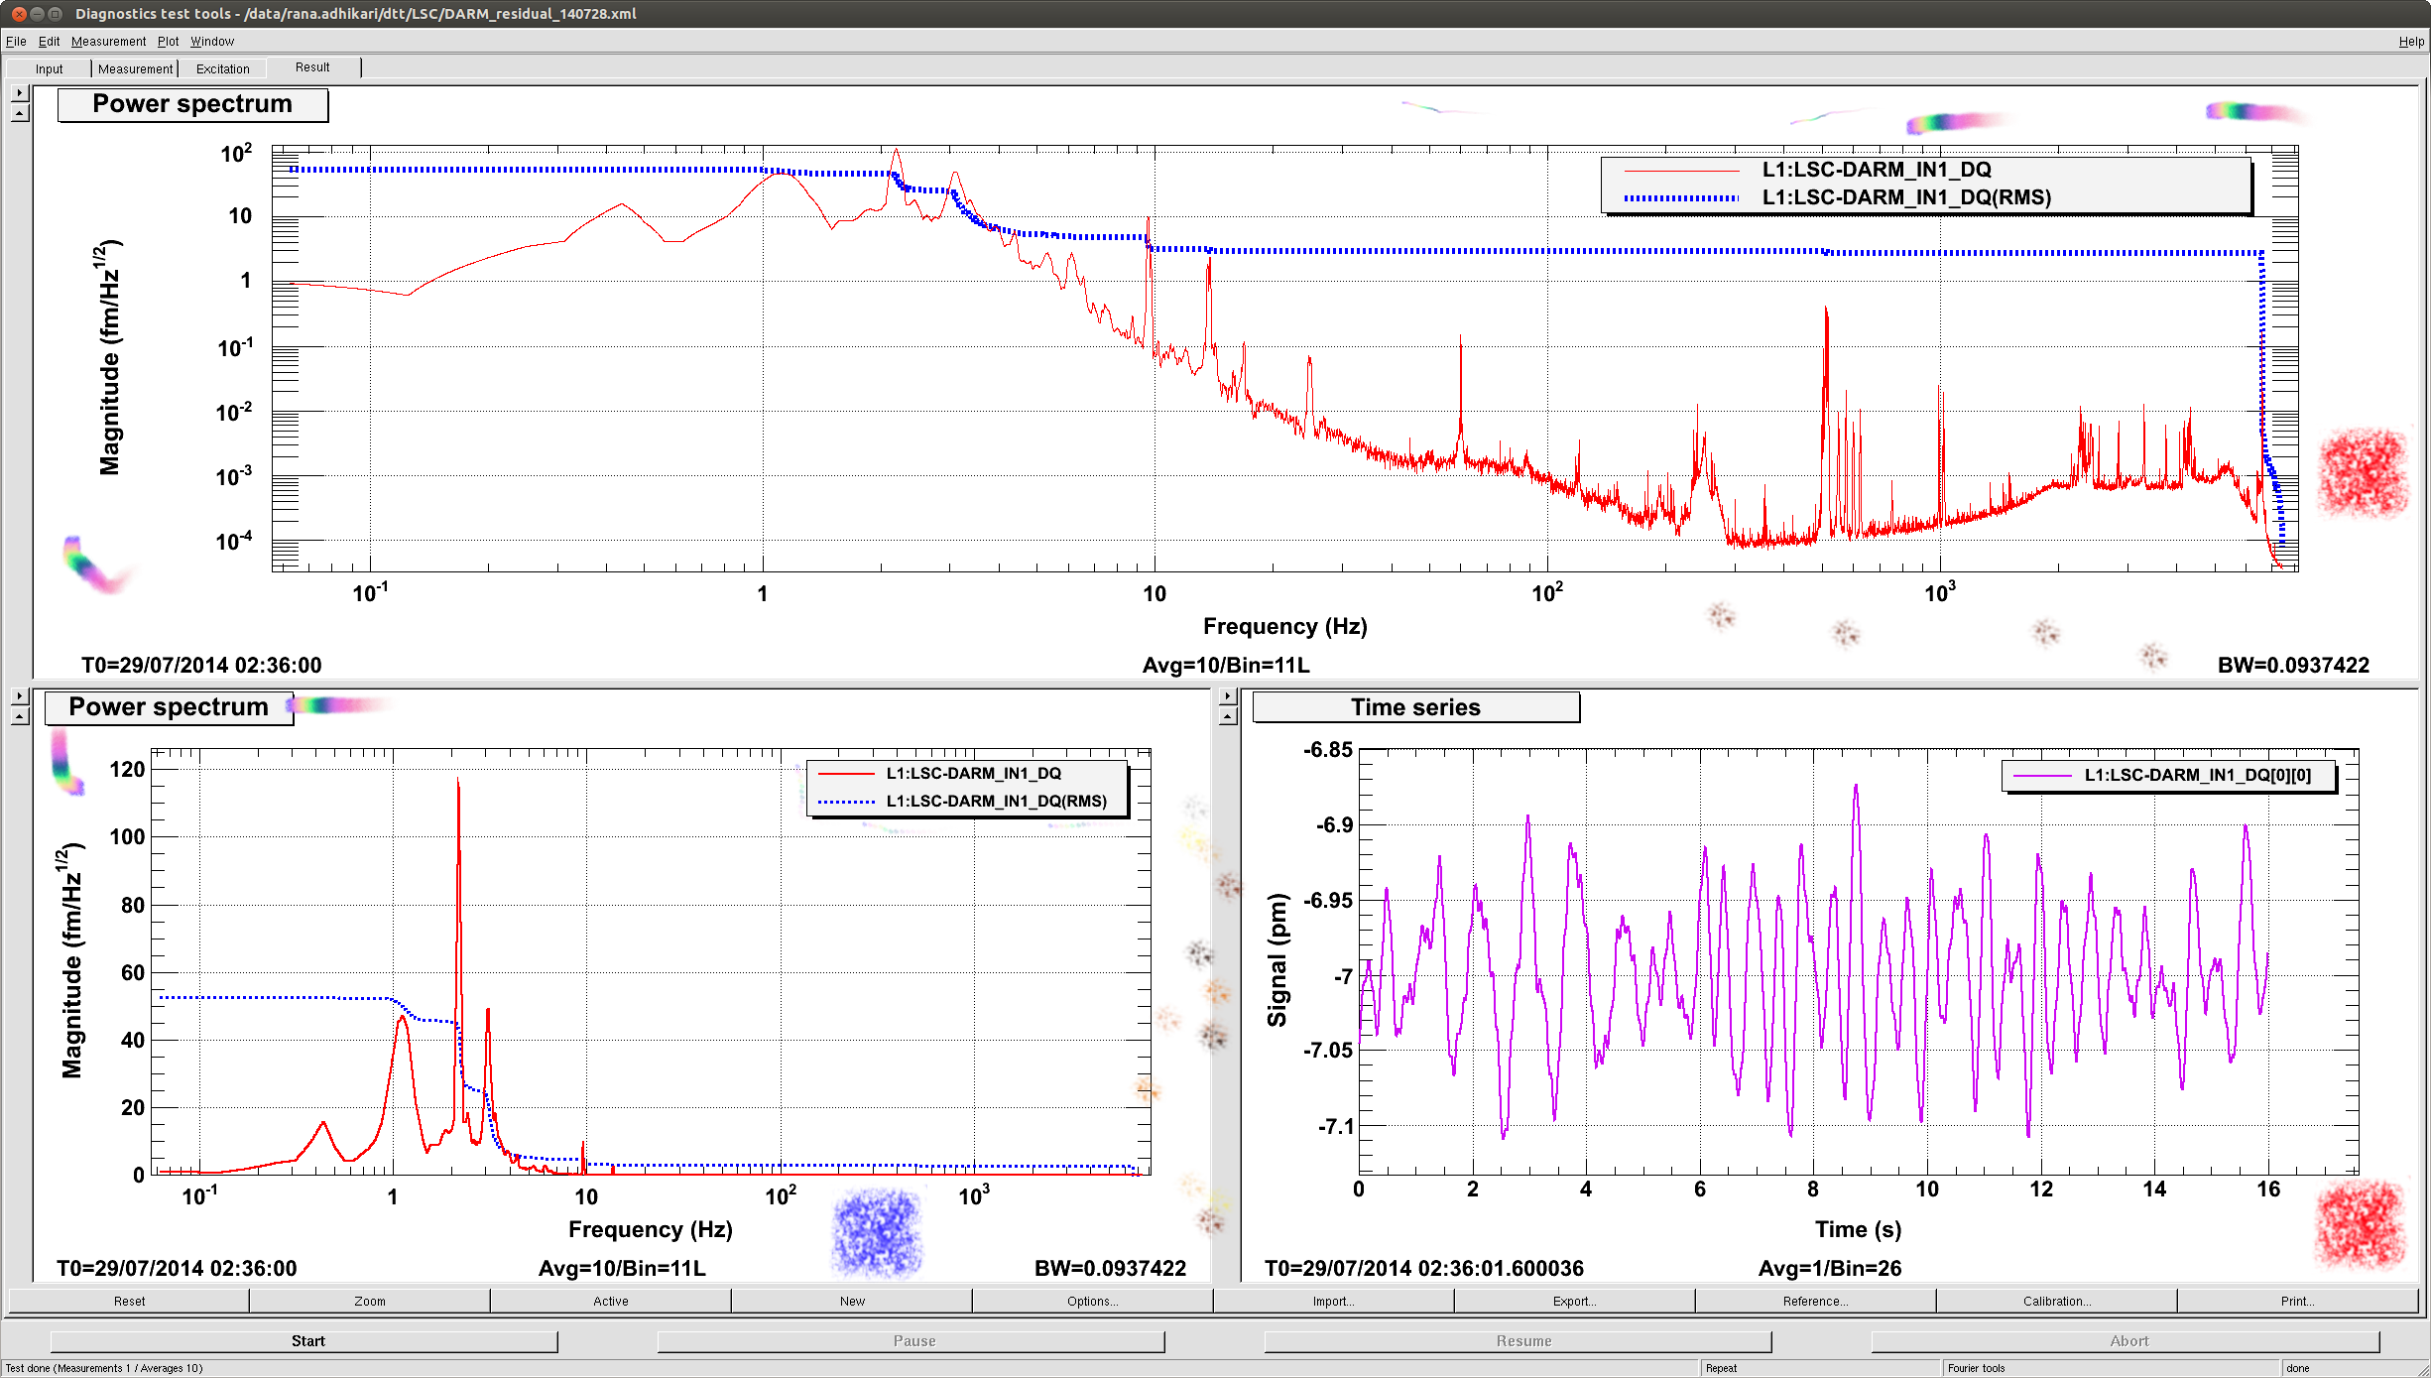
Introduction ~ Noise?
Example
PSD [fm/sqrtHz] in log-log scale, RMS [fm] ~ 50fm = 0.05pm
PSD [fm/sqrtHz] in log-lin scale
RMS [fm]
Time series [pm]

Slide 7
Components of the interferometer
3 fundamental elements of GW detectors
Mechanics
Optics
Electronics

Slide 8
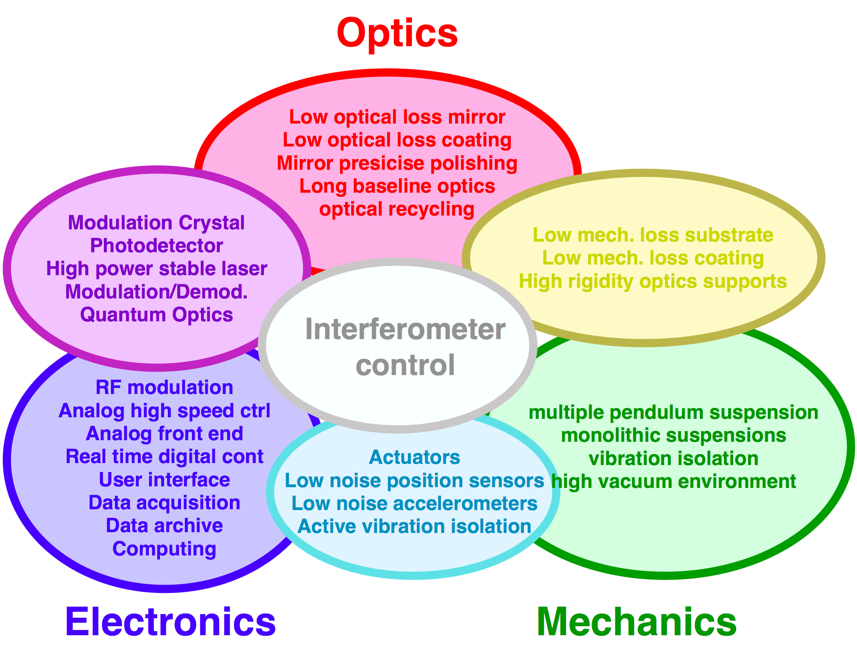
Components of the interferometer
3 fundamental elements of GW detectors
Mechanics
Optics
Electronics

Slide 9
Noise categories
3 fundamental elements of GW detectors
Mechanics -> Displacement noises
Optics -> Optical noises
Electronics -> Electrical noises
Displacement
Optical
Optical
Displacement
Electrical
Electrical
Electrical

Slide 10
Noise coupling
Noise source / Noise coupling
Reduce
this or this
Noise
Source
Coupling
Mechanism
GW
Channel

Slide 11
Sensitivity and noise
Sensitivity (=noise level) of Advanced LIGO
Current sensitivity
h= 8x10⁻²⁴ /rtHz

Slide 12
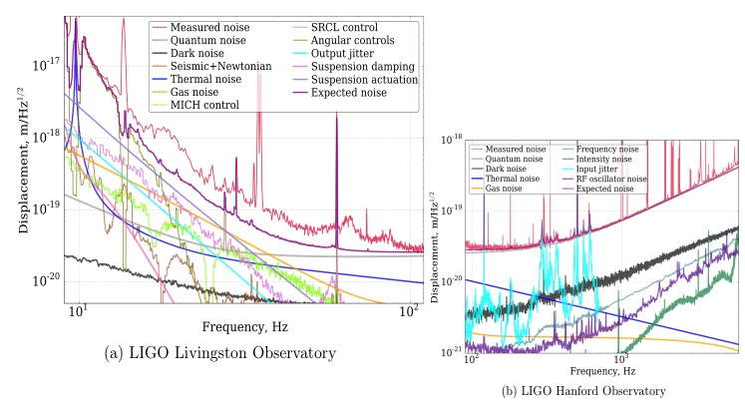
Sensitivity and noise
Sensitivity (=noise level) of Advanced LIGO
Noise budget
h= 2x10⁻²³ /rtHz

Slide 13
Displacement noises

Slide 14
Displacement noise
Mechanical displacement sensed
by a laser interferometer
The longer the arm length,
the smaller the strain noise
  Seismic noise
  Thermal noise
  Newtonian Gravity noise

Slide 15
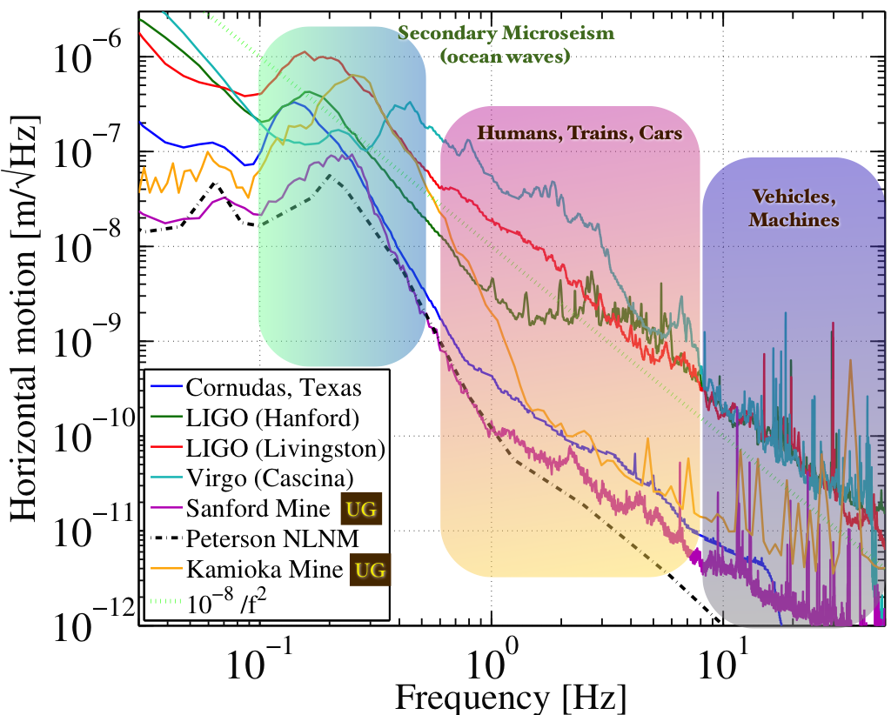
Displacement noise
Seismic noise
  Even when there is no noticeable earth quake…
Ground motion @10Hz
10⁻¹⁰m/rtHz
Target
disp. noise
10⁻²⁰m/rtHz
http://link.aps.org/doi/10.1103/RevModPhys.86.121 (http://arxiv.org/abs/1305.5188)

Slide 16
Displacement noise
Vibration isolation ~ utilize a harmonic oscillator
  A harmonic oscillator provides vibration isolation
  above its resonant frequency
w0=1Hz
|x/X|~1/1000@30Hz

Slide 17
Displacement noise
How to get more isolation?
Damping
Lower the peak height
Multi stage
Steeper isolation curve
Lower resonant freq
Better isolation
f ⁻⁴
f ⁻²
Worse isolation
More peaks
Complex to realize
In practice: employ combination of these measures

Slide 18
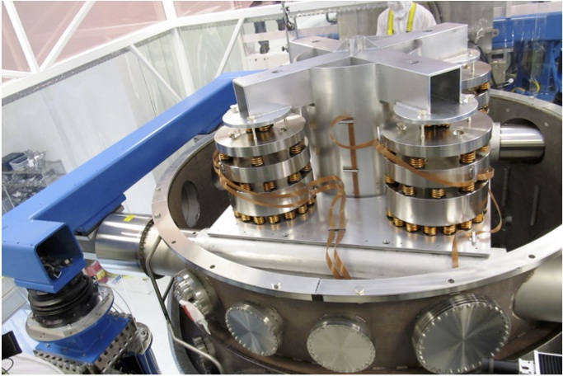
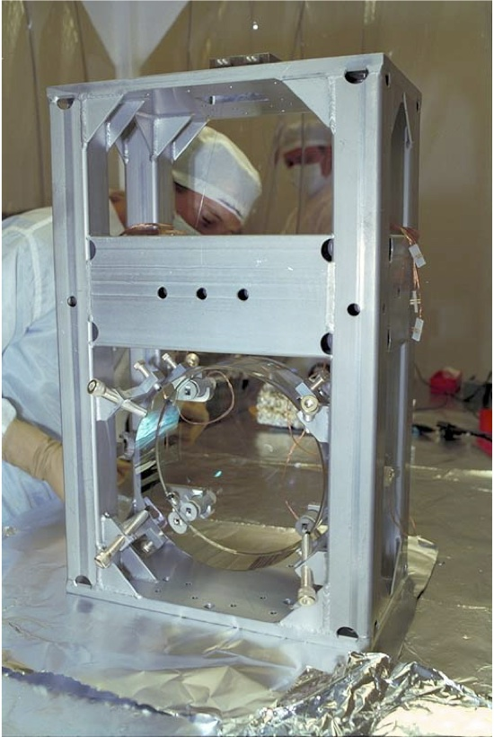
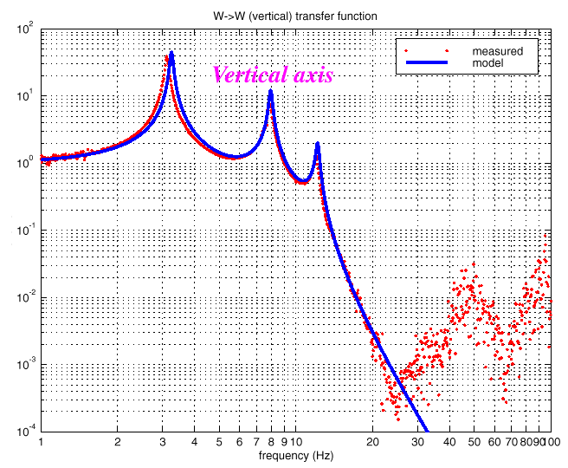
Displacement noise
iLIGO vibration isolation
Hydraulic active isolation / Isolation stack / Single Pendulum

Slide 19
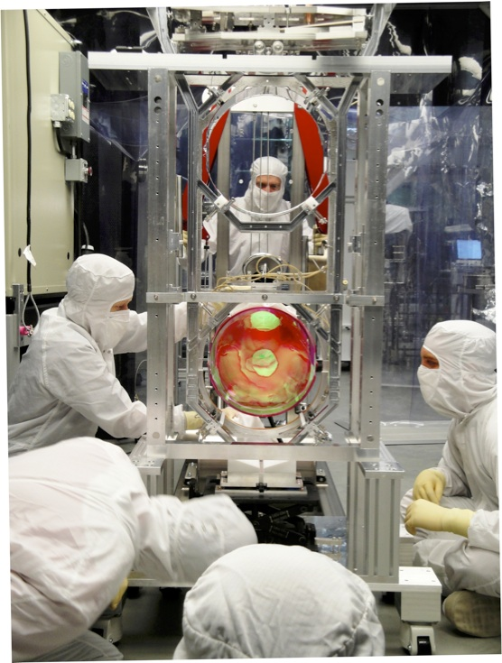
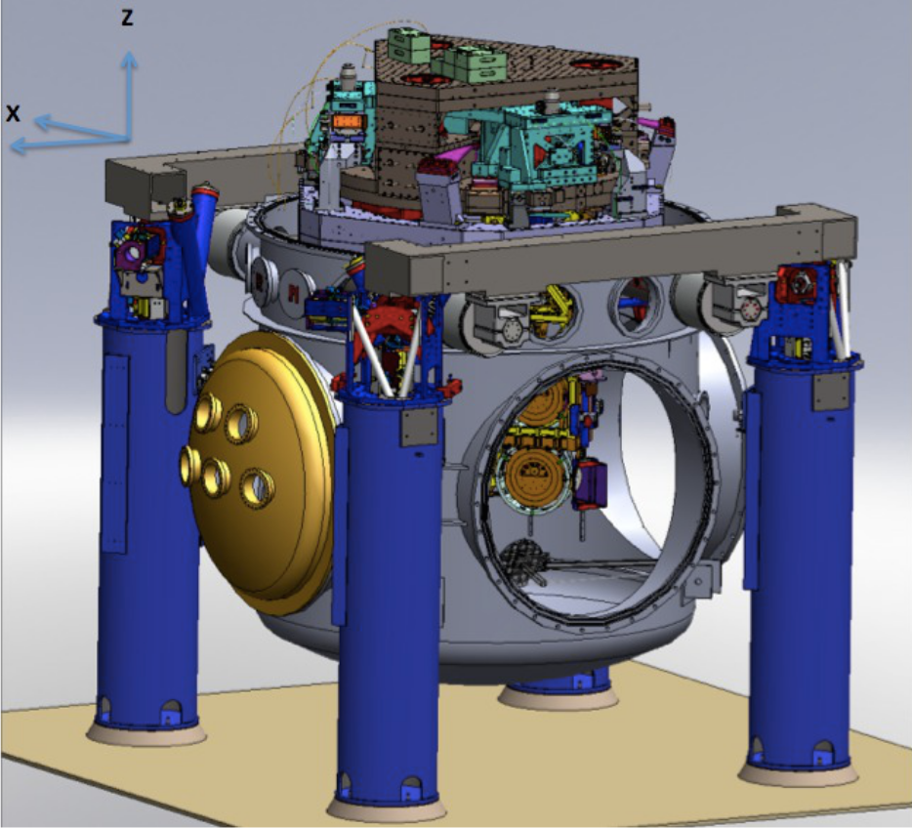
Displacement noise
aLIGO vibration isolation
Hydraulic active isolation / Invacuum Active Isolation Platforms / Multiple Pendulum

Slide 20
Displacement noise
10⁻¹⁰
http://link.aps.org/doi/10.1103/RevModPhys.86.121 (http://arxiv.org/abs/1305.5188)

Slide 21
Displacement noise
Thermal noise:
Thermally excitation of the motion of a system
  Each d.o.f. has <E> = ½ kb T (Equipartition theorem)
能量均分定理

Slide 22
Displacement noise
Thermal noise:
Fluctuation dissipation theorem (FDT)
涨落耗散定理

Slide 23
Displacement noise
cf Johnson noise:
Resistor R: Thermal voltage noise
Measurement of R:
R = V / I
Wikipedia: Johnson noise

Slide 24
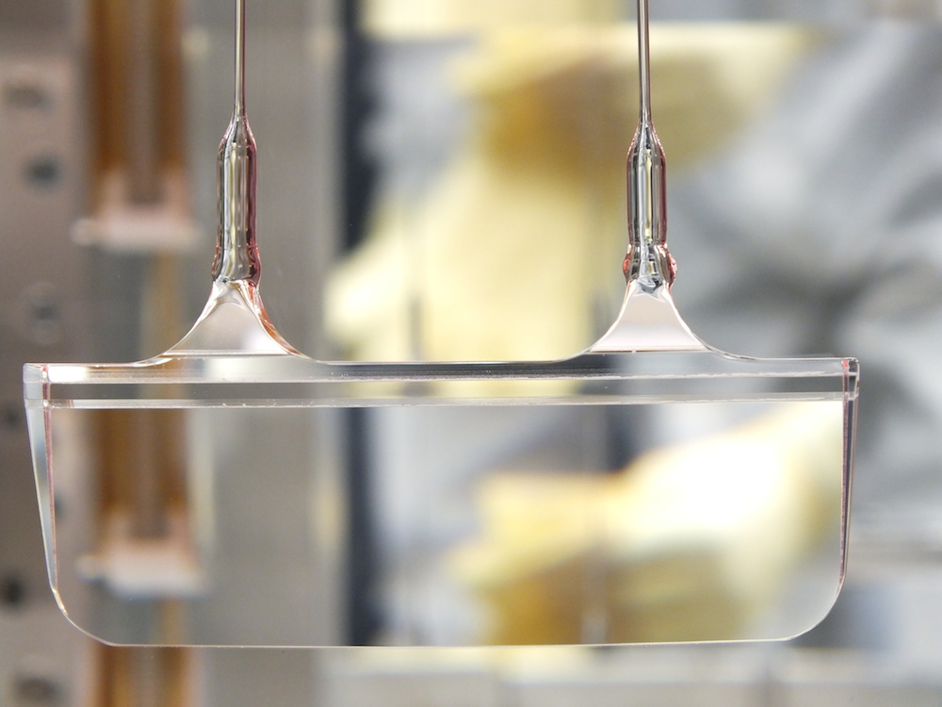
Displacement noise
Suspension thermal noise
Measurement of loss:
-> Q factor
Suspension thermal noise
http://www.giangrandi.ch/electronics/ringdownq/ringdownq.shtml
Monolithic suspension
for high pendulum Q
Q = 10¹ ~ 10⁶
Displacement noise [m/sqrtHz]
m = 40kg
T = 300K
Frequency [Hz]

Slide 25
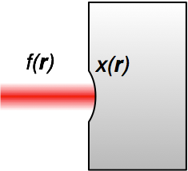

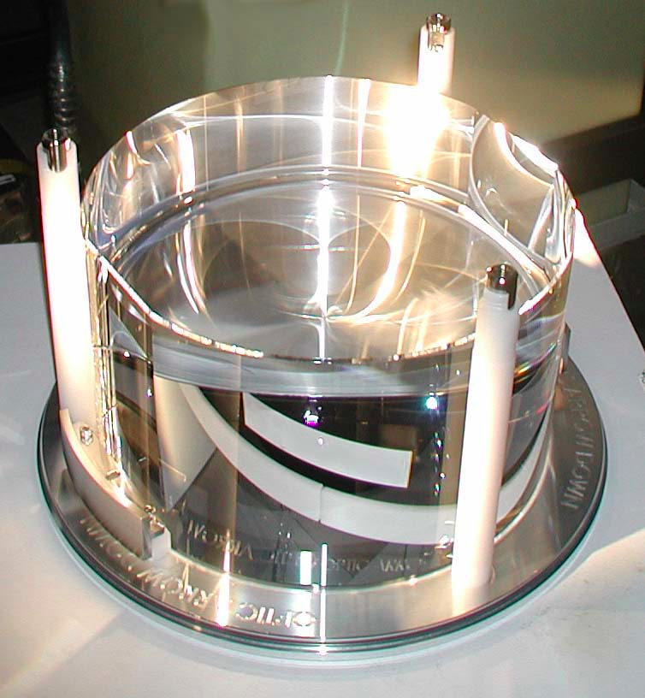

Displacement noise
Mirror thermal noise
Sensing of the mirror surface deformation with a laser beam (with intensity profile of f(r))
Apply periodic pressure with profile of f(r)
Calculate the rate of dissipation Wdiss
analytically, using FEA, or etc
Put this into the formula
Y. Levin PRD 57, 659-663 (1998)
We don’t need to
know Z(w)!

Slide 26
Displacement noise
Mirror substrate thermal noise
  Brownian motion
  Mechanical loss associated
  with the internal friction
  ⬄Thermally excited body modes
  Optical coating (high mechanical loss)
  will be limiting noise source in aLIGO
  Thermo elastic noise
  Elastic strain & thermal expansion coefficient
  => cause heat distribution & flow in the substrate
  ⬄Temperature fluctuation causes mirror displacement
  Thermo-refractive noise
  ⬄Temp. fluctuation causes fluctuation of refractive index
We don’t need to
know Z(w)!

Slide 27
Displacement noise
Newtonian Gravity noise
  Mass density fluctuations around the test masses
  => test mass motion via gravitational coupling
  Dominant source of Newtonian noise
  = Seismic surface wave
  Mitigation
  1) Going to quiet place (underground)
  2) Feedforward subtraction
  3) Passive reduction by shaping
  local topography
NN
aLIGO
sensitivity
J Driggers, et al, PRD 86, 102001 (2012)
J Harms, et al, Class. Quantum Grav. 31 185011 (2014)

Slide 28
Optical noises

Slide 29
Optical noises
Noises that contaminate the readout signal
  Quantum noises (shot noise, radiation pressure noise)
  Laser technical noises (frequency/intensity noise)
  Modulation noises
  Scattered light noise
Optical
Optical

Slide 30
Optical noises
Quantum noises: Shot noise
  Photon shot noise associated with photodetection
  Michelson interferometer
  Michelson response (@DC)
  i_{DC} : DC Photocurrent
  η : PD Quantum Efficiency
  ν : Optical Frequency
at the limit of d𝜙->0
Michelson
Strain Sensitivity
Shot-noise limit of the Michelson phase sensitivity
  1.3x10⁻²⁰ 1/sqrtHz
  @1W, 1064nm, 4km

Slide 31
Optical noises
Quantum noises ~ Radiation pressure noise
  Photon number fluctuation in the arm cavity
  => Fluctuation of the back action force
  Vacuum fluctuation injected
  from the dark port
  => Differential power fluctuation
  => Cause the noise in the GW signal

Slide 32
Optical noises
Quantum noises
  Standard Quantum Limit (SQL)
- Trade-off Between Shot Noise and Radiation-Pressure Noise
- Uncertainty of the test mass position due to observation
=> Quantum Optical techniques to overcome SQL

Slide 33
Optical noises
Laser frequency noise
  Laser wavelength (λ = c / ν)
  = reference for the displacement measurement
  Optical phase 𝜙 = 2 pi ν L / c
  d𝜙 = 2 pi / c (L dν + ν dL) <= indistinguishable
  Laser frequency stabilization

Slide 34
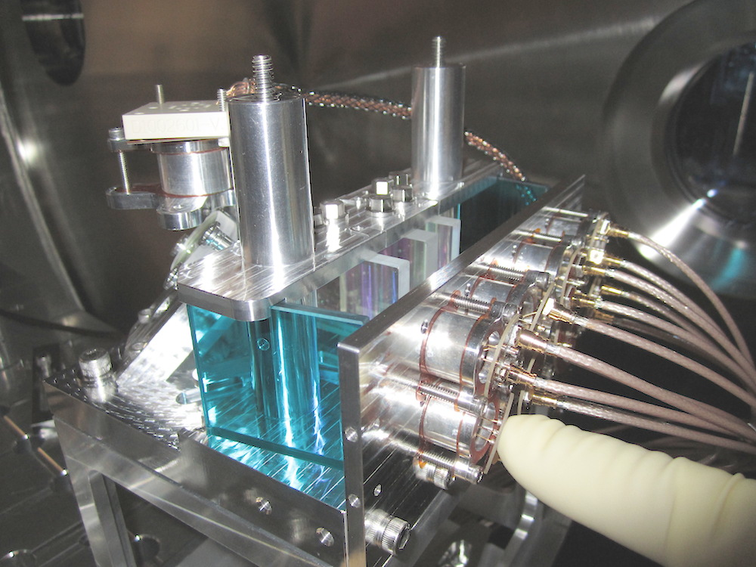
Optical noises
Laser intensity noise
  Relative Intensity Noise (RIN): dP/P
  Sensor output V = P x
  => dV = P dx + x dP <= indistinguishable
  Laser intensity stabilization
  In-vacuum 8-branch
  Photodiode array
P. Kwee et al,
Optics Express 20 10617-10634 (2012)

Slide 35
Electrical noises

Slide 36
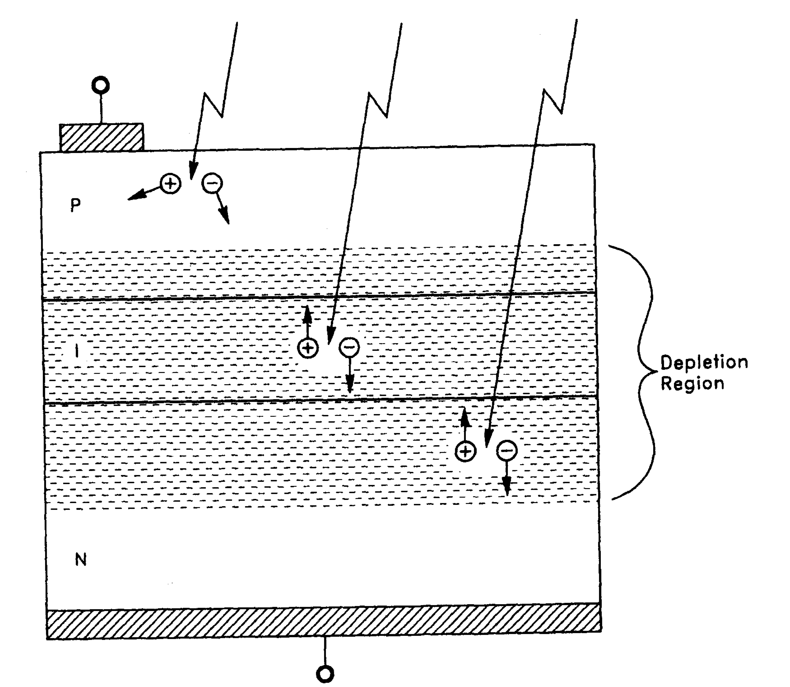
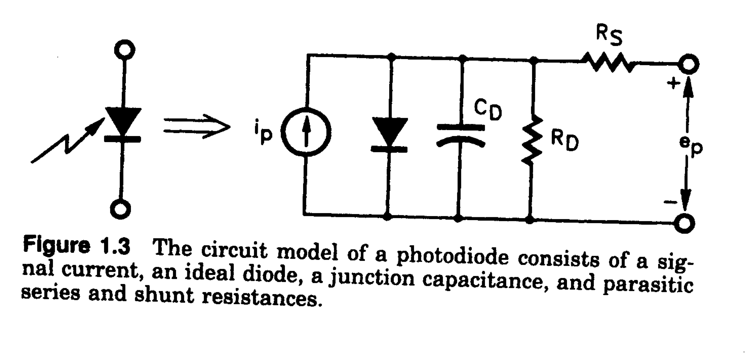
Noise in photodetectors
Photodiodes
Anode
aLIGO InGaAs PD (𝜙3mm)
P-layer
I-layer
N-layer
Photocurrent
Cathode
“Photodiode Amplifiers”,
J. Graeme (McGrawHill 1995)
  Photodiode equivalent circuit
    Shunt Capacitance R_{D}
    Junction Capacitance C_{D}
    Series Resistance R_{S}
input referred noise current

Slide 37
Digitization (Quantization) noise
Analog signals (~+/-10V) -> Digital signal
  Digitized to a discrete N bit integer number
  Quantization causes a white noise
  e.g. +/-10V 16bit => Δ = 0.3mV => Vn ~ 100 μV/sqrtHz
  cf. Input noise of a typical analog circuit 10nV/sqrtHz
quantization error
quantization
http://www.analog.com/static/imported-files/tutorials/MT-229.pdf

Slide 38
Digitization (Quantization) noise
Whitening
  Amplify a signal in the freq band where the signal is weak
Dewhitening
  Amplify a signal in the freq band where the signal is weak

Slide 39
Actuator noise
Actuator noise appears in the GW signal
as an external disturbance
  Mitigation
  1) Make the noise itself smaller
  2) Make the actuator response smaller
  We need to keep sufficient actuator strength
  for lock acquisition
  => Transition to a low-noise mode after achieving lock

Slide 40
Summary

Slide 41
Summary
Summary
  There are such large number of noises
  They are quite omni-disciplinary
  Even only one noise can ruin our GW detection
  GW detection will be achieved by
    Careful design / knowledge / experience
    Logical, but inspirational trouble shooting
  Noise “hunting”

