Slide 1
Detection of gravitational waves with a laser interferometer
引力波
LIGO-G1601925-v1
Koji Arai (新井宏二) – LIGO Laboratory / Caltech
GW mini-school: Beijing Normal Universuty 2016/9/15~18

Slide 2
Self-introduction
Senior Scientist @Caltech
  Interferometer Sensing and Control
Ph.D (U of Tokyo,1995-1999)
  TAMA300 double suspension
  Interferometer length sensing
  3m prototype interferomter
TAMA300 interferometer (NAOJ 1999-2009)
  Commissioning and science runs
LIGO (Caltech 2009-)
  Output optics chain, eLIGO/aLIGO commissioning

Slide 3
Detector Topics
Introduction
  Gravitational wave detection with laser interferometers
Laser interferometry
Noises in laser interferometer detectors
Linear control system

Slide 4
Interferometer GW detection

Slide 5
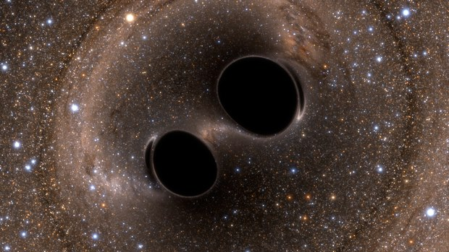
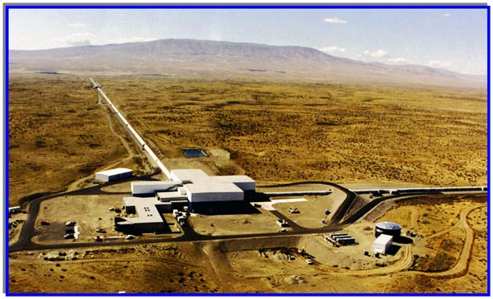
GW detection
GW Sources
GW Detectors

Slide 6
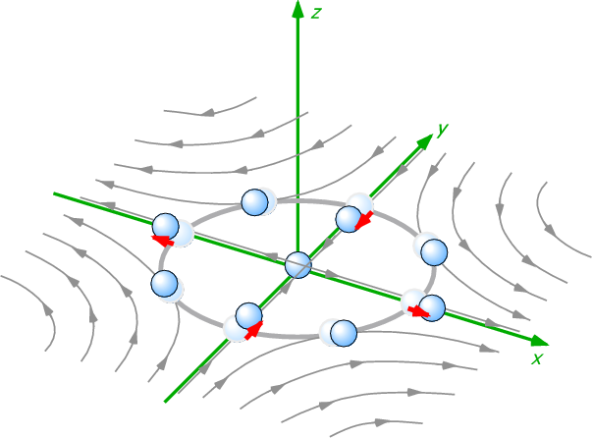
GW: Generation, Propagation, and Detection
Generation:
Change of quadrupole moment
Post-newtonian, NR
1/R
Propagation:
Wave equation of
the spacetime metric
Detection:
Quadrupolar “displacement” of the masses

Slide 7
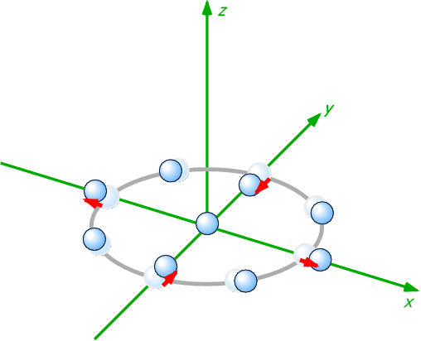
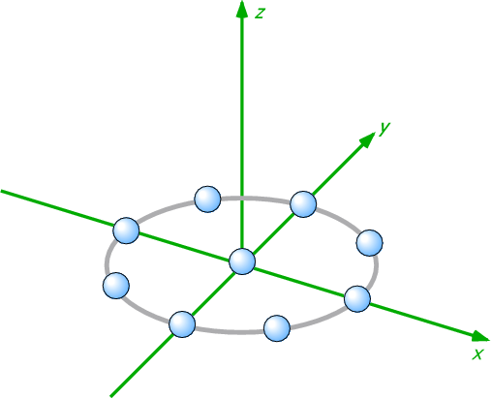
Gravitational wave
Quadrupole deformation of the spacetime
GW
Free mass

Slide 8
GW Detection
Measure strain between free masses
Free fall = no external force
Local measurement show no effect of GW
GW
free mass
= free fall
free mass
= free fall

Slide 9
GW Detection
Measure strain between free masses
GW
M1
M2
L
Notes:
{\bf Metric:\,\,\,} g_{\mu\nu} & = \eta_{\mu\nu} + h_{\mu\nu}\\
\eta_{\mu\nu} =
\left(\begin{matrix}
-1 & 0 & 0 & 0 \\
0 & 1 & 0 & 0 \\
0 & 0 & 1 & 0 \\
0 & 0 & 0 & 1
\end{matrix}\right),\,\,\,&
g_{\mu\nu} =
\left(\begin{matrix}
0 & 0 & 0 & 0 \\
0 & h_{+} & h_{\times} & 0 \\
0 & h_{\times} & h_{+} & 0 \\
0 & 0 & 0 & 1
&\\
\end{matrix}\right)\\
{\bf Distance:\,\,\,} ds^2 & = g_{\mu\nu} dx^{\mu} dx^{\nu} \\
ds^2 & = - (c\,dt)^2 + (1+h_{+}) dx^2 + dy^2 + dz^2

Slide 10
GW Detection
Measure strain between free masses
Changes in optical distance between the masses
GW
L -> (1+ h/2) L
Notes:
\int ds = \int_{\rm M1{\rightarrow}M2} \sqrt{1+h_{+}} dx &\simeq \int_{\rm M1{\rightarrow}M2} (1+h_{+}/2) dx = (1+h_{+}/2) L \\

Slide 11
Quadrupole nature of GWs
Differential motion => Michelson interferometer
Longer baseline
-> bigger change
  (displacement dx)
  = (Strain h) x (baseline L)
GW effect is tiny
  h~10⁻²¹ , L~1km -> dx~10⁻¹⁸ m
Need to measure the phase of the laser light
  => use “laser interferometry”
(1-h/2) L
(1+h/2) L

Slide 12
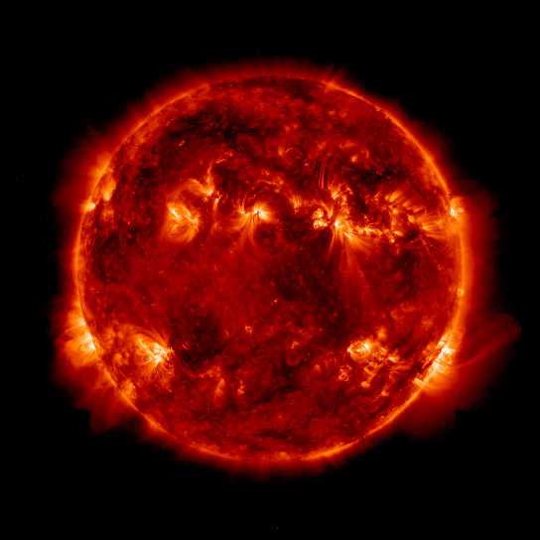
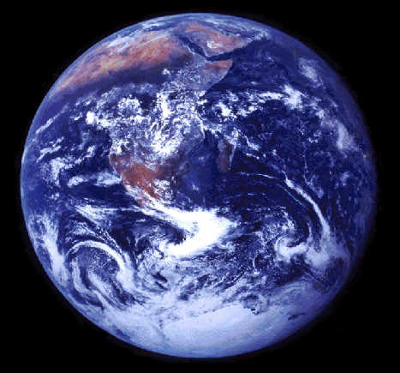
Amplitude of GWs
The effect of GW is very small
h ~ 10⁻²¹ => distance of 1m changes 10⁻²¹m
Corresponds to:
change by ~1 angstrom (or 100pm)
for distance between the sun and the earth
1.5 x 10¹¹ m
changes
by a H atom diameter!

Slide 13
Antenna pattern
Fixed on the ground, can not be directed
Poor directivity => More like an antenna
Antenna pattern (at low frequencies)
h₊ h_{x} UNPOL
Rev. Mod. Phys. 86 (2014) 121-151
http://link.aps.org/doi/10.1103/RevModPhys.86.121
(http://arxiv.org/abs/1305.5188)

Slide 14
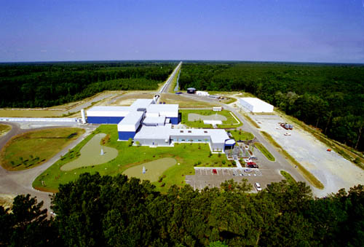
Interferometer GW Network
LIGO Observatories
Hanford / Livingston 4km
\
c.f. Virgo (FRA/ITA) 3km, KAGRA (JPN) 3km, GEO (GER/GBR) 600m
Still shorter than the optimum length
=> Use optical cavity to increase life time of the photons in the arm

Slide 15
Localization capability:
Localization of GW150914 & GW151226

Slide 16
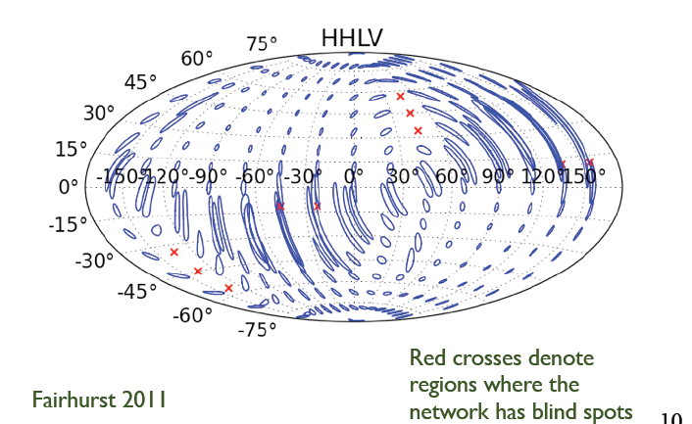
Localization capability:
LIGO-Virgo only

Slide 17
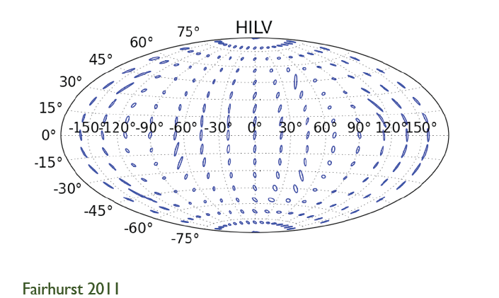
Localization capability:
LIGO-Virgo plus LIGO-India

Slide 18
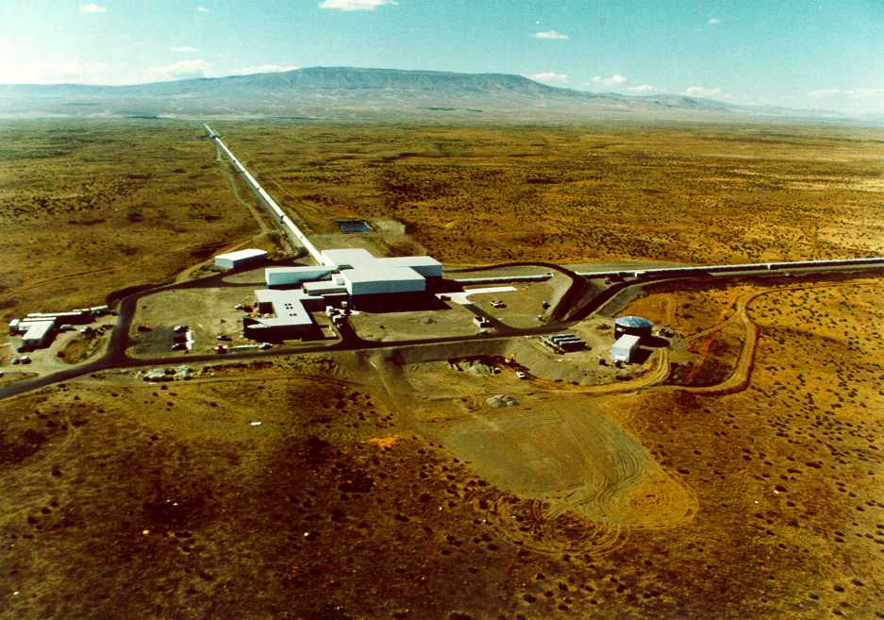
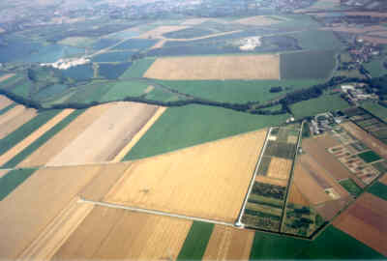
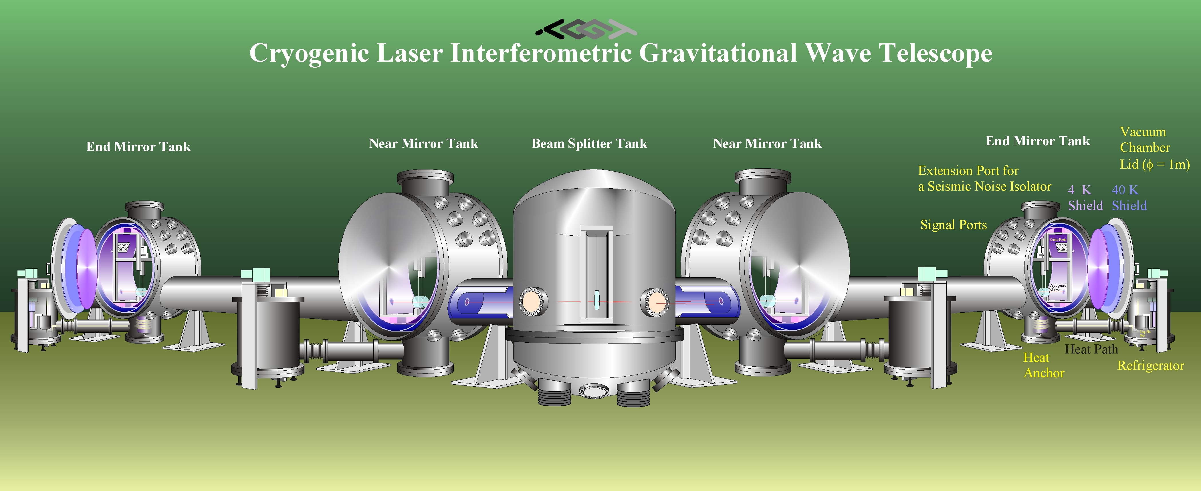
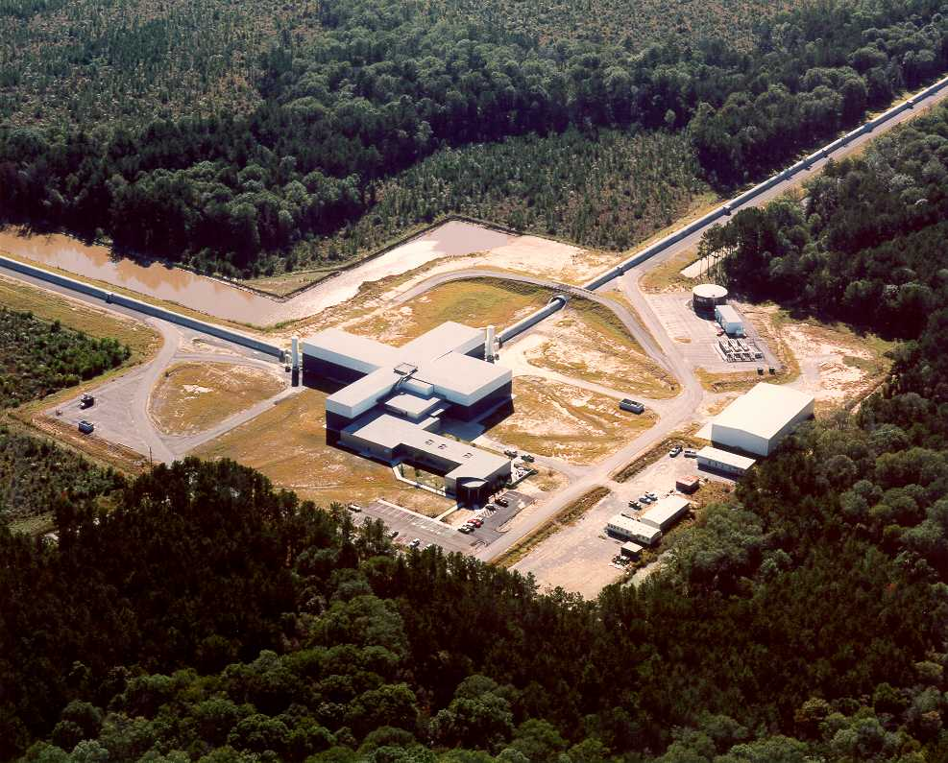
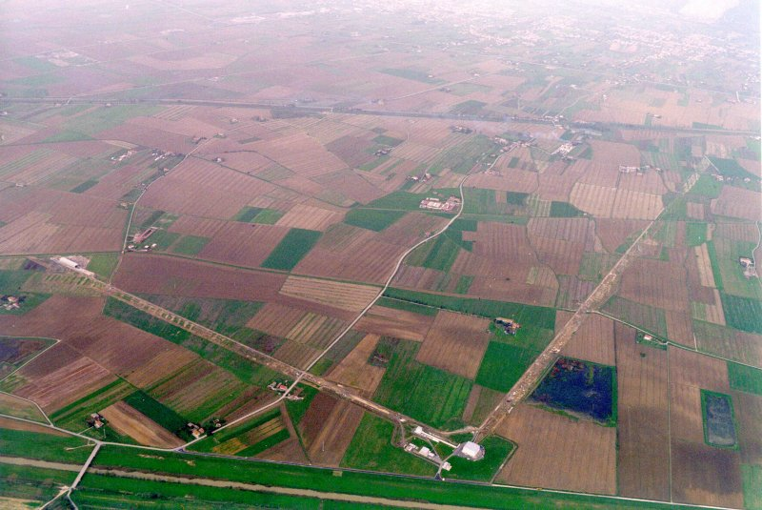
World Wide GW detector network
LIGO Hanford
GEO600
KAGRA
LIGO India
LIGO Livingston
Advanced VIRGO

Slide 19
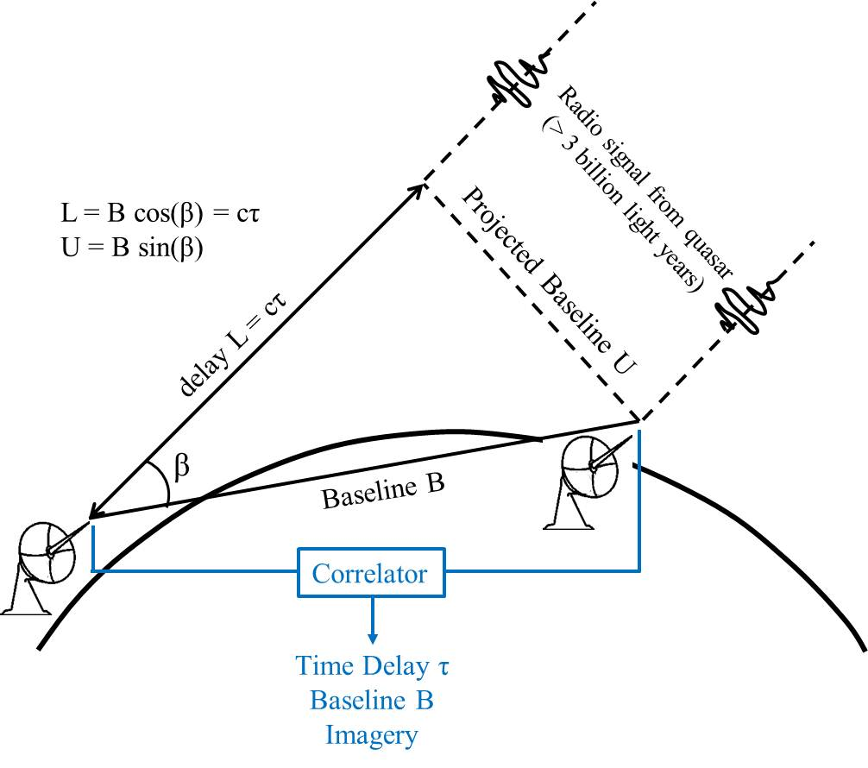
cf. Radio Telescope Interferometer ~ VLBI

Slide 20
Technologies of
Interferometer GW detectors

Slide 21
Simplified interferometer GW detector
Differential motion => Michelson interferometer

Slide 22
Actual GW detector (still simplified)
4km FP arm cavities
Mode
Cleaner
Vacuum Envelope
Seismic Attenuation
Recycling
Mirrors
Analog Electronics
Digital Control
Mirror Suspension
(Quad Pendulum)
High
Power Laser
Data Analysis
Signal
Readout
Scheme
Data Storage
Mirror & Coating
Fused Silica fiber

Slide 23

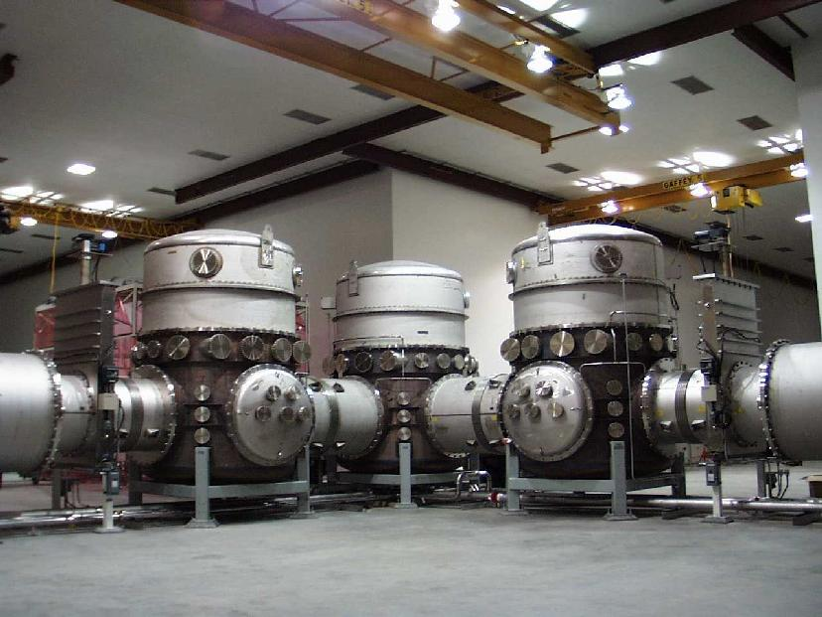
Vacuum system
World’s biggest UHV vacuum system, straighter than earth’s curvature
Large vacuum chambers to accommodate main optics and suspensions

Slide 24
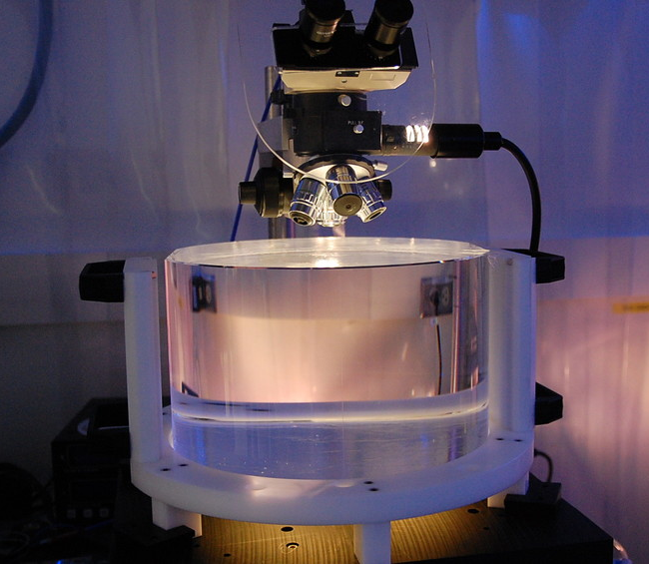
Test Masses
Requires the state of the art in substrates, polishing, coating
  Half-nm flatness over 300mm diameter
  0.2 ppm absorption at 1064nm
  Coating specs for 1064 and 532 nm
  Mechanical requirements: bulk and coating thermal noise, high resonant frequency

Slide 25
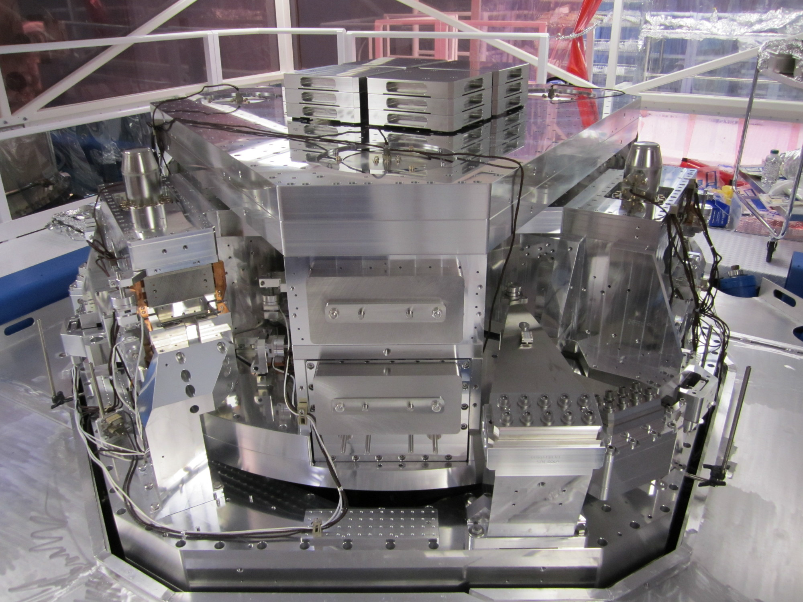
Seismic Isolation system
~2m

Slide 26
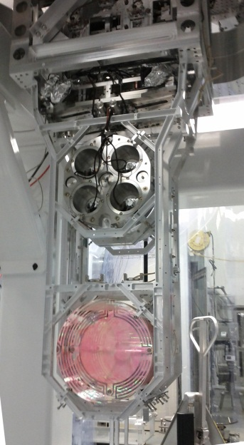

Quadruple monolithic suspension
Quadruple pendulum suspensions for the test masses
Monolithic final stage using fused silica fibers to suspend 40 kg test mass
Optics Table Interface
(Seismic Isolation System)
Damping Controls
Hierarchical Global
Controls
Final elements
All Fused silica
Electrostatic
Actuation

Slide 27
Components of the interferometer
3 elements of a GW detector
  Mechanics
  Optics
  Electronics

Slide 28
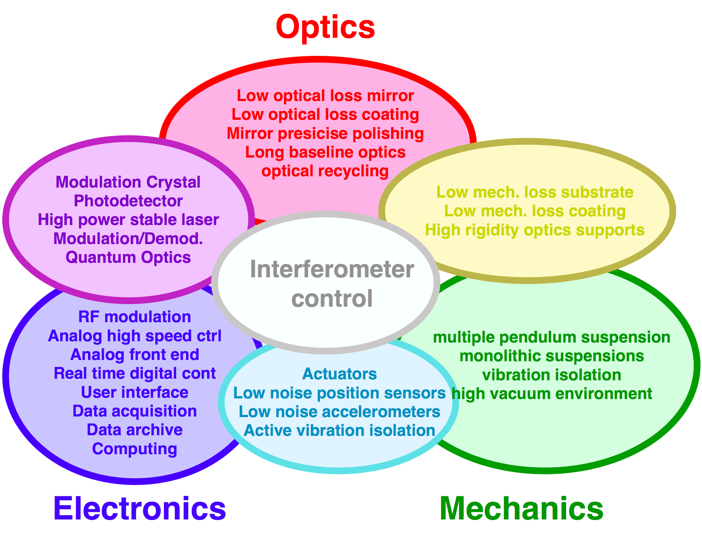
Components of the interferometer
3 elements of a GW detector
  Mechanics
  Optics
  Electronics

Slide 29
Size of interferometer GW detectors
Mirror
GW Detection = Length measurement
The longer arms, the bigger the effect
  GW works as strain => dx = h_{GW} x L_{arm}
  Until cancellation of the signal happens
  in the arms
  Optimum arm length
Mirror
Mirror
Laser
Photodetector
Mirror
Laser
Photodetector

Slide 30
Michelson interferometer
Frequency response of the Michelson to GWs
Cut off freq
longer -> lower
DC Response
longer -> larger
Notch freq
f = n c / (2 L)
  Michelson arm length optimized for 1kHz GW
  -> 75km, too long!

Slide 31
Fabry-Perot optical resonator
Storing light in an optical cavity
  Input vs circulating: constructive
  Prompt reflection vs leakage: destructive
  => The circulating field grows up
  N times more power
  Equivalent to have N times longer arm
99%
99.999%
Finesse
Folding Number

Slide 32
Fabry-Perot optical resonator
Storing light in an optical cavity
Finesse
Cutoff freq “Cavity pole”
DC Response
amplification
  1. FP increases stored power in the arm
  2. FP increases accumulation time of the signal
  => Above the roll-off, increasing F does not improve the response

Slide 33
GW telescope?
A continuous signal stream from an interferometer
GWs and noises: in principle, indistinguishable
=> Anything we detect is GW
Reduce noises!
  Obs. distance is inv-proportional to noise level
  x10 better => x10 farther => x1000 more galaxies

Slide 34
Sensitivity and noise
Sensitivity (=noise level) of Advanced LIGO
Design

Slide 35
Sensitivity and noise
Sensitivity (=noise level) of Advanced LIGO
Current sensitivity
h= 8x10⁻²⁴ /rtHz

Slide 36
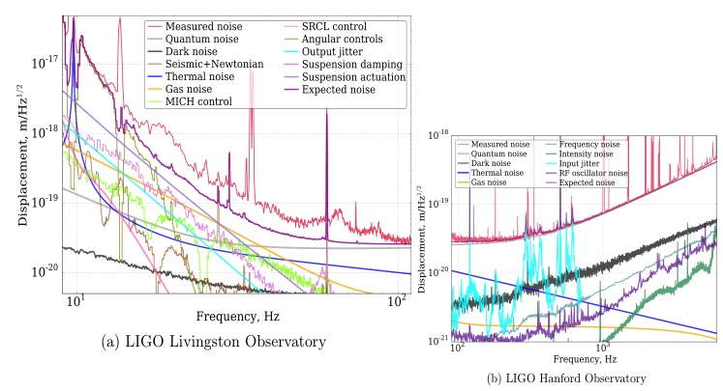
Sensitivity and noise
Sensitivity (=noise level) of Advanced LIGO
Noise budget
h= 2x10⁻²³ /rtHz

Slide 37
Summary
GWs ~ ripples of the spacetime
GW effect is very small
~ the effect is so small (h<10⁻²¹)
Not yet directly detected
Sufficiently sensitive detectors allow us to detect
Michelson-type interferometers are used
GW detection is a precise length (=displacement) measurement!

Slide 38
Summary
Basically, the larger, the better.
LIGO has two largest interferometers in the world,
and multiple detector will have very important role in GW astronomy
IFO consists of many components
Optics / Mechanics / Electronics
and their combinations (e.g. Opto-Electronics)
Noises and signals are, in principle, indistinguishable.
Noise reduction is essential

