Slide 1
Current and future ground-based gravitational-wave detectors
Haixing Miao
University of Birmingham
Key reference: LIGO Instrument Science White Paper (2015-2016)
LAAC Tutorial Glasgow

Slide 2
Outline
Background
Gravitational waves and their detection
Basic of noise
Noise spectral density and transfer function
Environmental noise
Passive isolation and active cancellation
Thermal noise
Fluctuation-dissipation theorem
How to reduce thermal noise
Quantum noise
Standard Quantum Limit
Frequency-dependent squeezing
Current and future detectors
Timeline and sensitivity
LAAC Tutorial Glasgow
1

Slide 3
Outline
Background
Gravitational waves and their detection
Basic of noise
Noise spectral density and transfer function
Environmental noise
Passive isolation and active cancellation
Thermal noise
Fluctuation-dissipation theorem
How to reduce thermal noise
Quantum noise
Standard Quantum Limit
Frequency-dependent squeezing
Current and future detectors
Timeline and sensitivity
LAAC Tutorial Glasgow
2

Slide 4
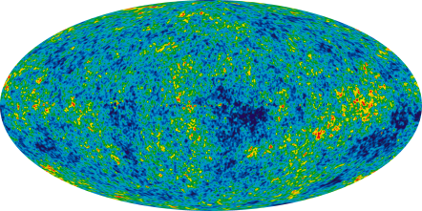
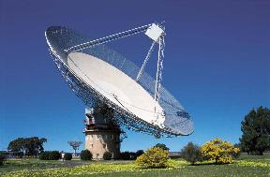
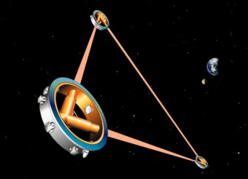
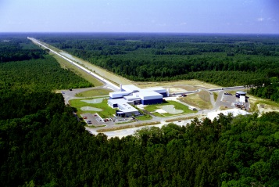
Gravitational waves and their detection
Quantum fluctuations in early universe
Supermassive black holes binary mergers
Compact objects captured by supermassive black holes
Compact binary mergers
Supernovae, neutron star
Wave period
Age of universe
years
hours
sec
ms
Log(frequency)
-16
-14
-12
-10
-8
-6
-4
-2
0
2
Cosmic Microwave Background polarization
Pulsar timing array
Space-based interferometers
Ground-based interferometers
LAAC Tutorial Glasgow
3

Slide 5
Gravitational waves and their detection
Quantum fluctuations in early universe
Supermassive black holes binary mergers
Compact objects captured by supermassive black holes
Compact binary mergers
Supernovae, neutron star
Wave period
Age of universe
years
hours
sec
ms
Log(frequency)
-16
-14
-12
-10
-8
-6
-4
-2
0
2
Cosmic Microwave Background polarization
Pulsar timing array
Space-based interferometers
Ground-based interferometers
LAAC Tutorial Glasgow
3

Slide 6
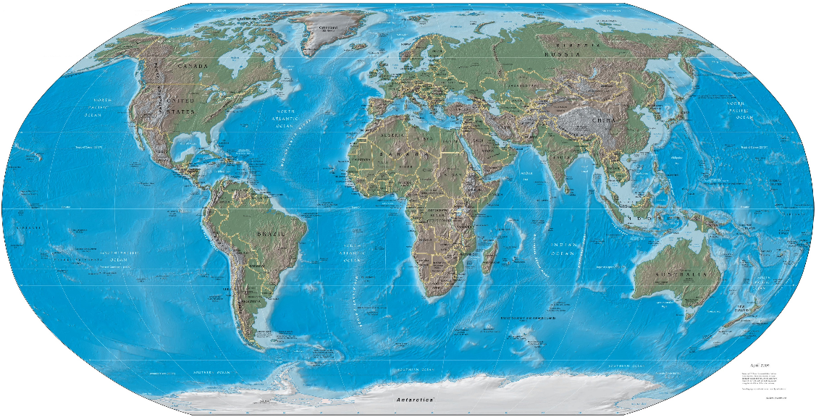
A Global Network
GEO600
LIGO
VIRGO
KAGRA
LIGO-India
LAAC Tutorial Glasgow
4

Slide 7
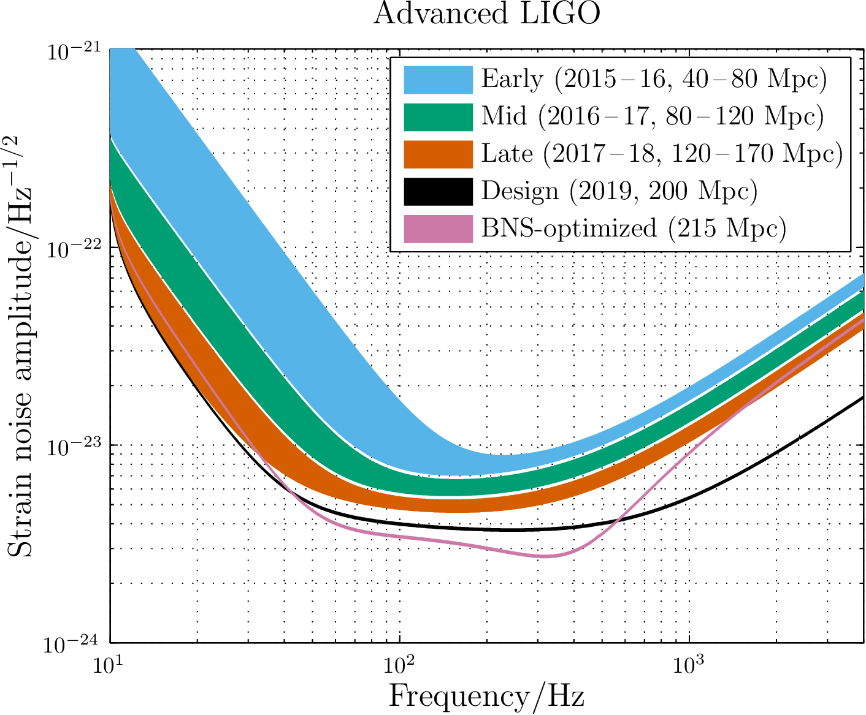
Different stages of Advanced LIGO
strain
LSC, Living Reviews in Relativity 19, 1 (2016)
LAAC Tutorial Glasgow
5

Slide 8
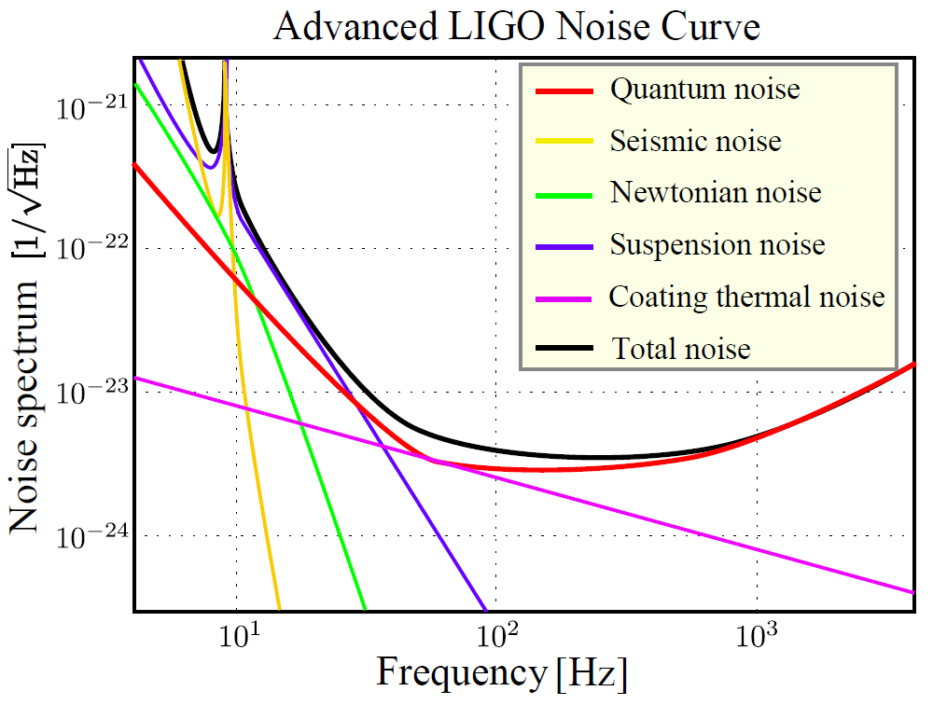
Design sensitivity of Advanced LIGO
strain
LSC, Class. Quantum Grav. 32, 074001 (2015)
LAAC Tutorial Glasgow
6

Slide 9
Outline
Background
Gravitational waves and their detection
Basic of noise
Noise spectral density and transfer function
Environmental noise
Passive isolation and active cancellation
Thermal noise
Fluctuation-dissipation theorem
How to reduce thermal noise
Quantum noise
Standard Quantum Limit
Frequency-dependent squeezing
Current and future detectors
Timeline and sensitivity
LAAC Tutorial Glasgow
7

Slide 10
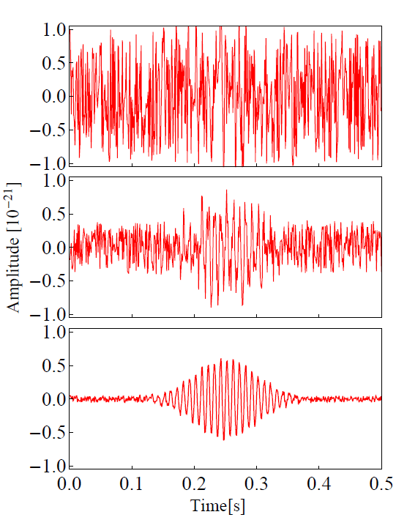
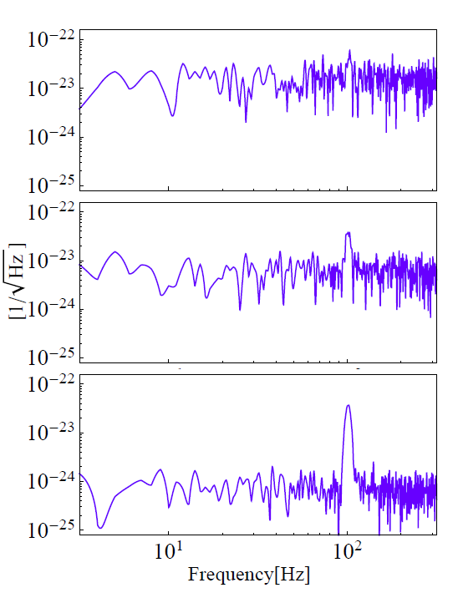
Signal and noise
Time Domain
Frequency Domain
LAAC Tutorial Glasgow
8

Slide 11
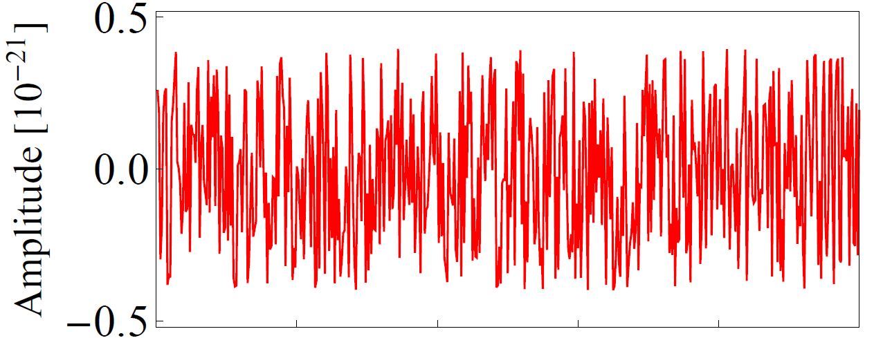
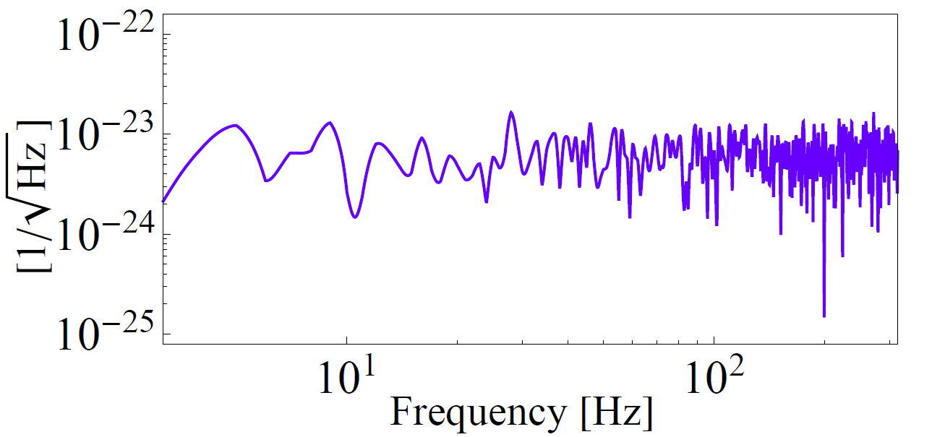
Noise spectral density (spectrum)
LAAC Tutorial Glasgow
9

Slide 12
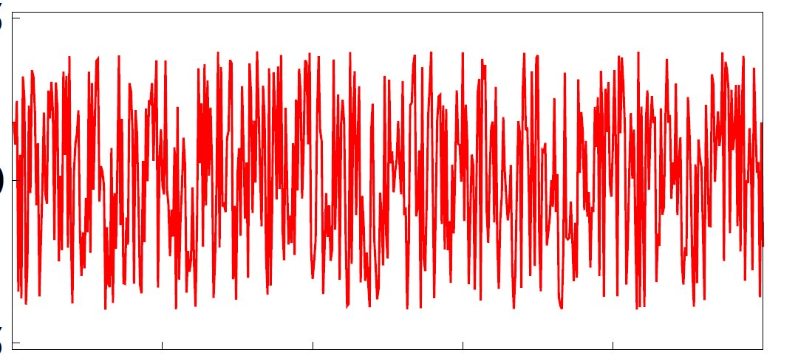
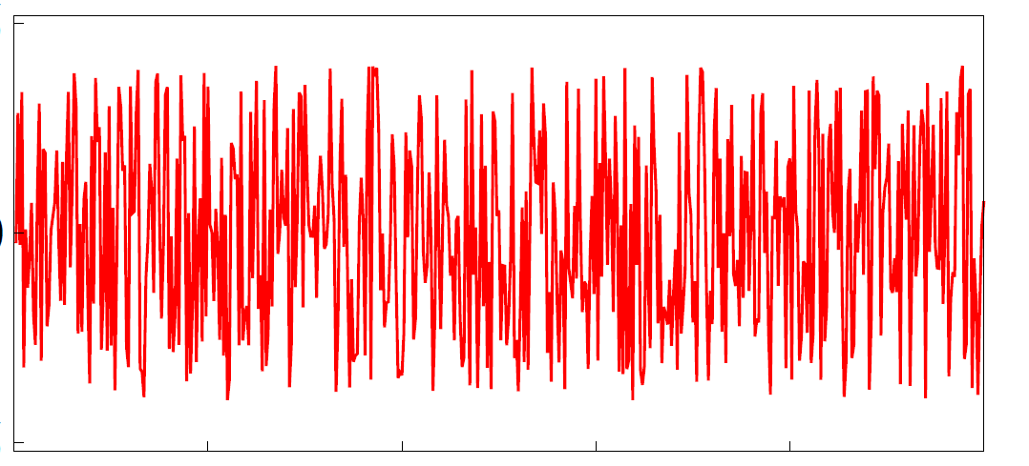
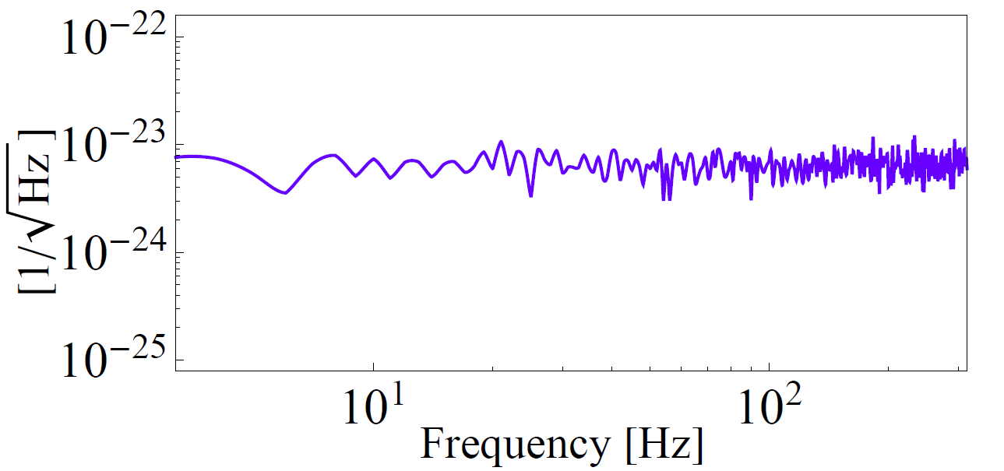
Noise spectral density (spectrum)
LAAC Tutorial Glasgow
10

Slide 13
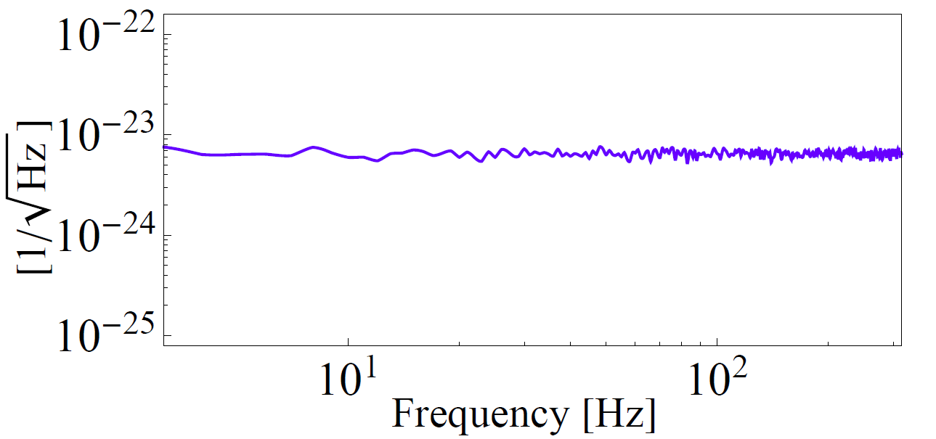
Noise spectral density (spectrum)
LAAC Tutorial Glasgow
11

Slide 14
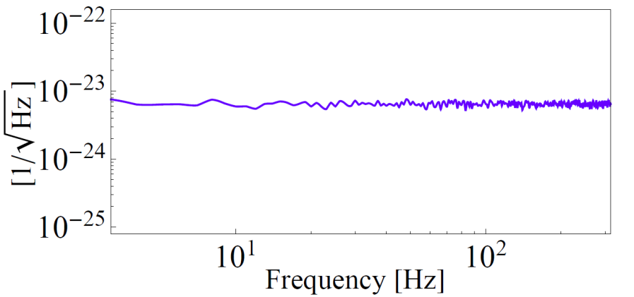
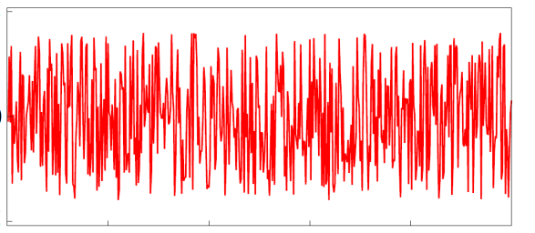
Noise spectral density (spectrum)
Spectral density:
LAAC Tutorial Glasgow
12

Slide 15
Noise spectral density (spectrum)
Spectral density:
Linear version:
resolution bandwidth
Order of magnitude:
Chap 6: Random Process in Applications of Classical Physics by Blandford & Thorne
LAAC Tutorial Glasgow
13

Slide 16
Noise spectral density (spectrum)
strain
100Hz signal (1sec long):
In general:
(with matched filtering)
LAAC Tutorial Glasgow
14

Slide 17
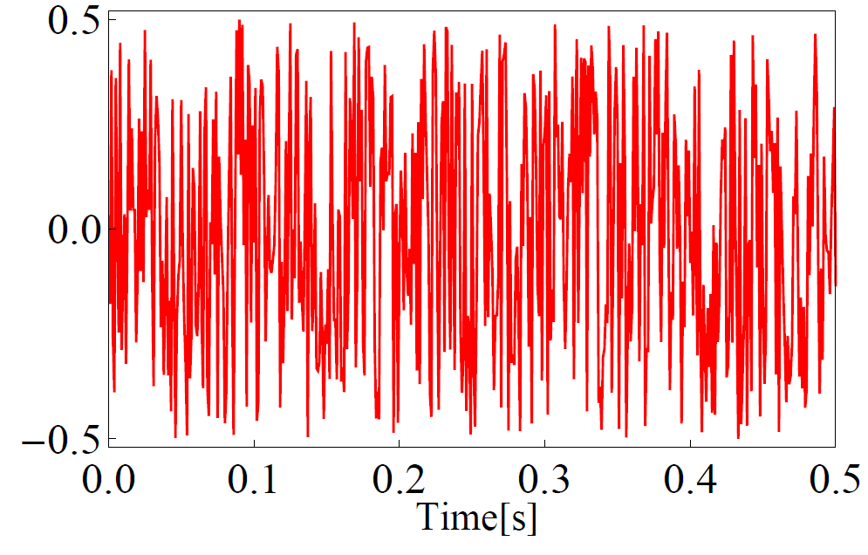
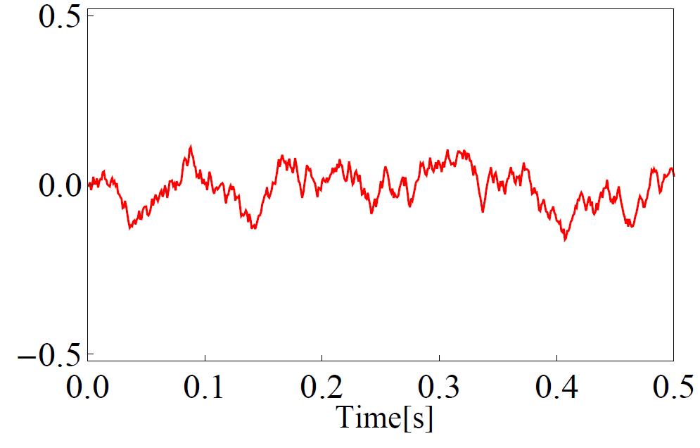
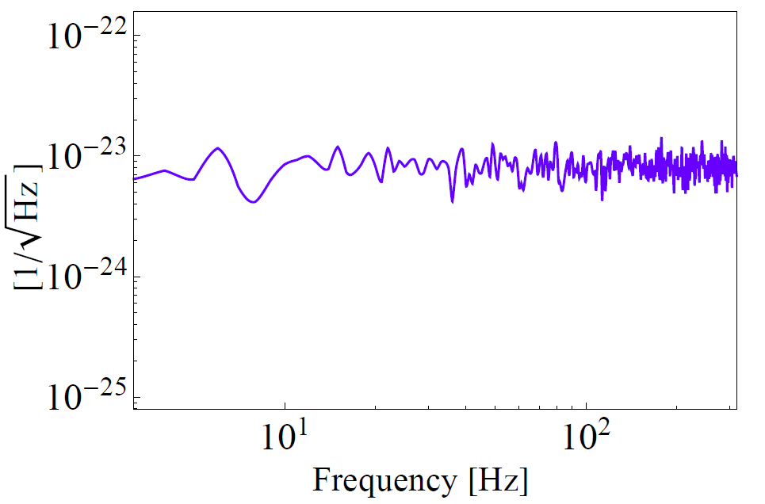
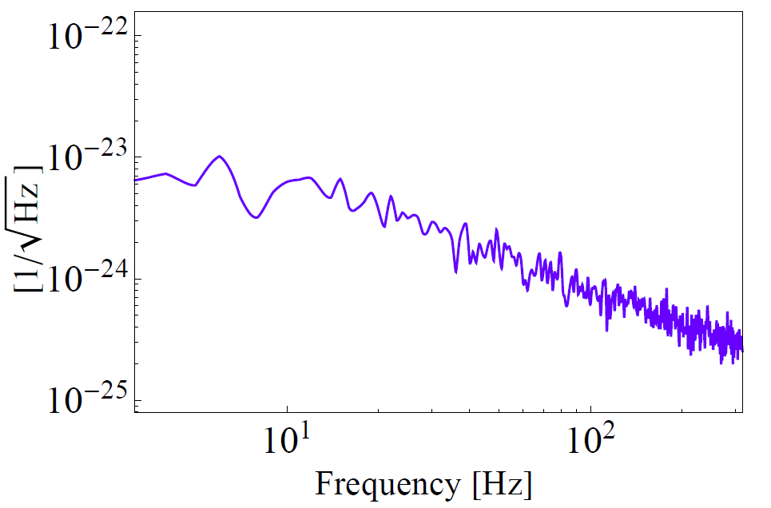
Transfer function
Physical
System
Transfer
Function
LAAC Tutorial Glasgow
15

Slide 18
Outline
Background
Gravitational waves and their detection
Basic of noise
Noise spectral density and transfer function
Environmental noise
Passive isolation and active cancellation
Thermal noise
Fluctuation-dissipation theorem
How to reduce thermal noise
Quantum noise
Standard Quantum Limit
Frequency-dependent squeezing
Current and future detectors
Timeline and sensitivity
LAAC Tutorial Glasgow
16

Slide 19
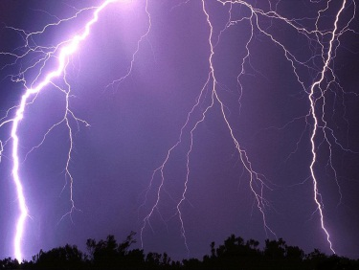
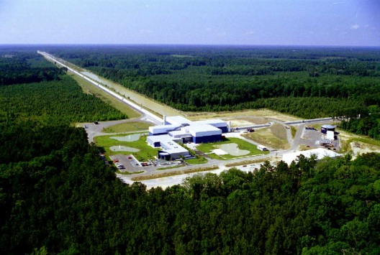
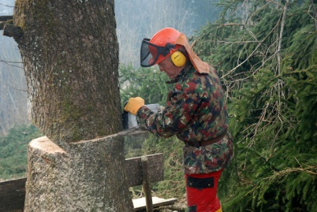
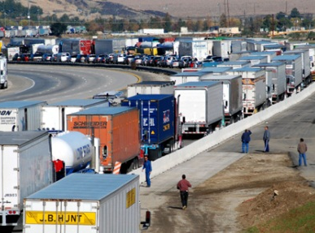
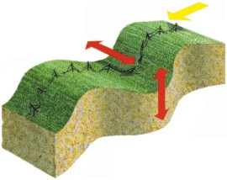
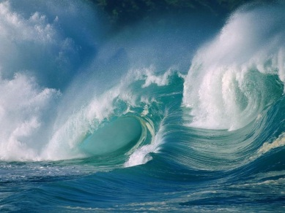
Environmental noise
Seismic noise
Newtonian noise
Acoustic noise
EM interference
LAAC Tutorial Glasgow
17

Slide 20
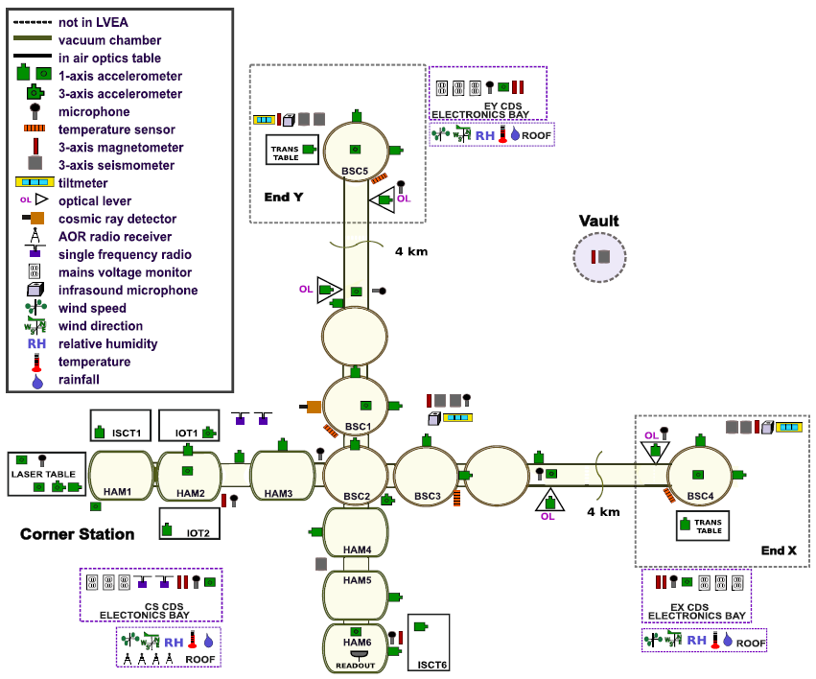
18

Slide 21
How to reduce environmental noise
1. Passive isolation:
Noise
source
Test
mass
2. Active cancelation: (on-line or off-line)
Noise
source
Test
mass
-
Sensors
LAAC Tutorial Glasgow
19

Slide 22
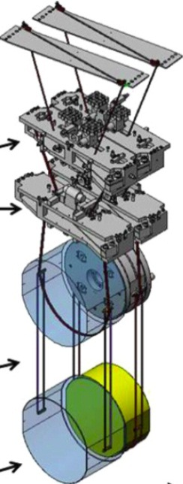
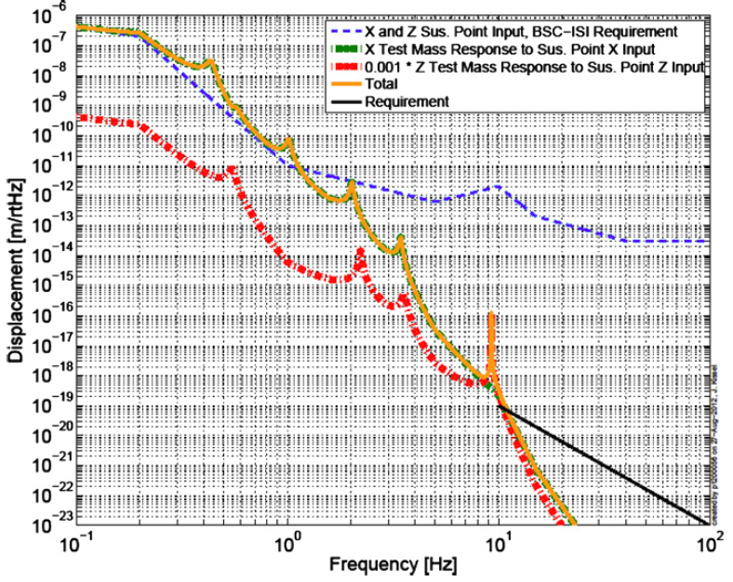
Example: Seismic noise
1. Passive isolation:
Noise
source
Test
mass
Advanced LIGO quadruple suspension:
Seven orders of magnitude passive isolation
LAAC Tutorial Glasgow
20

Slide 23
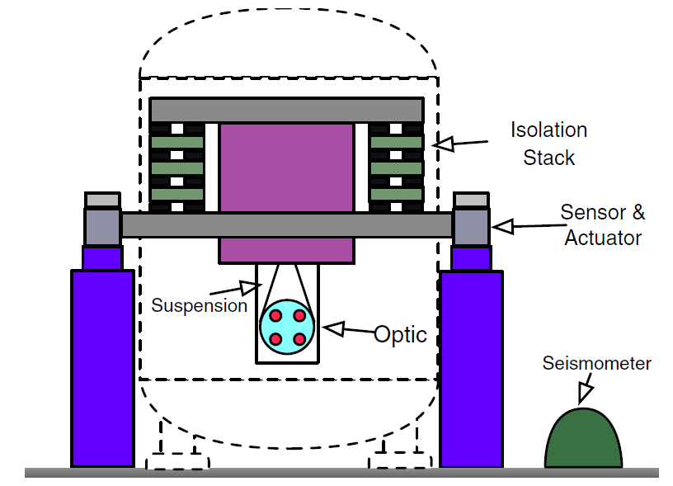
Example: Seismic noise
2. Active cancelation: (on-line or off-line)
Noise
source
Test
mass
Sensors
-
Similar technique can be used for cancelling Newtonian noise
LAAC Tutorial Glasgow
21

Slide 24
Outline
Background
Gravitational waves and their detection
Basic of noise
Noise spectral density and transfer function
Environmental noise
Passive isolation and active cancellation
Thermal noise
Fluctuation-dissipation theorem
How to reduce thermal noise
Quantum noise
Standard Quantum Limit
Frequency-dependent squeezing
Current and future detectors
Timeline and sensitivity
LAAC Tutorial Glasgow
22

Slide 25
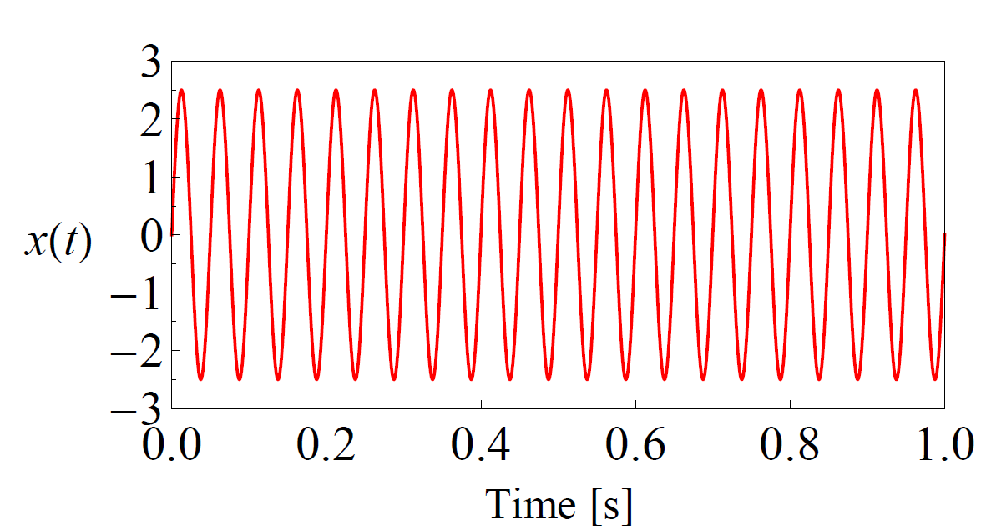
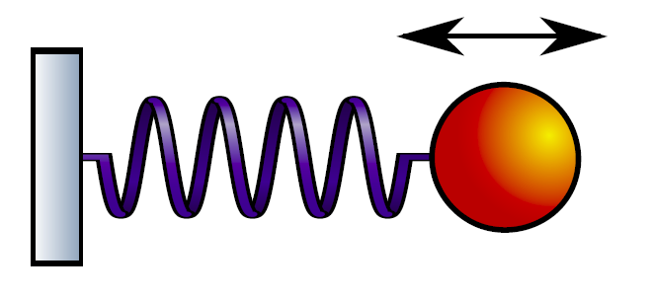
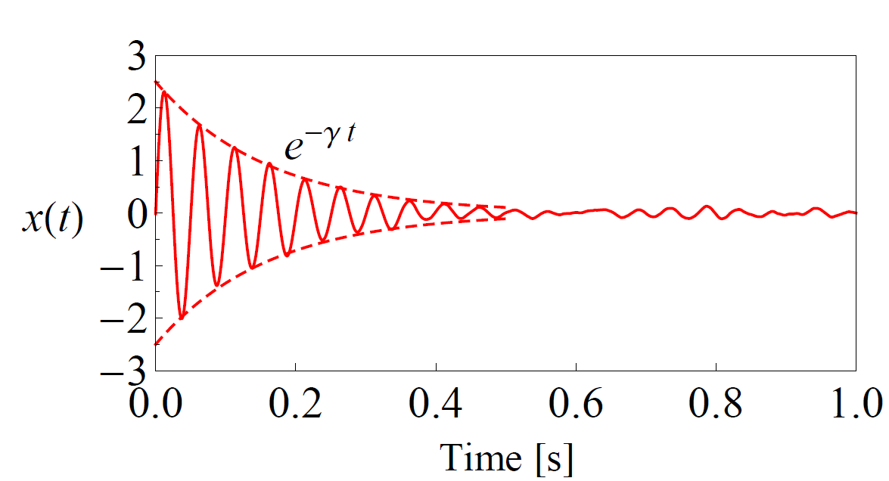
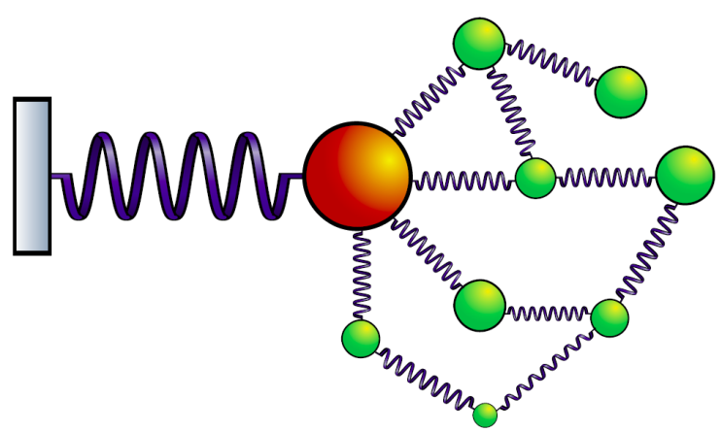
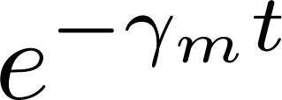
Fluctuation-dissipation theorem (FDT)
LAAC Tutorial Glasgow
23

Slide 26
Fluctuation-dissipation theorem (FDT)
LAAC Tutorial Glasgow
24

Slide 27
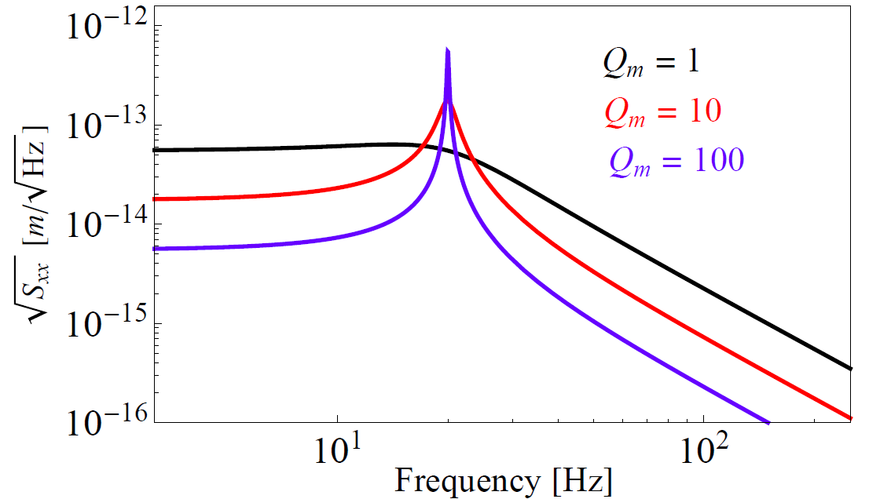
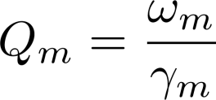
Fluctuation-dissipation theorem (FDT)
FDT:
Susceptibility:
H. Callen, and T. Welton, Phys. Rev. 83, 34 (1951)
LAAC Tutorial Glasgow
25

Slide 28
Fluctuation-dissipation theorem (FDT)
FDT:
Susceptibility:
(Equipartition)
LAAC Tutorial Glasgow
26

Slide 29
Outline
Background
Gravitational waves and their detection
Basic of noise
Noise spectral density and transfer function
Environmental noise
Passive isolation and active cancellation
Thermal noise
Fluctuation-dissipation theorem
How to reduce thermal noise
Quantum noise
Standard Quantum Limit
Frequency-dependent squeezing
Current and future detectors
Timeline and sensitivity
LAAC Tutorial Glasgow
27

Slide 30
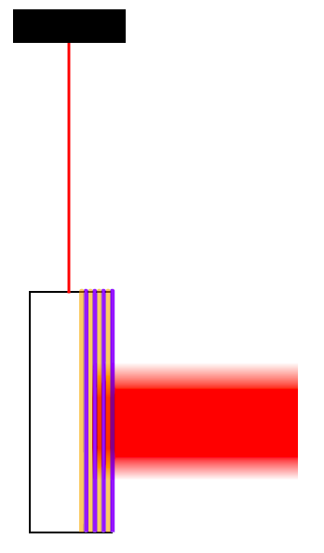
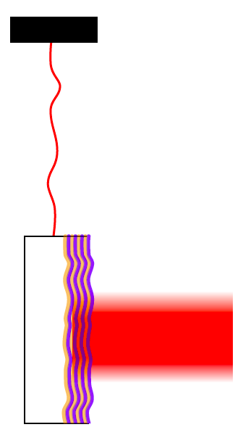
Sources of thermal noise
Our hope
Our life
Suspension
wire
Test
mass
Laser
Coating
Thermal noises are ubiquitous. Dominant: suspension and coating.
LAAC Tutorial Glasgow
28

Slide 31
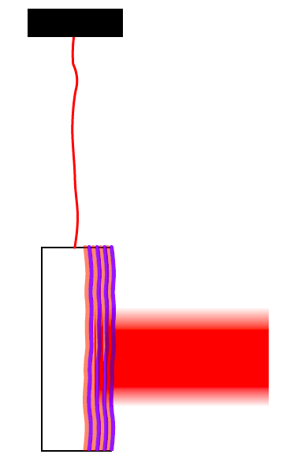
How to reduce thermal noise
1. Using low temperature
KAGRA in JAPAN will operated at cryogenic temperature.
Some designs of future detectors also incorporates cryogenic.
LAAC Tutorial Glasgow
29

Slide 32
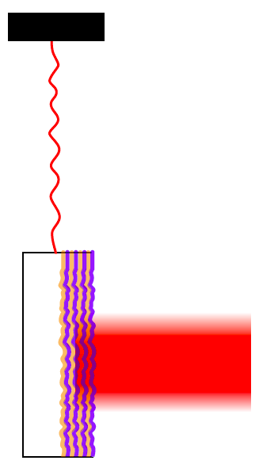
How to reduce thermal noise
2. Using high-quality material
FDT
Concentrating thermal energy; pushing noise outside band of interest.
LAAC Tutorial Glasgow
30

Slide 33
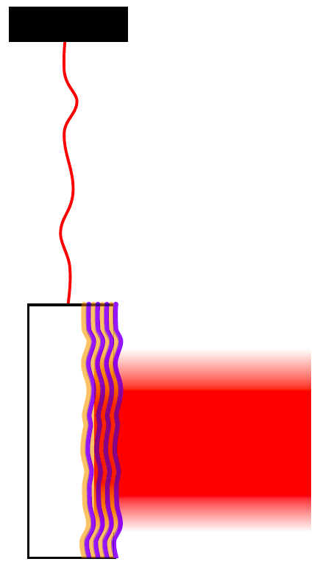
How to reduce thermal noise
3. Using larger beam size
Averaging out the thermal fluctuation.
LAAC Tutorial Glasgow
31

Slide 34
Outline
Background
Gravitational waves and their detection
Basic of noise
Noise spectral density and transfer function
Environmental noise
Passive isolation and active cancellation
Thermal noise
Fluctuation-dissipation theorem
How to reduce thermal noise
Quantum noise
Standard Quantum Limit
Frequency-dependent squeezing
Current and future detectors
Timeline and sensitivity
LAAC Tutorial Glasgow
32

Slide 35
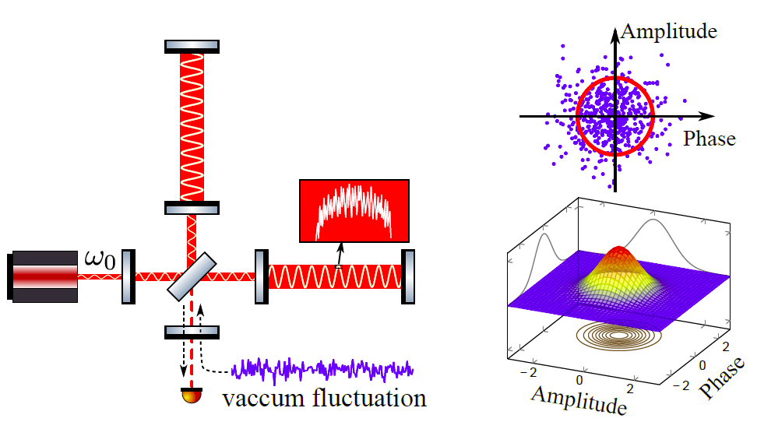
Origin of quantum noise
LAAC Tutorial Glasgow
33

Slide 36
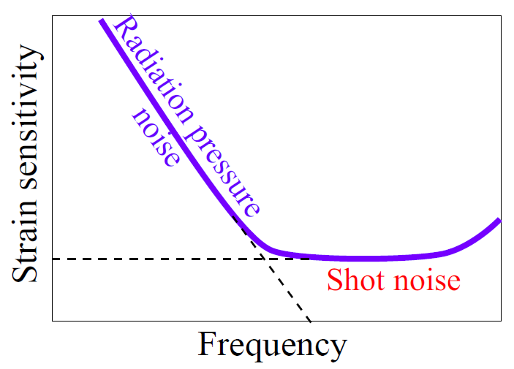
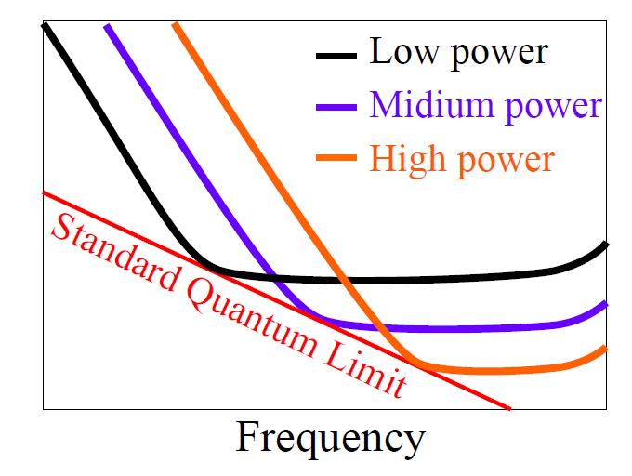
Standard quantum limit
GW
tidal force
Test
Mass
Optical
Field
Quantum fluctuation in optical phase
Shot noise
Power fluctuation
Radiation pressure noise
In optical amplitude
Standard Quantum Limit:
LAAC Tutorial Glasgow
34

Slide 37
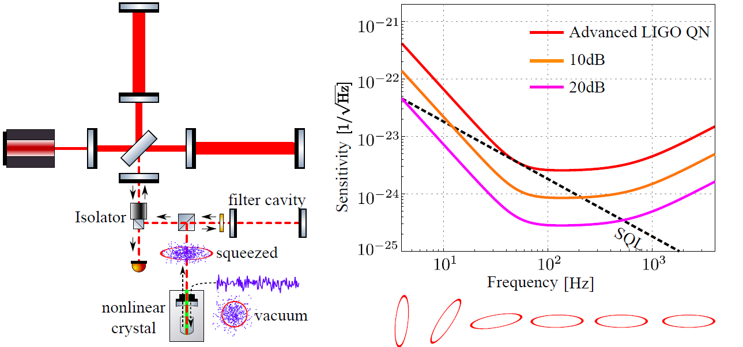
Frequency-dependent squeezing
strain
J. Kimble, et al. Conversion of conventional GW interferometers into QND by modifying their input and/or output optics, PRD 65, 022002 (2001)
LAAC Tutorial Glasgow
35

Slide 38
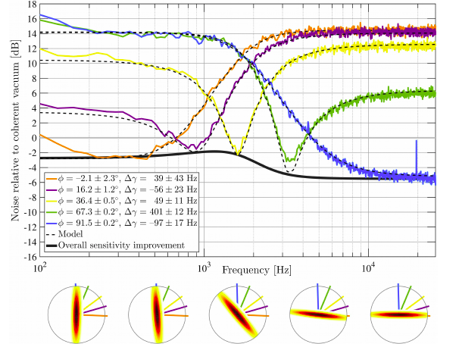
State-of-the-art
MIT proof-of-principle demonstration
E. Oelker et al., Audio-Band Frequency-Dependent Squeezing for Gravitational-Wave Detectors, PRL 116, 041102 (2016)
LAAC Tutorial Glasgow
36

Slide 39
Outline
Background
Gravitational waves and their detection
Basic of noise
Noise spectral density and transfer function
Environmental noise
Passive isolation and active cancellation
Thermal noise
Fluctuation-dissipation theorem
How to reduce thermal noise
Quantum noise
Standard Quantum Limit
Frequency-dependent squeezing
Current and future detectors
Timeline and sensitivity
LAAC Tutorial Glasgow
37

Slide 40
Timeline of current and future detectors
Cosmic Explorer / ET (new facility with longer baseline)
LIGO Voyager (current facility)
aLIGO Plus
Design study
LIGO-India
Experiments
KAGRA
Installation
aVIRGO
Data taking
aLIGO
2016
(now)
2020
2025
2030
LAAC Tutorial Glasgow
38

Slide 41
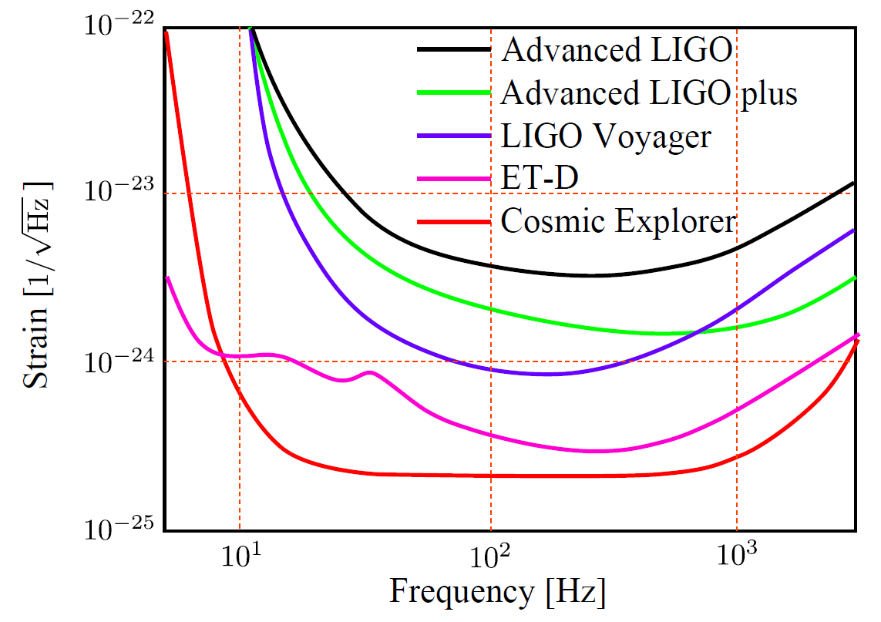
Sensitivity of future detectors
LAAC Tutorial Glasgow
39

Slide 42
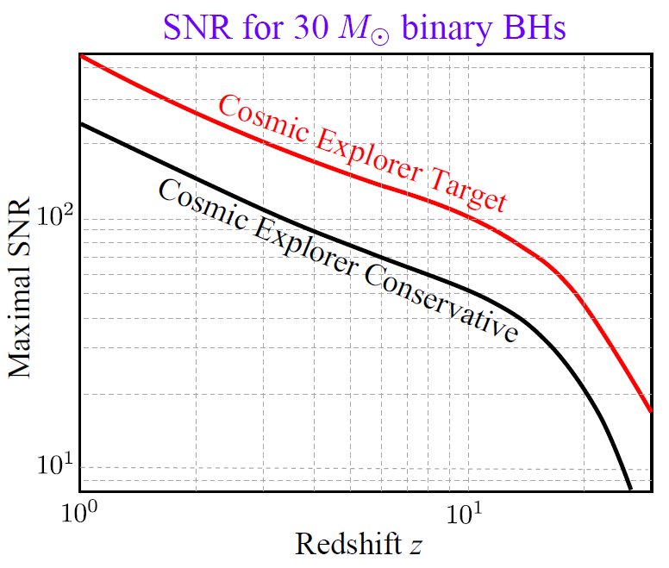
Science enabled by Cosmic Explorer
GW150914
LIGO-DCC: P1600143-v14 (2016)
LAAC Tutorial Glasgow
40

Slide 43
References for further reading
Advanced LIGO:
LSC, Class. Quantum Grav. 32, 074001 (2015)
Advanced LIGO plus:
M. Evans et al, Phys. Rev. D 88, 022002 (2013)
J. Miller et al, Phys. Rev. D 91, 062005 (2015)
LIGO Voyager:
R. X. Adhikari et al, LIGO-DCC: T1400226 –v7 (2016)
Einstein Telescope (ET):
ET science team, Einstein GW Telescope conceptual design study
Cosmic Explorer:
S. Dwyer et al, Phys. Rev. D 91, 082001 (2015)
LSC, LIGO-DCC: P1600143-v14 (2016)
Finally, refer to LIGO Instrument Science White Paper (2015-2016)
LAAC Tutorial Glasgow
41

Slide 44
Outline
Background
Gravitational waves and their detection
Basic of noise
Noise spectral density and transfer function
Environmental noise
Passive isolation and active cancellation
Thermal noise
Fluctuation-dissipation theorem
How to reduce thermal noise
Quantum noise
Standard Quantum Limit
Frequency-dependent squeezing
Current and future detectors
Timeline and sensitivity
LAAC Tutorial Glasgow

